Slide 1

Urban Economics
Econ. Research on Racial Bias in the criminal justice system
Prof. Patrick Button

Slide 2
Plan for today
Introduction to the “judge fixed effects” research methodology
Summary of three papers on the topic of racial bias in the criminal justice system:
Sloan - 2020 - Racial Bias by Prosecutors Evidence from Random Assignment
Arnold, Dobbie, Yang - 2018 - Racial bias in bail decisions
Eren, Mocan - 2018 - Emotional Judges and Unlucky Juveniles
(We will focus on policing later. This focuses on court systems.)

Slide 3
What are “judge fixed effects”?
It’s a very common and well-regarded natural experiment that economists and social scientists use to study the casual effects of “treatment” within the criminal justice system.
It exploits the fact that judges/prosecutors are randomly assigned to cases.
Some judges/prosecutors are pickier and some are less picky.
This random assignment to picky/less picky judges leads to quasi-random variation in outcomes.

Slide 4

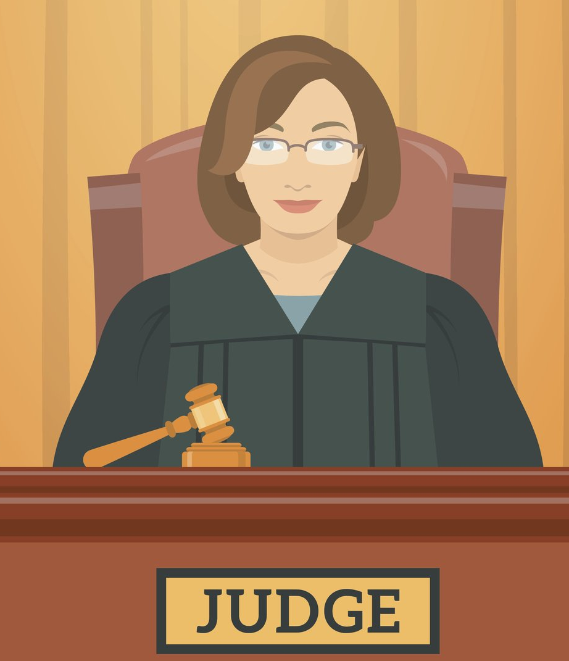



This quasi-random assignment of cases to judges creates quasi-random variation that can be used to study the causal effect of a conviction (or other judicial decision) on causal outcomes.
Or random assignment to a judge/prosecutor of a particular race, to study racial bias.
Lenient judge (less likely to convict)
Strict judge (more likely to convict)

Slide 5
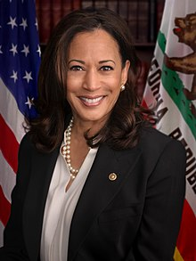
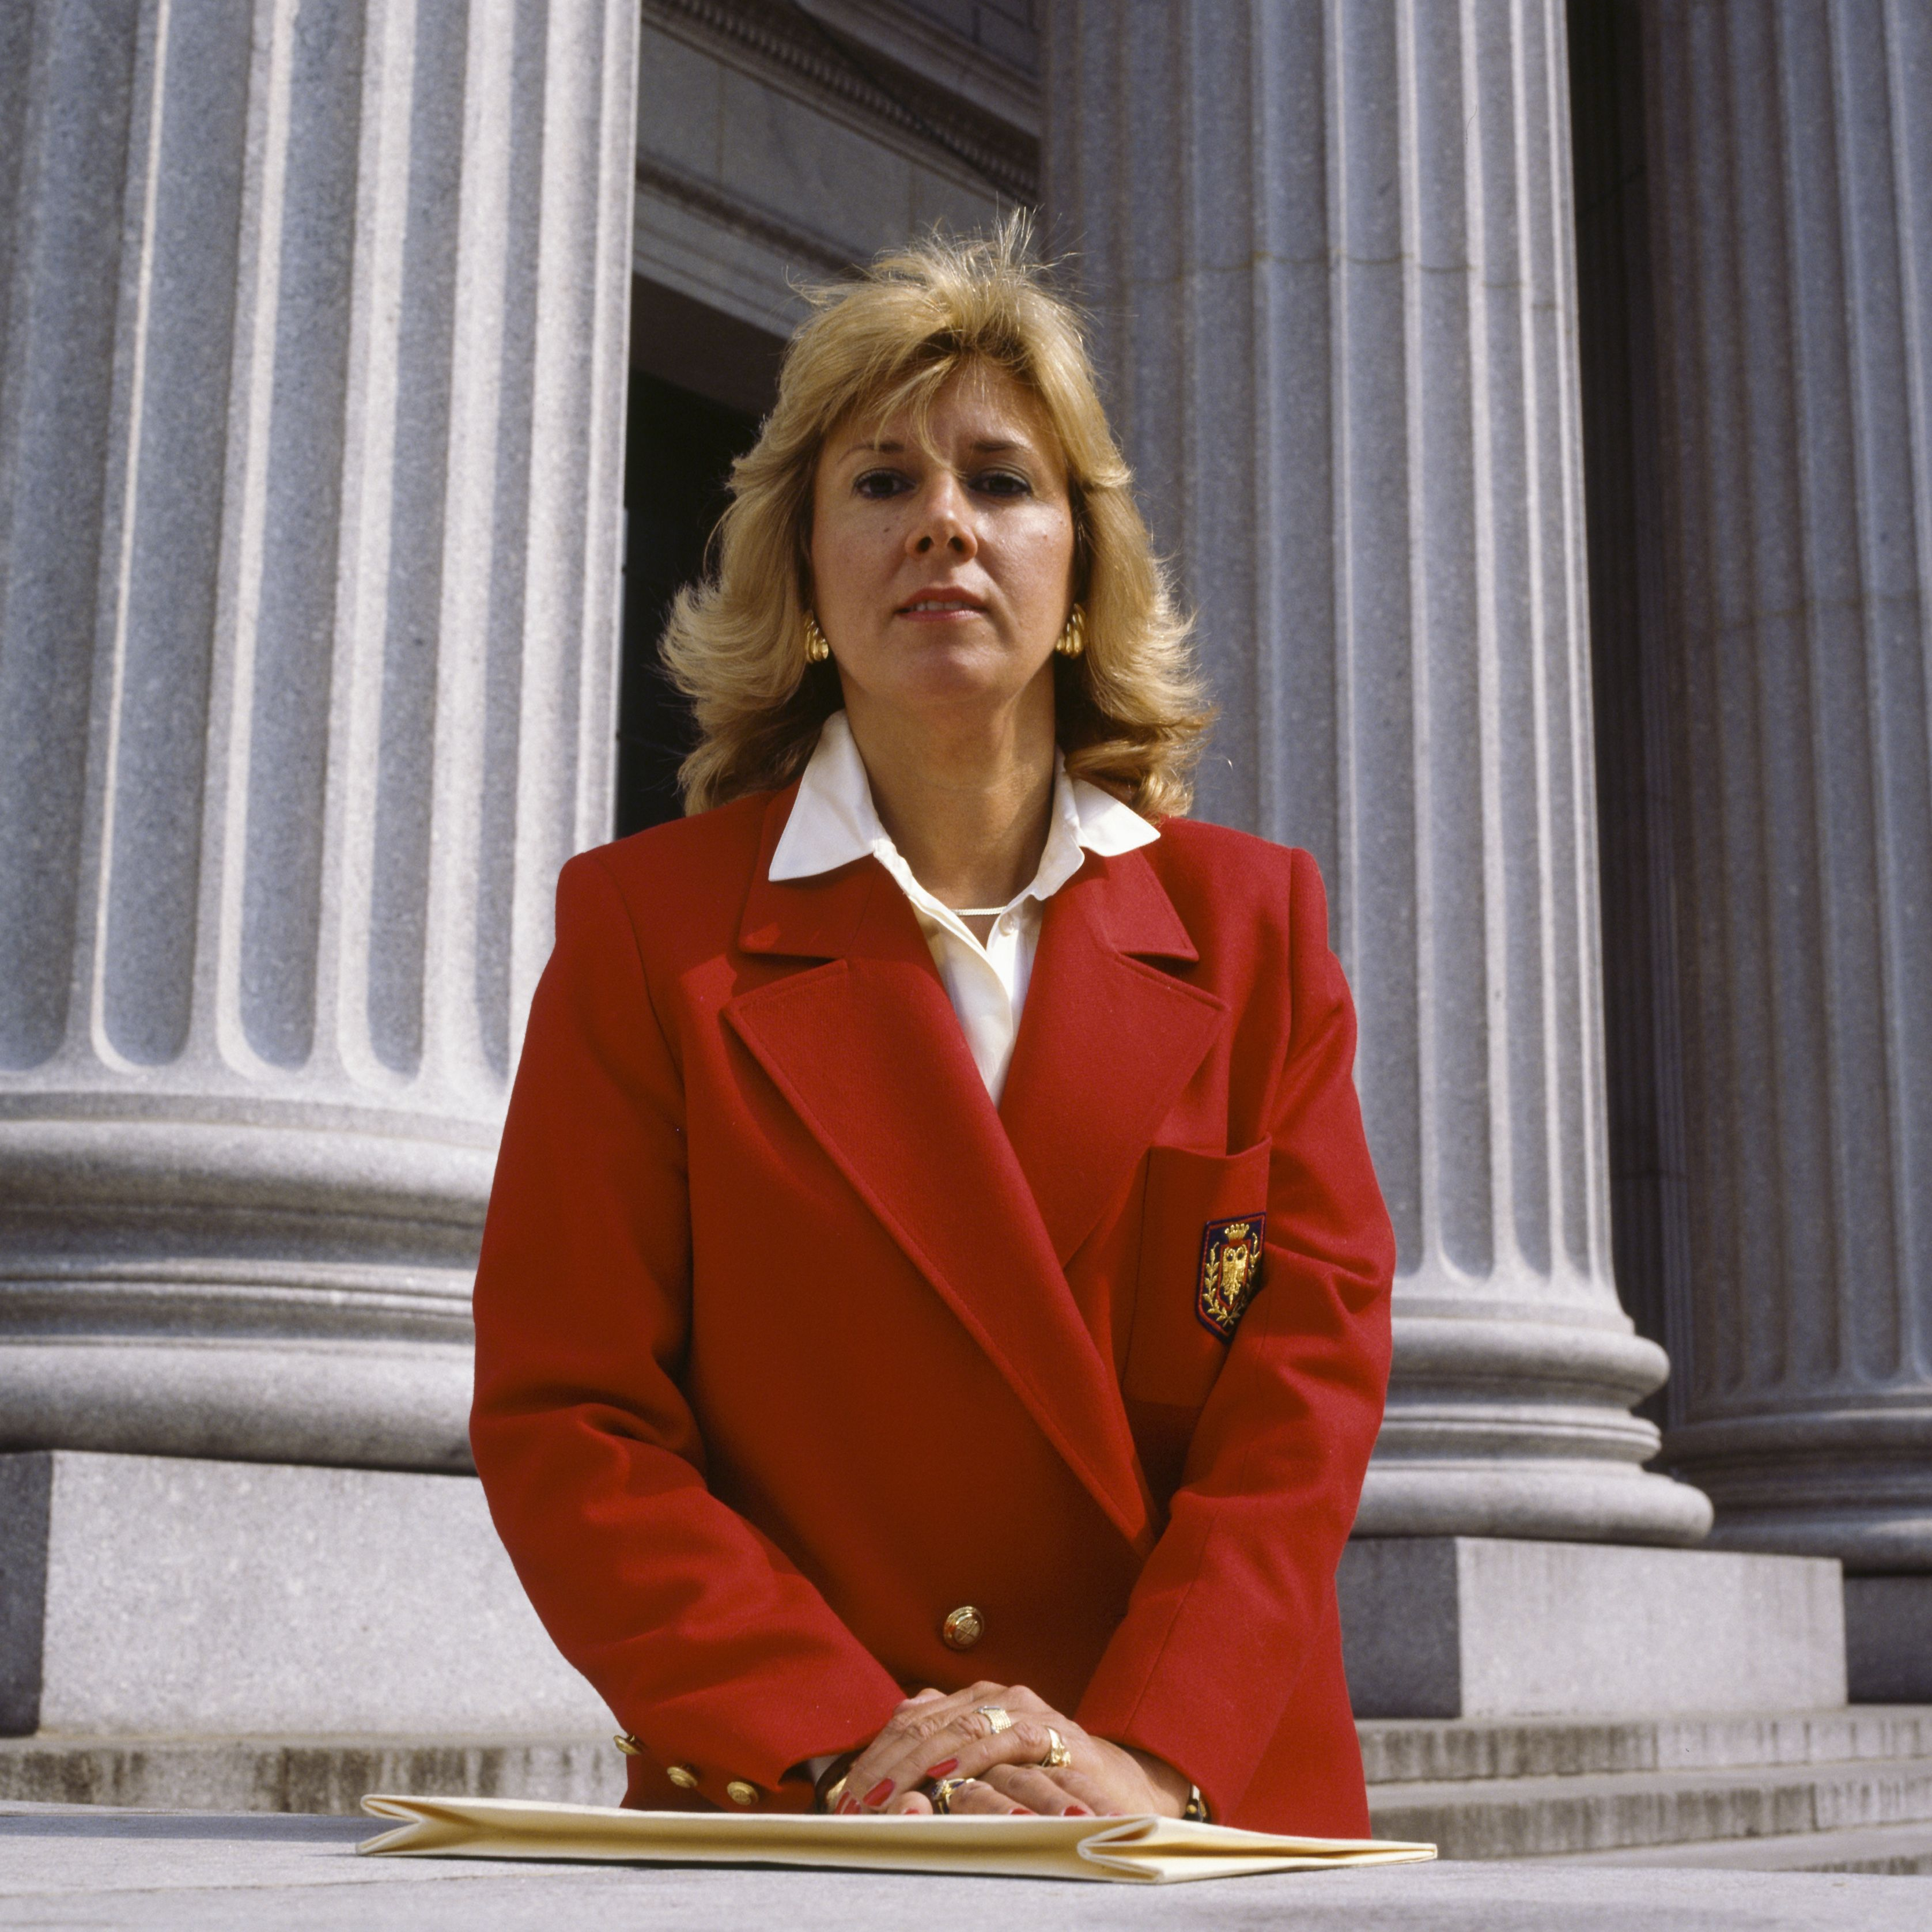



Or random assignment to a judge/prosecutor of a particular race, to defendants, to study racial bias (Sloan, 2020)
Black prosecutor
White prosecutor

Slide 6
Judge fixed effects in action – Sloan 2020
CarlyWill Sloan, the author of this paper, just finished her Ph.D. in economics a few years ago and this was her dissertation research!
Abstract: There is much interest in understanding the extent to which racial bias drives the large racial disparities in criminal justice outcomes. However, little is known about whether prosecutors exhibit racial bias, despite the widespread belief that prosecutors have more power and discretion than any other actor in the justice system.
This paper uses data from New York County to test for racial bias in convictions by being the first to exploit the conditionally random assignment of prosecutors to cases.
To overcome confounding factors associated with defendant and prosecutor race, I use a difference-in-differences to consider how much more black versus white defendants are convicted by white prosecutors, compared to the same difference for black prosecutors.

Slide 7
Judge fixed effects in action – Sloan 2020
Results indicate strong evidence of racial bias for property crimes but not for other crimes.
Property crime results show white defendants have similar conviction rates regardless of prosecutor race. However, while prosecutors of both races convict black defendants at higher rates, the difference in conviction rates across white and black defendants is 5 percentage points (8 percent) higher for white prosecutors than black prosecutors.
Additional results indicate this effect is driven by differences in dismissals and by defendants with no criminal history.

Slide 8
Data and methodology – Sloan 2020
Sloan uses case-level data from the New York County District Attorney’s Office.
Sloan has data on the race of the defendant, and the race of the prosecutor, and focuses on comparing white and black defendants who are randomly assigned prosecutors who are either white or black.
After controlling for screening date, assignment to prosecutors is as-good-as-random
Primary outcome = was the defendant found guilty
The research question is if the being quasi-randomly assigned a white or black prosecutor has a different effect on white vs. black defendants.

Slide 9
Random assignment to a judge/prosecutor of a particular race, to defendants, to study racial bias (Sloan, 2020)
Black prosecutor
White prosecutor

Slide 10
Defendant Race ---→ Prosecutor Race | v | Black | White
Black | Guilty conviction rate = C | Guilty conviction rate = D
White | Guilty conviction rate = A | Guilty conviction rate = B

Slide 11
Defendant Race ---→ Prosecutor Race | v | Black | White
Black | Guilty conviction rate = C | Guilty conviction rate = D
White | Guilty conviction rate = A | Guilty conviction rate = B
Difference-in-Differences Estimate = (A – B) – (C – D)
Both black and white prosecutors may have higher guilty conviction rates for black defendants, but is this white-black gap in conviction rates higher for white prosecutors? This would suggest racial bias.

Slide 12
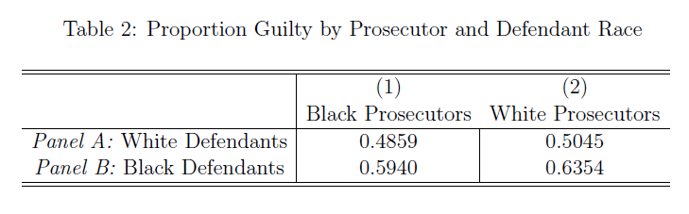
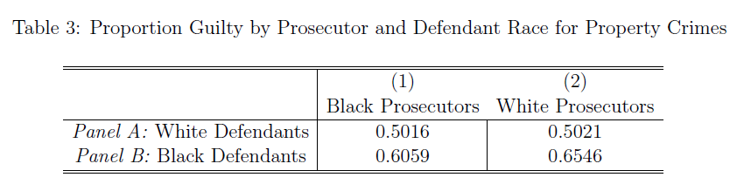
Judge fixed effects in action – Sloan 2020

Slide 13
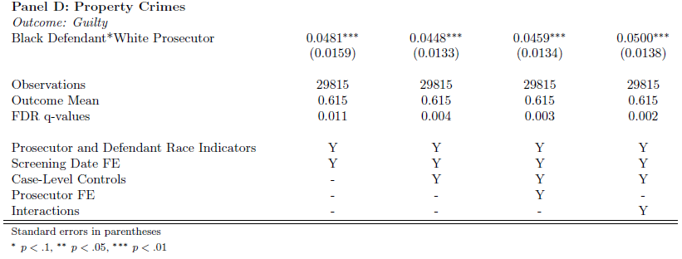
Judge fixed effects in action – Sloan 2020
If black defendants are quasi-randomly matched to white prosecutors, they are between 4.5 and 5 percentage points more likely to be deemed guilty, relative to:
Black defendants matched with black prosecutors
White defendants matched with white prosecutors
White defendants matched with white prosecutors
i.e. it’s a difference-in-differences

Slide 14
Judge fixed effects in action – Arnold, dobbie and yang
“Racial Bias in Bail Decisions”
Abstract: This article develops a new test for identifying racial bias in the context of bail decisions—a high-stakes setting with large disparities between white and black defendants.
We motivate our analysis using Becker’s model of racial bias…

Slide 15
Judge fixed effects in action – Arnold, dobbie and yang
Abstract: …Becker’s model which predict that rates of pretrial misconduct will be identical for marginal white and marginal black defendants if bail judges are racially unbiased.
In contrast, marginal white defendants will have higher rates of misconduct than marginal black defendants if bail judges are racially biased, whether that bias is driven by racial animus, inaccurate racial stereotypes, or any other form of bias…

Slide 16
Judge fixed effects in action – Arnold, dobbie and yang
Abstract: …To test the model, we use the release tendencies of quasi-randomly assigned bail judges to identify the relevant race-specific misconduct rates.
Estimates from Miami and Philadelphia show that bail judges are racially biased against black defendants, with substantially more racial bias among both inexperienced and part-time judges.
We find suggestive evidence that this racial bias is driven by bail judges relying on inaccurate stereotypes that exaggerate the relative danger of releasing black defendants.

Slide 17
Most defendants would get pre-trail release (or not) regardless of the judge, but for a portion of defendants, they are “marginal”.
Defendants are “marginal defendants” if whether they get released or not depends on if they get quasi-randomly allocated to a lenient vs. a strict judge.
Lenient judge (more likely to give pre-trial release)
Strict judge (less likely to give pre-trial release)

Slide 18
The quasi-random assignment to lenient vs. picky judges provides quasi-random variation in pre-trial release.
The idea is to see if those quasi-randomly assigned pre-trial release in this way re-commit crimes while on release.
Lenient judge (more likely to give pre-trial release)
Strict judge (less likely to give pre-trial release)

Slide 19
The idea is to see if those quasi-randomly assigned pre-trial release in this way re-commit crimes while on release.
The key thing for this paper is to see if the re-commit rate differs between white and black defendants. If it does, it could suggest racial bias in how pre-trial release is allocated.
Lenient judge (more likely to give pre-trial release)
Strict judge (less likely to give pre-trial release)

Slide 20
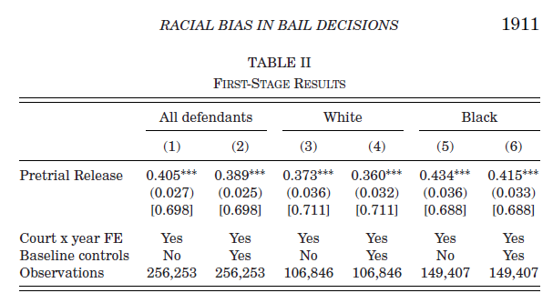
Arnold, dobbie, yang – bias in bail
First, does quasi-random assignment to a more lenient judge actually lead to pretrial release? If not, then we can’t use this quasi-random assignment to them test the effect of quasi-randomly assigned pretrial release on criminal behavior while on release.
Thus, there needs to be a first stage that shows a relationship. We need to see a relationship between judge leniency and pretrial release.

Slide 21
Arnold, dobbie, yang – bias in bail
All instrumental variables papers, of which this is one, require a strong first stage, otherwise there is no way to do the study.
E.g., Levitt (1997) uses electoral cycles to measure the effect of police on crime and had to show that police hiring did in fact follow electoral cycles to some extent (the first stage).
We see a strong first stage relationship here, which means we can then move to see how quasi-random assignment of pretrial release through lenient judges affects crimes committed while released.

Slide 22
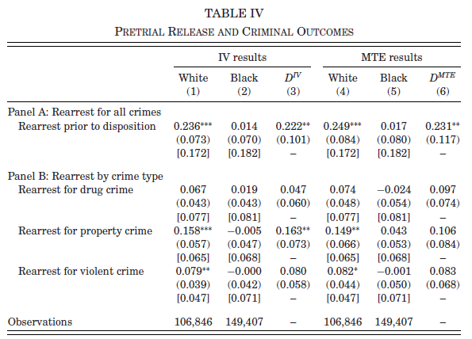
IV = Instrumental variable. We use quasi-randomly assigned “stricter” judges as a way to get quasi-random variation in pre-trial release.
Marginal defendant = those on the margins between getting pretrial release or not.
The idea is the random assignment of a pickier or less picky judge will create quasi-random variation in being released or not for this marginal group.

Slide 23
Main result:
White marginal defendants are much more likely to engage in pretrial misconduct compared to marginal black defendants.
For marginal black defendants, being quasi-randomly “assigned” pretrial release (via a less strict judge) or not (via a more strict judge) has no clear effect on pretrial misconduct (estimates are small and statistically insignificant).
This not the case for marginal white defendants: they are significantly more likely to engage in pretrial misconduct.

Slide 24
What does it mean that pretrial release has no effect on pretrial misconduct for black defendants, but significantly increases pretrial misconduct for white defendants?
Judges are making inefficient (racist) decisions. They would make fewer mistakes (i.e. giving pretrial release to those less likely to commit pretrial misconduct) if they gave much fewer marginal or near-marginal white defendants release, and gave many more marginal and near-marginal black defendants release.

Slide 25
i.e. judges over-release whites and under-release blacks.
This clearly implies racial bias: judges assume that marginal black defendants are more likely to commit pretrial misconduct, when that is not the case.

Slide 26
Other “natural experiments” – Eren and Mocan
Abstract: Employing the universe of juvenile court decisions in Louisiana between 1996 and 2012, we analyze the effects of emotional shocks associated with unexpected outcomes of football games played by a prominent college team in the state LSU.
We find that unexpected losses increase sentence lengths assigned by judges during the week following the game.
The effects of these emotional shocks are asymmetrically borne by black defendants…

Slide 27
Other “natural experiments” – Eren and Mocan
Abstract: …The impact of upset losses on sentence lengths is larger for defendants if their cases are handled by judges who received their bachelor’s degrees from the university with which the football team is affiliated LSU.
These results provide evidence for the impact of emotions in one domain on decisions in a completely unrelated domain among a uniformly highly educated group of individuals (judges) who make decisions after deliberation that involve high stakes (sentence lengths). They also point to the existence of a subtle and previously unnoticed capricious application of sentencing.

Slide 28
Other “natural experiments” – Eren and Mocan
In this paper, the authors use LSU winning or loses as quasi-random variation of negative emotions, to see how this differentially affects black versus white juvenile defendants.
The comparison is a difference-in-difference of sorts:
Upset loss (negative emotional shock) vs. not an upset loss (no shock)
Black juvenile defendant vs. white juvenile defendant

Slide 29
Defendant Race ---→ LSU game outcome | V | Black | White
Not an upset loss (no shock) | Average sentence length = C | Average sentence length = D
Upset loss (negative shock) | Average sentence length = A | Average sentence length = B
Difference-in-Differences Estimate = (A – B) – (C – D)
Black juvenile defendants may face a higher sentence length anyways (so, C > D), but if this increases after an upset loss, then it suggests that judges react to negative emotional shocks in racist ways.

Slide 30
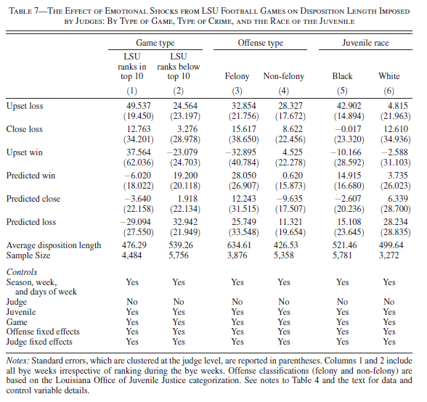
Disposition length increases by 42.9 days for black defendants, and only 4.8 days for white defendants after the negative shock of an upset game.
No statistically significant effects for any other types of game outcomes other than “upset loss”.

