Slide 1
Housing Policies in Practice: A Summary of Metcalf (2018) “Sand Castles Before the Tide? Affordable Housing in Expensive Cities”
HUSSAIN HADAH
Tulane University

Slide 2
Overview of the Article
This is a discussion piece published in the Journal of Economic Perspectives
This journal publishes articles that are useful, non-technical, summaries of issues.
This paper summarizes the housing affordability crisis, policies typically used to address it, and then provides some recommendations on better approaches.
Not an empirical study that provides new evidence (so this differs from most papers we’ve read)

Slide 3
Three Types of Cities
Declining populations – Decreasing job opportunities leads to out-migration but housing more affordable. Often “Rust Belt” cities like Detroit, Rochester, and St. Louis
Growing population and growing housing – These cities are growing but housing supply is also able to grow. Typically “Sun Belt” cities like Atlanta, Houston, and Tucson.
“Superstar” cities – Growing much faster than can housing supply due to both in-migration and an inability for housing supply to keep up. Includes New York City, Boston, DC, SF, LA, Seattle, and Denver.

Slide 4
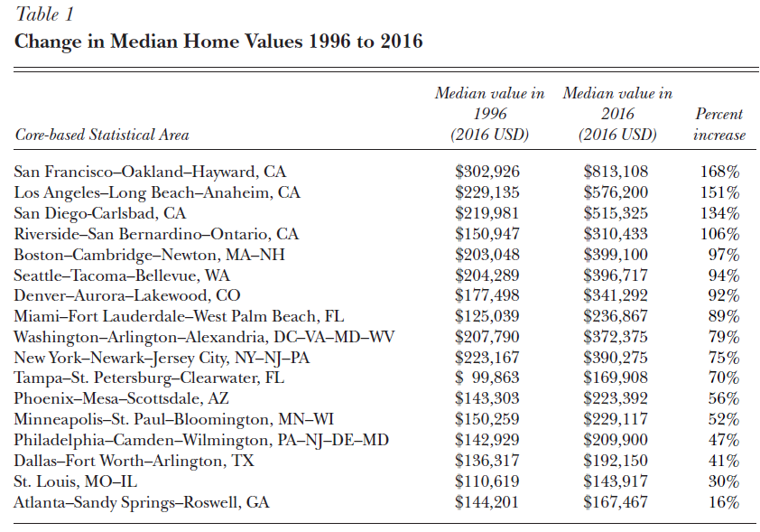

Slide 5
Why Focus on Superstar Cities?
Superstar cities are the ones where we see the affordable housing crisis being the most relevant.
These are cities were there are often agglomeration economies that increase wages and productivity, meaning that many workers should move there.
But high housing prices are a barrier to this.

Slide 6
Why Focus on Superstar Cities?
Housing unaffordability also pushes long-term residents out, causing many people to relocate when they would not like to.
Increased gentrification, changes in neighborhood demographics or culture
Also leads to an increase in poverty and homelessness.
(More could obviously be said on this topic…)

Slide 7
Housing Policies in Practice
Gabriel Metcalf summarizes housing policy today by grouping policies into four categories:
Social Housing
Vouchers
Rent Control
Regulation of the Housing Market

Slide 8
Social Housing
Provide housing outside of the normal market. Like public housing in the textbook.
i.e. government makes and manages housing.
High levels of social housing in Europe (e.g., Netherlands – 33%, Denmark – 20%, UK – 18%)

Slide 9
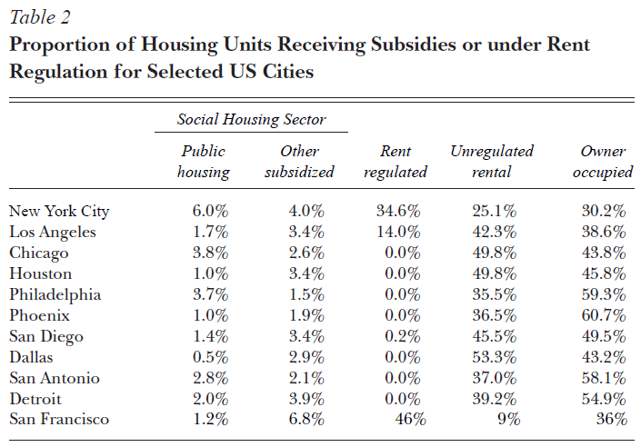

Slide 10
Social Housing in US History
Some experiments with social housing during WWI
Large-scale construction of public housing began in earnest with the 1937 Wagner Housing Act.
Tried to tear to “slum” housing to build “modern” housing.
Social housing fell out of favor in the 60s

Slide 11
Social Housing in US History
Many reforms to public housing launched since the Wagner Housing Act boom, with the most extensive being the HOPE VI program of 1993-1999.
Gave cities block grants to replace old public housing towers with low-rise, more traditional buildings like row houses.

Slide 12
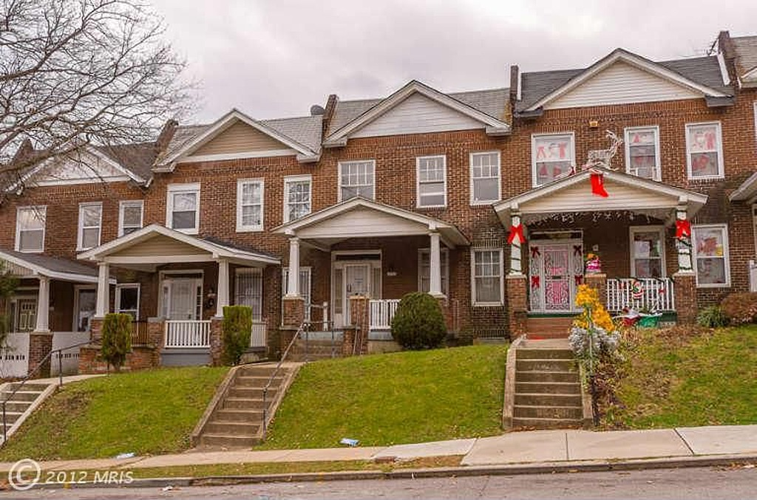
Row Houses in Baltimore
Source: Baltimore FishBowl https://baltimorefishbowl.com/stories/16-kinds-rowhouses-baltimore/

Slide 13
Inclusionary Housing
In more recent years, some cities (e.g., NYC, DC, Boston, Portland, LA, SF) require “inclusionary housing,” which requires the market-rate housing developers to set aside a portion of their units (usually 5-25%) to be provided at below-market rents.

Slide 14
Inclusionary Housing
Costly for businesses to provide inclusionary housing: $250k to $700k in foregone sales.
Developers can sometimes pay a fee instead of build these units on site, but the fees are costly: $336k for a two-bedroom inclusionary unit built off-site in SF in 2016.
These costs/fees are rising.

Slide 15
Inclusionary Housing
Inclusionary units are allocated by a lottery, where 100s or 1000s of people apply for each one.
But the supply of these units is low because:
1) Only a few units are made for each project due to the cost imposed
2) The number of market-rate projects each year isn’t that large

Slide 16
Vouchers
Fully or partially subsidize housing purchased in the private market.
Different than “housing voucher” (HV) in the textbook.
Most common program is Section 8, created in 1974.
Local governments usually don’t do vouchers, but could, opting more for social housing.

Slide 17
Vouchers
Under Section 8, households pay approximately 30% of their income in rent, and the local Housing Authority covers the rest of the rent
But the “fair market rent”, as calculated by the US Department of Housing and Urban Development (HUD), set a limit on the subsidy provided in each city.

Slide 18
Section 8
E.g., in 2017, the HUD fair market rent for a two-bedroom in SF was $3,319 per month.

Slide 19
Section 8
Eligibility criteria: In general, the applicant must be 18 years old and a U.S. citizen or eligible noncitizen with a household income of less than 50 percent of area median income. Eligibility is also based on family size.

Slide 20
Section 8
One study estimates that only 25% of those eligible get Section 8.
Thus, must cities have long waiting lists.
Very bad in LA – 600,000 residents applying for 2,400 vouchers (Smith 2017)

Slide 21
Vouchers - Pros
Directly target impoverished households
Can be used in a variety of areas
Flexible (can easily increase the number of vouchers quickly)
Flexible (can adapt the subsidy based on household income)
More directly affect housing or neighborhood choice (compared to IG)

Slide 22
Vouchers – Cons - Discrimination
In some cities, the Section 8 voucher amount is not sufficient, so landlords are less willing to rent to voucher holders.
Phillips (2017) documented in an audit field experiment that those mentioning paying with Section 8 were only half as likely to get a positive response to a landlord when sending a rental inquiry email.
Leads to landlords that specialize in Section 8.

Slide 23
Vouchers - Cons
In low-elasticity housing markets, vouchers can end up increasing the cost of housing, compared to social housing which directly increases the supply.
Low-elasticity meaning that housing supply is not sensitive to prices – perhaps because it’s hard to build or there are barriers to build.

Slide 24
Subsidizing Demand: Elastic Supply Case
P
S
p’
p
D
q
q’
Q

Slide 25
Subsidizing Demand: Inelastic Supply Case
P
S
p’
p
D
q
Q
q’

Slide 26
Demonstration on Board/Handout
Effects of vouchers under different elasticities of supply.

Slide 27
Rent Control
Rent control is relatively rare in American cities, occurring mainly in NY, NJ, and CA, especially NYC, LA, and SF.
More traditional rent control = maximum rent that can be charged (price ceiling) (economists generally hate this!)
More modern rent control is less damaging.
What is more “modern” rent control?

Slide 28
Traditional Rent Control – Demonstration on the Board/Handout
I will cover rent control in more depth, but wanted to give you the quick figure on the board/in a handout to jog your memory

Slide 29
Modern Rent Control
In the more “modern” and common form of rent control, landlords can only increase their rent by a maximum percentage each for existing tenants.
This does create an incentive to kick tenants out when the market surges and rents could be increased dramatically, as rents can be changed when tenants move out.
The laws create rules to try to prevent landlords from evicting tenants without “just cause”

Slide 30
Modern Rent Control
Nowhere in the US does rent control apply to new construction.
Trying to avoid the negative incentives that rent control would have on housing supply
In a sense, modern rent control works as a delay mechanism to slow the rate of rent increases for incumbent tenants for part of the housing stock.

Slide 31
Cons: Modern Rent Control
Limits unit turnover and increases mis-allocation of units
Families stay in housing with rent control too long
e.g., Getting a new job may mean you should move closer to the new job. Or you should move during family changes (e.g., relationships), but you don’t since you’d face an increase in rents.

Slide 32
Cons: Modern Rent Control
Poor targeting efficiency – Those who benefit from rent control may not be those that really need it.
If there is excess demand for rent controlled apartments, perhaps the better resourced tenant applicants, who are already better off, may be more likely to get the unit.

Slide 33
Cons: Modern Rent Control
Increases business risk, possibly decreases return on investment in new housing.
Could rent control eventually apply to the properties I want to build?
Rent control benefits current residents but does not support new migrants (they face market rates)

Slide 34

Cons: Modern Rent Control

Slide 35
Pros: Modern Rent Control
Makes rent cheaper
Rent increases are predictable – insulates renters from risk.
Modern rent control is “Not typically a major cause of supply suppression.” (p. 66)
Greater community stability (since tenants stay for longer)

Slide 36
Rent Control: Short Run
P
S
Controlled Rent
Shortage
D
Q

Slide 37
Rent Control: Long Run
P
S
Controlled Rent
D
Shortage
Q

Slide 38
Regulation of the Housing Market
Falls into four categories:
Zoning code
Building code
Permits to add supply
Fees

Slide 39
Zoning Code
Zoning codes regulate what land uses are allowed on a site – housing, office, retail, industrial, etc.
Zoning codes also control building heights, densities, set-backs (min. distance between building and street), rear-yard requirements, tower separation requirements, parking requirements, etc.

Slide 40
Zoning Code
Zoning codes can sometimes be even more restrictive (e.g., historic districts).
Zoning regulated by city councils or other city bodies.
In some places (e.g., California), zoning ordinances can be enacted by ballot initiatives.

Slide 41
Building Code
Zoning regulations WHAT can be built, the building code (and related codes) regulate HOW it can be built.
Regulates what materials are allowed, how big the windows must be, how large rooms must be, how much heat can be lost through a wall, earthquake proofing, etc.

Slide 42
Building Code
The general goal of zoning and building codes is to enforce what is considered “decent” housing.
Attempts to create minimum standards for housing (e.g., all housing must have heating, industrial plans cannot be in residential areas).
Building codes can be justified on the basis that they reduce information asymmetry between sellers and buyers, assuring housing purchases of the safety of housing.

Slide 43
Building Code
E.g., many cities ban or restrict single room occupant apartments, rooming houses, or other shared housing models.
Shared housing models may provide low-cost housing, but may not provide good quality housing.
Are the building codes set appropriately?

Slide 44
Permits
If a developer wants to build housing that meets the zoning and building code requirements, then they need to get a permit.
The process for getting a permit varied wildly by city.
Some jurisdictions provide permits automatically if the projects meets all code requirements.

Slide 45
Permits
In other places (e.g., much of CA), developers proposing a large project will need to pay for years of environmental impact studies, hold dozens of public hearings, hire lobbyists, make campaign contributions, and donate money to community groups to try to convince elected officials to allow the project.
Developer ultimately faces a council vote.
In some jurisdictions, the project may still end up on the ballot – need to convince the electorate to vote for it.

Slide 46
Permits
Difficult permit requirements may help ensure that only developments with benefits to the community are approved, but it also reduces new development, namely by making it costlier and riskier.
Strong regulations may serve as a barrier to entry, keeping new firms from entering building construction.
This leads to market power and higher rents.

Slide 47
Fees
Fees and exactions must be made in exchange for permission to build housing.
Cities collect these to support affordable housing production, transit expansion, parks, and other municipal projects.
Total fees and exactions in a city like SF is between $60k and $150k for each market-rate unit.

Slide 48
Fees
In some places, these fees are not set but are instead negotiated.
Developers must negotiate a distinct set of payments for each project.
Certain constituencies in the community will appose a project unless they receive sufficient payment or concessions.

Slide 49
Fees
Concessions might be:
Increased fees, labor union contracts, local hire preferences, private legal settlements.
Activists and politicians try to extract as many concessions as possible – want to maximize benefits to their community.
However, this increases costs and uncertainty for developers.
Makes it less lucrative to convert land from non-housing to housing.

Slide 50
Towards a Better Housing Policy
Metcalf (2018) proposes seven ideas:
Upzone
Rethink minimal standards
Connect superstar cities to less-expensive places
Build more cities
Pool taxes regionally
Move responsibility for housing to a higher level of government
Spend more on social housing

Slide 51
Upzone
Change zoning to allow more housing to be built (“upzoning”)
Needs to be done in a careful way to ensure good design and ensure that neighborhoods to built to be complete.
Planning process would normally include investments in infrastructure.

Slide 52
Rethink Minimal Standards
Reduce “red tape” – regulations that are less essential but are burdensome.
E.g., legalizing smaller unites created from accessory dwelling units (small dwelling attached to an existing structure), allowing single-room occupancy apartments, reducing parking requirements, allowing construction innovations like prefabricated housing.

Slide 53
Connect Superstar Cities to Less Expensive Places
Better public transit, especially longer commute transit like commuter rail, can connect major economic centers with more communities.
Allows individuals to reasonably live further away, increasing housing options.

Slide 54
Build More Cities
Most controversial of Metcalf’s (2018) suggestions.
Some new/planned cities had issues (inefficient land use, not connected to transit)
If sites can be found that are within a reasonable commuting distance, then this idea may have potential.

Slide 55
Pool Taxes Regionally
One reason for housing undersupply is fiscal competition between cities for sales and business tax revenues. If taxes are pooled regionally, it reduces inefficiencies and improves collaboration.
Minneapolis is an example of this.

Slide 56
Move Responsibility for Housing to a Higher Level of Government
With several cities in a metro area each working independently to improve housing, coordination is difficult.
Too many incentives for each city to “shirk” its responsibility to improve housing for the metro area.
If housing policy is conducted at a higher level, it may reduce these free rider problems.

Slide 57
Spend More on Social Housing
As you may recall, this is not done much in North America but is common in Europe.
More directly increases the housing supply.
Could be a good long-term investment.
Fund social housing more from general taxes, rather than from developer fees.

