Slide 1

Urban Economics
Effects of economic conditions on crime
Prof. HUSSAIN HADAH

Slide 2
Plan for today
Summarize two papers:
Yang, Crystal S. 2017. “Local labor markets and criminal recidivism.” Journal of Public Economics, 147: 16–29.
Palmer, Caroline, David C. Phillips, and James X. Sullivan. 2019. “Does emergency financial assistance reduce crime?” Journal of Public Economics, 169: 34–51.
Overview of upcoming classes.
Remaining time for practice questions in groups.

Slide 3
Yang – Labor markets and recidivism
Abstract: “This paper estimates the impact of local labor market conditions on criminal recidivism using administrative prison records on four million offenders released from 43 states between 2000 and 2013. Exploiting the timing of each offender’s release from prison, I find that being released to a county with higher low-skilled wages significantly decreases the risk of recidivism. The impact of higher wages on recidivism is larger for both black offenders and first-time offenders, and in sectors that report being more willing to hire ex-offenders. These results are robust to individual- and county-level controls, such as policing and corrections activity, and do not appear to be driven by changes in the composition of released offenders during good or bad economic times.”

Slide 4
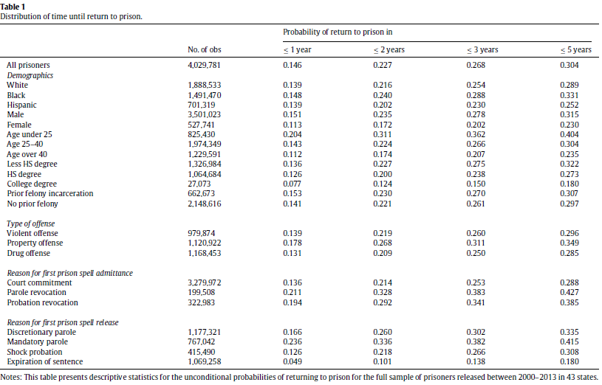
Yang – Labor markets and recidivism
This is a summary statistics table showing you what her data looks like.
This one shows facts about how often people return to prison (recidivate)

Slide 5
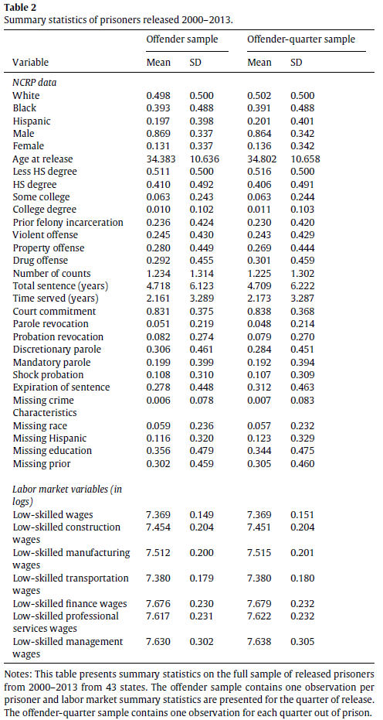
Yang – Labor markets and recidivism
This is another summary statistics table, showing what her sample looks like.
E.g., what is the demographic and educational make-up of her sample?
What kind of offenses were committed?

Slide 6
Yang – Labor markets and recidivism
Yang’s general approach is a version of a difference-in-differences.
The idea to compare people released from prison in the same county in good economic conditions versus bad economic conditions.
Yang measures economic conditions through wages in low skilled jobs.
These are the jobs that are most likely to hire those with criminal records.

Slide 7
Yang – Labor markets and recidivism
By looking at people within the same county, during times with higher vs. lower wages, it removes any bias for the fixed differences between counties
Recidivism rates and other factors may be different between counties.
Comparisons between, rather than within counties would be more of an “apples to oranges” comparison.
Like other DiD examples, where there are fixed differences that exist between groups.

Slide 8
Yang – Labor markets and recidivism
An assumption is required for Yang’s approach to provide an unbiased estimate of the causal effect of local economic conditions on crime.
The assumption is that when comparing those within the same county in good and bad economic times, there are no differences other than the different economic circumstances.
The ideal would be like a randomized control trial (RCT) -> higher/lower wages are randomly assigned over time.

Slide 9
Yang – Labor markets and recidivism
Obviously, that’s not possible.
But hopefully there are no important differences between good and bad economic times other than the economy.
Otherwise the treatment and control groups would be different.
The key example of possible differences are that the types of people released during good economic times, within the same county, could differ from those released during bad economic times, within the same county.
While some of this can be controlled for in the regression analysis (i.e. control variables), any differences that are not controlled for could cause bias.

Slide 10
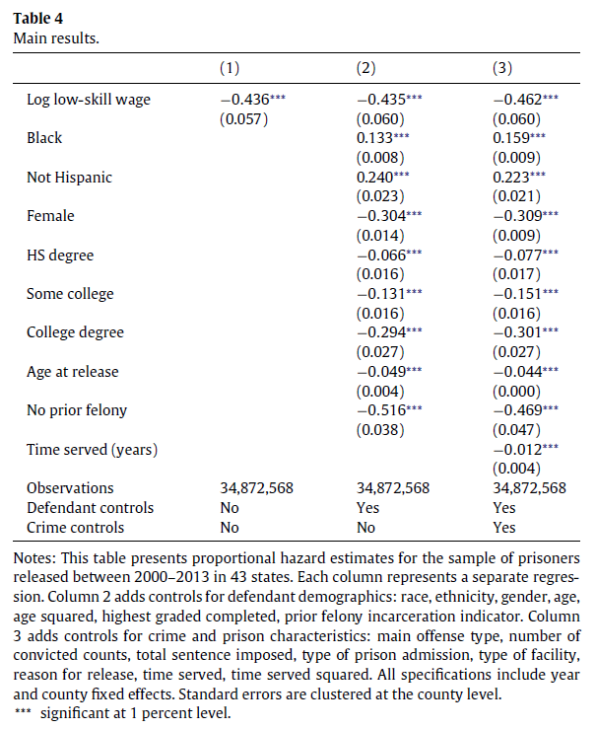
Yang – Labor markets and recidivism
This is the main results table
Results show that if the low-skill wage is higher, then recidivism decreases (hence the negative coefficient).
Results are very similar even when control variables are added.
Other results:
Blacks, non-Hispanics, younger people, those with less education, men, and those with less time served are more likely to recidivate.

Slide 11
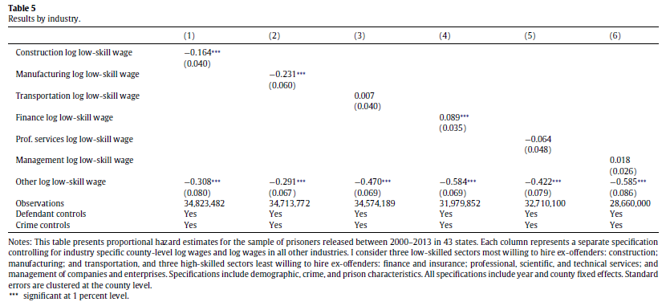
Yang – Labor markets and recidivism

Slide 12
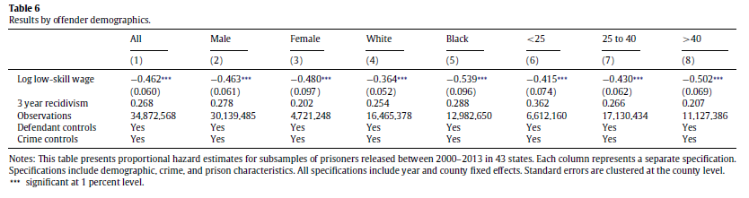
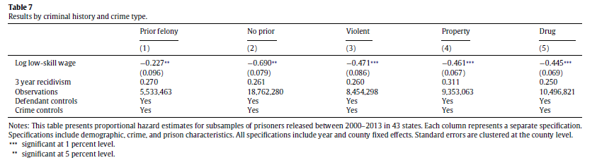
Yang – Labor markets and recidivism
These are additional heterogeneity tests.
The idea is to see if certain groups/factors strengthen or weakened the effect of economic conditions on recidivism.
E.g., larger effect on blacks and those with no prior conviction.

Slide 13
Palmer et al – Emergency assistance on crime
Abstract: “Does emergency financial assistance reduce criminal behavior among those experiencing negative shocks? To address this question, we exploit quasi-random variation in the allocation of temporary financial assistance to eligible individuals and families that have experienced an economic shock. Chicago's Homelessness Prevention Call Center (HPCC) connects such families and individuals with assistance, but the availability of funding varies unpredictably. Consequently, we can determine the impact of temporary assistance on crime by comparing outcomes for those who call when funds are available to those who call when no funds are available…

Slide 14
Palmer et al – Emergency assistance on crime
…Linking this call center information to arrest records from the Chicago Police Department, we find some evidence that total arrests fall between 1 and 2 years after the call.
For violent crime, police arrest those for whom funds were available 51% less often than those who were eligible but for whom no funds were available.
Single individuals drive this decrease.
The decline in crime appears to be related, in part, to greater housing stability—being referred to assistance significantly decreases arrests for homelessness-related, outdoor crimes such as trespassing…

Slide 15
Palmer et al – Emergency assistance on crime
... However, we also find that financial assistance leads to an increase in property crime arrests.
This increase is evident for family heads, but not single individuals;
the increase is mostly due to shoplifting; and the timing of this increase suggests that financial assistance enables some families to take on financial obligations that they are subsequently unable to meet.
Overall, the change in the mix of crime induced by financial assistance generates considerable social benefits due to the greater social cost of violence.”

Slide 16
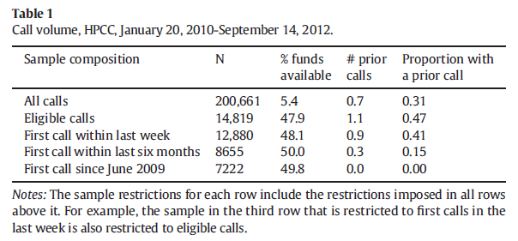
Palmer et al – Emergency assistance and Crime
The researchers use “eligible calls”, which are the people who are eligible, based on the HPCC’s criteria, for the assistance.
For these people it’s almost a coin toss if they get the funding.

Slide 17
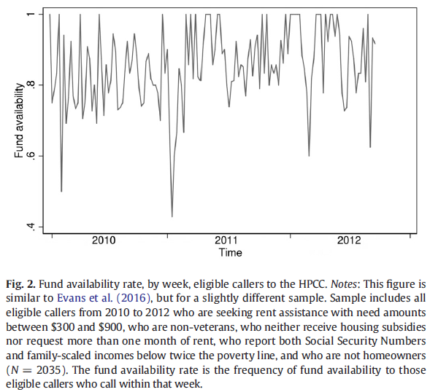
Palmer et al – Emergency assistance and Crime
For eligible callers, funding is pretty random.

Slide 18
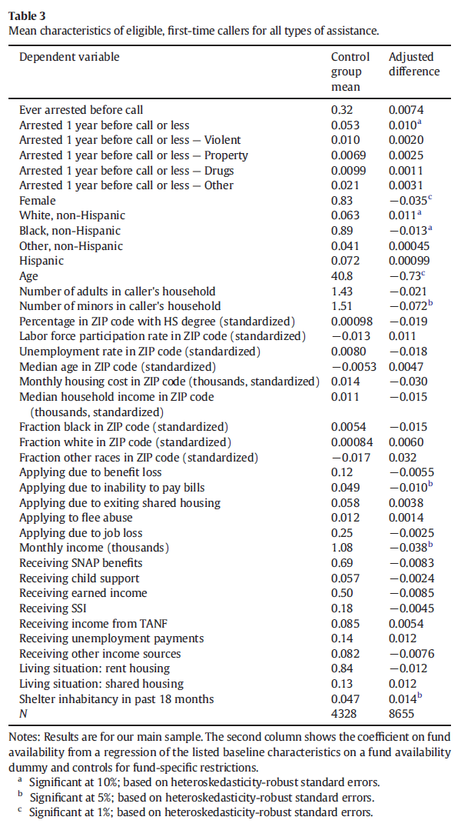
Palmer et al – Emergency assistance and Crime
This shows us what the sample of callers is like.
E.g., about a third have ever been arrested before they call.
83% women who call.
89% black, non-Hispanic people
Average monthly income just over $1,000

Slide 19
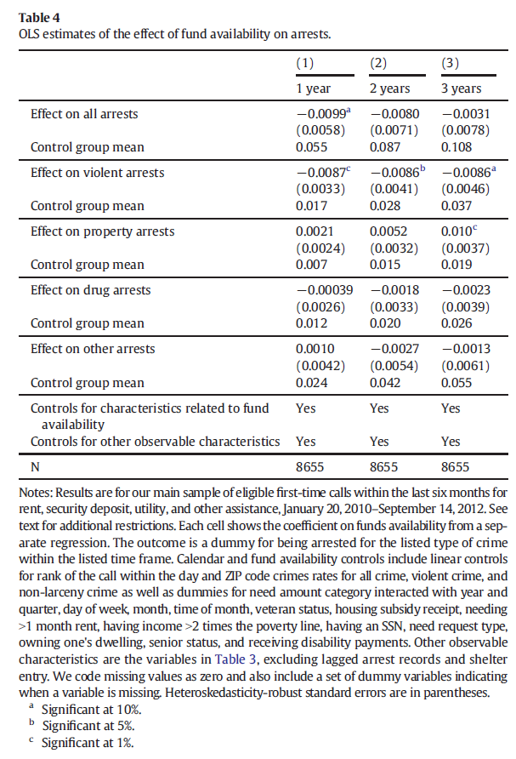
Palmer et al – Emergency assistance and Crime
This is the main results table.
Effect are strongest (more statistically significant) for violent arrests.
E.g., one year after getting the funding, violent arrests are 0.0087 lower. Compared to average rate (control group mean of 0.017), this is a decrease of about 50%!!!

Slide 20
Palmer et al – Emergency assistance and Crime
There is an increase in property arrests three years later, due to getting the funding.
The authors argue that this may be that when the families get the funding, they get requests for that money, and they overcommit on who they promise to give money to.
This could lead to an incentive to commit shoplifting once those “debts” catch up.

Slide 21
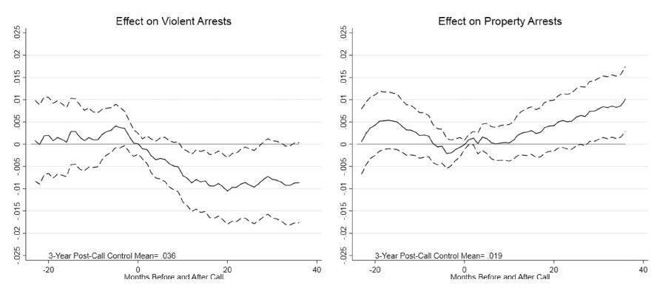
Palmer et al – Emergency assistance and Crime
Time on the x axis is relative to their eligible call.
0 = month of their eligible call.

Slide 22
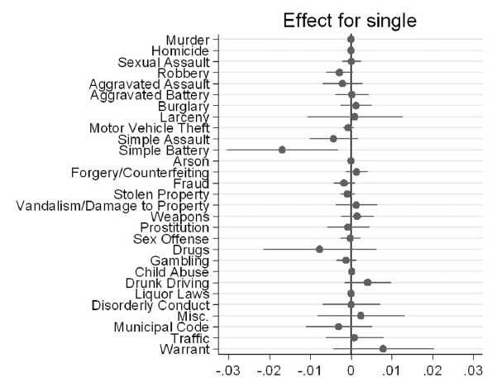
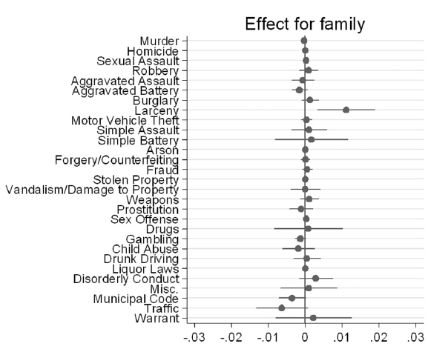
Palmer et al – Emergency assistance and Crime

Slide 23
Upcoming classes – Fri. Oct. 16
Summarize two papers on how COVID-19 is affecting crime.
More specifically, these papers deal with the effects of COVID-19 on domestic violence (once of the “shadow pandemics.”)
If talking about research on domestic violence could be difficult or triggering, let me know and we can create an alternative plan for you.
If a question on this ends up on Quiz 3, I’d provide an alternative for you.
So, you’d be in no way penalized for this decision.
If you need to back out partway through the content then that’s fine too.

Slide 24
Upcoming – Sunday Oct. 18
Please submit the first draft of your briefing note on economic development incentives.
If you need more time, then let me know in advance if at all possible.

Slide 25
Upcoming classes – Mon. Oct. 19
The entire class will be for Quiz 3.
Similar format to Quizzes 1 and 2
About two multiple choice / true or false questions.
About two short answer questions.
For more information on what is covered, see the modules page for that day.

Slide 26
Practice questions
You may be wondering what quiz/exam questions on this content might be like…
The remaining class time will be dedicated to having you work on two practice problems like the types of questions I could ask about these two papers on Quiz 3.
One question on Yang, one on Palmer et al.
If you want feedback on these practice problems, then please submit on Sunday, the day before Quiz 3.
But you can otherwise submit after the “due” date of Sunday without penalty (this policy applies for all “other activities” unless I otherwise state.)

Slide 27
Practice questions
For those on Zoom: I will randomize you into breakout rooms now and you can submit the answers as a group.
For those in person: you can either:
A) Form physically distanced groups in this classroom
B) Form physically distanced groups elsewhere (e.g., go outside)
C) Plan to collaborate at another time, either online or in-person
I will hang here in person / on Zoom in case anyone has any questions.
Thanks everyone! ☺

