Slide 1

urban Economics
Ban the box, criminal records discrimination and audit field experiments
Prof. Patrick Button

Slide 2
Plan for today
Overview of audit field experiments.
Introduction to “Ban the Box”
Summary of the paper:
Agan, Amanda, and Sonja Starr. 2018. “Ban the Box, Criminal Records, and Statistical Discrimination: A Field Experiment.” The Quarterly Journal of Economics 131 (1): 191–235. https://doi.org/10.1093/qje/qjx028.

Slide 3
Audit field experiments
The most common way that economists and sociologists measure discrimination.
Send on-average identical “testers” (e.g., resumes, emails, actors) that vary by minority status (e.g., white vs. black) to study discrimination in hiring, market access, etc.
Since the testers only differ by race, any differences in responses to them can isolate discrimination.

Slide 4
Audit field experiments - Housing
Audit field experiments are commonly used to study housing discrimination.
A great example comes from:
Phillips, David C. 2016. “Landlords Avoid Tenants Who Pay with Vouchers.” Economics Letters 151 (October): 48–52. https://doi.org/10.1016/j.econlet.2016.11.036.

Slide 5
Audit field experiments - Housing
Phillips (2016) finds housing rental ads online (e.g., Craigslist)
He then sends housing rental viewing requests from potential tenants to these landlords that posted the rental ads.
Viewing requests comes from individuals with white-sounding name (e.g., Emily Smith) of African-American names (e.g., Lakisha Washington).
Phillips (2016) also randomly includes a mention of if the individual is going to pay with a Section 8 voucher.
This is an anti-poverty program there the government pays part of your rent.

Slide 6
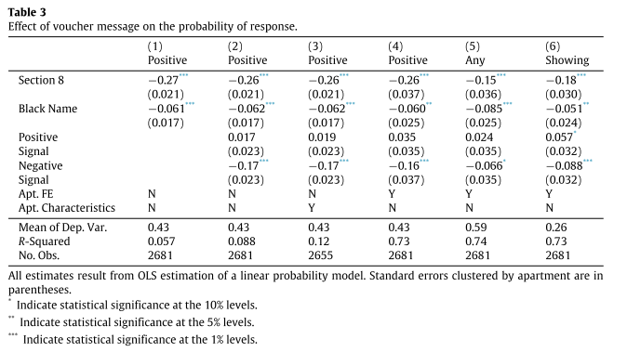
Audit field experiments - Housing
The average positive response rate (e.g., viewing offer) is 43%.
Those who mention Section 8 have about a 26 percentage point lower positive response rate (so, about 17%).
Those with African-American names have about a 6 percentage point lower positive response rate (so, about 37%).

Slide 7
Audit field experiments - Mortgages
In my pilot study, with Mary Penn and Cathy Balfe (former Urban Economics student), we study sexual orientation discrimination in access to mortgages.
We email mortgage loan originators, who you’d often work with to get a mortgage, with emails from couples who vary in gender pairings:
Female/Female
Female/Male
Male/Female
Male/Male
“Hi, my name is [gendered name] and my [husband/wife] [gendered name] and I are looking for a mortgage…”

Slide 8
Results from Pilot Study (vs. Hanson et al. 2016)

Slide 9
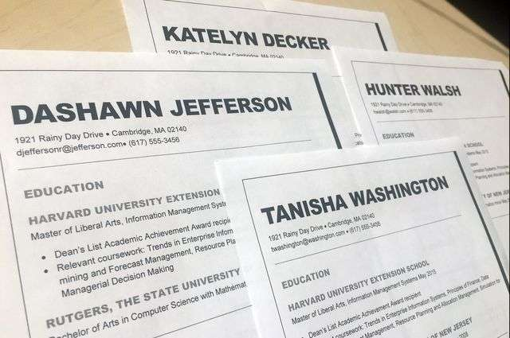
Audit field experiments - hiring
Audit field experiments are commonly used to study hiring discrimination.
These are the “resume experiments” you have likely heard of.
The Agan and Starr (2018) paper, the focus of today, is one of these resume experiments, but with an interesting difference-in-differences twist (explained later).

Slide 10
Audit field experiments - hiring
Researchers (like me ☺) sent on-average identical applications (resumes) to job ads.
Applicants vary in minority status (e.g., white vs. African-American name, male vs. female, older vs. younger, criminal record vs. no criminal record)
Discrimination is quantified by comparing “callback rates” – interview or similar positive response rates by employers.

Slide 11
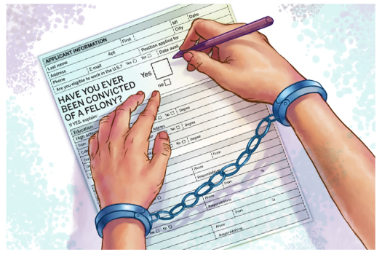
What is “ban the box”?
Before I get into the methodology of the Agan and Starr (2018) resume experiment, I first want to explain what “Ban the Box” is.
From Wikipedia: “Ban the Box is the name of an American campaign by advocates for ex-offenders, aimed at removing the check box that asks if applicants have a criminal record from hiring applications…”

Slide 12
What is “ban the box”?
“…Its purpose is to enable ex-offenders to display their qualifications in the hiring process before being asked about their criminal records. The premise of the campaign is that anything that makes it harder for ex-offenders to find a job makes it likelier that they will re-offend, which is bad for society.”
(FYI – this Wikipedia article could use an updated discussion of research on Ban the Box, since it doesn’t mention the Agan and Starr (2018) paper, which is I think one of the best on the topic.)

Slide 13
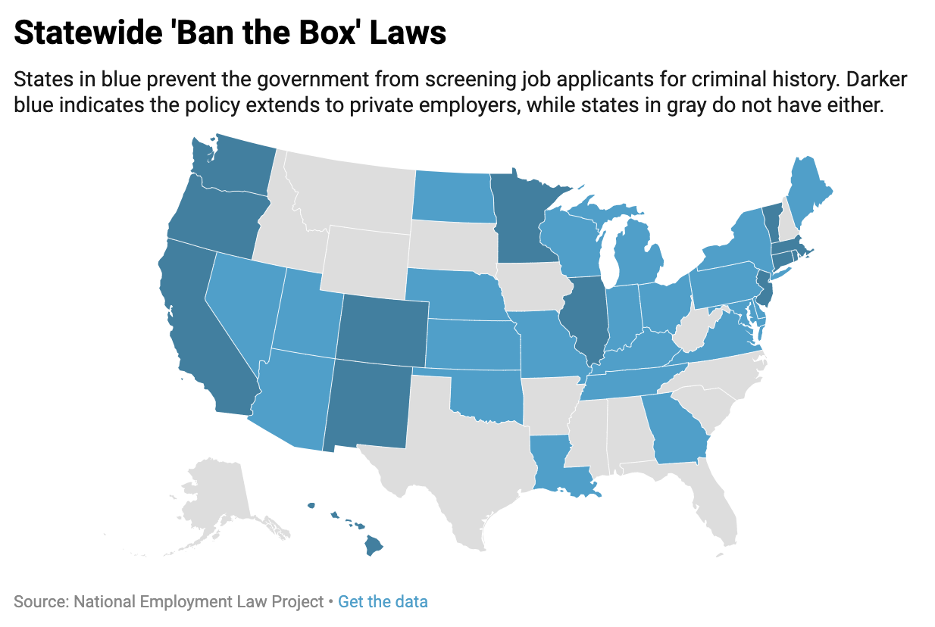
Who “bans the box”? Data as of 2019
Dark blue = box is banned for private employers and public employers.
Light blue = box is banned for public employers only.
Gray = no ban the box.
Note: this figure doesn’t show city or county-level laws, just state laws.
There is no “Ban the Box” law at the federal level.

Slide 14
Agan and Starr (2018) – BTB Audit study
ABSTRACT: “Ban the Box” (BTB) policies restrict employers from asking about applicants’ criminal histories on job applications and are often presented as a means of reducing unemployment among black men, who disproportionately have criminal records.
However, withholding information about criminal records could risk encouraging [statistical] racial discrimination: employers may make assumptions about criminality based on the applicant’s race.
To investigate BTB’s effects, we sent approximately 15,000 online job applications on behalf of fictitious young, male applicants to employers in New Jersey and New York City before and after the adoption of BTB policies.
These applications varied whether the applicant had a distinctly black or distinctly white name and the felony conviction status of the applicant.

Slide 15
Agan and Starr (2018) – BTB Audit study
ABSTRACT: …We confirm that criminal records are a major barrier to employment: employers that asked about criminal records were 63% more likely to call applicants with no record.
However, our results support the concern that BTB policies encourage racial discrimination: the black-white gap in callbacks grew dramatically at companies that removed the box after the policy went into effect.
Before BTB, white applicants to employers with the box received 7% more callbacks than similar black applicants, but BTB increased this gap to 43%.
We believe that the best interpretation of these results is that employers are relying on exaggerated impressions of real-world racial differences in felony conviction rates.”
[i.e. employers statistically discriminate against blacks, assuming they are more likely to have convictions, when they don’t have conviction status from a box].

Slide 16
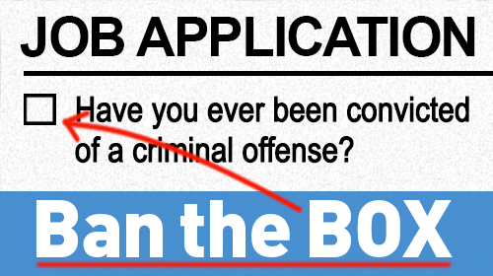
Agan and Starr (2018) – BTB Audit Study
Agan and Starr (2018) study the impact of the enactment of a BTB law on hiring discrimination against those with criminal records and African-Americans.
They use an audit study – a resume field experiment – to quantify this discrimination.
Race or ethnicity is signaled through names (e.g., Greg Nelson, Darius Washington)
Criminal record is signaled by checking the
“box” or not, if it is available.

Slide 17
Agan and Starr (2018) – BTB Audit Study
This is study is innovative because it uses an audit field experiment combined with a difference-in-differences to quantify the effect of BTB.
They first do a cross-sectional analysis, which just uses data before the BTB policy was passed.
They compare discrimination in jobs with and without a box, to see if having a box is associated with a different amount of racial discrimination.
They then use temporal variation in box, which occurs after NYC passes a BTB policy, and almost all NYC employers get rid of the box.
They compare New York City before and after its BTB to New Jersey during a similar time period, to see how racial discrimination in NYC changed during that time period, compared to the “control” of NJ.

Slide 18
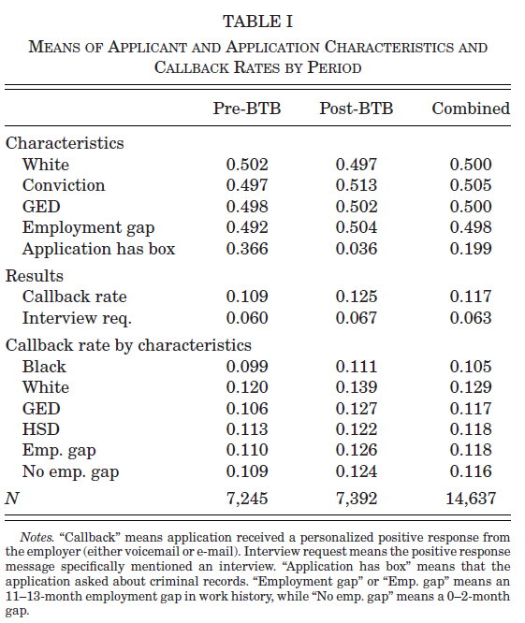
This table presents what their data looks like.
About half of the job applicants are white (vs. black), have a conviction (vs. no conviction), have a GED (vs. no GED), and have an 11-13 month employment gap in work history (vs. 0-2 month gap).
Callback rates on average are 10.9%, and interview offer rates are 6.0%
The difference between them – 4.9%, is other positive employer response that is not an explicit interview offer.

Slide 19
This table presents what their data looks like.
Callback rates are lower for blacks, slightly lower for GED compared to high school diploma, but are similar for those with and without employment gaps.
Callback rates seem to be increasing over time, hence the general increase comparing pre to post-BTB.
But the key question is if discrimination changes differentially after BTB (NYC) compared to the same time period without a BTB change (NJ)

Slide 20
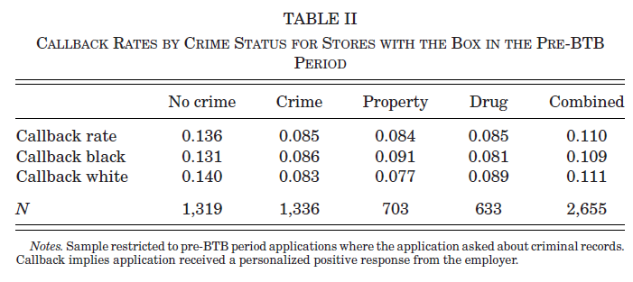
Callback rates lower for those with criminal records

Slide 21
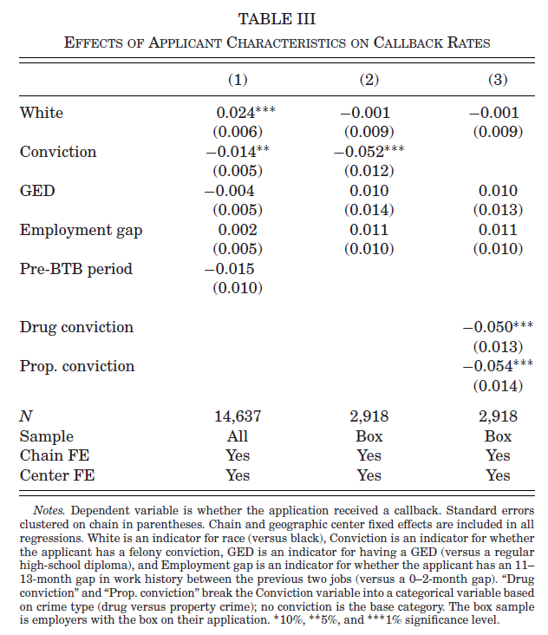
Regression analysis estimates give similar results to the raw data.
Whites have a 2.4 percentage point higher callback rate (column (1)).
But restricting to just employers that use a box (columns (2) and (3)), there is no difference by race.
Those with convinctions face lower callback rates, much more so in the box sample.

Slide 22
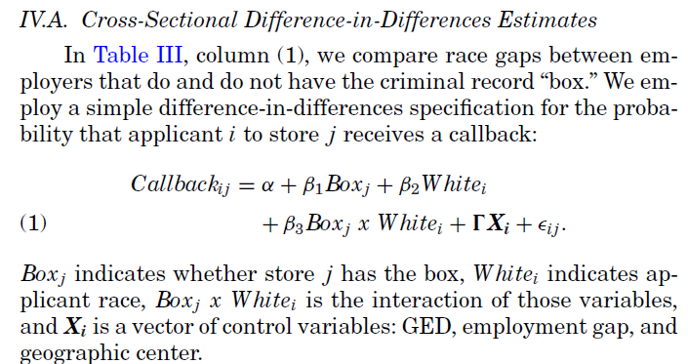
DiD estimate in regression form
They first use cross-sectional data (i.e. data from just one time period, in this case, pre BTB).
They quantify how racial discrimination differs between firms that use or do not use the box.

Slide 23
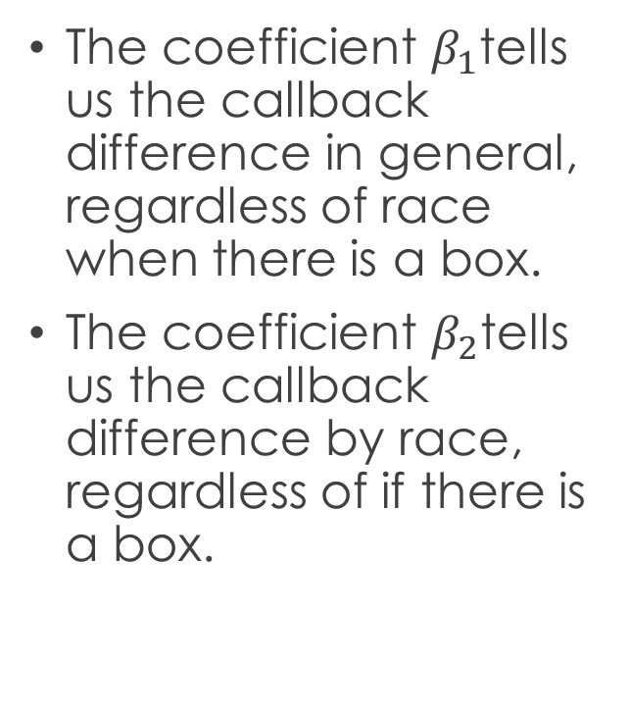
DiD estimate in regression form
The coefficient $β_{1}$tells us the callback difference in general, regardless of race when there is a box.
The coefficient $β_{2}$tells us the callback difference by race, regardless of if there is a box.

Slide 24
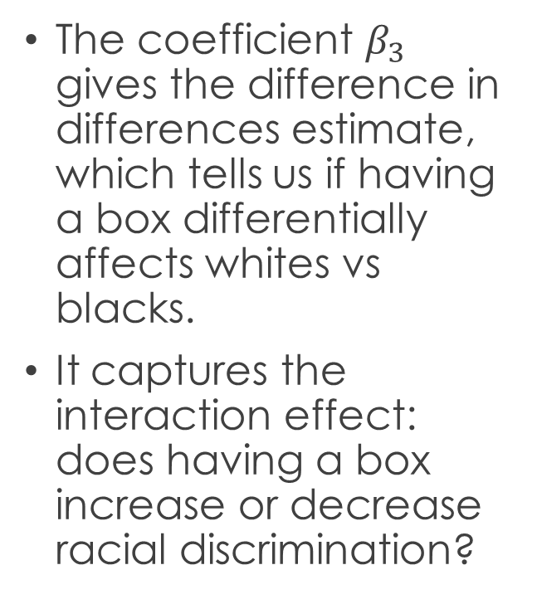
DiD estimate in regression form
The coefficient $β_{3}$ gives the difference in differences estimate, which tells us if having a box differentially affects whites vs blacks.
It captures the interaction effect: does having a box increase or decrease racial discrimination?

Slide 25
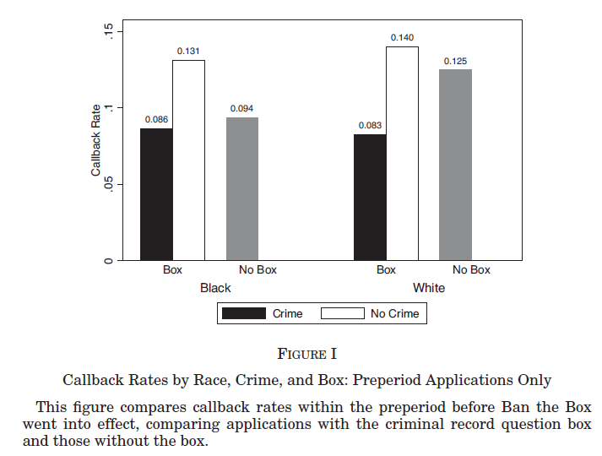
Figure 1 shows the raw data before bTB
Callback rates are similar between whites and blacks with a criminal record (only disclosed when there is a box).
Whites get a 0.9 percentage point higher callback rate compared to blacks when neither has a criminal record.
Callback rates for whites are 3.1 percentage points higher, compared to blacks, when there is no box.

Slide 26
Adding “temporal” variation
Agan and Starr (2018) then build up to their ideal DiD specification by using temporal variation in BTB.
New York City passes a BTB law, which creates variation in BTB that can be used in a DiD to try to quantify the effect of BTB on discrimination.
This DiD is preferred to their earlier cross-sectional approach (similar to the naïve approach of only using one time period, from earlier).

Slide 27
Adding “temporal” variation
The DiD is preferred because there could be non-random reasons why some employers use a box and others don’t. Given then, it’s hard to isolate how the box affects discrimination compared to how firms that use the box different and how this could affect racial differences.
For example, what if firms that use the box are more racist anyways? Then we might confuse the effect of the box for selection into who uses the box.
In this hypothetical example, banning the box doesn’t reduce racial discrimination.

Slide 28
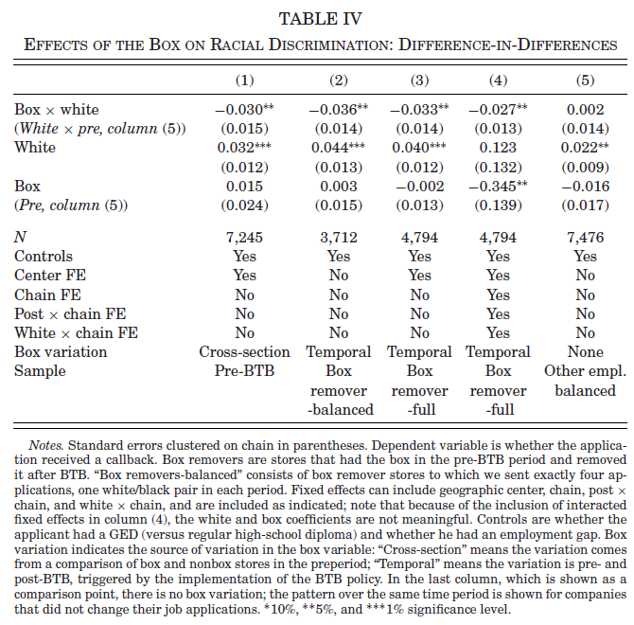
Turns out their results are similar comparing the naïve cross-sectional approach (column (1)) to the more advanced DiD approach (columns (2) to (4)).
Looking at column (2), the coefficient on white shows a 4.4 percentage point higher callback rate for whites when there is no box.
The coefficient on box is not statistically significant – callback rates for whites are similar with and without the box.

Slide 29
Box x white, the coefficient of interest is -0.036, suggesting that callback rates for whites are 3.6 percentage points lower, compared to blacks, when there is a box, compared to when there is no box.
Putting this together, the white “benefit” is 4.4 percentage points when there is no box, but only about 0.8 p.p.s when there is a box.
Removing the box is associated with an increase in racial discrimination.

Slide 30
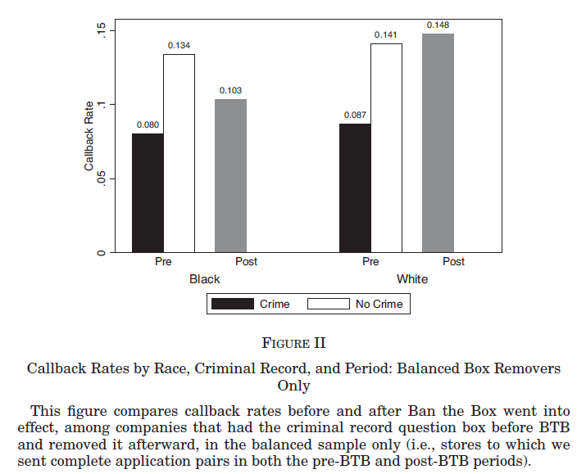
Figure 2 shows callback rates before and after BTB – i.e. temporal variation in “box”
The White “benefit” is about 7 percentage points when a box is present, regardless of criminal record.
Callback rates for whites are 4.5 percentage points higher, compared to blacks, when there is no box.
This is similar to the cross-sectional results, but a bigger magnitude of an effect.

Slide 31
Agan and Starr (2018) - Conclusion
The evidence from this paper suggests that employers statistically discriminate against black applicants, by being more likely to assume they have criminal convictions when they do not have information on criminal conviction status.
When the box is banned, employers who used to rely on the box make the assumption that black applicants are more likely to have a criminal record.
Therefore, we see racial discrimination increase after BTB takes effects.

Slide 32
Agan and Starr (2018) - Conclusion
This suggests unintended consequences, as BTB was ideally supposed to reduce employment disparities for blacks, who are more likely to have criminal records.
There is the benefit that without a box, there is less discrimination against those with records, and those with records are disproportionately black, so that is still a benefit of BTB.
But the cost is an increase, in general, in discrimination against blacks.

