Slide 1
Sexual Orientation Discrimination in Mortgage Lending: Evidence from a (Pilot) Field Experiment
Catherine Balfe
Research Analyst,
Education Research Alliance,
Tulane University
Patrick Button
Associate Prof.,
Dept. of Econ.,
Tulane University,
Javiera Selman
Postdoc,
Murphy Institute,
Tulane University
David Schwegman
Assistant Prof.,
Dept. of Public Admin. and Policy
American U.

Slide 2
Why focus on sexual orientation discrimination in the mortgage market?
Homeownership is a common method for wealth accumulation
However, not all individuals have equal access to homeownership
Same-sex couples are less likely to own homes than different-sex married couples (Jepsen & Jepsen, 2009; Leppel, 2007)
Mortgage approval rates are lower, and mortgage terms are worse, for relatively similar same- and different-sex couples. (Gao and Sun, 2019; Dillbary and Edwards 2019)
There are currently no federal laws prohibiting against sexual orientation discrimination in the mortgage market
Notes:
Say in presentation:
-According to the National Association of Realtors, 88% of American homebuyers financed their home purchase with a mortgage in 2017 (Lautz et al., 2017)
-Of those homebuyers, mortgages accounted for an average 90% of their home value (Lautz et al., 2017)
-There is a growing body of research on minority-based discrimination in the mortgage market
-Most of this research has focused on race, ethnicity, and gender based discrimination
-Gao and Sun (forthcoming) conduct first study on sexual orientation discrimination in mortgage market
Relative to opposite-sex couples, same-sex couples experience mortgage approval rates 3-8% lower and refinancing costs 0.02 to 0.2% higher

Slide 3
Previous Literature
Field experiments:
Tests for sexual orientation discrimination in the rental market:
Friedman et al. (2013), Schwegman (2019), Levy et al. (2017), Ahmed & Hammarstedt (2009)
Tests for sexual orientation discrimination in the labor market:
Weichselbaumer (2003), Drydakis (2009, 2011, 2014), Tilcsik (2011), Bailey (2013), Pedulla (2014), Weichselbaumer (2015), Mishel (2016)
Tests for racial discrimination in mortgage market:
Hanson, Hawley, Martin, & Liu (2016)
Emailed Mortgage Loan Originators (MLOs) to see how they react to identical mortgage applicants who have different names (white vs. African-American).
This study forms the back-bone for our experiment.
Notes:
As you can see, field experiments are a popular way of testing for S.O. discrimination…no exp. In mortgage lending

Slide 4
Previous Literature
Observational studies:
First study to attempt to measure discrimination on the basis of sexual orientation in the mortgage market:
Gao & Sun (2019)
“﻿The results reveal that, in contrast with otherwise comparable loan applicants, the average approval rate for potentially homosexual applicants is about 3% to 8% lower. Furthermore, conditional on being approved, their financing cost is about 0.02% to 0.2% higher. …﻿no evidence that homosexual status is associated with higher default risk.”
Notes:
As you can see, field experiments are a popular way of testing for S.O. discrimination…no exp. In mortgage lending

Slide 5
This project:
Research questions:
Do mortgage loan originators (MLOs) discriminate against credit-worthy individuals based on their sexual orientation and/or their parental status?
MLOs are a primary contact for borrowers during the search and application for a mortgage. They monitor the loan process from application to closing.
Discrimination by an MLO could lead to reduced access, delays, lower loan amounts, or worse terms.
If discrimination is detected, what is behind it or what affects it?
E.g., gender, homophobic attitudes, assumptions about credit-worthiness, assumptions about number of children, state credit discrimination laws, …

Slide 6
Introduction to Pilot Methodology
A pilot study is sort of a “trial” study – do a small amount of data collection to see how it goes, and then make adjustments.
Sent emails to 110 Mortgage Loan Originators (MLOs)
Each MLO receives four emails over the course of four weeks, in random order:
Same-sex female married couple
Same-sex male married couple
Opposite-sex married couple, wife sends the email
Opposite-sex married couple, husband sends the email
Test for differential treatment by MLOs by comparing:
Response rate
Delay of response (don’t have these results yet)
Response quality (don’t have these results yet)
Notes:
Role of MLOs:
Analyze and screen preliminary loan requests
Gather background financial information
Submit loan applications

Slide 7
Sexual Orientation Signal
In introduction and body of email
Introduction:
“Hello, my name is [male/female name]. My [husband, male name/wife, female name] and I are interested in taking out a mortgage with your bank.”
Body:
“My [husband/wife] and I got your contact information online and we hope that you can answer some questions for us.”
While it may be odd to reveal sexual orientation, there are large benefits to being married, and the marriage would be disclosed at some point anyways.
Notes:
External validity problems here:
One could argue that a gay or lesbian couple would not report their sexual orientation bc of fear of being discriminated against
While this is a valid concern, I argue that they have an incentive to report marital status: Married couples can deduct interest on up to $1 million worth of mortgage debt while a single taxpayer can only deduct up to $500,000 worth of debt. Married couples also have a better chance of getting a
deduction on mortgage insurance premiums.
Also, being married conveys that you are in a stable, committed relationship. If you are co-applicants on a mortgage, a bank will want to ensure that you will stay together and continue to pay back your mortgage.
Also, S.O. is bound to come out at some point in the process of discussion with an MLO bc they will most likely meet face to face at some point. Therefore, even if not every gay or lesbian household will include S.O. in their first email, S.O is likely to be showcased some point later in the process.

Slide 8
Parental Status Signals
Randomly assign emails a “family structure”
No children (no mention of children in email)
Expecting first child (for all couples but same-gender male)
1 child
2 children
Also allows us to control for statistical discrimination (may assume same-gender couple = fewer kids)
Also allows us to test for if same-gender couples face a larger child penalty, given negative attitudes about same-gender parenting.
Notes:
Research shows that families with children experience lower callback rates than families without. Therefore, it is possible that there may be a positive bias towards gay and lesbian households in mortgage market bc MLOs would assume they are less likely to have children. To control for this stat. discr. I include child signal.
However, signal is also interesting bc if disc. Is detected, child signal might also allow me to understand what form of taste based disc. Is occurring. If gay and lesbian with children experience lower callback rates than without, there may be some reason to believe that discriminatory MLOs take issue with gay parenting more than just being gay.
Also, if both same-sex and opposite-sex couples with children experience lower rates, we may be able to conclude that familial structure disc. Is occuring

Slide 9
Credit score signal
Randomly assign emails into credit score groups
Low credit score
High credit score
In full experiment, this allows us to quantify discrimination as a credit score penalty
e.g., in Hanson et al. (2016), having an African-American name was equivalent to a 73-point lower credit score.

Slide 10
Occupation and tenure signals
Randomly mention one of nine occupations for each applicant and applicant’s spouse.
Email originator also casually mentions how long they’ve been at that job (tenure).
Both are relevant (and applicable) additional signals for credit worthiness.
Occupations: average incomes range to $20,000 to over $200,000.
Construction Worker
Childcare provider
Retail Worker
High School Teacher
Admin Assistant
Registered Nurse
Human Resource Manager
Psychiatrist
Dermatologist
Notes:
Research shows that families with children experience lower callback rates than families without. Therefore, it is possible that there may be a positive bias towards gay and lesbian households in mortgage market bc MLOs would assume they are less likely to have children. To control for this stat. discr. I include child signal.
However, signal is also interesting bc if disc. Is detected, child signal might also allow me to understand what form of taste based disc. Is occurring. If gay and lesbian with children experience lower callback rates than without, there may be some reason to believe that discriminatory MLOs take issue with gay parenting more than just being gay.
Also, if both same-sex and opposite-sex couples with children experience lower rates, we may be able to conclude that familial structure disc. Is occuring

Slide 11
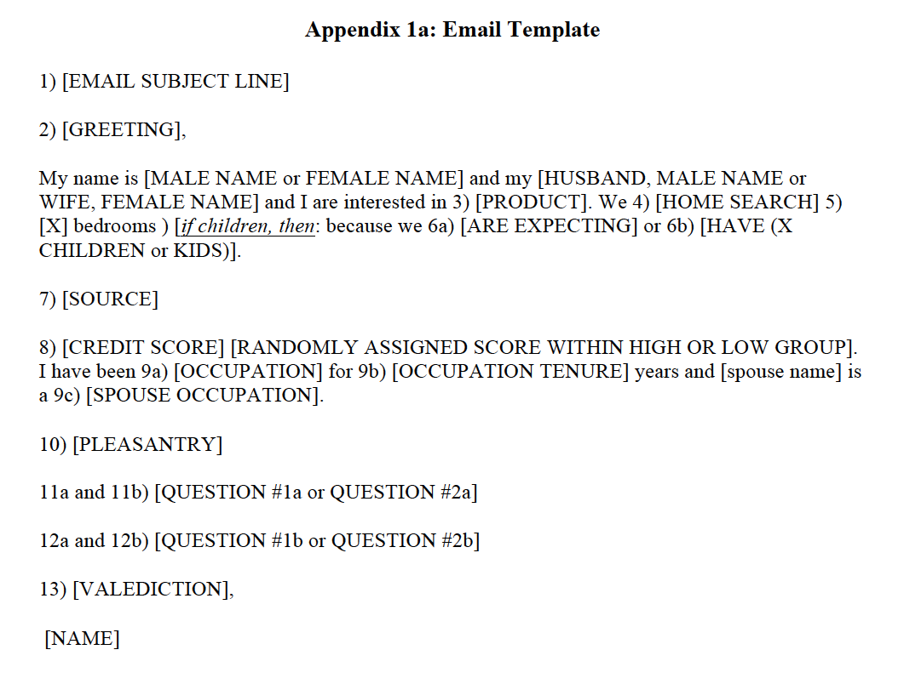
Email construction template

Slide 12
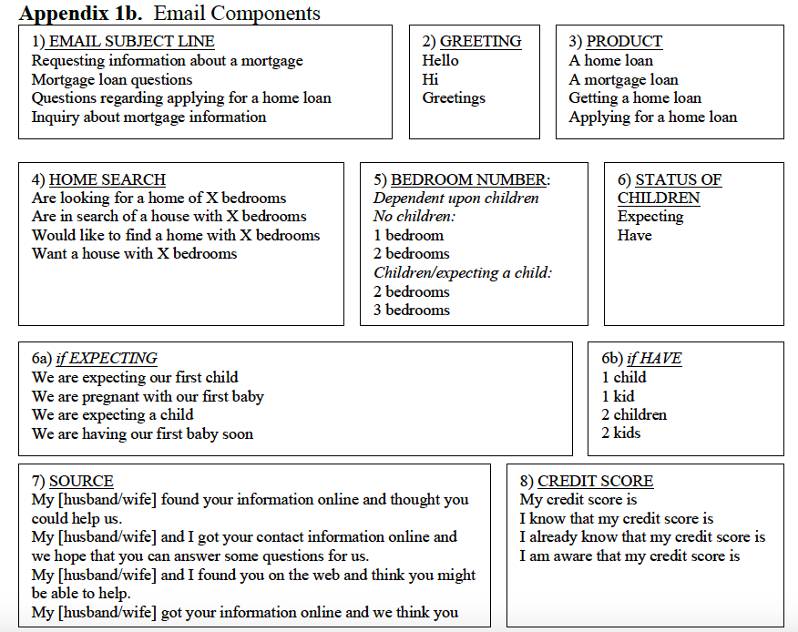
Email components: Part 1

Slide 13
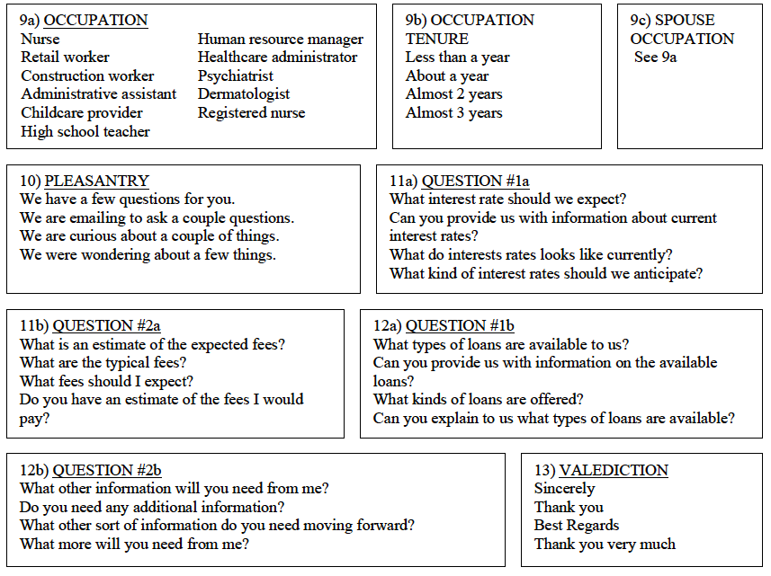
Email components: Part 2

Slide 14
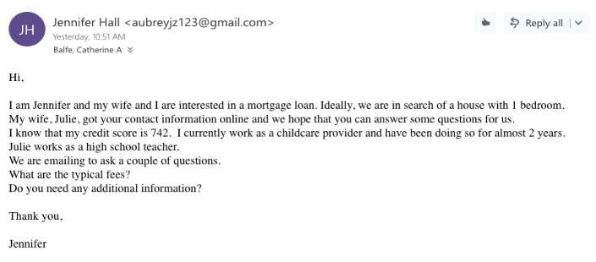
Example

Slide 15
Results from Pilot Study (vs. Hanson et al. 2016)

Slide 16
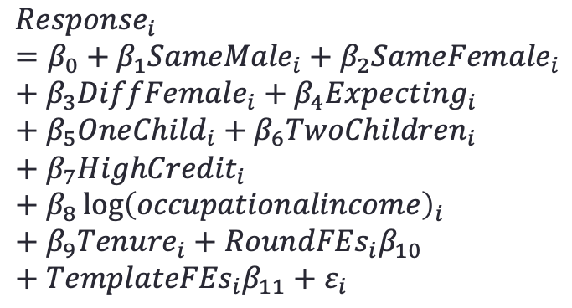
Regression Results
$${Response}_{i}=β_{0}+β_{1}{SameMale}_{i}+β_{2}{SameFemale}_{i}+β_{3}{DiffFemale}_{i}+β_{4}{Expecting}_{i}+β_{5}{OneChild}_{i}+β_{6}{TwoChildren}_{i}+β_{7}{HighCredit}_{i}+β_{8}\log{{\left(occupationalincome\right)}_{i}}+β_{9}{Tenure}_{i}+{RoundFEs}_{i}β_{10}+{TemplateFEs}_{i}β_{11}+ε_{i}$$
Same-Gender Male | -0.253**
 | (0.103)
Same-Gender Female | -0.340***
 | (0.120)
Different-Gender Female Originator | -0.018 (0.126)
Expecting a Child | 0.031
 | (0.116)
Has One Child | -0.100
 | (0.107)
Has Two Children | -0.216**
 | (0.102)
High Credit Score (vs. low) | -0.013
 | (0.103)
Log Occupational Income | -0.034
 | (0.079)
Occupational Tenure (years) | 0.038
 | (0.049)
Callback Rate for Different-Gender, Male Originator: | 72.34%
Excluded category: Different-Gender Male Originator (response rate of 72.34%)
Linear probability model
Standard errors clustered on MLO
Estimation is using our preferred sample, “Restricted Sample #2”

Slide 17
Next Steps
Update and tweak methodology (your comments are very helpful at this stage).
File pre-analysis plan in January 2022.
Start collecting publicly-posted MLO information in December 2021.
Start emailing MLOs in February 2022.
We will likely be hiring RAs in December, and then perhaps later in early 2022. The job ad will appear on Handshake, will be sent to econ majors, and distributed in other ways. If you are interested in a position and you haven’t see any ad posted by the end of December then reach out to me.

Slide 18
Thank you!

Slide 19
Estimating Main Effects – Interaction variables
Interaction Variable | Hypothesis | Source
LGBTQ Inclusivity | Rates of S.O. discrimination will vary by region and will decrease as city policies become more inclusive of LGBTQ people | Municipal Equality Index (MEI) from the HRC
Gay and lesbian Population by ZIP Code | Rates of S.O. discrimination will decrease as gay and lesbian population increases, as found by Gao and Sun (forthcoming). | Williams Institute’s county-level LGBT population estimates
MLO Gender | May discriminate less based on gender or family structure. S.O. discrimination unclear | We record MLO gender, if obvious to us through a photo and/or name during data collection
Type of Lending Institution | We may detect less discrimination from large banks (i.e. Capitol One, Chase) as they may have stricter anti-discrimination policies. | We record the type of lending institution during data collection. Options are: Large corporate bank Local bank Mortgage loan originator firm (national) Mortgage loan originator firm (local/state-wide)
State Policy Protections for LGBTQ Population | We may detect less discrimination in states with LGBTQ policy protections in the credit market. | 15 states and D.C. protect against discrimination on the basis of sexual orientation in the credit market.

Slide 20
References
Ahmed, A. M., & Hammarstedt, M. (2009). Detecting discrimination against homosexuals: Evidence from a field experiment on the Internet. Economica, 76(303), 588-597.
Bertrand, M., & Mullainathan, S. (2004). Are Emily and Greg more employable than Lakisha and Jamal? A field experiment on labor market discrimination. The American Economic Review, 94(4), 991-1013.
Friedman, S., Reynolds, A., Scovill, S., Brassier, F. R., Campbell, R., & Ballou, M. (2013). An estimate of housing discrimination against same-sex couples. Available at SSRN:
https://ssrn.com/abstract=2284243 or http://dx.doi.org/10.2139/ssrn.2284243
Gao, L. & Sun, H."The Rainbow of Credit: Same-Sex Mortgage Discrimination and Two-sided Spillover Effect", accepted by the Proceedings of the National Academy of Sciences of USA, (PNAS).
Hanson, A., Hawley, Z., Martin, H., & Liu, B. (2016). Discrimination in mortgage lending: Evidence from a correspondence experiment. Journal of Urban Economics, 92, 48-65.
Jepsen, C., & Jepsen, L. K. (2009). Does home ownership vary by sexual orientation?. Regional Science and Urban Economics, 39(3), 307-315.
Lautz, J., Dunn, M., Snowden, B., Riggs, A., Horowitz, B. (2017). 2017 Profile of Home Buyers and Sellers. Retrieved from
https://www.nar.realtor/sites/default/files/documents/2017-profile-of-home-buyers-and- sellers-11-20-2017.pdf
Leppel, K. (2007). Married and unmarried, opposite and same-sex couples: a decomposition approach. Journal of Housing Research, 16(1), 61–81.

Slide 21
References
Levy, D. K., Wissoker, D., Aranda, C. L., Howell, B., Pitingolo, R., Sewell, S., & Santos, R. (2017). A
Paired-Testing Pilot Study of Housing Discrimination against Same-Sex Couples and Transgender Individuals. The Urban Institute.
Neumark, D., Burn, I., & Button, P. (forthcoming). Age Discrimination and Hiring of Older Workers. Journal of Political Economy.
Robinson, J. K. (2002). Race, gender, and familial status: discrimination in one US mortgage lending market. Feminist Economics, 8(2), 63-85.
Schwegman, D. (2018). Understanding Discrimination against Same-Sex Couples in the United States: Evidence from an Email Correspondence Audit (No. 210). Center for Policy Research, Maxwell School, Syracuse University.
Tilcsik, A. (2011). Pride and Prejudice: Employment Discrimination against Openly Gay Men in the United States 1. American Journal of Sociology, 117(2), 586-626.

Slide 22
Role of MLOs
What are Mortgage Loan Originators (MLOs)?
Primary contact for borrowers during the search and application for a mortgage
Analyze and screen preliminary loan requests
Gather background financial information
Submit loan applications
Monitor loan process from application to closing
An email response from an MLO can be the first step in the information gathering stage of receiving a loan

Slide 23
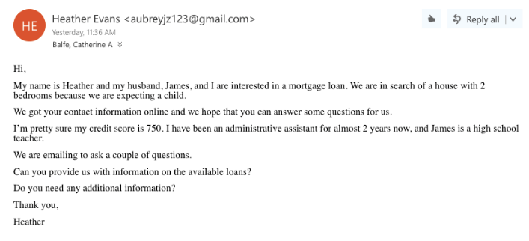
Example

Slide 24
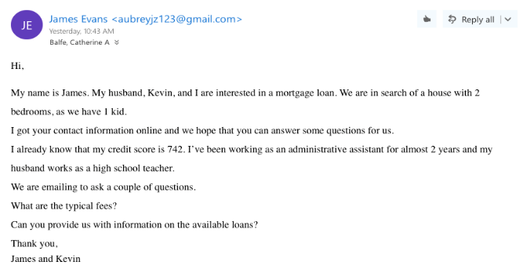
Example

Slide 25
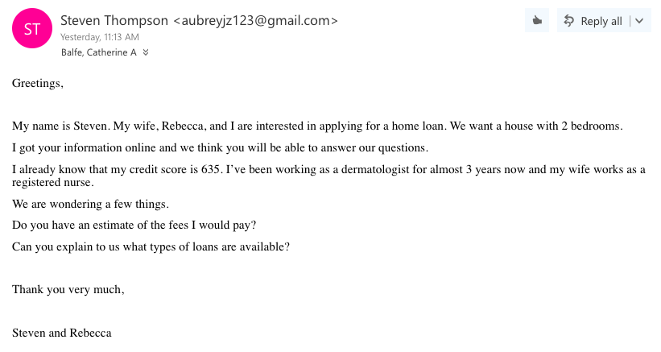
Example

