Slide 1

urban Economics
COVID-19 and crime
Prof. Patrick Button

Slide 2
Plan for today
General summary of anecdotal evidence of the effect of COVID-19 on crime.
Summary of two papers on how COVID-19 is affecting domestic violence:
Ravindran and Shah (2020)
Bullinger, Carr, and Packham (2020)
Practice questions on this material.

Slide 3
Anecdotal evidence of the effect of COVID-19 on crime
By “anecdotal” here I mean things like news articles.
This would contrast with research that can establish a causal link.
It’s always great to use a causal framework to try to test for any causal links that are hypothesized.
E.g., the media is discussing that COVID-19 may increase X, let’s test that!

Slide 4
Anecdotal evidence of the effect of COVID-19 on crime
There is a hodge-podge of anecdotal evidence, coming from various data sources and particular cities.
Sometimes the data on particular crime-city combinations show an increase, and sometimes they show a decrease.
This makes it hard to pin down the exact effects on crime.
In a discussion article, Boman and Gallups (2020) note that, on average, across all cities and crimes, anecdotal evidence from 911 service calls shows that crime is down in most cities.
Other sources back this up, such as a report by USA Today on April 4, 2020, which found that crime decreased in 19/20 cities examined (https://www.usatoday.com/story/news/investigations/2020/04/04/coronavirus-crime-rates-drop-and-domestic-violence-spikes/2939120001/)

Slide 5
Anecdotal evidence of the effect of COVID-19 on crime
Other data sources show positive or negative trends. Here is a small sampling:
Arrest rates are down in the US, partly as police as intentionally arresting fewer people due to the COVID-19 risks both in interacting with people and the risk for those sent to jail. (https://apnews.com/article/bbb7adc88d3fa067c5c1b5c72a1a8aa6)
Robberies and property crimes appear down.
Murder, homicide, aggravated assaults, and gun violence appear up (https://www.safewise.com/blog/covid-19-crimes/)

Slide 6
Anecdotal evidence of the effect of COVID-19 on crime
A more careful, early statistical analysis shows no consistent pattern in how six crime categories have changed in over a dozen US cities (Ashby, 2020).
Serious assaults in public,
Serious assaults in residences,
Residential burglaries
Non-residential burglaries
Motor vehicle theft
Stealing from cars

Slide 7
Anecdotal evidence of the effect of COVID-19 on crime
However, all research done early in the pandemic suffers from a lack of data.
We may not yet have the statistical power, due to a lack of data, to distinguish changes in trends (the “signal”) from the noise.
Observing the pandemic over a longer period of time or collecting data on more regions could help.
Or, the only data sources have other issues.
Intimate partner violence (IPV) is notoriously underreported, with only about half of incidents resulting in a 911 call (Reaves, 2017).
Not all 911 calls also lead to a report or arrest, an issue we will see later.
Self-reported data (e.g., from a survey or a complaint system) may be preferred.

Slide 8
Anecdotal evidence of the effect of COVID-19 on crime
So, we don’t have too many clear answers. The anecdotal evidence points in different directions.
Until we have more/better data and good causal estimation strategies, I’ll be hard to say for sure.
The two papers we will cover today are early attempts at leveraging early data to estimate a causal relationship between COVID-19 and crime.
They both focus on domestic violence, which anecdotally seems to be increasing in importance as an issue.

Slide 9
Ravindran and Shah – Evidence from India
The researchers study how COVID-19-related lockdown policies affected domestic violence rates in India.
They do a difference-in-differences study comparing areas with stronger lockdown policies before and after to areas over the same time period with weaker policies.
I.e. stronger lockdown (red zone) before and after, versus weaker lockdown (green zone) before and after.
They use data of complaints made to the National Commission for Women, a national statutory body of the government of Indian with a mandate for protecting and promoting the interests of women.

Slide 10
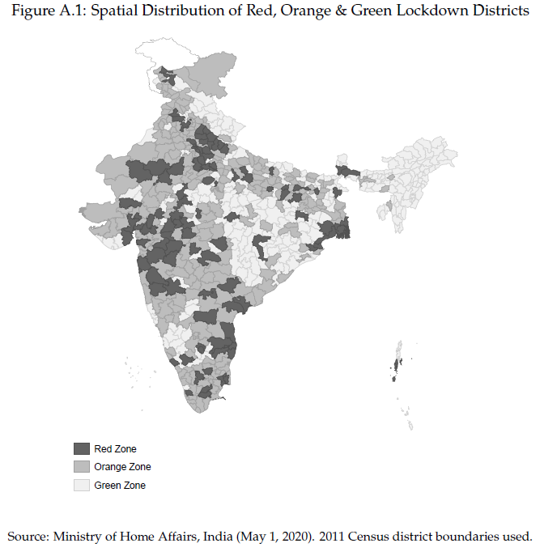
Ravindran and Shah – Evidence from India
More specifically, the Indian government classified districts as red (more restrictive), orange, and green.
They match this lockdown policy data with district-month level data on complaints.

Slide 11
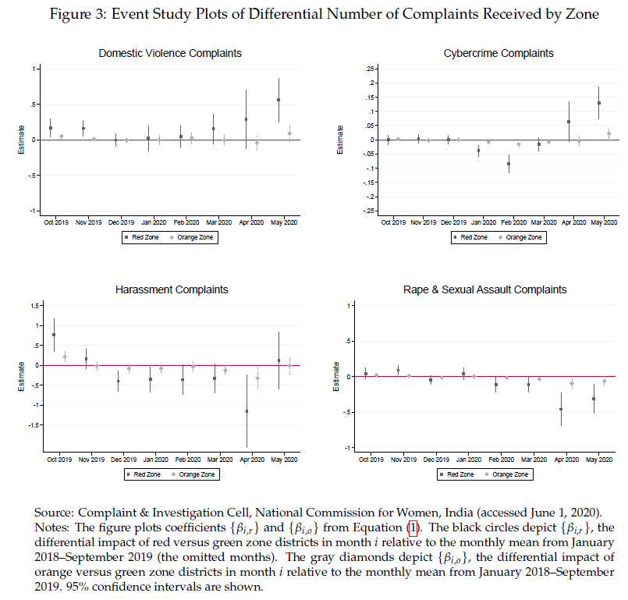
This is another “event study” type difference-in-differences results figure that you’ve seen many times.
Red zone = difference between red zone and green zone
Orange zone = diff. b/w orange and green
Orange zone isn’t much different than the green zone.

Slide 12
The red zone is affected differently compared to the green zone (and maybe the orange zone).
In the red zone, there was a relative increase in:
Domestic violence complaints
Cybercrime complaints
In the red zone, there was a relative decrease in:
Harassment complaints
Rape and sexual assault complaints

Slide 13
Bullinger et al – Evidence from chicago
Abstract:
Bullinger, Carr, and Packham (2020) estimate the effect of stay-at-home (SAH) policies in the city of Chicago on domestic violence.
They use cell phone data at the block level to show that the SAH order increased time spend at home.
There was a related decrease in total calls for police service, but then an increase in domestic violence-related calls.

Slide 14
Bullinger et al – Evidence from chicago
Abstract:
…These estimates are at odds with official reports and arrests data, which show that domestic violence crimes fell by 8.7% for reports and 26.3% for arrests.
But compared to similar data for other crimes, the decline in reported domestic violence crimes is significantly smaller than the decline in other crimes.

Slide 15
Bullinger et al – Evidence from chicago
The stay-at-home (MAH) order, which can help reduce the pandemic, could contribute to a “shadow pandemic” of domestic violence.
SAH forces victims to spend more time with their abusers.
COVID-19 is also increases stress and causing financial harm, which both contribute to domestic violence.
Leaving the household may be difficult for victims to due given worse financial circumstances and it being more difficult to leave the house, get a job, etc.

Slide 16
Bullinger et al – Evidence from chicago
Since victims are also interacting less often with those who would report domestic violence (e.g., police, non-profit groups), this increase in domestic violence could go undetected (or be understated).
Both of these factors make it unclear if the data on reported domestic violence would show an increase or a decrease.

Slide 17
Bullinger et al – Evidence from chicago
The authors study the SAH policy in Chicago, which started on March 21, 2020.
Their methodology is a version of a difference-in-differences:
Treatment group = blocks when SAH was in effect
Control group = same blocks last year when SAH was not in effect
The assumption is that changes in reported domestic violence in the comparison (control) weeks provide a good counterfactual for the change that would have occurred had there been no SAH policy.

Slide 18
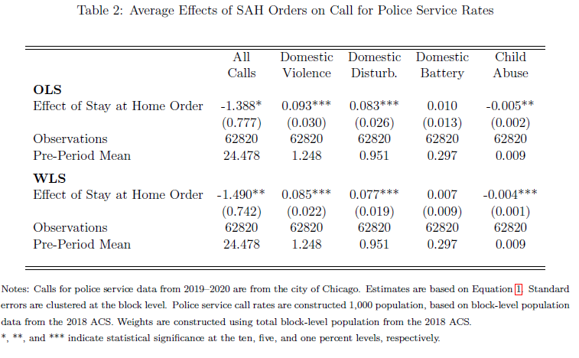
Outcome: 911 calls
There is a decrease in all 911 calls associated with the SAH order.
Taking the estimate (-1.388) and dividing it by the pre-period mean (24.478) means that calls decreased by about 5.7%.

Slide 19
Outcome: 911 calls
There is an increase in domestic violence and disturbance calls associated with the SAH.
These estimates are more precise/statistically significant.
Taking the estimate for domestic violence (0.093) and dividing it by the pre-period mean (1.248) means that domestic violence calls increased by about 74.5%

Slide 20
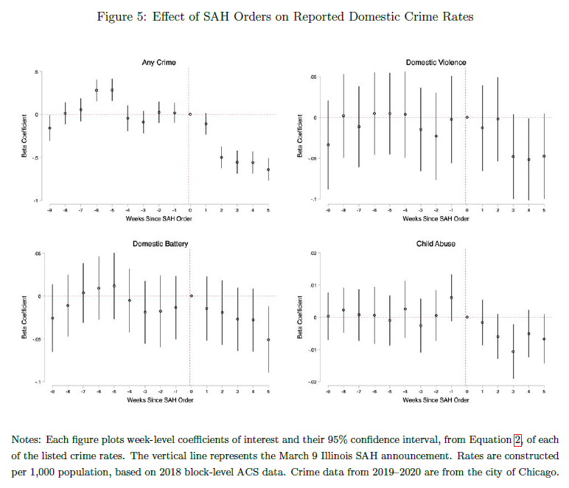
Outcome: REPORTED crimes
Reported crimes in general decreased.
The decrease in reported domestic violence, domestic battery, and child abuse crimes is much lower.

Slide 21
What’s going on with the results?
There is a decrease in domestic violence calls, but a slight decrease in reports of domestic violence.
Obviously a 911 call does not lead to a report or an arrest.
It seems like there are more domestic violence concerns, given the increased calls. But reports are perhaps less likely to happen since victims are less able to interact with police or support services (e.g., shelters may have temporarily shut down).
Reporting could otherwise be more difficult during this time.

Slide 22
References
Ashby MPJ. Initial evidence on the relationship between the coronavirus pandemic and crime in the United States. Crime Science. 2020;9(6):1–16. [PMC free article] [PubMed] [Google Scholar]
Boman, J. H., 4th, & Gallupe, O. (2020). Has COVID-19 Changed Crime? Crime Rates in the United States during the Pandemic. American journal of criminal justice : AJCJ, 1–9. Advance online publication. https://doi.org/10.1007/s12103-020-09551-3
Reaves, B. A. (2017). Police response to domestic violence, 2006–2015 (NCJ 250231). Bureau of Justice Statistics. Available at https://www.bjs.gov/content/pub/pdf/prdv0615.pdf.

