Slide 1

Urban Economics
Econ. Research on Racial Bias in police use of force
Prof. Patrick Button

Slide 2
Outline
Summary of papers on racial bias in police use of force:
Johnson et al. - 2019 - Officer characteristics and racial disparities in fatal officer-involved shootings (briefly)
Fryer Jr. - 2019 - An empirical analysis of racial differences in police use of force (briefly)
Hoekstra, Sloan - 2020 - Does Race Matter for Police Use of Force Evidence from 911 Calls (more in-depth)

Slide 3
Johnson et al. – officer characteristics in fatal shootings
Abstract: Despite extensive attention to racial disparities in police shootings, two problems have hindered progress on this issue.
First, databases of fatal officer-involved shootings (FOIS) lack details about officers, making it difficult to test whether racial disparities vary by officer characteristics.
Second, there are conflicting views on which benchmark should be used to determine racial disparities when the outcome is the rate at which members from racial groups are fatally shot.

Slide 4
Benchmarks?
A persistent point of the debate in studying police use of force concerns how to calculate racial disparities.
Racial disparities in FOISs have traditionally been tested by asking whether officers fatally shoot a racial group more than some benchmark, such as that group’s population proportion in the US.
However, using population as a benchmark makes the strong assumption that white and black civilians have equal exposure to situations that result in FOIS.
Prior researchers tried to sometimes try to get around this issue by using race-specific violent crime as the benchmark instead of population.

Slide 5
Aside – which benchmark?
Much of the literature uses one of the two denominators (to divide the # of FOISs by victim rate by):
1) Population of that racial group (e.g., # FOISs with black victims / black population).
2) Race-specific violent crime (e.g., # FOISs with black victims / # of incidents of violent crime involving black suspects)

Slide 6
Aside – which benchmark?
1) Population of that racial group (e.g., # FOISs with black victims / black population).
2) Race-specific violent crime (e.g., # “ “ “ / # of violent crime involving black suspects)
They can tell us different things about disparities in policing: 1) tells us more about differentially higher probability that a black person is a victim of FOIS.
Since FOISs are more likely in violent crime incidents, 2) tells us about the likelihood for a FOIS in incidents where police are sometimes motivated to use force.

Slide 7
Aside – which benchmark?
1) Population of that racial group (e.g., # FOISs with black victims / black population).
2) Race-specific violent crime (e.g., # “ “ “ / # of violent crime involving black suspects)
Benchmark 1) increases if black citizens face more police interactions, but this does not affect 2)
In this case, the # of FOISs with black victims rises just because of there being more police interactions, not because of a change in the likelihood of police using force in a given interaction.

Slide 8
Aside – which benchmark?
1) Population of that racial group (e.g., # FOISs with black victims / black population).
2) Race-specific violent crime (e.g., # “ “ “ / # of violent crime involving black suspects)
If police are more likely to use force against black citizens, then that appears especially in 2), but somewhat in 1).
So, these different benchmarks motivate to factors that we would like to study, which each benchmark better capturing one of them:
Are there racial disparities in how often citizens face interactions with police that lead to a FOIS? ( 1) better captures this.)
Are police more likely to use fatal force against black citizens? ( 2) better captures this).

Slide 9
Johnson et al. – officer characteristics in fatal shootings
They address these issues [of which benchmark to use] by creating a database of fatal officer-involved shootings (FOIS) that includes detailed officer information.
They [partially, in my opinion] sidestep the debate about benchmarking by using an approach that predicts the race of civilians who are fatally shot.
So, making assumptions about the appropriate benchmark are not required.

Slide 10
Johnson et al. – Methodology
“Rather than trying to identify which benchmark is best, another way to test for racial disparities in FOIS is to directly predict the race of a person fatally shot.
Specifically, we used multinomial regression with civilian race as the outcome and various factors—officer, civilian, and county characteristics—as predictors.
In this way, we approached racial disparity from a different angle and asked: “What factors predict the race of a person fatally shot by police?””

Slide 11
Johnson et al. – Methodology
Basically, Johnson et al. (2019) use civilian race as the outcome variable (dependent variable, “left hand side” variable) and see how several factors relate to civilian race: officer, civilian, and county characteristics.
This allows the authors to see which factors explain FOIS for each racial group, and if certain factors are more important for explaining FOIS against one group versus another.

Slide 12
Johnson et al. – officer characteristics in fatal shootings
They report three main findings:
As the proportion of black or Hispanic officers involved in a FOIS increases, a person shot is more likely to be black or Hispanic than white, a disparity explained by county demographics;
Black and Hispanic officers are more likely to assigned to areas with more black and/or Hispanic people, so this just reflects that and likely not the fact that black and Hispanic offers are more likely to commit a FOIS against black and Hispanic people.

Slide 13
Johnson et al. – officer characteristics in fatal shootings
They report three main findings:
2) race-specific county-level violent crime strongly predicts the race of the civilian shot;
So, when, e.g., the violent crime rates of Hispanics increases in a county, then Hispanics are more likely to be victims of FOIS.

Slide 14
Johnson et al. – officer characteristics in fatal shootings
3) although they find no overall evidence of anti-black or anti-Hispanic disparities in fatal shootings, when focusing on different subtypes of shootings (e.g., unarmed shootings or “suicide by cop”), data are too uncertain to draw firm conclusions.
[May be due to a lack of statistical power: if you look at smaller categories, it can be hard to detect differences.]
The authors highlight the need to enforce federal policies that record both officer and civilian information in FOIS.

Slide 15
Fryer – Racial Differences in Police Use of Force
Abstract: This paper explores racial differences in police use of force.
On non-lethal uses of force, blacks and Hispanics are more than 50 percent more likely to experience some form of force in interactions with police.
Adding controls that account for important context and civilian behavior reduces, but cannot fully explain, these disparities.

Slide 16
Fryer – Racial Differences in Police Use of Force
Abstract: … On the most extreme use of force—officer-involved shootings—we find no racial differences either in the raw data or when contextual factors are taken into account.
We argue that the patterns in the data are consistent with a model in which police officers are utility maximizers, a fraction of whom have a preference for discrimination, who incur relatively high expected costs of officer-involved shootings.

Slide 17
Critiques of Fryer and Johnson et al.
Hoekstra and Sloan (2020), the next paper I will cover, critiques the papers by Johnson et al. (2019) and Fryer (2019), arguing that they may give bias results.
The key issue regards the appropriate “benchmark” that these papers use. Researchers often do not observe interactions in which force was not used.
As a result, researchers must make assumptions regarding the appropriate benchmark, such as looking at incidents per capita [benchmark 1) from earlier] or incidents compared to violent crime rates or arrests [benchmark 2) from earlier] (Hoekstra and Sloan, 2020).

Slide 18
Critiques of Fryer and Johnson et al.
Also, most data sets do not allow the researchers to observe whether the underlying risk of situations involving white and minority civilians, or white and minority officers, is similar in terms of whether force was merited.
White and minority civilians have different situations, and white and minority officers are usually allocated differently, making it difficult to isolate bias from these different circumstances.
While researchers can try to control for these differences, data is imperfect.

Slide 19
Critiques of Fryer and Johnson et al.
As I will describe shortly, Hoekstra and Sloan (2020) argue that they improve on prior research by looking at a situation in which the race of the officer is as-good-as randomly assigned to 911 calls.
This quasi-random assignment means that there is not concern that officers of difference races are put in different scenarios.
Having officers put in different situations, on average, by officer race or ethnicity would generate selection bias.
With selection bias, it’s hard to isolate differences by officer race from the fact that officers are allocated differently.

Slide 20
Hoekstra and Sloan – evidence from 911 calls
Abstract: This paper uses data on officers dispatched to over 2 million 911 calls in two cities [which ones they are is kept anonymous in the paper], neither of which allows for discretion in the dispatch process.
Using a location-by-time fixed effects approach that isolates the random variation in officer race, we show white officers use force 60 percent more than black officers and use gun force twice as often.
To examine how civilian race affects use of force, we compare how white officers increase use of force as they are dispatched to more minority neighborhoods, compared to minority officers.

Slide 21
Hoekstra and Sloan – evidence from 911 calls
Abstract: … Perhaps most strikingly, we show that while white and black officers use gun force at similar rates in white and racially mixed neighborhoods, white officers are five times as likely to use gun force in predominantly black neighborhoods.
Similarly, white officers increase use of any force much more than minority officers when dispatched to more minority neighborhoods.

Slide 22
Hoekstra and Sloan – evidence from 911 calls
Abstract: Consequently, difference-in-differences estimates from individual officer fixed effect models indicate black (Hispanic) civilians are 30 - 60 (75 - 120) percent more likely to experience any use of force, and five times as likely to experience gun use of force, compared to if white officers scaled up force similarly to minority officers.
These findings highlight race as an important determinant of police use of force, including and especially lethal force.

Slide 23
Hoekstra and Sloan – evidence from 911 calls
Documenting whether race matters for police use of force is difficult.
Researchers often do not observe (have data on) interactions in which force was NOT used (they only have data for when force was used).
This forces researchers to make assumptions and use a particular denominator, such as population of that racial group (benchmark 1) from earlier) or number of violent crime interactions for that racial group (benchmark 2)).

Slide 24
Hoekstra and Sloan – evidence from 911 calls
There are also issues with selection bias, where it’s usually not random where officers of different races are deployed, for example.
A simple comparison of use of force probability between white and black officers would provide a biased estimate of how race affects use of force, since those officers are not being deployed in the same situations or to the same areas.

Slide 25
Hoekstra and Sloan – evidence from 911 calls
Documenting whether race matters for police use of force is difficult.
Researchers often do not observe (have data on) interactions in which force was NOT used (they only have data for when force was used).
There are also issues with selection bias, where it’s usually not random where officers of different races are deployed, for example.
A simple comparison of use of force probability between white and black officers would provide a biased estimate of how race affects use of force, since those officers are not being deployed in the same situations or to the same areas.

Slide 26
Hoekstra and Sloan – evidence from 911 calls
Hoekstra and Sloan get around these issues by using administrative data on over two million 911 calls.
This data is unique in that it:
Comes from two cities in which the dispatch protocols allow for no discretion on the part of the officer or the operator with respect to which officer is dispatched.
(i.e., the race of the officer is as-good-as-randomly assigned)
This data allows them to see over two million interactions, some of which end up with use of force and some which do not, rather than only having data on the incidents where force was used and having to pick a denominator (benchmark 1) or 2)).

Slide 27
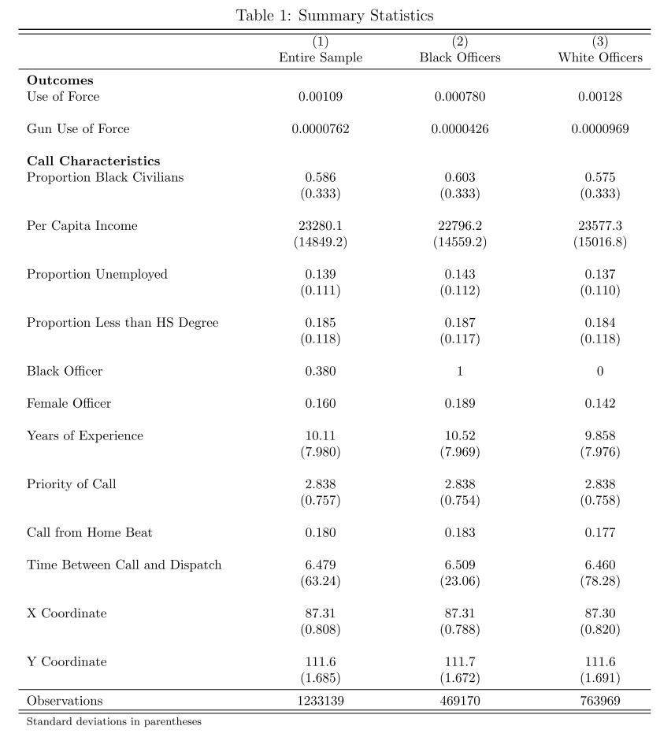
Use of force is quite rare, only 0.109% of 911 calls result in use of force.
For gun use of force this is 0.00762%.
In the raw data, white officers are much more likely to use force (with or without gun) compared to black officers.
911 dispatches occur to areas that tend to be predominantly black.
38% of officers are black
16% are female
Officers have about 10 years of experience on average

Slide 28
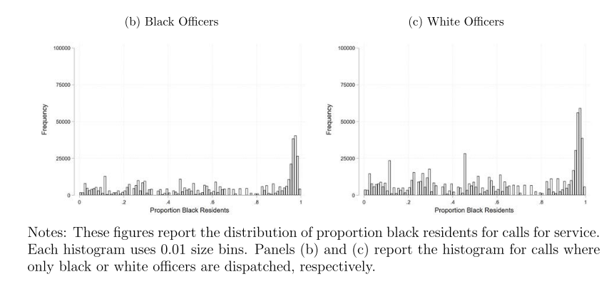
Hoekstra and Sloan – evidence from 911 calls
No clear difference in the raw data as to if black and white officers are deployed to 911 calls in different neighborhoods (based on proportion black residents).
This and other evidence in the paper is suggestive that officer race is as-good-as randomly assigned.
i.e., this is a good natural experiment

Slide 29
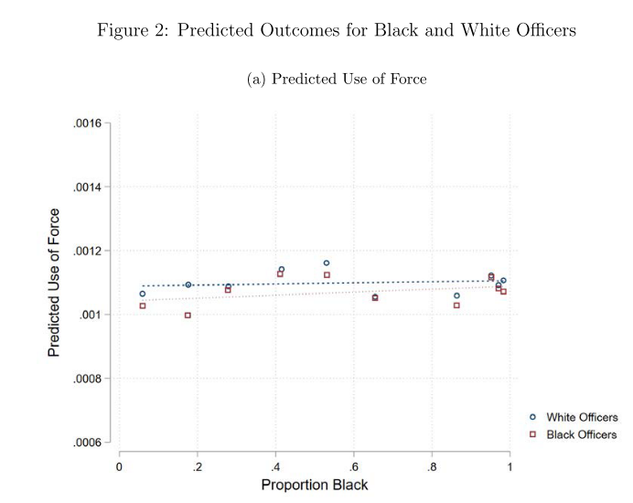
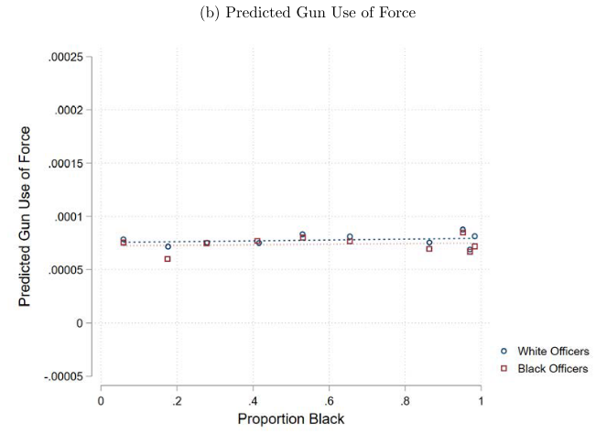
Y-axis = predicted use of force (left) or gun force (right), X-axis = proportion black
The figures show that white and black officers are allocated to 911 calls in neighborhoods with a similar level of predicted use of (gun) force.

Slide 30
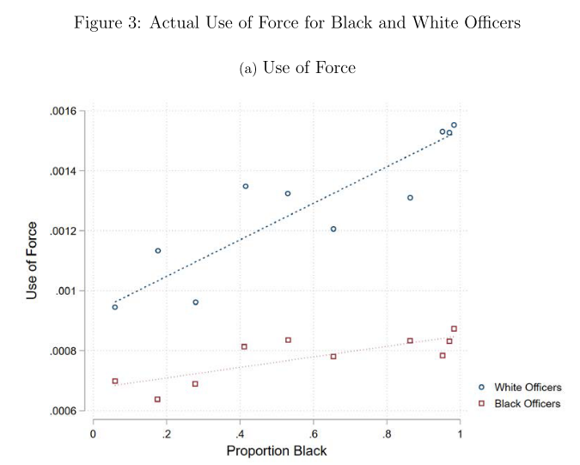
Hoekstra and Sloan – evidence from 911 calls
Both white and black officers are more likely to use force when randomly assigned to calls in areas with a higher proportion black.
But white officers are SIGNIFICANTLY more likely to use force 1) in general (higher intercept) and 2) when proportion black is higher (steeper slope).

Slide 31
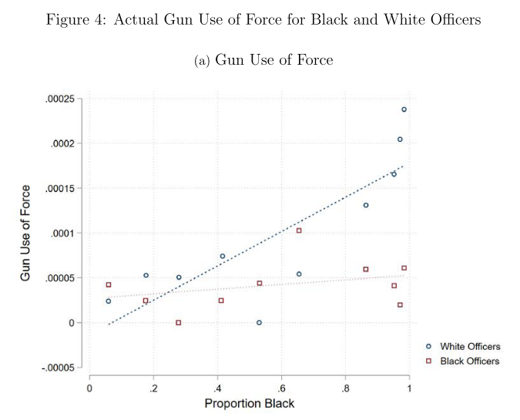
Hoekstra and Sloan – evidence from 911 calls
Only white officers are more likely to use gun force when randomly assigned to calls in areas with a higher proportion black.
This white-black officer differential in use of force by portion black is more pronounced for gun use of force.

Slide 32
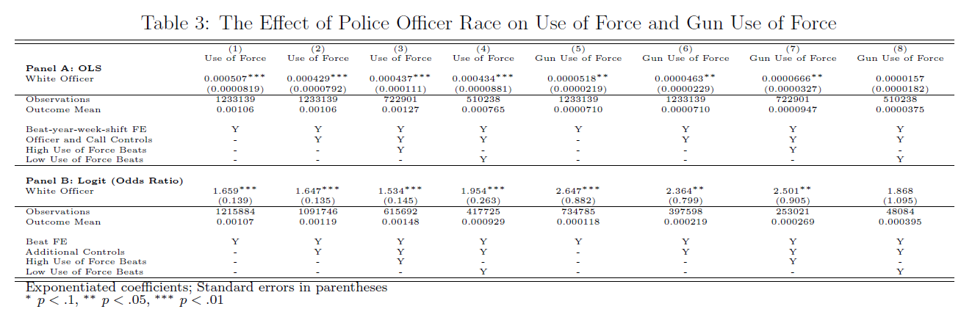
Hoekstra and Sloan – evidence from 911 calls

Slide 33
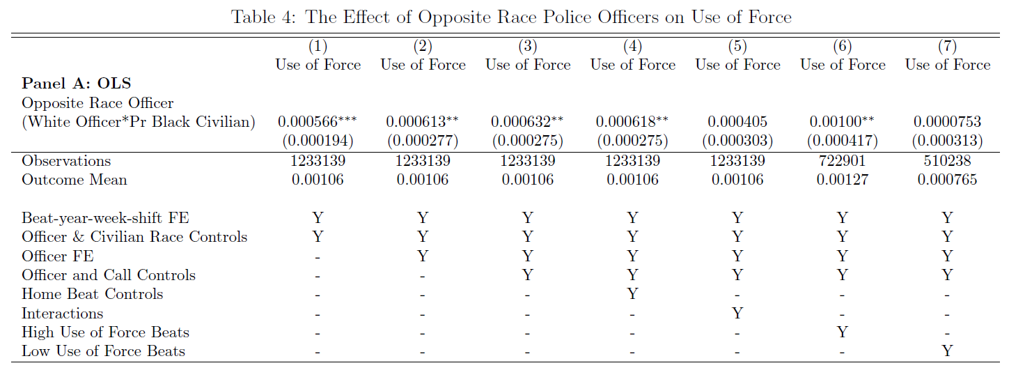
Hoekstra and Sloan – evidence from 911 calls

Slide 34
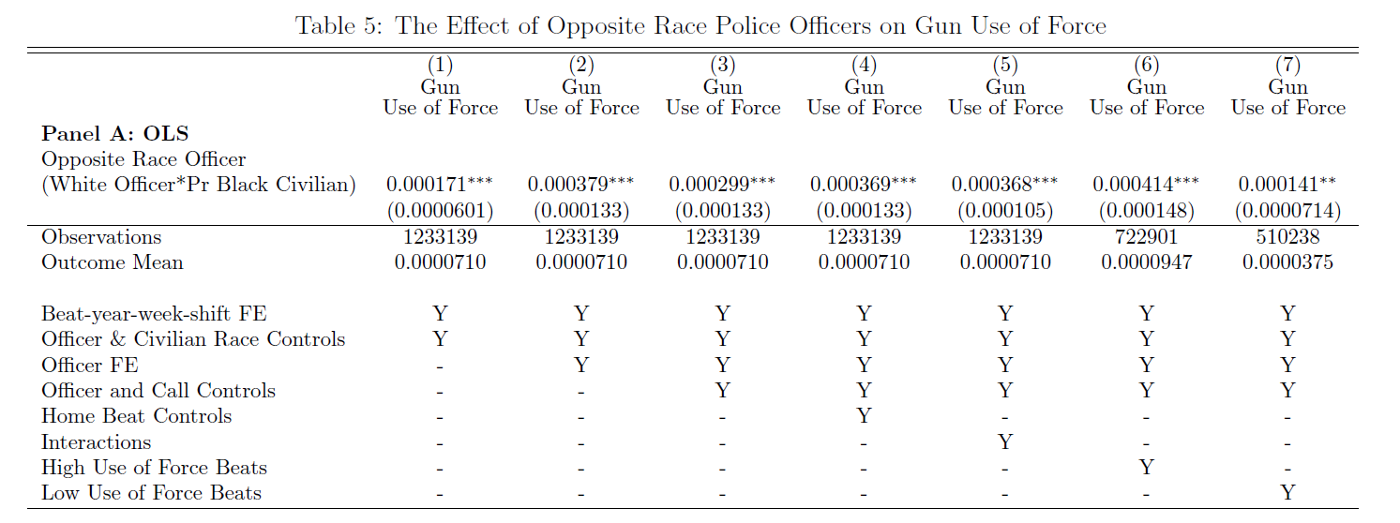
Hoekstra and Sloan – evidence from 911 calls

Slide 35
Summary of the papers
Johnson et al. (2019) – (1) As the proportion of black or Hispanic officers involved in a FOIS increases, a person shot is more likely to be black or Hispanic than white, a disparity explained by county demographics; (2) race-specific county-level violent crime strongly predicts the race of the civilian shot; (3) no disparities in fatal shootings on average, but they are unable to test if there is variation by type of interaction.
Fryer (2019) – Minorities face more non-lethal use of force, but there are no differences in lethal use of force.

Slide 36
Summary of the papers
Hoekstra and Sloan (2020) – Uses 911 calls where there is quasi-randomization of officer race. Observe if there was use of force or not, so there is a clear denominator.
Black citizens face significantly more police use of force (and gun force).
Finds that white officers are more likely to use force in general, and while all officers use more force is more black neighborhoods, this relationship is MUCH stronger for white officers.
The disparity of black citizens facing more gun use of force is entirely explained by white officers being more likely to use gun force in black neighborhoods.
(Black officers don’t change their use of gun force behavior based on neighborhood demographics.

