Slide 1

Urban Economics
Agglomeration, Clusters and Cities Prof. HUSSAIN HADAH

Slide 2
Outline
Lecture summarizing economic reasons why we have people and economic activity agglomerated into cities and regional clusters (about 20 minutes)
Practice question done on Canvas
Lecture on the “consumer city” (Glaeser, Kolko, and Saiz, 2001) (about 15 minutes)
Lecture on “tech clusters” (Kerr and Robert-Nicoud, 2020) (about 20 minutes)
Includes Kahoot quiz (about 5 minutes)
Activity on COVID-19 and agglomeration (about 15 minutes)
Practice questions in groups (flexible timing)

Slide 3
Background - Cities
Most people live in cities
According to the 2010 Census (data from data.census.gov), out of all the 131,704,730 housing units (“households”) in the United States, 105,019,731 or 79% are in urban areas.
Urban areas here is defined as living in an area with at least 2,500 people, otherwise it’s a rural area.
So, only 21% of people live in rural areas.
Even within cities there is a lot of concentration.
E.g., the New York metropolitan statistical areas has a population of 20.3 million

Slide 4
Background - Clusters
In addition to people clustering in cities, businesses that are similar also cluster.
A few examples:
Silicon Valley in the greater San Francisco area (tech firms)
“Hollywood” in the greater Los Angeles area (entertainment), and a similar entertainment cluster in New York City
About half of all motion picture production in the US occurs in Los Angeles County!
Automobile manufacturing in Detroit.
Biotech and health sciences firms in Boston
Tourism in New Orleans

Slide 5
Why is there agglomeration? - Summary
Lots of reasons, but here is a summary of some more economic ones:
Economies of scale (aka scale economies)
What are agglomeration economies? Definition and introduction
Pecuniary agglomeration economies
Technological agglomeration economies
Knowledge spillovers (e.g., “happy hour effect”)
Transportation costs

Slide 6
Economies of scale
The idea here is that firms become more productive as their scale (their size, production capacity) increases.
Larger production plants can produce output more efficiently (less cost per unit) than smaller production plants.
Many firms exhibit economics of scale, but they are especially common in situations where there are high fixed costs (e.g., need to invest in lots of technology).
Economies of scale create the incentive for firms to be large and in one place (one big plant) rather than having smaller production units (many smaller plants).

Slide 7
Economies of scale
More formally, increasing economies of scale (aka “increasing returns to scale” or just “economies of scale”) occurs when, if inputs into production are doubled, output more than doubles.
Decreasing economies of scale: double inputs => less than double output
Constant economies of scale: double inputs => doubles output
E.g., suppose the inputs into production are capital (e.g., machines) and labor (e.g., workers). Suppose that with 10 machines and 10 workers, the plant can produce 10,000 widgets. The plant would have increasing economies of scale if, with 20 machines and 20 workers, they produce at least 20,001 widgets.

Slide 8
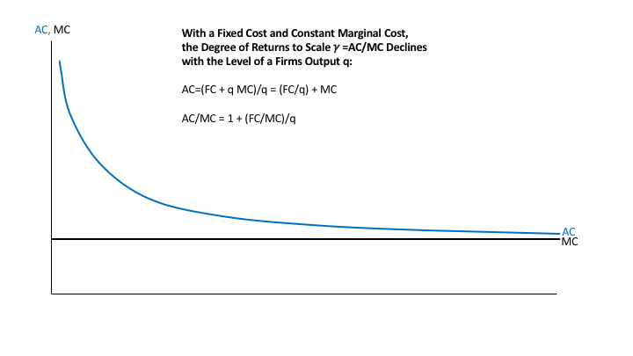
Economies of Scale
AC = average total cost
MC = marginal cost
FC = fixed cost
Economies of scale occurs when, as scale increases (producing more quantity), average total costs decrease.
Figure from https://blog.supplysideliberal.com/post/2017/6/7/returns-to-scale-and-imperfect-competition-in-market-equilibrium
Cost ($)
Quantity of production (q)

Slide 9
Economies of scale – Practice Question
Which out of the following situations represent INCREASING economies of scale? Respond on Canvas for the Quiz “Economies of Scale – Practice Question”
A firm doubles all its inputs and its output more than doubles.
A firm doubles all its inputs and its output less than doubles.
A firm doubles all its inputs and its output exactly doubles.
A firm doubles its employment and its output more than doubles.
With 10 employees and $10,000 of capital, output is 10 units. With 30 employees and $30,000 of capital, output is 33 units.
With 10 employees and $10,000 of capital, output is 10 units. With 30 employees and $30,000 of capital, output is 27 units.

Slide 10
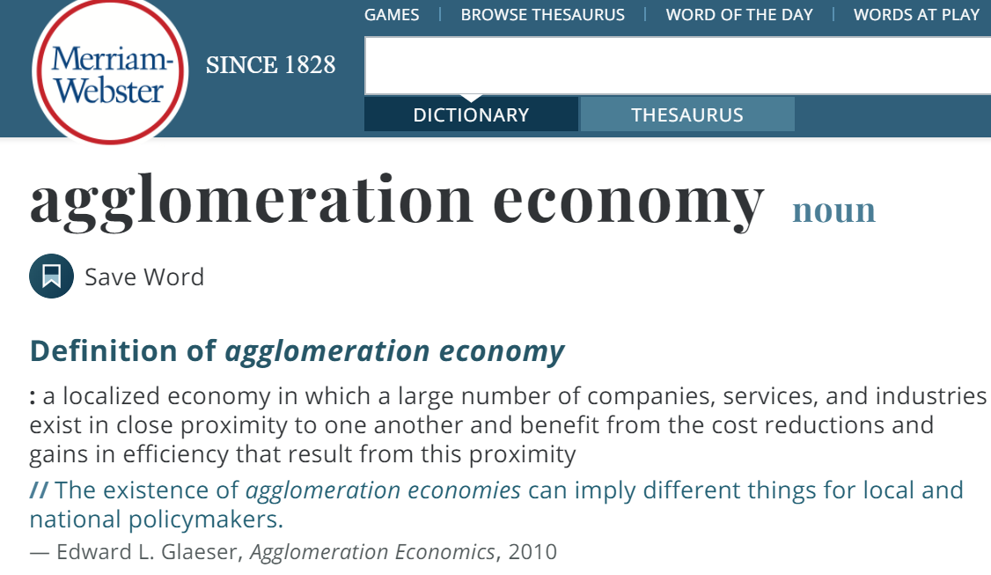
Agglomeration Economies - Definition

Slide 11
Agglomeration Economies - Definition
For there to be agglomeration economies, there must be positive spillovers to nearby businesses or people.
Having a similar firm nearby you helps you firm and increases your firm’s productivity.
Or, in the case of individuals, having other people in your same city helps you.
This is a positive externality.
Externality = when the production of a firm or the consumption of an individual affects others who are not part of the transaction.
Pollution = negative externality, Education = positive externality

Slide 12
Pecuniary Agglomeration economies
Lots of examples here (see, also, Ch. 1.3.1)
Pecuniary means relating to costs, meaning that these agglomeration economies reduce costs.
Some examples:
Lower input costs through specialization
More options for inputs due to specialization
Lower costs for high-cost inputs like soundstages (that input can be used by more firms, reducing costs)
With agglomeration, input markets, such as labor markets, are “thicker”, meaning more supply and demand. This leads to a better match between the input (e.g., worker) and the firm.
With thicker markets, can get rid of bad workers more easily.

Slide 13
Technological Agglomeration economies
Agglomeration leads to technological improvements or knowledge exchange, which is a key input.
Some examples:
“Happy hour effect”: In a tech cluster, tech workers will naturally socialize with each other and this will lead to informational exchange about next practices.
Worker mobility: In a cluster of similar firms, workers may move between firms and this can increase informational exchange (like bees moving between flowers to pollinate them).
With larger clusters, more industry groups appear that facilitate information exchange and provide services to that industry.

Slide 14
Transportation costs
Transportation costs can also lead to clustering of individuals and people in an area.
Firms have an incentive to be close to their customers but also close to the firms that provide them with inputs, as shorter distances will reduce transportation costs.
E.g., wine production will usually locate to where the grapes are.
(FYI you don’t need to read Ch. 1.4 on transportation costs and firm location, I just wanted to briefly mention this intuitive point about transportation costs)

Slide 15
“weird” cases of agglomeration?
Agglomeration economies can also occur in ways that you wouldn’t expect.
Why, for example, do bridal dress stores all tend to be clustered together?
It seems weird because these businesses directly compete.
However, there are agglomeration economies from locating your bridal dress store near other bridal dress stores.
When all the stores are together, shopping costs (time, gas) are lower for shoppers and they can do more comparison shopping.
You are also more likely to get foot traffic even if they didn’t plan to go to your store.
This phenomenon is why we used to have these things called “malls” that had a bunch of different stores in them.

Slide 16
Agglomeration in Consumption
In addition to agglomeration economies affecting production of goods, they can also affect consumption.
Some consumption goods (e.g., restaurants, cultural events, landmarks) are only available when there are enough people in the area.
It is useful to know to what extent there is agglomeration in consumption as well.

Slide 17
Glaser, Kolko, and Saiz (2001) – “Consumer City”
Abstract: Urban economics has traditionally viewed cities as having advantages in production and disadvantages in consumption. We argue that the role of urban density in facilitating consumption is extremely important and understudied. As firms become more mobile, the success of cities hinges more and more on cities' role as centers of consumption. Empirically, we find that high amenity cities have grown faster than low amenity cities. Urban rents have gone up faster than urban wages, suggesting that the demand for living in cities has risen for reasons beyond rising wages. The rise of reverse commuting suggests the same consumer city phenomena.

Slide 18
Do agglomeration effects work against cities or for them?
Agglomeration economies for firms leads them to concentrate in cities and clusters, often pushing up rent, prices, and congestion.
Agglomeration economies, of course, make workers more productive, and this leads to higher wages, but the higher wages may not fully compensate for the increased cost of living.
A decreased net cost of living would decrease the incentive to live in cities, especially ones with large clusters (e.g., Silicon Valley).
Are there other agglomeration incentives that relate to consumption that make cities more appealing?

Slide 19
Key argument in their paper
There are many cities that are growing in population, despite income growth being relatively slower than cost of living growth.
This differential is likely explained by the important role that urban amenities play, where cities are important for consumption reasons and not just for production reasons.
Cost of living increases are also attributable to increased demand for the consumption benefits of cities.
Cities with high and increasing amenities will experience more population growth.

Slide 20
Summary of consumption amenities
This paper argues against the idea that cities are good for production but bad for consumption.
There are four amenities that tend to be the most common in larger, urban centers that are growing, which provide incentives for individuals to be in cities for consumption reasons.
1) Rich variety of services and consumer goods
2) Aesthetics and physical setting (e.g., climate, architecture)
3) Good public services (e.g., good schools, city amenities)
4) Transportation speed (i.e. time to commute)

Slide 21
1) Rich variety of services and consumer goods
Just like how agglomeration can increase the diversity of inputs into production, it can increase the diversity of consumption good and services.
Many goods and services has substantial scale economies.
For example, baseball teams, opera companies, and comprehensive art museums all need large audiences to be successful.
The advantages from scale economies and specialization are also clear in the restaurant business where large cities will have restaurants that specialize in a wide range of cuisines
Specialized retail can only be supported in places large enough to have a critical mass of customers.

Slide 22
2) Aesthetics and physical setting
While not caused by agglomeration (it causes agglomeration), climate is the largest predictor of population or housing price growth at the county level in the US.
E.g., pacific coast states have generally benefited from faster population growth.
Larger cities often have more landmarks (e.g., architectural landmarks).

Slide 23
3) Good Public goods
Urban growth is linked with better schools and less crime.
That’s not to say that crime rates are necessarily lower in big cities
Rather cities that are growing tend to have growth in education and decreases in crime, and/or
Improvements in education and decreases in crime lead to population growth (Cullen and Levitt, 1999; Glaeser et al., 1995).
Larger cities also often have more services available that are not available in other cities (e.g., specialized community health clinics, composting, more diverse recreational options).

Slide 24
4) Transportation speed and socializing
The consumer benefits to a city are tied to how easy it is to get around it.
Low transport costs created by urban density may facilitate more social contact and consumption.
Dating is easier in more concentrated areas with more options.
Glaeser and Sacerdote (1999) document that individuals who live in denser buildings and big cities are more likely to socialize with their neighbors.
It’s also more possible to find more niche friend or activity groups – individuals can better “sort” into social groups.

Slide 25
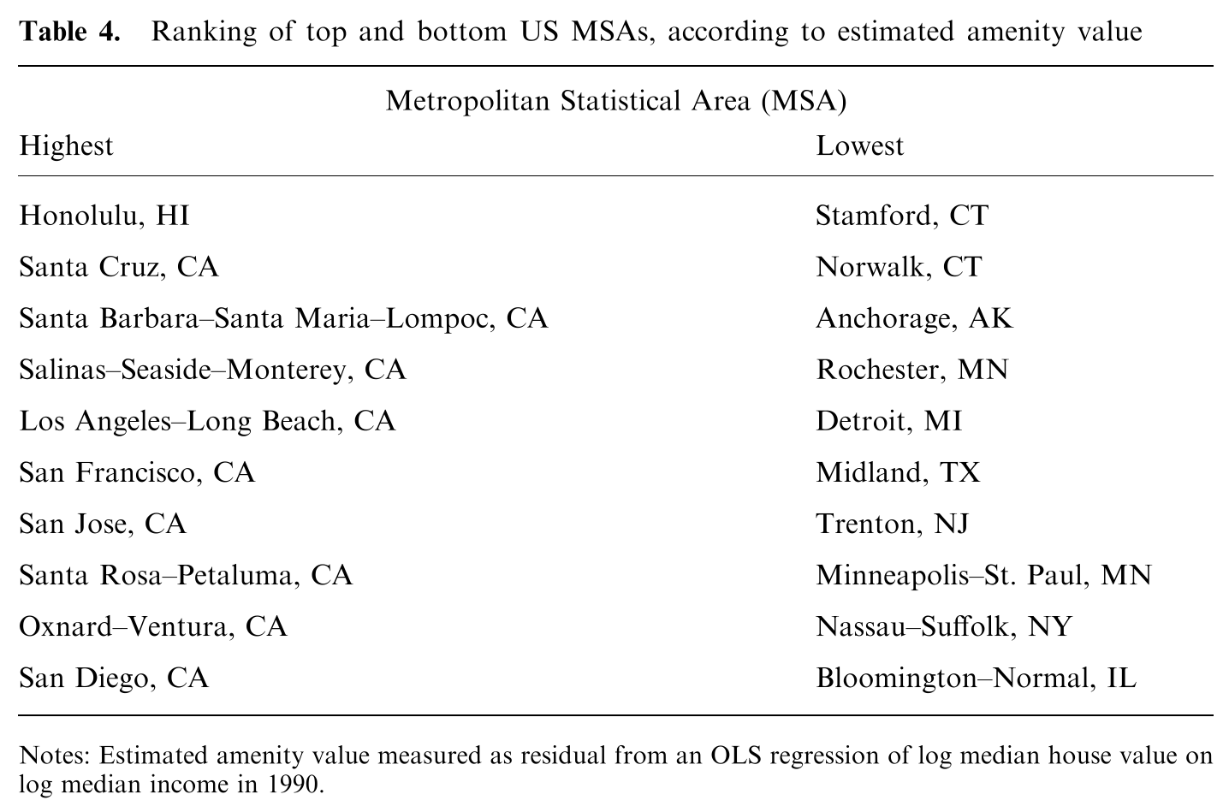

Slide 26
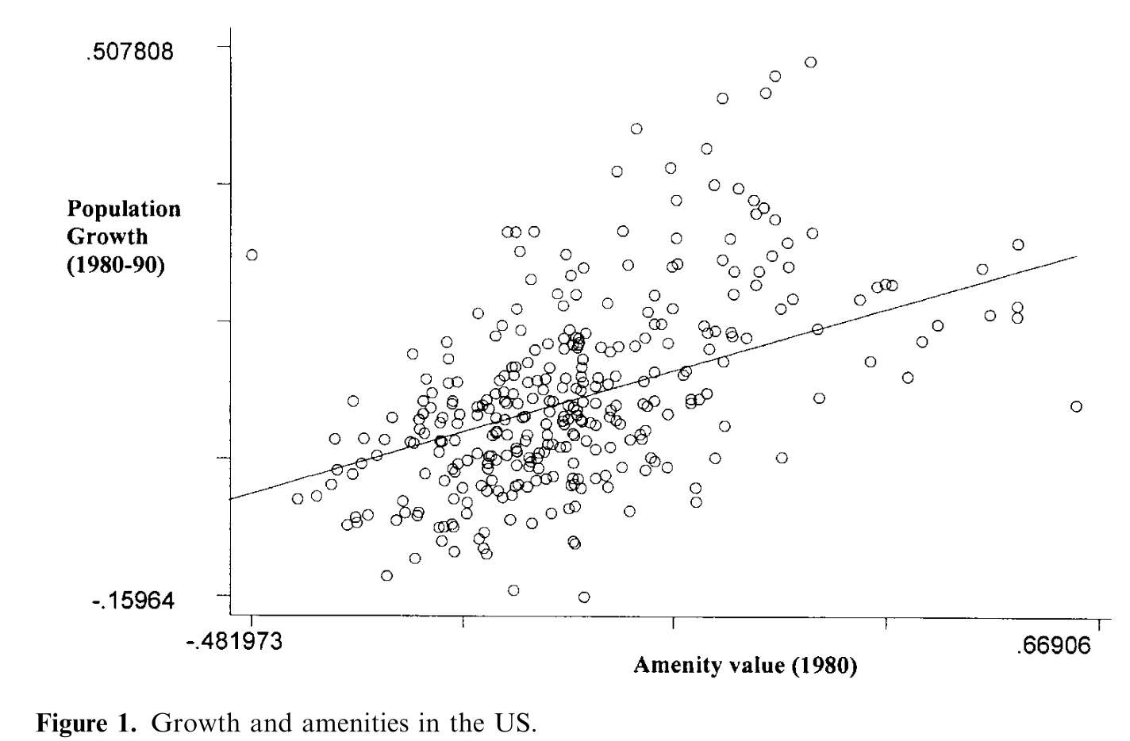

Slide 27
Industry clusters
In addition to studying the effects of agglomeration on production and consumption more broadly, it is useful to explore particular industry clusters
Examples include:
Silicon Valley
“Hollywood” motion picture production
Detroit auto industry
Boston-Cambridge Biotech
New Orleans tourism
Financial services in New York city

Slide 28
Kerr and Robert-Nicoud (2020) “Tech Clusters”
Abstract: Tech clusters like Silicon Valley play a central role for modern innovation, business competitiveness, and economic performance. This paper reviews what constitutes a tech cluster, how they function internally, and the degree to which policy makers can purposefully foster them. We describe the growing influence of advanced technologies for businesses outside of traditional tech fields, the strains and backlash that tech clusters are experiencing, and emerging research questions for theory and empirical work.

Slide 29
Background
Tech clusters are a big deal since they create many high-paying jobs both in the cluster itself and “spillover” jobs in support industries.
Each job in the tech industry creates about 5 other jobs in related industries (e.g., services, retail, education) (e.g., Moretti, 2013, “The New Geography of Jobs”)
The tech industry has a larger multiplier than other industries.
Multiplier = For each $1 in production in that industry, there is $X of activity generated in the local economy.

Slide 30
Background
Many regions want to create or improve their tech cluster.
238 US cities jumped through hoops in 2017-18 to enter Amazon’s infamous “bidding” process for where it would establish a second headquarters.
Ultimate winners: Arlington, Virginia (DC area), and Long Island City, New York City (Amazon later decided not to go with Long Island after opposition from residents and some politicians)

Slide 31
Defining tech clusters
Hard to definitely determine what is a cluster and what is not a cluster.
“Clusters” traditionally indicate an important overall scale of local activity, complemented by spatial density and linkages among local firms (e.g., Marshall 1890, Porter 1998).
Linkages may be:
Engineer mobility across employers
Flows of technical knowledge
Reliance on shared local inputs like a research university
Kerr and Robert-Nicoud (2020) define a tech cluster as a location where new products (goods or service) and production processes are created that impact multiple parts of the economy.

Slide 32
Defining tech clusters
For example, what Wall Street employs more engineers that LinkedIn and Twitter combined and uses more sophisticated technologies such as AI.
However currently Wall Street is specialized in supporting financial services, but it could be considered a tech cluster if it evolved more to serve multiple industries.

Slide 33
Using data to measure US tech clusters
Data-driven measurement of what a tech cluster is may be more helpful.
Which data to use? Possibilities:
Patents
High-growth entrepreneurship supported by venture capital
Employment in R&D-intensive industries or occupations
This employment data is available from the American Community Survey
Still not clear-cut even using data-driven approaches (more discussion in the paper).
Tech clusters seem fairly consistent over time, with existing clusters growing larger.

Slide 34
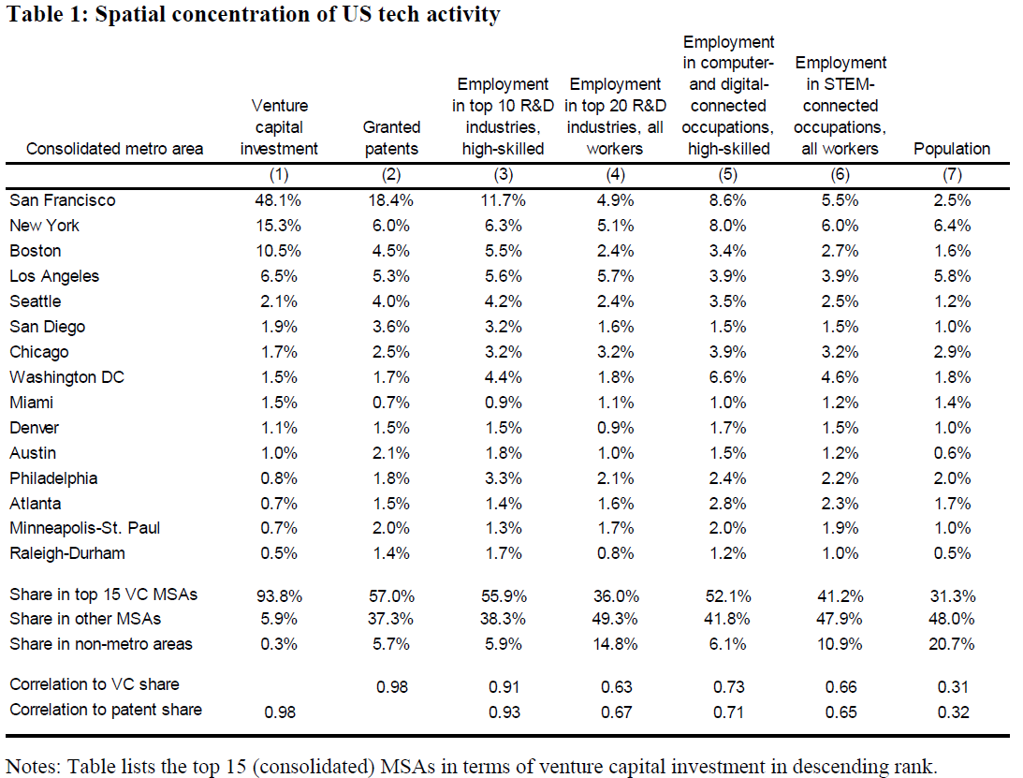

Slide 35
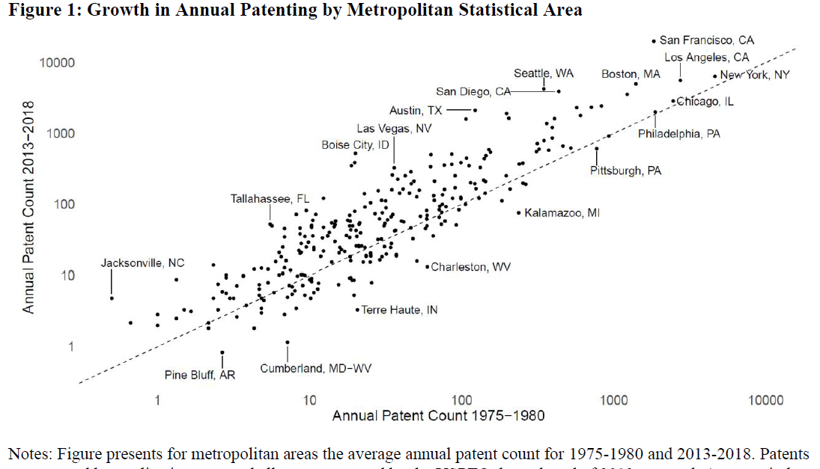

Slide 36
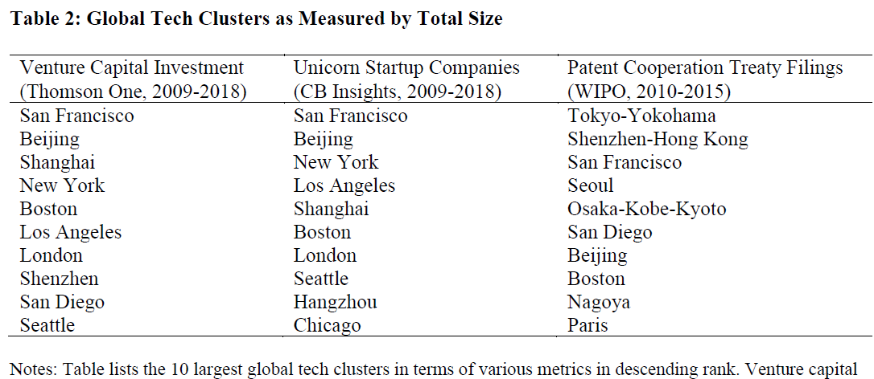
Global tech clusters
Harder to define since there is less data that is consistent across countries.

Slide 37
How are tech clusters different from other clusters?
According to famous work by Marshall (1890), there are three forces of what we now call agglomeration economies: knowledge spillovers, labor market pooling, and customer-supplier interactions.
Economics research over the last two decades has confirmed those factors as being important, along with natural advantages to each region (e.g., harbors, coal mines).
A few factors are different:
The velocity of employee movements between firms in tech clusters seems higher.
Immigration is a larger factor for tech.
“Anchor firms” seem important for tech cluster formation. These are large firms (e.g., Amazon HQ2) that attract other, smaller, firms.

Slide 38
Preconditions and dynamics of tech clusters
“Anchor” firms, people, or universities seem important.
E.g., many clusters got started because the key people involved (e.g., Bill Gates and Paul Allen of Microsoft) decided to move somewhere (Seattle) for personal reasons.
“Anchor” people and firms create spinoffs that help the industry form.
Thus, to some extent, the location or creation of a cluster can be random since it’s based on personal decisions of some key people at the outset.
Universities with specialization (e.g., Stanford, Harvard, MIT, UCLA) are an important part of certain industry clusters.

Slide 39
Preconditions and dynamics of tech clusters
We will get into more later on to what extent tax incentives can lead to economic development or lead to the creation/improvement of a cluster.
TL;DR: Kerr and Robert-Nicoud (2020) mention that there is little support for the idea that tax incentives can create a cluster, a point that I largely agree with.
Factors such as qualify of life and reducing local cost to experimentation with ideas (Kerr et al., 2014) could help encourage clusters.

Slide 40
Effect of COVID-19 on agglomeration
Must of what we’ve covered so far applies more-so to a pre-pandemic world.
How does COVID-19 affect agglomeration economies, both in terms of production and consumption?
With a partner or two, chat about which benefits of agglomeration do you think would be affected by COVID-19.
For those on Zoom, I’ll put you into breakout rooms.
I will then ask you to volunteer your ideas and we’ll put them on the “board”

Slide 41
Activity: How does COVID affect agglomeration?
With a partner or two, chat about which benefits of agglomeration do you think would be affected by COVID-19.
Some recaps of the benefits of agglomeration that could or could not be affected:
Easier consumer-producer interactions.
Knowledge spillovers.
Increased productivity.
“Thicker” labor markets (labor market pooling).
“Thicker” supplier markets (supplier market pooling).
Reduced transportation costs for production.
More consumer amenities (e.g., restaurants, culture).
Economies of scale.
Aesthetics and physical setting (e.g., climate, architecture)
Good public services (e.g., good schools, city amenities)
Transportation speed (i.e. time to commute)

Slide 42
Activity: How does COVID affect agglomeration?
I will go around and ask your group for your best, unique, contribution and will type it on here.
Those on Zoom: you can click “annotate” and type in your idea yourself!

Slide 43
Practice questions
What are some questions on this content and earlier content that could appear on the quiz or final exam?
What are short answer questions like in this course?
To help you figure this out, you will do a practice quiz in groups of 2 or 3.
Make your own groups if you are in the classroom, and for those on Zoom I’ll put you into breakout rooms.
There are two separate mini-quizzes that you will do on Canvas:
1) Practice Quiz 1 – Part 1 (Multiple Choice)
2) Practice Quiz 2 – Part 2 (Short Answer Questions)

Slide 44
Practice questions
Practice Quiz 1 – Part 1 (Multiple Choice)
For this one, each person submits the quiz individually (but you’ll collaborate). The reason for this is because I can’t set up a group quiz to auto-grade.
2) Practice Quiz 2 – Part 2 (Short Answer Questions)
For this one, each form a group on Canvas as follows.
On Canvas, click on “People” on the left side.
Click on “Practice Quiz 1 groups”
Each of you in the group needs to add yourselves to the same group (e.g., all join group 8).
One person from the group submits the quiz answers on behalf of the group.
You will find the links to these quizzes on the “Modules” page for today. You have the rest of class time to work on this. There is no deadline to submit these.

