Slide 1
What’s in a Neighborhood? Measuring Neighborhood Effects
ECON 3320 – Urban Economics
Tulane university
Professor HUSSAIN HADAH

Slide 2
Why Neighborhoods Matter
Where you live has an effect on a lot of outcomes.
-Victimization from crime
-Education (especially if there are school zone boundaries, whereby you need to go to a school in your zone)
-Health
-Employment
To name a few…

Slide 3
Why we need to know if they matter
It is important to know what the effects of neighborhoods are, as this may indicate how public policy should be conducted.
For example, your peers in your neighborhood could affect you or your family, such as by affecting the educational outcomes for children. Going to schools with children from low-income families may have a negative effect on your educational outcomes. On the other hand, children from high-income families may have a positive effect.

Slide 4
Why we need to know if they matter
Or perhaps the ability for you to get a job depends on your neighbors and if they have jobs (e.g., they can let you know about job leads).
If there are any effects like this then neighborhoods can be used as a policy tool to improve incomes.
E.g., strong neighborhood effects may suggest that it is important to have mixed-income schools/neighborhoods/public housing.

Slide 5
Issues with measuring Neighborhood Effects
“Neighborhood Effects” = The causal effect that living in a neighborhood has on you or your family.
A fundamental problem with measuring neighborhood effects is selection bias.

Slide 6
Selection Bias
Individuals and families select their neighborhood.
The choice of neighborhood is endogenous. It is a function of many factors:
-Income
-Preferences
-Race
-Employment (namely where you work)
-Local schools
Etc…
But these factors also influence outcomes.

Slide 7
Example: Crime
The extent that your neighbors are involved in criminal activity may affect the likelihood that you engage in criminal activity.
Suppose we want to determine the effect that neighbors have on criminal behavior.
i.e., does moving to a high crime neighborhood increase the likelihood that you engage in criminal activity?
We could measure if criminal activity changes when individuals move from a low crime to a high crime neighborhood (or vice-versa).
The individual stays the same, but the neighborhood changes. So could this help us determine the effect of neighborhoods on crime?

Slide 8
But there is Selection Bias
Individuals who choose to move into a higher crime neighborhood may be more likely to engage in criminal activity INDEPENDENTLY of the effect of their neighbors on them.
So we get an upward biased estimate of the effect of neighborhoods on crime.
Estimated effect = causal effect + selection bias

Slide 9
But there is Selection Bias
Estimated effect = causal effect + selection bias
So, if we see that moving to a high crime neighborhood increases the likelihood of criminal activity,
is it because the neighbors changed (causal effect)?
or is it because this individual already had a high propensity to engage in criminal activity (selection bias)?

Slide 10
Controls don’t solve the problem
To help make the comparison more apples to apples, we can control for individual or family characteristics that may affect criminal behavior and also effect neighborhood choice.
These control variables would be income, education, gender, race, ethnicity, family type, employment status, etc…
But even with lots of data, we can’t control for everything that affects neighborhood choice or criminal behavior.
Controls might be able to reduce selection bias, but it cannot eliminate it.

Slide 11
Eliminating Selection Bias with Randomization
Suppose individuals were assigned to neighborhoods randomly.
Then we have no selection bias, since individuals don’t choose neighborhoods based on factors that may also affect their criminal behavior.
The neighborhood is independent of all individual/family characteristics (e.g., income, education).

Slide 12
Eliminating Selection Bias with Randomization
In one neighborhood, individuals may randomly get high-crime neighbors, and other individuals may randomly get low-crime neighbors.
Comparing individuals in one neighborhood to another captures only the casual effect of neighborhoods on crime.
Estimated effect = causal effect + selection bias = causal effect + 0 = causal effect

Slide 13
But we can’t randomly assign neighborhoods…
It’s unethical to force people to move.
Is there a way we can still randomly assign neighborhoods so we can measure neighborhood effects?
The Moving to Opportunity (MTO) program did this in an ethical and welfare-enhancing way.

Slide 14
Moving to Opportunity
Moving to Opportunity (MTO) was a housing mobility experiment.
Conducted from 1994 to 1998.
Conducted in Baltimore, Boston, Chicago, Los Angeles, and New York.
Enrolled 4,604 low-income public housing families living in high poverty (poverty rate > 40%).

Slide 15
MTO “Treatment” and “Control” Groups
Families were randomized into one of three groups:
1) Low-Poverty Voucher (LPV) group: received housing vouchers to subsidize private-market rents but could only be used in census tracts with 1990 poverty rates below 10%
2) Traditional Voucher (TRV) group: received a housing voucher without the LPV constraint
3) Control group: Received no assistance.

Slide 16
Outcome Variables
The MTO research team was interested in the following outcomes:
-Economic self-sufficiency
-Physical health
-Mental health
-Subjective well-being
(more specific outcomes, e.g., impact of obesity, where looked at in other studies about MTO. The paper you had to read was a summary paper.)
This paper measures long term outcomes. Outcome data measured 10 to 15 years later.

Slide 17
Comparing Groups
Comparing Traditional Voucher (TRV) to the Control Group allows us to estimate the causal effect of receiving a housing voucher on the outcome variables (economic self-sufficiency, physical health, mental health, subjective well-being)
Comparing Low-Poverty Voucher (LPV) to Traditional Voucher (TRV) allows us to estimate the causal effect of the low-poverty neighborhood constraint. Since this constraint forces families to move to better neighborhoods, this difference captures if better neighborhoods have different effects on the outcome variables.

Slide 18
Comparing Groups
The paper you read/will read is a summary paper of the long-term effects, so they don’t present all the results. They only present the average difference between the control group and both treatment groups (so added or pooling the LPV and TRV groups together).

Slide 19
Summary of the Results Section
1) Did the randomization work? i.e., are the treatment and control groups on average identical?
Evidence of this in Table 1 – Baseline characteristics
2) Assuming that 1) holds, did MTO affect the neighborhood you live in? i.e., did families actually move to better neighborhoods?
Evidence of this in Table 2
3) Assuming that there is an effect in 2), then do we see an effect on long-term outcomes? (physical health, mental health, subjective well-being, economic self-sufficiency)
Evidence in Figure 1

Slide 20
Summary of the Results Section
1) Did the randomization work? i.e., are the treatment and control groups on average identical?
Evidence of this in Table 1 – Yes, the groups are on average identical in baselines characteristics.
2) Assuming that 1) holds, did MTO affect the neighborhood you live in? i.e., did families actually move to better neighborhoods?
Evidence of this in Table 2 – Yes, they did. Strong evidence of this.
3) Assuming that there is an effect in 2), then do we see an effect on long-term outcomes?
Evidence in Figure 1 – No statistically significant effect on economic self-sufficiency, physical health, and mental health. Statistically significant positive effect on subjective well-being.

Slide 21
Did the Randomization Work?
The researchers gave out a survey of baseline characteristics.
Baseline means BEFORE they randomized everyone into treatment (voucher offered) and control (no voucher offered) groups.
Asked them questions about social-economic background (gender, race, ethinicity, education, household income, marital status, current neighborhood characteristics, reasons they want to move)
If the randomization was successful, there should be few differences between the treatment and control groups.

Slide 22
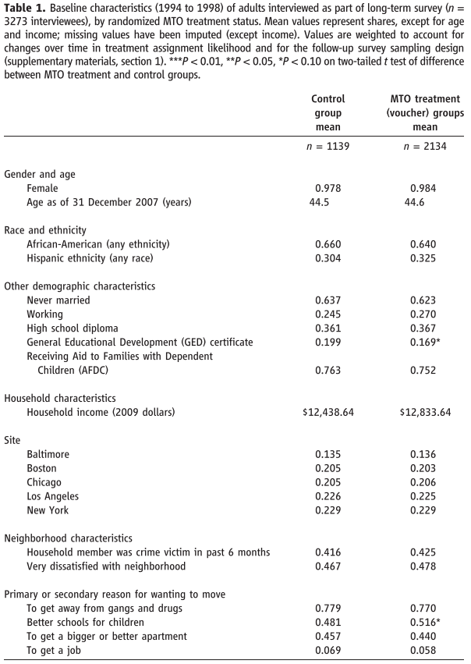
Did the Randomization Work?
See Table 1.
The means for each variable are similar for the control group and the treatment group.
Only twos estimates are weakly statistically significant.
For “Primary or secondary reasons for wanting to move”, 48.1% of the control group said “better schools for children” and 51.6% of the treatment group said this.
The difference between the two is statistically significant at the 90% level. The researchers are 90% sure that the proportion that mentioned better schools was different between treatment and control.
Similar slight difference, statistically significant at the 90% level, between the proportion of the treatment group with a GED (16.9%) and the control group with a GED (19.9%).

Slide 23
Reminder: Determining Statistical Significance
Good researchers will make it easy for you by allowing you to determine statistical significance by checking for *’s. The convention is shown below. The vast major of studies follow this convention.
* = weakly statistically significant at 10% level (“We are 90% sure that there is a difference between the control and treatment groups”)
** = statistically significant at 5% level
*** = strongly significant at 1% level
More *s means you are more sure that there is an effect. You are more sure that it’s not just random noise giving you that result.
So you can see that in Column 2 (MTO treatment), the mean of 0.516* has a * beside it, meaning that it’s statistically significantly different from the mean for the control group (0.481) at the 10% level.

Slide 24
When can randomization NOT work?
In this case it looks like the randomization worked, and that is tested by comparing the means of the baseline characteristics. They are extremely similar.
The randomization could fail if individuals who didn’t randomly get assigned a voucher could get one anyways (e.g., pleading for one, bribing study officials).
Similarly, study officials who do the randomization may not do it correctly. They may decide to give out vouchers non-randomly. They may give a voucher to a family that seems to really need it, even if they weren’t randomly supposed to get one.
These non-random assignments could be reflected in differences in baseline characteristics.

Slide 25
When can randomization NOT work?
Imagine an extreme scenario: Housing vouchers are supposed to be randomized. But the officials who give out the vouchers are corrupt, and will accept small bribes to exchange for vouchers.
Families with higher incomes may be more likely to pay the bribe.
So household income would be higher in baseline for the treatment group.

Slide 26
When can randomization NOT work?
Implication of this: selection bias!
The treatment and control groups are not on average identical.
Choice of neighborhood (through getting a voucher or not) becomes a function of family characteristics because individuals can select into getting vouchers.
Thus the experiment provides biased estimates of how neighborhoods affect outcomes.

Slide 27
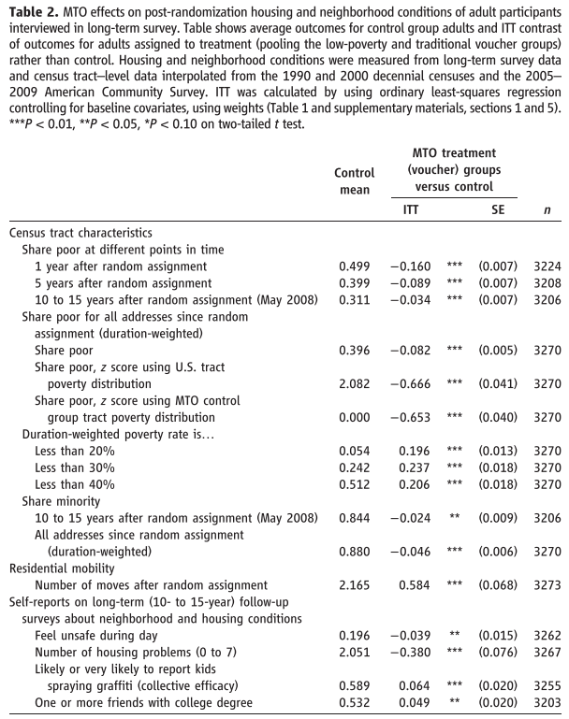
Did MTO affect your neighborhood?
Since the baseline characteristics are similar (the randomization worked), the next step is to see if MTO actually caused individuals to move into better neighborhoods.
This is shown in Table 2.
The authors determined neighborhood characteristics using census tract level data from the American Community Survey.

Slide 28
Did MTO affect your neighborhood?
They present how the control and treatment groups’ neighborhoods differed on average based on:
Share poor (1 year, 5 years, and 10-15 years after assignment)
Poverty rates
Share of the minority population

Slide 29
Did MTO affect your neighborhood?
They also present some self-reports on long-term (10-15 years) housing conditions. This was from a survey since this data wasn’t in the American Community Survey
-”Felt unsafe during day”
-”Number of housing problems (0 to 7)”
-”Likely or very likely to report kids spraying graffiti”
-”One or more friends with college degree”

Slide 30
Did MTO affect your neighborhood?
Results: everything is statistically significant at either the 1% (***, strong) level or the 5% level (**)
So, those in the treatment group that got a voucher were more likely to be in neighborhoods that were less poor, less likely to be in poverty, and have less minority families.
Treatment group also reports feeling more safe during the day, reports fewer housing problems, more likely to report kids spraying graffiti, and more likely to report friends with a college degree.

Slide 31
Interpreting Estimates
Let’s look at the first result: share poor 1 year after random assignment (row 1)
For the control group it is 0.499 (Column 1), or 49.9% of control group families report being in a poor neighborhood one year after random assignment.
The treatment group column (Column 2) has an estimate of -0.160, meaning that the treatment group has a 16 percentage point lower probability of being in a poor neighborhood one year after random assignment. So a 33.9% probability.

Slide 32
Accepting or Rejecting “Treatment”
Many families that were offered a voucher still chose not to move.
Thus, they didn’t accept the “treatment”, where the treatment is moving and using the voucher.
Those who moved and use the voucher “complied” with the treatment and are called “compliers”.
Complier = You were randomly given a voucher and you used it.

Slide 33
Compliance Rates
48% of families in the Low-Poverty Voucher (LPV) group managed to relocate using the MTO voucher.
63% for the Traditional Voucher (TRV) group.
The compliance rate is likely higher for the TRV group because the LPV had the restriction that they had to move to a low-poverty neighborhood.

Slide 34
Implications of Compliance
So, families who got vouchers “selected” into if they wanted to take the voucher and move.
Several factors may affect the decision to take the voucher or not. For example:
-Family structure
-Income
-Employment (especially work location)
-Race/Ethnicity
-Schools
Is there still selection bias?

Slide 35
Implications of Compliance
There is selection bias if you’re not careful.
Suppose you compared the compliers (those who got the voucher and CHOSE to use it) to the control group.
The average characteristics of compliers may be different from the average characteristics of the control group.
The control group includes those who would be compliers (would have used the voucher if they got it) and non-compliers (wouldn’t have used the voucher, even if they got it).
Thus, this comparison doesn’t separate the causal effect from this selection bias.

Slide 36
Dealing with Compliance
Ignoring the fact that families “select” into using the voucher leads to selection bias.
How do the authors deal with this?
The authors calculate and present two types of estimates: intent to treat (ITT) and the treatment-on-the-treated (TOT) (to be explained in the next several slides)

Slide 37
Intent to Treat (ITT)
First, they present what are called the “Intent to Treat” (ITT) estimates. These are presented in Table 2, Column 2.
The ITT comparison is compares those in the treatment groups, who were given the voucher, to those in the control group (no voucher).
ITT estimate = average outcome for groups offered vouchers (treatment groups)
MINUS
average outcome for control group

Slide 38
Intent to Treat (ITT)
But the treatment group includes both compliers (used the voucher) and non-compliers (didn’t use the voucher).
Thus, not all individuals in the treatment group are “treated”.
So, what do the ITT estimates mean?

Slide 39
Intent to Treat (ITT)
ITT estimate means “What is the effect of getting a voucher?”
Note the same is “What is the effect of getting a voucher AND moving?” (this effect estimate is called the Treatment-on-the-Treated or TOT)
Under the ITT, some people move and some don’t.
Under TOT, you are estimating the effect just for the group that moved (more on how to get this later).
So TOT doesn’t include some non-movers (non-compliers), like the ITT does.
TOT will be greater than the ITT for this reason.

Slide 40
A Silly but Helpful Example
(Based on http://people.bu.edu/lang/itt-tot.pdf from Kevin Lang, Boston University)
Suppose I am a researcher trying to determine the effect of giving you a chocolate bar on how many chocolate bars you have.
Suppose I were to randomly give out chocolate bars
Flip a coin...
HEADS = Evens get a chocolate bar
TAILS = Odds do not get a chocolate bar

Slide 41
Chocolate bar survey
After assigning chocolate bars randomly, I survey the class.
“How many chocolate bars do you have?”
The answer is that everyone in the treatment group (got a chocolate bar) has one more chocolate bar than everyone in the control group.
In this case, the intent to treat (ITT) is one chocolate bar.
Since everyone who was randomly assigned a chocolate bar got a chocolate bar (100% compliance, because chocolate), the ITT is the same as the treatment-on-the-treated (TOT)
ITT = TOT when compliance is 100%.

Slide 42
Chocolate, with restrictions
Now suppose I do the same study, but instead of giving everyone a chocolate bar and getting 100% compliance (assuming no one rejects it), I instead email the treatment group telling them that they can stop by my office during office hours for a free chocolate bar.
I don’t send any email to the control group.
Not everyone in the treatment group will come to my office hours to get a chocolate bar. Likely decision to do so depends on:
-Preference for chocolate
-Range of like/dislike for Professor Button
-Time constraints
-Dietary restrictions

Slide 43
Chocolate, with restrictions
Suppose that 40% of the treatment group shows up to get chocolate.
Treatment group is 40% got chocolate (compliers), 60% didn’t get chocolate (non-compliers)
Control group is 100% didn’t get chocolate.
Intent to Treat (ITT) is the average difference in chocolate between treatment and control groups.
ITT = 0.4 bars (since only 40% got a bar)
But of course anyone was in the treatment group and got a bar got a whole bar.
So the TOT is 1 bar.

Slide 44
Inflating ITT to get TOT
If you know the ITT effect and the compliance rate, you can get the TOT.
ITT = 0.4 bars
Compliance rate = 40% or 0.4
TOT = ITT / (difference in percentage treated)
Which is the same as…
TOT = ITT / (compliance rate) = 0.4/0.4 = 1
Essentially I multiply the ITT by 2.5 times (0.4 x 2.5 = 1) to get what the effect would be if everyone had picked up a chocolate bar.

Slide 45
Intent to Treat (ITT)
Example from Table 2. In the control group, 19.6% of families (0.196, Column 1) indicated that they “felt unsafe during day”. The ITT point estimate is -0.039 (Column 2).
What this means is that the treatment group had a 3.9 percentage point lower probability (so a 15.7% probability) of saying that they “felt unsafe during the day”.
But this 3.9 percentage point decrease comes from both those that moved (compliers) and those that did not (non-compliers). If everyone had moved, the effect would have been larger than 3.9 percentage points!

Slide 46
Intent to Treat (ITT) to Treatment-on-the-Treated (TOT)
So how do we get from ITT: “What is the effect of getting a voucher (and maybe moving)?”
To the TOT estimate: “What is the effect of getting a voucher AND moving, for those that choose to move (the compliers)?”
i.e. how do we remove the non-compliers (non-movers)?
One simple way is to “inflate” up the ITT point estimate to get the estimate for the Treatment-on-the-Treated (TOT).

Slide 47
Intent to Treat (ITT) to Treatment-on-the-Treated (TOT)
From earlier, the ITT was a 3.9 percentage point decrease in “feel unsafe during day”.
48% in LPV group moved (48% compliance rate).
63% in TRV group moved (63% compliance rate).
Roughly an equal number in LPV (low-poverty voucher) and TRV (traditional voucher) groups. This suggests an average compliance rate of 0.5*0.48 + 0.5*0.63 = 0.555 = 55.5%

Slide 48
Intent to Treat (ITT) to Treatment-on-the-Treated (TOT)
From earlier, the ITT was a 3.9 percentage point decrease in “feel unsafe during day”.
Average compliance rate of 55.5% (55.5% moved, 44.5% did not)
This suggests that if everyone had been treated (100% moved), that the effect would be larger.
We can “inflate” up the ITT estimate to get the TOT.
TOT = ITT / (difference in percentage treated) = ITT / (compliance rate)
= 3.9 / (0.555) = 7.0 percentage point decrease.
The ITT estimate, 3.9, gets inflated 1.8 times (1/0.555 = 1.8) to get the TOT estimate.

Slide 49
A more formal way to get the TOT
“Inflating” the ITT allows us to go from the ITT estimate, which means “What is the effect of getting a voucher (and maybe moving)?”
To the TOT estimate of “What is the effect of getting a voucher AND moving for those that choose to move (the compliers)?”
The more formal way this is done is through a regression analysis strategy called “instrumental variables” (IV)
We saw IV previously in the Bhuller et al. (2016) paper, which looked at how incarceration affects criminality after release.
In Bhuller et al. (2016) they don’t just compare those that were incarcerated vs. not, since there is selection bias. They use IV to just compare those randomly incarcerated due to randomly getting a pickier judge, to those randomly not incarcerated due to randomly getting a less picky judge.
IV allows researchers to ignore the variation in incarceration that is due to selection bias, and just use the random variation in incarceration induced by the random assignment of judges.

Slide 50
IV in this MTO Paper
The IV approach here is similar.
They do not compare those that moved to those that did not, and they also do not compare those that USED the voucher to those that did not. In both cases there is selection bias.
They instead use IV to only use the variation in where you live that is induced by the random voucher offer.
This allows them to estimate the effect of neighborhoods on outcomes, using just this random variation, and not other variation in neighborhoods that would have selection bias.
This is as much detail as I need you to know about IV. You don’t need to know the equations or technical aspects.

Slide 51
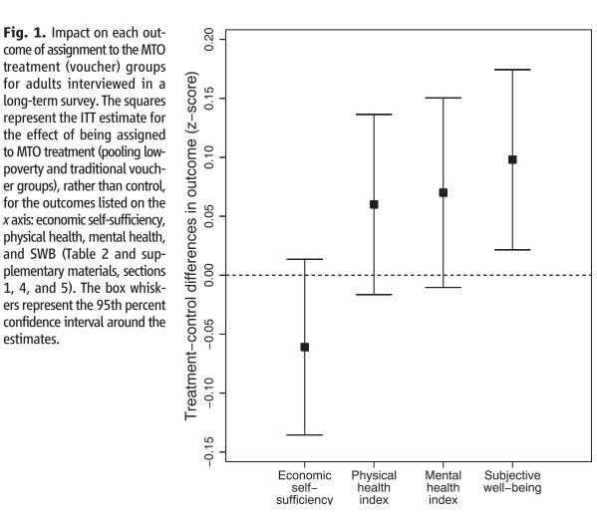
Effects of Moving to Opportunity (MTO) on Final Outcomes
The effects are presented in Figure 1.
This figure presents point estimate of the ITT: the average outcome for those offered vouchers (treatment group) and the average outcome for those not offered vouchers (control group).
The point estimates are the box (black square) and the whiskers (end points) represent the 95% confidence interval.

Slide 52
A note on z-scores
The y axis is measured as z-scores. How is this interpreted?
E.g.: A value of 0.1 for subjective well-being means that the treatment group had a 0.1 standard deviation higher value for subjective well-being than the control group.
0.1 standard deviation means that the control group had the median value (50th percentile) of subjective well-being, but the subjective well-being for the treatment group was at the 54th percentile (54% had lower well-bring, 46% had higher).
Since the units for subjective well-being and other variables don’t have independent meaning (kind of like how “100 units of utility” doesn’t have meaning), conversion to a z-score gives a relative increase that’s easier to understand.

Slide 53
Effects of Moving to Opportunity (MTO) on Final Outcomes
Example: for economic self-sufficiency the point estimate (where the black square is) is about -0.06. The 95% confidence interval is about -0.13 to 0.02.
Meaning is “We are 95% confident that the ITT estimate for economic self-sufficiency is between -0.13 to 0.02.”
The point estimate is negative, suggesting negative effects of MTO on self-sufficiency, but because the estimate is not statistically significant (the confidence interval contains zero, so can’t rule out no effect).

Slide 54
Effects of Moving to Opportunity (MTO) on Final Outcomes
Physical health: point estimate is about 0.06, confidence interval is about -0.02 to 0.14
Mental health: 0.07, -0.01 to 0.15
(both not statistically significant, but effects lean positive)
Subjective well-being: 0.10, 0.02 to 0.017
Statistically significant! We are at least 95% confident that there is a positive effect!

Slide 55
Summary of the Results Section
1) Did the randomization work? i.e. are the treatment and control groups on average identical?
Evidence of this in Table 1 – Yes, the groups are on average identical in baseline characteristics.
2) Assuming that 1) holds, did MTO affect the neighborhood you live in? i.e. did families actually move to better neighborhoods?
Evidence of this in Table 2 – Yes, they did. Strong evidence of this. But only over half used the voucher to move.
3) Assuming that there is an effect in 2), then do we see an effect on long-term outcomes?
Evidence in Figure 1 – No statistically significant effect on economic self-sufficiency, physical health, and mental health. Statistically significant positive effect on subjective well-being.

Slide 56
Policy Implications of the Results
Moving to Opportunity had a positive and statistically significant effect on subjective well-being, but no statistically significant effects on physical or mental health, or economic self-sufficiency.
Suggests the housing vouchers can’t be used to affect certain policy outcomes in the long run (e.g., improve health, increase income) but it does increase well-being.

