Slide 1

Urban Economics
Introduction to the Economics of Discrimination
Prof. HUSSAIN HADAH

Slide 2
Outline
What is discrimination?
Types of discrimination (these are all not mutually exclusive):
Taste-based discrimination
Statistical discrimination
Implicit discrimination
An overview of audit field experiments
Resume correspondence studies
Correspondence studies of rental housing discrimination
Audit experiments on transportation discrimination
Ridesharing
Public transportation
Overview of my audit field experiment of sexual orientation discrimination in access to mortgages (different slide deck)

Slide 3
What is discrimination?
When two individuals who are the same are treated differently.
There is a lot of debate around to what extent discrimination occurs, and a part of the reason for this debate is that discrimination is hard to measure.
Sometimes discrimination manifests itself in extreme and obvious ways.
But often times it’s subtle – e.g., not getting an interview offer.
What that because of discrimination, or was there another factor?
Isolating discrimination as the factor can be difficult due to a lack of data.
But using data we have or can create can be important to bring evidence to the table to complement qualitative research and anecdotal evidence.

Slide 4
Types of discrimination
There are different types of discrimination. Economists typically focus on:
Taste-based discrimination
Statistical discrimination
Often economists try to determine to what extent discrimination is taste-based vs. statistical
Sociologists and psychologists also study discrimination.
Sociologists are aware of the taste-based discrimination vs. statistical discrimination situation, but focus on discrimination more broadly, instructing concepts such as structural discrimination and systemic disadvantage.
Psychologists coined/discovered implicit discrimination

Slide 5
Taste-Based Discrimination – “Animus”
Discrimination that occurs due to not liking or having animus against a group.
Think outright racism, homophobia, sexism, transphobia, ageism, etc.
The term was coined by Gary Becker, a famous labor economist who is known for being one of the first to apply economics to study discrimination in the labor market.
Unsurprisingly, taste-based discrimination is seen as uniformly bad, both because it is inequitable, but it also creates inefficiencies (e.g., not hiring the employee who is the best fit for the company.)

Slide 6
Taste-Based Discrimination – “Animus”
It’s often hard to measure to what extent discrimination is taste-based since:
It’s hard to perfectly witness discrimination in a way where it can be obviously isolated
People usually aren’t going to reveal that they are bigots, although outright, observable sexism, homophobia, anti-Semitism, racism, etc., are becoming more common.

Slide 7
Statistical discrimination
This theory is typically attributed to Kenneth Arrow's 1973 work The Theory of Discrimination and to Edmund Phelp's 1972 paper The Statistical Theory of Racism and Sexism.
The idea is that some discrimination is based on individuals using actual or perceived information about the differences between groups – i.e. actual or perceived statistical differences between groups.
Minority status – such as race or ethnicity – is used a proxy for something else.

Slide 8
Statistical discrimination
The best way to describe what is meant by statistical discrimination is to give some examples from different contexts:
Employment (which you’ll see in the Agan and Starr, 2018, paper on “Ban the Box”)
Housing (which you’ll see in a few papers, including my experiment on sexual orientation discrimination in mortgage loans)
Policing (which you’ll see in a few papers, such as Antonovics and Knight, 2009)

Slide 9
Statistical discrimination - Employment
In the face of imperfect information (employers don’t know everything about job applicants), employers may make assumptions about job applicants based on the minority group they are in.
Agan and Starr (2018) study discrimination against Hispanics, African Americans, and those with criminal records in job applications.
They note that employers statistically discriminate against Hispanics and African Americans by assuming they are more likely to have criminal records in cases when criminal record data is not available to them.
Race and ethnicity are unfortunately used as a proxy for criminal records.

Slide 10
Statistical discrimination - Housing
You’ll hear later in the course about a research project I am working on that quantifies sexual orientation discrimination in access to mortgage loans.
One concern we have is that mortgage loan originators – who people work with to get mortgages – may statistically discriminate against applicants based on perceptions of their credit worthiness.
E.g., may assume that same-gender male couples are more creditworthy (since two men, and men on-average earn more) while same-gender female couples are less credit worthy (since two women, and women on-average earn less).

Slide 11
Statistical discrimination - Policing
Police offers could (and likely do) statistically discriminate in interactions with citizens.
They may, for example, be more likely to assume that people of color have done something wrong, have drugs in their car, etc.,
For these “reasons”, police may be more likely to search people of color through car searches, “stop and frisk” etc.
In this example, race is used as a proxy for assumptions about criminality.

Slide 12
Implicit Discrimination
A type of discrimination that occurs due to implicit bias.
Implicit bias is an unconscious form of bias discovered by psychologists
It’s a bias that most people are often not aware that they have.
Implicit bias usually appears when making quick decisions such as quickly reviewing resumes.
In these situations, you may be more likely to rely on implicit bias.

Slide 13
Implicit bias is pervasive
They appear as statistically "large" effects that are often shown by majorities of samples of Americans.
Over 80% of web respondents show implicit negativity toward the elderly compared to the young
75-80% of self-identified Whites and Asians show an implicit preference for racial White relative to Black.
(Finding from http://www.projectimplicit.net/about.html via http://diversifyingecon.org/index.php?title=Personal_prejudices)

Slide 14
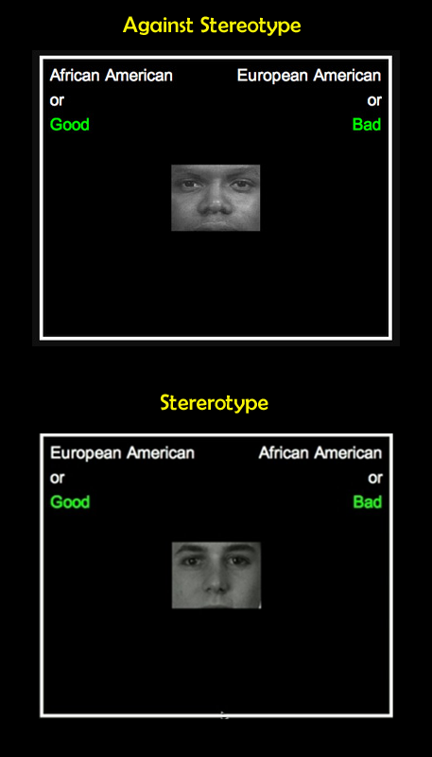
Implicit association test
Psychologists use the Implicit Association Test (IAT) to try to measure implicit bias.
You can take the test yourself at: https://implicit.harvard.edu/implicit/
There are numerous versions:
Race IAT (bias against black people)
Asian IAT (bias against Asian people)
Gender-Career IAT (bias against women in employment)
Transgender IAT (bias against trans people)
…

Slide 15
Implicit association test
The idea behind the IAT is that you have to quickly sort photos of people (e.g., black vs. white people) and good or bad words by pressing the left or right keys on a keyboard.
The round order is random, but in one round(top figure) you press “left” if you see a photo of a black person or you see a positive word (e.g., “pleasure”), and you press “right” if you see a photo of a white person or a negative word (e.g., “awful”)

Slide 16
Implicit association test
The round order is random, but in another round (bottom figure) you press “left” if you see a photo of a white person or you see a positive word (e.g., “pleasure”), and you press “right” if you see a photo of a black person or a negative word (e.g., “awful”)
If you are faster in one round than another, it means you have an implicit association between a group and good/bad.
Most people are biased and are faster at the bottom scenario than the top scenario.

Slide 17
IAT homework
As an “other activity”, please take an IAT test at https://implicit.harvard.edu/implicit/selectatest.html
My suggestion is to take one or more of the following:
Race IAT – tests for bias against black people through an association between black/white faces and good/bad words
Weapons IAT – tests for bias against black people through an association between black/white faces and weapons/harmless objects
Skin-tone IAT – tests for bias against people with darker skin
(If you have taken the IAT before then please take one you haven’t taken.)
As an “other activity”, you’ll anonymously submit a very short reflection statement after completing the IAT.

Slide 18
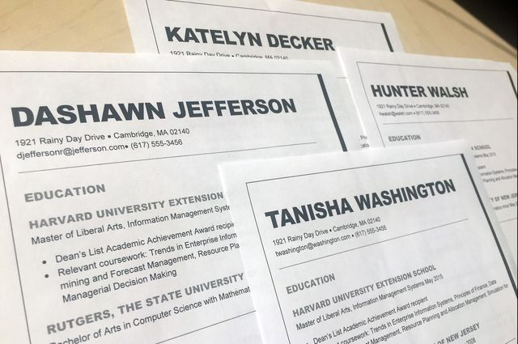
Audit Field experiments
Also called audit studies.
Also called correspondence studies when they involve sending “correspondence” (email, mail).
My speciality!
These are experiments in real life (the “field”).
Most commonly these are resume correspondence studies, where researchers study hiring discrimination by applying to jobs with minority and non-minority candidates.
All applicants are on-average identical.
In rare cases, sometimes the researcher will hire people to go to the interviews (examples later)

Slide 19
Why Audit Field experiments?
Having the applicants (“testers”) be on-average identical allows the researcher to isolate discrimination just like in a randomized control trial (RCT).
Discrimination is measured as differences in the interview offer rates (usually referred to as the “callback rate”), or, in other studies, the positive response rate.

Slide 20
Example: Neumark, Burn, and Button (2019)
Largest resume study to date, over 40,000 resumes sent to 13,000 jobs in 12 cities.
Studies hiring in common “bridge” jobs that older workers often take to delay retirement: retail sales (men and women), admin. assistant (women), janitor (men), security (men)
Younger people also commonly take these jobs.
Resumes were for young (age 30), middle age (50) and older (65). Age 65 is new to the literature.

Slide 21
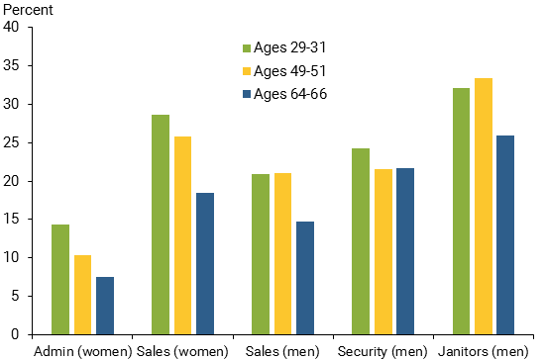
Interview (“Callback”) Rates

Slide 22
Audit field experiments - Housing
In addition to resume correspondence studies, which send matched resumes, there are also audit field experiments that study discrimination in…
Rental housing
(emails to landlords, roommate wanted ads)
Mortgage applications
(emails to mortgage loan originators, I have a study I am working on on this that you’ll hear more about later)

Slide 23
Audit field experiments - Transportation
In addition to resume correspondence studies, which send matched resumes, there are also audit field experiments that study discrimination in…
Ridesharing (Uber/Lyft)
Mujcic and Frijters (2020) hired white and black RAs to attempt to board public transift without paying (i.e., they’d mention that they couldn’t pay). Bus drivers let white RAs board 72% of the time but black RAs only 36% of the time.

Slide 24
Audit field experiments - Transportation
In addition to resume correspondence studies, which send matched resumes, there are also audit field experiments that study discrimination in…
Public Transportation
Ge et al. (2020) “In a randomized audit study, we sent passengers in Boston, MA on nearly 1000 rides on controlled routes using the Uber and Lyft smartphone apps, recording key performance metrics. Passengers randomly selected between accounts that used African American-sounding and white-sounding names. We find that the probability an Uber driver accepts a ride, sees the name, and then cancels doubles when passengers used the account attached to the African American-sounding name. In contrast, Lyft drivers observe the name before accepting a ride and, as expected, we find no effect of name on cancellations.”

