Slide 1

Urban Economics
Introduction to Economic Development Incentives
Prof. Patrick Button

Slide 2
Outline
Why economic development incentives? Overview of motivations.
Overview of common types of economic development incentives.
Summary of key points of the theory in O’Flaherty.

Slide 3
What are economic development incentives?
This is a broad category of incentives that provide cash, tax reductions, or other benefits, to firms to either relocate their businesses to the region and/or expand their existing business in the region (e.g., “make more jobs”).
Usually these incentives are provided by state government or municipal governments, or these incentives are provided in specific geographic areas, hence why they fall more under “urban economics”.
Some have more targeted goals and criteria, while others try to make a more friendly business environment in general.
Incentive categories are often very heterogeneous – incentives of the same type across jurisdictions can vary greatly.

Slide 4
Why incentives?
Economic development is important as it can lead to job creation, wage increases, and increases in job quality.
Better economic conditions is associated with many societal benefits (e.g., reduction in poverty and crime, improved standard of living, more tax revenue – see O’Flaherty reading for summary)
Policymakers often consider incentives so they can try to increase this economic activity, or a least appear to be doing so.

Slide 5
Examples of common incentives
Job creation tax/hiring credits
Job training subsidies
Property tax abatements
Investment tax credits
R&D tax credits
Enterprise zone
Empowerment zone

Slide 6
Job creation tax/hiring credits
These tax credits are awarded to companies when they either (1) hire workers or (2) create a net new job (more jobs appear on payroll).
It depends on how the program is structured, which could influence its effectiveness.
These programs try to be more intentional than general tax credits by tying the incentive to job creation.

Slide 7
Examples: Job creation tax/hiring credits
The Work Opportunity Tax Credit, or WOTC, is a federal income tax credit designed for the benefit of employers that hire individuals from specific target groups of the American population that have historically faced higher rates of unemployment. Individuals within these target groups include veterans, ex-felons, the long-term unemployed, summer youth and individuals who are recipients of certain federal assistance programs
Source: https://www.alliantgroup.com/services/hiring-credits-incentives/

Slide 8
The tax credit amounts and the type of tax the credits offset vary by state, but here are a few examples from around the country:
California Businesses in certain designated geographic areas can claim up to $73,500 in tax credits per eligible employee over a five-year period to offset income tax liability.
New York Companies located in the state, or planning to move to the state, that will create or retain jobs in specific industries can claim a tax credit of 6.85% of wages per net new job for up to a 10-year period.
Georgia Businesses in the state of George can take advantage of multiple job creation tax credits that provide as much as $5,000 in annual tax savings per job for up to five years. After offsetting corporate income tax liability, excess tax credits can also offset a company’s payroll withholding as well.
Alaska Businesses employing qualified veterans can claim a tax credit up to $3,000 per individual against the state’s corporate income tax.
Source: https://www.alliantgroup.com/services/hiring-credits-incentives/

Slide 9
Job training subsidies
These are subsidies that reduce the costs for businesses to train employees.
The focus is often on making U.S. workers more competitive or to help businesses fill shortfalls in skilled labor (e.g., healthcare workers in rural areas, apprenticeship programs).
In these sense, these incentives are very targeted and are more-so used to try to solve rather specific problems rather than to encourage business expansion/relocation more generally.

Slide 10
Examples: Job training subsidies
H-1B Skills Training Grants fund projects that provide training and related activities to workers to assist them in gaining the skills and competencies needed to obtain or upgrade employment in high-growth industries or economic sectors. These grants are supported by user fees paid by employers seeking high skilled foreign workers under the H-1B visa program. The goal of the training grants is to prepare Americans for high skill jobs, reducing the dependence on foreign labor. Funds are authorized by Section 414(c) of the American Competitiveness and Improvement Act of 1998 (ACWIA), as amended (29 USC 3224a).
Source: https://www.dol.gov/agencies/eta/skills-grants/h1-b-skills-training

Slide 11
Property tax abatements
This is simply a reduction in property taxes that a business would have to pay.
Property taxes can be a large cost for a business, particularly if it has a large facility and/or operates in an expensive area with high property values (since the taxes are usually a % of property value).
This is an easy incentive for municipalities to offer since they set property taxes. They can create this incentive through the already-existing property tax system.

Slide 12
Examples: property tax abatements
The New Orleans Restoration Tax Abatement (RTA) Program provides to commercial property owners and homeowners who expand, restore, improve, or develop an existing structure in a downtown development district, economic development district, or historic district the right to pay ad valorem taxes based on the assessed valuation of the property for the year prior to the commencement of the project for five years after completion of the work.
[i.e., they pay property taxes on the previous value of the property, not the value after the restoration.]
Source: https://nola.gov/economic-development/business-services/tax-incentive-programs/restoration-tax-abatement/

Slide 13
Investment tax credits
Tax credits for certain investments.
If your investment qualifies, you get some % of your investment back in the form of a tax credit.
The type of investment covered can vary:
R&D investment
Investment in machinery or buildings
Investment in particular technology (e.g., solar)

Slide 14
Examples: investment tax credits
As of about 2008, 40% of states offer a general, state-wide tax credit on investment in machinery and buildings, and the average rate of this credit exceeds 6 percentage points in 2004 (Chirinko and Wilson, 2008)
The federal solar Investment Tax Credit (ITC) is one of the most important federal policy mechanisms to support the growth of solar energy in the United States. The ITC is a 26 percent tax credit for solar systems on residential and commercial properties. Source: https://www.seia.org/initiatives/solar-investment-tax-credit-itc

Slide 15
R&D tax credits
The first state R&D tax credit was offered in the early 1980s, and since then many other states now offer them (Miller and Richard, 2010).
Research and Development (R&D) tax credits reward companies for conducting R&D in the United States. The credit was implemented to incentivize innovation throughout the economy and to keep technical jobs here in the U.S.
What constitutes R&D varies by the incentive, but in can be broad, including the applied sciences and other technical projects.

Slide 16
Examples: R&D tax credits
The Louisiana R&D Tax Credit is a credit of 40%/20%/8% of Louisiana Qualified Research Expenses (for firms with fewer than 50 LA employees/50-99/100+)
Source: https://intrepid-advisors.com/state-rd-tax-credit-eligibility-map/louisiana-rd-tax-credit/

Slide 17
Enterprise zones
Enterprise zones (EZ) are geographic areas in which companies can qualify for a variety of subsidies.
The original intent of most EZ programs was to encourage businesses to stay, locate, or expand in depressed areas and thereby help to revitalize them.
EZ subsidies often include a variety of corporate income tax credits, property tax abatements, and other tax exemptions and incentives to encourage businesses to locate in low-income areas of a city or county.
Zones range in size from hundreds to several thousand acres.
Source: https://www.goodjobsfirst.org/accountable-development/enterprise-zones

Slide 18
Examples: enterprise zones
Louisiana’s Enterprise Zone program is a jobs incentive program that provides Louisiana income and franchise tax credits to a new or existing business located in Louisiana creating permanent net new full-time jobs, and hiring at least 50% of those net new jobs from one of four targeted groups. The benefit provides:
Either a one-time $3,500 or $1,000 tax credit for each net new job created.
A rebate of state sales and use taxes paid on qualifying materials, machinery, furniture, and/or equipment purchased or a 1.5% refundable investment tax credit on the total capital investment, excluding tax exempted items. The rebate shall not exceed $100,000 per net new job.
(So, this program is adds job creation tax credit requirements on top of an enterprise zone framework.)

Slide 19
Eligibility requirements
Hire 50% of the net new jobs created from one or more of the certification requirements from these targeted groups:
Residents: someone living in Enterprise Zone within the state.
See Enterprise Zone listing by Parish – 2010 (lists disadvantaged Census block groups using data from the ACS!!!)
People receiving an approved form of public assistance.
People lacking basic skills. A person performing below a ninth grade proficiency in reading, writing or mathematics.
People unemployable by traditional standards.
Source: https://www.opportunitylouisiana.com/business-incentives/enterprise-zone

Slide 20
Examples: enterprise zones
The Illinois Enterprise Zone Program is designed to stimulate economic growth and neighborhood revitalization in economically depressed areas of the state through state and local tax incentives, regulatory relief and improved governmental services. Businesses located or expanding in an Illinois enterprise zone may be eligible for the following state and local tax incentives:
Exemption on retailers’ occupation tax paid on building materials
Expanded state sales tax exemptions on purchases of personal property used or consumed in the manufacturing process or in the operation of a pollution control facility
An exemption on the state utility tax for electricity and natural gas
An exemption on the Illinois Commerce Commission’s administrative charge and telecommunication excise tax
Source: https://www2.illinois.gov/dceo/ExpandRelocate/Incentives/taxassistance/pages/enterprisezone.aspx

Slide 21
Empowerment zones
An empowerment zone is an economically distressed community eligible to receive tax incentives and grants from the United States federal government under the Empowerment Zones and Enterprise Communities Act of 1993.
Qualifying businesses in EZs are eligible for employment credits
Qualifying EZ businesses are also eligible for:
low-cost loans through EZ facility bonds,
increased Section 179 tax deductions,
partial-exclusion of tax on capital gains upon the sale of certain assets, and
other incentives.
https://en.wikipedia.org/wiki/Empowerment_zone

Slide 22
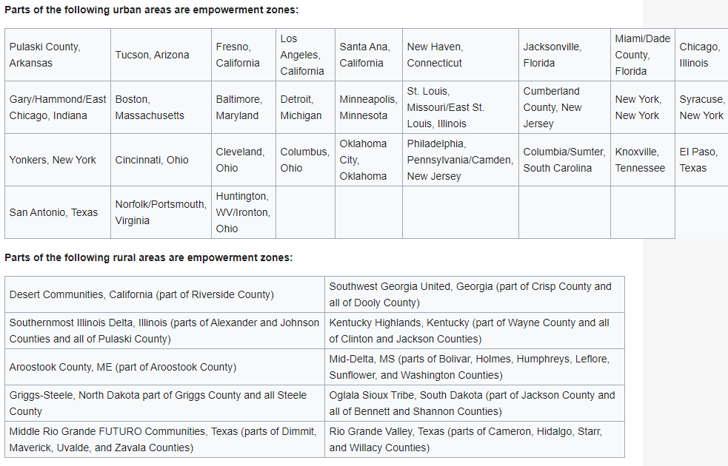

Slide 23
Some terminology
Incentives are usually one or more of the following:
Cash rebates or grants
Refundable tax credits
Transferable tax credits
Tax credits that allow carry forward
These categories are not mutually exclusive (e.g., some tax credits are refundable and/or transferable and/or allow carry forward)

Slide 24
Cash rebates or grants
Money given directly to the business, rather than indirectly like with tax credits.
Refundable tax credits
Tax credits that can pay for state/federal taxes (depending on the entity giving them out). HOWEVER, if you don’t use all your tax credits, you can get the remaining credits back in cash.
In effect this is like just getting a cash rebate or grant.
Transferable tax credits
… HOWEVER, if you don’t use all your tax credits, you can sell them to others who have tax liabilities.
These tax credits are usually sold of broker firms, that take a 20-25% cut.
This incentive is like refundable tax credits, but slightly weaker due to the transaction costs will selling them.
Tax credits that allow carry forward
…HOWEVER, if you don’t use all your tax credits this year, you can apply them to pay your future taxes.

Slide 25
Stylized facts about incentives (via bartik, 2017)
Timothy Bartik, a very notable economist who is famous for studying economic development incentives, recently compiled an extremely helpful database of them, which allows us to better understand the types of incentives that are available and how they have evolved over time.
The big take-ways from this research are:
Business incentives are large
…incentives for new or expanding businesses in 2015 had a present value that averaged 1.42 percent of business value added, about 30 percent of average state and local business taxes. This incentive percentage leads to a projection that, for the entire nation, state and local business incentives had an annual cost in 2015 of $45 billion.

Slide 26
Business incentives are insufficiently targeted in many states, although targeting is better in some states and has improved somewhat over time.
Targeting as in focused on industry characteristics that predict greater local benefits, such as industry wages, employment, or R&D (which generates spillovers).

Slide 27
Business incentives vary by state/region
This is even the case for bordering (adjacent) states or “contiguous counties” (bordering counties – see the Holmes paper on Thursday)
There is significant political science/economics research on what factors predict state/local adoption of incentives, and politics often plays a major role, as does the role of lobbying groups.

Slide 28
Business incentives have more than tripled since 1990
However, the average national rate of increase has slowed since 2000 (i.e. growth is at a more gradual rate).
Many states are cutting back on incentives, especially as more research comes out (e.g., my work and others) that often shows that incentives are not effective (but that’s not by any means the conclusion of all studies, as you will see.)

Slide 29
More incentives are focused on the first year of business investment
The idea here is to help businesses get started or to reward them just after expansion/relocation.
Short-term incentives (“money now”) is also more attractive to businesses than longer-term incentives (“money over time”) given time discounting, business uncertainty, and possible credit constraints that businesses face as they try to start up/expand.

Slide 30
The biggest type of incentive is job creation tax credits (JCTCs), followed by property tax abatements.
Together these make up 70% of total incentive costs.
JCTCs have had the fastest growth rate since 1990.
JCTCs may be popular because they can have very specific targeting criteria.
E.g., hiring of veterans, those from disadvantaged areas, those with particular skills.
Property tax abatements are likely popular since they are easier to adopt (just tweak existing tax code).

Slide 31
Incentive costs can be significantly reduced by a wide variety of reforms
E.g., many incentives are cash grants, rebates, or refundable tax credits, which give firms more money than they pay in taxes.
In simulations, making incentives non-refundable/transferable can reduce incentive spending significantly.
Pros and cons to this of course.

Slide 32
Preliminary work suggests that a state’s incentives are not highly correlated with a state’s fortunes.
So, more incentives does not appear to correlate with better economic outcomes.
Of course, correlation =/= causation, and you’ll see studies of causation during the group briefing note activity.

Slide 33
Summary of O’Flaherty chapter (up to p. 525)
This part of the chapter provided a mostly theoretical look at the effects of incentives.
Some key take-aways:
Effects on different markets (e.g., labor markets, land)
Short-run vs. long-run effects

Slide 34
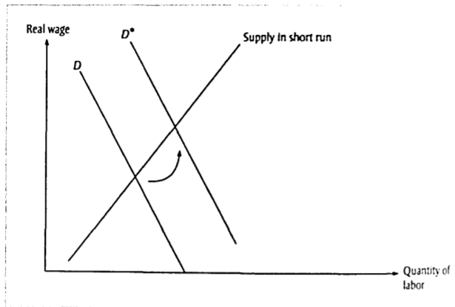
Short-run effects (labor market)
Suppose the state adopts a tax incentive (that works) and leads to an increase in business activity (existing firms want to expand employment and/or new businesses locate to the state).
This increases the demand for labor (demand shifts right), leading to an increase in the price of labor (the wage rate) and employment.
The incentive leads to both an increase in wages and employment.
However, this result could dissipate over time…

Slide 35
Short-run -> Long-Run
Over time more workers will move to the state to take advantage of the higher wages.
This increases the supply of labor.
Eventually, supply shifts until the wage is back where it was before the incentive effect.
(*PB to use annotation tools to add rightward shifting supply curves.)
Employment is higher, but these new jobs are taken by the migrants.
So, all the benefits to locals are gone in the long run.

Slide 36
Long-Run
How long does it take for the “long run” to kick in?
It depends on how easy migration is.
Easy examples (transition to long run is fast):
E.g., if the incentive just affects, say, Kansas City, MO, and not Kansas City, KS, then it’s pretty easy for people/firms to “hop” the state border within the same metropolitan area.
E.g., the incentive targets a neighborhood (e.g., enterprise/empowerment zones).

Slide 37
Long-Run
How long does it take for the “long run” to kick in?
It depends on how easy migration is.
Hard examples (transition to long run is slow):
E.g., if the incentive affects an entire country – it can be tricky for individuals to hop borders.

