Slide 1

Labor Economics
Policing the police: “Pattern-or-practice”, BLM, and other policies
Prof. Patrick Button

Slide 2
Plan for today
Overview of:
Pattern-or-Practice investigations (Devi and Fryer, 2020) (larger focus).
Body-worn cameras (Cubukcu et al., 2021).
Effect of Black Lives Matter on police use of force (Campbell, 2021).
What police policies reduce racial disparities in discounts on speeding tickets? (Goncalves and Mello, 2021) (brief).

Slide 3
Devi and Fryer – Pattern or Practice
Abstract: This paper provides the first empirical examination of the impact of federal and state "Pattern-or-Practice" investigations on crime and policing.
For investigations that were not preceded by "viral" incidents of deadly force, investigations, on average, led to a statistically significant reduction in homicides and total crime.
In stark contrast, all investigations that were preceded by "viral" incidents of deadly force have led to a large and statistically significant increase in homicides and total crime.
We estimate that these investigations caused almost 900 excess homicides and almost 34,000 excess felonies.

Slide 4
Devi and Fryer – Pattern or Practice
The leading hypothesis for why these investigations increase homicides and total crime is an abrupt change in the quantity of policing activity.
In Chicago, the number of police-civilian interactions decreased by almost 90% in the month after the investigation was announced.
In Riverside CA, interactions decreased 54%. In St. Louis, self-initiated police activities declined by 46%.
Other theories we test such as changes in community trust or the aggressiveness of consent decrees associated with investigations – all contradict the data in important ways.

Slide 5
What is pattern or practice?
(Summarized from pages 7 and 8 of Devi and Fryer, 2020)
On May 3, 1991, America witnessed - after a high-speed chase - Rodney King being beaten by four Los Angeles police officers while a dozen others watched. The officers were charged with assault with a deadly weapon and use of excessive force - all were acquitted.
Within hours of the acquittal, the 1992 Los Angeles riots began. The rioting lasted six days – 63 people were killed and thousands injured (Post, 1992).
An independent commission linked the beating of King to institutional failure within the Los Angeles Police Department (LAPD) and Congress held hearings on how the federal government could do more to address police misconduct (Christopher Commission Report, 1991).

Slide 6
What is pattern or practice?
In 1994, Congress passed the Violent Crime Control and Law Enforcement Act which authorized the Attorney General to investigate and litigate cases involving a “pattern or practice of conduct by law enforcement officers" that violates the constitution or federal rights.
Under this authority, the Civil Rights Division of the Department of Justice may obtain a court order requiring state or local law enforcement agencies to address institutional failures that cause systemic police misconduct.
Pattern-or-practice cases are investigated, litigated, and resolved by the Special Litigation Section of the Civil Rights Division of the Department of Justice.

Slide 7
What is pattern or practice?
A typical investigation has the following arc. The first step involves a process by which staff of the Civil Rights Division decide whether to open an investigation into a particular law enforcement agency.
(1) Would the allegations, if proven, establish a violation of the Constitution or federal laws?; and
(2) would the allegations, if proven, constitute a pattern or practice, as opposed to a sporadic or isolated, violation of the Constitution or federal laws.
The second step is to prioritize among the set of viable investigations.

Slide 8
What is pattern or practice?
The second step is to prioritize among the set of viable investigations.
The Civil Rights Division reports that many more jurisdictions meet the basic criteria to be investigated but that they do not have the resources to investigate them all (Civil Rights Division, 2017).
A range of metrics are reportedly used to choose which cities to investigate, including whether the issues a city is dealing with are common across other law enforcement agencies and thus an investigation can provide a model of reform for other jurisdictions - or whether other tools, such as civil rights lawsuits aimed at individual officers, are better suited to address the issues in a particular law enforcement agency.

Slide 9
What is pattern or practice?
In brief, during an investigation, the Department of Justice examines complaints, scrutinizes past data and contemporary interactions between law enforcement officials and civilians to determine if police departments have engaged in a pattern or practice of civil rights violations.
Since the initial investigation in Torrance, CA (May 1995), there have been 69 federal pattern or practice investigations (as of the writing of this working paper in 2020).

Slide 10
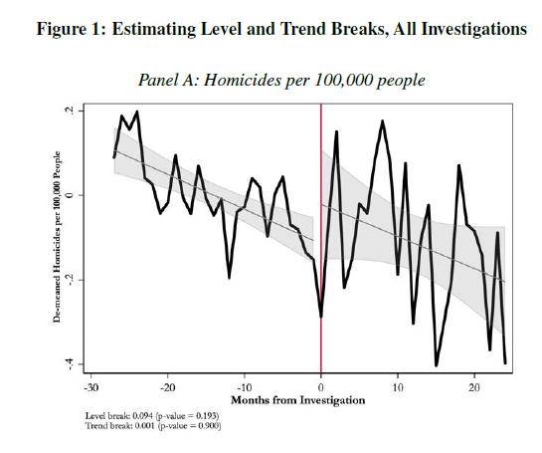
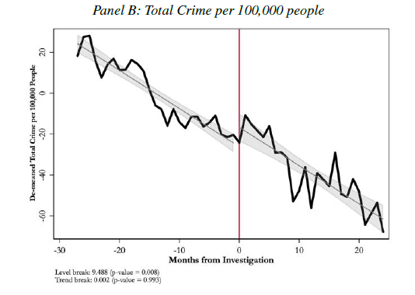
Homicides (left) and Total crime (right) before and after P-or-p investigations

Slide 11
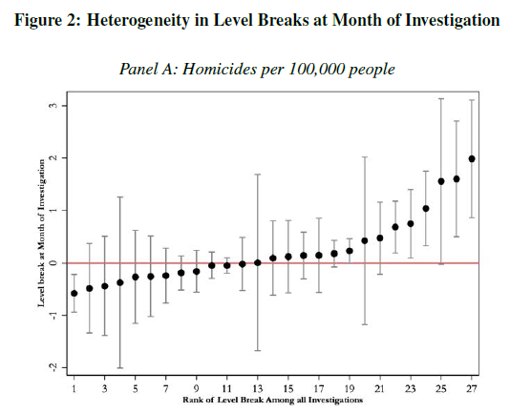
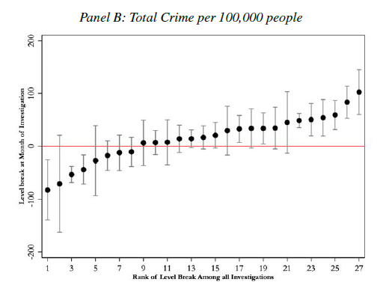
Heterogeneous effects – each dot is a separate investigation

Slide 12
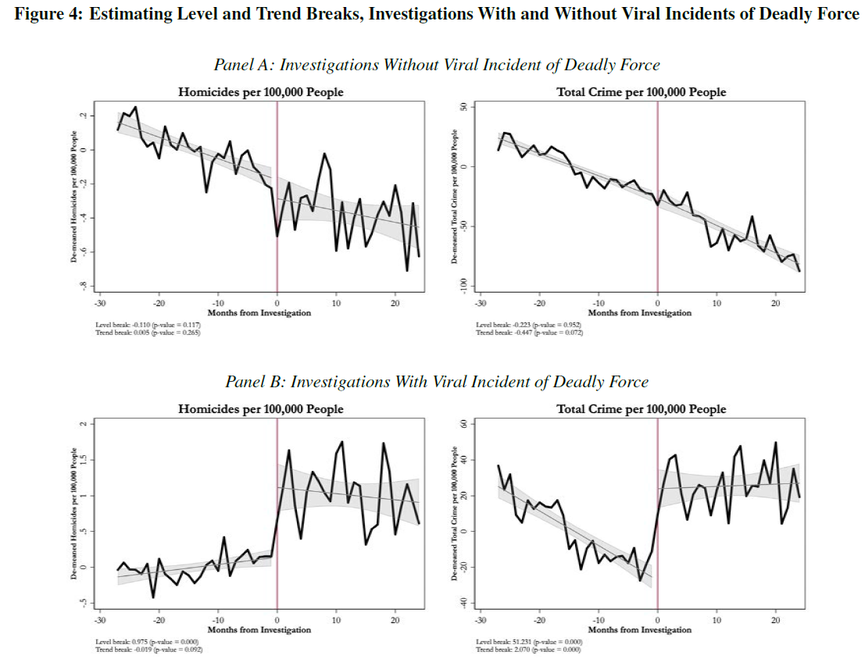
No clear statistically significant evidence of a level break (jump) or trend break (change in slope) on average after investigations without viral incidents of deadly force.
Strong statistically significant evidence of a level break (jump) for homicides and total crime after investigations with viral incidents.
Strong statistically significant evidence of an increase in the growth rate of total crime after investigations with viral incidents.

Slide 13
Alternative explanations
There are two possible violations of their identification assumptions, i.e., two ways that they could be wrong in these results, which they discuss in their paper:
The controversial police use of force that kills a civilian causes crime to increase, and this is being confounded with the pattern or practice investigations.
That is, the increase in crime is caused by the event of police brutality, and not the investigations, which happen at around the same time.
This represents and endogeneity concern as likely the event prompted the pattern or practice investigation, but also caused the crime increase.

Slide 14
Testing 1): crime increase due to the event, not the investigation
A partial test of this hypothesis is to investigate the impact of viral shootings that resulted in a fatality but for which the federal or state government did not launch an investigation.
Do we see the spike in crimes after these viral events, suggesting that it’s the viral events and not the pattern or practice investigations?
The authors construct a sample of 8 viral shootings that were not followed by pattern or practice investigations.
They compared these to the “treated” cities (one that had viral events and then a pattern or practice investigations.
They use a synthetic control approach, which is a style of DiD.

Slide 15
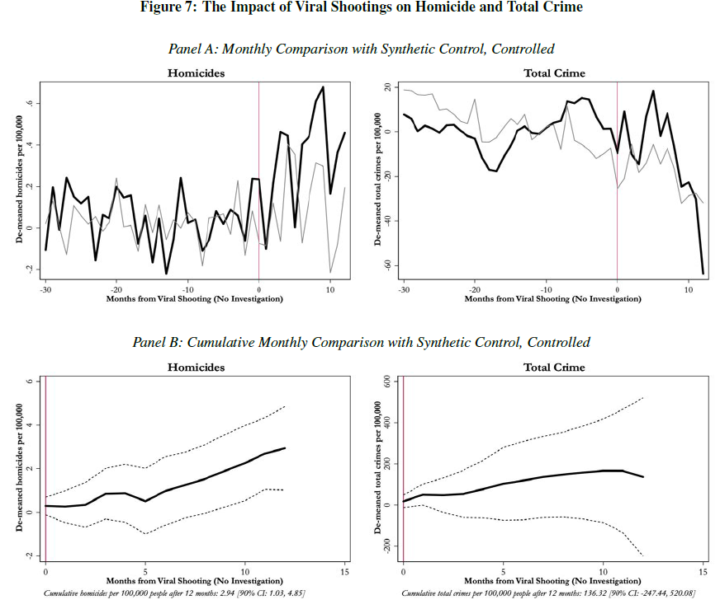
Thick black line = treated cities (viral event + PoP investigation)
Thin gray line = the synthetic control (a combination of other cities with viral event but no PoP investigations)
It appears that the increase in crime is related to the investigation and not the viral event of police brutality.

Slide 16
Alternative explanations
2) There was something unique about the five cities studied in the paper where there was a viral event of use of deadly force followed by a pattern or practice investigation (Baltimore, Chicago, Cincinnati, Riverside, Ferguson). Perhaps for any controversial use of deadly force in these cities in a sensitive time period leads to an increase in crime.
i.e., there are heterogeneous treatment effects by city, and these cities just happen to be ones where events of police brutality led to larger increases in crime, where this increase in crime wouldn’t happen to the same extent in other cities.
i.e., the results could differ for other cities – there is something unique about these ones.

Slide 17
2) continued
“Investigations are not randomly assigned. Thus, one may suspect that there is something special about cities that the Department of Justice decides to investigate. This, coupled with the increased scrutiny on policing after a controversial incident of deadly use of force, may violate our exogeneity condition.
If there is something special about Baltimore, Chicago, Cincinnati, Riverside and Ferguson, then comparing them to cities that have had viral shootings but no investigations is inadequate because there is a reason that those cities were not investigated.” (p. 23)

Slide 18
2) continued
“To make this more concrete, consider the following thought experiment.
Imagine that what leads to an investigation is that the Civil Rights Division is sufficiently convinced that a police department is racist.
In the case of Baltimore, Chicago, Cincinnati, Riverside and Ferguson there were enough signals of racism that the death of Freddie Gray and the shootings of Laquan McDonald, Timothy Thomas, Tyisha Miller and Michael Brown were enough to tip the scales in favor of an investigation…”

Slide 19
2) continued
“…Yet, for Baton Rouge, St. Paul, or North Charleston, there were not enough signals of racism that the shootings of Alton Sterling, Philando Castille, or Walter Scott were enough to lead to an investigation. In this case, our estimates are not simply the causal effect of investigations but are about a controversial shooting in a city with a racist police department in a sensitive time period.” (p. 24)

Slide 20
Testing 2): Something special about those five cities
A partial test of this hypothesis is to examine police shootings of unarmed blacks in Baltimore, Chicago, and Cincinatti – three treated cities with a viral event and a PoP investigation – in the pre-investigation months but before the shootings that led to their investigation.
Is it the case that these shootings of unarmed blacks that were not followed by a PoP investigation also led to an increase in crime?

Slide 21
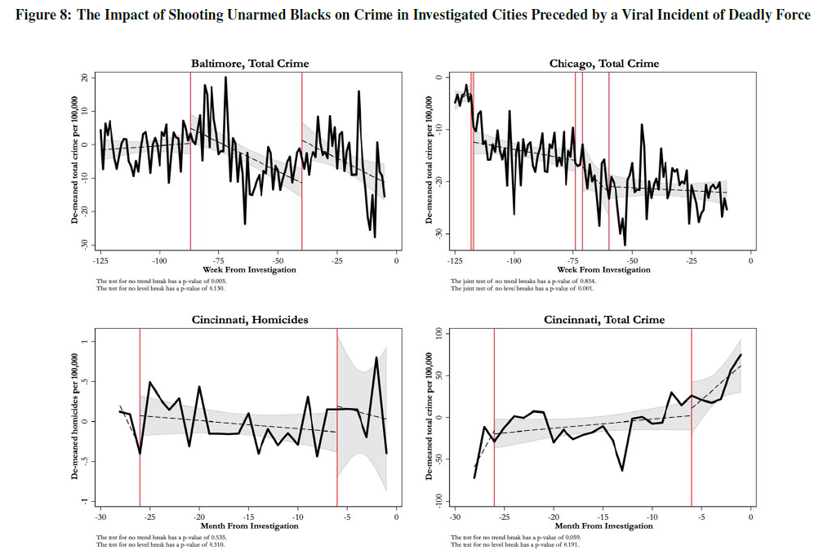
Vertical red lines represent police shootings of unarmed black men that happened before the viral shootings that were followed by PoP investigations.

Slide 22
Mixed evidence on how crime changes in these estimates looking at the effect of shootings of unarmed black men before the PoP investigation.
This suggests that the increase in crime that we see after PoP investigations is due to the investigations.

Slide 23
Recap of results
We see that crime increases after a PoP investigation if the investigation was preceded by a viral event of police brutality.
This does not seem to have other explanations (the authors generally rule out explanations (1) and (2) from earlier).
However, PoP investigations that are not preceded by a viral event of police brutality there is some evidence of a smaller decrease in crime.

Slide 24
What explains these effects?
It’s important to understand the mechanisms of what explains these effects.
Why do we see an increase in crime after investigations preceded by viral police use of force?
Why do we see generally no change in crime after investigations NOT preceded by viral police use of force?
What is the explanation of all this?

Slide 25

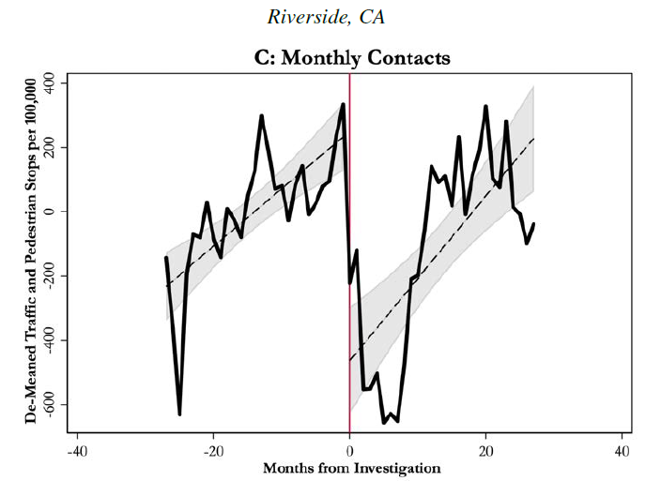
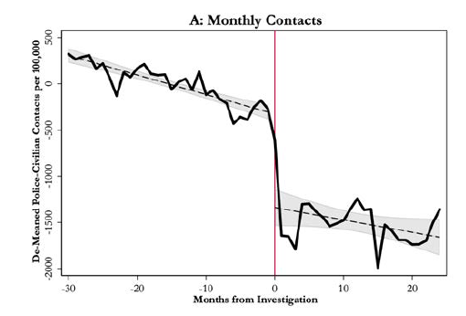
Likely Mechanism: Reduction in police-civilian contacts

Slide 26
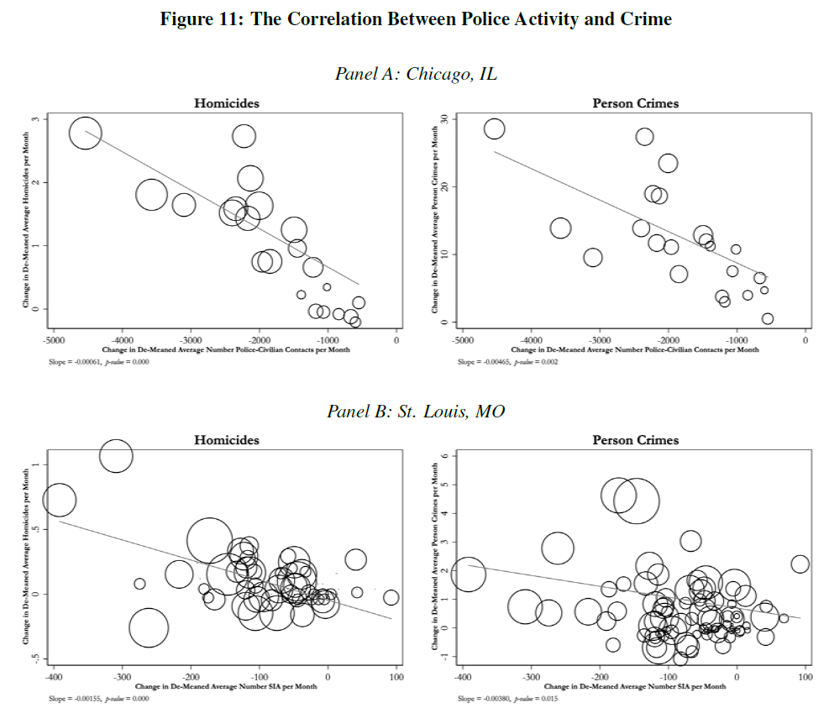
X-axis = change in average # police-civilian contacts per month.
(Moving left to right -> smaller reduction in contacts)
Y-axis = change in average homicides (left) or person crimes (right) per month.
(Moving up -> more crime)
Strong evidence of a negative correlation, so reductions in contacts is associated with increased crime.

Slide 27
Police contact decrease seems to explain the increase in crime
It appears that after the pattern or practice investigation, there is a significant decrease in police-civilian contact.
This decrease in contact appears associated with an increase in crime.
This is suggestive that police-civilian contact reduces crime.

Slide 28
Conclusion – Devi and Fryer (2020)
The ideal goal of pattern or practice investigations is probably to eliminate racial bias in policing without causing police to retreat from activities that suppress crime and save lives.
“A troubling possibility is that the types of police activities that keep crime low are inherently unconstitutional and hence we face a tradeoff between allowing uncomfortable amounts of police bias and reducing crime in the very communications which are most impacted by that bias.” (p. 34)

Slide 29
Body-Worn Cameras – Cubukcu et al. 2021
Abstract: Police body-worn cameras (BWCs) have been the subject of much research on how the technology’s enhanced documentation of police/citizen interactions impact police behavior.
Less attention has been paid to how BWC recordings affect the adjudication of citizen complaints against the police.

Slide 30
Body-Worn Cameras – Cubukcu et al. 2021
Abstract: …We employ citizen complaint data from the Chicago Police Department and Civilian Office of Police Accountability filed between 2012-2020 to determine the extent to which BWC footage enhances
the efficacy of evidence used to formulate a conclusion of responsibility, and
whether bias against complainants based on race would subsequently be reduced.

Slide 31
Body-Worn Cameras – Cubukcu et al. 2021
Abstract: …Accordingly, we exploit the staggered deployment of BWCs across 22 Chicago police districts over time to estimate the effect of BWCs on these outcomes. [Think a difference-in-differences]
Our findings indicate that BWCs led to a significant decrease in the dismissal of investigations due to insufficient evidence ("not sustained")

Slide 32
Body-Worn Cameras – Cubukcu et al. 2021
Abstract: … [Their findings also indicate]… a significant increase in disciplinary actions against police officers ("sustained" outcomes”) with sufficient evidence to sanction their misconduct.
We further find that disparities in complaints across racial groups for the “unsustained” category fade away with the implementation of BWCs.

Slide 33
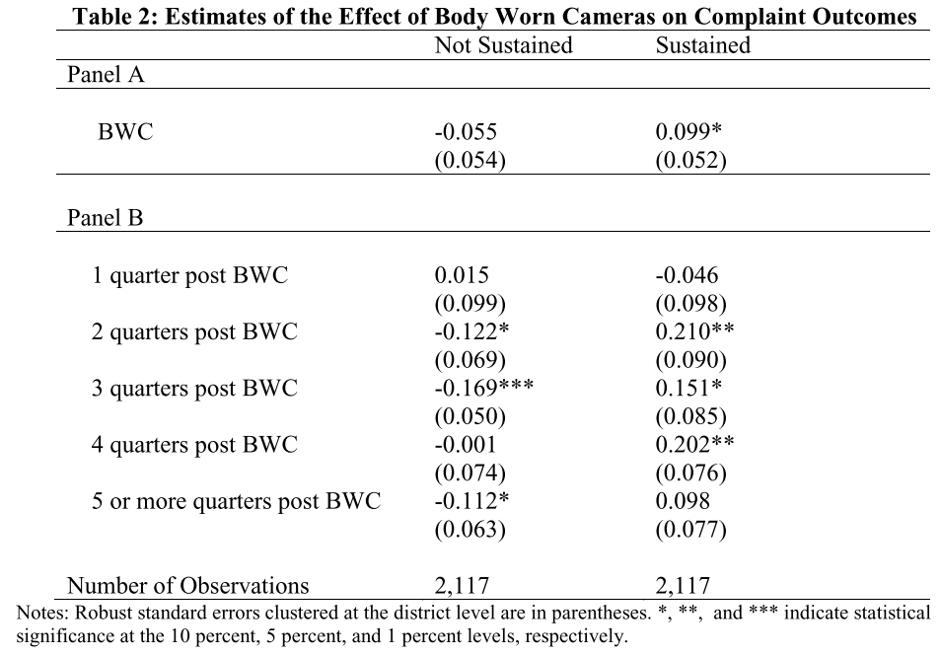
Not Sustained = Dismissal of investigations due to insufficient evidence
Sustained = Disciplinary actions against police officers

Slide 34
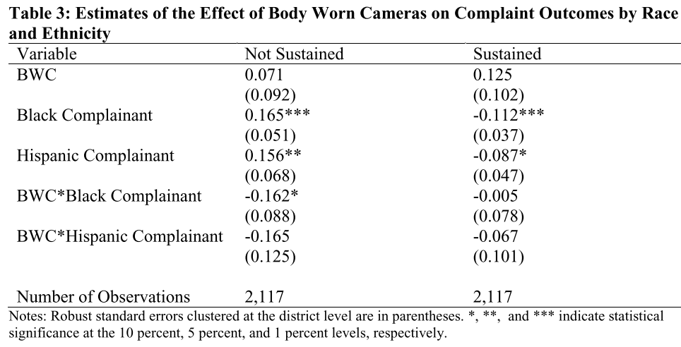
⬅Officers less likely to be charged for black and Hispanic complainants.
BWCs seem to have no effect (but imprecise estimates – so more-so inconclusive)
⬅Black and Hispanics face higher “not sustained” rulings, and while the data is noisy, it appears that BWCs reduce this disparity.

Slide 35
Effect of BLM on Police violence – Campbell (2021)
Abstract: “Has Black Lives Matter influenced police lethal use-of-force?
A difference-in-differences design finds census places with Black Lives Matter protests experience a 15% to 20% decrease in police homicides over the ensuing five years, around 300 fewer deaths.
The gap in lethal use-of-force between places with and without protests widens over these subsequent years and is most prominent when protests are large or frequent.

Slide 36
Effect of BLM on Police violence – Campbell (2021)
Abstract: …This result holds for alternative specifications, estimators, police homicide datasets, and population screens; however, it does not hold if lethal use-of-force is normalized by violent crime or arrests…
[So, when using benchmark 1: deaths / pop, there are effects, but not for benchmark 2: deaths / violent crime arrests]

Slide 37
Effect of BLM on Police violence – Campbell (2021)
Abstract: …Protests also influence local police agencies, which may explain the reduction.
Agencies with local protests become more likely to:
obtain body-cameras,
expand community policing,
receive a larger operating budget, and
reduce the number of property crime-related arrests,
but forego some black officer employment and college education requirements.”

Slide 38
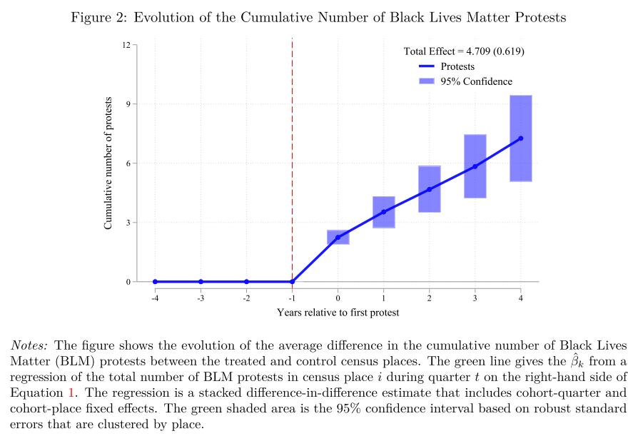
Methodology is a DiD:
Treatment group (census places with BLM protests)
Vs.
Control group (census places without BLM protests)
Before BLM protests
Vs.
After BLM protests
This figure shows that, compared to the control group, the treatment group had significantly more exposure to BLM protests.

Slide 39
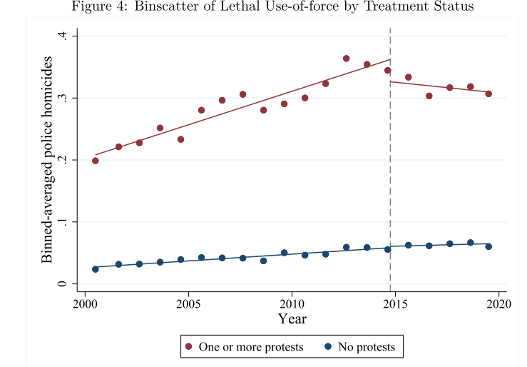
There seems to be a decrease in police homicides for the treatment group after BLM protests start, but not change for the control group.
The author will dive deeper into this in subsequent analysis.
The next figures will present the data as the difference between the treatment and control group, so treatment – control.

Slide 40
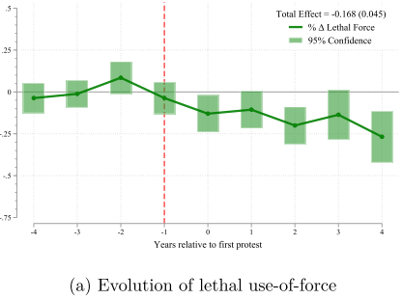
Outcome variable (y-axis) = demeaned treatment – control difference in police homicides.
[This means taking treatment homicides – control homicides, and then centering this at zero by subtracting out the mean of treatment – controls for the pre-period.]
If the outcome variable decreases (increases), then that means that homicides decrease (increase) relatively more of the treatment group compared to the control group.
The figure shows that in the year of the first protest, and afterwards, areas with BLM protests experience fewer police homicides.

Slide 41
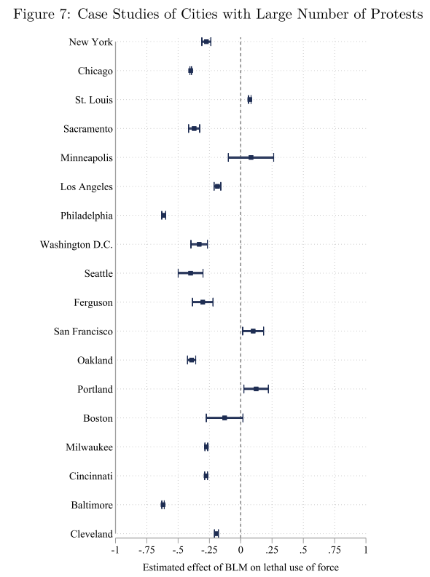
Effects differ by city
Three cities experienced more homicides after BLM protests (compared to control group) (St. Louis, San Francisco, Portland).
Unclear effects for two cities: Minneapolis and Boston.
Negative effects for 13 cities: NY, Chicago, Sacramento, LA, Philadelphia (especially), DC, Seattle, Ferguson, Oakland, Milwaukee, Cincinnati, Baltimore (especially), and Cleveland.

Slide 42
Policies to reduce racial bias in speeding ticket discounts – Goncalves and Mello
Abstract: “We estimate the degree to which individual police officers practice racial discrimination.
Using a bunching estimation design and data from the Florida Highway Patrol, we show that minorities are less likely to receive a discount on their speeding tickets than White drivers.
Disaggregating this difference to the individual police officer, we estimate that 42 percent of officers practice discrimination.
We then apply our officer-level discrimination measures to various policy-relevant questions in the literature. In particular, reassigning officers across locations based on their lenience can effectively reduce the aggregate disparity in treatment. (JEL H76, J15, K42)
The

Slide 43
Policies to reduce racial bias in speeding ticket discounts – Goncalves and Mello
Abstract: …We then apply our officer-level discrimination measures to various policy-relevant questions in the literature.
In particular, reassigning officers across locations based on their lenience can effectively reduce the aggregate disparity in treatment.

Slide 44
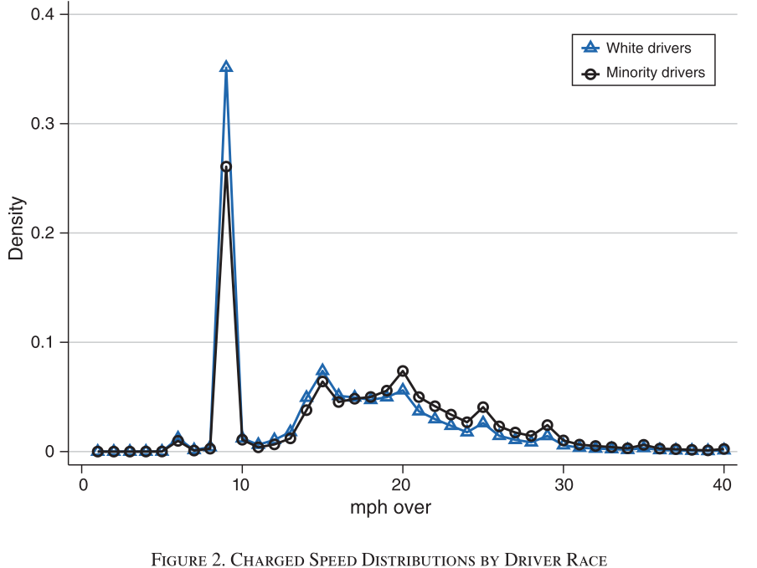
You can see “bunching” of tickets written as being 9, 14, 19, 24, or 29 MPH over the speed limit.
Usually fines increase at 5 MPH increments.
This bunching happens more for white motorists.
Officers “round down” more for them.

Slide 45
Policies to reduce racial bias in speeding ticket discounts – Goncalves and Mello
Focusing on policies to reduce this disparity, the authors investigate to what extent re-assigning officers across locations can reduce this disparity.
Option 1): Sort officers such that the least racially biased officers are in counties with the most minorities. Reduces the gap by 11%.
Option 2): Sort officers such that the more lenient officers are in counties with the most minorities. Reduces the gap by 91%.
“The policy aimed at exposing minorities to lenience is much more effective than removing overall bias through firing biased officers or hiring minority and female officers.”

