Slide 1
Sexual Orientation in Mortgage Lending: Evidence from a (Pilot) Field Experiment
Catherine Balfe
Research Analyst,
Education Research Alliance,
Tulane University
Patrick Button
Assistant Prof.,
Dept. of Econ.,
Tulane University,
and Post-Doc,
RAND Corp.
Mary Penn
Ph.D. Candidate,
Dept. of Econ.,
Tulane University
David Schwegman
PhD. Candidate,
Maxwell School,
Syracuse University

Slide 2
Introduction to Audit/Correspondence Studies
It’s difficult to prove discrimination – there could be other factors going on. Can’t "control” for everything…
Experimental audit/correspondence studies are considered the “gold standard” because they allow researchers to control for all factors other than minority status.
Betrand and Mullainathan (2004): influential correspondence study that responded with fictitious resumes to help-wanted ads in Boston and Chicago newspapers.
To manipulate perception of race, each resume assigned either a very African American sounding name or a very White sounding name.
White sounding names received 50% more callbacks.

Slide 3
Audit Studies in Housing
We can use similar methods to test for discrimination in the housing market.
Email correspondence approach in the rental market:
Respond to rental ads with applications similar in every way except sexual orientation, race, gender, etc.
Test for differences in callbacks, appointments.
For example: Friedman et al. (2013): first measure of sexual orientation discrimination in the United States rental market.
Two e-mails were sent to the housing provider, each inquiring about the availability of the unit advertised on the Internet. The only difference between the two e-mails was the sexual orientation of the couple making the inquiry.
Same-sex couples receive significantly fewer responses.

Slide 4
Why focus on LGBTQ and parental status discrimination in the mortgage market?
Homeownership is a common method for wealth accumulation
However, not all individuals have equal access to homeownership
Same-sex couples are less likely to own homes than different-sex married couples (Jepsen & Jepsen, 2009; Leppel, 2007)
Mortgage approval rates are lower, and mortgage terms are worse, for relatively similar same- and different-sex couples. (Gao and Sun, Forthcoming)
Anecdotal evidence suggests families with or expecting children experience discrimination in mortgage approval (Robinson, 2002; Bernard, 2010)
There are currently no federal laws prohibiting against sexual orientation discrimination in the mortgage market
Notes:
Say in presentation:
-According to the National Association of Realtors, 88% of American homebuyers financed their home purchase with a mortgage in 2017 (Lautz et al., 2017)
-Of those homebuyers, mortgages accounted for an average 90% of their home value (Lautz et al., 2017)
-There is a growing body of research on minority-based discrimination in the mortgage market
-Most of this research has focused on race, ethnicity, and gender based discrimination
-Gao and Sun (forthcoming) conduct first study on sexual orientation discrimination in mortgage market
Relative to opposite-sex couples, same-sex couples experience mortgage approval rates 3-8% lower and refinancing costs 0.02 to 0.2% higher

Slide 5
Role of MLOs
What are Mortgage Loan Originators (MLOs)?
Primary contact for borrowers during the search and application for a mortgage
Analyze and screen preliminary loan requests
Gather background financial information
Submit loan applications
Monitor loan process from application to closing
An email response from an MLO can be the first step in the information gathering stage of receiving a loan
Most MLOs work for commission.
Notes:
Role of MLOs:
Analyze and screen preliminary loan requests
Gather background financial information
Submit loan applications
MLOs are essentially licensed mortgage salespeople who assist customers with loan applications and have the ability to offer and negotiate terms of the mortgage with applicants.
Have discretion over if/how to respond to costumer questions.
Might suggest waiting to improve credit score or to act quickly to take advantage of low interest rates.
If using an MLO, this is your primary contact in the mortgage processes
Why MLOs? They have a large incentive to help individuals get a mortgage – they typically get 1% of the total loan amount
Loan officers usually work for a mortgage broker, a mortgage banker or a financial institution, such as a bank or credit union. Most brokerage loan officers are commission-only salespeople.
We contacted a bunch of MLOs. He emailed MLO giving price house range and asked about rates. Gives you the rates, how much are you looking to be approved for, what house price range? Can get a letter of preapproval from a bank so your offer is more appealing. Once get an accepted offer, have 30 days to go through steps and show you can pay with a more rigorous check. The loan officer walks you though this and sends you all the forms.
.
MLO are an integrated part of the mortgage process.
Not everyone will email an MLO first – may just go to the bank, look up information online, or hire a mortgage broker. It is more efficient to email multiple MLOs if trying to shop around for the best rates. Might be more accurate to email about fees and rates based on your own circumstances than just look online.
-Who accepts/rejects the loan? The mortgage underwriter is the key decision-maker during the mortgage approval process. Reviews all the documents prepared by the MLO.
-Easier to discriminate via email than in person?

Slide 6
Previous Literature
Field experiments:
Tests for sexual orientation discrimination in the rental market:
Friedman et al. (2013), Schwegman (Forthcoming), Levy et al. (2017), Ahmed & Hammarstedt (2009)
Tests for sexual orientation discrimination in the labor market:
Weichselbaumer (2003), Drydakis (2009, 2011, 2014), Tilcsik (2011), Bailey (2013), Pedulla (2014), Weichselbaumer (2015), Mishel (2016)
Tests for racial discrimination in mortgage market:
Hanson, Hawley, Martin, & Liu (2016)
Emailed Mortgage Loan Originators (MLOs) to see how they react to identical mortgage applicants who have different names (white vs. African-American).
This study forms the back-bone for our experiment.
Notes:
As you can see, field experiments are a popular way of testing for S.O. discrimination…no experiment in mortgage lending.
Rental market:
-Email correspondence study: same-gender couples receive fewer responses to email inquires relative to different-gender couples (Friedman)
-Matched-pair email correspondence study:
-In-person audit study: received yearly quotes higher than those of straight men, but lesbians treats the same as straight couples (Levy)
-Evidence of sexual orientation discrimination outside the U.S. (Ahmed & Hammarstedt)
Labor market:
-Large-scale audit study by sending fictitious resumes to job posting, added experience at a gay camp, found significant evidence of discrimination in 3/7 states (Tilcik)
-Sexual discrimination in Germany – sent out responses to job advertisements or job applications (Weichselbaumer)
Racial Discrimination in the mortgage market:
-Hanson et all finds evidence of racial discrimination – net discrimination of 1.8% lower response rate. Being African American is equivalent of a credit score 71 points lower,which is enough to push individuals into a lower credit group. Exceptional 850-800, very good 799-740, good 739-670, fair 669-580

Slide 7
Previous Literature
Observational studies:
First study to attempt to measure discrimination on the basis of sexual orientation in the mortgage market:
Gao & Sun, (forthcoming)
“﻿The results reveal that, in contrast with otherwise comparable loan applicants, the average approval rate for potentially homosexual applicants is about 3% to 8% lower. Furthermore, conditional on being approved, their financing cost is about 0.02% to 0.2% higher. …﻿no evidence that homosexual status is associated with higher default risk.”
Notes:
As you can see, field experiments are a popular way of testing for S.O. discrimination…no exp. In mortgage lending
Could be possible bias with this study – not controlling for credit signals?

Slide 8
This project:
Research questions:
Do mortgage loan originators (MLOs) discriminate against credit-worthy individuals based on their sexual orientation and/or their parental status?
MLOs are a primary contact for borrowers during the search and application for a mortgage. They monitor the loan process from application to closing.
Discrimination by an MLO could lead to reduced access, delays, lower loan amounts, or worse terms.
If discrimination is detected, what is behind it or what affects it?
E.g., gender, homophobic attitudes, assumptions about number of children or fertility, assumptions about credit-worthiness, state credit discrimination laws, …

Slide 9
Introduction to Pilot Methodology
Sent emails to 110 Mortgage Loan Originators (MLOs)
Each MLO receives four emails over the course of four weeks, in random order:
Same-sex female married couple
Same-sex male married couple
Opposite-sex married couple, wife sends the email
Opposite-sex married couple, husband sends the email
Test for differential treatment by MLOs by comparing:
Response rate
Delay of response (don’t have these results yet)
Response quality (don’t have these results yet)
Notes:
Role of MLOs:
Analyze and screen preliminary loan requests
Gather background financial information
Submit loan applications
Checked to ensure each MLO email address receiving one of each type of couple.
We define discrimination as differential treatment (e.g. differential response rates, differential rate of response, and/or differential response quality) because of an applicant’s sexual orientation and/or family structure.
Full experiment will include a national representative sample of MLOs.
Collect email addresses, zip code, if possible gender from each MLO.
Actual experiment will have 5,000-7,000 MLOs. G*Power plus accounting for inter-correlation between clusters, we need 7,229 MLOs to detect a three percentage point difference in response rates. However, Hanson et al were able to detect differences of smaller magnitudes with about 5,000 MLOs.
MLOs will only receive 2 emails: one same gender (randomize if gay or lesbian), one different gender (randomize if sent by male or female)
Don’t consider responses if greater than two weeks or automatic responses by machines. Quality is word count and RA’s judgment and justification of similar, not similar, etc. Possibly use automated system to detect “friendly” language.

Slide 10
Sexual Orientation Signal
In introduction and body of email
Introduction:
“Hello, my name is [male/female name]. My [husband, male name/wife, female name] and I are interested in taking out a mortgage with your bank.”
Body:
“My [husband/wife] and I got your contact information online and we hope that you can answer some questions for us.”
While it may be odd to reveal sexual orientation, there are large benefits to being married, and the marriage would be disclosed at some point anyways.
Notes:
External validity problems here:
One could argue that a gay or lesbian couple would not report their sexual orientation bc of fear of being discriminated against
While this is a valid concern, I argue that they have an incentive to report marital status: Married couples can deduct interest on up to $1 million worth of mortgage debt while a single taxpayer can only deduct up to $500,000 worth of debt. Married couples also have a better chance of getting a
deduction on mortgage insurance premiums.
Also, being married conveys that you are in a stable, committed relationship. If you are co-applicants on a mortgage, a bank will want to ensure that you will stay together and continue to pay back your mortgage.
Also, S.O. is bound to come out at some point in the process of discussion with an MLO bc they will most likely meet face to face at some point. Therefore, even if not every gay or lesbian household will include S.O. in their first email, S.O is likely to be showcased some point later in the process.

Slide 11
Parental Status Signals
Randomly assign emails a “family structure”
No children (no mention of children in email)
Expecting first child (for all couples but same-gender male)
1 child
2 children
Also allows us to control for statistical discrimination (may assume same-gender couple = fewer kids)
Also allows us to test for if same-gender couples face a larger child penalty, given negative attitudes about same-gender parenting.
Notes:
3 reasons why include this signal.
Research shows that families with children experience lower callback rates than families without. Therefore, it is possible that there may be a positive bias towards gay and lesbian households in mortgage market bc MLOs would assume they are less likely to have children. To control for this stat. discr. I include child signal.
However, signal is also interesting bc if disc. Is detected, child signal might also allow me to understand what form of taste based disc. Is occurring. If gay and lesbian with children experience lower callback rates than without, there may be some reason to believe that discriminatory MLOs take issue with gay parenting more than just being gay.
Also, if both same-sex and different-sex couples with children experience lower rates, we may be able to conclude that familial structure disc. Is occurring
Mention children/expecting/adopting half the time
Adding adoption
Should be include 2 kids? Does this introduce confusion about how old they are?
If mention kids, randomize between 1 and 2 bedrooms. If no mention of kids, then say looking for 1 bedroom.

Slide 12
Credit score signal
Randomly assign emails into credit score groups
Low credit score
High credit score
In full experiment, this allows us to quantify discrimination as a credit score penalty
e.g., in Hanson et al. (2016), having an African-American name was equivalent to a 73 point lower credit score.
Notes:
-Only give credit score of email sender. Should we include both?
-In full experiment:
1/3 of couples mention no scores,
1/3 mention both
1/3 mention the score of the originator only
-We signal for creditworthiness by randomly assigning either a low credit score (mean 641, drawn from a uniform distribution between 631 to 655), high credit score (mean 740, range 731 to 774), or no mention of credit score (in full experiment).

Slide 13
Occupation and tenure signals
Randomly mention one of nine occupations for each applicant and applicant’s spouse.
Email originator also casually mentions how long they’ve been at that job (tenure).
Both are relevant (and applicable) additional signals for credit worthiness.
Occupations: average incomes range to $20,000 to over $200,000.
Construction Worker
Childcare provider
Retail Worker
High School Teacher
Admin Assistant
Registered Nurse
Human Resource Manager
Psychiatrist
Dermatologist
Notes:
Occupation signals income.
Why not income? Need to mention occupation in order to mention tenure.
Full exp: mention half time
Tenure:
-for pilot randomized between 1 month, 6 months, 1 year, 2 years or 3 years
-for full experiment: randomize between less than one year, two years and three years
-Replacing retail worker with truck driver in full experiment to add to gender non-conformity portion of the study.
Can see if individuals with gender nonconforming jobs experience discrimination.
In addition to signaling income, occupations can also signal gender (non-)conformity or gender presentation if the occupation is deemed particularly gendered.
Could affect same-gender and different-gender couples.
(Data from CPS)
Majority female: administrative assistant, human resource manager, childcare provider, registered nurse.
Balanced: high school teacher, dermatologist, psychiatrists, healthcare administrator.
Majority male: construction worker, truck driver.

Slide 14
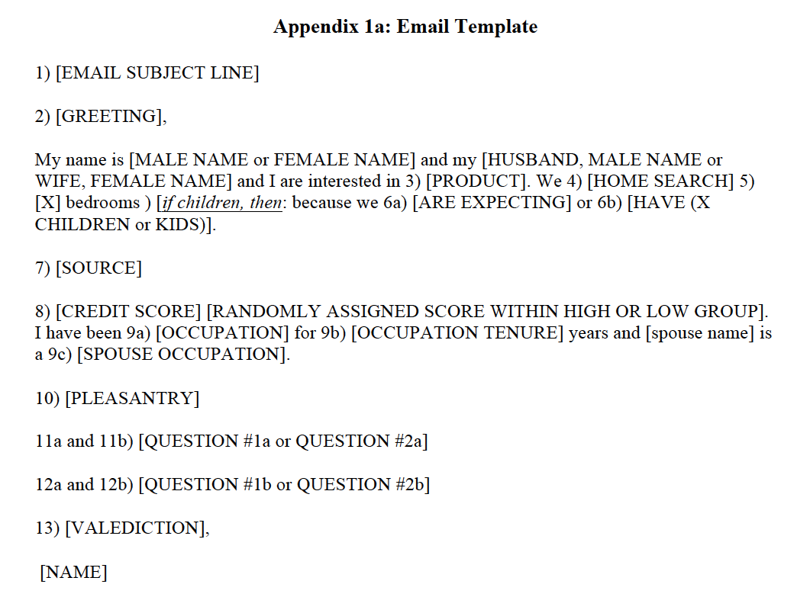
Email construction template
Notes:
Checked to ensure each MLO email address not receiving same type of email template – randomize on template and spacing structure of email.
4 template styles, 2 spacing styles.
Names are all stereotypically “white”

Slide 15
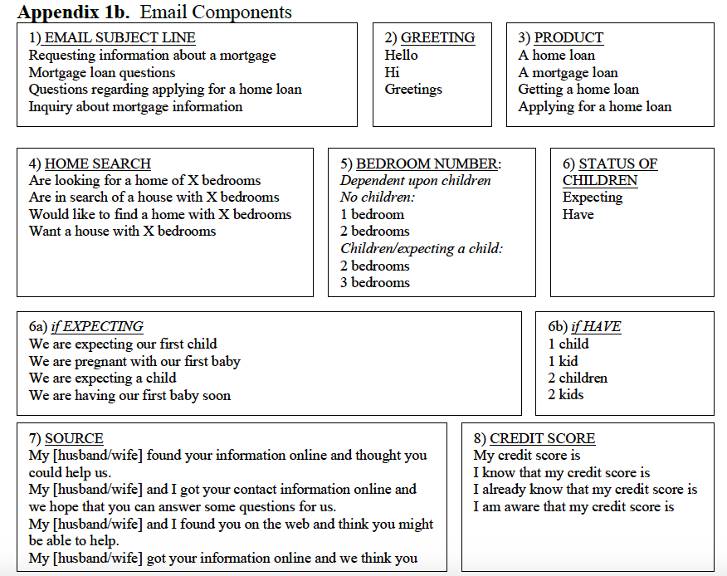
Email components: Part 1

Slide 16
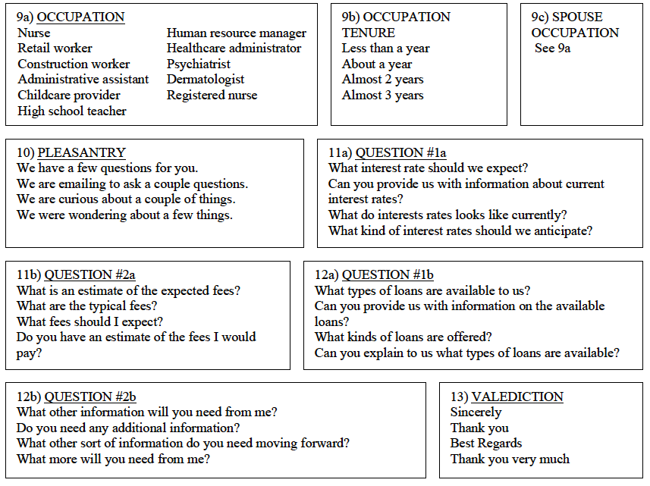
Email components: Part 2

Slide 17
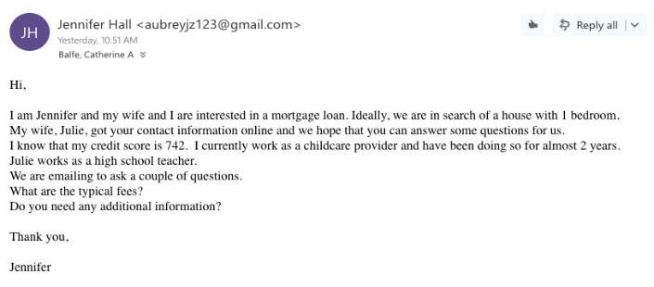
Example

Slide 18
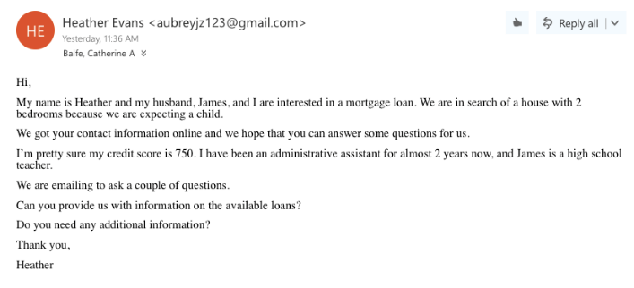
Example

Slide 19
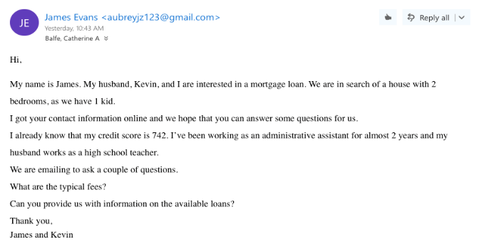
Example

Slide 20
Results from Pilot Study (vs. Hanson et al. 2016)

Slide 21
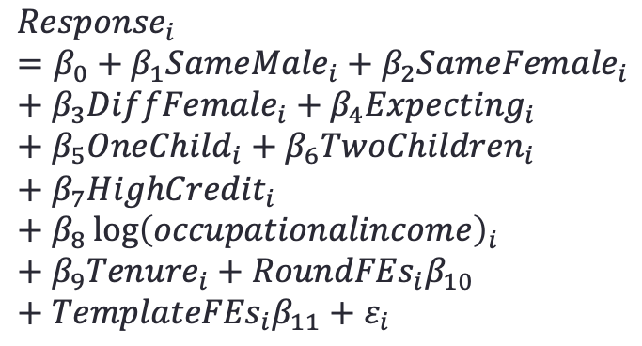
Regression Results
$${Response}_{i}=β_{0}+β_{1}{SameMale}_{i}+β_{2}{SameFemale}_{i}+β_{3}{DiffFemale}_{i}+β_{4}{Expecting}_{i}+β_{5}{OneChild}_{i}+β_{6}{TwoChildren}_{i}+β_{7}{HighCredit}_{i}+β_{8}\log{{\left(occupationalincome\right)}_{i}}+β_{9}{Tenure}_{i}+{RoundFEs}_{i}β_{10}+{TemplateFEs}_{i}β_{11}+ε_{i}$$
Same-Gender Male | -0.253**
 | (0.103)
Same-Gender Female | -0.340***
 | (0.120)
Different-Gender Female Originator | -0.018 (0.126)
Expecting a Child | 0.031
 | (0.116)
Has One Child | -0.100
 | (0.107)
Has Two Children | -0.216**
 | (0.102)
High Credit Score (vs. low) | -0.013
 | (0.103)
Log Occupational Income | -0.034
 | (0.079)
Occupational Tenure (years) | 0.038
 | (0.049)
Callback Rate for Different-Gender, Male Originator: | 72.34%
Excluded category: Different-Gender Male Originator (response rate of 72.34%)
Linear probability model
Standard errors clustered on MLO
Estimation is using our preferred sample, “Restricted Sample #2” (will explain shortly)
Notes:
Results from column 7 – regular controls.
Regular controls: log occupation income, job tenure in years, round fixed effects, template style fixed effects, clustered at MLO level.
Detailed controls: control for each job type separately, tenure fixed effects, round fixed effects, template style fixed effects.

Slide 22
Issues with Spillovers/Detection
We botched the pilot as evidence clearly shows that some MLOs thought something was fishy in later email rounds.
Discrimination seems to decrease in later rounds.
Round 4 is a total mess.
Spillovers/Detection could have occurred for a few reasons:
May be weird to get more than one same-gender email in a month.
Emails were not spaced out enough (each round is one week later.)
Emails were too similar despite randomizing phrasing and questions (e.g., all emails mention occupations)

Slide 23
Issues with Spillovers/Detection
To explore this, we first moved to “Restricted Sample #1”:
dropped Round 4
dropped the second same-gender email
dropped any emails after the second same-gender email.
Round 1 | Round 2 | Round 3 | Round 4
Full Sample
Different | Different | Same | Same
Different | Same | Different | Same
Different | Same | Same | Different
Same | Different | Same | Different
Same | Different | Different | Same
Same | Same | Different | Different
Round 1 | Round 2 | Round 3 | Round 4
Restricted Sample # 1
Different | Different | Same | DROPPED
Different | Same | Different | DROPPED
Different | Same | DROPPED | DROPPED
Same | Different | DROPPED | DROPPED
Same | Different | Different | DROPPED
Same | DROPPED | DROPPED | DROPPED
Same = Same-Gender couple
Different = Different-Gender couple
From N = 469 to N = 258
Then added indicator variables to earlier regression to see if the response rate for different-gender varied based on if a same-gender email came first.
With no spillovers, ordering shouldn’t matter
Notes:
Two indicator variables:
Equal to one for different-gender emails sent in Round 2 when a same-gender email was sent in Round 1.
Equal to 1 for different-gender emails sent in Round 3.

Slide 24
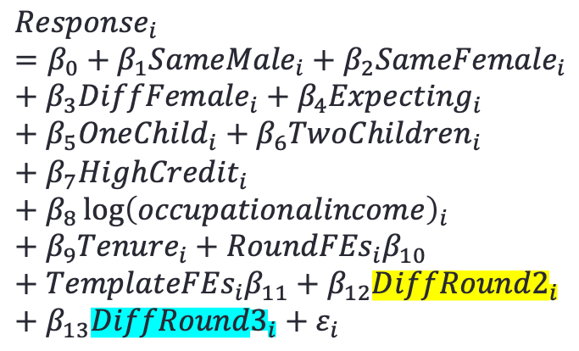
Issues with Spillovers/Detection
Same regression as before but with two added indicator variables:
Different-Gender email sent in Round 2
Different-Gender email sent in Round 3
$${Response}_{i}=β_{0}+β_{1}{SameMale}_{i}+β_{2}{SameFemale}_{i}+β_{3}{DiffFemale}_{i}+β_{4}{Expecting}_{i}+β_{5}{OneChild}_{i}+β_{6}{TwoChildren}_{i}+β_{7}{HighCredit}_{i}+β_{8}\log{{\left(occupationalincome\right)}_{i}}+β_{9}{Tenure}_{i}+{RoundFEs}_{i}β_{10}+{TemplateFEs}_{i}β_{11}+β_{12}{DiffRound2}_{i}+β_{13}{DiffRound3}_{i}+ε_{i}$$
Round 1 | Round 2 | Round 3 | Round 4
Restricted Sample # 1
Different | Different | Same | DROPPED
Different | Same | Different | DROPPED
Different | Same | DROPPED | DROPPED
Same | Different | DROPPED | DROPPED
Same | Different | Different | DROPPED
Same | DROPPED | DROPPED | DROPPED
-0.072
(0.122)
-0.264
(0.162)
Still likely spillovers!
Notes:
Two indicator variables:
Equal to one for different-gender emails sent in Round 2 when a same-gender email was sent in Round 1.
Equal to 1 for different-gender emails sent in Round 3.
Likely spillovers after receive a same-gender email – lower response rates for different-gender emails in round 3.
(regular controls model)

Slide 25
Issues with Spillovers/Detection
Therefore, dropped Round 3 emails as well (”Restricted Sample #2”). Results presented earlier are from this sample.
Round 1 | Round 2 | Round 3 | Round 4
Full Sample
Different | Different | Same | Same
Different | Same | Different | Same
Different | Same | Same | Different
Same | Different | Same | Different
Same | Different | Different | Same
Same | Same | Different | Different
Round 1 | Round 2 | Round 3 | Round 4
Restricted Sample # 2
Different | Different | DROPPED | DROPPED
Different | Same | DROPPED | DROPPED
Different | Same | DROPPED | DROPPED
Same | Different | DROPPED | DROPPED
Same | Different | DROPPED | DROPPED
Same | DROPPED | DROPPED | DROPPED
From N = 469 to N = 258 to N = 204
Then added an indicator variable for the different-gender emails sent after a same-gender email to test for potential spillovers again.
Coefficient ranges from -0.067 to 0.052 depending on specification and is never statistically significant.
Not really evidence of spillovers using a two email model, but we will will have to test for and possibly control for this in the final experiment.

Slide 26
Lessons from the Pilot
Sexual orientation discrimination appears severe: 72.38% response for different gender, versus 50.00% for same-gender male and 37.84% for same-gender female.
Penalty for kids could also be large: e.g., 21.6 p.p. penalty for two kids in the preferred model.
MLOs don’t focus much on credit worthiness signals, especially relative to sexual orientation and parental status. May suggest that discrimination is taste-based.
We must send two emails to each MLO only: one same-gender, one different-gender, with gender randomized. Test for spillovers based on ordering.
Space emails out by a month each rather than one a week.
Make emails less similar: e.g., we will randomize mention of occupations and credit scores.
Notes:
Penalty for kids regardless of couple’s gender, but only for 2 kids. 1 kid neg. but not significant, expecting positive but insignificant.
Why? Kids are really expensive.
Race?
Mention occupation for partner?

Slide 27
Modifications to Pilot
Make emails less similar:
¼ probability one couple mentions of kids/expecting, and the other couple has no mention.
Randomize mention/no mention of sender/partner credit score (1/3 probability no mention, mention sender, mention both).
Randomize mentioning occupation/ occ. of partner (1/4 of the time).
randomly assign a high-income or low-income pair of occupations for each couple.
Conditional on mentioning tenure, mention occupation tenure 2/3 of the time - “half a year” or ”more than a year” (equal probability).
Ensure not sending emails to multiple MLO’s in same branch.
Notes:
Also need to discuss if we should mention that we are looking for our first house / first mortgage. The children/expecting signal also signals timing of the mortgage (e.g., could be first time), and that could explain some differences.
*Ignore this concern, no easy/sufficient fix.
Need to rephrase the tenure signal to make clear tenure is at a JOB and not within an OCCUPATION
2) Should we do one kid or one or two kids? Also need to decide on bedrooms, which is a related issue.
*Always mention either two bedrooms, or switch between two or three randomly (i.e. bedrooms don't vary by couple or kids). Not sure if there are thus any follow-ups on this since I can’t remember off the top of my head what we do now Mary/David.
*We should always select one couple to have a mention of kids/expecting/adopting, and the other couple has no mention.
*We should add in adopting as follows. Conditional on having a kids mention (one couple selected in each pair), the probability for each option is as follows:
FM/MF/FF - adopting 25%, expecting 25%, 1 kid 25%, 2 kids 25%
MM - adopting 50%, 1 kid 25%, 2 kids 25%
7) We may want to think about if we do want to add in race or ethnicity to some extent, given constant comments about that and the fact that we seem to have a ton of power for testing sexual orientation anyways.
*Tabled - Patrick/David/Mary/Cathy to all think about. Email us when you have ideas/opinions and that'll get the ball rolling on discussions.
-We are considering including race to be similar to the national distribution – 12.3% African-American names and 12.5% Hispanic names, approximately.

Slide 28
Thank you!

Slide 29
References
Ahmed, A. M., & Hammarstedt, M. (2009). Detecting discrimination against homosexuals: Evidence from a field experiment on the Internet. Economica, 76(303), 588-597.
Bertrand, M., & Mullainathan, S. (2004). Are Emily and Greg more employable than Lakisha and Jamal? A field experiment on labor market discrimination. The American Economic Review, 94(4), 991-1013.
Friedman, S., Reynolds, A., Scovill, S., Brassier, F. R., Campbell, R., & Ballou, M. (2013). An estimate of housing discrimination against same-sex couples. Available at SSRN:
https://ssrn.com/abstract=2284243 or http://dx.doi.org/10.2139/ssrn.2284243
Gao, L. & Sun, H."The Rainbow of Credit: Same-Sex Mortgage Discrimination and Two-sided Spillover Effect", accepted by the Proceedings of the National Academy of Sciences of USA, (PNAS).
Hanson, A., Hawley, Z., Martin, H., & Liu, B. (2016). Discrimination in mortgage lending: Evidence from a correspondence experiment. Journal of Urban Economics, 92, 48-65.
Jepsen, C., & Jepsen, L. K. (2009). Does home ownership vary by sexual orientation?. Regional Science and Urban Economics, 39(3), 307-315.
Lautz, J., Dunn, M., Snowden, B., Riggs, A., Horowitz, B. (2017). 2017 Profile of Home Buyers and Sellers. Retrieved from
https://www.nar.realtor/sites/default/files/documents/2017-profile-of-home-buyers-and- sellers-11-20-2017.pdf
Leppel, K. (2007). Married and unmarried, opposite and same-sex couples: a decomposition approach. Journal of Housing Research, 16(1), 61–81.

Slide 30
References
Levy, D. K., Wissoker, D., Aranda, C. L., Howell, B., Pitingolo, R., Sewell, S., & Santos, R. (2017). A
Paired-Testing Pilot Study of Housing Discrimination against Same-Sex Couples and Transgender Individuals. The Urban Institute.
Neumark, D., Burn, I., & Button, P. (forthcoming). Age Discrimination and Hiring of Older Workers. Journal of Political Economy.
Robinson, J. K. (2002). Race, gender, and familial status: discrimination in one US mortgage lending market. Feminist Economics, 8(2), 63-85.
Schwegman, D. (2018). Understanding Discrimination against Same-Sex Couples in the United States: Evidence from an Email Correspondence Audit (No. 210). Center for Policy Research, Maxwell School, Syracuse University.
Tilcsik, A. (2011). Pride and Prejudice: Employment Discrimination against Openly Gay Men in the United States 1. American Journal of Sociology, 117(2), 586-626.

