Slide 1

Labor Economics
Policing the police: “Pattern-or-practice”
Prof. HUSSAIN HADAH

Slide 2
Plan for today
Overview of:
Devi, Tanaya, and Roland G. Jr. Fryer. 2020. “Policing the Police: The Impact of ‘Pattern-or-Practice’ Investigations on Crime.” NBER Working Paper 27324.

Slide 3
Devi and Fryer – Pattern or Practice
Abstract: This paper provides the first empirical examination of the impact of federal and state "Pattern-or-Practice" investigations on crime and policing.
For investigations that were not preceded by "viral" incidents of deadly force, investigations, on average, led to a statistically significant reduction in homicides and total crime.
In stark contrast, all investigations that were preceded by "viral" incidents of deadly force have led to a large and statistically significant increase in homicides and total crime.
We estimate that these investigations caused almost 900 excess homicides and almost 34,000 excess felonies.

Slide 4
Devi and Fryer – Pattern or Practice
The leading hypothesis for why these investigations increase homicides and total crime is an abrupt change in the quantity of policing activity.
In Chicago, the number of police-civilian interactions decreased by almost 90% in the month after the investigation was announced.
In Riverside CA, interactions decreased 54%. In St. Louis, self-initiated police activities declined by 46%.
Other theories we test such as changes in community trust or the aggressiveness of consent decrees associated with investigations – all contradict the data in important ways.

Slide 5
What is pattern or practice?
(Summarized from pages 7 and 8 of Devi and Fryer, 2020)
On May 3, 1991, America witnessed - after a high speed chase i Rodney King being beaten by four Los Angeles police officers while a dozen others watched. The officers were charged with assault with a deadly weapon and use of excessive force - all were acquitted.
Within hours of the acquittal, the 1992 Los Angeles riots began. The rioting lasted six days - sixty three people were killed and thousands injured (Post, 1992).
An independent commission linked the beating of King to institutional failure within the Los Angeles Police Department (LAPD) and Congress held hearings on how the federal government could do more to address police misconduct (Christopher Commission Report, 1991).

Slide 6
What is pattern or practice?
In 1994, Congress passed the Violent Crime Control and Law Enforcement Act which authorized the Attorney General to investigate and litigate cases involving a “pattern or practice of conduct by law enforcement officers" that violates the constitution or federal rights.
Under this authority, the Civil Rights Division of the Department of Justice may obtain a court order requiring state or local law enforcement agencies to address institutional failures that cause systemic police misconduct.
Pattern-or-practice cases are investigated, litigated, and resolved by the Special Litigation Section of the Civil Rights Division of the Department of Justice.

Slide 7
What is pattern or practice?
A typical investigation has the following arc. The first step involves a process by which staff of the Civil Rights Division decide whether to open an investigation into a particular law enforcement agency.
(1) Would the allegations, if proven, establish a violation of the Constitution or federal laws?; and
(2) would the allegations, if proven, constitute a pattern or practice, as opposed to a sporadic or isolated, violation of the Constitution or federal laws.
The second step is to prioritize among the set of viable investigations.

Slide 8
What is pattern or practice?
The second step is to prioritize among the set of viable investigations.
The Civil Rights Division reports that many more jurisdictions meet the basic criteria to be investigated but that they do not have the resources to investigate them all (Civil Rights Division, 2017). A range of metrics are reportedly used to choose which cities to investigate, including whether the issues a city is dealing with are common across other law enforcement agencies and thus an investigation can provide a model of reform for other jurisdictions - or whether other tools, such as civil rights lawsuits aimed at individual officers, are better suited to address the issues in a particular law enforcement agency.

Slide 9
What is pattern or practice?
In brief, during an investigation, the Department of Justice examines complaints, scrutinizes past data and contemporary interactions between law enforcement officials and civilians to determine if police departments have engaged in a pattern or practice of civil rights violations.
Since the initial investigation in Torrance, CA (May 1995), there have been 69 federal pattern or practice investigations.

Slide 10
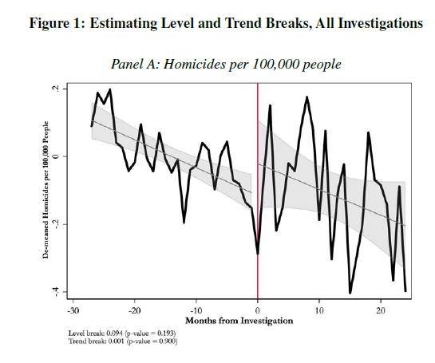
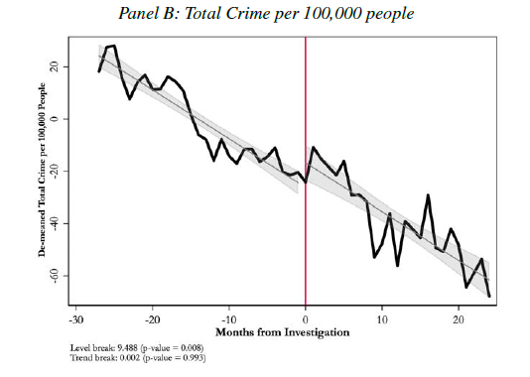
Event study, investigations both w/ and w/o viral incident of deadly force

Slide 11
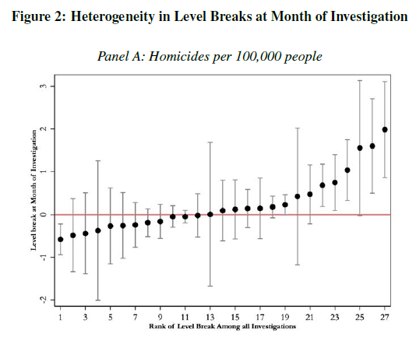
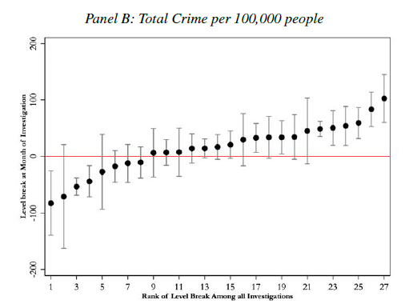
Heterogeneous effects – each dot is a separate investigation

Slide 12
Why are there heterogeneous effects?

Slide 13
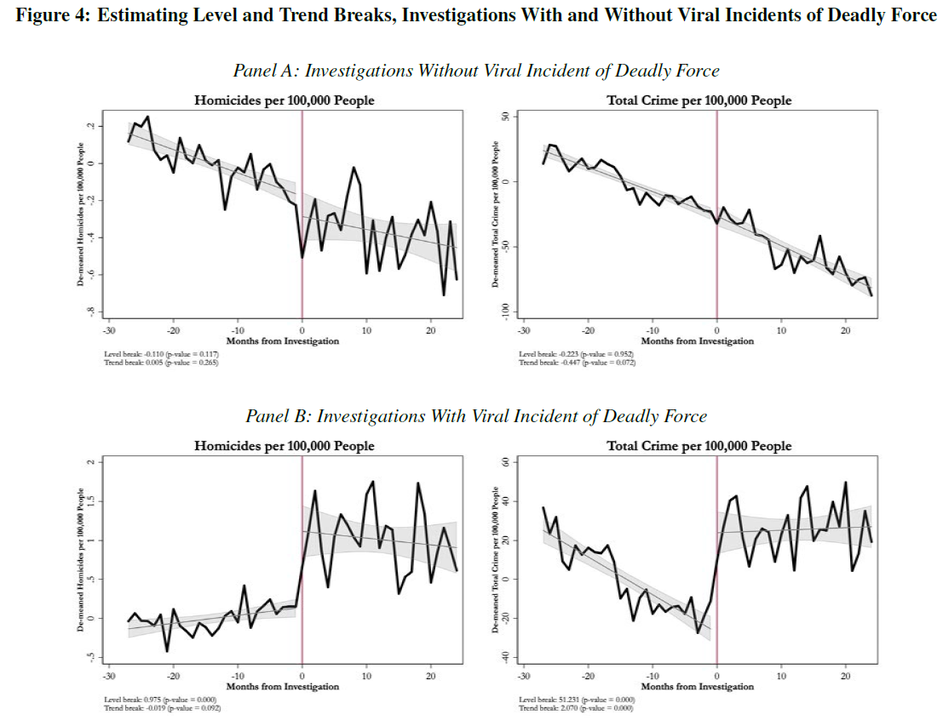
No clear statistically significant evidence of a level break (jump) or trend break (change in slope) on average after investigations without viral incidents of deadly force.
Strong statistically significant evidence of a level break (jump) for homicides and total crime after investigations with viral incidents.
Strong statistically significant evidence of an increase in the growth rate of total crime after investigations with viral incidents.

Slide 14
Alternative explanations
There are two possible violations of their identification assumptions, i.e. two ways that they could be wrong in these results, which they discuss in their paper:
The controversial police use of force that kills a civilian causes crime to increase, and this is being confounded with the pattern or practice investigations.
That is, the increase in crime is caused be the event of police brutality, and not the investigations.
This represents and endogeneity concern as likely the event prompted the pattern or practice investigation, but also caused the crime increase.

Slide 15
Testing 1): crime increase due to the event, not the investigation
A partial test of this hypothesis is to investigate the impact of viral shootings that resulted in a fatality but for which the federal or state government did not launch an investigation.
Do we see the spike in crimes after these viral events, suggesting that it’s the viral events and not the pattern or practice investigations?
The authors construct a sample of 8 viral shootings that were not followed by pattern or practice investigations.
They compared these to the “treated” cities (one that had viral events and then a pattern or practice investigations.
They use a synthetic control approach, which is a style of DiD.

Slide 16
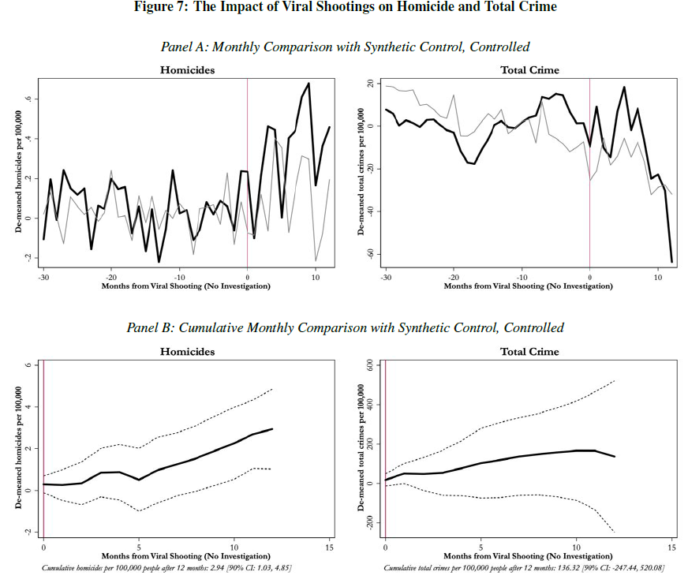
Thick black line = treated cities (viral event + PoP investigation)
Thin gray line = the synthetic control (a combination of other cities with viral event but no PoP investigations)
It appears that the increase in crime is related to the investigation and not the viral event of police brutality.

Slide 17
Alternative explanations
2) There was something unique about the five cities studied in the paper where there was a viral event of force followed by a pattern or practice investigation (Baltimore, Chicago, Cincinnati, Riverside, St. Louis). Perhaps for any controversial use of deadly force in these cities in a sensitive time period leads to an increase in crime.
i.e. there are heterogeneous treatment effects by city, and these cities just happen to be ones where events of police brutality lead to larger increases in crime, where this increase in crime wouldn’t happen to the same extent in other cities.

Slide 18
2) continued
“Investigations are not randomly assigned. Thus, one may suspect that there is something special about cities that the Department of Justice decides to investigate. This, coupled with the increased scrutiny on policing after a controversial incident of deadly use of force, may violate our exogeneity condition. If there is something special about Baltimore, Chicago, Cincinnati, Riverside and Ferguson, then comparing them to cities that have had viral shootings but no investigations is inadequate because there is a reason that those cities were not investigated.” (p. 23)

Slide 19
2) continued
“To make this more concrete, consider the following thought experiment. Imagine that what leads to an investigation is that the Civil Rights Division is sufficiently convinced that a police department is racist. In the case of Baltimore, Chicago, Cincinnati, Riverside and Ferguson there were enough signals of racism that the death of Freddie Gray and the shootings of Laquan McDonald, Timothy Thomas, Tyisha Miller and Michael Brown were enough to tip the scales in favor of an investigation…”

Slide 20
2) continued
“…Yet, for Baton Rouge, St. Paul, or North Charleston, there were not enough signals of racism that the shootings of Alton Sterling, Philando Castille, or Walter Scott were enough to lead to an investigation. In this case, our estimates are not simply the causal effect of investigations but are about a controversial shooting in a city with a racist police department in a sensitive time period.” (p. 24)

Slide 21
Testing 2): Something special about those five cities
A partial test of this hypothesis is to examine police shootings of unarmed blacks in Baltimore, Chicago, and Cincinatti – three treated cities with a viral event and a PoP investigation – in the pre-investigation months but before the shootings that led to their investigation.
Is it that case that these shootings of unarmed blacks that were not followed by a PoP investigation also led to an increase in crime?

Slide 22
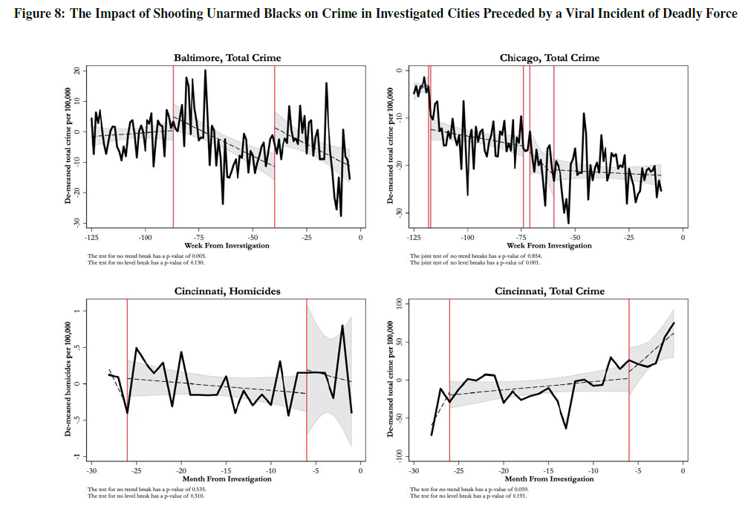
Vertical red lines represent police shootings of unarmed black men that happened before the viral shootings that were followed by PoP investigations.

Slide 23
Mixed evidence on how crime changes in these DiD estimates looking at the effect of shootings of unarmed black men before the PoP investigation.
This suggests that the increase in crime that we see after PoP investigations is due to the investigations.

Slide 24
Recap of results
We see that crime increases after a PoP investigation if the investigation was preceded by a viral event of police brutality.
This does not seem to have other explanations (the authors generally rule out explanations (1) and (2) from earlier).
However, PoP investigations that are not preceded by a viral event of police brutality there is some evidence of a smaller decrease in crime.

Slide 25
What explains these effects?
It’s important to understand the mechanisms of what explains these effects.
Why do we see an increase in crime after investigations preceded by viral police use of force?
Why do we see generally no change in crime after investigations NOT preceded by viral police use of force?
What is the explanation of all this?

Slide 26

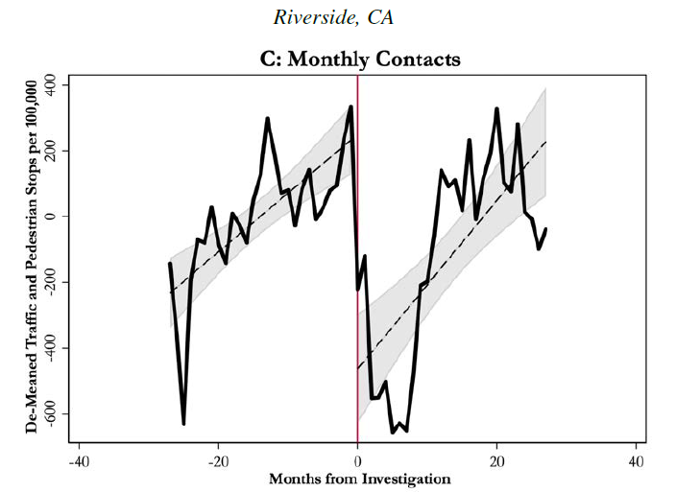
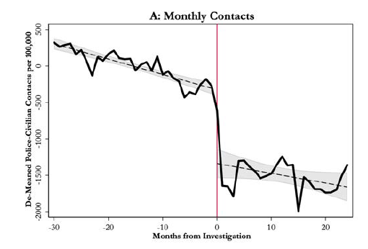
Likely Mechanism: Reduction in police-civilian contacts

Slide 27
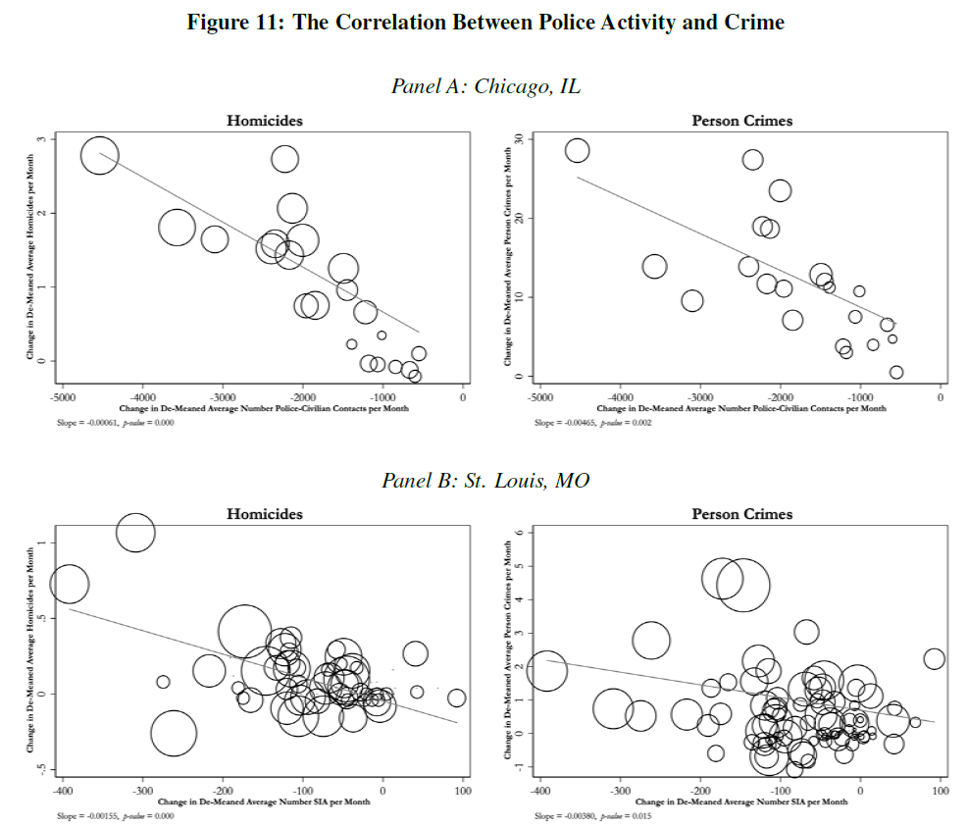
X-axis = change in average # police-civilian contacts per month.
(Moving left to right -> smaller reduction in contacts)
Y-axis = change in average homicides (left) or person crimes (right) per month.
(Moving up -> more crime)
Strong evidence of a negative correlation, so reductions in contacts is associated with increased crime.

Slide 28
Police contact decrease seems to explain the increase in crime
It appears that after the pattern or practice investigation, there is a significant decrease in police-civilian contact.
This decrease in contact appears associated with an increase in crime.
This is suggestive that police-civilian contact reduces crime.

Slide 29
Conclusion
The ideal goal of pattern or practice investigations is probably to eliminate racial bias in policing without causing police to retreat from activities that suppress crime, and save lives.
“A troubling possibility is that the types of police activities that keep crime low are inherently unconstitutional and hence we face a tradeoff between allowing uncomfortable amounts of police bias and reducing crime in the very communications which are most impacted by that bias.” (p. 34)

