Slide 1

Urban Economics
Effects of Police on crime
Prof. Hussain Hadah

Slide 2
Plan for today
Discussion and summary of the five papers covered during the jigsaw you did last class:
Cheng, Cheng, and Wei Long. 2018. “Improving police services: Evidence from the French quarter task force.” Journal of Public Economics, 164: 1–18.
Di Tella, Rafael, and Ernesto Schargrodsky. 2004. “Do Police Reduce Crime? Estimate Using the Allocation of Police Forces after a Terrorist Attack.” American Economic Review, 94(1): 115–133.
Dur, Robert, and Ben Vollaard. 2019. “Salience of law enforcement: A field experiment.” Journal of Environmental Economics and Management, 93: 208–220.
Levitt, Steven D. 1997. “Using Electoral Cycles in Police Hiring to Estimate the Effect of Police on Crime.” American Economic Review, 87(3): 270–290.
Sullivan, Christopher M, and Zachary P. O’Keeffe. 2017. “Evidence that curtailing proactive policing can reduce major crime.” Nature Human Behaviour, 1(10): 730–737.

Slide 3
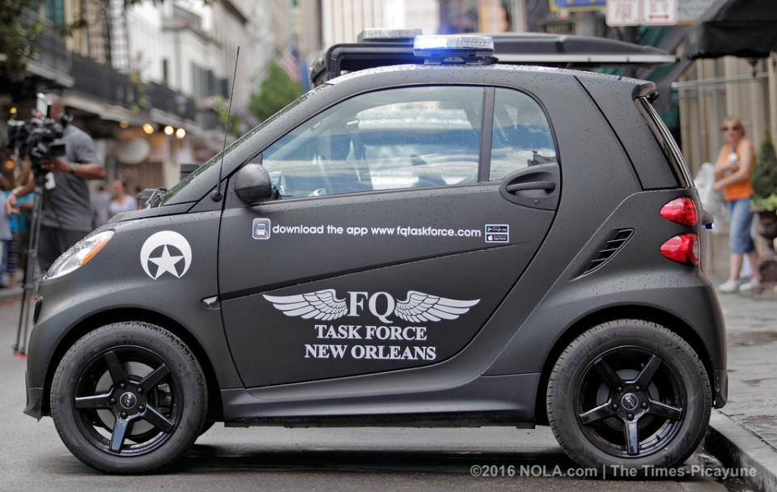
Cheng and Long – FQ Task force
This is a DiD paper that compares policing policy changes in the French Quarter in New Orleans and how they affected crime, comparing the FQ before and after these policing changes to other neighborhoods during the same period.
The context is the creation of the “French Quarter Task Force” (FQTF)

Slide 4
Cheng and Long – FQ Task force
The FQTF was originally funded and run by Sidney Torres.
They would drive around the FQ in these tiny cars to more quickly respond to reported crimes or issues (which could be reported via an app), and to otherwise patrol the FQ.
Cheng and Long study three phases:
Pre FQTF
FQTF under private direction
FQTF under public direction (run by NOPD)

Slide 5
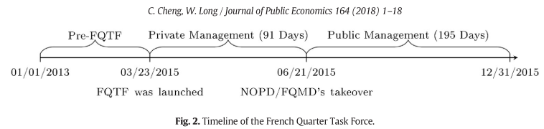
Cheng and Long – FQ Task force

Slide 6
Cheng and long – FQ task force
Cheng and Long study “susceptible crimes”
These are crimes that could be affected by the FQTF patrols:
robbery,
aggravated assault,
burglary, and,
theft (larceny and motor vehicle theft)

Slide 7
Cheng and long – FQ task force
As a falsification test, the researchers also test effects on a non-susceptible crime, that is, a crime that should not be affected by the FQTF.
This crime is homicide.
A falsification test is a way to see if the results you are finding in your study could potentially be spurious.
The idea is to test an outcome that you think you should not change at all. If there is good reason that it shouldn’t change due to the treatment, and you find an effect, it may suggest problems with your DiD approach.
E.g., parallel trends (aka “common trends”) assumption doesn’t hold

Slide 8
Cheng and long – FQ task force
The methodology is a difference-in-differences:
Compare FQ during the three phases:
Before FQTF
During FQTF – private management
During FQTF – public management
To the 70 other neighborhoods in New Orleans over the same time period.

Slide 9
Cheng and Long – FQ Task force
They find that the increased police presence from the FQTF reduced robberies by 37.4%, aggravated assaults by 16.9%, and thefts by 13%.
However, the program was more effective under private management rather than public management (NOPD).
This may be because the private management structure provided more incentives for police to be productive.

Slide 10
Di tella and Schargrodsky – Terrorist attack
This paper uses the reaction to a terrorist attack as a “natural experiment” to study the effects of police on crime.
The main Jewish center in Buenos Aires, Argentina faced a terrorist attack in July 1994.
After this attack, all Jewish institutions received police protection.
This is essentially a DiD study comparing the blocks at or right by the Jewish centers before and after they get police presence, compared to similar areas during the same time period.

Slide 11
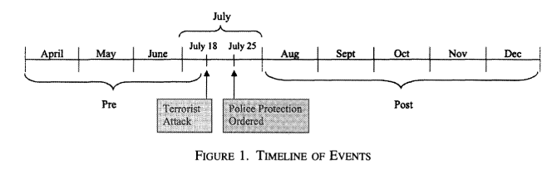
Di tella and Schargrodsky – Terrorist attack
Treatment groups = Block with Jewish Institution
One block from Jewish Institution
Two blocks from Jewish Institution
Control groups = 2+ blocks from Jewish Institution

Slide 12
Di tella and Schargrodsky – Terrorist attack
The key assumption is that the allocation of police outside Jewish centers and synagogues is exogenous to the crime trends in those areas.
They study the effect on crimes like property theft, so for their to be an endogeneity concern, it would have to be the case that there was increased property theft right near synagogues, and the police were allocated in an endogenous way to curb that.
This seems highly unlikely.
The allocation of police here has nothing to do with LOCAL crime trends in property crime, etc., local to the area right by Jewish centers

Slide 13
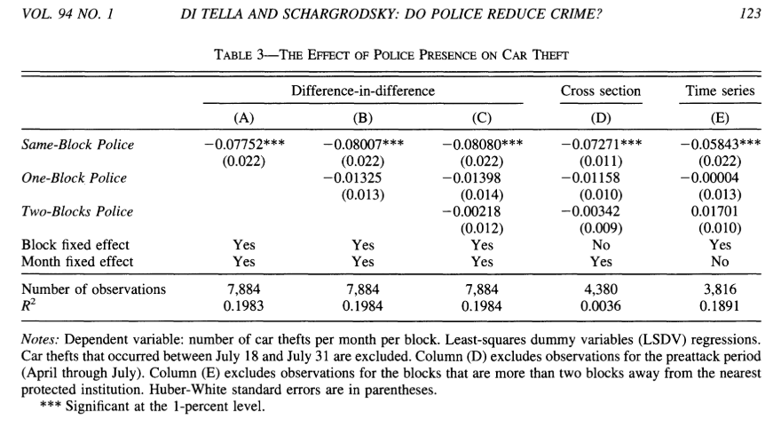
Di tella and Schargrodsky – Terrorist attack
Effects only seem to occur for the same block the Jewish Institution is on.
No detectable spillover effects even a block away.

Slide 14
Di tella and Schargrodsky – Terrorist attack
What is “Cross section”?
This is the naïve comparison of not using the pre-period data.
Compare treatment to control group in the post period.
This could create bias if there are fixed average differences between same-block and one/two blocks, however this generates only a smaller effect estimate.

Slide 15
Di tella and Schargrodsky – Terrorist attack
What is “Time series”?
This is the naïve comparison of not using a control group.
Just look at crime before and after.
Could be biased from existing time trends. In this case the estimate decreases. Perhaps this is because there was an existing trend of decreasing crime over time?

Slide 16
Di tella and Schargrodsky – Terrorist attack
The authors find that the police presence has a significant effect on reducing car thefts, but only right by the Jewish centers that got police protection.
The effects don’t seem to occur outside of adjacent blocks, so the effects dissipate significantly with geography.
This could be due to the nature of this policing, which was more like armed guards near the entrance, and less like proactive policing where the police patrol around.

Slide 17
DUR And Vollaard – rCT on waste disposal enforcement
This is a randomized control trial (RCT) where the researchers worked with police to randomize a trash enforcement policy.
They picked 56 trash disposal sites in a city in the Netherlands. They randomized those sites into treatment and control.
Control = no change in policing policy
Treatment = illegal disposed of trash bags got a warning label applied to the bags that noted that the bag was disposed of illegally and that there is a fine for this.
Thus the “treatment” is more saliency policy enforcement of laws.

Slide 18
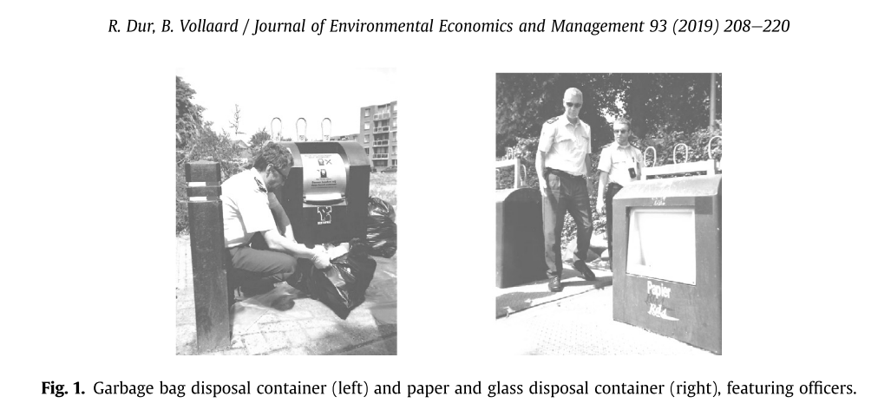
DUR And Vollaard – rCT on waste disposal enforcement

Slide 19
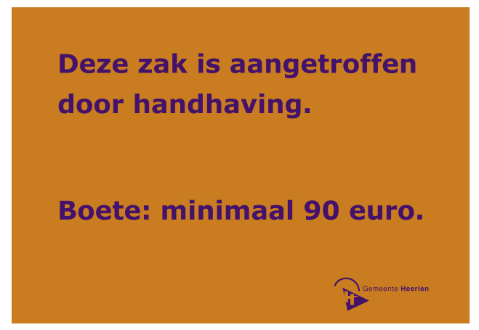
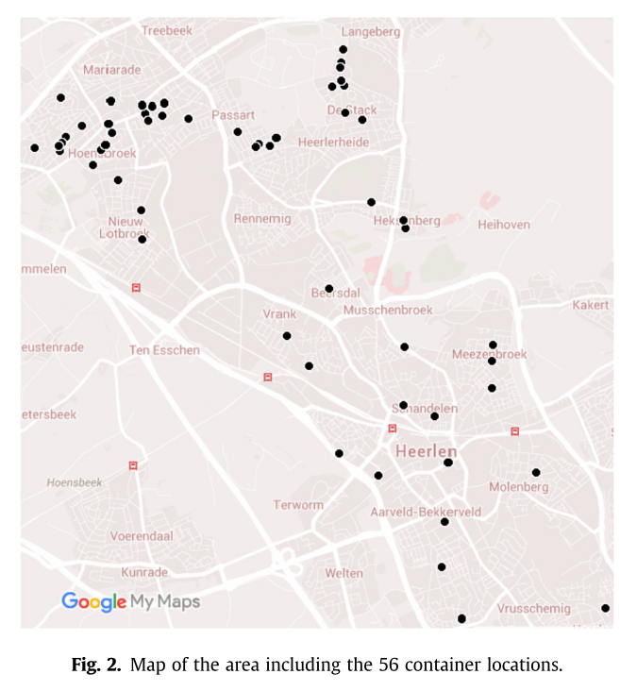
The message reads “Found by law enforcement. Fine: at least 90 euros.

Slide 20
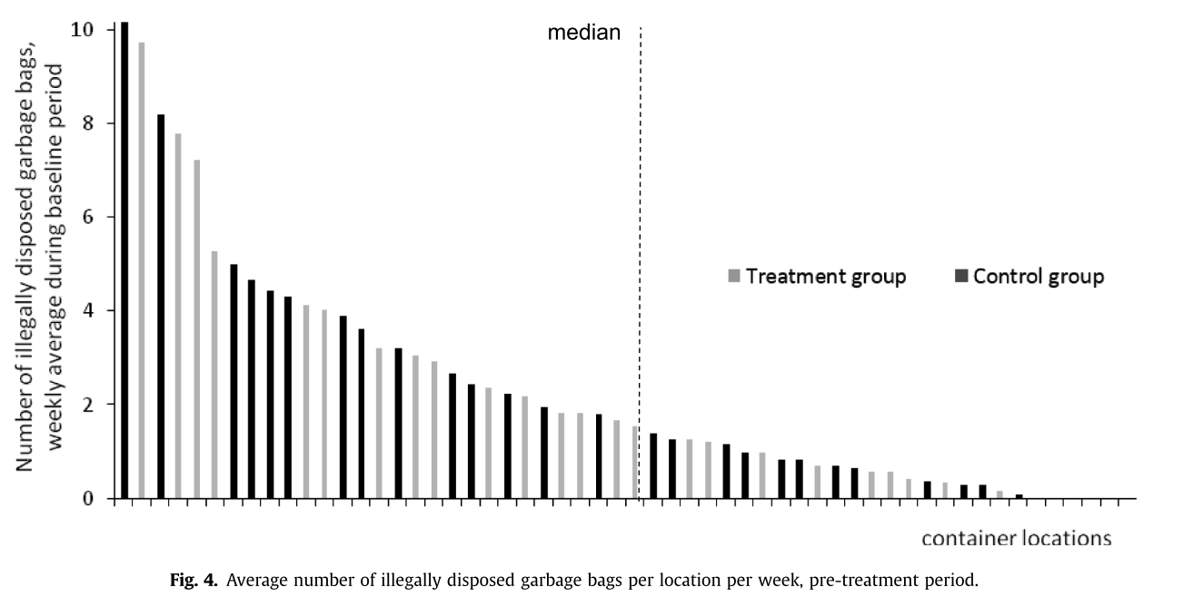
DUR And Vollaard – rCT on waste disposal enforcement

Slide 21
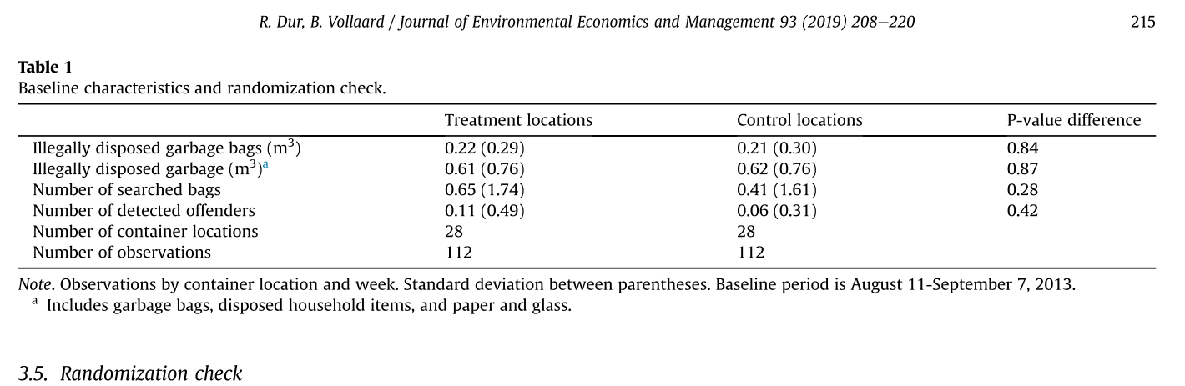
DUR And Vollaard – rCT on waste disposal enforcement

Slide 22
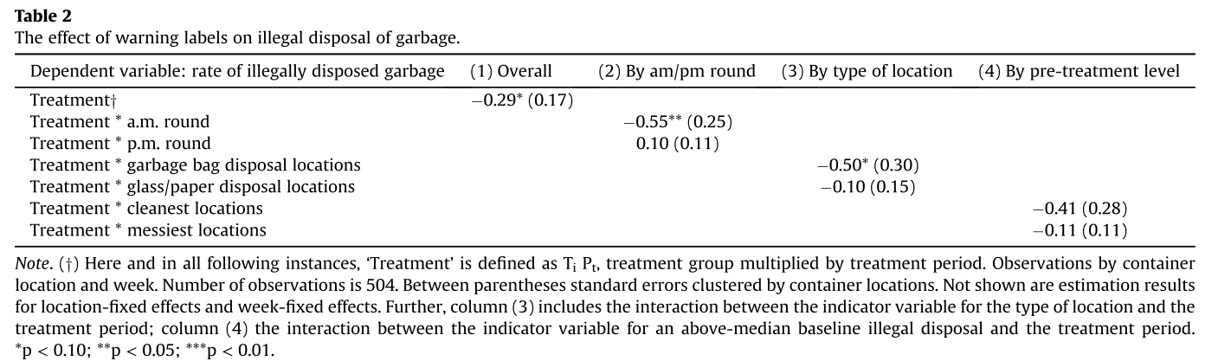
DUR And Vollaard – rCT on waste disposal enforcement

Slide 23
Levitt – Using police hiring during electoral cycles
Steven Levitt is a creative economist known for his “Freakonomics” books.
He is famous for this early study of the effects of police on crime.
Levitt wanted to try to break the endogeneity loop, where crime affects allocation of police, by leveraging the fact that more police are hired during electoral cycles, before mayoral/municipal and gubernatorial elections.
If this increase in policing is quasi-random and not endogenous, then it provides useful treatment variation to isolate the effect of police on crime, while ignoring the back channel of crime affecting the allocation of police.

Slide 24
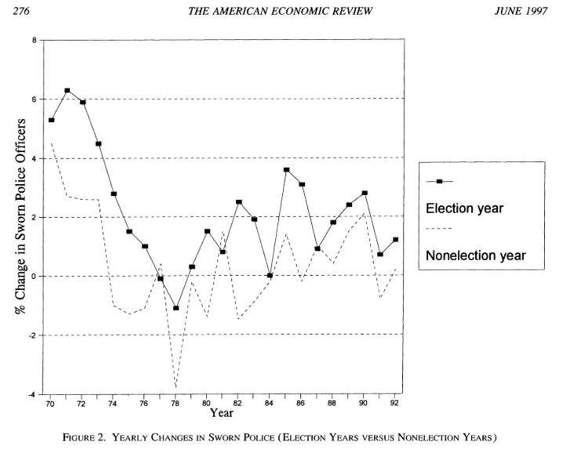
Levitt – Using police hiring during electoral cycles
It does seem to be the case that police hiring increases during election years!

Slide 25
Levitt – Using police hiring during electoral cycles
The technique is called “instrumental variables”.
The idea is to find an instrumental variable (an IV) that is related to your X variable (# of police) but is only related to your Y variable (crime) through it effect of the IV on X.
I.e. the IV cannot have an independent effect on Y.
The IV can only affect Y through X.

Slide 26
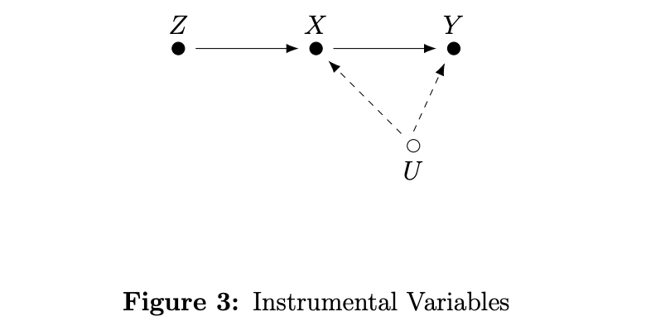
Levitt – Using police hiring during electoral cycles
This is a directed acyclic graph (DAG),
Z = the IV (electoral cycles)
X = # of Police
Y = Crime
U = confounding factor
In this case, we should also have an arrow flowing from Y to X

Slide 27
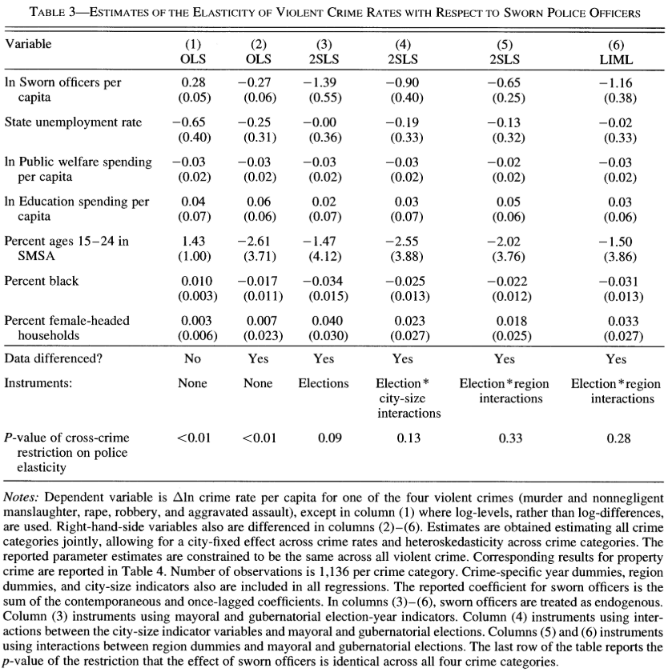
The main estimates are in columns (3) to (6).
These use the IV approach.
Columns (1) and (2) just estimate the general effect of police on crime, without using the instrumental variable.
We are concerned that the estimates from (1) and (2) are biased due to endogeneity.
Using IV makes the estimate much more negative -> police have a big effect on reducing crime.

Slide 28
Levitt – Using police hiring during electoral cycles
Levitt finds that the increase in police hiring during electoral cycles is associated with a substantial reduction in violent crime.
The impacts on property crime as smaller.

Slide 29
Sullivan and O’Keeffe – NYC police go on “strike”
In 2014-2015, like now, there was intense political discussions around police brutality, racism, violent protests, and how policing policy should be changed.
NYPD stopped proactive policing (systematic and aggressive enforcement of low-level violations) in late 2014 to early 2015.
This was a “work slowdown” for seven weeks to try to show how valuable NYPD was.
(Narrator: they did not show this.)
This is a great paper to study what the effects of proactive policing are. Should we believe the “broken window” theory, or is the narrative that proactive policing increases criminality correct?

Slide 30
Sullivan and O’Keeffe – NYC police go on “strike”
The researchers compare crime before, during, and after this “work slowdown” to crime levels during the same time of the year in a prior year.
This is like a DiD, so it comes down to if the seasonal pattern in crime would have been the same in May 2013 to May 2014 (control) compared to May 2014 to May 2015 (treated) had “treatment” not occurred.
Key results.
The figures I’ll show you -> the work slowdown did reduce proactive policing.
The table I’ll show you -> this seems to have caused a decrease in complaints of more serious crimes.

Slide 31
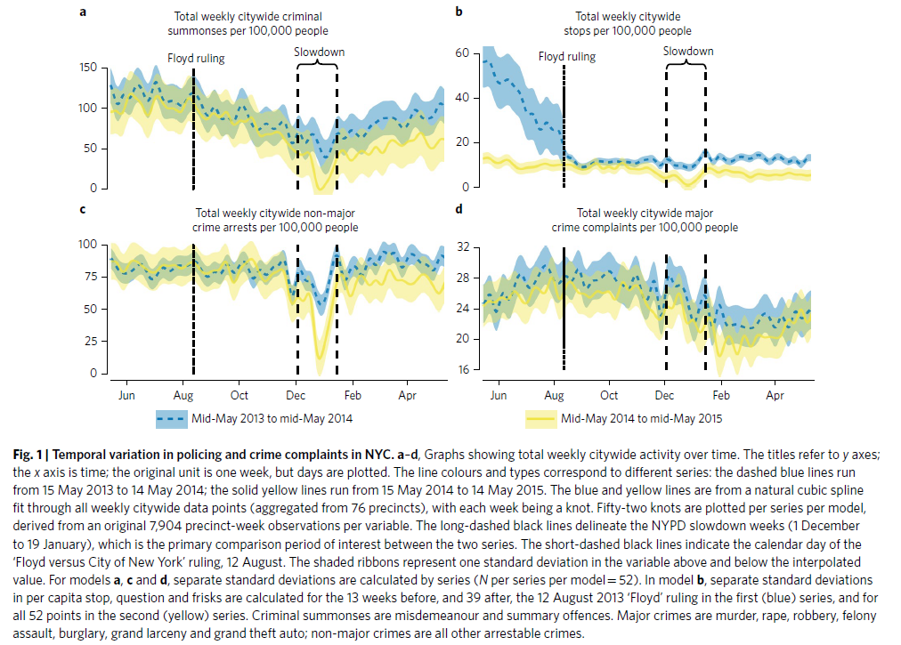

Slide 32
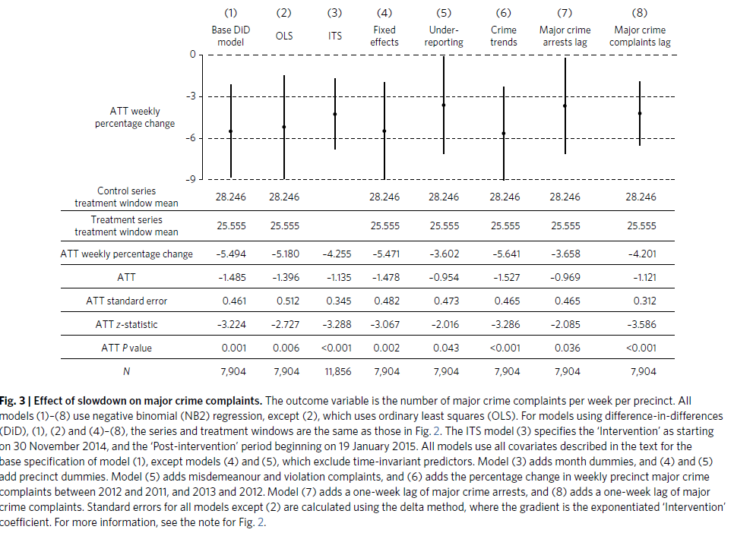

Slide 33
Comparing – External validity
An important way to compare these studies is based on external validity.
Do they tell us about policing or police policy more broadly?
Or are they very specific case studies that are only externally valid for similar cases?
How broadly can be apply the lessons learned from this paper?

Slide 34
Comparing – External validity
My hot take is that the papers can be sorted in this way, from most externally valid to least externally valid:
Levitt (uses variation that tells us about the effects of police in general, uses a national set of data)
Sullivan and O’Keeffe (only issue is that it’s NYC only, and NYC could be unique)
Cheng and Long (NOLA is rather unique, as is the FQ)
Di Tella and Schargrodsky (this isn’t policing so much as armed guards outside synagogues)
Dur and Vollaard (it’s basically a case study of trash enforcement practices in a western European city)

Slide 35
Comparing – exogeneity
Another important way to compare these papers is in terms of how exogenous the treatment variation is.
Was the variation in police or policy random? Close to random? Or could it have been endogenous to something?
Cheng and Long – FQ Task Force – For this paper it comes down to the parallel trends assumption since this is a DiD.
E.g., were pre-existing time trends in the FQ similar to those in the control group neighborhoods?
Were any other changes going on that differentially impacted one neighborhood over others over time?
It’s a big subjective as to if the assumption holds or not.

Slide 36
Comparing – exogeneity
Di Tella and Schargrodsky – Terrorist Attack
This paper leverages a fairly random event – a terrorist attack.
The terrorist attack led to the gov’t adding police outside of synagogues.
This is a DiD study, so the parallel trends assumption is important again.
The “treatment” here is likely exogenous to LOCAL crime trends in those neighborhoods.
So, I don’t have concerns that blocks adjacent to a synagogue and blocks just a bit further away, for example, had different trends in crime.
Seems like a pretty good “natural experiment”.

Slide 37
Comparing – exogeneity
Dur and Vollaard – Trash Enforcement RCT
This is a randomized control trial (RCT), i.e. an experiment, that seems well done (e.g., properly randomized).
This paper uses the most exogeneous treatment variation for that reason.

Slide 38
Comparing – exogeneity
Levitt – More police hired before elections.
Levitt exploits the fact that more police were hired before mayoral/municipal elections.
To some extent, this hiring is exogenous, since it is related to electoral cycles.
However, the increase in hiring due to an electoral cycle could vary in an endogenous way.
E.g., pre-election hiring increases more in higher crime areas? In red states? Etc…
Given this, while Levitt may use treatment variation that is more exogenous then more naïve approaches, there are still some concerns.

Slide 39
Comparing – exogeneity
Sullivan and O’Keeffe – NYC police strike and effect on serious crime
NYPD had a seven week “work slowdown”, where proactive policing was reduced.
The researchers compare crime before, during, and after this “work slowdown” to crime levels during the same time of the year in a prior year.
This is like a DiD, so it comes down to if the seasonal pattern in crime would have been the same in May 2013 to May 2014 (control) compared to May 2014 to May 2015 (treated) had “treatment” not occurred.
Was the seasonal pattern and trend in crime the same in May 2013 to May 2014 as it would have been in May 2014 to May 2015, absent the work slowdown?
Seems relatively likely and the figures show similar trends, with the effects during the work slowdowns being clear outliers.
Generally seems exogeneous.

Slide 40
Comparing - exogeneity
My hot take is that the papers fall in this range from most exogeneous to least:
Dur and Voollaard (it’s an RCT!)
Di Tella and Schargrodsky
Sullivan and O’Keeffe
Cheng and Long (to be clear, this paper maybe only has mild concerns)
Levitt (there are endogeneity concerns and other economists have brought this up)

