Slide 1
The Economics of Crime
Econ 3320 – Urban economics
Tulane university
Professor HUSSAIN HADAH

Slide 2
Announcements
1. Quiz 2 grading is done. There is a modules page that discusses this quiz.
Average score = 86% (range of 30% to 100%)
Let me know if you have any questions after you review the modules page and your answers.
Some discussion of Question 4:
“Suppose you were interested in quantifying the agglomeration spillovers from Amazon HQ2. You decide to use the GHM paper as an example of how you could quantify the agglomeration spillovers from HQ2. Describe the approach you would use, namely how you'd determine the treatment group, how you would select control groups (and why), and what the parallel trends assumption would be in your study. ”

Slide 3
Discussion of Amazon HQ2 Activities
Here is some discussion of possible answers.
This discussion is going to go FAR more in depth then I would every expect you do go, but I wanted to highlight some of the trade offs researchers could face as they decide on a proper control group.

Slide 4
Discussion of Amazon HQ2 Activities
Control groups you mentioned:
Use Long Island/Queens as control group, since Amazon ended up not going there at the last minute.
Some of you suggested excluding Long Island/Queens from the study entirely. This only makes sense if we think that Amazon pulling own is “endogenous” to (i.e. caused by) our outcome variable (productivity). E.g., economic growth in Long Islands/Queens doesn’t seem as good as was projected.
If Amazon pulling out is more random (so “exogenous”) this it provides a good “natural experiment”.
I think the later (more “exogenous”) over the former but it depends on the circumstances.

Slide 5
Discussion of Amazon HQ2 Activities
Control groups you mentioned:
Use Long Island/Queens as control group, since Amazon ended up not going there at the last minute.
Assuming the choice to pull out creates a good natural experiment, then this is probably a good control group, similar to GHM, perhaps even better than what they do since Long Island/Queens isn’t really a “runner up”.
A con of using this as a control group, though is that it only gives us one control group. This can reduce statistical power to detect effects (e.g., if you had more control groups, random noise would get smoothed out more).

Slide 6
Discussion of Amazon HQ2 Activities
Control groups you mentioned:
Use the 20 or so finalist cities as control groups.
Pro: increases statistical power by smoothing out more noise in the data
Pro: having more possible control groups essentially allows you to construct a control group that better matches pre-trends.
This makes the parallel trends assumption more likely to hold, but again there is no way to test if it holds or guarantee that it holds.
Con: If we think that the winner is much different in terms of productivity trends than these finalists, the it’s less likely that the parallel trends assumption holds.
(Note that it is also possible to try both control groups, or add the Long Island control group in with these other 20 or so control cities.)

Slide 7
Synthetic Control Introduction
A popular technique to make a better control group in a difference-in-differences study is “synthetic control”.
The idea is to create a control group from a set of possible control groups.
The control group you make is a weighted combination of the other control groups, with the weights selected such that the control group best matches the treated group in pre-trends.
So, if the treated metro area is DC, then synthetic control creates a “synthetic DC” which matches actual DC in the pre-period, but is instead made up of a combination of control cities.

Slide 8
Example of a Synthetic Control Study
Here is an example. You’ll find that synthetic control is easier to understand when you see it in a figure.
In a 2017 paper in Regional Science and Urban Economics, Castillo et al. study the effects of a tourism development campaign in the Argentinian province of Salta.
They compare Salta pre and post the tourism campaign to a “synthetic Salta” which is made up of a combination of other provinces that didn’t get the tourism campaign.

Slide 9
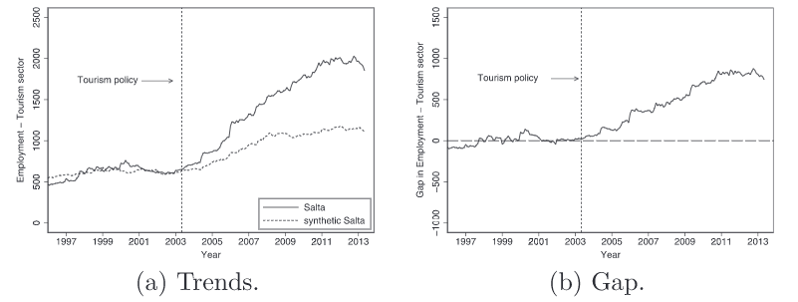
Y-axis = employment in the tourism sector (outcome variable)
Left of the dashed vertical line = pre-period
“Synthetic Salta” (dashed series) is a combination of control provinces that best matches the pre-trend of Salta, which you can visually see.
You can see the treatment effect as the divergence in the post-period

Slide 10
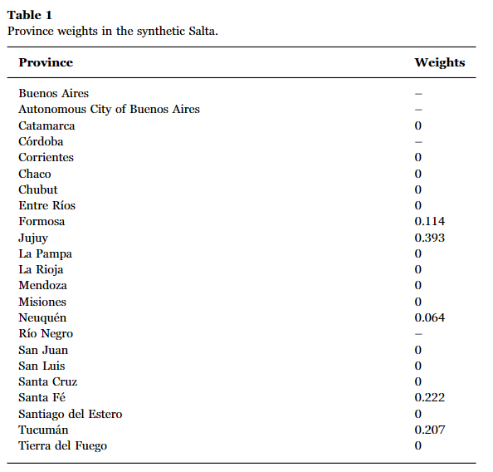
The combination of control provinces that best matches Salta’s pre-trend is:
39.3% Jujuy
22.2% Santa Fe
20.7% Tucuman
11.4% Formosa
6.4% Neuquen

Slide 11
Discussion of Amazon HQ2 Activities
Control groups you mentioned:
Use an area near the winner (e.g., bordering city/county)
Pro: that area may have a similar productivity trend, so may be more likely that the parallel trends assumption holds.
Con: it’s likely that neighboring areas get spillover effects too, albeit smaller. This makes your “control” group partially treated, causing you to understate the spillovers since the control group gets some of those as well.
For this reason I wasn’t a fan of this option, but only applied a small penalty.

Slide 12
Discussion of Amazon HQ2 Activities
Control groups you mentioned:
Specifically selecting a control group that matches the pre-trend
Pro: if the treatment and control group(s) match in pre-trends (e.g., productivity trends before the Amazon HQ2 moves in), then it’s more likely (but not guaranteed) that the parallel trends assumption holds.
This approach of selecting control groups this way is rising in popularity and is the idea behind a technique called “synthetic control” which is a version of DiD.
Intuitively, if you have a pool of possible control groups (e.g., the 20 finalist cities), you construct your control group to be a combination of those control groups that best matches the pre-trend of the treatment group.

Slide 13
Announcements
2. I commented on your Wiki ideas that you submitted on Sept. 26. If you want more feedback or have questions, then shoot me an email!
3. Make-up class is asynchronous; no class on Saturday: You may recall that due to the hurricane, one of our classes was cancelled. The university designated our make-up class day to be Sunday Oct. 11. Instead of having us do a synchronous class that day, I am going to do an asynchronous “class” later which will be me recording a video that discusses the plan for the final, tips for studying for the final, and the general style and topics covered. I usually do this as one of the last classes of the semester, but in this case I’ll have it by asynchronously and we’ll do a different activity as your final exam review.

Slide 14
Announcements
4. Midterm grades
I will calculate and submit these shortly.
It’s hard to estimate those since you get to drop at least two quizzes, one briefing note, and three other activities. You can also submit most things late.
Therefore, as a rough approximation (perhaps an overestimate), I am calculating your midterm grade as:
0.75*highest quiz score out of 100 + 0.25*100

Slide 15
Announcements
5. Plan for Friday
See the modules page I made for more information.
You are assigned one paper to read before this class (see modules page).
Jigsaw activity on the effect of police on crime (entire class time)
First grouping -> everyone in your group read the same paper.
Paper assignments are on Canvas as a modules page
You work with your group to submit answers to a few questions about your paper
Second grouping -> everyone in your group read a different paper.
You each summarize it for each other.
Then you work together to answer some questions that compare and contrast the papers.

Slide 16
Announcements
6. Quiz 3 is on Oct. 19 + Upcoming classes
Save the date!
This quiz will occur after we have finished the crime module, which includes:
An introduction to the Economics of Crime (today!)
Measuring the effects of police on crime – jigsaw activity (Friday)
Measuring the effects of police on crime – lecture (Monday Oct. 12)
Measuring the effects of economic circumstances on crime (Wednesday Oct. 14)
COVID-19 and crime (Friday Oct. 16)
Quiz 3 (Monday Oct. 19)

Slide 17
Issues: Endogeneity
Suppose you were to compare areas/cities with more police officers to areas/cities with fewer officers to see how crime differs.
Do the areas/cities with more officers have less crime?
But the number of police officers is endogenous to crime.
Endogenous since crime affects the number of police officers, but police officers affect crime.
E.g., police officers allocated to high crime areas.
Increases in crime prompt the hiring of additional officers.
Crime
Police

Slide 18
Issues: Endogeneity
Suppose you were to do this comparison anyways…
Suppose you were to compare areas/cities with more police officers to areas/cities with fewer officers to see how crime differs.
Do the areas/cities with more officers have less crime?
Do you think that by doing this comparison you would overestimate or underestimate the effect of police on reducing crime?
Crime
Police

Slide 19
Issues: Endogeneity
Suppose you were to compare areas/cities with more police officers to areas/cities with fewer officers to see how crime differs.
…
This would probably underestimate the effect of police on crime, perhaps showing incorrectly that they increase crime, or that their effect on crime reduction is smaller than it actually is.
Estimates would be negatively biased.
Why?
Crime
Police

Slide 20
Issues: Endogeneity
Estimates would be negatively biased.
Why?
Since police are allocated to places with higher crime rates, or more police are deployed when crime increases, there is going to be a positive correlation between the two.
Mistaking that for a causal relationship will bias the estimate.
We have to break this endogeneity loop!
Crime
Police

Slide 21
Ideal Fix: Randomization
The ideal way to investigate the effect of police on crime would be to randomly allocate areas/cities with more/fewer police officers.
Likely not possible…
Is there a way that police are allocated that is “quasi-random”?
Is there a natural experiment?
Or, phrased another way, is there a way that police were allocated that was independent from the crime level (i.e. Is there a case where police officers were not allocated based on crime levels?)

Slide 22
Empirical studies on how police affect crime
In this course we will cover some neat empirical research articles that investigate how police affect crime using different experimental or “quasi-experimental” methods.
Levitt, Steven D. 1997. “Using Electoral Cycles in Police Hiring to Estimate the Effect of Police on
Crime.” American Economic Review, 87(3): 270–290.
Sullivan, Christopher M, and Zachary P. O’Keeffe. 2017. “Evidence that curtailing proactive
policing can reduce major crime.” Nature Human Behaviour, 1(10): 730–737.
Tella, Rafael Di, and Ernesto Schargrodsky. 2004. “Do Police Reduce Crime? Estimate Using the
Allocation of Police Forces after a Terrorist Attack.” American Economic Review, 94(1): 115–133.
Dur, Robert, and Ben Vollaard. 2019. “Salience of law enforcement: A field experiment.” Journal
of Environmental Economics and Management, 93: 208–220.
Cheng, Cheng, and Wei Long. 2018. “Improving police services: Evidence from the French quarter
task force.” Journal of Public Economics, 164: 1–18.

