Slide 1
Industry Team 5
Comparative Analysis of LLMs: Performance vs. Cost

Slide 2
Text-based output analysis
MODEL | USE CASE | OTHER FEATURES
OpenAI (GPT-4.1 / GPT-5 family) | Highest reasoning & accuracy (choose if errors have consequences) | Strong instruction following + structured outputs High-stakes text where accuracy > cost.
Anthropic (Claude 3.5+) | Safety-critical & policy-heavy text | Excellent context retention. Weaker than OpenAI on abstract reasoning
Google Gemini | Search-grounded & factual answers | Large context window. Less creative. Supports correctness + scale.
Meta LLaMA 3 | Open-source / on-prem control | Highly customizable but requires ML infrastructure. Best for enterprises needing data control.
Mistral | Cost-efficient EU-hosted option | Strong multilingual support but smaller ecosystem.
xAI Grok | Real-time & social-trend aware | Not ideal for formal or regulated outputs

Slide 3
Price Comparison ref: https://university.mindstudio.ai/docs/usage-pricing-reference?utm_source=chatgpt.com /
https://countless.dev/
Input tokens: prompts and context sent to model
Output tokens: text generated by model
Output tokens usually cost 3–5x more
USE CASE | MODEL | $ per 1M Tokens | BEST FOR
High-performance commercial models ie., high-value tasks only | OpenAI GPT-4o and Claude Opus | $90 I.e., strongest reasoning/quality but also attract significantly higher costs | Legal, compliance, high-risk decisions
Balanced quality & cost models i.e., production applications where quality and cost balance matters. | OpenAI GPT-4.1 and Anthropic Claude Standard | ~$10–18 | Enterprise workflows
Low-cost, high-volume options | Gemini Flash/Lite and Anthropic Claude Haiku | ~$0.5–5 | Summarization and extraction
Self-hosted / Open-source alternatives | Models like LLaMA on own infrastructure | Cheapest | Regulated or cost-sensitive environment

Slide 4
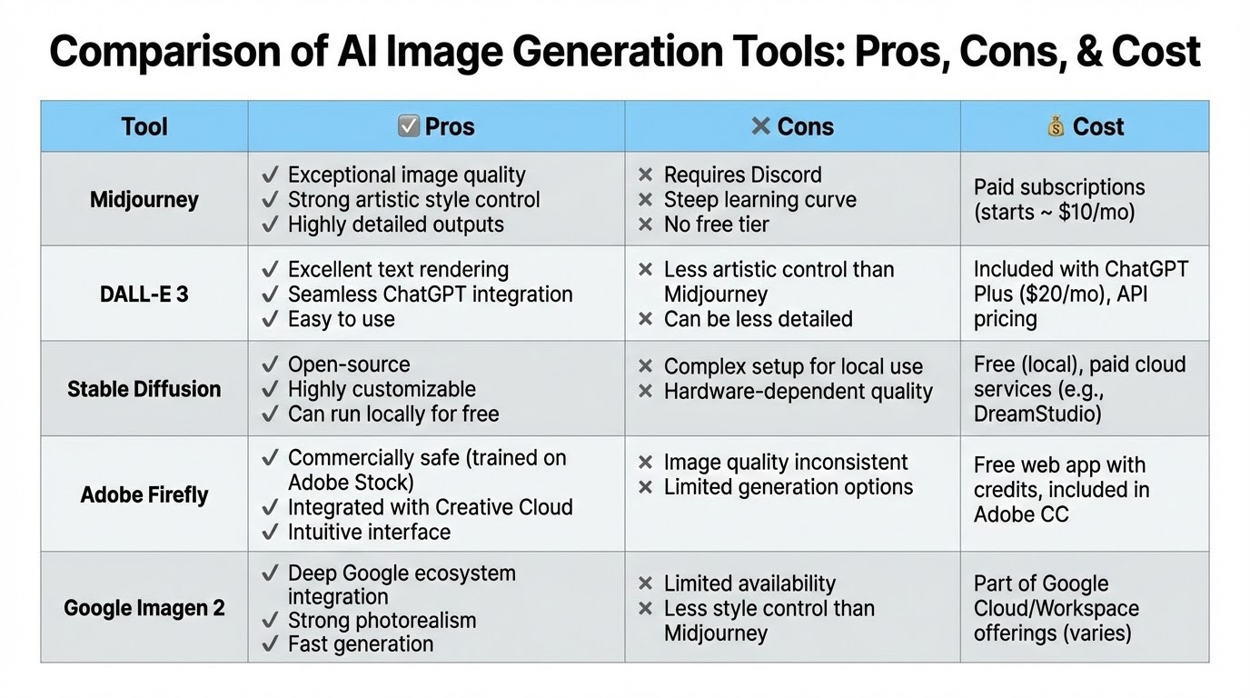

Slide 5
Workflow Integration: Editing & Ecosystem(Images)
In-Painting (The "Fix It" Feature)
Adobe Firefly: Industry Leader. Integrated directly into Photoshop. Select an area and type "remove person" or "add sunglasses."
DALL-E 3: Conversational. You ask ChatGPT, "Make the cat blue instead," but it often regenerates the entire image, losing the original composition.
Midjourney: Region Vary. Allows re-rolling specific parts of the image, but requires technical UI navigation (Discord/Web).
Consistency (Character Reference)
Midjourney & Flux: Strong. Can use a reference image to keep the same character face across different scenes.
DALL-E 3 & Firefly: Weaker. struggles to maintain exact character identity between generated shots.
Ecosystem Fit
Copilot/Gemini: Best for inserting images directly into slides/docs.
Midjourney: Standalone tool (Disruptive to workflow).
Firefly: Native to Creative Cloud (Seamless for designers).

Slide 6
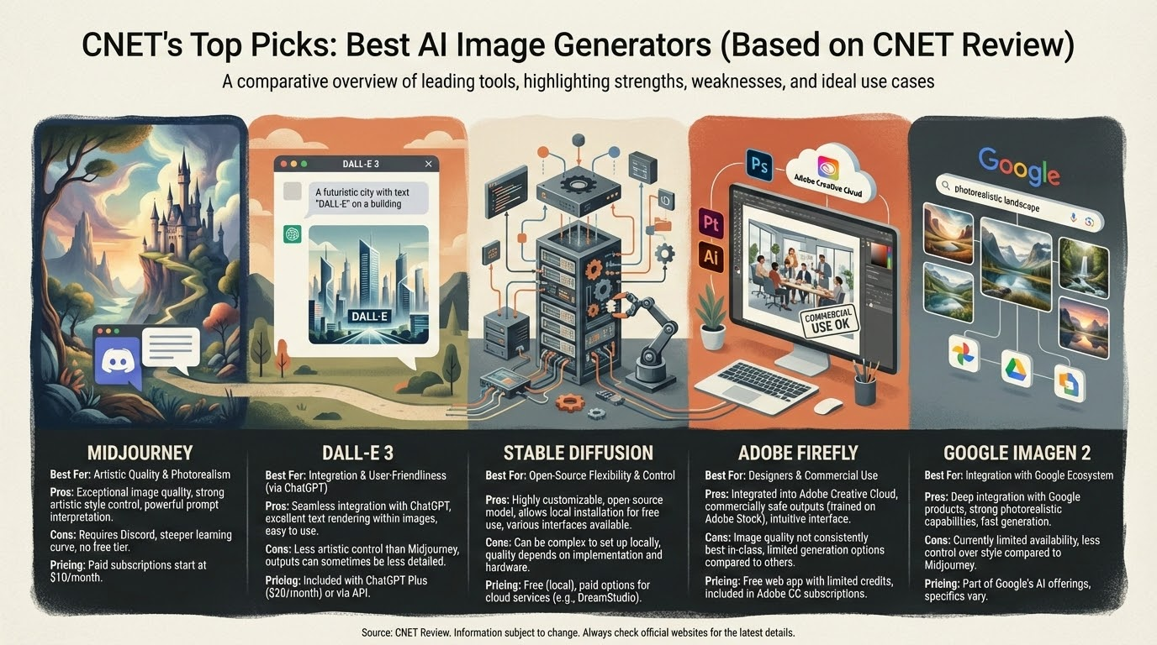

Slide 7
AI Video Generator Analysis
Reference: https://massive.io/gear-guides/the-best-ai-video-generator-comparison/
Same text prompt used across all tools to ensure fair comparison.
Tools and models covered:
  Kling (Kling 01, Kling 2.6)
  Runway(Runway Gen 4.5),
  Google (Veo 3.1)
  OpenAI (Sora 2)
  Pika (Pika 2.5)
  Adobe (Firefly video model)
  Hailuo (Minimax 2.3)
  Luma Labs (Ray3, Ray3 HDR)
  Vidu (Vidu Q2)
  ByteDance (Seedance V1 Pro)
Tools and their models were compared based on
  Accuracy: How many errors are in the video?
  Realism: Does it look real?
  Consistency: How closely does it follow the prompt?
  Creativity: Does it look interesting?
  Cost Point
  Text to video, image to video conversations
  Video length and resolution
  Sound Generation

Slide 8
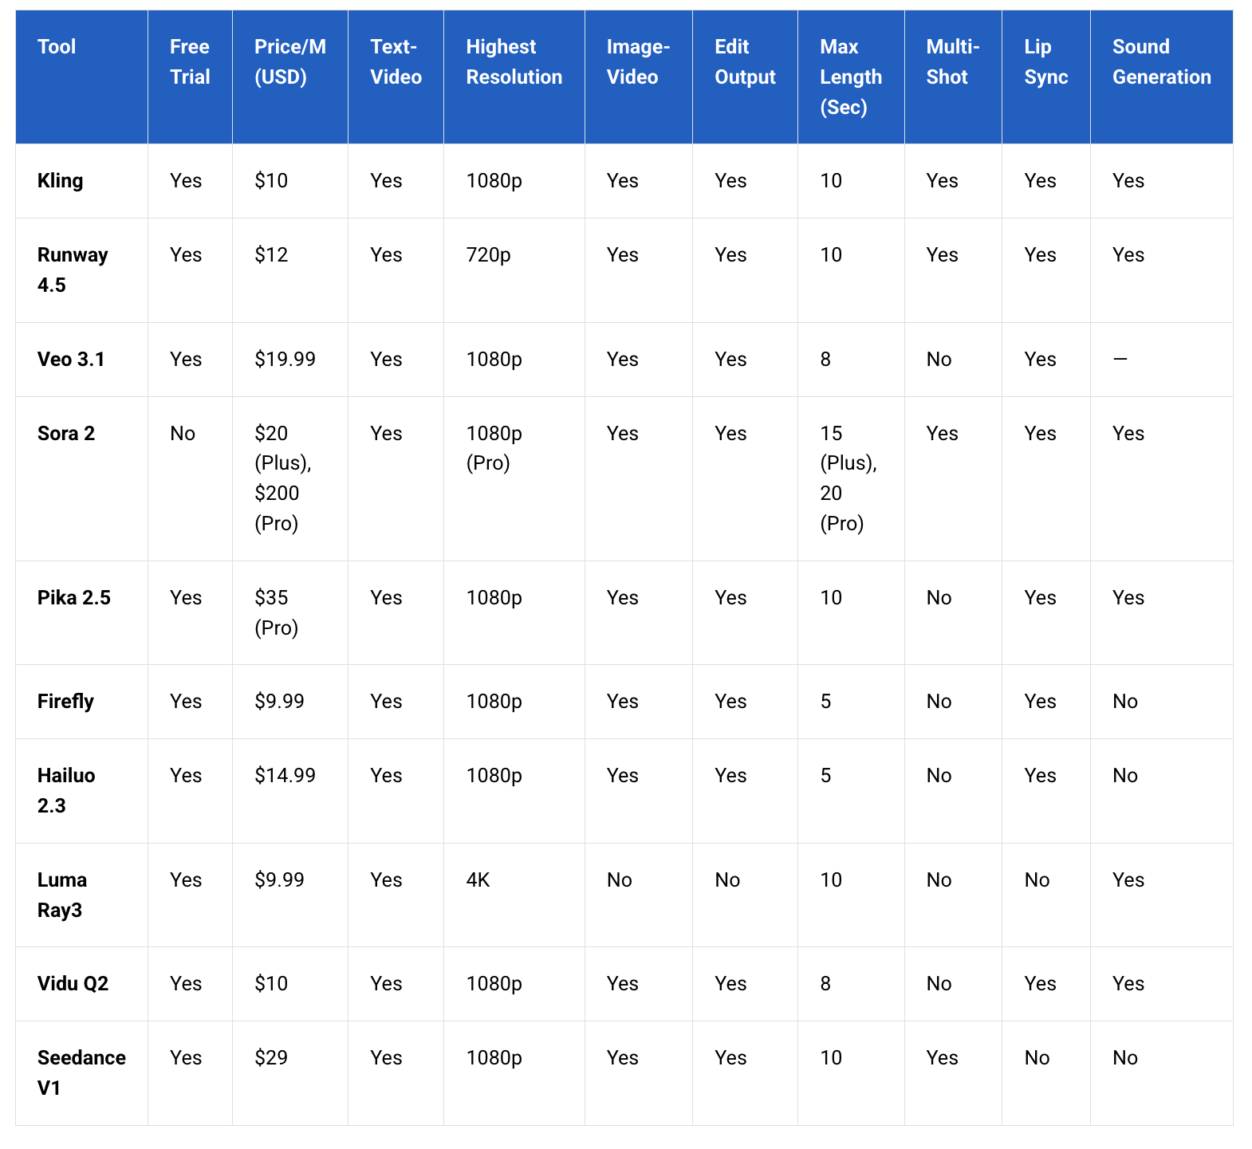
Most cost-effective models
Kling 01 (~$10/month)
LumaRay3 / Ray3HDR($9.99/mon)
Hailuo 2.3 (~$14.99/month)
Most accurate & realistic models
Kling 01: Most balanced realistic model.
Google Veo 3.1: Technically strong but not perfect realism.
Pika 2.5: Realistic visuals but weaker prompt accuracy.
Creative but weaker realism models
Runway Gen 4.5: Good for innovation, not realistic.
Sora 2: Creative but realism gap.
Weakest models
Adobe Firefly: lower visual quality
Vidu Q2: faulty and weakest output.
Seedance V1 Pro: weakest realism
Overall best-rated models models
Luma Ray3 HDR → Most visually stunning, true 4K HDR cinematic output.
Kling 01 → Best balance of accuracy, realism, and prompt consistency.
Pika 2.5 → Very realistic lighting, reflections, and textures.

Slide 9
