Slide 1




Zurich University, 11 April 2007

Slide 2


A secret sharing scheme is a method of dividing a secret S among a finite set of participants.
only certain pre-specified subsets of participants can recover the secret(Qualified subsets).

Slide 3

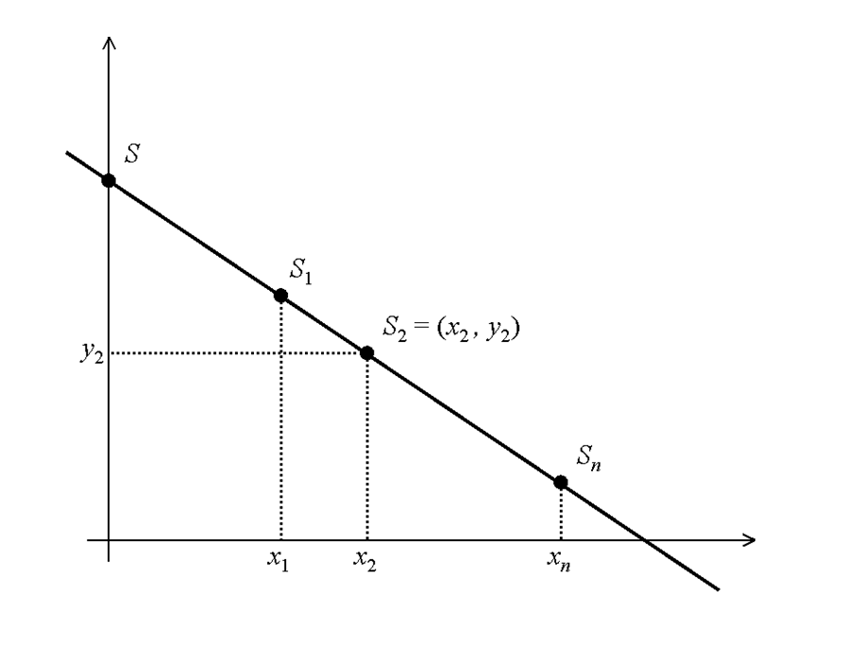

Slide 4

Let P={1,..,n} be a set of elements called participants.
2^P denote the set of all subsets of P .
Q: members of qualified sets.
F : members of forbidden sets.
Q⊆ 2^P and F⊆ 2^P , Q ∩ F=∅.
Γ=(Q ,F) is called the access structure of the schemes.
Γ_0 : Call all the minimal qualified sets of Γ basis for access structure Γ and show them by Γ_0:
Γ_0={A∈ Q : B ∉Q for all B⊂ A, B≠A}.

Slide 5

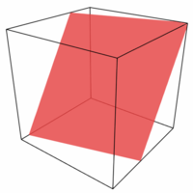
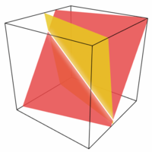
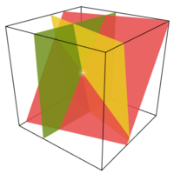
A secret sharing scheme is perfect if all authorized subsets can reconstruct the secret but no other subset can determine any information about the secret.
This scheme is not perfect!

Slide 6

Secret s for the (k, n)-threshold
Consider a finite field GF(q) where q≥n+1.
Choose a secret key s from GF(q) .
Randomly choose m₁, m₂,…, m_{k-1} from GF(q),
Freely choose distinct x_{i} (1≤i≤n).
Give to person i Secret share (x_{i}, F(x_{i})) for all (1≤i≤n).

Slide 7




Slide 8

  Secret Image: The Secret consists of a collection of black and white pixels.
  Share: Secret image encode into n shadow images in the form of the transparencies, called shares, where each participant receives one share.
  Subpixel: Each pixel is divided into a certain number of subpixels.

Slide 9

+
→
+
→
+
→
+
→

Slide 10


2 out of 2
Shares
#1 #2
Superposition of
the two shares
Pixel
Probability
White
Pixels
Black
Pixels

Slide 11



(0,1,0,1,0)
(1,1,0,0,1)
Sticking
(1,1,0,1,1)
[
0 1 0 1 0
1 1 0 0 1
]
Representation
with Matrix

Slide 12

    Pixel Matrix: An n×m Boolean matrix S=[Sij] where Sij=1 iff the j-th subpixel in the i-th transparency is black.
    Hamming weight w(V): The number of non-zero symbols in a symbol V. Since we are working with binary representation, Hamming weight V is the number of “1” bits in the binary sequence V.
V=(0,1,0,1,0)
w(V)=2

Slide 13

`
[
1 0
1 0
]
Pixel
Probability
Shares
#1 #2
Superposition of
the two shares
C_0
[
0 1 0 1
]
[
1 0
0 1
]
C_1
[
0 1
1 0
Same Matrices
with
Same Frequency
]

Slide 14

The number of sub-pixels that each pixel of the original image is encoded into on each transparency is termed pixel expansion.
The difference measure between a black and a white pixel in the reconstructed image is called contrast.
[
[
0 1 0 1
]
[
1 0 1 0
]
[
1 0 0 1
]
[
0 1 1 0
]
Expansion = 2
Contrast=(2-1)/2=0.5

Slide 15

Let Γ=(Q, F) be an access structure on a set of n participants. A Γ- VCS with expansion m and contrast α(m) consists of two collections of n×m matrices C_0 and C_1 such that:
For any qualified subset X={i_1,…,i_k} and A ε C_0, the or V of rows i_1,…,i_t of A satisfies w(V) ≤ t_X- α(m).m ; whereas, for any B ε C_1 it results that w(V) ≥ t_X.
For any non-qualified subset X={i_1,…,i_k}. The two collections of k×m matrices D_j, with j ε {0,1}, obtained by restricting each n×m matrix in C_j to rows i_1,…,i_k are indistinguishable in the sense that they contain the same matrices with the same frequencies.

Slide 16
[
0 1 0 1
]
[
1 0
1 0
]
X={1,2}, W(V)=1
D_0
C_0
X={1}
[
1 0
0 1
]
[
0 1
1 0
]
X={1,2}, W(V)=2
D_1
C_1

Slide 17

Let Γ=(Q, F) be an access structure on a set of n participants. A basis for Γ- VCS with expansion m and contrast α(m) consists of two matrices C^0 and C^1 such that:
For any qualified subset X={i_1,…,i_k}, the or V of rows i_1,…,i_t of C^0 satisfies w(V) ≤ t_X- α(m).m ; whereas, for C^1 it results that w(V) ≥ t_X.
For any non-qualified subset X={i_1,…,i_k}. The two k×m matrices D^j, with j ε {0,1}, obtained by restricting rows i_1,…,i_k to C^j are equal up to a permutation of columns.

Slide 18

{1} {2} {3} {1,2,3}
{ } {1,2} {1,3} {2,3}
C^1=
[
0 0 1
0 1 0 1
0 0 1 1
]
C^0=
[
0 1 1 0
0 1 0 1
0 0 1 1
]
C_1={A: A is a permutation column of C^1}
C_0={B: B is a permutation column of C^0}

Slide 19

There is a k out of k scheme with expansion 2^{k-1} and
contrast α=2^{-k+1}.
In any k out of k scheme m≥2^{k-1} and α≤2^{1-k}.
For any n and k, there is a k out of n VCS with
m=log n 2^{O(klog k)}, α=2^{Ώ(k)}.

Slide 20

Question: Let Γ be a access structure. Is there an
Γ-VCS?
Note that if there exists an Γ-VCS then Γ should be monotone.
Theorem: Let Γ =(Q,F) be a monotone access structure where F=Q, and let Z_M be the family of maximal forbidden sets in F. Then there exists a Γ-VCS with expansion less than or equal to
2^(|Z_M|-1).

Slide 21

Let Γ =(Q,F) be a monotone access structure with n participants where F is complement of Q. Also, let F_1,… , F_t be maximal forbidden sets in F.
Let S^0 and S^1 be basis of white matrix and black matrix of t out of t VCS, respectively.
Construct n×2^(t-1) white basis matrix C^0 and black basis matrix C^1 of Γ as follows:
For any participant i, set the i-th row of C^0 be the or of rows i_1,…,i_s of S^0 that i_1,…,i_s are rows of S^0 where for any 1≤j≤s, “i’’ is not member of F_(i_j).
Similarly, construct C^1.

Slide 22
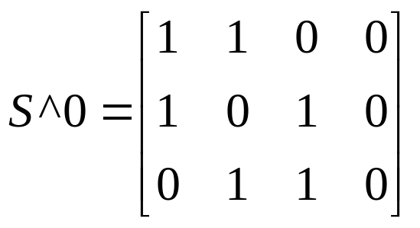
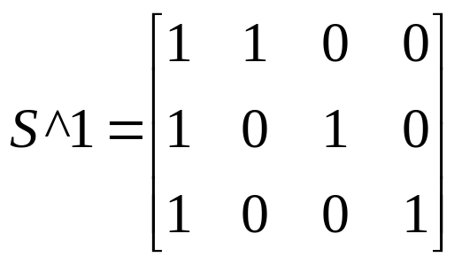
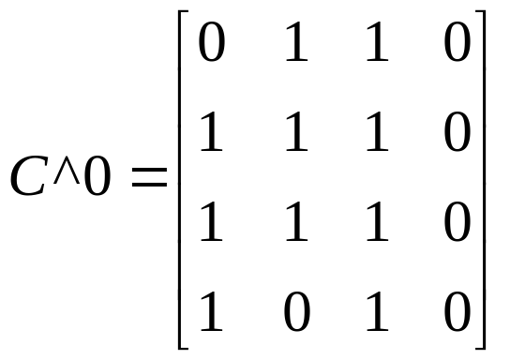
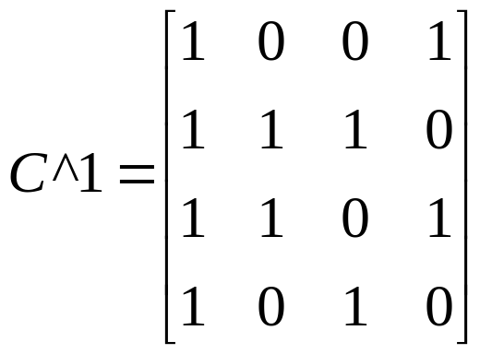
Example: Let P={1, 2, 3, 4}, Γ_0={{1, 2}, {2, 3}, {3, 4}}, and Z_M={{1, 4}, {1, 3}, {2, 4}}. Hence,

Slide 23

Color of Secret
Let Γ=(Q, F) be an access structure on a set of n participants. A Γ- VCS with expansion m and contrast α(m) consists of two collections of n×m matrices C_0 and C_1 such that:
For any qualified subset X={i_1,…,i_k} and A ε C_0, the or V of rows i_1,…,i_t of A satisfies w(V) = t_X; whereas,
For any non-qualified subset X={i_1,…,i_k}. The two collections of k×m matrices D_j, with j ε {0,1}, obtained by restricting each n×m matrix in C_j to rows i_1,…,i_k are indistinguishable in the sense that they contain the same matrices with the same frequencies.
for any B ε C_1 it results that w(V) ≥ t_X-α(m).m
or
for any B ε C_1 w(V) ≤t_X- α(m).m.

Slide 24

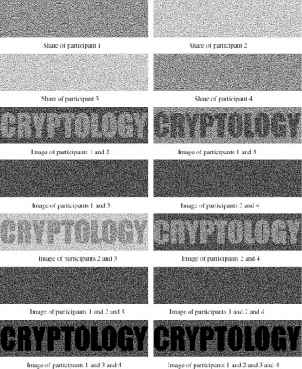

Slide 25

In 1998, S. Droste introduced an extension of the visual cryptography. In fact, he has presented an extended VCS in which every combination of the transparencies can contain independent information.
In 2001, G. Ateniese, C. Blundo, A. Santis and
D.R. Stinson has introduced another version of extended visual cryptography in which every share have to be an image.

Slide 26
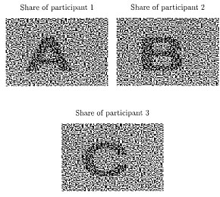
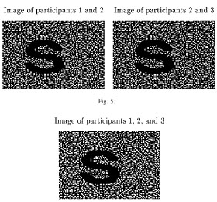

Slide 27



Slide 28
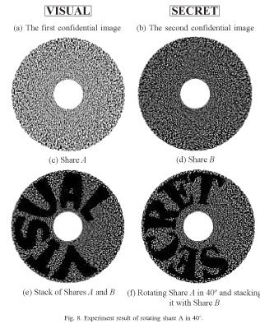

Slide 29


