Slide 1
Is it Possible to Evaluate the Quality of Scientific Journals?
Hossein Hajiabolhassan
Department of Mathematical Sciences Shahid Beheshti University faculties.sbu.ac.ir/~hhaji

Slide 2
Research
Innovation and Patent
Technology
Applied Research
Produce Products
Academic Publishing: Papers
The First Wave: Establishment of graduate programs (MS and Ph.D. Degrees)
The Second Wave: Learning to publish (A quantitative improvement)
The Third Wave: Learning how to publish high quality reserach (A qualitative improvement)
Questions: Non-Tenure-Track Faculty, Time!, Ph.D. Students!, Evaluation!

Slide 3
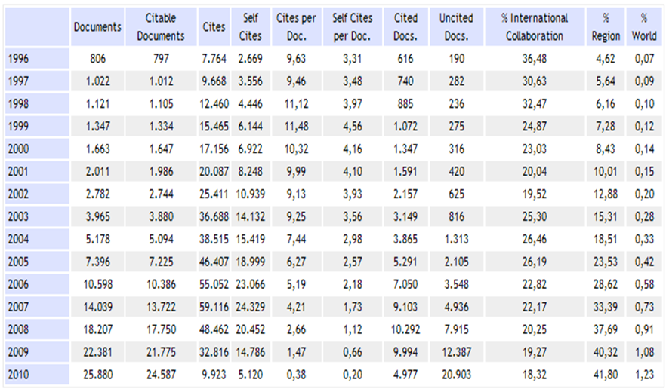
Iranian’s Articles
http://www.scimagojr.com/countrysearch.php?country=IR

Slide 4
Journal Ranking
Papers determine journal rankings, not vice versa. Although, journal ranking is widely used to evaluate the academic research. Hence, we need efficient methods to evaluate journals.
Evaluating research is difficult! “Not everything that counts is countable, and not everything that is countable counts.” (Albert Einstein, 1879 – 1955)
(Sign hanging in Einstein's office at Princeton)
but…
Is a partial portrait an invalid portrait?

Slide 5
Journal Ranking
Journal ranking is widely used in academic circles in the evaluation of an academic journal's impact and quality. Journal rankings are intended to reflect the place of a journal within its field, the relative difficulty of being published in that journal, and the prestige associated with it. This has been recently introduced as official research evaluation tools in some countries such as Australia, Denmark, Finland, France and Norway.
http://en.wikipedia.org/wiki/Journal_ranking

Slide 6

Times World University Rankings Top 400 Universities
Our rankings of the top universities across the globe employ 13 separate performance indicators designed to capture the full range of university activities, from teaching to research to knowledge transfer. These 13 elements are brought together into five headline categories, which are:
Teaching — the learning environment (worth 30 per cent of the overall ranking score)
Research — volume, income and reputation (worth 30 per cent)
Citations — research influence (worth 30 per cent)
Industry income — innovation (worth 2.5 per cent)
International outlook — staff, students and research (worth 7.5 per cent).
University ranking positions are primarily marketing tools, not research management tools
http://www.timeshighereducation.co.uk/world-university-rankings/

Slide 7

Jiao Tong University in Shanghai Top 500 Universities
Criteria | Indicator | Code | Weight
Quality of Education | Alumni of an institution winning Nobel Prizes and Fields Medals | Alumni | 10%
Quality of Faculty | Staff of an institution winning Nobel Prizes and Fields Medals | Award | 20%
 | Highly cited researchers in 21 broad subject categories | HiCi | 20%
Research Output | Articles published in Nature and Science | N&S | 20%
 | Articles indexed in Science Citation Index-expanded, and Social Science Citation Index | PUB | 20%
Per Capita Performance | Per capita academic performance of an institution | PCP | 10%
Total | 0 | 0 | 100%
University ranking positions are primarily marketing tools, not research management tools
http://www.universityrankings.ch/methodology/shanghai_jiao_tong

Slide 8





Journal Ranking
What is it?
Quality?
Prestige?
Approaches:
Metrics: IF, AI, SJR, SNIP, MCQ
Consensus: Denmark, Finland, Aust., & Norway Ranking
Do use scientometric data, but do it in a reasonable way!

Slide 9
BIBLIOMETRICS: Journal Ranking
Measures
Impact factor: Reflecting the average number of citations to articles published in science and social science journals.
h-index : Attempts to measure both the scientific productivity and the apparent scientific impact of an individual scientist.
Eigenfactor: A rating of the total importance of a scientific journal according to the number of incoming citations, with citations from highly ranked journals weighted to make a larger contribution to the eigenfactor than those from poorly ranked journals.
SCImago Journal Rank: A measure of scientific influence of scholarly journals that accounts for both the number of citations received by a journal and the importance or prestige of the journals where such citations come from.
SNIP: It measures a journal’s contextual citation impact, taking into
account characteristics of its properly defined subject field.
http://en.wikipedia.org/wiki/Journal_ranking

Slide 10
Impact Factor
The impact factor, often abbreviated IF, is a measure reflecting the average number of citations to articles published in science and social science journals. It is frequently used as a proxy for the relative importance of a journal within its field, with journals with higher impact factors deemed to be more important than those with lower ones. The impact factor was devised by Eugene Garfield, the founder of the Institute for Scientific Information (ISI), now part of Thomson Reuters. Impact factors are calculated yearly for those journals that are indexed in Thomson Reuter's Journal Citation Reports.
In a given year, the impact factor of a journal is the average number of citations received per paper published in that journal during the two preceding years.
http://en.wikipedia.org/wiki/Impact_factor

Slide 11



Formula of Impact Factor
• Citable items: ISI (Institute for Scientific Information)
state that only research articles and reviews are “citable” items.
• Non citable articles: Editorials, letters, news items, and meeting abstracts are “non-citable items” for the purpose of calculating the denominator. (But if cited will be included in the numerator!) • Why two years? No convincing answer. The impact factor of a Journal A in a particular year Y is:
All citations in Y to articles in A during (Y-1) + (Y-2) ______________________________________
All citable articles in A during (Y-1) + (Y-2)
2010 Impact Factor
All Previous Years
2008
2009
2010

Slide 12
Criticisms (IF)
The impact factor is highly discipline-dependent. The percentage of total citations occurring in the first two years after publication varies highly among disciplines from 1-3 percent in the mathematical and physical sciences to 5-8 percent in the biological sciences.
The impact factor could not be reproduced in an independent audit.
In the short term — especially in the case of low-impact-factor journals — many of the citations to a certain article are made in papers written by the author(s) of the original article. This means that counting citations may be independent of the real "impact" of the work among investigators.
Incorrect application of impact factor
The IF may be incorrectly applied to evaluate the significance of an individual publication or to evaluate an individual researcher.
Editorial policies which alter the impact factor
http://en.wikipedia.org/wiki/Impact_factor

Slide 13
We are more often wrong than right !
Impact Factor
Citation Statistics: A report from the International Mathematical Union (IMU) , by Robert Adler, John Ewing (Chair), Peter Taylor , 2008

Slide 14
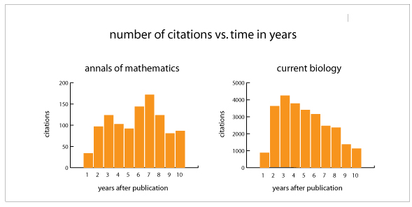
Citation:
In many research areas, articles are not frequently cited until several years after publication. Therefore, measures that only look at citations in the first two years after publication can be misleading.
http://www.eigenfactor.org/whyeigenfactor.htm

Slide 15
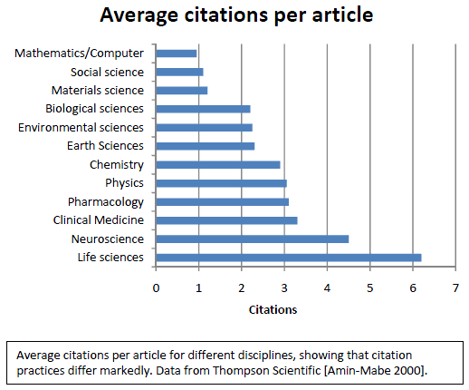
Citation: A report from the International Mathematical Union (IMU)
Amin, M.; Mabe, M. 2000. Impact factor: use and abuse. Perspectives in Publishing, No. 1, October, pp. 1‐6.

Slide 16

H-Index Proposed in 2005 by physicist Jorge Hirsch
The h-index of a given scientists is equal to h if his h papers obtained at least h citations each. Index designed to characterize the overall impact of the researcher on his field. H-index is bounded by the total number of publications: h_{Évariste Galois}= 2
http://en.wikipedia.org/wiki/H-index

Slide 17



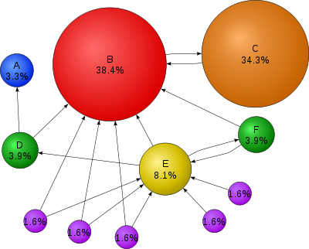
Page Rank (GOOGLE)
http://en.wikipedia.org/wiki/PageRank

Slide 18
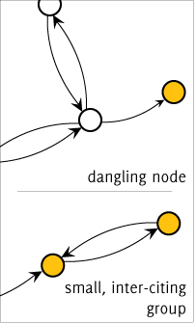
Eigenfactor and Article Influence
www.eigenfactor.org/methods.htm.

Slide 19

Random walk
1
1

Slide 20
Random walk
1
1

Slide 21
Random walk
1
1

Slide 22
Random walk
1
1

Slide 23
Random walk
1
1

Slide 24
Random walk
1
1

Slide 25
Random walk
Strongly Connected: There is a directed path from every node to every other node.
Aperiodic: The GCD of all cycle lengths is 1. The GCD is also called period.
4
1
6
4
1
3
2
5
3
2
Strongly Connected and Aperiodic
Not Strongly Connected

Slide 26
Transition Matrix
1
1
A transition matrix is an n×n matrix A with column sum Σ_{j=1..n} a_{ij} = 1 for each row i.

Slide 27
Page Rank (GOOGLE)
The importance of a page is given by the importance of the pages that link to it.
New importance of page i
importance of page j
number of outlinks from page j
pages j that link to page i

Slide 28
Page Rank (GOOGLE)
1
1
New Rank of :

Slide 29
Page Rank (GOOGLE)
Initialize:
Repeat until convergence:
importance of page i
importance of page j
pages j that link to page i
number of outlinks from page j

Slide 30
Consequences of Perron-Frobenius Theorem:
If a directed graph is strongly connected and aperiodic then the largest eigenvalue of the transition matrix will be equal to 1 and all other eigenvalues have the property |λ|<1. Also, there is an eigenvector π with eigenvalue 1 such that π≥0 and Σ_{i} π_{i} = 1.

Slide 31
Rank of a Vertex
“The rank of a vertex can be interpreted as the probability that a surfer will be at the vertex after following a large number of random walks.”
2
5
3
1
6
4

Slide 32
Page Rank (GOOGLE)
A "random surfer" who is given a web page at random and keeps clicking on links, never hitting "back“, but eventually gets bored and starts on another random page. Model a random walk of a Web surfer as follows:
follow outgoing edges with uniform probabilities
perform random jump with probability 1−α
Consequences of Perron-Frobenius Theorem:
PageRank of a page is its visiting probability (uniquely determined and independent of starting condition)
Further generalizations have been studied:
For instance, random walk with back button etc.

Slide 33
Page Rank Algorithm
One forms a citation graph, the corresponding citation matrix A of size N (the number of pages)
To assure that A is irreducible (i.e., citation graph is strongly connected) and increase the spectral gap one defines PageRank matrix
where J is a matrix A matrix whose entries are all 1. Also, in Google, α =0.85
Page rank is defined by components of the leading eigenvector of G (Perron-Frobenius!)

Slide 34
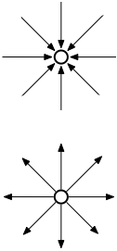
Page Rank (GOOGLE)
A page can have a high PageRank
If there are many pages that point to it
Or if there are some pages that point to it, and have a high PageRank.

Slide 35
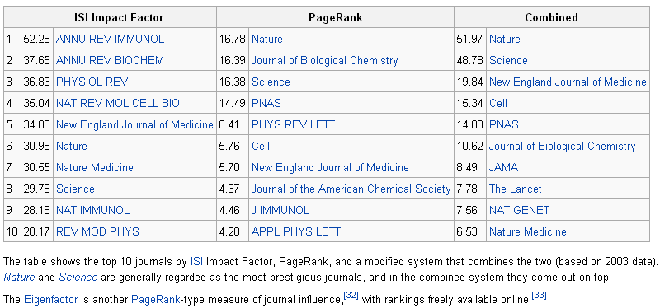
Impact Factor & Page Rank
http://en.wikipedia.org/wiki/Impact_factor

Slide 36

The Eigenfactor score, developed by Jevin West and Carl Bergstrom at the University of Washington, is a rating of the total importance of a scientific journal.
Available free at eigenfactor.org (1995-2010 data)
As with the JCR, only ISI journals are ranked
Uses “all” ISI data, analyzed differently.
all cited and citing references (so includes citations from non-ISI journals, books, dissertations, etc.)
Uses similar algorithm as Google’s PageRank
By this approach, journals are considered to be influential if they are cited often by other influential journals.
Looks at five years of data
Since 2007, also available within JCR!
Notes:
Info to add?
From: http://www.insidehighered.com/news/2010/12/17/scholars_develop_new_metrics_for_journals_impact
Eigenfactor<http://www.eigenfactor.org/>, a project based at the University of Washington, measures the influence of scholarly journals using the old-fashioned method of counting citations, but adds an algorithmic wrinkle similar to the one that Google deploys in ranking search returns: when evaluating the impact of a journal, Eigenfactor takes into account how many times that journal is cited by other journals that are themselves frequently cited. (Google ranks search returns using a similar method, but with hyperlinks instead of citations.) The idea is to control for the fact that, as with Google, "a single citation from a high-quality journal may be more valuable than multiple citations from peripheral publications,” wroteCarl T. Bergstrom, one of the project's developers, shortly after it launched in 2007. … see original article for more!

Slide 37
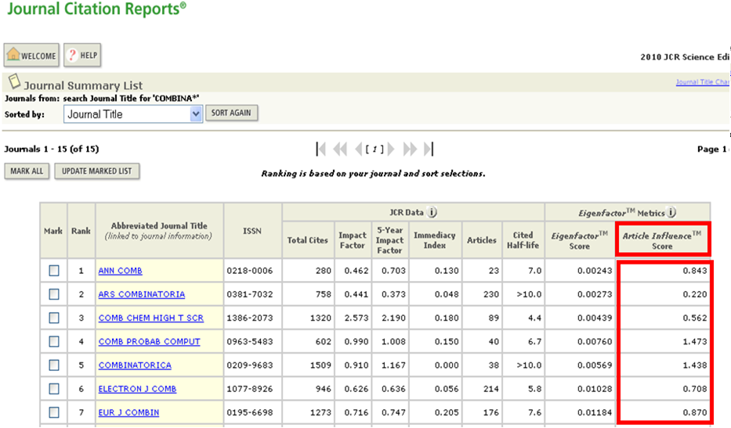
ISI Web of Knowledge

Slide 38
Eigenfactor and Article Influence
Article Influence scores of a journal can vary between eigenfactor.org and JCR, even for the same year. This may be because the eigenfactor metrics take into account some other sources, such as dissertation and newspaper citations.

Slide 39
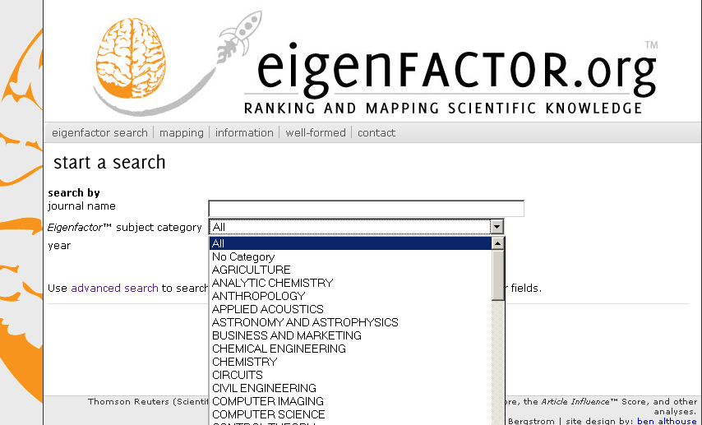
Eigenfactor
http://www.eigenfactor.org

Slide 40
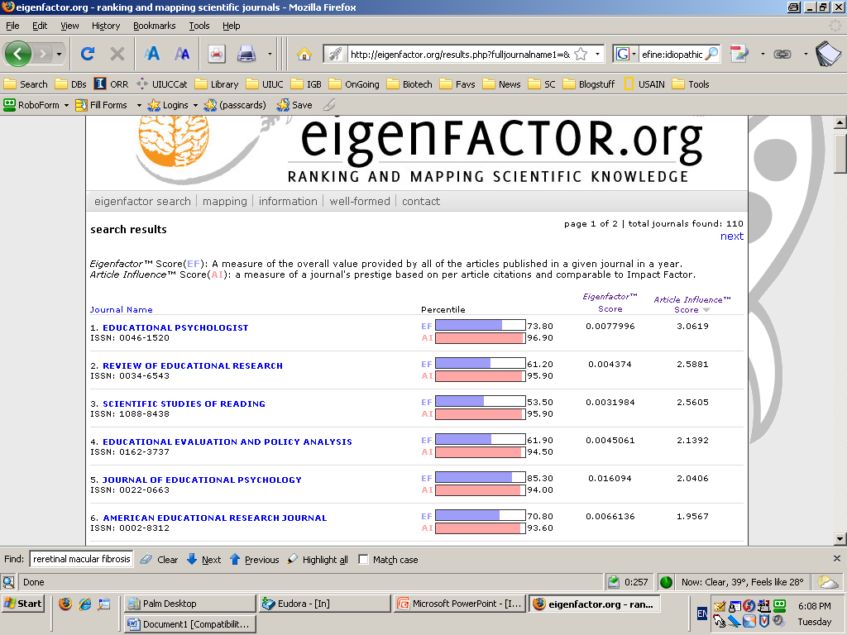
Eigenfactor and Article Influence
http://www.eigenfactor.org

Slide 41
Eigenfactor and Article Influence
The Eigenfactor of journal J in year X is defined as the percentage of weighted citations received by J in X to any item published in (X-1), (X-2), (X-3), (X-4), or (X-5), out of the total citations received by all journals in the dataset. Only citations received from a journal other than J are counted. Each (non-self) citation is assigned a value greater or less than one based on the Eigenfactor of the citing journal. The weighting to be applied is calculated iteratively from an arbitrary constant. Article Influence is calculated by dividing the Eigenfactor by the percentage of all articles recorded in the Journal Citation Reports that were published in J. Article Influence is therefore is conceptually similar to the Impact Factor.
www.eigenfactor.org/methods.htm.

Slide 42
Eigenfactor and Article Influence 2010
1- Citation from j in 2010 to articles published in i during 2005-2009. When constructing A, we omit all self-citations.
2- Normalize matrix A to construct matrix H:
3- Set , where is the number of articles published by journal i over 2005-2009, divided by the total number of articles published by all source journals over 2005-2009.
4- Replace any column of the H matrix that has all 0 entries, with the a vector to produce a new modified matrix H′.
http://www.eigenfactor.org/methods.pdf

Slide 43
Eigenfactor and Article Influence 2010
5- Set , where e is a row vector of 1’s. Therefore, is a matrix with identical columns each equal to a.
6- The journal influence vector is the leading eigenvector of P.
7- Define

Slide 44
Eigenfactor and Article Influence
The mean Article Influence Score is 1.00: A score greater than 1.00 indicates that each article in the journal has above-average influence. A score less than 1.00 indicates that each article in the journal has below-average influence.
A journal can have a high article influence:
If there are many journals that point to it.
Or if there are some journals that point to it, and have a high article influence.

Slide 45
Article Influence & Impact Factor
A journal can have high impact factor and low article influence:
If there are few journals with high article influence that point to it.
If it is in a small iter-citing group.
Because of Self-citations!
Citation patterns vary greatly across disciplines!

Slide 46
Article Influence & Impact Factor
Discipline | The number of Journals | Impact Factor 5 Years > 1 | Article Influence > 1
Chemistry (Analytical) | 73 | 52 | 6
Chemistry (Organic) | 56 | 38 | 11
Physic (Applied) | 118 | 76 | 22
Mathematics | 279 | 60 | 65
Engineering (electrical) | 247 | 131 | 28
Biology | 86 | 55 | 20

Slide 47
Article Influence & Impact Factor
Discipline | The number of Journals | Impact Factor 5 Years > 2 | Article Influence > 2
Chemistry (Analytical) | 73 | 34 | 1
Chemistry (Organic) | 56 | 28 | 3
Physic (Applied) | 118 | 38 | 11
Mathematics | 279 | 10 | 17
Engineering (electrical) | 247 | 57 | 5
Biology | 86 | 31 | 11

Slide 48

SNIP
http://www.journalmetrics.com/
Garfield (1979) underlined that it is improper to make comparisons between citation counts generated in different research fields, because the “citation potential” can vary significantly from one field to another. He suggested that “the most accurate measure of citation potential is the average number of references per paper published in a given field”.
= Number of citations in year of analysis to a journal’s papers published in 3 preceding years, divided by the number of a journal’s papers in these 3 years
H.F. Moed, Measuring contextual citation impact of scientific journals, Journal of Informetrics, 2010
http://www.journalindicators.com/SearchField.aspx

Slide 49
Journal Rankings SJR: SCImago, Journal and Country Rank
SCImago is a research group from the Consejo Superior de Investigaciones Científicas (CSIC), University of Granada, Extremadura, Carlos III (Madrid) and Alcalá de Henares, dedicated to information analysis, representation and retrieval by means of visualisation techniques. The SCImago Journal & Country Rank is a portal that includes the journals and country scientific indicators developed from the information contained in the Scopus® database (Elsevier B.V.). These indicators can be used to assess and analyze scientific domains.
This platform takes its name from the SCImago Journal Rank (SJR) indicator, developed by SCImago from the widely known algorithm Google PageRank™. This indicator shows the visibility of the journals contained in the Scopus® database from 1996.
http://www.scimagojr.com/index.php

Slide 50
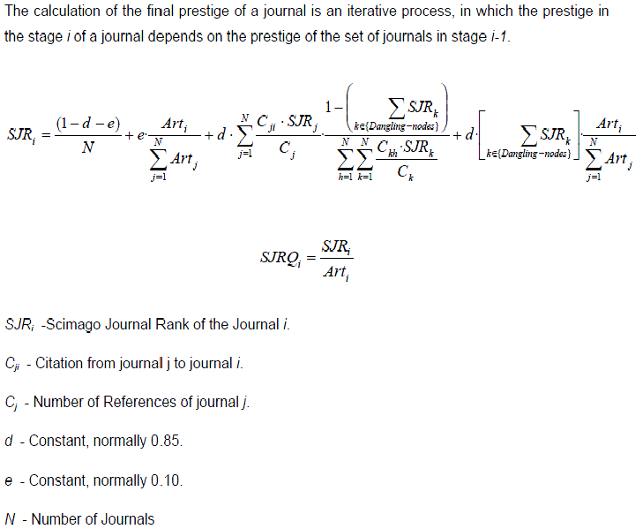
SJR: SCImago, Journal and Country Rank
www.scimagojr.com/SCImagoJournalRank.pdf

Slide 51
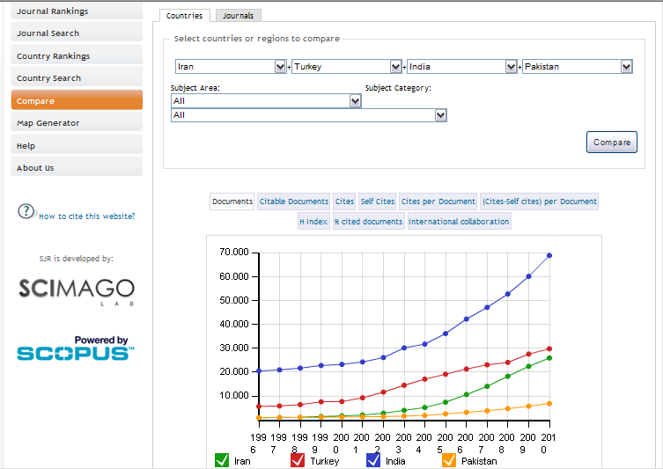
Comparison: All Subjects
www.scimagojr.com

Slide 52
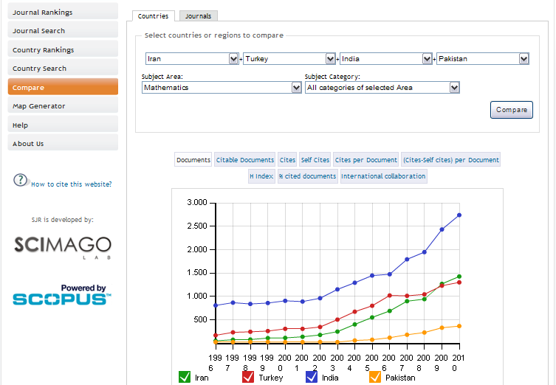
Comparison: Mathematics
www.scimagojr.com

Slide 53
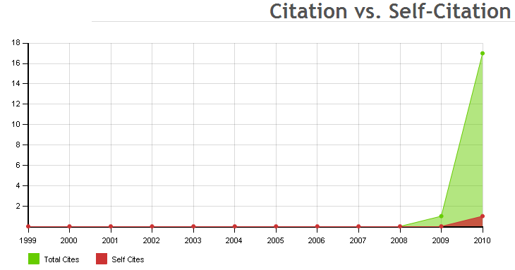
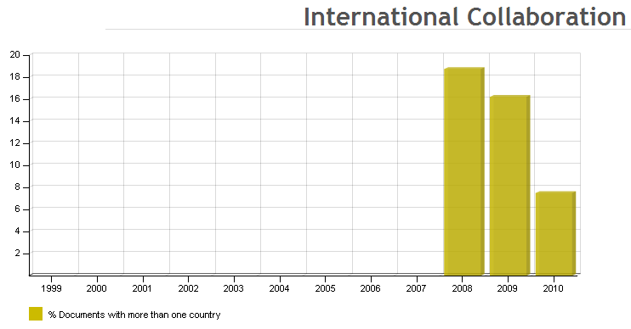
Bulletin of the Iranian Mathematical Society
http://www.scimagojr.com

Slide 54
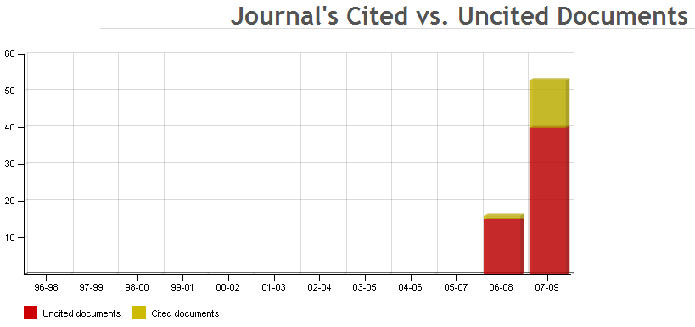
Bulletin of the Iranian Mathematical Society
http://www.scimagojr.com/journalsearch.php?q=15900154754&tip=sid&clean=0

Slide 55
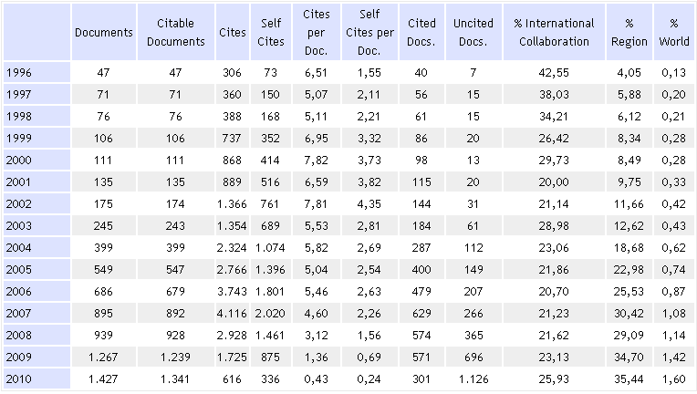
Iran: Mathematics 1996-2010
Documents: 7.128 Citable Documents: 6.988 Citations: 24.486 Self Citations: 12.086 Citations per Document: 3,44
http://www.scimagojr.com/countrysearch.php?area=2600&country=IR&w=

Slide 56
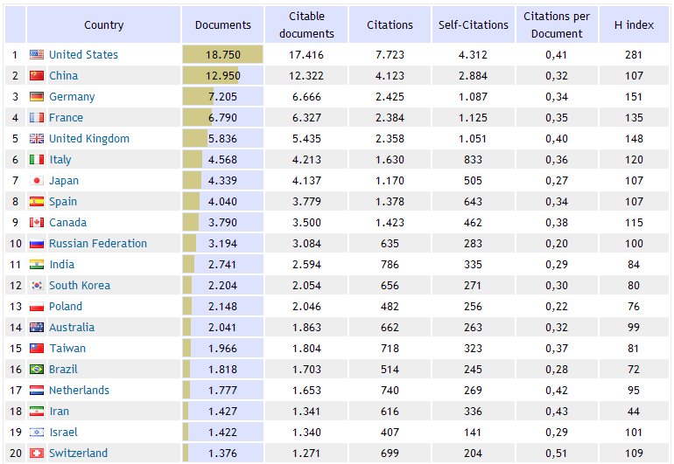
Mathematics (all categories): 2010
http://www.scimagojr.com/countryrank.php?area=2600&category=0&region=all&year=2010&order=it&min=0&min_type=it

Slide 57
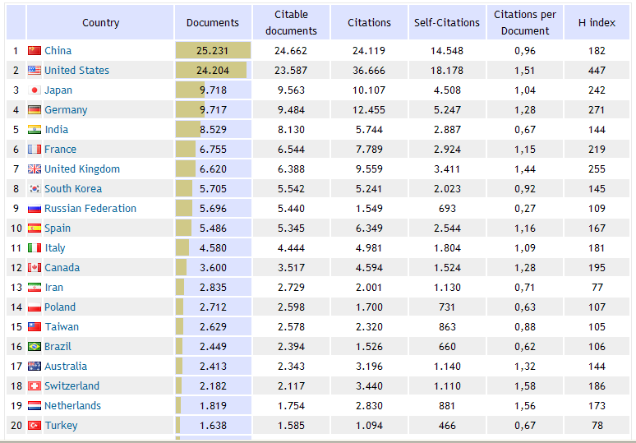
Chemistry (all categories): 2010
http://www.scimagojr.com/countryrank.php?area=1600&category=0&region=all&year=2010&order=it&min=0&min_type=it

Slide 58
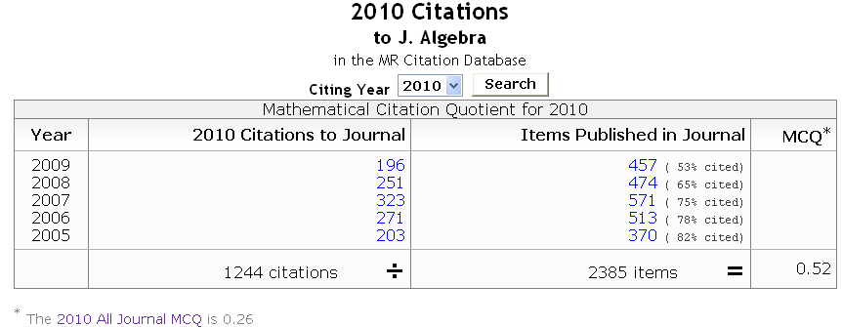
Mathematical Citation Qutient: MathScinet
The Mathematical Citation Quotient (MCQ) is the number of citations to papers in a given journal over a five year period divided by the number of papers in the journal over the same period.
For the period 2004–2008, the top five journals in Mathematical Reviews by MCQ:
Acta Numerica – MCQ 3.43 Annals of Mathematics – MCQ 2.97
Journal of the American Mathematical Society – MCQ 2.92
Communications on Pure and Applied Mathematics – MCQ 2.43
Publications Mathématiques de l'IHÉS – MCQ 2.33 The current underlying Citation Database comprises journal article citations from reference lists in a selected collection of reference list journals.
http://en.wikipedia.org/wiki/Mathematical_Reviews

Slide 59
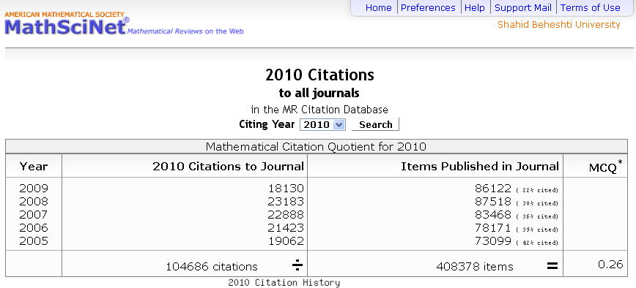

Total MCQ* 2007, 2008, 2009: 0.28 Total MCQ* 2006: 0.27 Total MCQ* 2005: 0.26 Total MCQ* 2000, 2001, 2002, 2003, 2004: 0.25

Slide 60
ERA: Journal Ranking
Measures
All journals included must fulfill international academic standards, i.e., selection of articles is based on objective review policy.
The journal must fulfill basic publishing standards , i.e., ISSN, timeliness of publication, complete bibliographic information for all cited references, full address information for every author.
http://halshs.archives-ouvertes.fr/halshs-00568746/fr/

Slide 61
As part of their Excellence in Research for Australia (ERA) program, the Australian Research Council rated more than 20,000 peer-reviewed journals. The ratings were released in February 2010. Each journal was assigned one to three fields of research and one of four tiers: A* - one of the best in its field or subfield 5% A - very high quality 15% B - solid, though not outstanding 30% C - does not meet the criteria of the higher tiers 50%
ARC Journal Ranking

Slide 62
ARC Journal Ranking
A*
Typically an A* journal would be one of the best in its field or subfield in which to publish and would typically cover the entire field/subfield.
A
The majority of papers in a Tier A journal will be of very high quality. Publishing in an A journal would enhance the author’s standing, showing they have real engagement with the global research community and that they have something to say about problems of some significance.
B
Tier B covers journals with a solid, though not outstanding, reputation. Generally, in a Tier B journal, one would expect only a few papers of very high quality. They are often important outlets for the work of PhD students and early career researchers.
C
Tier C includes quality, peer reviewed, journals that do not meet the criteria of the higher tiers. http://www.arc.gov.au/era/tiers_ranking.htm

Slide 63
8 Clusters
1 Physical, Chemical & Earth Sciences (PCE)
FoRs: 02xx, 03xx, 04xx
2 Humanities & Creative Arts (HCA)
FoRs: 1201, 1203, 1205, 1299, 18xx, 19xx, 20xx, 21xx, 22xx
3 Engineering & Environmental Sciences (EE)
FoRs: 05xx, 09xx, 1202, 1204
4 Social, Behavioural & Economic Sciences (SBE)
FoRs: 13xx, 14xx, 15xx, 16xx, 17xx
5 Mathematical, Information & Computing Sciences (MIC)
FoRs: 01xx, 08xx, 1005, 1006, 1007, 1099
6 Biological & Biotechnological Sciences (BB)
FoRs: 06xx, 07xx, 1001, 1002, 1003, 1004
7 Biomedical & Clinical Health Sciences (BCH)
FoRs: 1101, 1102, 1103, 1105, 1107, 1108, 1109, 1112, 1113, 1114, 1115, 1116
8 Public & Allied Health Sciences (PAH)
FoRs: 1104, 1106, 1110, 1111, 1117, 1199

Slide 64
22 Divisions, 157 Disciplines
01 Mathematical Sciences 02 Physical Sciences 03 Chemical Sciences 04 Earth Sciences 05 Environmental Sciences 06 Biological Sciences 07 Agricultural & Veterinary Sciences 08 Information & Computing Sciences 09 Engineering 10 Technology 11 Medical & Health Sciences | 12 Built Environment & Design 13 Education 14 Economics 15 Commerce, Management, Tourism & Services 16 Studies in Human Society 17 Psychology & Cognitive Sciences 18 Law & Legal Studies 19 Studies in Creative Arts & Writing 20 Language, Communication & Culture 21 History & Archaeology 22 Philosophy & Religious Studies

Slide 65
For Codes (ERA)
01 Mathematical Sciences: Mathematical, Information and Computing Sciences (MIC)
0101 Pure Mathematics: this group has thirteen fields:
010101 Algebra and Number Theory 010102 Algebraic and Differential Geometry
010103 Category Theory, K Theory, Homological Algebra 010104 Combinatorics and Discrete Mathematics (excl. Physical Combinatorics) 010105 Group Theory and Generalisations 010106 Lie Groups, Harmonic and Fourier Analysis 010107 Mathematical Logic, Set Theory, Lattices and Universal Algebra 010108 Operator Algebras and Functional Analysis 010109 Ordinary Differential Equations, Difference Equations and Dynamical Systems 010110 Partial Differential Equations 010111 Real and Complex Functions (incl. Several Variables) 010112 Topology 010199 Pure Mathematics not elsewhere classified
0102 Applied Mathematics
0103 Numerical and Computational Mathematics
0104 Statistics
0105 Mathematical Physics
0199 Other Mathematical Sciences

Slide 66
Ranking is Discipline Specific …
John Lamp: Where is Open Access in the ARC's ERA?
School of Information Systems
Organic Chemistry
Seven (12%) journals at A*
Publish fortnightly - 182 issues/year
Many people have many A* papers
Information Systems
Nine (5%) journals at A*
0806, less HCI, CS journals – see ACPHIS list
Publish quarterly - 36 issues/year
Few people have A* papers

Slide 67
ERA 2012
The refinement of the journal quality indicator to remove the prescriptive A*, A, B and C ranks;
The introduction of a journal quality profile, showing the most frequently published journals for each unit of evaluation;
Increased capacity to accommodate multi-disciplinary research to allow articles with significant content from a given discipline to be assigned to that discipline, regardless of where it is published (this method was successfully trialed in ERA 2010 within Mathematical Sciences);
The relaxation of rules on the attribution of patents, plant breeders’ rights and registered design, to allow those granted to eligible researchers to also be submitted.
http://minister.innovation.gov.au/carr/mediareleases/pages/improvementstoexcellenceinresearchforaustralia.aspx

Slide 68
Ranking Journals
Norway's national scientific database (2004): 2 Levels
There are two levels: Ordinary publication channels (level 1) and highly prestigious publication channels (level 2).
Journals of Mathematics & Statistics: Level 1: 924 Level 2: 117
Danish list of journals (2010): 2 Levels
Journals divided in 68 subjects and lists almost 20.000 journals. The journals are divided into 2 levels: a high level 2 and a normal level 1 Both the content and level of classification reviewed annually.
Journals of Mathematics & Statistics: Level 1: > 730 Level 2: 128
Finland list of journals (2010): 3 Levels
Journals of Mathematics & Statistics: ? Level 2:? Level 3: 51
http://www.ltu.se/ltu/lib/Publicering/Rankning?l=en

Slide 69
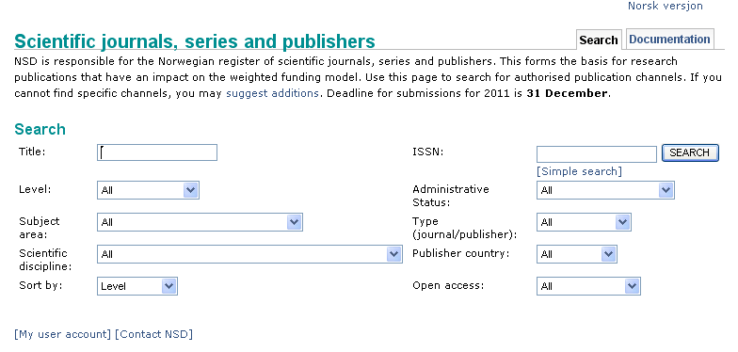
Norwegian Ranking of Journals
There are two levels: Ordinary publication channels (level 1) and highly prestigious publication channels (level 2). This classification is used in the Norwegian funding system for higher education.
http://dbh.nsd.uib.no/kanaler/?search=advanced

Slide 70
CNRS: French National Centre for Scientific Research
The National Center of Scientific Research (Centre national de la recherche scientifique or CNRS)^{[1]} is the largest governmental research organization in France^{[2]} and the largest fundamental science agency in Europe.^{[3]} It involves 26,000 permanent employees (researchers, engineers, and administrative staff) and 6,000 temporary workers.
Ranking of peer journals in economics and management (CNRS)
CNRS rank
A: Top Journals
B: Revues de très haute qualité mais moins diffusées
C: Specialized International Journals
D: Refereed Journals
http://www.cnrs.fr/en/aboutCNRS/overview.htm
http://www.gate.cnrs.fr/IMG/pdf/RankingCNRS_2008.pdf

Slide 71
National Academy of Agricultural Sciences (INDIA)
The National Academy of Agricultural Sciences (NAAS), established in 1990, is among the youngest of the Science Academies of India.
The Fellowship of National Academy of Agricultural Sciences embodies a wide spectrum of national and international scientists
Important Note: The purpose of Academy’s exercise of attributing relevant weightage/marks to journals is to provide an objective and numeral criteria to publications for the purpose of screening applications for admission to the Fellowship of the Academy only. Please note that the numerical value shown against each of the journal is not its Impact Factor. Each journal is assessed for a maximum of 10 marks and its relative weightage is indicated by assigning appropriate marks against each journal.
http://www.naasindia.org/rating.html

Slide 72
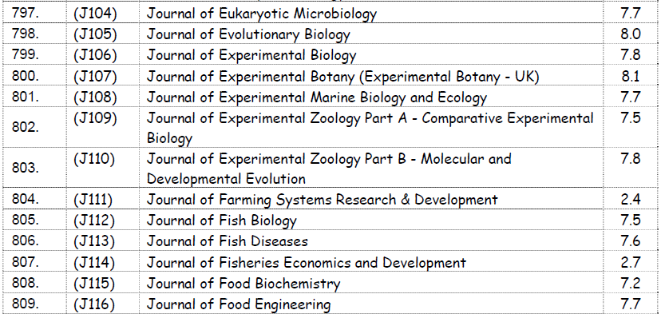
National Academy of Agricultural Sciences (INDIA)
http://www.naasindia.org/rating.html

Slide 73
Notations
Hereafter, we use the following notations:
Article Infl.= Article Influence which has been obtained from www.eigenfactor.org
ERA Aust, Norway, and Denmark mean Australia, Norway, Denmark Journal Ranking, respectively.
# Paper= The number of papers published by the journal in 2010.
Z means that the journal is not in the associated list of ranking.
N means that the journal is in the associated list but there is no rank for this journal.

Slide 74

Journals: Combinatorics 2010
Journals & Start year | Article Infl. | ERA Aust | Nor way | Denmark | #Paper | ISI
J. of Combinatorial Theory, B , 1971 | 1.397 | A* | 2 | 2 | 56 | ISI
Algorithmica, 1986 | 0.668 | A* | 2 | 2 | 118 | ISI
Combinatorica, 1981 | 1.545 | A | 2 | 2 | 38 | ISI
Random Structures and Alg., 1990 | 1.392 | A | 2 | 2 | 42 | ISI
Computational Complexity, 1991 | 1.586 | A | 2 | 2 | 21 | ISI
J. of Combinatorial Theory, A, 1971 | 1.258 | A* | 2 | 1 | 91 | ISI
Journal of Algorithms, 1980 | 1.229 | A | 2 | 2 |  | ISI
Combin., Prob. and Computing,1992 | 1.142 | A | 1 | 2 | 40 | ISI
Journal of Graph Theory, 1977 | 0.847 | A | 1 | 2 | 77 | ISI
Journal of Complexity, 1985 | 1.005 | A | 1 | 2 | 34 | ISI
ACM Trans. on Algorithms, 2005 | --- | A | 1 | 2 | 47 | ISI
Complexity, 1993 | 0.350 | B | 1 | 2 | 28 | ISI
http://www.eigenfactor.org
October , 2011

Slide 75
Journals: Combinatorics 2010
Journals & Start year | Article Influ. | ERA Aust | Norway | Denmark | #paper | ISI
J. of Algebraic Combinatorics, 1992 | 1.248 | A | 1 | 1 | 51 | ISI
European J. of Combinatorics, 1980 | 0.882 | A | 1 | 1 | 176 | ISI
SIAM J. on Discrete Math., 1988 | 0.823 | A | 1 | 1 | 130 | ISI
Annals of Combinatorics, 1997 | 0.868 | A | 1 | 1 | 23 | ISI
J. of Combinatorial Designs, 1993 | 0.870 | A | 1 | 1 | 33 | ISI
Linear Algebra and Its Appl., 1968 | 0.600 | A | 1 | 1 | 442 | ISI
Designs, Codes and Crypt., 1991 | 0.674 | A | 1 | 1 | 85 | ISI
Discrete Applied Mathematics,1979 | 0.558 | A | 1 | 1 | 222 | ISI
Electronic J. of Combinatorics1994 | 0.791 | Z | 1 | Z | 214 | ISI
Discrete Math. & Theoretical Computer Science, 1997 | 0.711 | B | 1 | 1 | 42 | ISI
Discrete Mathematics , 1971 | 0.511 | B | 1 | 1 | 436 | ISI
Graphs and Combinatorics, 1985 | 0.614 | B | 1 | 1 | 65 | ISI
http://www.eigenfactor.org
October , 2011

Slide 76
Journals: Combinatorics 2010
Journals & Start year | Article Infl. | ERA Aust | Nor way | Denmark | #Paper | ISI
J. of Graph Algorithms & Appl., 1997 | --- | B | 1 | 1 | --- | N
The Aust. J. of Combinatorics 1990 | --- | B | 1 | 1 | --- | N
Discrete Math. and Applications, | --- | B | N | Z | --- | N
Online J. Anal. Comb., 2006 | --- | Z | 1 | 1 | --- | N
Contributions to Discrete Math., 2006 | --- | C | 1 | Z | --- | N
MATCH, 1975 | 0.602 | C | 1 | 1 | 117 | ISI
Discussiones Mathematicae Graph Theory, 1995 | --- | C | N | Z | --- | N
Appl. Analysis & Discrete Math., 2006 | --- | C | 1 | 1 | 27 | ISI
Utilitas Math., 1972 | 0.333 | C | 1 | 1 |  | ISI
Ars Combinatoria1976 | 0.309 | C | 1 | 1 | 230 | ISI
Bull. Inst. of Combin. &Its Appl., 1991 | --- | C | N | Z | --- | N
Journal of Discrete Algorithms, 2003 | --- | C | 1 | Z | --- | N
http://www.eigenfactor.org
October , 2011

Slide 77
Journals: Combinatorics 2010
Journals & Start year | Article Infl. | ERA Aust | Nor way | Denmark | #Paper | ISI
J. of Combin. & Number The., 2009 | --- | Z | 1 | Z | --- | N
J. Combin. Math. Comb. Comp., 1987 | --- | C | N | Z | --- | N
J. Autom. Lang. Combinatorics, | --- | C | N | Z | --- | N
Cryptography & Communications 2009 | --- | Z | 1 | 1 | --- | N
Algebra Discrete Mathematics, | --- | C | N | Z | --- | N
AKCE Int. J. Graphs & Combin., 2004 | --- | C | N | Z | --- | N
Congressus Numerantium, 1970 | --- | C | 1 | Z | --- | N
J. Combinatorics, Inf. Syst. Sci., | --- | C | N | Z | --- | N
J. Discrete Math. Sci. Crypt., 1998 | --- | C | N | Z | --- | N
Adv. & Appl. in Discrete Math. 2008 | --- | N | 1 | 1 | --- | N
Int. J. Math. Combinatorics, 2007 | --- | Z | 1 | Z | --- | N
http://www.eigenfactor.org
October , 2011

Slide 78
Journals: Combinatorics 2010
Journals & Start year | Article Infl. | ERA Aust | Nor way | Denmark | #Paper | IF
Algorithms, 2008 | --- | Z | 1 | Z | --- | N
Discrete Math. Algorit. & Appl., 2009 | --- | Z | 1 | Z | --- | N
Journal of Combinatorics, 2010 | --- | C | 1 | 1 | --- | N
Elect. Notes in Discrete Math., 1999 | --- | C | 1 | 1 | --- | N
http://www.eigenfactor.org
October , 2011

Slide 79
Journals: Algebra 2010
Journals & Start year | Article Infl. | ERA Aust | Nor way | Denmark | #Paper | ISI
J. of Algebraic Geometry, 1992 | 2.207 | A | 2 | 2 | 20 | ISI
Journal of Algebra, 1964 | 0.768 | A* | 2 | 1 | 412 | ISI
Transformation Groups, 1996 | 1.157 | A | 1 | 2 | 39 | ISI
Algebra and Number Theory, 2007 | ------ | B | 1 | 2 | 38 | ISI
K-theory, 1987 | 0.973 | A | 1 | 1 |  | ISI
J. Pure Applied Algebra, 1971 | 0.814 | A | 1 | 1 | 189 | ISI
Linear Algebra and Its Appl., 1968 | 0.600 | A | 1 | 1 | 442 | ISI
Semigroup Forum, 1970 | 0.484 | A | 1 | 1 | 70 | ISI
Journal of Lie Theory, 1994 | 0.497 | A | 1 | 1 | 39 | ISI
Applicable Algebra in Engineering, Communication and Computing, 1990 | 0.461 | B | 2 | 1 | 20 | ISI
Int. J. of Algebra and Comput., 1991 | --- | A | 1 | 1 | --- | N
Groups, Geometry and Dynamics, 2006 | 1.211 | B | 1 | 1 | 41 | ISI
Alg. Representation Theory, 1998 | 0.567 | B | 1 | 1 | 43 | ISI
http://www.eigenfactor.org
October , 2011

Slide 80
Journals: Algebra 2010
Journals & Start year | Article Infl. | ERA Aust | Nor way | Denmark | #Paper | ISI
Finite Fields and Their Applications | 0.759 | B | 1 | 1 | 41 | ISI
Applied Categorical Structures | 0.554 | B | 1 | 1 | 30 | ISI
Linear Multilinear Algebra, 1973 | 0.569 | B | 1 | 1 | 83 | ISI
Journal of Group Theory | 0.592 | B | 1 | 1 | 65 | ISI
Communications in Algebra, 1974 | 0.439 | B | 1 | 1 | 307 | ISI
Algebra Universalis, 1971 | 0.321 | B | 1 | 1 | 39 | ISI
B. Zur Algebra Und Geometrie, 1971 | --- | B | 1 | 1 |  | N
Algebra and Logic, 1968 | --- | B | 1 | 1 | 32 | ISI
Journal of K-Theory, 2008 | 0.744 | N | 1 | Z | 26 | ISI
J. of Algebra and its Applications, 2002 | --- | C | 1 | 1 | 63 | ISI
Electronic J. Linear Algebra, 1996 | 0.671 | Z | 1 | 1 | 67 | ISI
J. of Gen. Lie Theory & Appl. | --- | C | 1 | Z |  | N
Algebra Colloquium, 1994 | 0.381 | C | 1 | 1 | 86 | ISI
http://www.eigenfactor.org
October , 2011

Slide 81
Journals: Algebra 2010
Journals & Start year | Article Infl. | ERA Aust | Nor way | Denmark | #Paper | ISI
Adv. in Applied Clifford Algebras | 0.193 | C | Z | Z | 64 | ISI
Quasigroups & Related Systems | --- | C | 1 | Z | --- | N
Algebra and Discrete Math. | --- | C | Z | Z | --- | N
JP Journal of Algebra Number Theory and Applications | --- | C | Z | Z | --- | N
Algebras, Groups & Geometries | --- | C | 1 | Z | --- | N
J. of Appl. Algebra & Disc. Struc. | --- | C | Z | Z | --- | N
Journal of Commutative Algebra, 2009 | --- | Z | 1 | Z | --- | N
Int. Electronic J. of Algebra, 2007 | --- | Z | 1 | 1 | --- | N
Int. J. of Algebra, 2007 | --- | Z | 1 | 1 | --- | N
Asian Journal of Algebra, 2008 | --- | Z | 1 | Z | --- | N
http://www.eigenfactor.org
October , 2011

Slide 82
Journals: Logic and Philosophy 2010
Journals & Start year | Article Infl. | ERA Aust | Nor way | Denmark | #Paper | ISI
Journal of Philosophical Logic , 1972 | ---- | A* | 2 | 2 | 30 | N
Bulletin of Symbolic Logic, 1995 | 0.669 | A | 2 | 2 | 12 | ISI
Jornal of Symbolic Logic, 1936 | 0.478 | A | 2? | 2 | 80 | ISI
Annals of Pure & Applied Logic, 1969 | 0.521 | A | 2 | 2 | 85 | ISI
J. of Logic & Alg. Programming, 1984 | 0.444 | A | 2 | 2 | 45 | ISI
ACM Trans. on Comp. Logic, 2000 | 1.416 | A | 1 | 2 | 27 | ISI
Journal of Mathematical Logic, 2001 | 1.436 | A* | 1 | 1 | 11 | ISI
Notre Dame J. of Formal Logic , 1960 | ---- | A | 2 | 1 | 24 | N
J. of Logic and Computation, 1990 | 0.457 | A | 1 | 2 | 50 | ISI
Logical Methods in Computer Sci.,2005 | ---- | A | 1 | 2 | 49 | ISI
Journal of Applied Logic, 2003 | ---- | A | 1 | 2 |  | N
J. of Logic, Language & Inform., 1992 | ---- | A | 1 | 2 |  | N
Australasian Journal of Logic, 2003 | ---- | A | 1 | 1 |  | N
Studia Logica (an int. J. for symbolic logic), 1953 | ---- | A | 1 | 1 |  | N
October , 2011

Slide 83
Journals: Logic and Philosophy 2010
Journals & Start year | Article Infl. | ERA Aust | Nor way | Denmark | #Paper | ISI
Logic Journal of the IGPL, 1993 | 0.136 | B | 1 | 2 | 40 | ISI
History and Philosophy of Logic , 1980 | 0.045 | B | 1 | 2 | 16 | ISI
J. of Applied Non-Classical Logics,1991 | ---- | B | 1 | 2 |  | N
Archive for Mathematical Logic , 1950 | 0.277 | B | 1 | 1 | 39 | ISI
Mathematical Logic Quarterly | 0.264 | B | 1 | 1 | 63 | ISI
Algebra and Logic, 1961 | 0.809 | B | 1 | 1 | 32 | ISI
Informal Logic, 1978 | ---- | B | 1 | 1 |  | N
B. of the Section of Logic Uni. of Łódź | ---- | B | Z | 1 |  | N
Reports on Mathematical Logic | ---- | B | Z | 1 |  | N
Review of Symbolic Logic, 2008 | 0.148 | N | 1 | Z | 26 | ISI
Logic and Analysis, 2009 | ---- | C | 1 | Z |  | N
Logica Universalis | ---- | C | 1 | 1 |  | N
J. of Multiple-Valued Logic & Soft Computing, 2003 | 0.113 | C | 1 | 1 | 35 | ISI
http://www.eigenfactor.org
October , 2011

Slide 84
Journals: Analysis 2010
Journals & Start year | Article Infl. | ERA Aust | Nor way | Denmark | #Paper | ISI
Geometric & Functional Analysis, 1991 | 2.245 | A* | 2 | 2 | 68 | ISI
Journal of Functional Analysis, 1967 | 1.339 | A* | 2 | 2 | 272 | ISI
Annales de l'Institut Henri Poincaré (C) Analyse Non Linéaire, 1984 | 1.549 | A* | 2 | 2 | 64 | ISI
SIAM J. on Math. Analysis, 1970, 1996 | 1.480 | A | 2 | 2 | 120 | ISI
J. of Fourier Analysis & Applic., 1994 | 1.505 | A | 2 | 2 | 47 | ISI
Journal of Geometric Analysis, 1991 | 1.258 | A | 2 | 2 | 42 | ISI
Journal d'Analyse Mathematique | 1.007 | A | 2 | 2 | 35 | ISI
Com. in analysis & geometry, 1993 | 1.133 | A | 2 | 2 | 28 | ISI
Nonlinearity, 1988 | 1.061 | A* | 1 | 1 | 152 | ISI
Journal of Convex Analysis, 1994 | 0.706 | A | 1 | 1 | 67 | ISI
Journal of Operator Theory, 1979 | 0.738 | A | 1 | 1 | 49 | ISI
J. of Math. Analysis & Applicat., 1960 | 0.696 | A | 1 | 1 | 759 | ISI
http://www.eigenfactor.org
October , 2011

Slide 85
Journals: Analysis 2010
Journals & Start year | Article Infl. | ERA Aust | Nor way | Denmark | #Paper | ISI
Integral Equations and Operator Theory, 1978 | 0.572 | A | 1 | 1 | 89 | ISI
Nonlinear Analysis: Theory Methods & Applications, 1976 | 0.692 | A | 1 | 1 | 764 | ISI
Annales Henri Poincare, 2000 | 1.144 | B | 1 | 2 | 54 | ISI
Nonlinear Analysis: Real World A.,2000 | 0.760 | B | 1 | 1 |  | ISI
Functional Anal. & Its Applic., 1967 | 0.440 | B | 1 | 1 | 40 | ISI
Abstract and Applied Analysis, 1996 | 0.868 | B | 1 | 1 | 123 | ISI
Zeitschrift für Analysis und Ihre Anwendungen, 1982 | 0.549 | B | 1 | 1 | 26 | ISI
Fixed Point Theory &Applications,2004 | 0.601 | B | 1 | 1 | 172 | ISI
Complex Variables & Elliptic Equations, 1982 |  | B | 1 | 1 | 78 | ISI
Journal of Inequalities & Appl., 1997 | 0.496 | B | 1 | 1 | 264 | ISI
Math. Inequalities & Applic., 1998 | 0.450 | B | 1 | 1 | 65 | ISI
http://www.eigenfactor.org
October , 2011

Slide 86
Journals: Analysis 2010
Journals & Start year | Article Infl. | ERA Aust | Nor way | Denmark | #Paper | ISI
Analysis (Munich), 1981 | ---- | B | 1 | 1 |  | N
Set-Valued & Variational Anal., 1993 | 0.698 | B | 1 | 1 | 25 | ISI
Methods of Functional Analysis & Topology, | ---- | B | Z | Z |  | N
Analysis Mathematica, 1975 | ---- | B | 1 | 1 | 16 | ISI
Nonlinear Anal.: model. & control, | ---- | B | 1 | 1 | 37 | ISI
Adv.in Nonlinear Variational Inequalities, 1998 | ---- | B | Z | Z |  | N
Comm. on Pure & Applied Anal., 2002 | 0.712 | C | 1 | 1 | 102 | ISI
J. of Nonlinear &Convex Analysis, 2000 | ---- | C | 1 | 1 | 25 | ISI
Analysis and Applications, 2003 | ---- | C | Z | Z | 22 | ISI
Complex Analysis and Operator Theory, 2007 | 0.581 | C | 1 | 1 | 38 | ISI
Operators and Matrices, 2007 | 0.447 | C | 1 | 1 | 33 | ISI
J. of Fixed Point Theory & Appli.,2007 | 0.435 | C | 1 | Z | 29 | ISI
http://www.eigenfactor.org
October , 2011

Slide 87
Journals: Analysis 2010
Journals & Start year | Article Infl. | ERA Aust | Nor way | Denmark | #Paper | ISI
Appli. Analysis & Discrete Math., 2006 | 0.393 | C | 1 | 1 | 27 | ISI
Fractional Calculus and Applied Analysis, 1998 | ---- | C | 1 | Z |  | N
Fixed Point Theory (Romania), 2000 | ---- | Z | Z | Z | 42 | ISI
Banach J. of Mathematical Anal., 2007 | 0.217 | C | 1 | Z | 29 | ISI
Comm. on Appl. Nonlinear Anal., 1994 | ---- | C | 1 | 1 |  | N
Com. in Mathematical Analysis, 2007 | ---- | C | 1 | Z |  | N
Nonlinear Anal.: Hybrid Syst., 2001 | ---- | C | 1 | Z |  | N
J. of Applied Functional Analysis, 2006 | ---- | C | Z | Z |  | N
J. of Mathematical Inequalities, 2007 | ---- | C | 1 | Z |  | N
Journal of Inequalities in Pure and Applied Mathematics, 1998 | ---- | C | 1 | 1 |  | N
JP J. of Fixed Point Theory&Appli.,2006 | ---- | C | 1 | Z |  | N
Nonlinear Analysis Forum, | ---- | C | Z | Z |  | N
Int. J. of Mathematical Analysis, 2007 | ---- | C | 1 | 1 |  | N
http://www.eigenfactor.org
October , 2011

Slide 88
Journals: Analysis 2010
Journals & Start year | Article Infl. | ERA Aust | Nor way | Denmark | #Paper | ISI
Annals of Functional Analysis, 2010 | ---- | Z | 1 | Z |  | N
Int. J. of Functional Analysis, Operator Theory and Applications, 2009 | ---- | Z | 1 | Z |  | N
Bulletin of Math. Analysis & Ap., 2009 | ---- | Z | 1 | Z |  | N
Australian Journal of Mathematical Analysis and Applications | ---- | C | Z | Z |  | N
Analysis in Theory and Applications | ---- | C | Z | Z |  | N
Applicable Analysis, 1971 | 0.968 | B | 1 | 1 | 110 | ISI
Mathematical Physics Analysis and Geometry, 1998 | 0.534 | B | 1 | 1 | 20 | ISI
Journal of Mathematical Physics, Analysis, Geometry , 1994 | ---- | Z | 1 | Z | 22 | ISI
Advances in Calculus of Variations | ---- | Z | 1 | Z | 18 | ISI
J. of Contemporary Math. Analysis | ---- | C | Z | Z | 38 | ISI
Journal of Function Spaces and Applications | ---- | Z | 1 | 1 | 15 | ISI
http://www.eigenfactor.org
October , 2011

Slide 89
Journals: Probability & Stochastic P.; 2010
Journals & Start year | Article Infl. | ERA Aust | Nor way | Denmark | #Paper | ISI
Annals of Applied Probability | 1.813 | A* | 2 | 2 | 74 | ISI
Annals of Probability | 1.858 | A* | 2 | 2 | 71 | ISI
Probability Theory and Related Fields | 1.811 | A* | 2 | 2 | 60 | ISI
Advances in Applied Probability, 1969 | 0.974 | A | 2 | 2 | 56 | ISI
Stochastic Processes &their Applications, 1973 | 1.374 | A | 2 | 2 | 110 | ISI
Journal of Applied Probability | 0.722 | A | 2 | 2 | 83 | ISI
Annales De L Institut Henri Poincare B Probability and Statistics, 1983 | 1.074 | A | 1 | 2 | 52 | ISI
Probabilistic Engineering Mechanics | 1.033 | A | 1 | 2 |  | ISI
Combin., Prob. and Computing,1992 | 1.142 | A | 1 | 1 | 40 | ISI
Electronic Journal of Probability | 1.237 | A | 1 | 1 | 74 | ISI
Infinite Dimensional Analysis Quantum Probability and related topics | 0.570 | B | 2 | 1 | 32 | ISI
Methodology and Computing in Applied Probability | 0.502 | B | 2 | 1 | 43 | ISI
http://www.eigenfactor.org
October , 2011

Slide 90
Journals: Probability & Stochastic P.; 2010
Journals & Start year | Article Infl. | ERA Aust | Nor way | Denmark | #Paper | ISI
Theory of Probability & Its Applications | 0.367 | A | 1 | 1 | 59 | ISI
J. of Applied Math. & Stochastic Analysis, 1987 | ---- | B | 1 | 1 |  | N
Stochastics and Dynamics , 2001 | 0.563 | B | 1 | 1 | 31 | ISI
Stochastic Analysis &Applications,1983 | 0.428 | B | 1 | 1 | 59 | ISI
Journal of Theoretical Probability | 0.664 | B | 1 | 1 | 61 | ISI
Probability in the Engineering and Informational Sciences | 0.706 | B | 1 | 1 | 33 | ISI
Electronic Communications in Probability | 0.702 | B | 1 | 1 | 53 | ISI
Stochastic Models, | 0.641 | B | 1 | 1 | 28 | ISI
Stochastics, 2005 | ---- | C | 1 | 1 | 27 | ISI
Comm. on Stochastic Analysis , 2007 | ---- | Z | 1 | Z |  | N
Random Operators &Stochastic Equations, 1993 | ---- | Z | 1 | 1 | 19 | N
Int. J. of Stochastic Analysis , 2010 | ---- | Z | 1 | Z |  | N
http://www.eigenfactor.org
October , 2011

Slide 91
Journals: Analysis; ODE & PDE 2010
Journals & Start year | Article Infl. | ERA Aust | Nor way | Denmark | #Paper | ISI
Comm. in Partial Diff. Equations , 1976 | 1.493 | A* | 2 | 2 | 80 | ISI
J. of Differential Equations , 1965 | 1.185 | A* | 2 | 2 | 261 | ISI
Calculus of Variations and Partial Differential Equations , 1993 | 1.287 | A* | 1 | 2 | 76 | ISI
J. of Dynamics & Differential Equations, 1989 | ---- | A | 1 | 2 | 32 | ISI
Journal of evolution equations , 2001 | 0.896 | A | 1 | 1 | 41 | ISI
NoDEA. Nonlinear differential equations & applications,1994 | 0.609 | A | 1 | 1 | 43 | ISI
Integral equat. & operator theory,1978 | 0.572 | A | 1 | 1 | 89 | ISI
Journal of Difference Equations and Applications , 1994 | 0.328 | A | 1 | 1 | 84 | ISI
Advances in Differential Equations, 1996 | ---- | A | 1 | 1 |  | N
Differential and Integral equations, 1988 | ---- | A | 1 | 1 |  | N
Dynamics of Partial Differential Equations, 2004 | 0.848 | B | 1 | 1 | 17 | ISI
http://www.eigenfactor.org
October , 2011

Slide 92
Journals: Analysis; ODE & PDE 2010
Journals & Start year | Article Infl. | ERA Aust | Nor way | Denmark | #Paper | ISI
J. of Hyperbolic Differential Equations, 2004 | 0.813 | B | 1 | 1 | 27 | ISI
Interfaces and Free Boundaries | 1.207 | B | 1 | 1 | 22 | ISI
Boundary Value Problems | 0.481 | B | 1 | 1 | 75 | ISI
Integral Transforms and Special Functions | 0.397 | B | 1 | 1 | 80 | ISI
Advances in Difference Equations, 2004 | 0.287 | B | 1 | Z | 118 | ISI
Electronic J. of Differential Equations, 1993 | ---- | B | 1 | 1 |  | N
Functional Differential Equations | ---- | B | 1 | 1 |  | N
Complex Variables and Elliptic Equations, 1982 | ---- | B | 1 | 1 | 78 | ISI
Differential equations , 1965 | 0.223 | C | 1 | 1 | 182 | ISI
Elec. J. on the Qualitative Theory of Differential Equations, 1998 | ---- | C | 1 | 1 | 79 | ISI
Differential Equations and Nonlinear Mechanics | ---- | C | 1 | 1 |  | N
Analysis & PDE | ---- | Z | 1 | Z | 15 | ISI
http://www.eigenfactor.org
October , 2011

Slide 93
Journals: Geometry & Topology 2010
Journals & Start year | Article Infl. | ERA Aust | Nor way | Denmark | #Paper | ISI
Geometric & Functional Analysis, 1991 | 2.245 | A* | 2 | 2 | 68 | ISI
Journal of Differential Geometry, 1967 | 2.259 | A* | 2 | 2 | 48 | ISI
Geometry and Topology, 1997 | 2.033 | A* | 2 | 2 | 58 | ISI
Ergodic Theory and Dynamical Systems, 1981 | 1.013 | A* | 2 | 2 | 85 | ISI
Journal of Algebraic Geometry, 1992 | 2.207 | A | 2 | 2 | 20 | ISI
Journal of Topology, 2008 | 1.359 | N | 2 | 2 | 34 | ISI
Communications in Analysis &Geometry, 1993 | 1.133 | A | 2 | 2 | 28 | ISI
Discrete &Continuous Dynamical Syst. A, 1995 | 1.000 | A | 2 | 1 | 232 | ISI
Algebraic & Geom. Topology, 2001 | 1.116 | A | 1 | 2 | 65 | ISI
J. of Noncommutative Geometry, 2006 | 1.213 | B | 1 | 2 | 20 | ISI
Topology, 1962 | 1.439 | A | 1 | 1 |  | ISI
K-Theory, 1987 | 0.973 | A | 1 | 1 |  | ISI
http://www.eigenfactor.org
October , 2011

Slide 94
Journals: Geometry & Topology 2010
Journals & Start year | Article Infl. | ERA Aust | Nor way | Denmark | #Paper | ISI
Discrete and Computational Geometry, 1986 | 0.847 | A | 1 | 1 | 101 | ISI
Discrete & Continuous Dynamical Syst. B, 2001 | 0.543 | A | 1 | 1 | 124 | ISI
Differential Geometry & its Appl., 1991 | 0.676 | A | 1 | 1 | 55 | ISI
Journal of Symplectic Geometry, 2001 | ---- | A | Z | 1 | 18 | ISI
Conformal Geometry and Dynamics, 1997 | ---- | A | 1 | 1 |  | N
Geometriae Dedicata | 0.781 | B | 1 | 1 | 111 | ISI
J. of Knot Theo. & its Ramifications,1992 | 0.4033 | B | 1 | 1 | 86 | ISI
Innovations in Incidence Geometry | ---- | B | Z | Z |  | N
Math. Physics, Analysis & Geometry, 1998 | 0.534 | B | 1 | 1 | 20 | ISI
Groups, Geometry and Dynamics, 2006 | 1.211 | B | 1 | 1 | 41 | ISI
Beitrage zur Algebra und Geometrie, 1971 | ---- | B | 1 | 1 |  | N
Methods of Functional Analysis and Topology | ---- | B | Z | Z |  | N
http://www.eigenfactor.org
October , 2011

Slide 95
Journals: Geometry & Topology 2010
Journals & Start year | Article Infl. | ERA Aust | Nor way | Denmark | #Paper | ISI
Advances in Geometry, 2001 | 0.785 | B | 1 | 1 | 45 | ISI
Journal of Geometry and Physics, 1984 | 0.627 | B | 1 | 1 | 151 | ISI
Topology and its Applications, 1980 | 0.373 | B | 1 | 1 | 284 | ISI
Dynamic Systems and Applications | 0.205 | B | Z | 1 | 47 | ISI
Topological Methods in Nonlinear Analysis, | 0.579 | B | Z | Z | 41 | ISI
Journal of Knot Theory and Its Ramifications | 0.403 | B | 1 | 1 | 86 | ISI
Journal of Modern Dynamics | ---- | Z | 1 | Z | 26 | ISI
Fractals, 1993 | 0.355 | C | 1 | 1 | 47 | ISI
Journal of K-Theory, 2008 | 0.744 | N | 1 | Z | 26 | ISI
Differential Geometry-Dynamical Syst., 1999 | ---- | C | 1 | 1 |  | N
Applied General Topology | ---- | C | Z | Z |  | N
Journal of Geometry, 1971 | ---- | C | 1 | 1 |  | N
Balkan Journal of Geometry and its Applications, 1996 | ---- | C | 1 | 1 |  | N
http://www.eigenfactor.org
October , 2011

Slide 96
Journals: Geometry & Topology 2010
Journals & Start year | Article Infl. | ERA Aust | Nor way | Denmark | #Paper | ISI
Topology Proceedings, 1976 | ---- | Z | 1 | 1 |  | N
Questions and Answers in General Topology | ---- | C | Z | Z |  | N
JP J. of Geometry and Topology | ---- | C | Z | Z |  | N
J. of Geom. & Symmetry in Physics | ---- | C | Z | Z |  | N
Journal of Topology and Analysis, 2009 | ---- | N | 1 | Z |  | N
Int. Elec. Journal of Geometry, 2009 | ---- | N | 1 | Z |  | N
Discrete and Continuous Dynamical Systems. Series S, 2007 | ---- | Z | 1 | Z |  | N
http://www.eigenfactor.org
October , 2011

Slide 97
Journals: Mathematics Education 2010
Journals & Start year | Article Infl. | ERA Aust | Nor way | Denmark | #Paper | ISI
J. for Research in Math.Education,1970 | 0.459 | A* | 2 | 2 | 12 | ISI
Educat. Studies in Mathematics, 1968 | ---- | A* | 2 | 2 |  | N
J. of Mathematical Behavior, 1980 | ---- | A | 2 | 2 |  | N
Math. Thinking and Learning, 1999 | ---- | A | 2 | 2 |  | N
ZDM: The International Journal on Mathematics Education, 1969 | ---- | A | 2 | Z |  | N
J of Math. Teacher Education, 1998 | ---- | A | 2 | 1 |  | N
Int.J. of Science&Math.Education,2003 | ---- | A | 1 | 2 |  | N
Issues in Mathematics Education, 1990 | ---- | Z | 1 | 2 |  | N
For the Learning of Mathematics, 1981 | ---- | A | 1 | 1 |  | N
Math. Education Research J., 1989 | ---- | A | 1 | 1 |  | N
Canadian J. of Science Mathematics & Technology Education, 2001 | ---- | B | 1 | 1 |  | N
The Int. J. for Technology in Mathematics Education, 1997 | ---- | C | 1 | 1 |  | N
Int. Elec. J. of Math. Education, 2006 | ---- | C | 1 | 1 |  | N
October , 2011

Slide 98
Journals: Mathematics Education 2010
Journals & Start year | Article Infl. | ERA Aust | Nor way | Denmark | #Paper | ISI
Asia Pacific Education Review, 2000 | ---- | C | 1 | 1 |  | N
Educational Research & Reviews, 2006 | ---- | C | 1 | Z |  | N
PRIMUS (Problems, Resources, Issues in Undergraduate Math. Studies), 1991 | ---- | C | 1 | Z |  | N
Bolema Math. Education Bulletin, 2006 | ---- | Z | Z | Z |  | ISI
Nordic Studies in Math. Edu., 1993 | ---- | Z | 1 | 1 |  | N
Récherches en Didactiques des Mathématiques , 1980 | ---- | Z | 1 | 1 |  | N
Nordic Studies in Math. Edu., 1993 | ---- | Z | 1 | 1 |  | N
Mathematics Education Review, 1993 | ---- | Z | 1 | 1 |  | N
Research in Math. Education, 2000 | ---- | Z | 1 | 1 |  | N
Int.J. for the History of Math.Edu.,2006 | ---- | Z | 1 | 1 |  | N
Int. J. for Studies in Math.Educati.,2009 | ---- | Z | 1 | Z |  | N
Eurasia Journal of Mathematics, Science & Technology Education, 2005 | ---- | Z | 1 | 1 |  | N
J. of Urban Math. Education, 2008 | ---- | Z | N | 1 |  | N
October , 2011

Slide 99
Rejecta Mathematica, 2009
Do you have a paper that's been rejected from a peer-reviewed journal in the mathematical sciences but deserves to be seen? Submit an Article to Rejecta Mathematica!
Editorial Policies:
The screening process for publication in Rejecta Mathematica includes no technical peer review (hence the slogan Caveat Emptor); rather, papers are selected on the basis of their apparent potential interest to researchers in the mathematical sciences. The editors may consult with experts in a specific field on a case-by-case basis to determine the interest of a particular topic to the mathematical community.
math.rejecta.org/

Slide 100

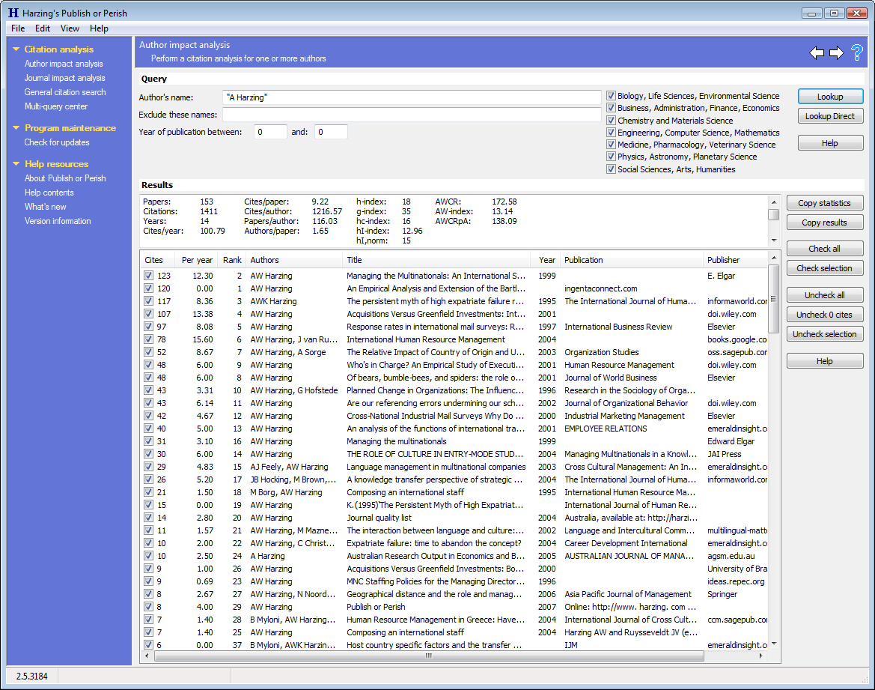
Other Journal Ranking Efforts…
Publish or Perish (PoP)
Based on Google Scholar citations, can analyze (up to 999 entries) by author or journal. For journals POP provides:
Free software (for academics) ; download: harzing.com/pop.htm
harzing.com/pop.htm

Slide 101
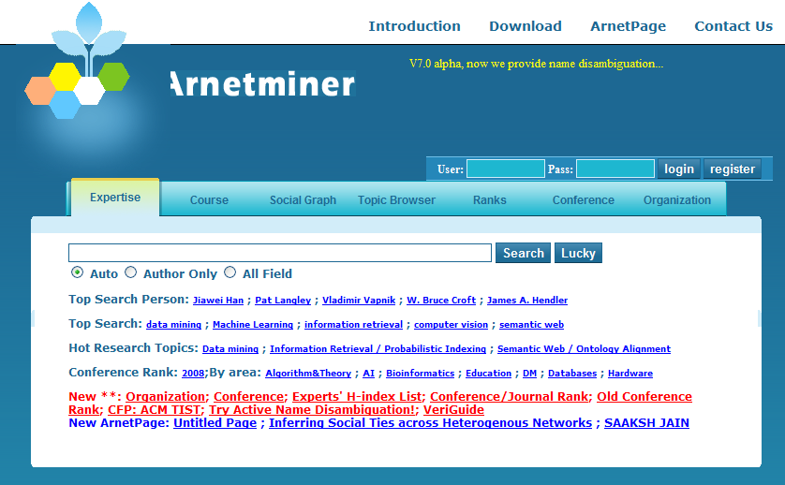
Arnetminer
http://www.arnetminer.org/

Slide 102
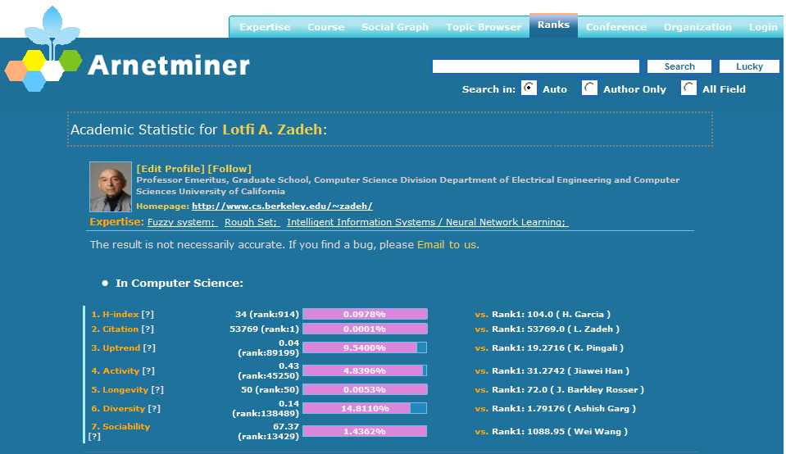
Arnetminer
http://www.arnetminer.org/

Slide 103
Paul Halmos's Comments
From P. Halmos, Selecta: Expository Writing, Springer-Verlag, 1983, pp. 192-195.
If someone offered you $1000 for a paper you are about to submit, if you instead tear it up, would you take the money? If so, do not submit the paper.
Do not publish a solution for a problem in 2 dimensions in 1992, 3 dimensions in 1993, and k dimensions in 199k.
Do not publish your failures: I tried to prove so-and-so, and I couldn't; here it is --- see?
A theory is worth studying if it has at least three distinct good hard examples.

Slide 104
Your 10 Best Papers Define Your Career
Concluding Remarks
Tenure/Promotion/Career Advancement: One of the best ways for researchers to make contributions to society and to be recognized professionally is to publish as many papers as possible in a number of prestigious professional journals. Moreover, most institutions ask you to identify your single most important “contribution” and the top 5-10 papers that define that contribution. You must develop a body of research that is identified as your research independent of your mentors and colleagues.

Slide 105
Concluding Remarks Karol Życzkowski
One should not abuse bibliometric data:
For instance, article influence, impact factor (IF) say something about the quality of the journal, but it should not be used to evaluate research !
Citation – based indices are better for this purpose (but by far not perfect.) In any case one should compare similar branches of sciences and rescaled data only !

Slide 106
Concluding Remarks Karol Życzkowski
For Researchers:
* Do well your research, write fine papers and publish them in good journals.
* Do not care much about impact factors, citations, benchmarks and indices…
* Do not use your time and energy to enter the game to inflate your bibilometric indices:
** A good scientist will have healthy numbers according to any bibliometric measure...

Slide 107
Concluding Remarks Karol Życzkowski
For Administrators of Science:
Science has multiple goals – do not try to project the multi-dimensional system into a single axis!
Do not hope to get a single bibliometric parameter universally suitable for evaluation.
Usage of several bibliometric indicators in parallel reduces the risk of data manipulation.
Support versatile usage of scientometry, in which evaluated researchers take active part.
example: benchmarks used in ERC grants:
Applicant selects his ten best papers published in the last decade and provides the number each of them was cited.

Slide 108
Scientific Advisors:
My sincere thanks goes to those who helped me with their constructive comments, specially:
Dr. Bijan Ahmadi; Analysis
Dr. Hossein Azari; Applied Mathematics
Dr. Amir Hossein Asghari; Mathematics Education
Dr. Amir Daneshgar; Combinatorics & General
Dr. Masoud Hajarian; Applied Mathematics
Dr. Morteza Moniri; Logic
Dr. Mona Nabiei; Analysis
Dr. Hossein Sabzrou; Algebra & General
Dr. Jafar Shafaf; Geometry
Dr. Alireza Taheryoun; Statistics

Slide 109
Also, I wish to acknowledge:
Ms. Abbasgholi; B.D. of Statistics
Ms. Maleki; Ph.D. Student of Mathematics
Mr. Rostami; M.D. Of Mathematics
Mr. Shaebani; Ph.D. Student of Mathematics
Ms. Shakouri; B.D. of Statistics
Thank you very much for your attention!

Slide 110
