Slide 1

Welcome to PHI 201
Introductory Logic

Slide 2
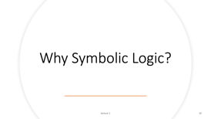

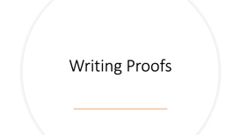
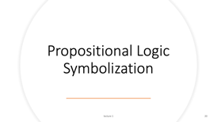
Outline of Today’s Lecture

Slide 3
Course Information

Slide 4

Instructors
Hans Halvorson
Quanzhi Liang
Ludovica Medaglia
Pacy Yan
Chris Hughes
Jacob Khawaja
Jaehyun Hong
Junyan Jiang

Slide 5
Course flow chart (semester)
psets
midterm exam
psets
final exam

Slide 6
Exams – In Class
Midterm
80 minutes
Propositional logic translation, proofs, truth tables
Final
2 hours
Cumulative
Predicate logic translation, proofs, structures
This course is more like a language course than a history course: focus on learning a skill, not on storing information

Slide 7
Course flow chart (weekly)
precept
complete pset
read over pset
lecture
read textbook

Slide 8
Problem sets
Encouraged to work together with other students
Don’t copy something if you don’t understand it
If you rely on AI for psets, then you will flounder on the exams

Slide 9
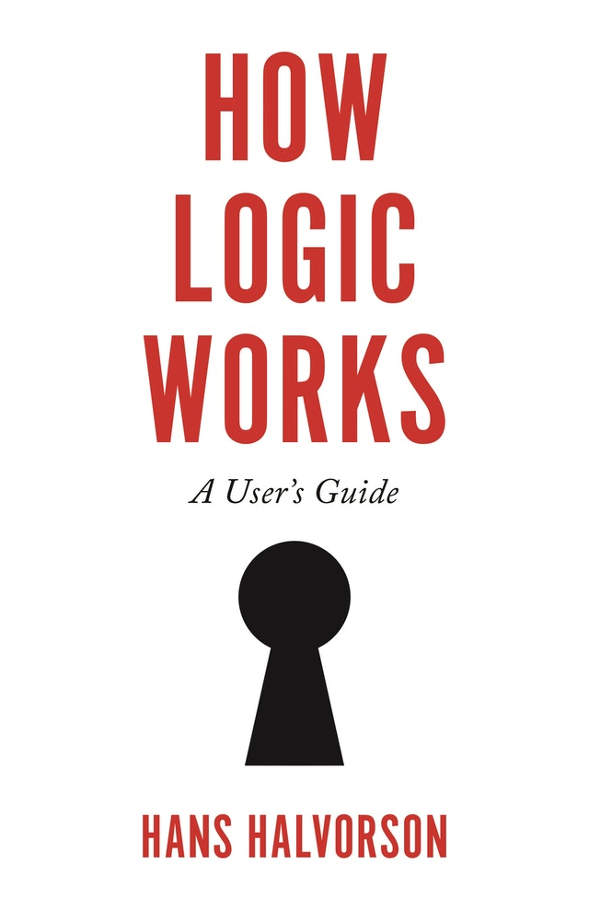

Slide 10
Why Symbolic Logic?

Slide 11
Arguments
Arguments occur in every academic discipline, and in every profession that requires active thinking
An argument occurs whenever somebody tries to show that one claim (the conclusion) follows logically from some other claims (the premises)
The conclusion and premises are statements: declarative sentences that are either true or false.
Statement
Proposition
Assertion

Slide 12
Three goals of this course
Get better at producing good arguments
Get better at judging whether arguments are good
Get better at convincing yourself (and others) that arguments are not good

Slide 13
What is a “good” argument?
Subjective: ”seems convincing to me”
Objective: an argument that is strong in an objective sense
Abductive argument: premises are intended to give some support for the conclusion
Deductive argument: premises are intended to prove (entail, imply) the conclusion
A flawless deductive argument is said to be sound

Slide 14
What is a sound argument?
To say that an argument is sound means:
Its premises are true.
The truth of its premises establish the truth of its conclusion.

Slide 15
What is an argument’s form?
All people are mortal. Beyoncé is a person. Therefore, Beyoncé is mortal.
All Princeton alumni are rich. Bezos is a Princeton alumnus. Therefore, Bezos is rich.

Slide 16
All whales are mammals. Every mammal has a heart. Every whale has a heart.
All lizards are mammals. Every mammal has a heart. Every lizard has a heart.

Slide 17
Some philosophy concentrators are in this class.
Some people in this class are female.
Therefore, some philosophy concentrators are female.
Some philosophy concentrators are in this class.
Some people in this class are physics concentrators.
Therefore, some philosophy concentrators are physics concentrators.

Slide 18
What are the valid argument forms?
Top down: define valid argument form
Bottom up: sort arguments into good and bad, then try to figure out what is common to the good ones

Slide 19
Preview
Identify propositional form of English sentences
Identify some basic valid propositional forms (e.g. modus ponens)
Learn how to chain valid forms together

Slide 20
Propositional Logic Symbolization

Slide 21
Thesis
Every sentence has a unique propositional structure: it is built out of logically simple (atomic) sentences, using propositional connectives (such as “...and...” and “...or...”).

Slide 22
Conjunction
Roses are red and violets are blue.

Slide 23
Atomic Sentences
There are infinitely many prime numbers.
A sentence is atomic if it contains no connectives – equivalently, contains no proper sub-sentences
We will symbolize an atomic sentence with a single letter

Slide 24
Negation
Roses are not blue.
It is not the case that (roses are blue).
It is not the case that B.

Slide 25
Embedded negation
Roses are red and violets are not green.
R and not-G

Slide 26
It is not the case that roses are red and violets are green.
It is not the case that (roses are red and violets are green)

Slide 27
Disjunction
Either roses are red or violets are blue
Either R or B

Slide 28
Either roses are red or both violets are blue and emeralds are green.
Either roses are red or (violets are blue and emeralds are green)

Slide 29
Conditional (if … then …)
If Biden wins PA then Biden wins the election
If P then E

Slide 30
If Biden lost the election then he lost both Pa and Ga

Slide 31
Peculiar constructions
Neither P nor Q

Slide 32
Peculiar constructions
Not both P and Q

Slide 33
Peculiar constructions
P only if Q
A person can vote in the US election only if she is at least 18 years old

Slide 34
Peculiar constructions
P unless Q
Trump will be nominated unless Haley pulls off an upset.

Slide 35
If Jones isn’t a crook, then neither is Smith.
I will graduate, provided I pass both logic and history.

Slide 36
I will SUCCEED only if I WORK hard and take RISKS.
JONES will win the championship unless she gets INJURED, in which case SMITH will win.

Slide 37
If you work hard only if you are threatened, then you will not succeed.
If you CONCENTRATE well only if you are ALERT, then provided that you are WISE you will not FLY an airplane unless you are SOBER.

Slide 38

Summary
Propositional connectives
And $∧$
Or $∨$
Not $¬$
If...Then... $→$
Atomic sentences

Slide 39
Writing Proofs

Slide 40
Goal: be able to reproduce all and only valid argument forms
Examples
Should be able to prove 𝑃 ∨ ¬𝑃
Should not be able to prove 𝑃 ∧ ¬𝑃
Constructing validities
Atoms = one step basic arguments
Molecules = string arguments together

Slide 41
Philosophical idea
Each valid inference is licensed by the meaning of some or other special logical word
For each propositional connective, there will be an introduction rule and an elimination rule

Slide 42
Plan of action
Deducing: rule of assumptions, and-elim, and-intro, or-intro, if-elim (modus ponens), modus tollens, double negation intro and elim
Supposing: if-intro (conditional proof), or-elim, reductio ad absurdum
See page 231 of HLW for a summary of the inference rules

Slide 43
Rule of assumptions
If we ask you to prove conclusion Y from premises X₁,...,X_{n}, then you should begin your proof with these assumed lines:
(1) X₁ A
(2) X₂ A
(n) X_{n} A
The “A” on the right indicates “Assumption”, and is the justification for the line

Slide 44
and-elimination

Slide 45
and-introduction

Slide 46

$$P∧Q⊢Q∧P$$

Slide 47

To show: $P⊢P∧P$ and $P∧P⊢P$

Slide 48

To show: $\left(P∧Q\right)∧R⊢P∧(Q∧R)$

Slide 49
or-introduction

Slide 50

To show: $P⊢Q∨(P∨Q)$

Slide 51

To show: $P∧Q⊢Q∨R$

Slide 52

To show: $P∧Q⊢\left(P∨R\right)∧(R∨Q)$

Slide 53

Modus ponens (MP)
$$\left(m\right) A→B \\ \left(n\right) A \\ ⋮ \\ \left(o\right) B m,n MP$$
To show: $\left(P∨Q\right)→R,P⊢R$

Slide 54

To show: $P→\left(P→Q\right),P⊢Q$

Slide 55

Modus tollens (MT)
$$\left(m\right) A→B \\ \left(n\right) ¬B \\ ⋮ \\ \left(o\right) ¬A m,n MT$$

Slide 56

To show: $Q→\left(P→R\right), ¬R∧Q⊢¬P$

Slide 57

Double negation (DN)
$$\left(m\right)A$$ $\left(n\right)¬¬A$ m DN
$$\left(m\right)¬¬A$$ $\left(n\right)A$ m DN

Slide 58

To show: $P→¬Q, Q⊢¬P$

Slide 59

To show: $¬\left(P→Q\right)→Q,¬Q⊢¬P$

