Slide 1
Niels Bohr’s Livsanskuelse

Slide 2
Defensive
”Without doubt, Bohr’s philosophical views have shaped the way generations of physicists think about quantum mechanics, but they have also, in the eyes of an increasing number, discouraged and stifled progress.” Jim Al-Khalili, The World According to Physics

Slide 3
Defensive
”And so there is this philosophy [i.e. Bohr’s], which was designed to reconcile people to the muddle; You shouldn't strive for clarity — that’s naive. “Muddle is sophisticated.” I have heard distinguished people say that this philosophy was important to them as physicists. It allowed them to feel somehow that these things were understood and that nothing could be done except what they were doing. Then they got on with their work.” (John Bell)

Slide 4
Offensive
Closing the gap between history and contemporary practice in physics
Closing the gap between the humanities and science
Conceptual understanding in physics
Deep humanities roots grow stronger scientists

Slide 5
Wanted: A worldview adequate to life in science
Lack of philosophical sophistication in postwar (US centric) physics
Polarization
Realism versus Antirealism
Objectivism versus Subjectivism
Science versus Humanities [educational polarization]

Slide 6
What made Bohr tick (as a scientist)?
How did Bohr conceive of the goal of science?
Human centric
Høffding, Personlighedsprincippet
Einstein: “I want to know God’s thoughts”

Slide 7
Objectivity
Éntydighed
“No man who is called a philosopher really understands what one means by the complementary description. … they did not see that it was an objective description, and that it was the only possible objective description.”
Complementarity

Slide 8
Complementarity as a generalization of Einstein’s relativity
“… the principle of relativity has thus essentially extended the frame and scope for objective description of physical phenomena.”
“In pointing directly to our position as regards objective description of experience, the notion of complementarity exhibits a certain resemblance with the principle of relativity.
…the lesson of physical science reminds us of our position as regards objective description in many other fields of knowledge.”

Slide 9
Complementarity as a generalization of Einstein’s relativity
“Before concluding I should still like to emphasize the bearing of the great lesson derived from general relativity theory upon the question of physical reality in the field of quantum theory. In fact, notwithstanding all characteristic differences, the situations we are concerned with in these generalizations of classical theory present striking analogies which have often been noted.”

Slide 10
Objectivity
Objectivity = Éntydighed
Ambiguity = Tvetydighed
“By the lesson regarding our position as observers of nature, which the development of physical science in the present century has given us, a new background has, however, been created just for the use of such words as objectivity and subjectivity. From a logical standpoint, we can by an objective description only understand a communication of experience to others by means of a language which does not admit ambiguity as regards the perception of such communications.”

Slide 11
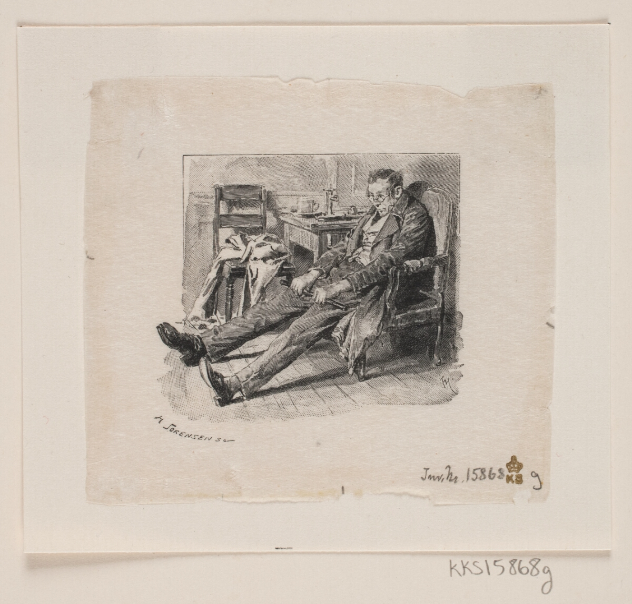
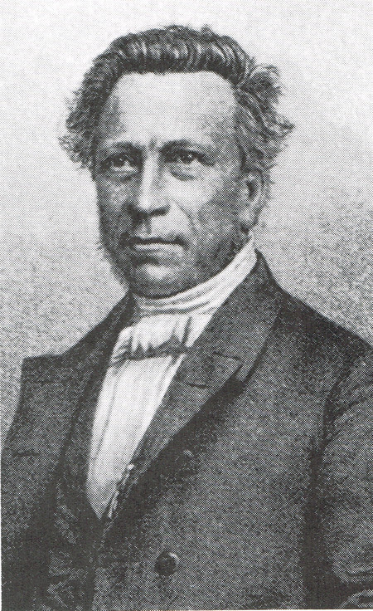
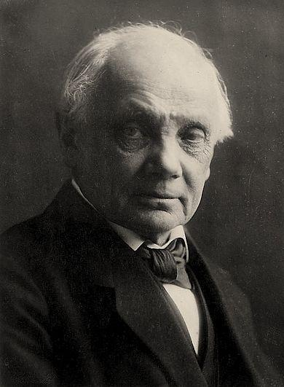
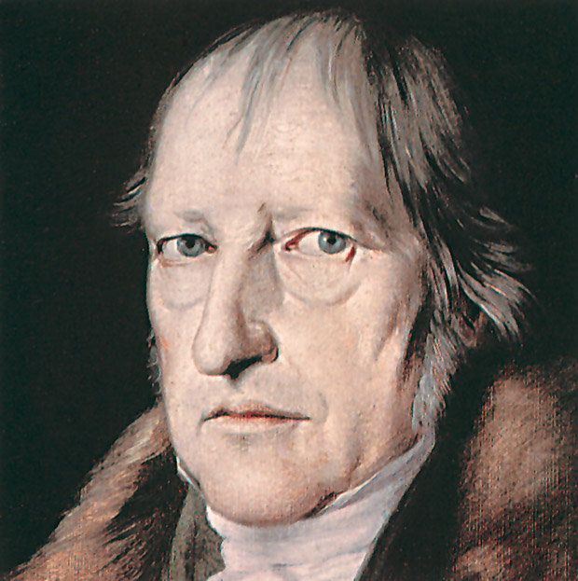
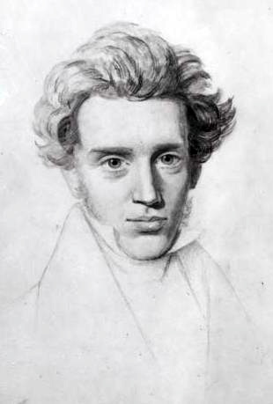
Subject and object
”Viljesfølelse og årsagskrav er lige uundværlige elementer i forholdet mellem subjekt og objekt, som er erkendelsesproblemets kerne.”

Slide 12
”Enhver entydig meddelelse om vor sindstilstand indebærer naturligvis en skelnen mellem indholdet af vor bevidsthed og den baggrund, som vi løst henviser til som ‘os selv’. Men ethvert forsøg på udtømmende at beskrive det bevidste livs rigdom forlanger i de varierende situationer en forskellig placering af skillelinjen mellem subjekt og objekt.”

Slide 13
“Det er imidlertid indlysende, at enhver søgen efter et sidste subjekt er i strid med objektiv beskrivelses væsen, der jo forlanger en modstilling af subjekt og objekt.”

Slide 14
New research strategies
Bohr in context
19th century Danish and German philosophy
E.g. Høffding’s notes from Nielsen’s Filosofikum
Language
Niels Bohr as language engineer
Fruitfulness of Danish word search (éntydig, skillelinje, at bestemme, osv.)
Extended intellectual circles
Anton Thomsen, Edgar Rubin, Brandes brothers
Friends and family
E.g. letters between Christian Bohr and friends

Slide 15
New research strategies
Postwar physics and the backlash against Bohr
Princeton connection?
Logic and analytic philosophy
Theory of theories
Communication and context
Don’t lose touch with contemporary physics or physicists
Quantum dialogues [the correspondence]

Slide 16
Definition

Slide 17
Mechanism and teleology

Slide 18
Reference frames

Slide 19
Causality

