Slide 1
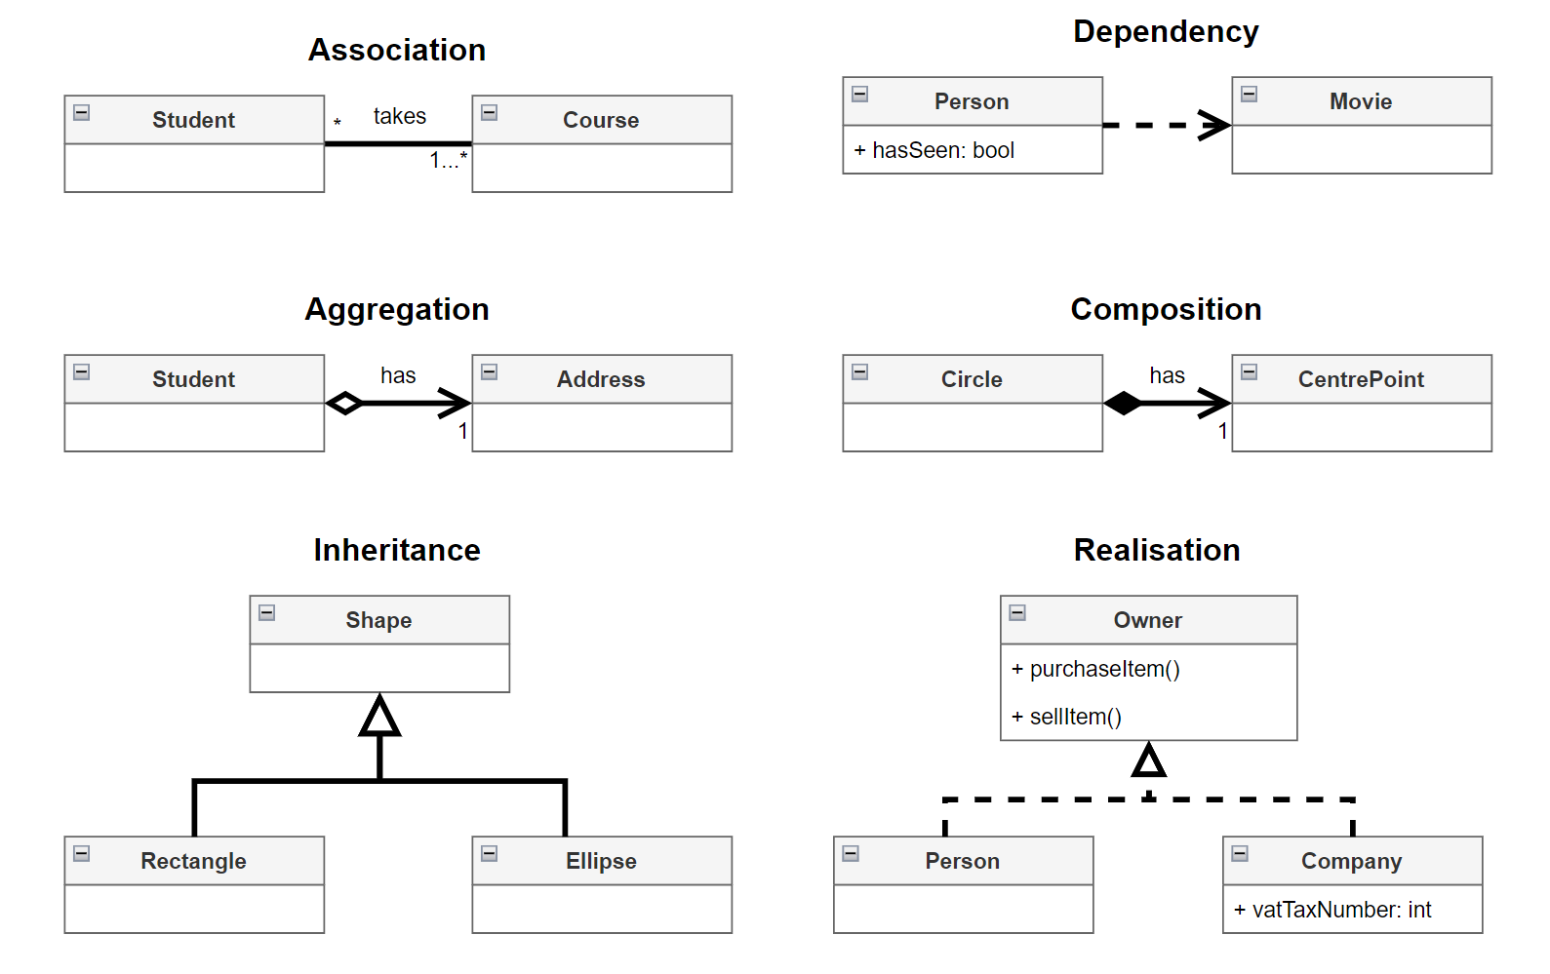
Realization depicts the
relationship between
an interface and
a class implementing
that interface.

Slide 2
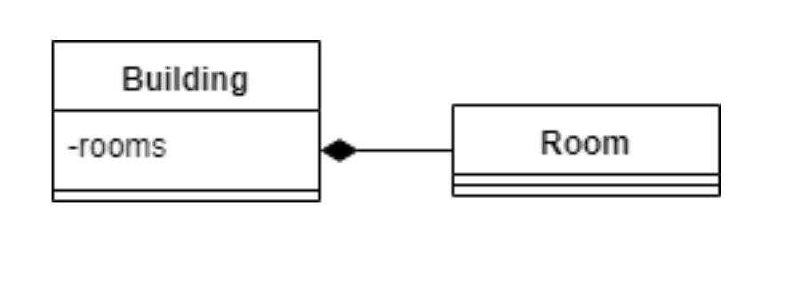
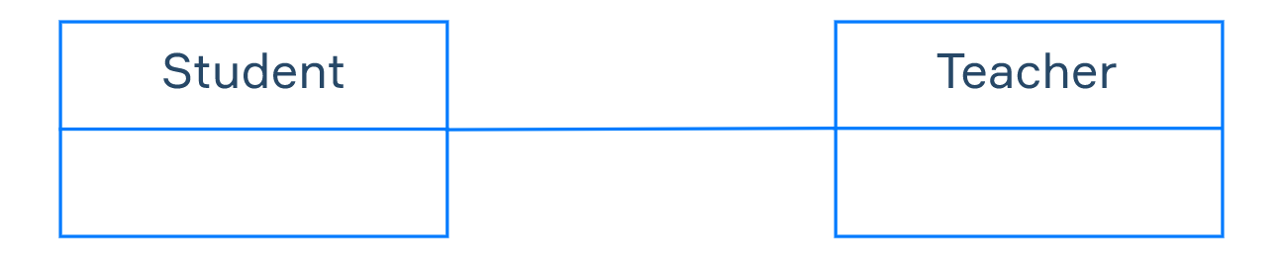
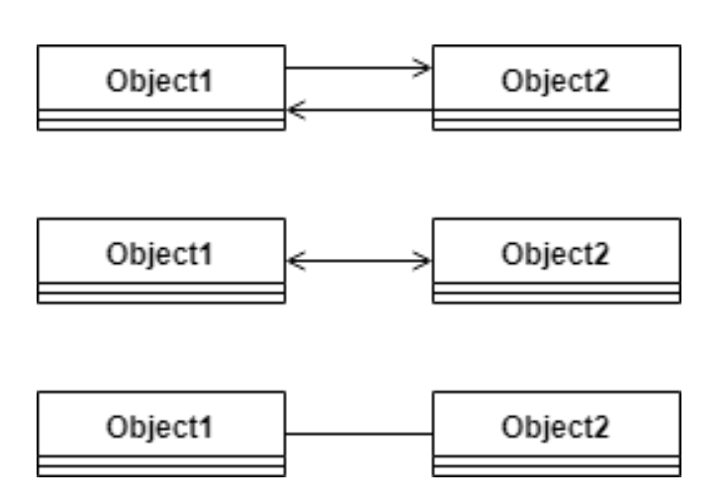
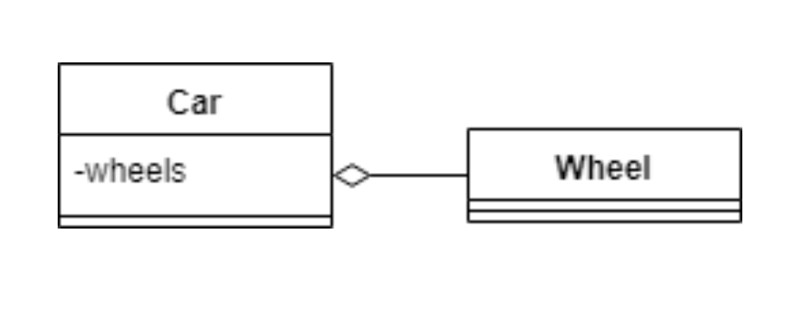
COMPOSITION
ASSOCIATION
AGGREGATION

Slide 3
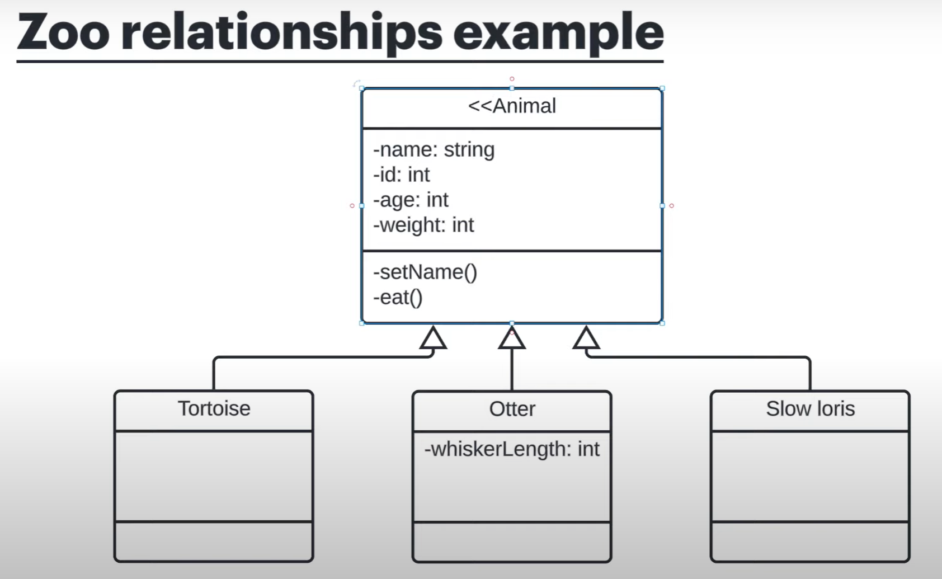
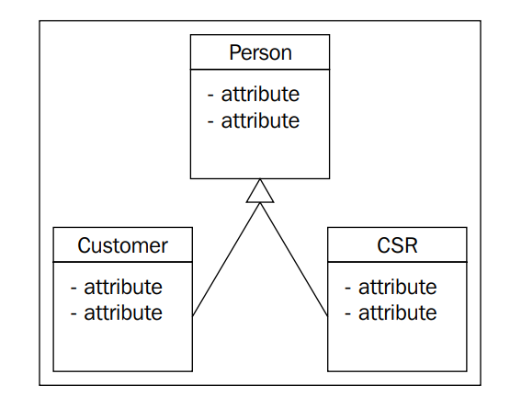
INHERITANCE

Slide 4
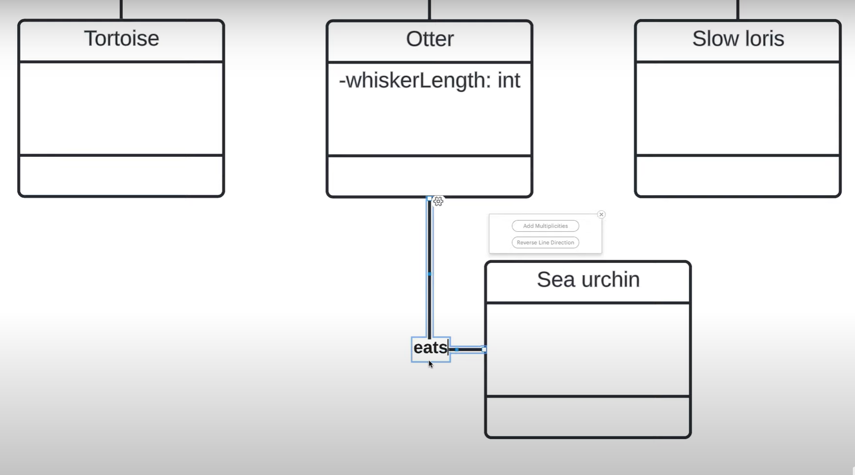
ASSOCIATION

Slide 5
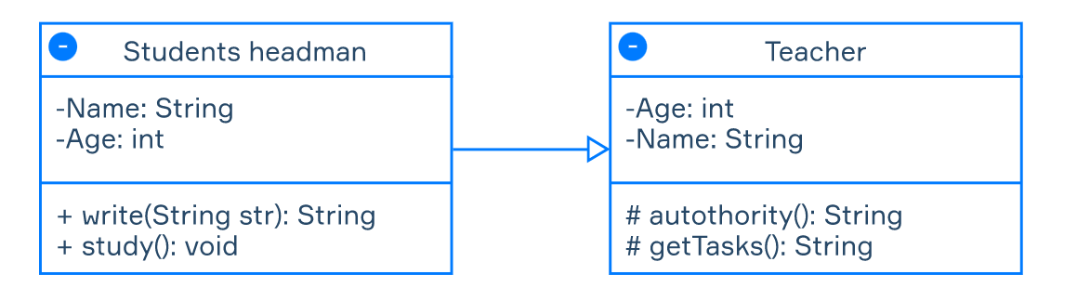
+ (Public) – element can be accessed by any class in the system;
- (Private) – element can be accessed only by a class that owns it;
# (Protected) – element can be accessed by classes that have a generalization (or inheritance) relationship with its class;
~ (Package) – element can be accessed by classes that are located in the same package.

Slide 6
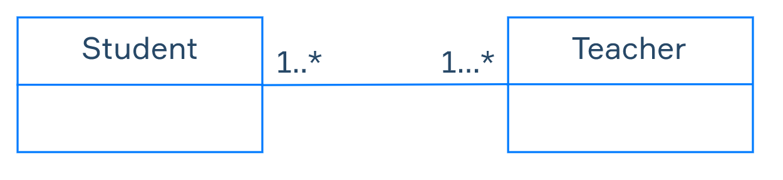
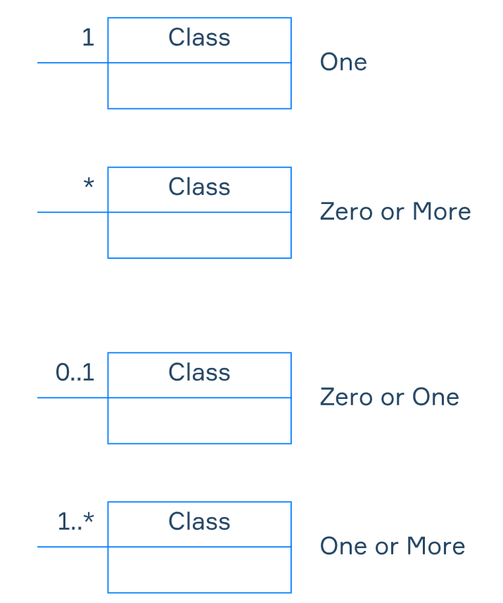
CADINALITY

Slide 7
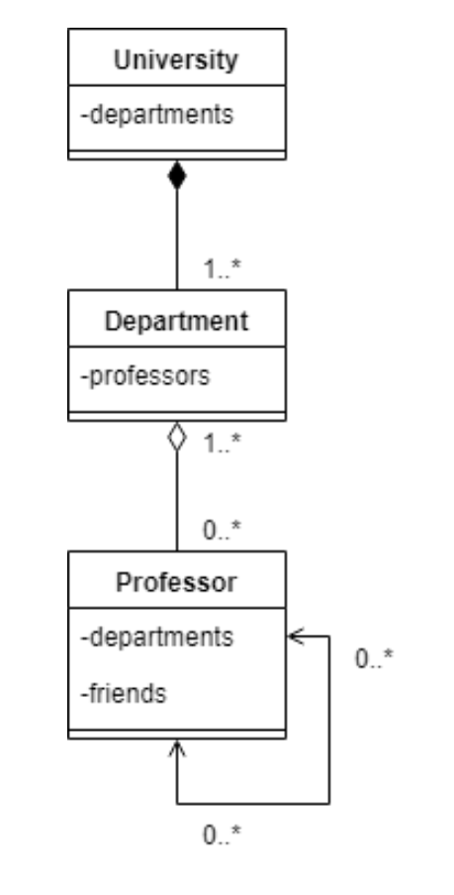
A university, which has its departments.
Professors work in each department, who also has friends among each other.
Will the departments exist after we close the university? Of course not, therefore it’s a composition.
But the professors will still exist.
A professor can work in multiple departments.

Slide 8
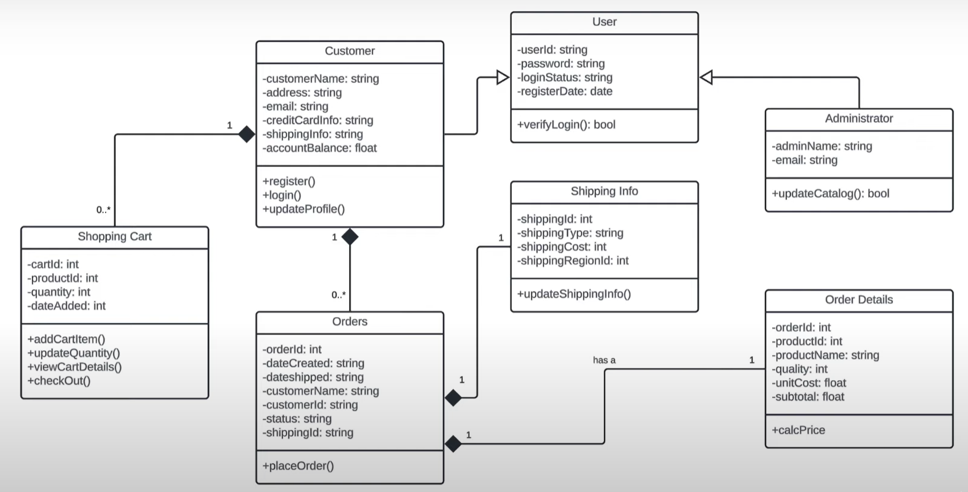
REAL WORLD EXAMPLE

