Slide 1

Be Real Not Fake – Know Your Value SOFTWARE DEPARTMENT
AORBIS

Slide 2
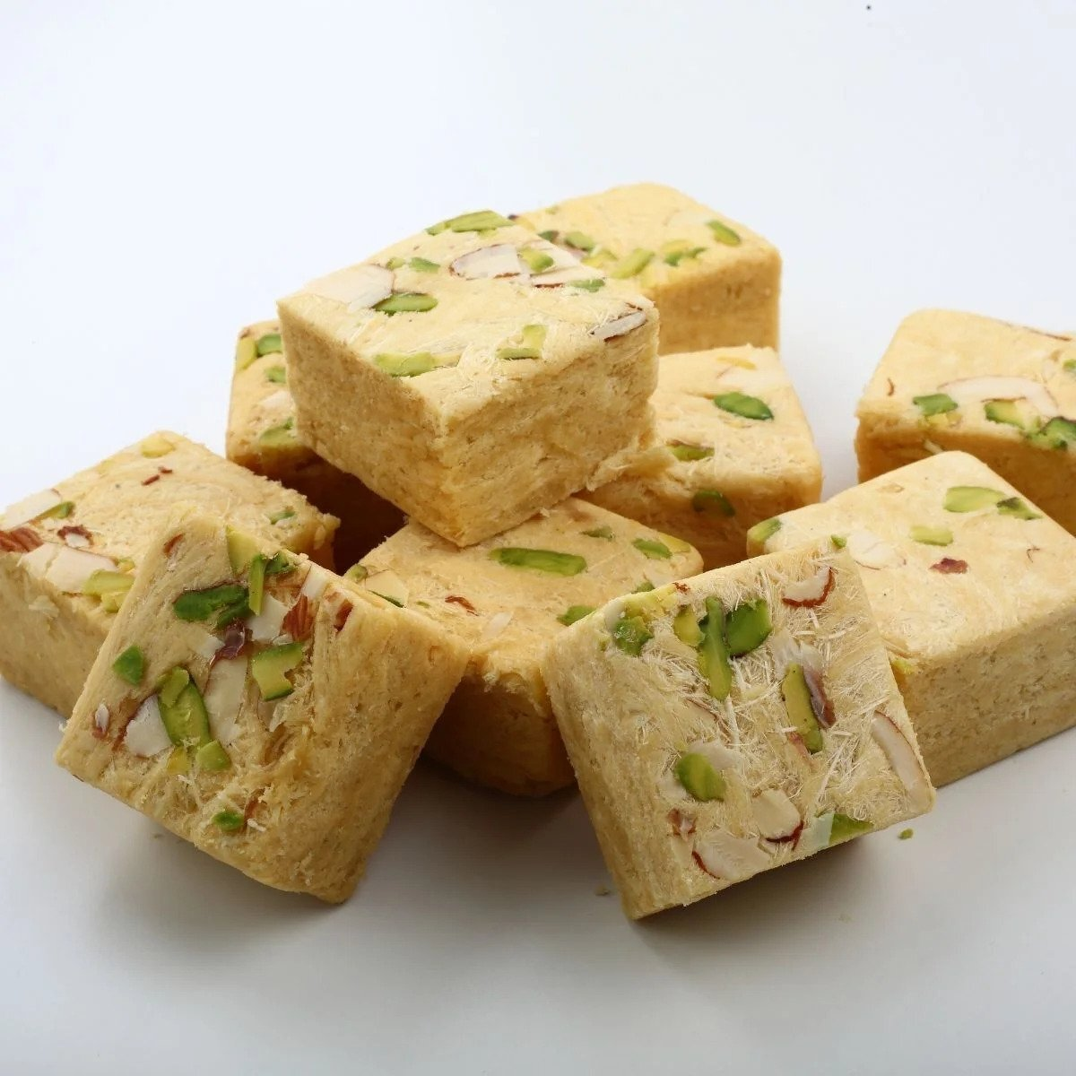
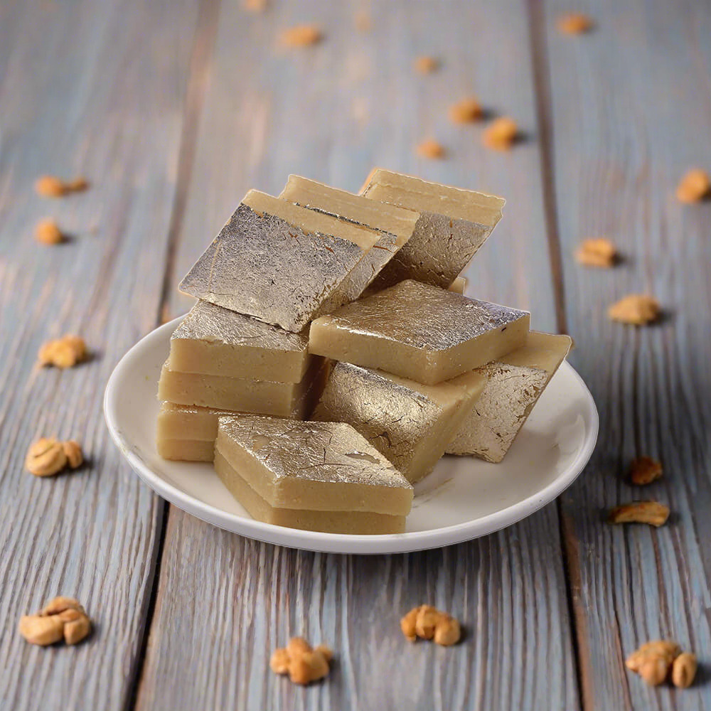
Identify the Sweet

Slide 3
Identify the Sweet
< ₹500
> ₹1000
ss

Slide 4
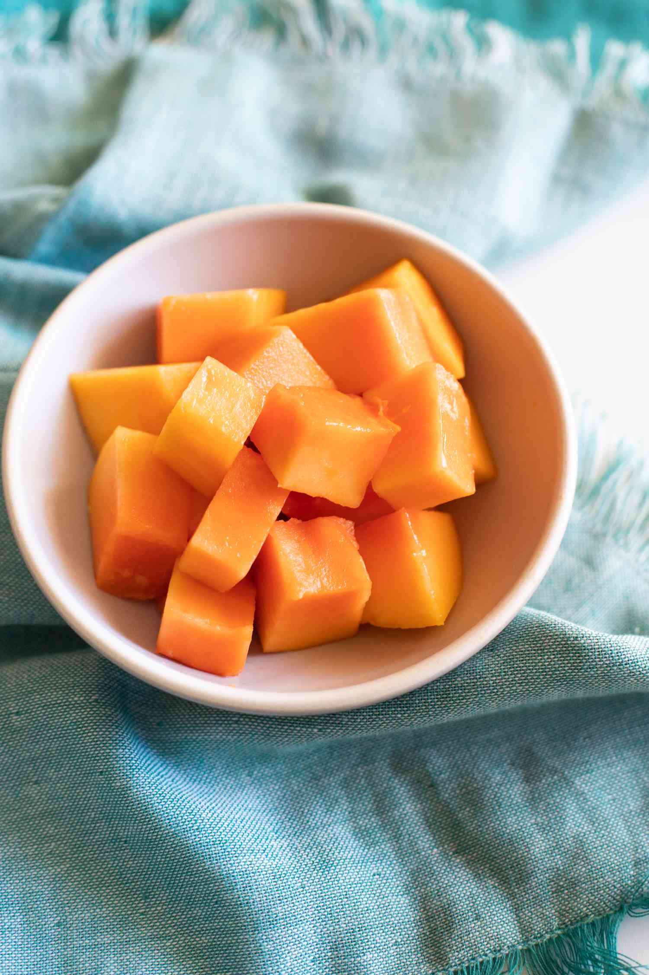
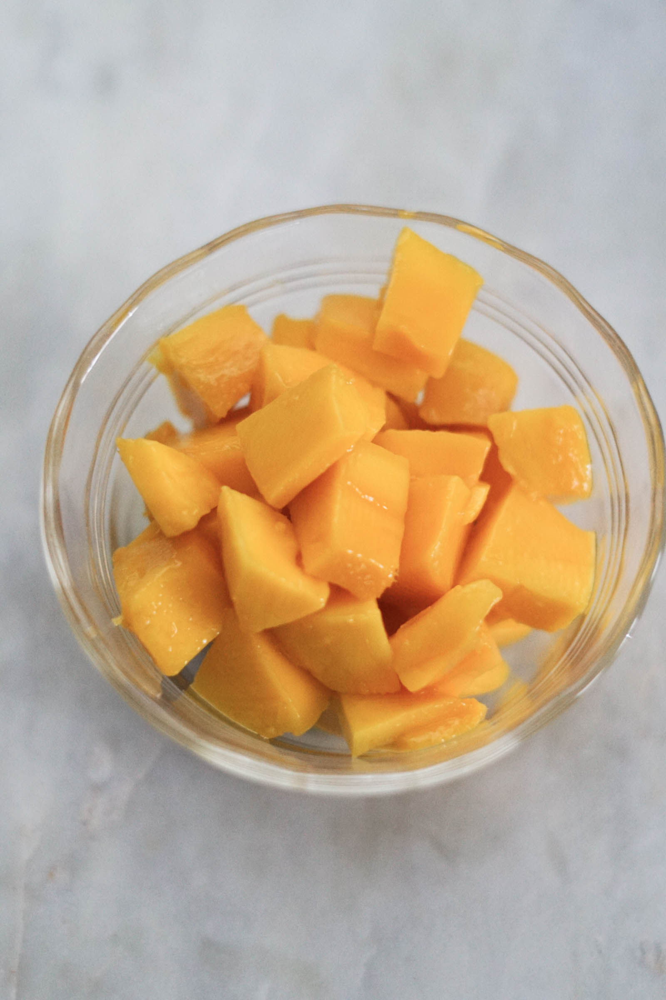
Identify the fruit

Slide 5
Identify the fruit
Papaya
Mango

Slide 6
Identify the fruit
Papaya
Mango

Slide 7
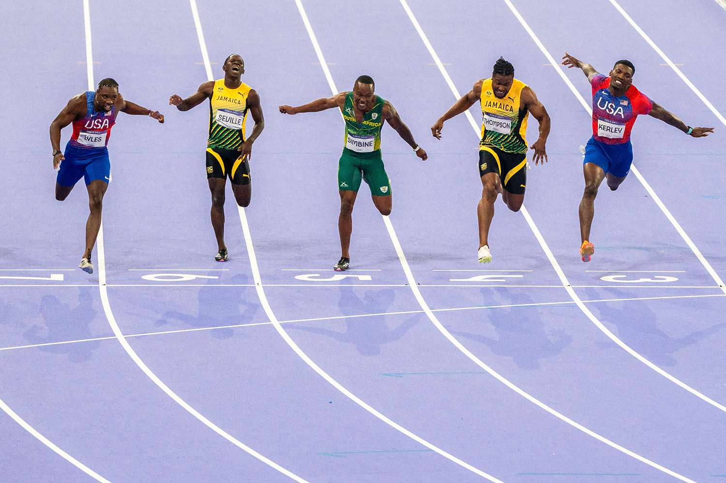
Everyone starts Equally

Slide 8
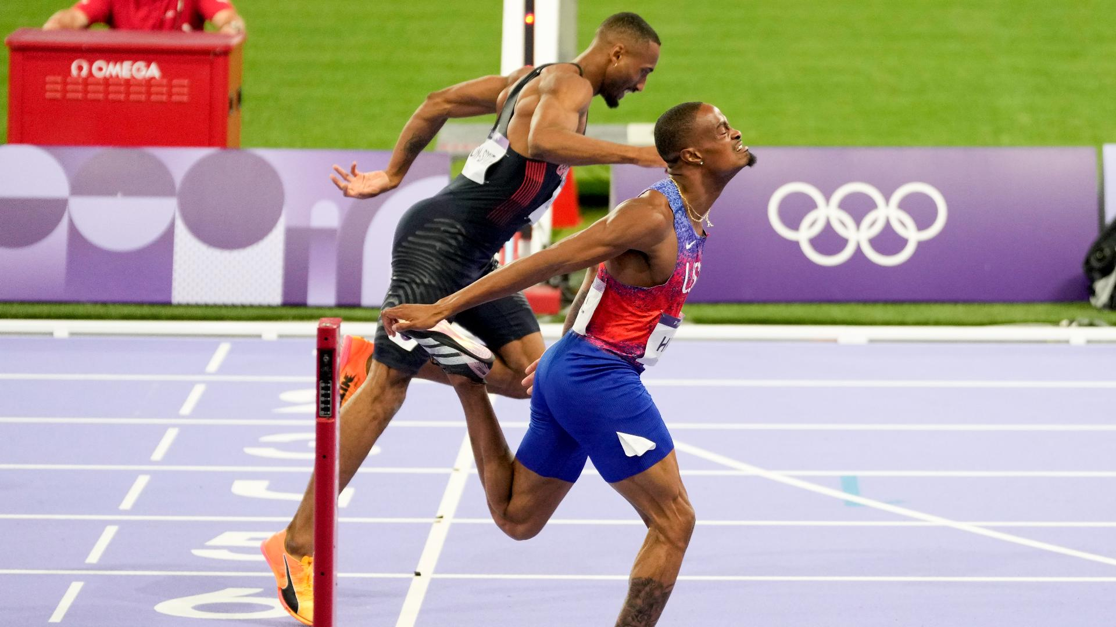
Winner Can be Only ONE

Slide 9

Effort takes time – balancing Bits & Pieces

Slide 10

Minify the Potential Risk

