Slide 1
COMP3311 Tutorial Week 3
Yifan He

Slide 2
Week 2 Summary
Self check:
  ER → SQL mapping
  create table, insert, delete, update
Due date: Quiz 2 (2%), Friday this week
All code will be uploaded to https://github.com/hharryyf/COMP3311-23T1-Tutoring

Slide 3
Today’s plan
ER → SQL mapping
  Map relationship (n:n, 1:n, 1:1); Q2
  Map hierarchy; Q4
  Example: Q15
Insert table with circular dependencies

Slide 4
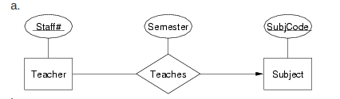
Q2 (1)

Slide 5
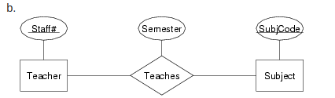
Q2 (2)

Slide 6
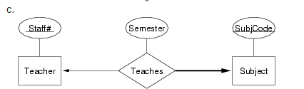
Q2 (3)

Slide 7
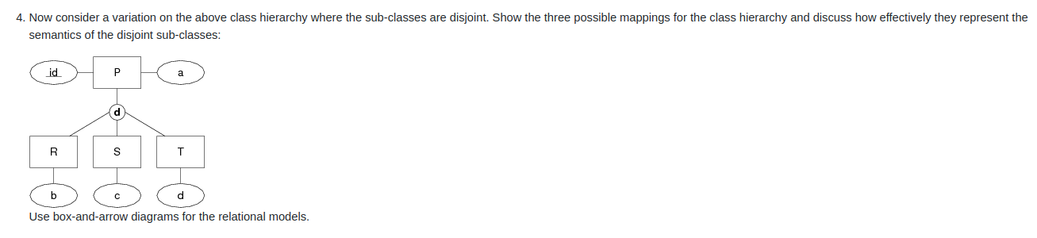
Q4

Slide 8
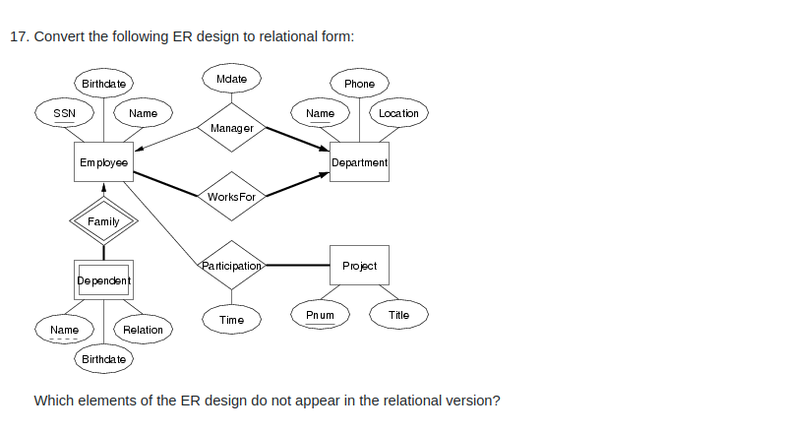
Q17

Slide 9
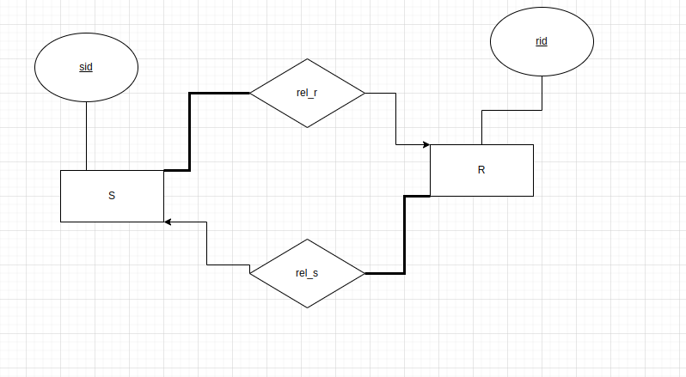
Q17 Remark
The tables in Q17 can be created normally
How can we insert any tuples into the following tables?

