Slide 1
A strategy game based approach on solving logic formulas
Yifan He
Supervised By Dr. Abdallah Saffidine
Thesis A seminar
2021 T2

Slide 2
Motivation
QBF is similar to 2-player strategy game in a theoretical level
All search based QBF solving algorithms used depth first search
Depth first search or iterative deepening search is rarely used in solving strategy games
- Shogi dfs cannot solve a game with more than 17 steps
- best first search can solve games with 100+ steps.
Depth first search based algorithms might be trapped on the wrong side of the searching space
QBF has a very deep searching space, dfs is not ideal
Notes:
Put it at the beginning of the slides.

Slide 3
Outline
Technical Background
Aim of the project and Preliminary Results
Future Plan

Slide 4
Outline
Technical Background
QBF preliminaries
QDLL
Backjumping
QCDCL
QBF as strategy game
PNS
Aim of the project and Preliminary Results
Future Plan
Notes:
Add subsections

Slide 5
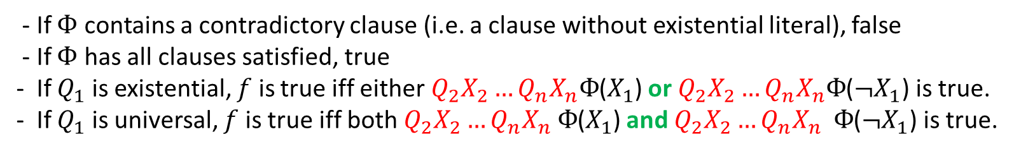
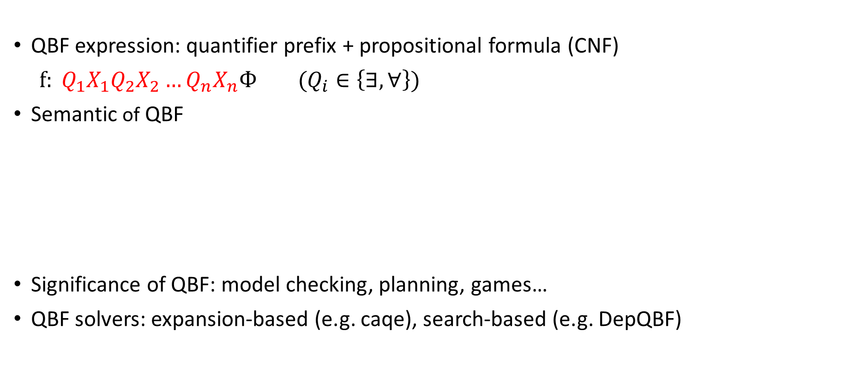
QBF
QBF expression: quantifier prefix + propositional formula (CNF)
$f: Q_{1}X_{1}Q_{2}X_{2}…Q_{n}X_{n}Ф (Q_{i}∈\left\{∃,∀\right\})$
Semantic of QBF
Significance of QBF: model checking, planning, games…
QBF solvers: expansion-based (e.g. caqe), search-based (e.g. DepQBF)
- If $Ф$ contains a contradictory clause (i.e. a clause without existential literal), false
- If $Ф$ has all clauses satisfied, true
- If $Q_{1}$ is existential, $f$ is true iff either $Q_{2}X_{2}…Q_{n}X_{n}Ф$($X_{1}$) or $Q_{2}X_{2}…Q_{n}X_{n}Ф$($¬X_{1}$) is true.
- If $Q_{1}$ is universal, $f$ is true iff both${ Q}_{2}X_{2}…Q_{n}X_{n} Ф$($X_{1}$) and $Q_{2}X_{2}…Q_{n}X_{n} Ф$($¬X_{1}$) is true.

Slide 6
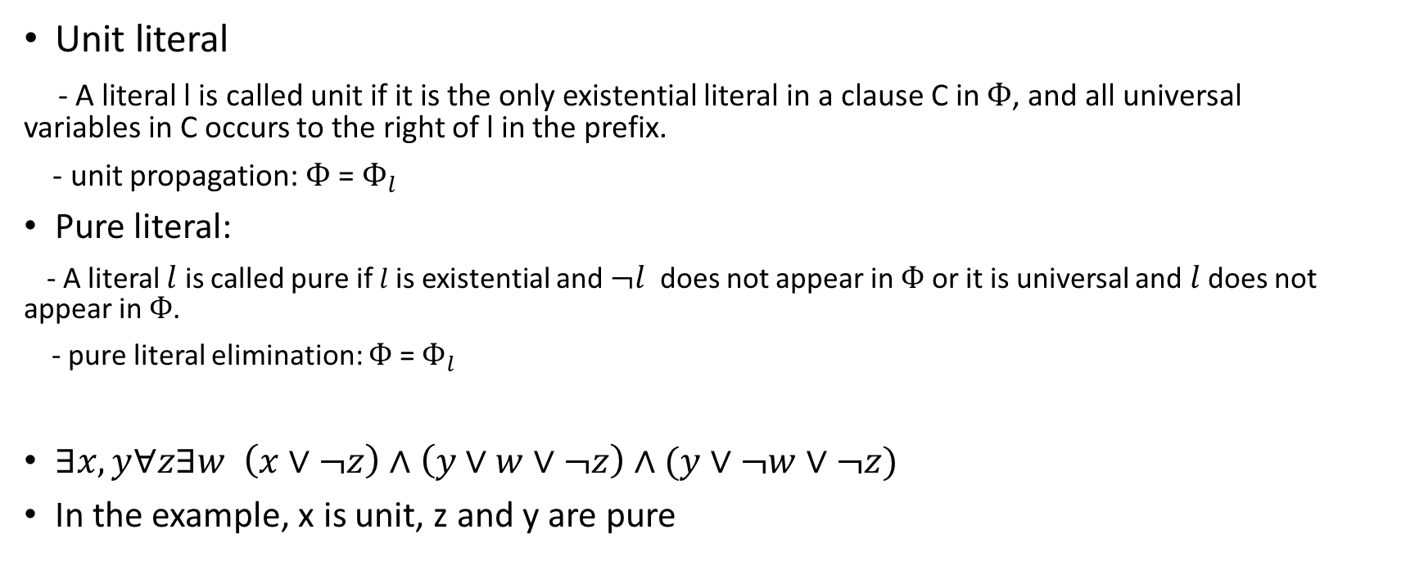
Unit and pure literals
Unit literal
- A literal l is called unit if it is the only existential literal in a clause C in $Ф$, and all universal variables in C occurs to the right of l in the prefix.
- unit propagation: $Ф$ = $Ф_{l}$
Pure literal:
- A literal $l$ is called pure if $l$is existential and $¬l$ does not appear in $Ф$ or it is universal and$l$ does not appear in $Ф$.
- pure literal elimination: $Ф$ = $Ф_{l}$
$∃x,y∀z∃w \left(x∨¬z\right)∧\left(y∨w∨¬z\right)∧(y∨¬w∨¬z)$
In the example, x is unit, z and y are pure
Notes:
Add examples, some unit literals, some pure literals

Slide 7
QDLL
Modification of the DPLL (Davis–Putnam-Logemann–Loveland) algorithm in SAT
Proposed by Cadoli, Giovanardi, and Schaerf in around 1998
Baseline procedure for search based solver
QBF semantic + unit propagation + pure literal elimination
Notes:
What QDLL stands for
Explain the partial assignment
No universal variables

Slide 8
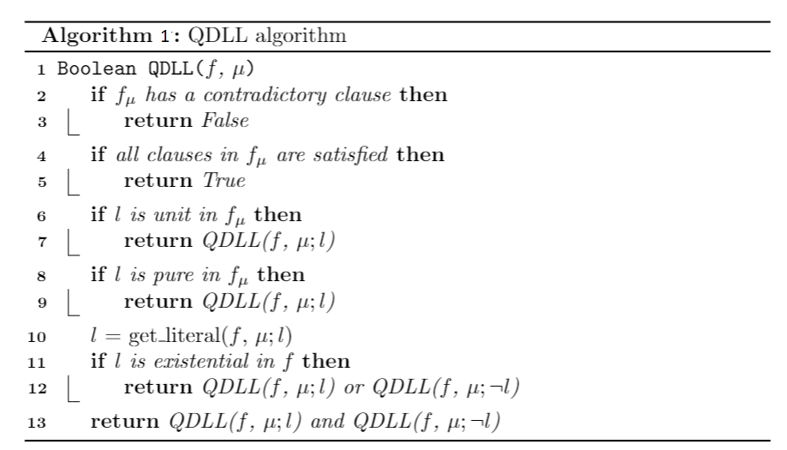

QDLL (conventional)

Slide 9
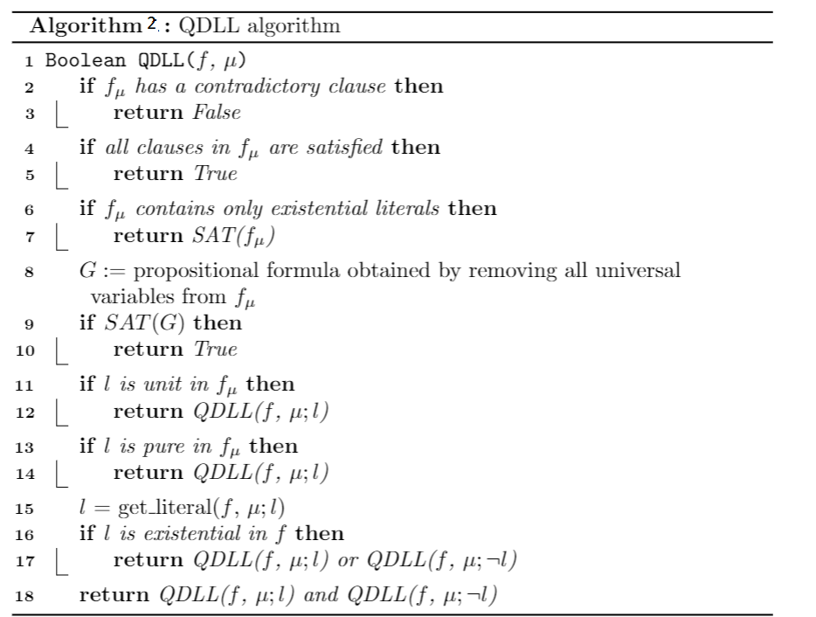
QDLL (original paper)

Slide 10
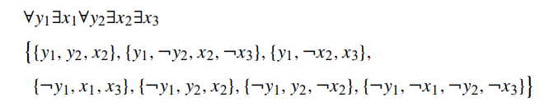
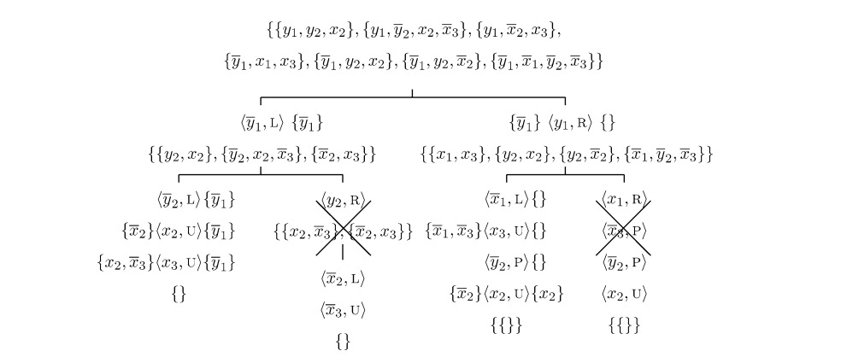
Backjumping (Dependency backtracking)
Proposed by E. Giunchiglia in 2001
Quaffle-BJ (2006), QUBE-BJ (2004)
Main idea:
- reason for conflict/solution
- maintain reason during backtrack
- pruning and level-cut
- the body of the QDLL algorithm is unchanged
Reference: https://www.sciencedirect.com/science/article/pii/S0004370202003739

Slide 11
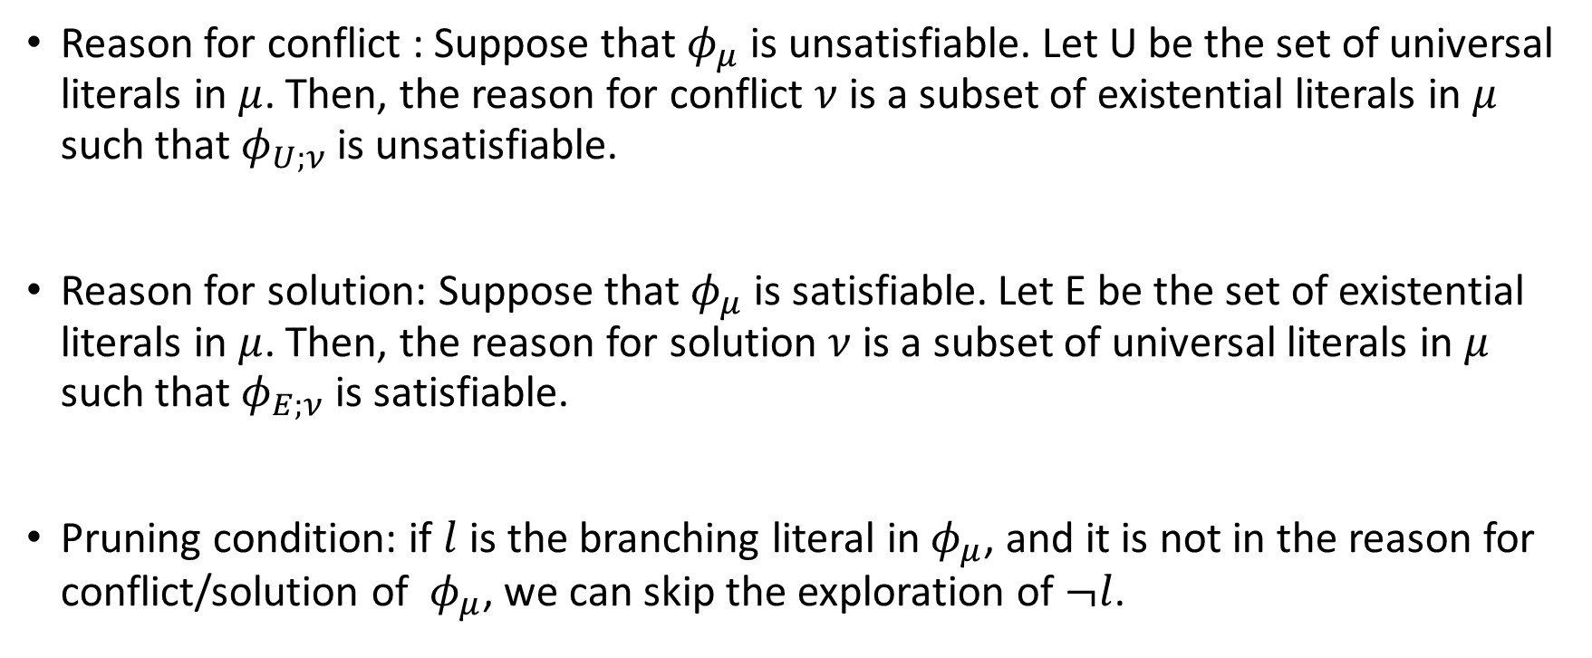
Backjumping (Dependency backtracking)
Reason for conflict : Suppose that $φ_{μ}$is unsatisfiable. Let U be the set of universal literals in $μ$. Then, the reason for conflict $ν$ is a subset of existential literals in $μ$ such that $φ_{U;ν}$ is unsatisfiable.
Reason for solution: Suppose that $φ_{μ}$is satisfiable. Let E be the set of existential literals in $μ$. Then, the reason for solution $ν$ is a subset of universal literals in $μ$ such that $φ_{E;ν}$ is satisfiable.
Pruning condition: if $l$ is the branching literal in$φ_{μ}$, and it is not in the reason for conflict/solution of $φ_{μ}$, we can skip the exploration of $¬l$.
Notes:
Dual

Slide 12
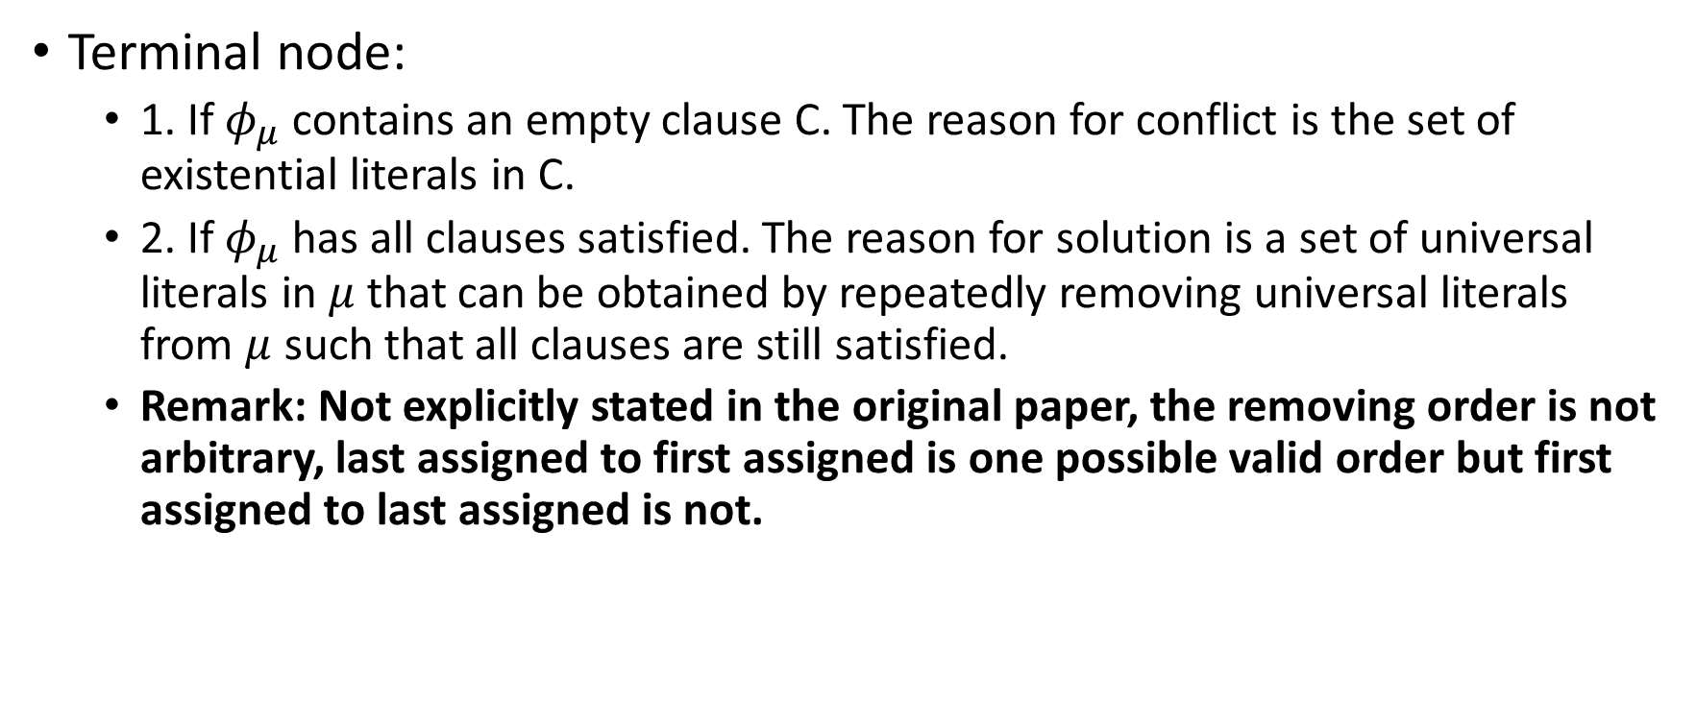
Backjumping (Reason computation rules)
Terminal node:
1. If $φ_{μ}$contains an empty clause C. The reason for conflict is the set of existential literals in C.
2. If $φ_{μ}$ has all clauses satisfied. The reason for solution is a set of universal literals in $μ$that can be obtained by repeatedly removing universal literals from $μ$ such that all clauses are still satisfied.
Remark: Not explicitly stated in the original paper, the removing order is not arbitrary, last assigned to first assigned is one possible valid order but first assigned to last assigned is not.
Notes:
If SAT solver can be called, present the exists already, introduce what’s new

Slide 13
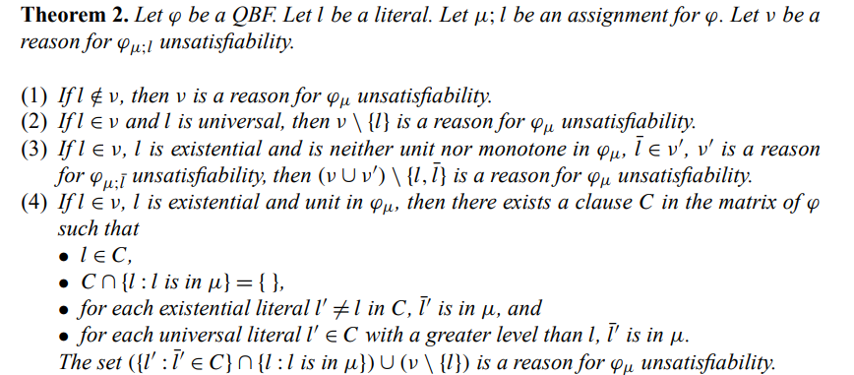
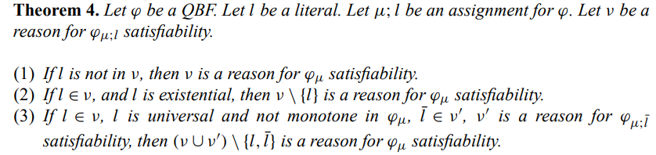

Backjumping (Reason computation rules)
Maintain reason during backtrack, calculate reason $r$for $φ_{μ}$
$ν$ is the reason for $φ_{μ;l}$ and $ν′$ is the reason for $φ_{μ;¬l}$
Reference: https://www.sciencedirect.com/science/article/pii/S0004370202003739
Notes:
Eliminate existential branching, increase the font.
Add the original theorems

Slide 14
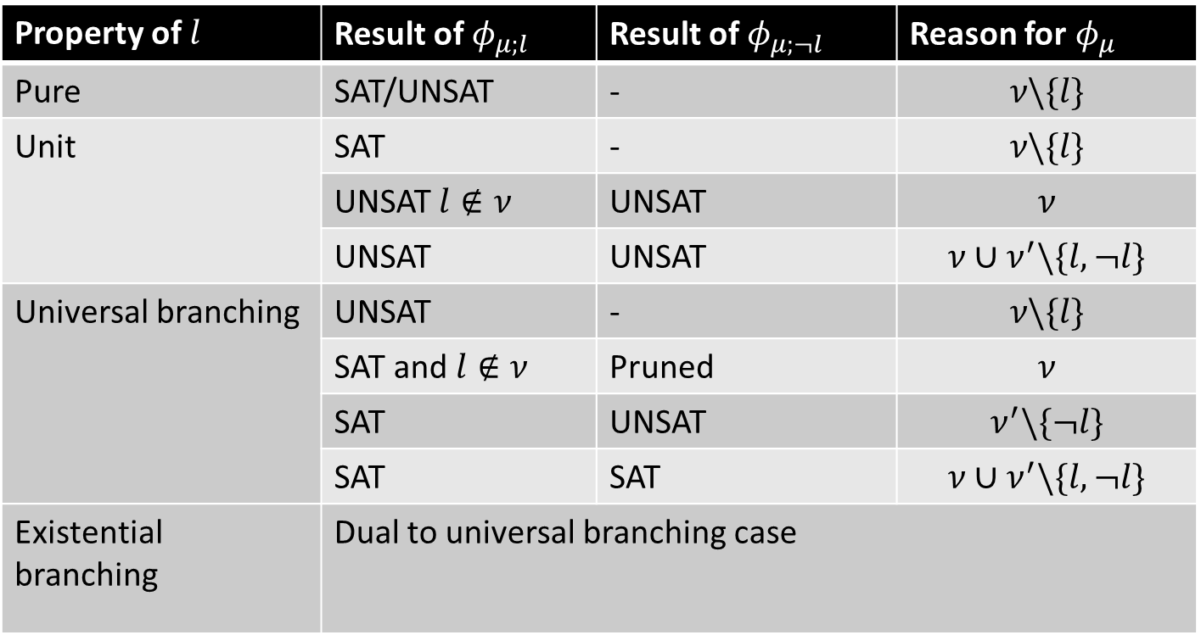

Backjumping (Reason computation rules)
Maintain reason during backtrack, calculate reason $r$for $φ_{μ}$
$ν$ is the reason for $φ_{μ;l}$ and $ν′$ is the reason for $φ_{μ;¬l}$
Property of $l$ | Result of $φ_{μ;l}$ | Result of $φ_{μ;¬l}$ | Reason for $φ_{μ}$
Pure | SAT/UNSAT | - | $$ν\backslash \{l\}$$
Unit | SAT | - | $$ν\backslash \{l\}$$
 | UNSAT $l∉ν$ | UNSAT | $$ν$$
Unit | UNSAT | UNSAT | $$ν∪ν^{′}\backslash \{l, ¬l\}$$
Universal branching | UNSAT | - | $$ν\backslash \{l\}$$
Universal branching | SAT and $l∉ν$ | Pruned | $$ν$$
Universal branching | SAT | UNSAT | $$ν^{′}\backslash \{¬l\}$$
Universal branching | SAT | SAT | $$ν∪ν^{′}\backslash \{l, ¬l\}$$
Existential branching | Dual to universal branching case

Slide 15
Backjumping (Dependency backtracking)
Pros: relatively easy to implement without too much computation overhead, guaranteed to be not worse than baseline QDLL
Cons: Conflicts/solutions can only affect the search on the current searching path

Slide 16
QCDCL
Modify the CDCL algorithm in SAT, proposed by l. Zhang/E. Giunchiglia
QUBE (2004-2010), DepQBF (2010-)
Learned new clauses/terms based on conflicts/solutions using Q-resolution
Pros: conflicts/solutions can affect the search not restricted to the current path
Cons: implementation is hard, does not guarantee to perform better than baseline QDLL if the clauses/terms are not learned properly

Slide 17
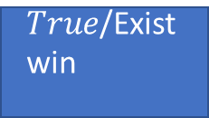


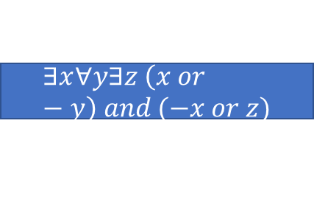

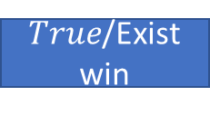

Game Based Approach
QBF can be viewed as an and-or two player strategy game (GhostQ 2010-)
- existential quantifier is the or player (maximizer)
- universal quantifier is the and player (minimizer)
- existential quantifier tries to satisfy the formula
- universal quantifier tries to falsify the formula
$$∃x∀y∃z \left(x or −y\right) and (−x or z)$$
X = 1
X = 0
$$∃z z$$
$$∀y∃z \left(−y\right)$$
Z = 1
Z = 0
Y = 1
Y = 0
$True$/Exist win
$False/exist$ lose
$False$/exist lose
$$True\text{/}\text{Exist} \text{win}$$

Slide 18
PNS Overview
Proposed by V. Allis in 1994
A best first search algorithm that prioritized the search on the direction of the most proving node (MPN)
Achieved massive success in strategy games
- Shogi, hex, checkers, Othello

Slide 19
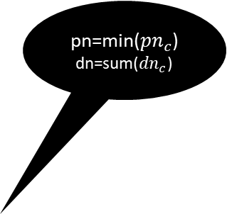

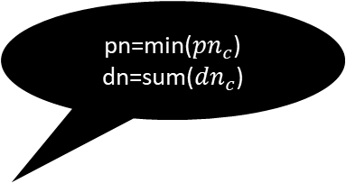
PNS Overview
pn=min(${pn}_{c}$) dn=sum(${dn}_{c}$)
argmin(pn)
Each node stores 2 information:
- proof number (pn)
- disproof number (dn)
Selection (find MPN) -> Expansion -> Initialization -> Backpropagation
Advantage: not get stuck at one side of the searching space
Drawback: memory issue, seesaw effect
Variations: DeepPNS, df-pn, PN2, PN* etc.
pn=sum(${pn}_{c}$) dn=min(${dn}_{c}$)
argmin(dn)
2,2
1,2
pn=min(${pn}_{c}$)
dn=sum(${dn}_{c}$)
argmin(pn)
2,1
4,1
1,1
1,1
1,1
0,inf
0, inf
1,1
Notes:
Identify MPN, MPN is always a leaf. How to do MPN
Guaranteed, MPN. Exploration->selection is find the MPN

Slide 20
Outline
Technical Background
Project Aim and Preliminary Results
Future Plan

Slide 21
Problem Formulation
Investigate if proof number search can improve the performance of the depth first search based QBF solvers
Combine PNS algorithm and search based QBF solving methods (Backjumping or QCDCL)
Modify PNS algorithms and let it works well in the QBF world
Expected result
- beat state-of-art search based QBF solver DepQBF? Unfeasible
- PNS is helpful on all benchmarks, unlikely
- PNS is helpful on some family of benchmarks and analyse the reason

Slide 22
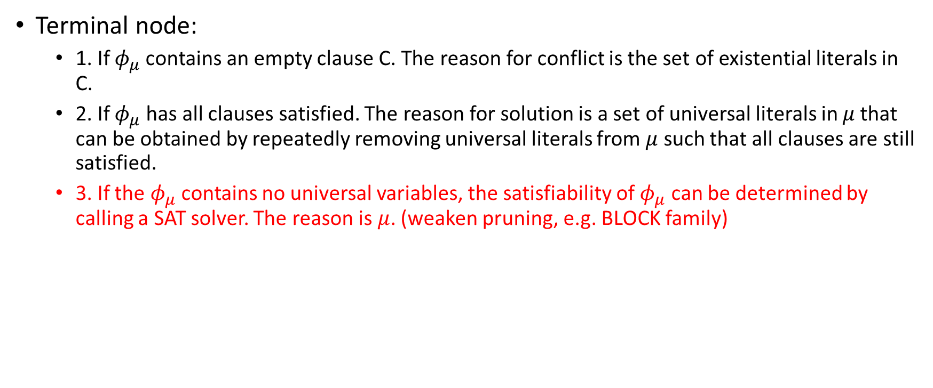
Backjumping modification (Reason computation rules)
Terminal node:
1. If $φ_{μ}$contains an empty clause C. The reason for conflict is the set of existential literals in C.
2. If $φ_{μ}$ has all clauses satisfied. The reason for solution is a set of universal literals in $μ$that can be obtained by repeatedly removing universal literals from $μ$ such that all clauses are still satisfied.
3. If the $φ_{μ}$contains no universal variables, the satisfiability of $φ_{μ}$ can be determined by calling a SAT solver. The reason is $μ$. (weaken pruning, e.g. BLOCK family)
Notes:
If SAT solver can be called, present the exists already, introduce what’s new

Slide 23
Preliminary Results
Instance | DeepPNSBJ | QDLLBJ
CHAIN12v13 | 8,239 | 8,215
CHAIN13v14 | 16,435 | 16,409
CHAIN14v15 | 32,823 | 32,795
CHAIN16v17 | 131,135 | 131,103
CHAIN17v18 | 262,211 | 262,177
CHAIN18v19 | 524,359 | 524,323
TOILET6.1.iv.11 | 1,896,123 | 1,441,537
TOILET6.1.iv.12 | 10,073 | 218,581
TOILET10.1.iv.20 | 10,373 | > 4,000,000
TOILET16.1.iv.32 | 11271 | > 4,000,000
Adder-2-S | 4,519 | 3,543
Adder-2-U | 45,923 | 46,335
K_d4_n-1 | 809 | 582
K_d4_p-3 | 1,482,245 | > 4,000,000
K_lin_p-2 | 3,522,933 | 1,188,617
K_path_p-4 | 28,313 | 10,927
K_path_n-3 | > 4,000,000 | 505,581
K_t4p_n-1 | 2,446,447 | 1,816,773
3qbf-5cnf-50var-500cl.2 | 29,053 | > 4000,000
DeepPNS + Backjumping
Experiment: QDLLBJ vs DeepPNSBJ
- 4 million node expansions
- SAT solver enabled
Proof number search can potentially improve the performance of search based QBF solver
Total | DeepPNSBJ | QDLLBJ
95 | 47 | 32
Table 2: number of solved encoded gttt4x4 (game) instances for DeepPNSBJ and QDLLBJ
Table 1: number of node expansions for DeepPNSBJ and QDLLBJ on 10 families of benchmarks
Notes:
Say something about time.
Go back to the latex, put numbers is bold if it is much better.
Either, both.
Put gttt4x4 highlight
Name of the solver

Slide 24
Outline
Technical Background
Aim of the project and Preliminary Results
Future Plan

Slide 25
TODO and difficulty
Improve PNS + Backjumping
- Reason computation when SAT solver is enabled
- Seesaw effect of PNS in QBF
Implement PNS + QCDCL
- Possible case: PNS + Backjumping + learned clauses
Two main tasks: PNS + QCDCL and improve PNS + Backjumping
Difficulty: PNS + QCDCL >> PNS + Backjumping
Notes:
SAT solver in the second section

Slide 26
Plan
Thesis period | Week | Task
A | 9-11 | Thesis A report
B | 1-2 | QCDCL reading
 | 3-6 | Investigate computation of reason when SAT solver is activated + seesaw effect of PNS on different families of instances | Implement the data structure for QCDCL
 | 7-9 | Finish PNS + Backjumping | start dfs + QCDCL implementation
 | 10-11 | Thesis B presentation
C | 1 | Finish dfs + QCDCL implementation
 | 2-6 | PNS + QCDCL + experiment
 | 7-8 | Thesis C presentation
 | 9-11 | Thesis C report
Notes:
Larger font.

Slide 27
Reference
Cadoli. (1998). An Algorithm to Evaluate Quantified Boolean Formulae *. AAAI, 262-267.
Giunchiglia, E. (2001). Backjumping for quantified boolean logic satisfiability. IJCAI International Joint Conference on Artificial Intelligence, 275-281. Retrieved from https://www.scopus.com/record/display.uri?eid=2-s2.0-84880887706&origin=inward&txGid=b61935ab48a6902fd012c2d7b673d36b
Kishimoto. (2012). Game-Tree Search Using Proof Numbers: The First Twenty Years. ICGA Journal, 131-156.

