Slide 1
A strategy game based approach on solving logic formulas Part 2: PNS and QCDCL
Yifan He
Supervised By Dr. Abdallah Saffidine
Thesis B seminar
2021 T3

Slide 2
Outline
Thesis A recap
Progress in thesis B
Future work

Slide 3
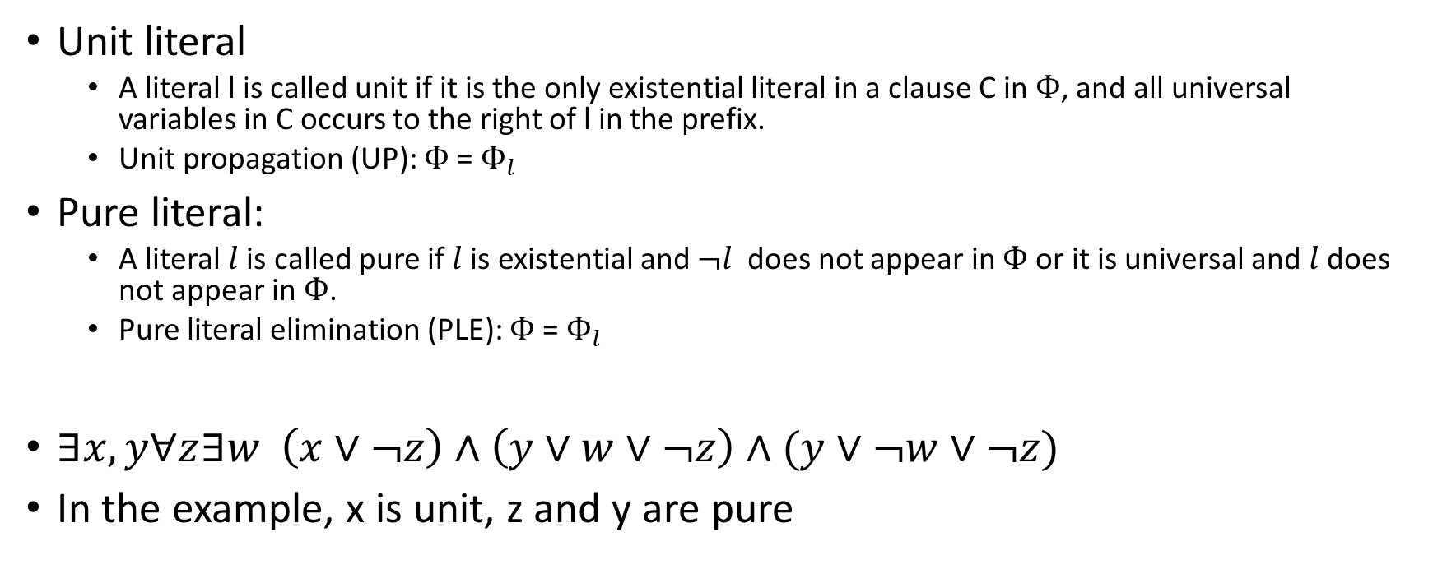
Unit and pure literals
Unit literal
A literal l is called unit if it is the only existential literal in a clause C in $Ф$, and all universal variables in C occurs to the right of l in the prefix.
Unit propagation (UP): $Ф$ = $Ф_{l}$
Pure literal:
A literal $l$ is called pure if $l$is existential and $¬l$ does not appear in $Ф$ or it is universal and$l$ does not appear in $Ф$.
Pure literal elimination (PLE): $Ф$ = $Ф_{l}$
$∃x,y∀z∃w \left(x∨¬z\right)∧\left(y∨w∨¬z\right)∧(y∨¬w∨¬z)$
In the example, x is unit, z and y are pure
Notes:
Add examples, some unit literals, some pure literals

Slide 4
Proof number search and Backjumping (cont.)
Initialize the root
Select MPN, assign, simplify
no
Solved?
yes
Exit and print
no
yes
Leaf?
Root?
no
Backtracking, Q-res and unassign
yes
Expand L,R children
BJ Prun?
no
yes
Prun both children
no
Terminal?
Compute reason for SAT/UNSAT, initialize pn, dn
Backpropagation
yes
Initialize the branching variable, pn, dn

Slide 5
Outline
Thesis A recap
Progress in thesis B
Future work

Slide 6
Thesis A Recap
Literature review
Important definitions in QBF (semantic, unit propagation, QDLL procedure)
Backjumping (reason computation rules)
QCDCL
proof number search
Define the final target
Combine proof number search with existing QBF solving techniques
Progress made
DFS based Backjumping solver
PNS based Backjumping solver
Modified the heuristic formula for PNS solver
Compare the performance
Notes:
1 + e trick

Slide 7
Proof number search and CDCL
Initialize the root
yes
Branching assigned?
Schl ̈oter’s method
Add learned clause
no
Select MPN
no
Assign, simplify
Solved?
no
yes
Exit and print
Leaf?
yes
Direct Terminate?
no
yes
Root?
no
Backtracking, Q-res and unassign
yes
Expand L,R children
no
BJ Prun?
yes
Compute reason for SAT/UNSAT, initialize pn, dn
Prun both children
Terminal?
yes
Backpropagation
no
Initialize the branching variable, pn, dn

Slide 8
Thesis A Recap (cont.)
Original plan for thesis B:
Combine Backjumping with a SAT solver
Investigate QCDCL in greater depth (theory aspect)
Implement the data structure part of QCDCL
Investigate proof number search heuristics in the QBF world

Slide 9
Dependency graph of the thesis tasks
Backjumping
QCDCL theory
QCDCL
implementation
PNS + QCDCL
Theory and implementation
PNS
heuristics
Thesis A, B
Thesis B
Thesis C
Thesis B, C
Thesis B
PNS
Thesis A
Parameter tuning of PNS should happen at the last stage!

Slide 10
New plan in thesis B
Backjumping with SAT solver enabled (minor priority)
QCDCL and its implementation (DFS version)
Combining QCDCL and PNS (theory)
Backjumping
QCDCL theory
QCDCL
implementation
PNS + QCDCL
Theory and implementation
PNS heuristics
Thesis A, B
Thesis B
Thesis B
Thesis B,C
Thesis C
PNS
Thesis A
Notes:
Clarify QCDCL in context of dfs

Slide 11
Outline
Thesis A recap
Progress in thesis B
Backjumping with SAT solver enabled
QCDCL algorithm and implementation
Combining QCDCL with Proof number search
Future work

Slide 12
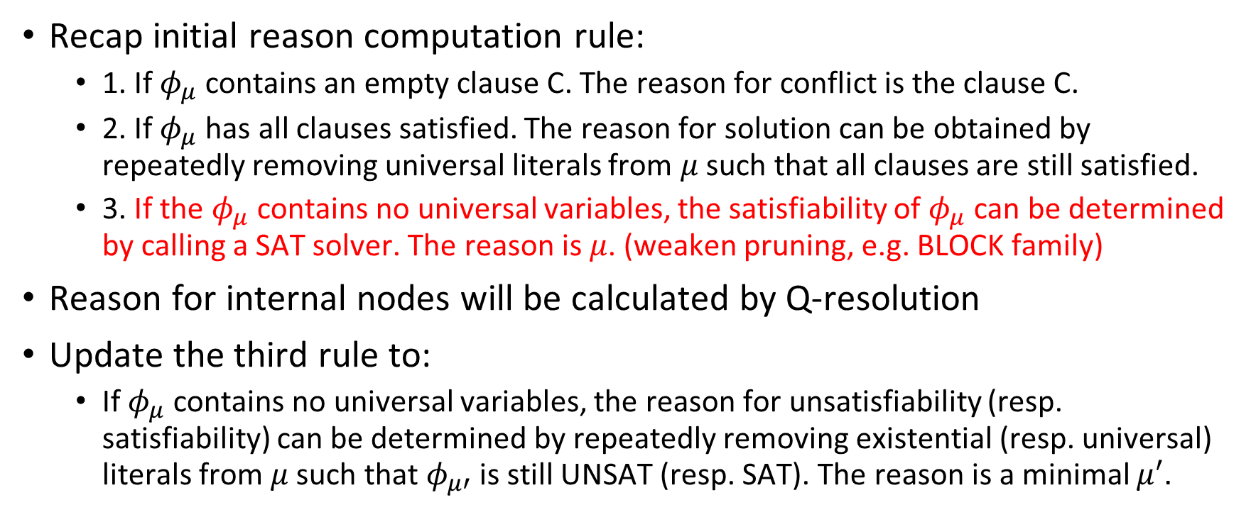
Backjumping with SAT solver enabled
Recap initial reason computation rule:
1. If $φ_{μ}$contains an empty clause C. The reason for conflict is the clause C.
2. If $φ_{μ}$ has all clauses satisfied. The reason for solution can be obtained by repeatedly removing universal literals from $μ$ such that all clauses are still satisfied.
3. If the $φ_{μ}$contains no universal variables, the satisfiability of $φ_{μ}$ can be determined by calling a SAT solver. The reason is $μ$. (weaken pruning, e.g. BLOCK family)
Reason for internal nodes will be calculated by Q-resolution
Update the third rule to:
If $φ_{μ}$contains no universal variables, the reason for unsatisfiability (resp. satisfiability) can be determined by repeatedly removing existential (resp. universal) literals from $μ$ such that $φ_{μ′}$ is still UNSAT (resp. SAT). The reason is a minimal $μ^{′}.$

Slide 13
Experimental results
Family | Total | #BJ-NOSAT | #BJ-OldSAT | #BJ-NewSAT
Counter (2004) | 8 | 2 | 2 | 2
BLOCKS | 13 | 3 | 0 | 7
Tree | 14 | 11 | 11 | 11
k_d4_n | 21 | 2 | 2 | 2
k_d4_p | 21 | 5 | 6 | 6
k_ph_n | 21 | 5 | 5 | 5
k_ph_p | 21 | 4 | 4 | 5
k_lin_n | 21 | 3 | 3 | 3
k_lin_p | 21 | 5 | 5 | 5
k_dum_n | 21 | 3 | 3 | 3
k_dum_p | 21 | 6 | 6 | 6
k_t4p_n | 21 | 1 | 1 | 1
k_t4p_p | 21 | 1 | 1 | 1
The computational overhead is not negligible for reason of UNSAT
Significantly improve the performance of the solver on BLOCKS
No significant improvement of the solver for other instances
A stronger proof system is desired
Number of solved instances with a 900s time limit

Slide 14
Outline
Thesis A recap
Progress in thesis B
Backjumping with SAT solver enabled
QCDCL algorithm and implementation
Combining QCDCL with Proof number search
Future work

Slide 15
QCDCL introduction
Q: QBF, CDCL: Conflict Driven Clause Learning (1990s)
Conflict driven clause learning + solution driven cube learning
Improve Backjumping
Proposed by l. Zhang (2002), R. Letz (2002), E. Giunchiglia (2003)

Slide 16
Implementation details
Efficient QBF data structure supports:
Assign literal
Unassign literal
Unit clause detection
Conflict clause detection
Solution detection
Add new clauses
Two watched literal data structure:
Efficient lazy data structure for SAT (Chaff 2001)
First used by QUBE (2004) and Quaffle (2006) in the QBF world
Reduce the number of clause iteration per variable assignment
Nothing is done to the data structure during backtracking

Slide 17
2-WL vs. Data structure used in thesis A
Instance | Time-BJOld (s) | Time-2wl-BJ (s) | Clause/ass-BJOld | Clause/ass-2wl-BJ
chain23v24 | > 900 | 654.12 | 6.26 | 1.02
L*BWL*B1 | > 900 | 714.16 | 235.19 | 1.17
toilet_a10.01.15 | > 900 | 74.75 | 67.24 | 1.13
L*BWL*A1 | > 900 | 47.54 | 153.13 | 1.12
k_path_n-4 | > 900 | 23.87 | 8.03 | 0.93
TOILET7.1.iv.13 | 478.03 | 232.50 | 6.77 | 0.98
k_ph_p-5 | 123.20 | 29.46 | 10.58 | 1.02
k_lin_p-5 | 415.82 | 62.22 | 11.96 | 0.94
k_t4p_p-1 | 3.12 | 1.55 | 7.13 | 0.88
k_lin_n-3 | 282.45 | 13.95 | 13.95 | 0.93
Time and number of clause iterated per assignment for different Backjumping solvers

Slide 18
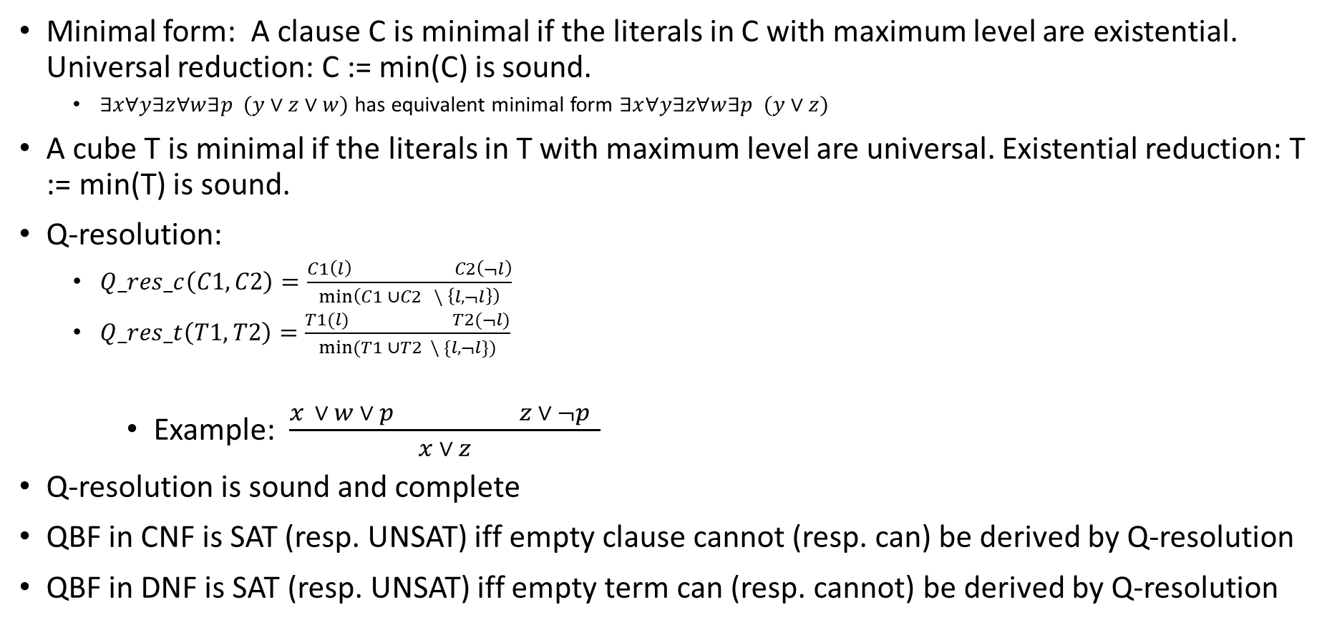
Important definitions
Minimal form: A clause C is minimal if the literals in C with maximum level are existential. Universal reduction: C := min(C) is sound.
$∃x∀y∃z∀w∃p (y∨z∨w)$ has equivalent minimal form $∃x∀y∃z∀w∃p (y∨z)$
A cube T is minimal if the literals in T with maximum level are universal. Existential reduction: T := min(T) is sound.
Q-resolution:
$Q_res_c\left(C1,C2\right)=\frac{C1\left(l\right) C2\left(¬l\right)}{\min\left(C1 ∪C2 \backslash \left\{l, ¬l\right\}\right)}$
$Q_res_t\left(T1,T2\right)=\frac{T1(l) T2(¬l)}{min⁡(T1 ∪T2 \backslash \{l, ¬l\})}$
Example: $\frac{x ∨ w ∨ p z ∨ ¬p }{x ∨ z}$
Q-resolution is sound and complete
QBF in CNF is SAT (resp. UNSAT) iff empty clause cannot (resp. can) be derived by Q-resolution
QBF in DNF is SAT (resp. UNSAT) iff empty term can (resp. cannot) be derived by Q-resolution

Slide 19
QCDCL introduction (cont.)
Combine Q-resolution with QDLL
When we reach a conflict, we compute the reason for unsatisfiability
When we reach a solution, we compute the reason for satisfiability
Add Q-resolved conflicts to the formula conjunctively (i.e. clause learning)
Add Q-resolved solutions to the formula disjunctively (i.e. cube learning, dual to clause learning)
Produce more unit propagation
Degenerates to CDCL (zChaff, Minisat) if no universal variables exist
Used by state of art search based QBF solvers after 2006
To make testing easier, only conflict driven clause learning and solution driven backjumping was implemented in thesis B

Slide 20
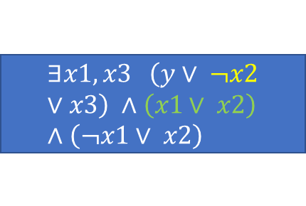

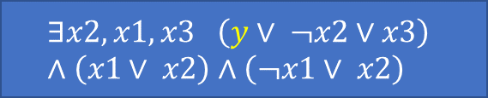
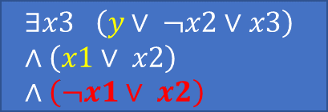


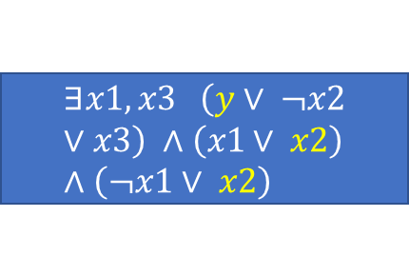
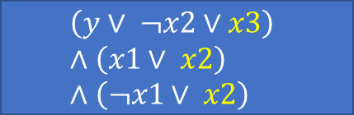

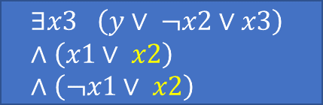
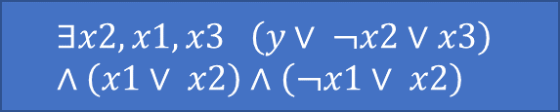
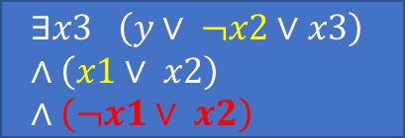
QCDCL example
$$∀y∃x2,x1,x3 \left(y∨ ¬x2∨x3\right) ∧\left(x1∨ x2\right)∧\left(¬x1∨ x2\right)$$
T:{y}
T: {}
y
-y
$$∃x2,x1,x3 \left(y∨ ¬x2∨x3\right) ∧\left(x1∨ x2\right)∧\left(¬x1∨ x2\right)$$
$$∃x2,x1,x3 \left(y∨ ¬x2∨x3\right) ∧\left(x1∨ x2\right)∧\left(¬x1∨ x2\right)$$
T:{y}
T: {}
-x2
x2
-x2
x2
$$∃x1,x3 \left(y∨ ¬x2∨x3\right) ∧\left(x1∨ x2\right)∧\left(¬x1∨ x2\right)$$
$$∃x1,x3 \left(y∨ ¬x2∨x3\right) ∧\left(x1∨ x2\right)∧\left(¬x1∨ x2\right)$$
$$∃x1,x3 \left(y∨ ¬x2∨x3\right) ∧\left(x1∨ x2\right)∧\left(¬x1∨ x2\right)$$
$$∃x3 \left(y∨ ¬x2∨x3\right) ∧\left(x1∨ x2\right)∧\left(¬x1∨ x2\right)$$
F: {x2}
T: {y}
F: {x2}
T: {}
Unit: x1
Unit: x1
Unit: x3
$$∃x3 \left(y∨ ¬x2∨x3\right) ∧\left(x1∨ x2\right)∧\left(¬x1∨ x2\right)$$
$$\left(y∨ ¬x2∨x3\right) ∧\left(x1∨ x2\right)∧\left(¬x1∨ x2\right)$$
$$∃x3 \left(y∨ ¬x2∨x3\right) ∧\left(x1∨ x2\right)∧\left(¬x1∨ x2\right)$$
F: {$¬$x1, x2}
F: {$¬$x1, x2}
T: {}

Slide 21
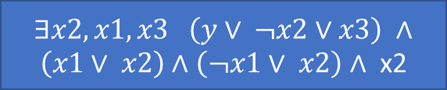

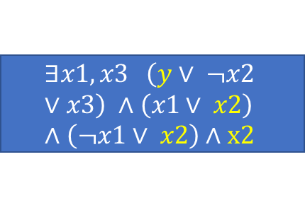
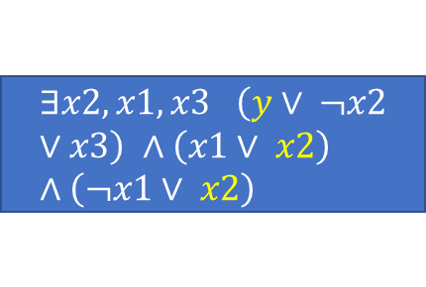
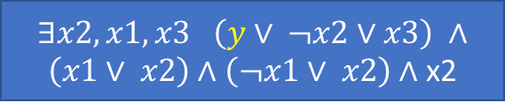

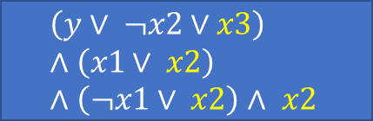
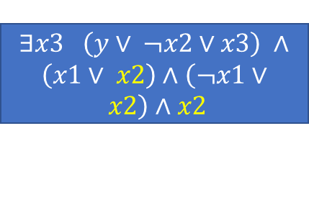
QCDCL example (cont.)
$$∀y∃x2,x1,x3 \left(y∨ ¬x2∨x3\right) ∧\left(x1∨ x2\right)∧\left(¬x1∨ x2\right)∧ \text{x}\text{2}$$
$$∀y∃x2,x1,x3 \left(y∨ ¬x2∨x3\right) ∧\left(x1∨ x2\right)∧\left(¬x1∨ x2\right)$$
T:{y}
T: {}
y
-y
$∃x2,x1,x3 \left(y∨ ¬x2∨x3\right) ∧\left(x1∨ x2\right)∧\left(¬x1∨ x2\right)∧$ x2
$$∃x2,x1,x3 \left(y∨ ¬x2∨x3\right) ∧\left(x1∨ x2\right)∧\left(¬x1∨ x2\right)$$
$∃x2,x1,x3 \left(y∨ ¬x2∨x3\right) ∧\left(x1∨ x2\right)∧\left(¬x1∨ x2\right)$ $∧ \text{x}\text{2}$
$$∃x2,x1,x3 \left(y∨ ¬x2∨x3\right) ∧\left(x1∨ x2\right)∧\left(¬x1∨ x2\right)$$
T: {}
T:{y}
-x2
x2
Unit: x2
$$∃x1,x3 \left(y∨ ¬x2∨x3\right) ∧\left(x1∨ x2\right)∧\left(¬x1∨ x2\right)$$
$$∃x1,x3 \left(y∨ ¬x2∨x3\right) ∧\left(x1∨ x2\right)∧\left(¬x1∨ x2\right)∧x2$$
$$∃x2,x1,x3 \left(y∨ ¬x2∨x3\right) ∧\left(x1∨ x2\right)∧\left(¬x1∨ x2\right)$$
$$∃x3 \left(y∨ ¬x2∨x3\right) ∧\left(x1∨ x2\right)∧\left(¬x1∨ x2\right)$$
$∃x3 \left(y∨ ¬x2∨x3\right) ∧\left(x1∨ x2\right)∧\left(¬x1∨ x2\right)∧$ $x2$
F: {x2}
Unit: x1
T: {y}
T: {}
Unit: x3
$$∃x3 \left(y∨ ¬x2∨x3\right) ∧\left(x1∨ x2\right)∧\left(¬x1∨ x2\right)$$
$$\left(y∨ ¬x2∨x3\right) ∧\left(x1∨ x2\right)∧\left(¬x1∨ x2\right)$$
$$\left(y∨ ¬x2∨x3\right) ∧\left(x1∨ x2\right)∧\left(¬x1∨ x2\right)∧ x2$$
F: {$¬$x1, x2}
T: {}

Slide 22
QCDCL vs Backjumping
Family | Total | # 2wl-BJ | # 2wl-QCDCLSBJ
Counter (2004) | 8 | 3 | 4
BLOCKS | 13 | 3 | 2
Tree | 14 | 11 | 14
k_d4_n | 21 | 3 | 5
k_d4_p | 21 | 21 | 21
k_ph_n | 21 | 6 | 13
k_ph_p | 21 | 5 | 6
k_lin_n | 21 | 3 | 8
k_lin_p | 21 | 5 | 21
k_dum_n | 21 | 4 | 7
k_dum_p | 21 | 8 | 21
k_t4p_n | 21 | 1 | 2
k_t4p_p | 21 | 2 | 5
Number of solved instances for pure Backjumping and CDCL + solution driven backjumping solvers

Slide 23
Outline
Thesis A recap
Progress in thesis B
Backjumping with SAT solver enabled
QCDCL algorithm and implementation
Combining QCDCL with Proof number search
Future work

Slide 24
PNS and QCDCL: Motivation
PNS + Backjumping outperforms DFS + Backjumping on gttt4x4 instances
QCDCL outperforms Backjumping on most instances
Combine PNS and QCDCL will be interesting

Slide 25
PNS and QCDCL: Difficulty
Recall PNS + QBF: each node in the tree corresponds to a branching variable
Searching space might change after clause learning
Branching variable becomes unit

Slide 26
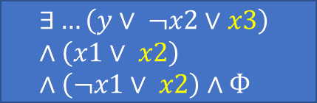
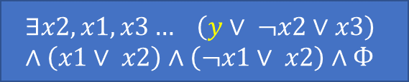
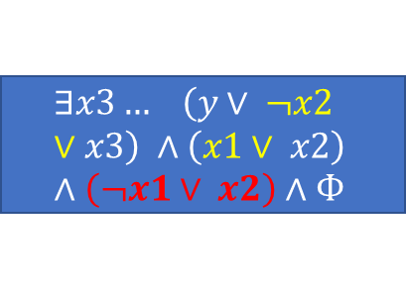

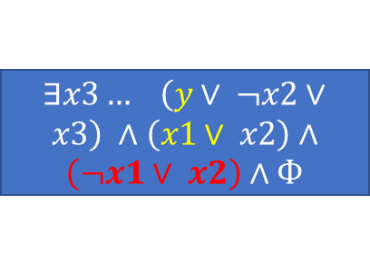
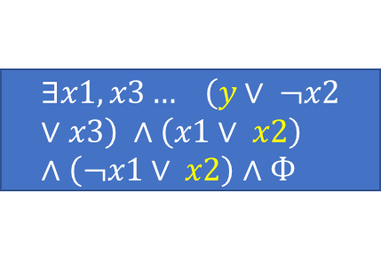
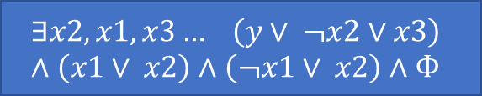
PNS + QCDCL example
$$∀y∃x2,x1,x3… \left(y∨ ¬x2∨x3\right) ∧\left(x1∨ x2\right)∧\left(¬x1∨ x2\right)∧Ф$$
|Y|
(1,1)
y
-y
|x2|
$$∃x2,x1,x3… \left(y∨ ¬x2∨x3\right) ∧\left(x1∨ x2\right)∧\left(¬x1∨ x2\right)∧Ф$$
$$∃x2,x1,x3… \left(y∨ ¬x2∨x3\right) ∧\left(x1∨ x2\right)∧\left(¬x1∨ x2\right)∧Ф$$
|x2|
x2
-x2: unit x1
x2: unit x3
-x2: unit x1
$$∃x1,x3… \left(y∨ ¬x2∨x3\right) ∧\left(x1∨ x2\right)∧\left(¬x1∨ x2\right)∧Ф$$
$∃x3… \left(y∨ ¬x2∨x3\right) ∧\left(x1∨ x2\right)∧\left(¬x1∨ x2\right)$ $∧Ф$
$$∃…\left(y∨ ¬x2∨x3\right) ∧\left(x1∨ x2\right)∧\left(¬x1∨ x2\right)∧Ф$$
$$∃x3… \left(y∨ ¬x2∨x3\right) ∧\left(x1∨ x2\right)∧\left(¬x1∨ x2\right)∧Ф$$
Unknown
F
Unknown
F

Slide 27
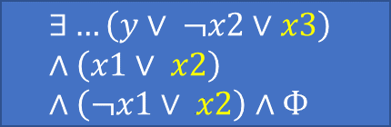
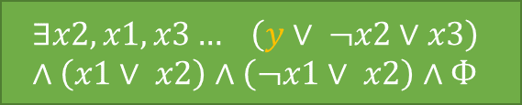
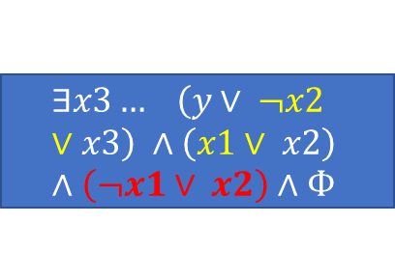
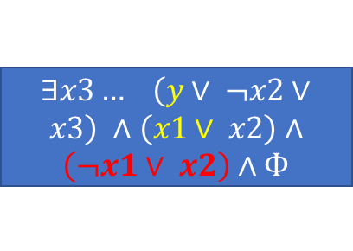
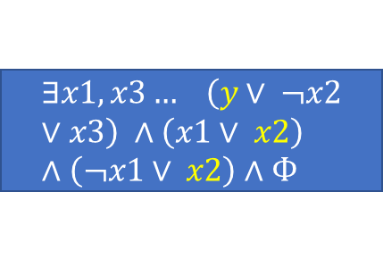
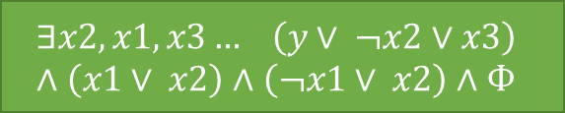
PNS + QCDCL example
$$∀y∃x2,x1,x3… \left(y∨ ¬x2∨x3\right) ∧\left(x1∨ x2\right)∧\left(¬x1∨ x2\right)∧Ф$$
|Y|
(2,1)
y
-y
$$∃x2,x1,x3… \left(y∨ ¬x2∨x3\right) ∧\left(x1∨ x2\right)∧\left(¬x1∨ x2\right)∧Ф$$
$$∃x2,x1,x3… \left(y∨ ¬x2∨x3\right) ∧\left(x1∨ x2\right)∧\left(¬x1∨ x2\right)∧Ф$$
|x2|
|x2|
(1,1)
(1,1)
x2
-x2: unit x1
x2: unit x3
-x2: unit x1
$$∃x1,x3… \left(y∨ ¬x2∨x3\right) ∧\left(x1∨ x2\right)∧\left(¬x1∨ x2\right)∧Ф$$
$∃x3… \left(y∨ ¬x2∨x3\right) ∧\left(x1∨ x2\right)∧\left(¬x1∨ x2\right)$ $∧Ф$
$$∃…\left(y∨ ¬x2∨x3\right) ∧\left(x1∨ x2\right)∧\left(¬x1∨ x2\right)∧Ф$$
$$∃x3… \left(y∨ ¬x2∨x3\right) ∧\left(x1∨ x2\right)∧\left(¬x1∨ x2\right)∧Ф$$
F
Unknown
Unknown
F

Slide 28
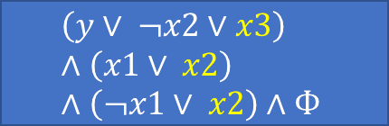
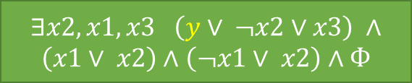
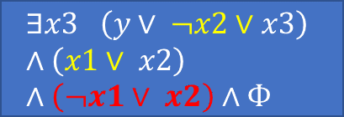
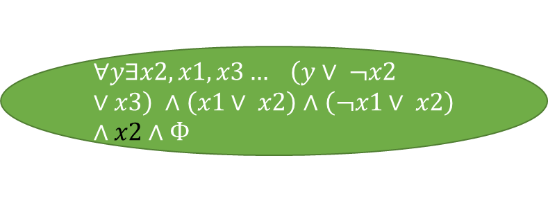
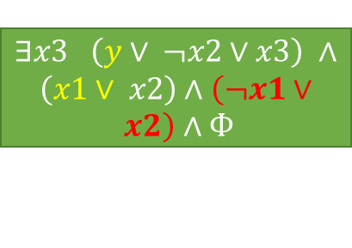
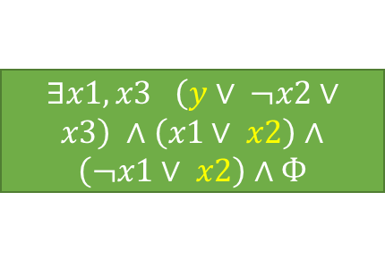
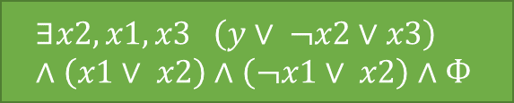
PNS + QCDCL example
$$∀y∃x2,x1,x3… \left(y∨ ¬x2∨x3\right) ∧\left(x1∨ x2\right)∧\left(¬x1∨ x2\right)∧x2∧Ф$$
(2,1)
|Y|
y
-y
|x2|
$∃x2,x1,x3 \left(y∨ ¬x2∨x3\right) ∧\left(x1∨ x2\right)∧\left(¬x1∨ x2\right)$ $∧Ф$
$$∃x2,x1,x3 \left(y∨ ¬x2∨x3\right) ∧\left(x1∨ x2\right)∧\left(¬x1∨ x2\right)∧Ф$$
|x2|
(1,1)
(1,1)
x2
-x2: unit x1
x2: unit x3
-x2: unit x1
$∃x1,x3 \left(y∨ ¬x2∨x3\right) ∧\left(x1∨ x2\right)∧\left(¬x1∨ x2\right)$ $∧Ф$
$∃x3 \left(y∨ ¬x2∨x3\right) ∧\left(x1∨ x2\right)∧\left(¬x1∨ x2\right)$ $∧Ф$
$$\left(y∨ ¬x2∨x3\right) ∧\left(x1∨ x2\right)∧\left(¬x1∨ x2\right)∧Ф$$
$$∃x3 \left(y∨ ¬x2∨x3\right) ∧\left(x1∨ x2\right)∧\left(¬x1∨ x2\right)∧Ф$$
(1,1)
(ꝏ,0)
Unknown
F
Unknown
F
learn unit literal x2, add x2 to the formula at the root after backpropagation

Slide 29
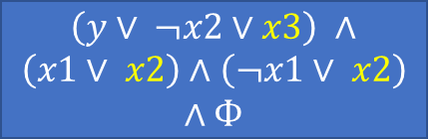
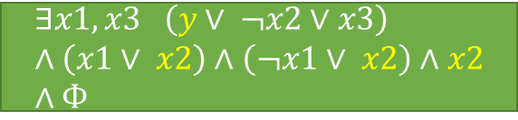
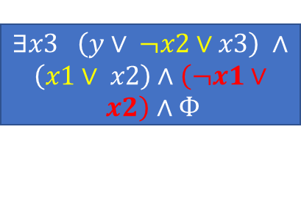
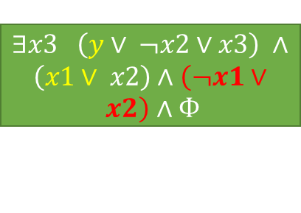
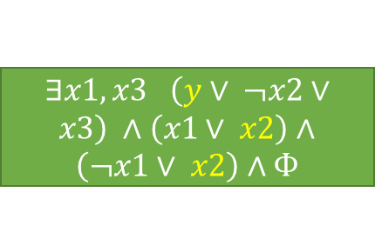
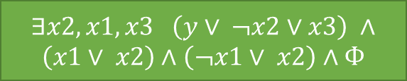
PNS + QCDCL example
$$∀y∃x2,x1,x3… \left(y∨ ¬x2∨x3\right) ∧\left(x1∨ x2\right)∧\left(¬x1∨ x2\right)∧x2∧Ф$$
(2,1)
|Y|
y: unit x2
-y
$$∃x1,x3 \left(y∨ ¬x2∨x3\right) ∧\left(x1∨ x2\right)∧\left(¬x1∨ x2\right)∧x2∧Ф$$
$∃x2,x1,x3 \left(y∨ ¬x2∨x3\right) ∧\left(x1∨ x2\right)∧\left(¬x1∨ x2\right)$ $∧Ф$
|x2|
|x2|
(1,1)
(1,1)
x2
-x2: unit x1
x2: unit x3
-x2: unit x1
$∃x1,x3 \left(y∨ ¬x2∨x3\right) ∧\left(x1∨ x2\right)∧\left(¬x1∨ x2\right)$ $∧Ф$
$∃x3 \left(y∨ ¬x2∨x3\right) ∧\left(x1∨ x2\right)∧\left(¬x1∨ x2\right)$ $∧Ф$
$\left(y∨ ¬x2∨x3\right) ∧\left(x1∨ x2\right)∧\left(¬x1∨ x2\right)$ $∧Ф$
$∃x3 \left(y∨ ¬x2∨x3\right) ∧\left(x1∨ x2\right)∧\left(¬x1∨ x2\right)$ $∧Ф$
(1,1)
(ꝏ,0)
Unknown
F
Unknown
F
X2 has been assigned as unit! The searching space changed, we can no longer assign x2!

Slide 30
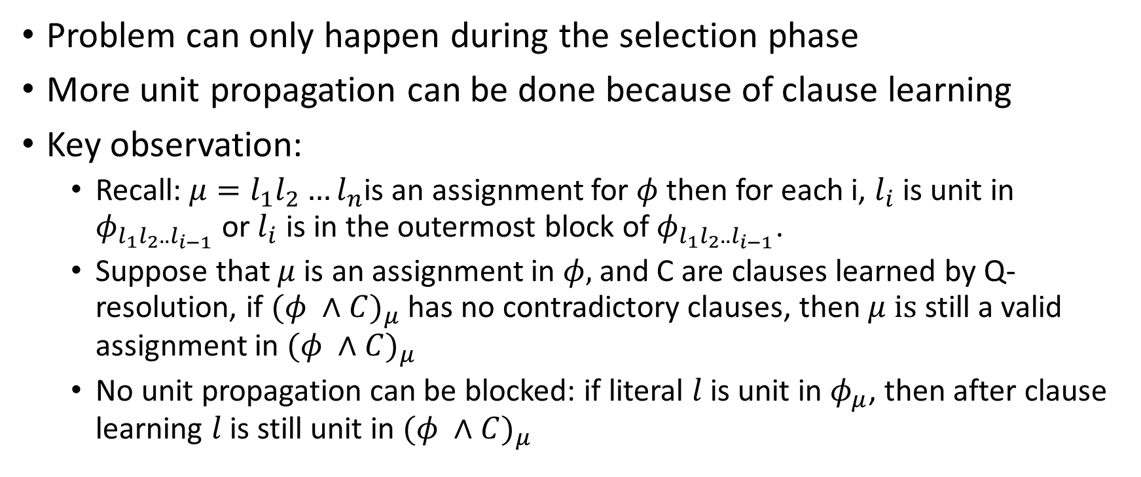
Potential solution
Problem can only happen during the selection phase
More unit propagation can be done because of clause learning
Key observation:
Recall: $μ=l_{1}l_{2}…l_{n}$is an assignment for $φ$ then for each i, $l_{i}$ is unit in $φ_{l_{1}l_{2}..l_{i−1}}$ or${ l}_{i}$ is in the outermost block of $φ_{l_{1}l_{2}..l_{i−1}}$.
Suppose that $μ$ is an assignment in $φ,$and C are clauses learned by Q-resolution, if ${(φ ∧C)}_{μ}$has no contradictory clauses, then $μ is$ still a valid assignment in ${(φ ∧C)}_{μ}$
No unit propagation can be blocked: if literal $l$ is unit in $φ_{μ}$, then after clause learning $l$ is still unit in ${(φ ∧C)}_{μ}$

Slide 31
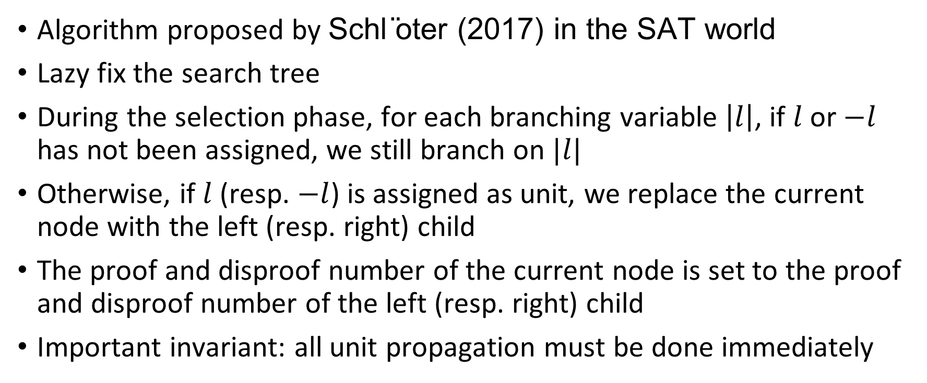
Potential solution
Algorithm proposed by Schl ̈oter (2017) in the SAT world
Lazy fix the search tree
During the selection phase, for each branching variable $\left|l\right|$, if $l$ or $−l$ has not been assigned, we still branch on $|l|$
Otherwise, if $l$ (resp. $−l$) is assigned as unit, we replace the current node with the left (resp. right) child
The proof and disproof number of the current node is set to the proof and disproof number of the left (resp. right) child
Important invariant: all unit propagation must be done immediately

Slide 32
QCDCL and PNS example
y1
(3,3)
Learn unit x3
y1
-y1
x2
(1,3)
(2,9)
x2
-x2
x3
x4
(1,2)
(1,1)
x3
-x3
x5
x4
(1,1)
(1,1)

Slide 33
QCDCL and PNS example
y1
(3,3)
Learn unit x3
y1: add unit x3
-y1
x2
(1,3)
(2,9)
x2
-x2
x3
x4
(1,2)
(1,1)
x3
-x3
x5
x4
(1,1)
(1,1)

Slide 34
QCDCL and PNS example
y1
(3,3)
Learn unit x3
y1: unit x3
-y1
x2
(1,3)
(2,9)
x2
-x2
x3
x4
(1,2)
(1,1)
x3
-x3
x5
x4
(1,1)
(1,1)

Slide 35
QCDCL and PNS example
y1
(3,3)
Learn unit x3
y1: unit x3
-y1
x2
(1,3)
(2,9)
-x2
x4
x2
(1,1)
x5
(1,1)

Slide 36
QCDCL and PNS example
y1
(3,3)
Learn unit x3
y1: unit x3
-y1
x2
(1,3)
(2,9)
-x2
x4
x2
(1,1)
x5
(1,2)
x5
-x5
x4
x6
(1,1)
(1,1)

Slide 37
Previous PNS + QCDCL example
$$∀y∃x2,x1,x3… \left(y∨ ¬x2∨x3\right) ∧\left(x1∨ x2\right)∧\left(¬x1∨ x2\right)∧x2∧Ф$$
(2,1)
|Y|
y: unit x2
-y
$$∃x1,x3 \left(y∨ ¬x2∨x3\right) ∧\left(x1∨ x2\right)∧\left(¬x1∨ x2\right)∧x2∧Ф$$
$∃x2,x1,x3 \left(y∨ ¬x2∨x3\right) ∧\left(x1∨ x2\right)∧\left(¬x1∨ x2\right)$ $∧Ф$
|x2|
|x2|
(1,1)
(1,1)
x2
-x2: unit x1
x2: unit x3
-x2: unit x1
$∃x1,x3 \left(y∨ ¬x2∨x3\right) ∧\left(x1∨ x2\right)∧\left(¬x1∨ x2\right)$ $∧Ф$
$∃x3 \left(y∨ ¬x2∨x3\right) ∧\left(x1∨ x2\right)∧\left(¬x1∨ x2\right)$ $∧Ф$
$\left(y∨ ¬x2∨x3\right) ∧\left(x1∨ x2\right)∧\left(¬x1∨ x2\right)$ $∧Ф$
$∃x3 \left(y∨ ¬x2∨x3\right) ∧\left(x1∨ x2\right)∧\left(¬x1∨ x2\right)$ $∧Ф$
(ꝏ,0)
(1,1)
Unknown
F
Unknown
F
X2 has been assigned as unit! The searching space changed, we can no longer assign x2!

Slide 38
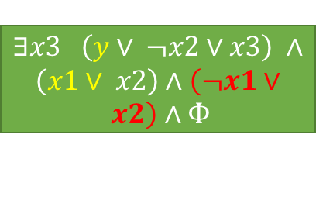
Previous PNS + QCDCL example
$$∀y∃x2,x1,x3… \left(y∨ ¬x2∨x3\right) ∧\left(x1∨ x2\right)∧\left(¬x1∨ x2\right)∧x2∧Ф$$
(2,1)
|Y|
-y
$∃x2,x1,x3 \left(y∨ ¬x2∨x3\right) ∧\left(x1∨ x2\right)∧\left(¬x1∨ x2\right)$ $∧Ф$
|x2|
y: unit x2
(1,1)
x2: unit x3
-x2: unit x1
$∃x1,x3 \left(y∨ ¬x2∨x3\right) ∧\left(x1∨ x2\right)∧\left(¬x1∨ x2\right)$ $∧Ф$
$∃x3 \left(y∨ ¬x2∨x3\right) ∧\left(x1∨ x2\right)∧\left(¬x1∨ x2\right)$ $∧Ф$
$\left(y∨ ¬x2∨x3\right) ∧\left(x1∨ x2\right)∧\left(¬x1∨ x2\right)$ $∧Ф$
$∃x3 \left(y∨ ¬x2∨x3\right) ∧\left(x1∨ x2\right)∧\left(¬x1∨ x2\right)$ $∧Ф$
(ꝏ,0)
(1,1)
F
Unknown
Unknown
F

Slide 39

Complications in the QBF world
x1
x2
x2
Additional unit: x6
caused by C
Learn C
x4
x3
y1
y1
Can we still conclude the green node is SAT
after additional unit propagation caused by
clause learning?
T
x3
Many assignments
T: uses $¬$x6

Slide 40
Complications in the QBF world
Obvious solution: cut-off the green node and replace it with a newly expanded node
Too many cut-off, waste our previous work in the subtree
Key observation: The cut-off is unnecessary if the node y1 is a unique implication point (UIP), the truth value of the green node is reusable
Proof is related to the definition of UIP and the property of cube learning
If y1 is not a UIP, require further investigation

Slide 41
Thesis B summary
Modify the reason computation rule with the SAT solver enabled
Implement QCDCL algorithm with 2-watched literal data structure
Investigate the algorithm that combines PNS + QCDCL

Slide 42
Outline
Thesis A recap
Progress in thesis B
Backjumping with SAT solver enabled
QCDCL algorithm and implementation
Combining QCDCL with Proof number search
Future work

Slide 43
Future work
PNS + QCDCL theory and implementation
PNS heuristics in QBF world
Expected outcome:
1) worst case: implement a correct PNS + QCDCL solver/pre-preprocessor
2) best case: implement a PNS + QCDCL solver that can achieve some unexpected performance on some families of instances

Slide 44
Thesis C timetable
Week | Task
Term break | Implement solution driven cube learning and debug the full QCDCL + 2wl solver
1 – 4 | PNS + QCDCL theory cont. and implementation
5 – 6 | PNS heuristics in QBF world + experiments
7 – 8 | Thesis C presentation
9 - 11 | Thesis C report

Slide 45
Reference
Enrico Giunchiglia, Massimo Narizzano, and Armando Tacchella. Clause/term resolution andlearning in the evaluation of quantified boolean formulas.Journal of Artificial IntelligenceResearch, 26:371–416, 2006.
Jens Schl ̈oter. A monte carlo tree search based conflict-driven clause learning sat solver. InGI-Jahrestagung, 2017.
Gent, I., Giunchiglia, E., Narizzano, M., Rowley, A., & Tacchella, A. (2004). Watched Data Structures for QBF Solvers. Lecture Notes in Computer Science, 25–36. https://doi.org/10.1007/978-3-540-24605-3_3

