Slide 1
Proof number search and QBF solving
Yifan He
Supervisor: Dr. Abdallah Saffidine

Slide 2
Motivation
QBF is similar to 2-player strategy game in a theoretical level
All search based QBF solvers use depth-first search
DFS or IDS is not ideal for game solving
Shogi dfs cannot solve a game with more than 17 steps
Best first search can solve games with 100+ steps.
Huge searching depth
QBF has a very deep searching space
Notes:
Put it at the beginning of the slides.

Slide 3
Outline
Background
Expectation
Methodology
Result and Discussion
Conclusion and Future work

Slide 4
Outline
Background
Expectation
Methodology
Implementation and Result
Conclusion and Future work

Slide 5
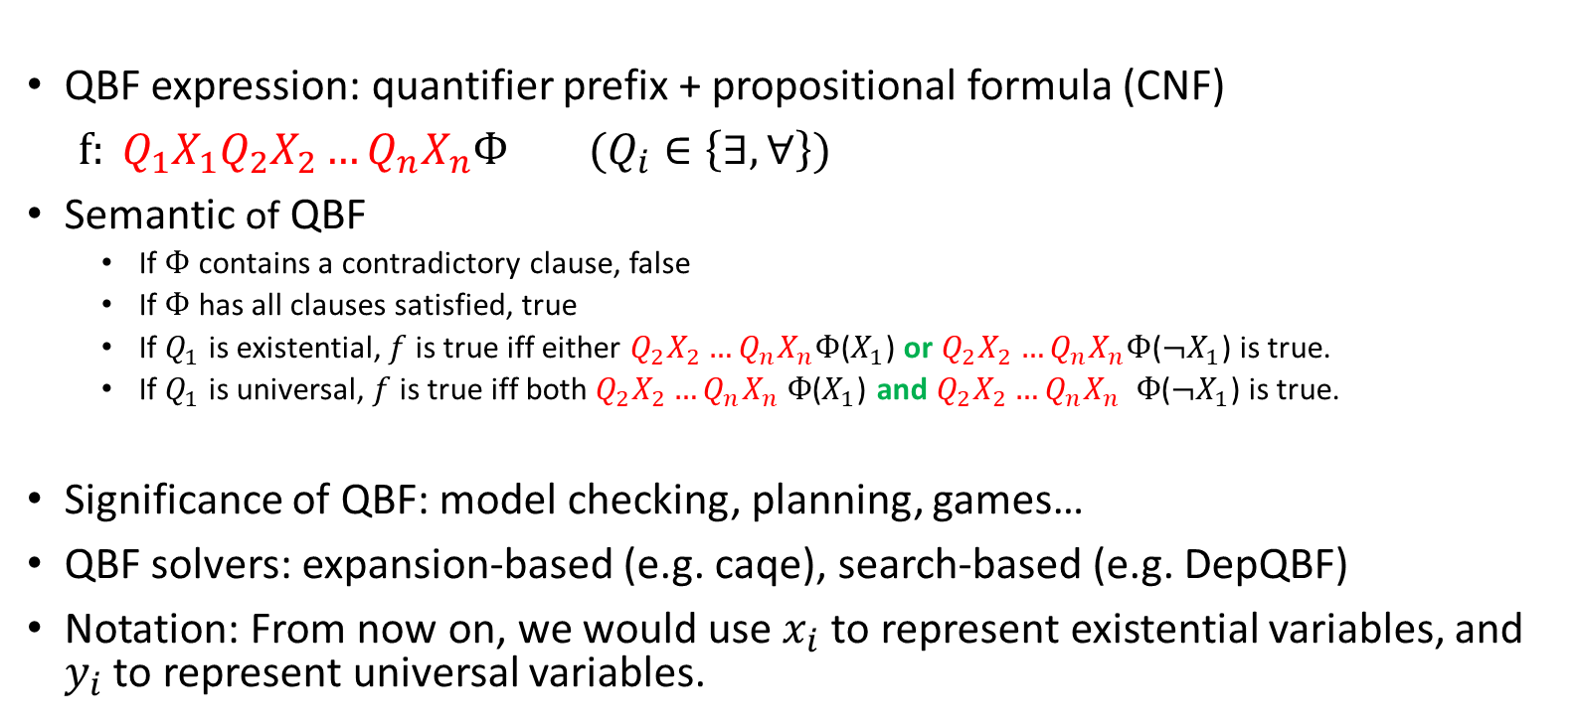
QBF
QBF expression: quantifier prefix + propositional formula (CNF)
$f: Q_{1}X_{1}Q_{2}X_{2}…Q_{n}X_{n}Ф (Q_{i}∈\left\{∃,∀\right\})$
Semantic of QBF
If $Ф$ contains a contradictory clause, false
If $Ф$ has all clauses satisfied, true
If $Q_{1}$ is existential, $f$ is true iff either $Q_{2}X_{2}…Q_{n}X_{n}Ф$($X_{1}$) or $Q_{2}X_{2}…Q_{n}X_{n}Ф$($¬X_{1}$) is true.
If $Q_{1}$ is universal, $f$ is true iff both${ Q}_{2}X_{2}…Q_{n}X_{n} Ф$($X_{1}$) and $Q_{2}X_{2}…Q_{n}X_{n} Ф$($¬X_{1}$) is true.
Significance of QBF: model checking, planning, games…
QBF solvers: expansion-based (e.g. caqe), search-based (e.g. DepQBF)
Notation: From now on, we would use $x_{i}$ to represent existential variables, and $y_{i}$ to represent universal variables.

Slide 6
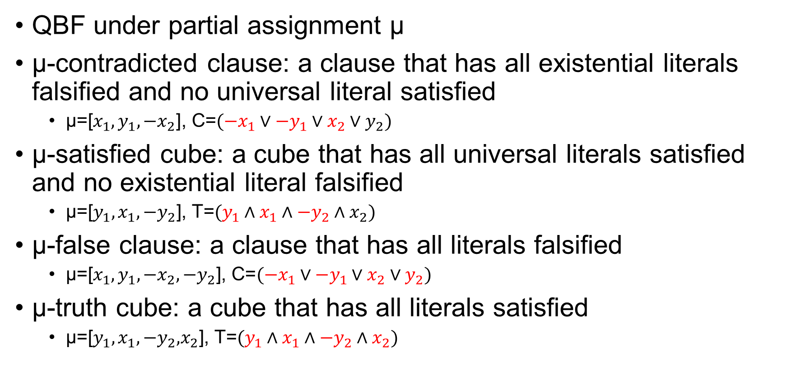
Assertion clauses/cubes
QBF under partial assignment μ
μ-contradicted clause: a clause that has all existential literals falsified and no universal literal satisfied
$\text{μ}\text{=[}x_{1},y_{1},{−x}_{2}\text{], }\text{C}\text{=}({−x}_{1}∨{−y}_{1}∨x_{2}∨y_{2})$
μ-satisfied cube: a cube that has all universal literals satisfied and no existential literal falsified
$\text{μ}\text{=[}y_{1},x_{1},{−y}_{2}\text{], }\text{T}\text{=}(y_{1}∧x_{1}∧{−y}_{2}∧x_{2})$
μ-false clause: a clause that has all literals falsified
$\text{μ}\text{=[}x_{1},y_{1},{−x}_{2},{−y}_{2}\text{], }\text{C}\text{=}({−x}_{1}∨{−y}_{1}∨x_{2}∨y_{2})$
μ-truth cube: a cube that has all literals satisfied
$\text{μ}\text{=[}y_{1},x_{1},{−y}_{2}\text{,}x_{2}\text{], }\text{T}\text{=}(y_{1}∧x_{1}∧{−y}_{2}∧x_{2})$
Adapt from: https://www.researchgate.net/publication/220543407_ClauseTerm_Resolution_and_Learning_in_the_Evaluation_of_Quantified_Boolean_Formulas

Slide 7
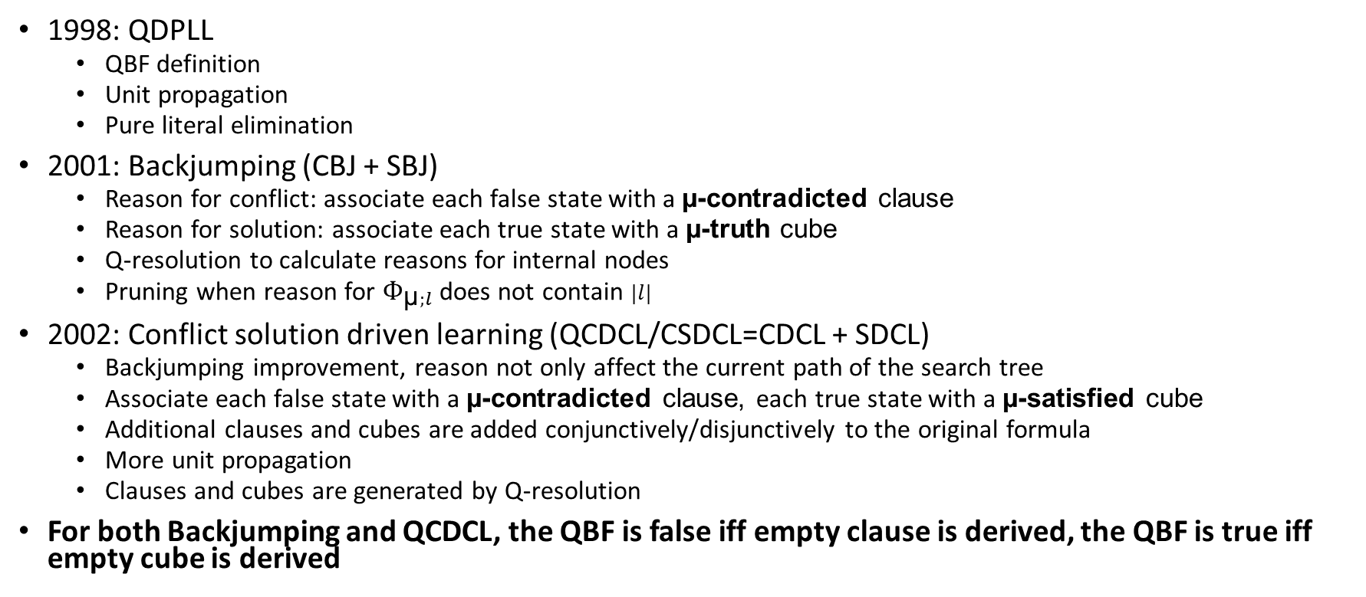
Search based QBF solving
1998: QDPLL
QBF definition
Unit propagation
Pure literal elimination
2001: Backjumping (CBJ + SBJ)
Reason for conflict: associate each false state with a μ-contradicted clause
Reason for solution: associate each true state with a μ-truth cube
Q-resolution to calculate reasons for internal nodes
Pruning when reason for $Ф_{\text{μ};l}$ does not contain $|l|$
2002: Conflict solution driven learning (QCDCL/CSDCL=CDCL + SDCL)
Backjumping improvement, reason not only affect the current path of the search tree
Associate each false state with a μ-contradicted clause, each true state with a μ-satisfied cube
Additional clauses and cubes are added conjunctively/disjunctively to the original formula
More unit propagation
Clauses and cubes are generated by Q-resolution
For both Backjumping and QCDCL, the QBF is false iff empty clause is derived, the QBF is true iff empty cube is derived
Notes:
p5 "we assign the variable ~x1 to true" -> literal or variable to false p6 clause vs assignment p7 write down the year of qdpll, backjumping, and QCDCL p7 what does it mean to add a cube to a QBF? p16 "make to be" p23 is it new with PNS or new with QBF? p27 CDL or CDCL? p32 with without p36 unfeasible? last slide: future work can be more

Slide 8
QBF game representation
QBF can be viewed as an and-or two player strategy game
existential quantifier is the or player (maximizer)
universal quantifier is the and player (minimizer)
existential quantifier tries to satisfy the formula
universal quantifier tries to falsify the formula

Slide 9
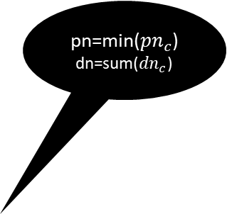

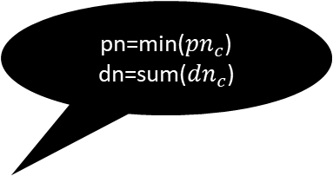
Proof number search
pn=min(${pn}_{c}$) dn=sum(${dn}_{c}$)
argmin(pn)
Each node stores 2 information:
Proof number (pn)
Disproof number (dn)
Iteration:
Selection (find MPN)
Expansion
Initialization
Backpropagation
Advantage
Not get stuck at one side of the searching space
Drawback
Memory issue, seesaw effect
Variations
DeepPNS, df-pn, PN2, PN* etc.
pn=sum(${pn}_{c}$) dn=min(${dn}_{c}$)
argmin(dn)
2,2
1,2
pn=min(${pn}_{c}$)
dn=sum(${dn}_{c}$)
argmin(pn)
2,1
4,1
1,1
1,1
1,1
0,inf
0, inf
1,1
Notes:
Identify MPN, MPN is always a leaf. How to do MPN
Guaranteed, MPN. Exploration->selection is find the MPN

Slide 10
Outline
Background
Expectation
Methodology
Implementation and Result
Conclusion and Future work

Slide 11
Expectation
Design a PNS-based QBF solver
Combine existing search based QBF solving techniques with PNS
Backjumping
QCDCL

Slide 12
Expectation (cont.)
Can we design and implement a PNS-based Backjumping solver?
Can we design and implement a PNS-based QCDCL solver?
Can PNS bring any performance benefits?

Slide 13
Outline
Background
Expectation
Methodology
Implementation and Result
Conclusion and Future work

Slide 14
Proof number search and Backjumping
Information in each node
Proof number (pn)
Disproof number (dn)
Branching variable (v)
Reason for (un)satisfiability (reason, default null)
Reason for UNSAT is a μ-contradicted clause
Reason for SAT is a μ-truth cube
r
r1
r2
During backpropagation, calculate reason r for the parent based on r1 and r2.

Slide 15
Proof number search and Backjumping
r
r5
r2
r1
r4
v
r4: reason for $Ф_{μ;−v}$ does not contain v or -v
r3

Slide 16
Proof number search and QCDCL
Each node stores exactly the same information as backjumping
Potential Benefit
Same as Backjumping vs QCDCL
Learned clause/cube can simplify the search on other parts of the tree
Main obstacle
Learned constraints create more unit propagation, make the branching variables be assigned earlier

Slide 17
Proof number search and QCDCL (cont.)
y1
(3,3)
Learn unit x3
y1,
additional x3
-y1
X3 has been assigned, cannot branch on it anymore
x2
(1,3)
(2,9)
x2
-x2
x3
x4
(1,2)
(1,1)
x3
-x3
x5
x4
(1,1)
(1,1)

Slide 18

Proof number search and QCDCL (cont.)
MCTS + CDCL based SAT solver, Schloeter (2017)
Lazy fix the search tree
All unit propagation must be done immediately
Pure literal elimination is shut down
yes
Current := left
Node with branching $|L|$
|L| or –|L| assigned?
yes
|L| assigned?
no
Branch on |L|
no
Current:= right

Slide 19
QCDCL and PNS example
y1
(3,3)
Learn unit x3
y1: add unit x3
-y1
x2
(1,3)
(2,9)
x2
-x2
x3
x4
(1,2)
(1,1)
x3
-x3
x5
x4
(1,1)
(1,1)

Slide 20
QCDCL and PNS example
y1
(3,3)
Learn unit x3
y1: unit x3
-y1
x2
(1,3)
(2,9)
x2
-x2
x3
x4
(1,2)
(1,1)
x3
-x3
x5
x4
(1,1)
(1,1)

Slide 21
QCDCL and PNS example
y1
(3,3)
Learn unit x3
y1: unit x3
-y1
x2
(1,3)
(2,9)
-x2
x4
x2
(1,1)
x5
(1,1)

Slide 22
Full story?
We “can” design a PNS-based QBF solver with Schloeter’s method that features:
Unit propagation
Conflict driven clause learning
Solution driven cube learning
Not even close!

Slide 23

Proof number search and QCDCL (cont.)
x1
x2
x2
Additional unit: x6
caused by C
Learn C
x4
x3
y1
y1
Can we still conclude the green node is SAT
after additional unit propagation caused by
Clause + cube learning?
How can we deduce the reason for the green node after the searching space has changed?
T
x3
Many assignments
T: uses $¬$x6

Slide 24
Important fact
UP > PLE
CDCL + SDCL (with special care) > CDCL + SBJ > Backjumping
Most search based solvers has CDCL, some does not have SDCL (e.g. Quaffle-CDL)

Slide 25
Simplified problem
Can we design a PNS-based QBF solver with Schloeter’s method that features:
Unit propagation (UP)
Conflict driven clause learning (CDCL)
Solution driven Backjumping (SBJ)

Slide 26

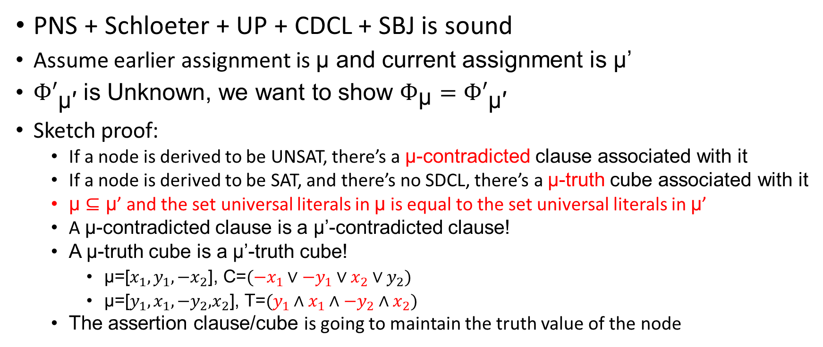
Simplified problem (cont.)
Ф
Ф’= Ф$∧C$
μ
μ'
PNS + Schloeter + UP + CDCL + SBJ is sound
Assume earlier assignment is μ and current assignment is μ’
${Ф′}_{\text{μ}\text{′}}$ is Unknown, we want to show $Ф_{\text{μ}}={Ф′}_{\text{μ}\text{′}}$
Sketch proof:
If a node is derived to be UNSAT, there’s a μ-contradicted clause associated with it
If a node is derived to be SAT, and there’s no SDCL, there’s a μ-truth cube associated with it
$\text{μ}⊆\text{μ}$’ and the set universal literals in $\text{μ}$ is equal to the set universal literals in $\text{μ}$’
A μ-contradicted clause is a μ’-contradicted clause!
A μ-truth cube is a μ’-truth cube!
$\text{μ}\text{=[}x_{1},y_{1},{−x}_{2}\text{], }\text{C}\text{=}({−x}_{1}∨{−y}_{1}∨x_{2}∨y_{2})$
$\text{μ}\text{=[}y_{1},x_{1},{−y}_{2}\text{,}x_{2}\text{], }\text{T}\text{=}(y_{1}∧x_{1}∧{−y}_{2}∧x_{2})$
The assertion clause/cube is going to maintain the truth value of the node

Slide 27
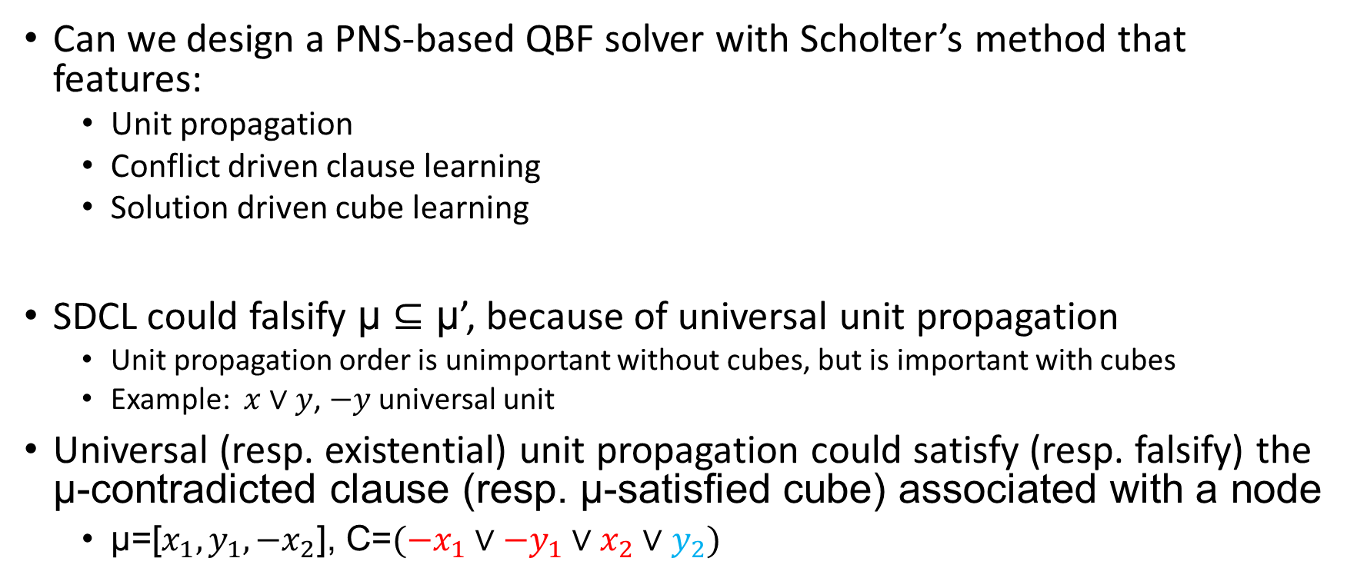
Can we go further?
Can we design a PNS-based QBF solver with Scholter’s method that features:
Unit propagation
Conflict driven clause learning
Solution driven cube learning
SDCL could falsify $\text{μ}⊆\text{μ}$’, because of universal unit propagation
Unit propagation order is unimportant without cubes, but is important with cubes
Example: $x∨y$, $−y$ universal unit
Universal (resp. existential) unit propagation could satisfy (resp. falsify) the μ-contradicted clause (resp. μ-satisfied cube) associated with a node
$\text{μ}\text{=[}x_{1},y_{1},{−x}_{2}\text{], }\text{C}\text{=}({−x}_{1}∨{−y}_{1}∨x_{2}∨y_{2})$

Slide 28
Can we go further?
Can we design a PNS-based QBF solver with Schloeter’s method that features:
Unit propagation
Conflict driven clause learning
Solution driven cube learning
Potential solution:
Memorized the order of unit propagation, postpone additional unit propagation until creating new nodes
Postpone unit propagation is always undesired
Unit: X1, X2, new X3
Unit: X4, new Y1
UP if x3 and y1 are still unit
new
new

Slide 29
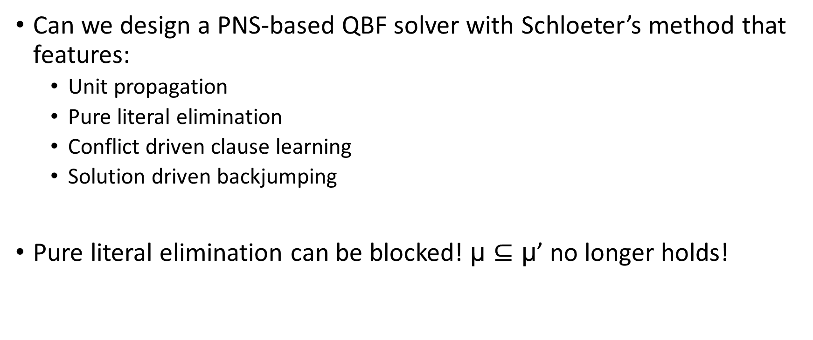
Can we go further?
Can we design a PNS-based QBF solver with Schloeter’s method that features:
Unit propagation
Pure literal elimination
Conflict driven clause learning
Solution driven backjumping
Pure literal elimination can be blocked! $\text{μ}⊆\text{μ}$’ no longer holds!
Unit: X1, X2
Pure: X3

Slide 30
Outline
Background
Expectation
Methodology
Implementation and Result
Conclusion and Future work

Slide 31
Implementation details
2-watched literal data structure
Lazy data structure for state of art SAT solvers and many search based QBF solver
Learning strategy
1-UIP
Never delete learned constraints

Slide 32
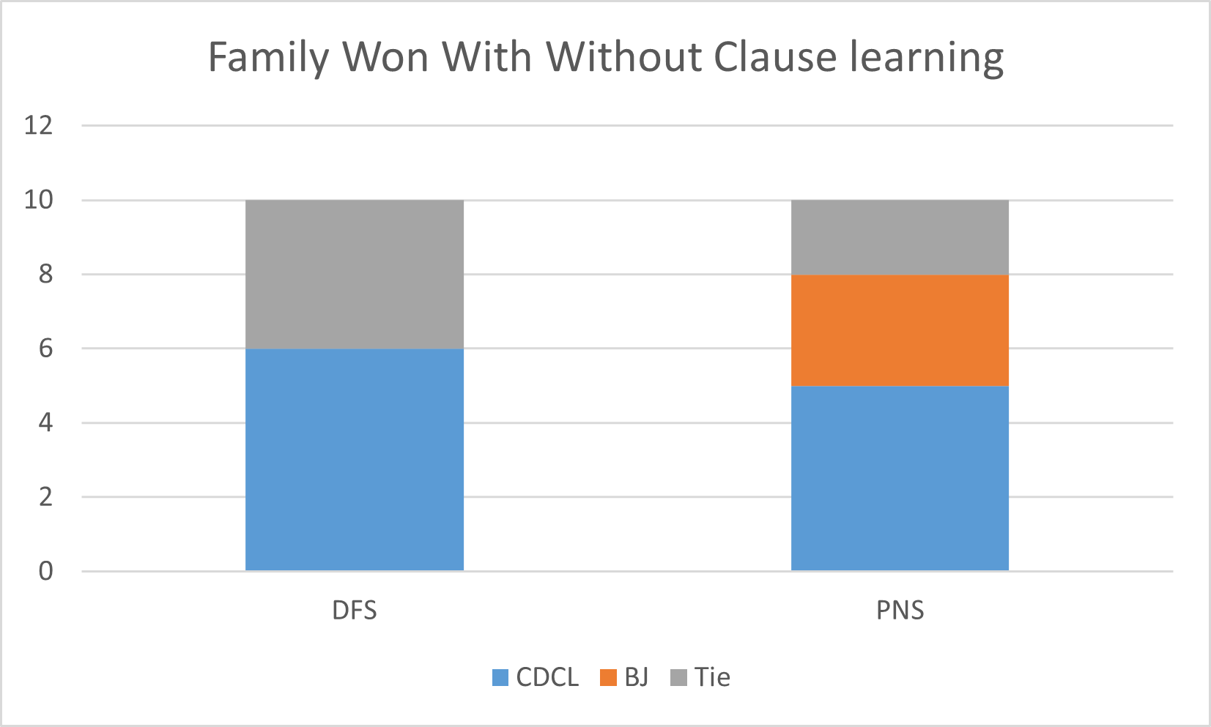
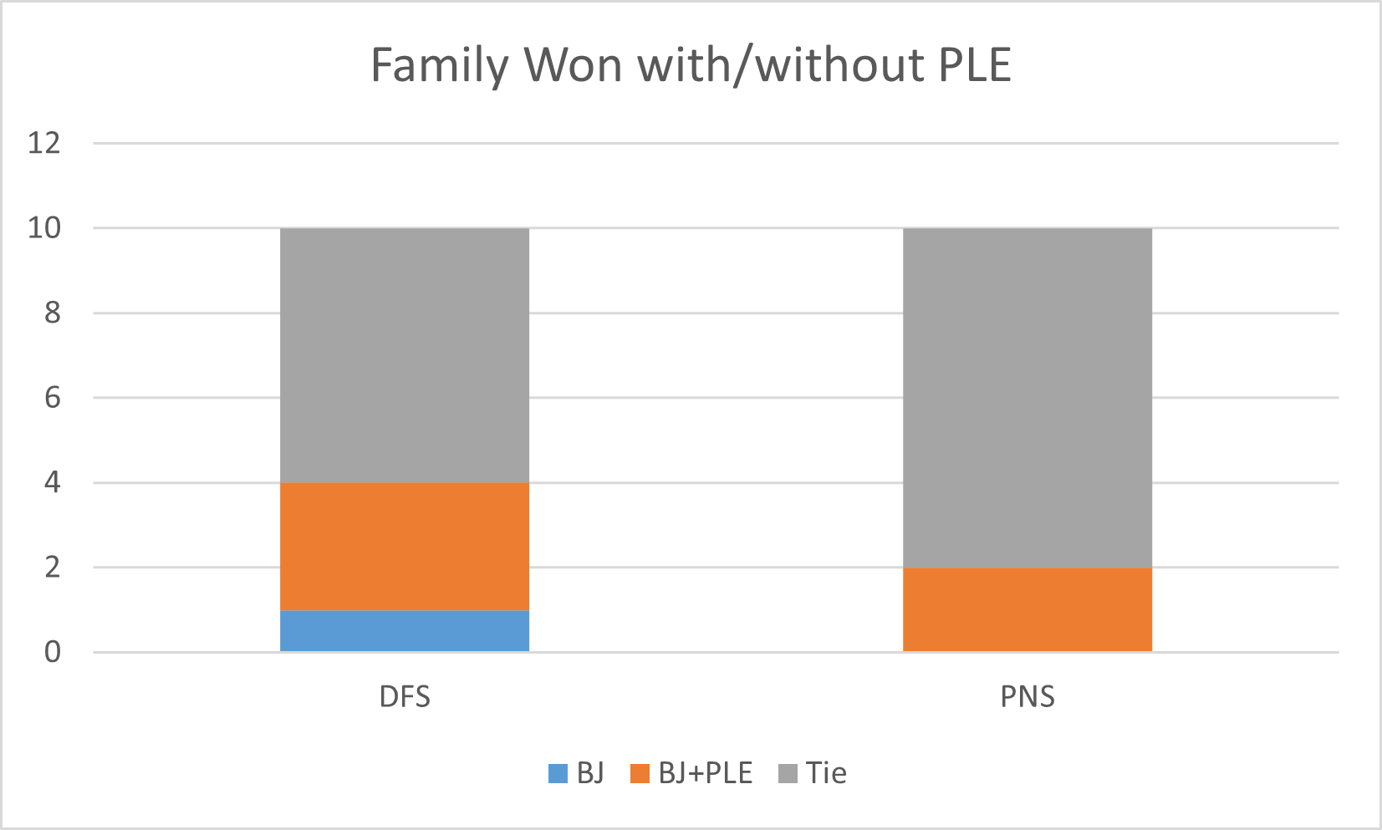
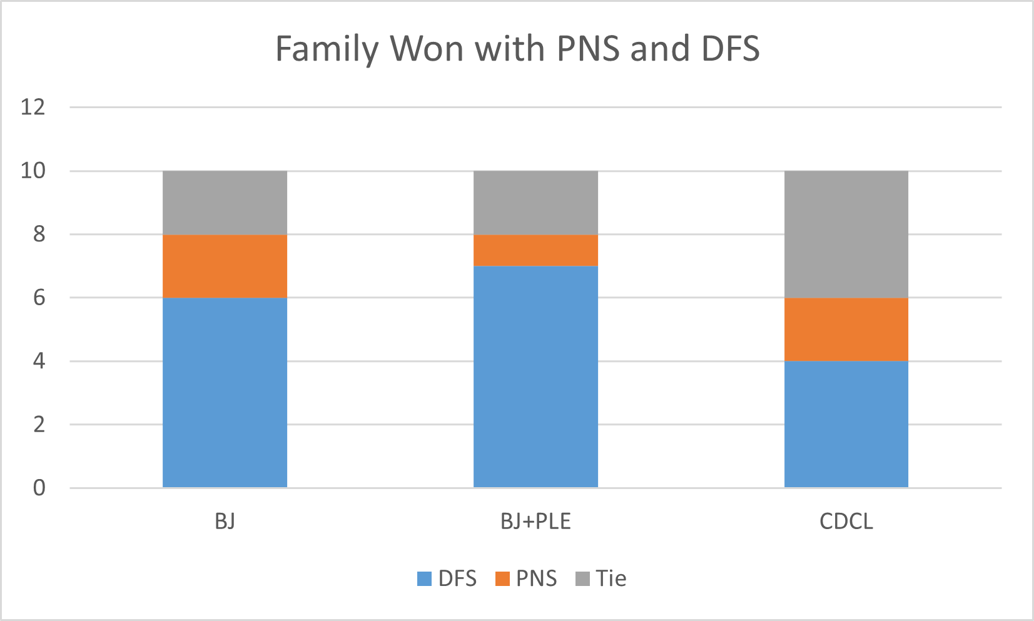
Result and discussion
Family | Total | BJ | BJ + PLE | CDCL+SBJ | PBJ | PBJ + PLE | PCL+SBJ
Block (2004) | 8 | 2 | 3 | 3 | 0 | 1 | 1
Chain (2004) | 8 | 8 | 8 | 8 | 7 | 7 | 6
Counter (2004) | 8 | 3 | 3 | 4 | 2 | 2 | 2
K_dum_p (2004) | 8 | 3 | 3 | 7 | 1 | 1 | 7
K_lin_p (2004) | 8 | 2 | 3 | 8 | 1 | 1 | 3
Logn | 2 | 2 | 1 | 2 | 0 | 0 | 2
Toilet | 8 | 6 | 6 | 6 | 7 | 7 | 7
Tree (2004) | 8 | 6 | 6 | 8 | 6 | 6 | 8
 | 58 | 32 | 33 | 46 | 24 | 25 | 36
Real world instances
Adder | 32 | 4 | 4 | 4 | 4 | 4 | 4
Gttt4x4 | 95 | 13 | 40 | 15 | 18 | 38 | 17
The PNS based solver produced the correct result on all solved benchmarks
Clause learning helps the PNS solver
PNS solver is beneficial to some families of instances, although no benefits on most
PNS cannot solve instances that DFS solvers cannot solve when advanced reasoning technique is required (e.g. Adder)
PLE is very useful to PNS as well (gttt4x4)
Number of solved instances by different methods
Time limit per instance: 900s
PLE pure literal elimination, BJ: DFS based Backjumping solver; CDCL+SBJ: DFS based CDCL solver with SBJ
PBJ: PNS based Backjumping solver,PCL: PNS based CDCL solver; PCL+SBJ: PNS based CDCL solver with SBJ

Slide 33
Result and discussion (cont.)
Family | #Both CDCL-SBJ and PCL-SBJ | Average visit ratio in PCL-SBJ | #Solved PCL-SBJ not CDCL-SBJ
Block (2004) | 1 | 69 | 0
Chain (2004) | 6 | 37 | 0
Counter (2004) | 2 | 12 | 0
K_dum_p (2004) | 7 | 11 | 1
K_lin_p (2004) | 3 | 14 | 0
Logn | 2 | 98 | 0
Toilet | 5 | 39 | 2
Tree (2004) | 8 | 21 | 0

Slide 34
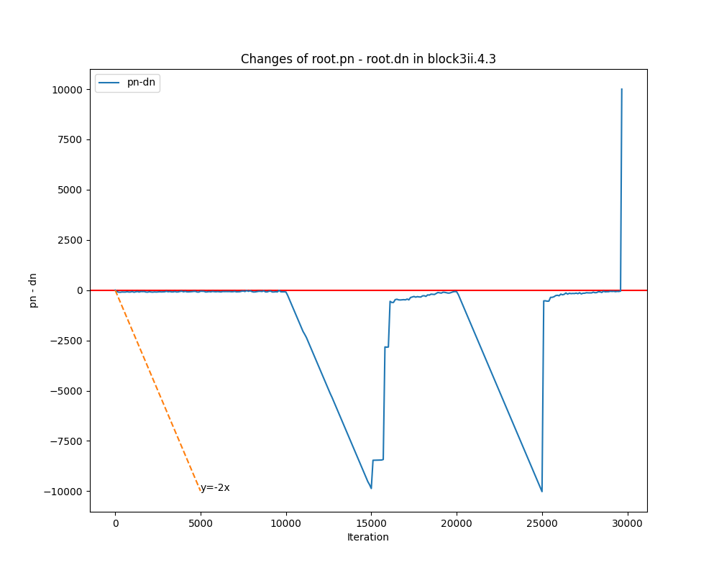
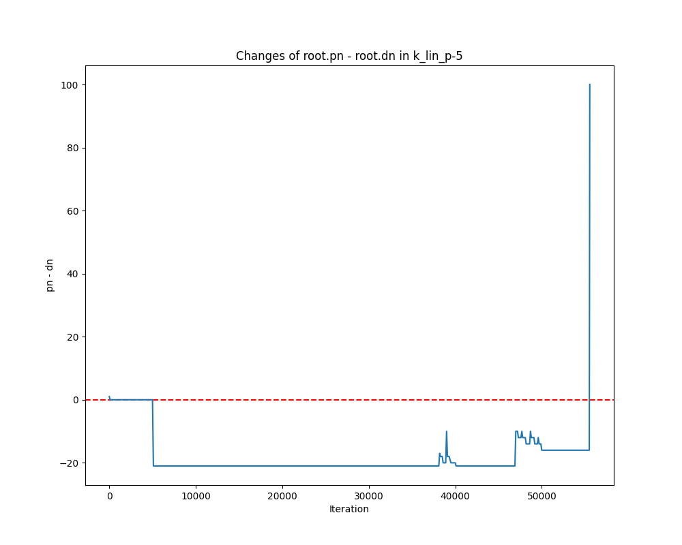
Result and discussion (cont.)
Proof and disproof number is not very informative in the current setting
PNS is unhelpful: Both instances are UNSAT, pn-dn becomes positive only before they are solved

Slide 35
Outline
Background
Expectation
Methodology
Implementation and Result
Conclusion and Future work

Slide 36
Outcome
Can we design and implement a PNS-based Backjumping solver?
Definitely
Can we design and implement a PNS-based QCDCL solver?
Yes, if we ignore cube learning and pure literal elimination
Doable with full QCDCL if postpone new unit propagation
There are significant obstacles when we activate pure literal elimination
Can PNS bring any performance benefits?
Open question, need to design initialization heuristics for QBF

Slide 37
Related Work
Related work | My work
Proof number search (Allis, 1994) | PNS + Backjumping based QBF solver
QDLL algorithm (Cadoli, 1998) | PNS + Backjumping based QBF solver
2 watched literal data structure (Zhang, 2001)
Backjumping in QBF (Giunchiglia, 2001) | PNS + Backjumping based QBF solver
QCDCL (Zhang, Letz, Giunchiglia, 2002) | PNS + CDCL + SBJ based QBF solver Show the difficulty of combining PNS + SDCL or activate pure literal elimination
MCTS + CDCL based SAT solver (Schloeter, 2017)

Slide 38
Future work
Resolve the issue with PLE
PNS and SDCL
Parameter tuning
Initialization heuristics

Slide 39
Thanks

