Slide 1



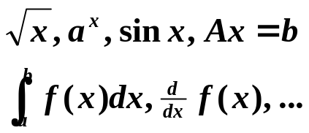
Q1: What is numerical analysis for?
Input
Computer
Output
NA
+ −
× ÷
Approximations
&
Transformation
Q2: What is this course for?
To give an introduction to classical approximation technique
To explain how, why, and when they can be expected to work
To provide a firm basis for future study of scientific computing
1/11

Slide 2
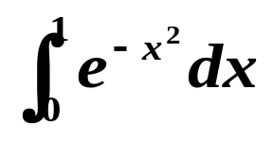

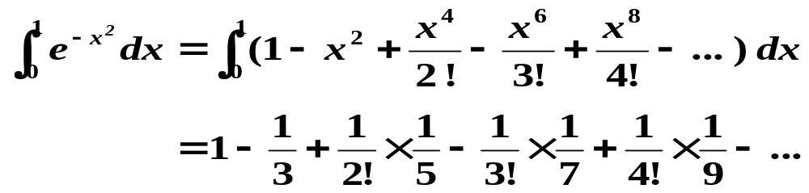
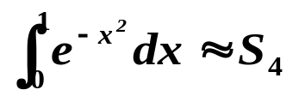
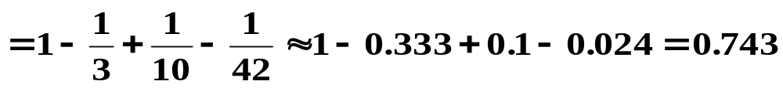
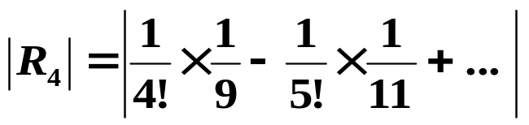
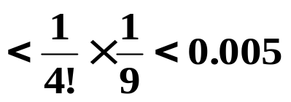
Chapter 1 Mathematical Preliminaries
☑ 1.2 Roundoff Errors and Computer Arithmetic
Discussion 1: Approximate
= 0.747… …
Solution: Use Taylor expansion of
S₄
R₄ /* Remainder */
Take
| Total error |
< 0.006
Roundoff error (by included terms)
< 0.0005×2 = 0.001
Truncation error (by excluded terms)
< 0.005
2/11

Slide 3

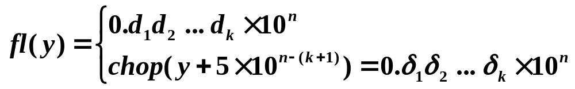
Chapter 1 Mathematical Preliminaries -- Roundoff Errors and Computer Arithmetic
Truncation Error: the error involved in using a truncated, or finite, summation to approximate the sum of an infinite series.
Roundoff Error: the error produced when performing real number calculations. It occurs because the arithmetic performed in a machine involves numbers with only a finite number of digits.
Normalized decimal floating-point form of a real number:
where 1 ≤ d₁ ≤ 9 and 0 ≤ d_{i} ≤ 9 ( i = 2, …, k )
k-digit decimal machine number
Given a real number y = 0.d₁d₂ … d_{k} d_{k+1}d_{k+2} … × 10^{n}
/* Chopping */
/* Rounding */
3/11

Slide 4

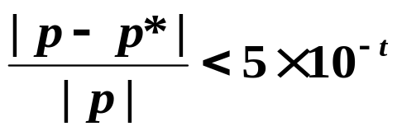
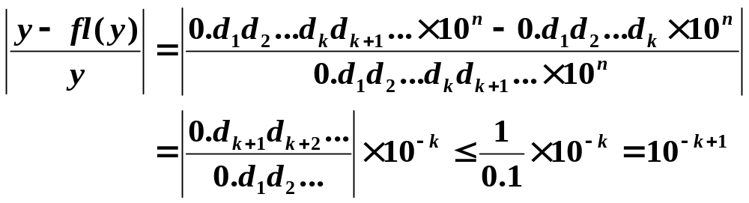
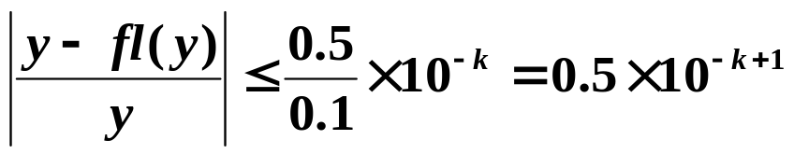
Chapter 1 Mathematical Preliminaries -- Roundoff Errors and Computer Arithmetic
Definition: If p* is an approximation to p, the absolute error is | p – p* |, and the relative error is | p – p* | / | p |, provided that p ≠ 0.
Of course mine is more accurate ! The accuracy relates to not only the absolute error, but also to the size of the exact value.
I can tell that distance between two planets is
1 million light year ±1 light year.
I can tell that this part’s diameter is 20cm±1cm.
Definition: The number p* is said to approximate p to t significant digits (or figures) if t is the largest nonnegative integer for which
Chopping:
Rounding:
4/11

Slide 5

Chapter 1 Mathematical Preliminaries -- Roundoff Errors and Computer Arithmetic
How will roundoff error affect our results?
☞ Subtraction of nearly equal numbers will cause a cancellation of significant digits.
Example: a₁ = 0.12345 and a₂ = 0.12346 both have 5 significant digits.
However, a₂ − a₁ = 0.00001 has only 1 significant digit left.
☞ Dividing by a number with small magnitude (or, equivalently, multiplying by a number with large magnitude) will cause an enlargement of the error.
Remember: always simplify your formulae before you give them to your computer!
5/11

Slide 6

Chapter 1 Mathematical Preliminaries -- Roundoff Errors and Computer Arithmetic
Research topic 1:
Discuss the best way of finding the roots of a quadratic equation ax² + bx + c = 0.
Take x² + 62.10x + 1 = 0 as an example, and assume that your calculator has only 4-digit rounding.
6/11

Slide 7
Chapter 1 Mathematical Preliminaries -- Roundoff Errors and Computer Arithmetic
Discussion 2: Evaluate f(x) = x³ – 6.1x² + 3.2x + 1.5 at x = 4.71 using 3-digit arithmetic.
x
x²
x³
6.1x²
3.2x
Exact
4.71
22.1841
104.487111
135.32301
15.072
Chopping
4.71
HW: p.27-28
#3, 11, 17(b)
22.1
104.
134.
15.0
Rounding
4.71
22.2
105.
135.
15.1
Exact = –14.263899; Chopping = –13.5; Rounding = –13.4
Relative error (Chopping) ≈ 5%; Relative error (Rounding) ≈ 6%
 An alternative approach:
f(x) = x³ – 6.1x² + 3.2x + 1.5 = ((x – 6.1) x + 3.2) x + 1.5
Chopping = –14.2; Rounding = –14.3
Relative error (Chopping) ≈ 0.45%
Relative error (Rounding) ≈ 0.25%
秦九韶算法
Horner’s Method
7/11

Slide 8

Chapter 1 Mathematical Preliminaries -- Algorithms and Convergence
☑ 1.3 Algorithms and Convergence
Definition: An algorithm that satisfies that small changes in the initial data produce correspondingly small changes in the final results is called stable; otherwise it is unstable. An algorithm is called conditionally stable if it is stable only for certain choices of initial data.
Definition: Suppose that E₀ > 0 denotes an initial error and E_{n} represents the magnitude of an error after n subsequent operations. If E_{n} ≈ C n E₀, where C is a constant independent of n, then the growth of error is said to be linear. If E_{n} ≈ C^{n} E₀, for some C > 1, then the growth of error is called exponential.
Note:
Linear growth of error is usually unavoidable, and when C and E₀ are small the results are generally acceptable.
Exponential growth of error should be avoided since the term C^{n} becomes large for even relatively small values of n. This leads to unacceptable inaccuracies, regardless of the size of E₀.
8/11

Slide 9
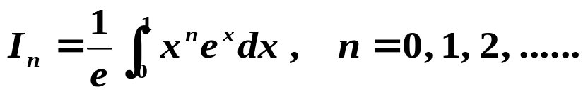

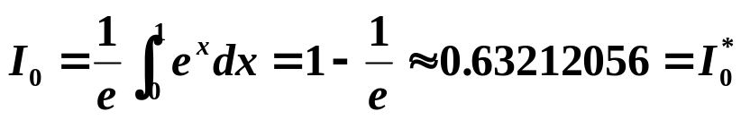

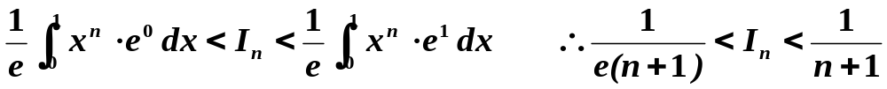
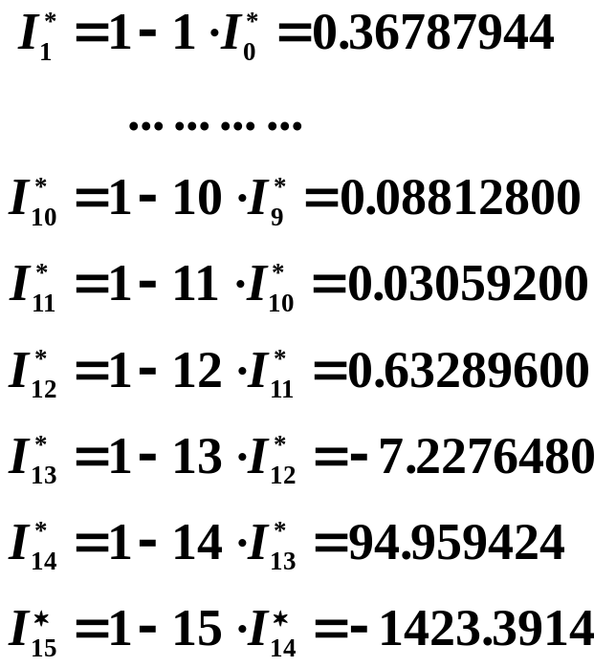


Chapter 1 Mathematical Preliminaries -- Algorithms and Convergence
Example: Evaluate
 Method 1:
This is theoretically accurate.
Discussion 3:
What happened?!
?
Unstable!
??
? !
! !
9/11

Slide 10
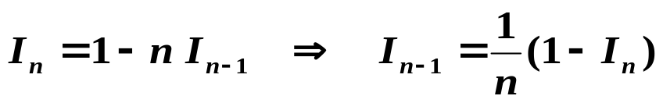
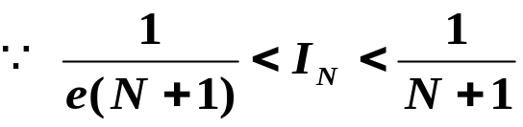
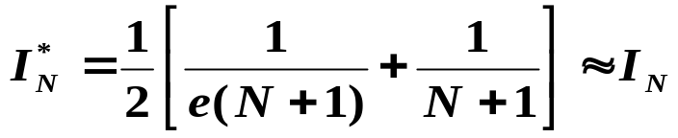

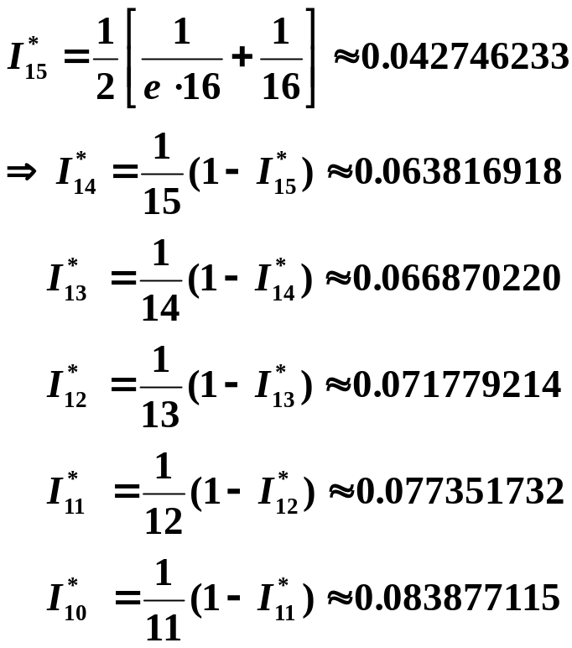
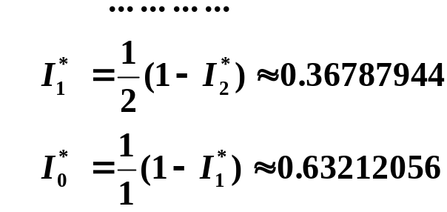

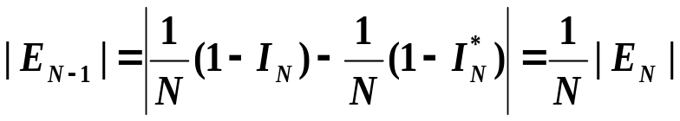
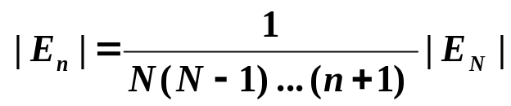
Chapter 1 Mathematical Preliminaries -- Algorithms and Convergence
 Method 2:
HW: p.38 #7
We may take
This is theoretically equivalent
to the previous formula.
Take
Excuses for not
doing homework
I accidentally divided by zero
and my paper burst into flames.
We just got lucky?
Stable!
10/11

Slide 11
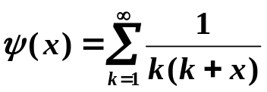
Chapter 1 Mathematical Preliminaries -- Algorithms and Convergence
Lab 01. Numerical Summation of a Series
Time Limit: 1 second; Points: 4
Produce a table of the values of the series
(1)
for the 3001 values of x, x = 0.0, 0.1, 0.2, …, 300.00. All entries of the table must have an absolute error less than 1.0e-10. This problem is based on a problem from Hamming (1962), when mainframes were very slow by today's microcomputer standards.
11/11

