Slide 1

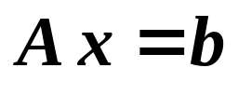

Chapter 6 Direct Methods for Solving
Linear Systems
Solve
☑ 6.1 Linear Systems of Equations
➢ Gaussian Elimination
First reduce A into an upper-triangular matrix, and then solve for the unknowns by a backward-substitution process.
Idea
=
1/5

Slide 2
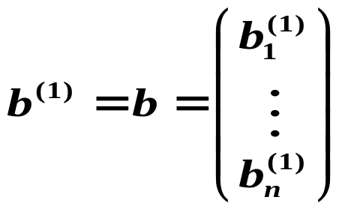





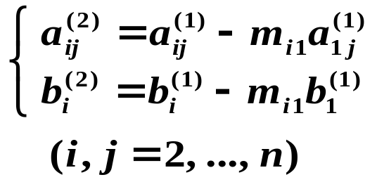
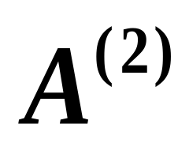
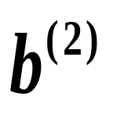


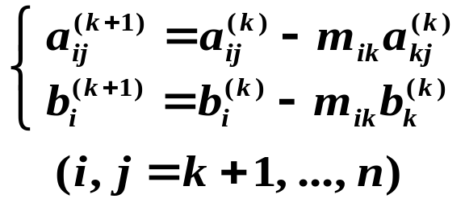

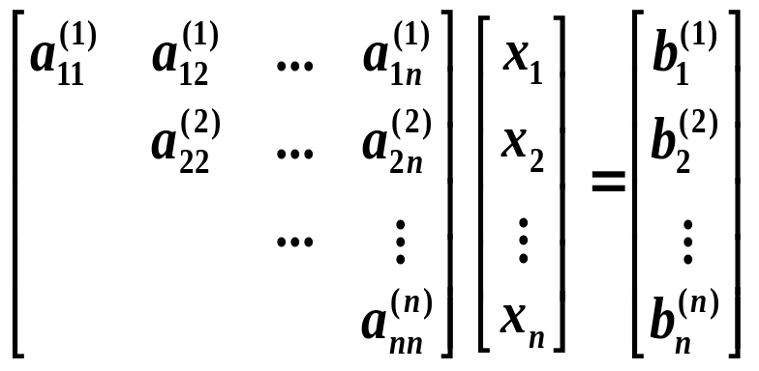
Chapter 6 Direct Methods for Solving Linear Systems -- Linear Systems of Equations
Elimination
Let
Step 1：If
, compute
row_{i} of the augmented matrix − m_{i1} × row₁
where
Pivot element
Step k：
If
, compute
There are steps
n − 1
2/5

Slide 3
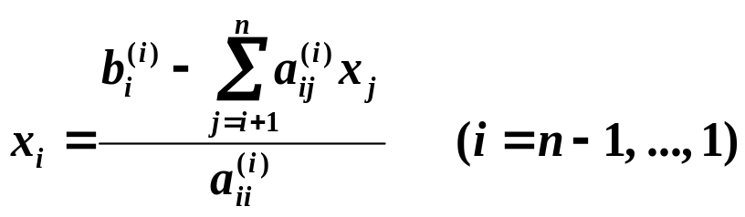




Chapter 6 Direct Methods for Solving Linear Systems -- Linear Systems of Equations
Backward-substitution
What if we can’t find such k ?
Then we must find the smallest integer k ≥ i with
, and interchange the k-th row with the i-th row.
No unique solution exists.
No unique solution exists.
What if ?
What if ?
3/5

Slide 4
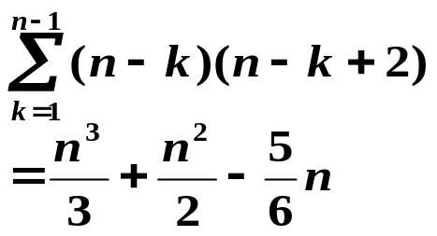
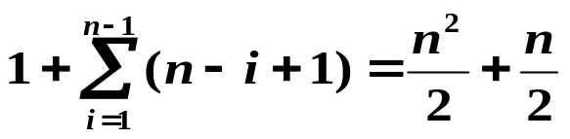
Chapter 6 Direct Methods for Solving Linear Systems -- Linear Systems of Equations
(n − k)
(n − k)²
(n − k)
➢ Amount of Computation (count multiplications / divisions only)
Step k：
If
, compute
HW:
p.357 #8
p.358 #11
There are steps
n − 1
1
(n − i +1)
Elimination:
Backward-substitution
For large n, the total number of multiplications and divisions is approximately n³/3.
4/5

Slide 5

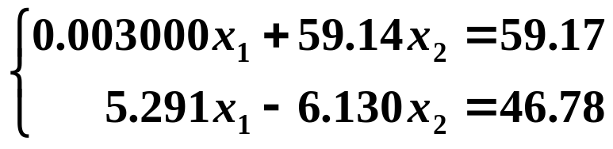
Chapter 6 Direct Methods for Solving Linear Systems -- Linear Systems of Equations
Research topic 4:
Solve the linear system
by applying Gaussian elimination using 4-digit arithmetic with rounding.
What is wrong? Who is the trouble maker?
How would you solve the above given problem in a better way? (One solution is good enough)
5/5

