Slide 1
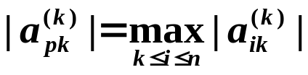
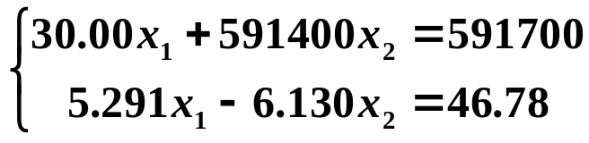
Chapter 6 Direct Methods for Solving Linear Systems -- Pivoting Strategies
☑ 6.2 Pivoting Strategies
Problem: Small pivot element may cause trouble.
➢ Partial Pivoting (or maximal column pivoting)
-- Determine the smallest p ≥ k such that
and interchange the pth and the kth rows.
Example: Solve the linear system
using 4-digit arithmetic with rounding.
Small relative to the entries in its row.
1/15

Slide 2
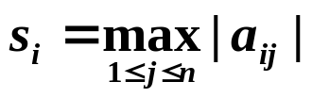
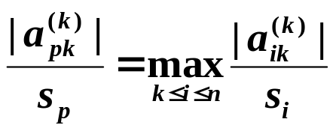

Chapter 6 Direct Methods for Solving Linear Systems -- Pivoting Strategies
➢ Scaled Partial Pivoting (or scaled-column pivoting)
-- Place the element in the pivot position that is largest relative to the entries in its row.
Step 1: Define a scale factor s_{i} for each row as
Step 2: Determine the smallest p ≥ k such that
and interchange the pth and the kth rows.
Note:
The scaled factors s_{i} must be computed only once, otherwise this method would be too slow.
2/15

Slide 3
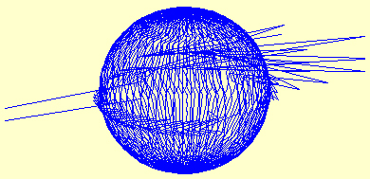
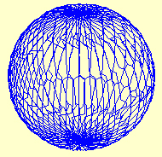
Chapter 6 Direct Methods for Solving Linear Systems -- Pivoting Strategies
➢ Complete Pivoting (or maximal pivoting)
-- Search all the entries a_{ij} for i, j = k, …, n, to find the entry with the largest magnitude. Both row and column interchanges are performed to bring this entry to the pivot position.
Result of solving 3 by 3 linear systems with direct Gaussian elimination
Result of solving 3 by 3 linear systems with complete pivoting
3/15

Slide 4

Chapter 6 Direct Methods for Solving Linear Systems -- Pivoting Strategies
➢ Amount of Computation
 Partial Pivoting: Requires about O(n²) additional comparisons.
 Scaled Partial Pivoting: Requires about O(n²) additional comparisons and O(n²) divisions.
 Complete Pivoting: Requires about O(n³/3) additional comparisons.
Note:
If the new scaled factors were determined each time a row interchange decision was to be made, then the scaled partial pivoting would add O(n³/3) comparisons in addition to the O(n²) divisions.
Discussion 10: What would happen to the scaled partial pivoting if the new scaled factors were determined each time a row interchange decision was to be made?
4/15

Slide 5

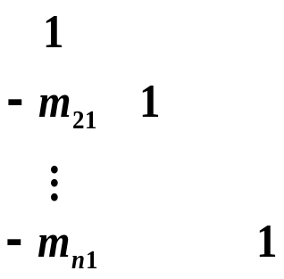


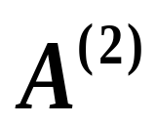
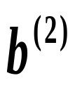
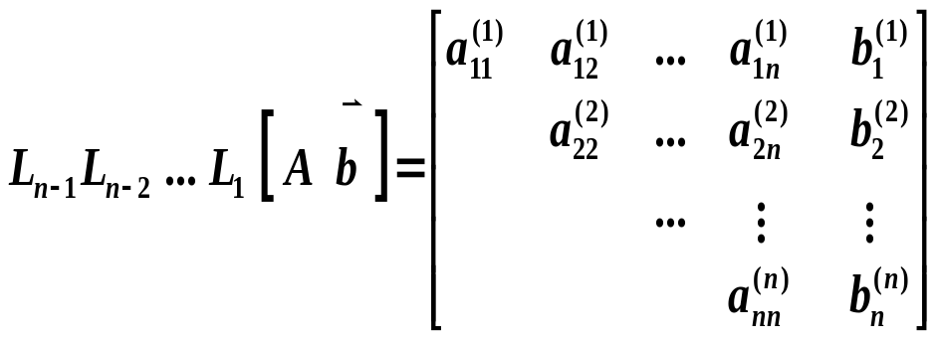
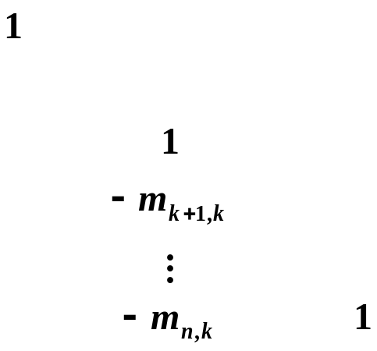
Chapter 6 Direct Methods for Solving Linear Systems -- Matrix Factorization
☑ 6.5 Matrix Factorization
➢ Matrix Form of Gaussian Elimination
Step 1:
Let L₁ =
, then
Step n − 1:
where
L_{k} =
5/15

Slide 6
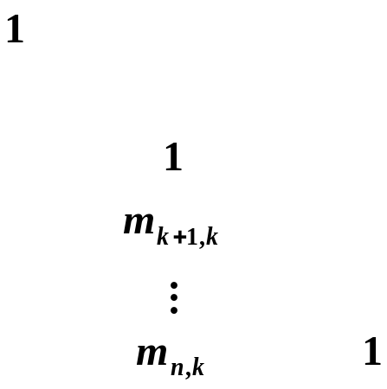
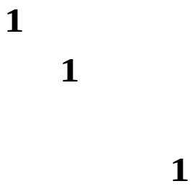


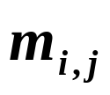
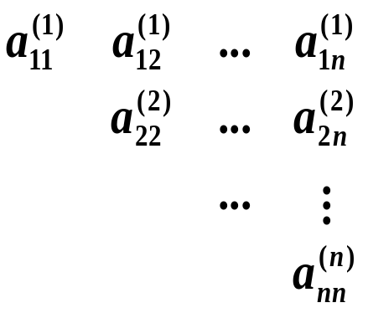

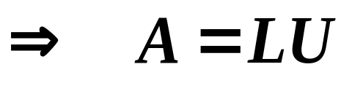



Chapter 6 Direct Methods for Solving Linear Systems -- Matrix Factorization
L
Hey hasn’t GE given me enough headache? Why do I have to know its matrix form??!
unitary lower-triangular matrix
Factorize A first, then
for every you only have to
solve two simple triangular
systems and
.
When you have to solve the system for different with a fixed A.
Could you be more specific, please?
Let U =
LU factorization of A
Discussion 11
6/15

Slide 7



Chapter 6 Direct Methods for Solving Linear Systems -- Matrix Factorization
Theorem: If Gaussian elimination can be performed on the linear system Ax = b without row interchanges, then the matrix A can be factored into the product of a lower-triangular matrix L and an upper-triangular matrix U.
If L has to be unitary, then the factorization is unique.
Proof (for uniqueness): If the factorization is NOT unique, then there exist L₁, U₁, L₂ and U₂ such that A = L₁U₁ = L₂U₂ .
✓
Lower-triangular
with diagonal entries 1
Upper-triangular
Note: The factorization with U being unitary is called the Crout’s factorization. Crout’s factorization can be obtained by the LU factorization of A^{t}. That is, find A^{t} = LU, then A = U^{t} L^{t} is the Crout’s factorization of A.
7/15

Slide 8

Chapter 6 Direct Methods for Solving Linear Systems -- Matrix Factorization
Repeated computations.
What a waste!
Research topic 5:
Self-study Doolittle Factorization. Illustrate why this algorithm is called a compact form of LU factorization.
HW: p.397 #7
8/15

Slide 9
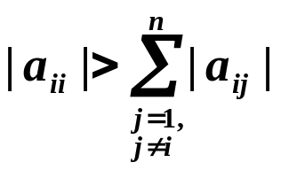
Chapter 6 Direct Methods for Solving Linear Systems -- Special Types of Matrices
☑ 6.6 Special Types of Matrices
➢ Strictly Diagonally Dominant Matrix
for each i = 1, …, n.
Theorem: A strictly diagonally dominant matrix A is nonsingular. Moreover, Gaussian elimination can be performed without row or column interchanges, and the computations will be stable with respect to the growth of roundoff errors.
Proof:
① A is nonsingular – proof by contradiction.
② Gaussian elimination can be performed without row or column interchanges – proof by induction: each of the matrices A⁽²⁾, A⁽³⁾, …, A^{(n)} generated by the Gaussian elimination is strictly diagonally dominant.
③ Omitted.
9/15

Slide 10
Chapter 6 Direct Methods for Solving Linear Systems -- Special Types of Matrices
➢ Choleski’s Method for Positive Definite Matrix
Definition: A matrix A is positive definite if it is symmetric and if
x ^{t}A x > 0 for every n-dimensional vector x ≠ 0.
 Review: A is positive definite
A⁻¹ is positive definite as well, and a_{ii} > 0.
max | a_{ij} | ≤ max | a_{kk} |; ( a_{ij} )² < a_{ii} a_{jj} for each i ≠ j.
Each of A’s leading principal submatrices A_{k} has a positive determinant.
HW: Read the proofs on
p. 401-402
10/15

Slide 11









Chapter 6 Direct Methods for Solving Linear Systems -- Special Types of Matrices
Consider the LU factorization of a positive definite A:
u₁₁
1
u_{ij} / u_{ii}
u_{ij}
1
u₂₂
U =
=
u_{nn}
1
A is symmetric
Let D^{1/2} =
is still a lower-triangular matrix
A is positive definite
Why is u_{ii} > 0?
Since det(A_{k}) > 0
A can be factored in the form LDL^{t}, where L is a unitary lower-triangular matrix and D is a diagonal matrix with positive diagonal entries.
A can be factored in the form LL^{t}, where L is lower-triangular with nonzero diagonal entries.
11/15

Slide 12


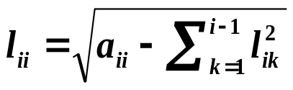
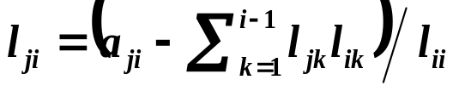
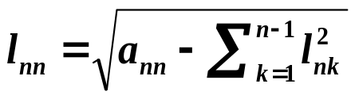
Chapter 6 Direct Methods for Solving Linear Systems -- Special Types of Matrices
Algorithm: Choleski’s Method
To factor the symmetric positive definite n×n matrix A into LL^{t}, where L
is lower-triangular.
Input: the dimension n; entries a_{ij} for 1≤ i, j ≤ n of A.
Output: the entries l_{ij} for 1≤ j ≤ i and 1≤ i ≤ n of L.
Step 1 Set ;
Step 2 For j = 2, …, n, set ;
Step 3 For i = 2, …, n−1, do steps 4 and 5
Step 4 Set ;
Step 5 For j = i+1, …, n, set ;
Step 6 Set ;
Step 7 Output ( l_{ij} for j = 1, …, i and i = 1, …, n );
STOP.
LDL^{t} is faster,
but must be modified to
solve Ax = b.
12/15

Slide 13
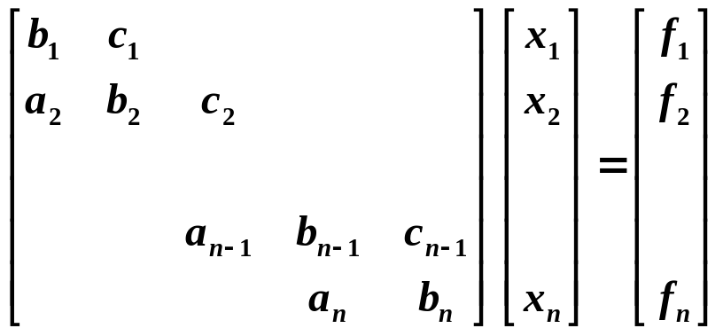
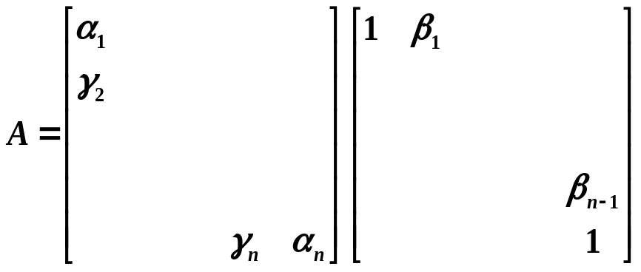
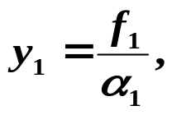
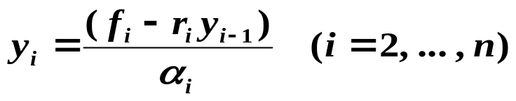


Chapter 6 Direct Methods for Solving Linear Systems -- Special Types of Matrices
➢ Crout Reduction for Tridiagonal Linear System
The process cannot
continue if α_{i} = 0. Hence not all the
tridiagonal linear system can be solved
by this method.
Step 1: Find the Crout factorization of A
Step 2: Solve
Step 3: Solve
13/15

Slide 14
Chapter 6 Direct Methods for Solving Linear Systems -- Special Types of Matrices
Theorem: If A is tridiagonal and diagonally dominant. Moreover, if
Then A is nonsingular, and the linear system can be solved.
HW: p.412 #17
Note:
☞ If A is strictly diagonally dominant, then it is not necessary to have all the entries a_{i}, b_{i}, and c_{i} being nonzero.
☞ The method is stable in a sense that all the values obtained during the process will be bounded by the values of the original entries.
☞ The amount of computation is O(n).
14/15

Slide 15
Chapter 6 Direct Methods for Solving Linear Systems -- Special Types of Matrices
Lab 03. There is No Free Lunch
Time Limit: 1 second; Points: 4
One day, CYJJ found an interesting piece of commercial from newspaper: the Cyber-restaurant was offering a kind of "Lunch Special" which was said that one could "buy one get two for free". That is, if you buy one of the dishes on their menu, denoted by d_{i} with price p_{i} , you may get the two neighboring dishes d_{i−1} and d_{i+1} for free! If you pick up d₁, then you may get d₂ and the last one d_{n} for free, and if you choose the last one d_{n}, you may get d_{n−1} and d₁ for free.
However, after investigation CYJJ realized that there was no free lunch at all. The price p_{i} of the i-th dish was actually calculated by adding up twice the cost c_{i} of the dish and half of the costs of the two "free" dishes. Now given all the prices on the menu, you are asked to help CYJJ find the cost of each of the dishes.
15/15

