Slide 1

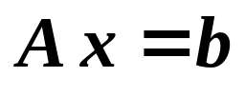






Chapter 7 Iterative Techniques in
Matrix Algebra
Solve
Similar to the fixed-point iterations for solving f(x) = 0 ……
Equivalently transform into . Then start the iteration from an initial guess
and obtain the (convergent) sequence .
Idea
☞ The accuracy can be controlled by number of iterations.
☞ Iterative techniques are practically used to solve sparse linear systems of equations.
Discussion 12: What to analyze?
 How to design an iterative scheme?
 Under what conditions that the sequence will converge?  How fast can a method converge?
 Error estimation?
1/6

Slide 2







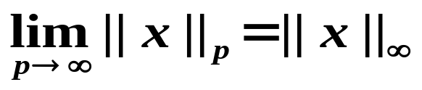
Chapter 7 Iterative Techniques in Matrix Algebra -- Norms of Vectors and Matrices
☑ 7.1 Norms of Vectors and Matrices
➢ Vector Norms
Definition: A vector norm on R^{n} is a function, || · ||, from R^{n} into R with the following properties for all and α ∈C:
/* positive definite */
/* homogeneous */
/* triangle inequality */
Some popularly used norms:
Euclidean norm
❖
n
n
1
/
p
Σ
❖
Σ
❖
n
||
x
||
=
|
x
|
||
x
||
=
|
x
|
2
||
x
||
=
Σ
|
x
|
p
1
i
2
i
p
i
i
=
1
i
=
1
i
=
1
❖
Note:
||
x
||
=
max
|
x
|
∞
1
≤
i
≤
n
i
2/6

Slide 3





Chapter 7 Iterative Techniques in Matrix Algebra -- Norms of Vectors and Matrices
Definition: A sequence of vectors in R^{n} is said to converge to with respect to the norm || · || if, given any ε > 0, there exists an integer N(ε) such that for all k ≥ N(ε).
Theorem: The sequence of vectors converges to in R^{n} with respect to the norm || · ||∞ if and only if for each i = 1, 2, …, n.
Definition: If there exist positive constants C₁ and C₂ such that
, then || · ||_{A} and || · ||_{B} are said to be equivalent.
Theorem: All the vector norms on R^{n} are equivalent.
HW: Read the proof of Theorem 7.7 on p.423
3/6

Slide 4


Chapter 7 Iterative Techniques in Matrix Algebra -- Norms of Vectors and Matrices
➢ Matrix Norms
Definition: A matrix norm on the set of all n × n matrices is a real-valued function, || · ||, defined on this set, satisfying for all n × n matrices A and B and all α ∈C:
/* positive definite */
/* homogeneous */
/* triangle inequality */
(4)* || AB || ≤ || A || · || B || /* consistent */
When you have to analyze
the error bound of AB – imagine you doing it
without a consistent matrix norm…
Oh haven’t I had enough
of new concepts? What do I need
the consistency for?
In general, if we have
|| AB ||_{γ} ≤ || A ||_{α} · || B ||_{β} , then
the 3 norms are said to be consistent.
4/6

Slide 5
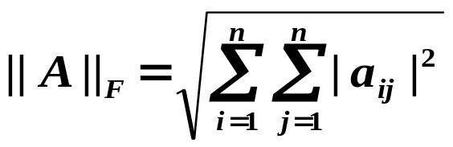
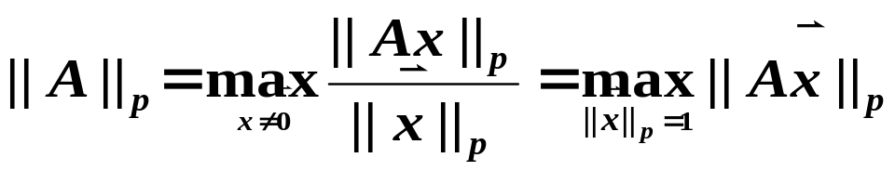
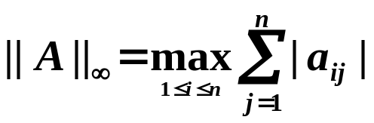
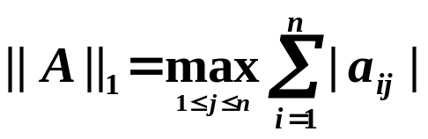
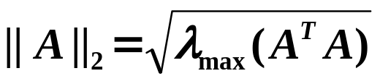
Chapter 7 Iterative Techniques in Matrix Algebra -- Norms of Vectors and Matrices
Some popularly used norms:
Frobenius Norm
Natural Norm
/* operator norm */
associated with the vector norm || · ||_{p}
/* spectral norm */
5/6

Slide 6
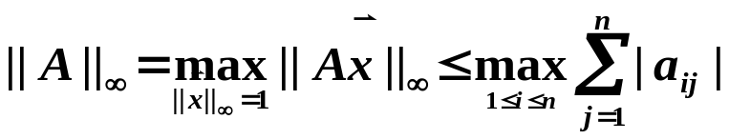
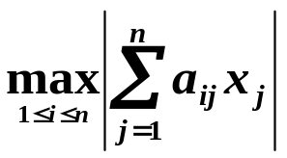
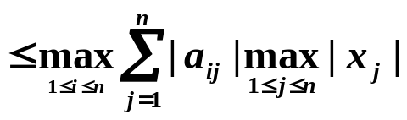



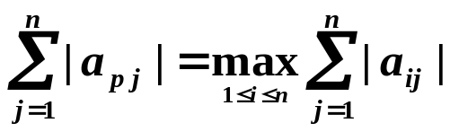
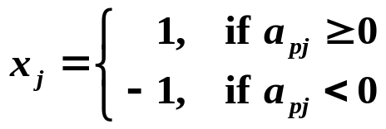

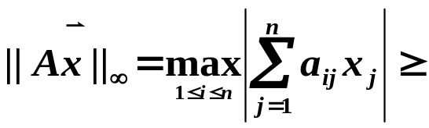
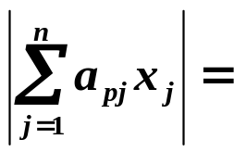
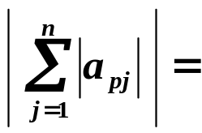
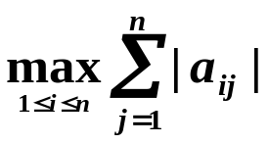
Chapter 7 Iterative Techniques in Matrix Algebra -- Norms of Vectors and Matrices
Proof (for ):
HW: p.429-430
#5(a), 7, 13
① Show that
✓
1
Excuses for not
doing homework
I have the proof, but there
isn't room to write it in
this margin.
② Show that
✓
Let row p be the maximum row, that is
Take a special unit vector such that
6/6

