Slide 1




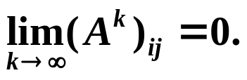
Chapter 7 Iterative Techniques in Matrix Algebra -- Eigenvalues and Eigenvectors
☑ 7.2 Eigenvalues and Eigenvectors
➢ Spectral Radius
Im
ρ (A)
λ
Definition: The spectral radius ρ (A) of a matrix A is defined by ρ (A) = max | λ | where λ is an eigenvalue of A.
λ
λ
λ
Re
λ
λ
λ
λ
Theorem: If A is an n × n matrix, then
ρ (A) ≤ || A || for any natural norm || · ||.
Proof:
For any eigenvalue λ of A with eigenvector and
Definition: We call an n × n matrix A convergent if for all i, j = 1, 2, …, n we have
HW: p.436 #3
1/14

Slide 2

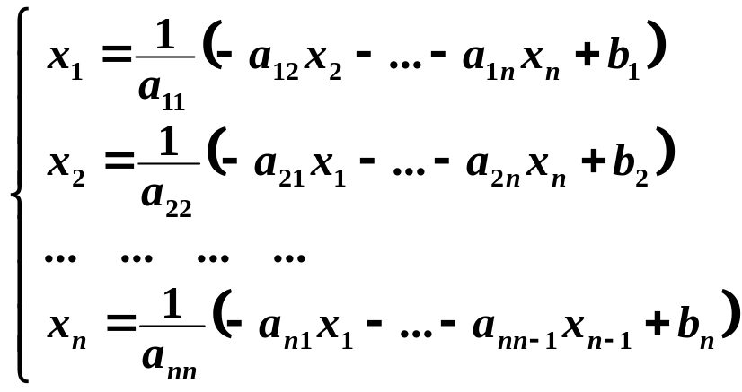
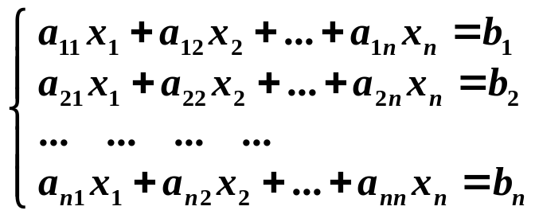

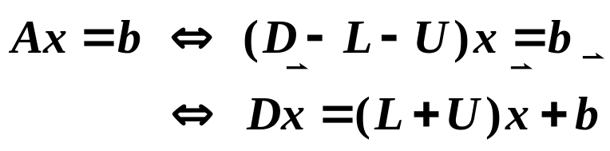




Chapter 7 Iterative Techniques in Matrix Algebra -- Iterative Techniques for Solving Linear Systems
☑ 7.3 Iterative Techniques for Solving Linear Systems
➢ Jacobi Iterative Method
In matrix form:
– U
– L
A =
D
T_{j}
Jacobi iterative matrix
2/14

Slide 3


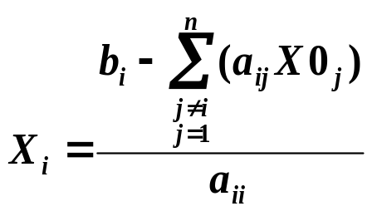

Chapter 7 Iterative Techniques in Matrix Algebra -- Iterative Techniques for Solving Linear Systems
Algorithm: Jacobi Iterative Method
Solve given an initial approximation .
Input: the number of equations and unknowns n; the matrix entries a[ ][ ];
the entries b[ ]; the initial approximation X0[ ]; tolerance TOL;
maximum number of iterations N_{max}.
Output: approximate solution X[ ] or a message of failure.
Step 1 Set k = 1;
Step 2 While ( k ≤ N_{max}) do steps 3-6
Step 3 For i = 1, …, n
Set ; /* compute x_{k} */
Step 4 If then Output (X[ ]);
STOP; /* successful */
Step 5 For i = 1, …, n Set X 0[ ] = X [ ]; /* update X0 */
Step 6 Set k ++;
Step 7 Output (Maximum number of iterations exceeded);
STOP. /* unsuccessful */
Since A will not be
changed during the iterations,
we can reorder the equations
so that a_{ii} ≠ 0. Otherwise
A is singular.
A bit wasteful, isn’t it?
What if a_{ii} = 0?
X^{(k+1)} must wait
till all the entries of X^{(k)} are
obtained. Hence two vectors are
needed to store the results.
3/14

Slide 4
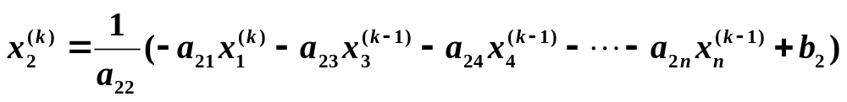

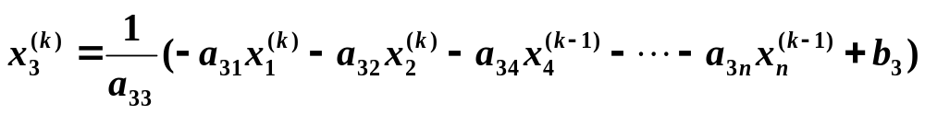
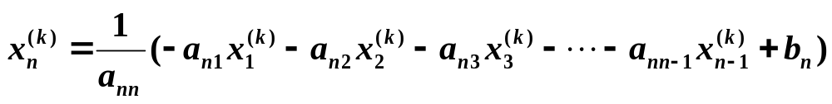


Chapter 7 Iterative Techniques in Matrix Algebra -- Iterative Techniques for Solving Linear Systems
➢ Gauss - Seidel Iterative Method
Discussion 13: Do you have a better idea?
Only one vector needs to be saved.
… … … …
In matrix form:
Gauss-Seidel
iterative matrix
T_{g}
4/14

Slide 5

Chapter 7 Iterative Techniques in Matrix Algebra -- Iterative Techniques for Solving Linear Systems
A mathematician about his colleague:
" He made a lot of mistakes, but he made them
in a good direction. I tried to copy this, but I found
out that it is very difficult to make good mistakes. "
Note:
Neither of the methods are always convergent.
And more, there are cases in which Jacobi method fails while Gauss-Seidel is convergent, and vice-versa.
See Exercises 9 and 10.
5/14

Slide 6







Chapter 7 Iterative Techniques in Matrix Algebra -- Iterative Techniques for Solving Linear Systems
➢ Convergence of Iterative Methods
Theorem: The following statements are equivalent:
(1) A is a convergent matrix;
(2) lim_{n→∞}|| A^{n} || = 0 for some natural norm;
(3) lim_{n→∞}|| A^{n} || = 0 for all natural norms;
(4) ρ(A) < 1;
(5) lim_{n→∞} A^{n} for every
Sufficient condition: ||T|| < 1
Necessary condition:
？
→ O
6/14

Slide 7





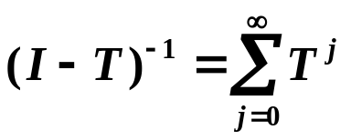
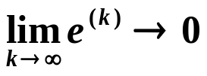
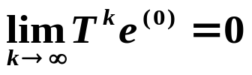

Chapter 7 Iterative Techniques in Matrix Algebra -- Iterative Techniques for Solving Linear Systems
Theorem: For any ∈R^{n}, the sequence defined by
for each k ≥ 1, converges to the unique solution of
if and only if ρ(T) < 1.
Proof:
① Given that ρ(T) < 1, then
p.443
ρ(T) < 1
✓
②
for any
ρ(T) < 1
7/14

Slide 8



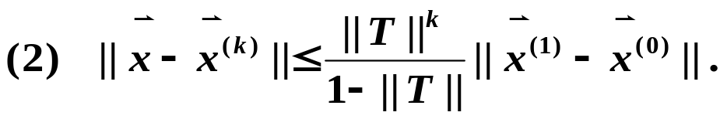


Chapter 7 Iterative Techniques in Matrix Algebra -- Iterative Techniques for Solving Linear Systems
Theorem: If || T || < 1 for any natural matrix norm and is a given vector, then the sequence defined by converges for any ∈R^{n}, to a vector ∈R^{n}. And the following error bounds hold:
Theorem: If A is strictly diagonally dominant, then for any choice of
both the Jacobi and Gauss-Seidel methods give sequences
that converge to the unique solution of
Proof (Hint): Simply prove that for any | λ | ≥ 1 we have | λI − T | ≠ 0. That is, λ cannot be an eigenvalue of the corresponding iteration matrix T.
8/14

Slide 9

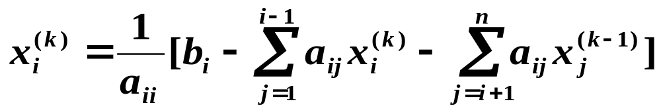
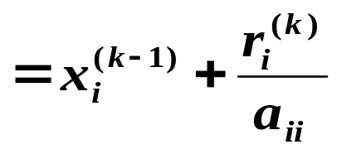
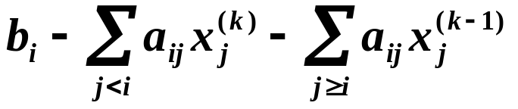
Chapter 7 Iterative Techniques in Matrix Algebra -- Iterative Techniques for Solving Linear Systems
➢ Relaxation Methods
Examine Gauss - Seidel method from another angle:
where r_{i}^{(k)} =
r
(k)
Let . For certain choice of positive ω , we can reduce the the norm of the residual vector and obtain faster convergence. Such methods are called Relaxation Methods.
x
(k)
=
x
(k – 1)
+
ω
i
i
i
a
/* residual */
ii
0 < ω < 1
/* Under- Relaxation methods */
ω = 1
/* Gauss - Seidel */
ω > 1
/* Successive Over- Relaxation methods */
9/14

Slide 10
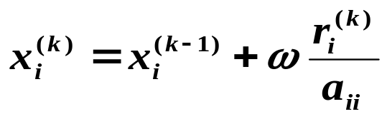
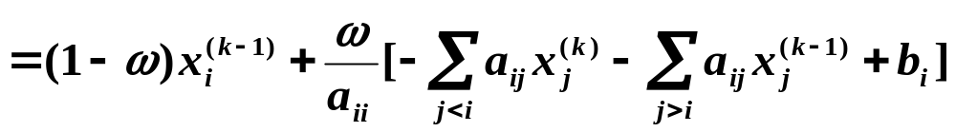


Chapter 7 Iterative Techniques in Matrix Algebra -- Iterative Techniques for Solving Linear Systems
In matrix form:
Oooooh come on!
It’s way too complicated to compute T_{ω} ,
and you can’t expect me to get
its spectral radius right!
There’s gotta be a short cut …
10/14

Slide 11
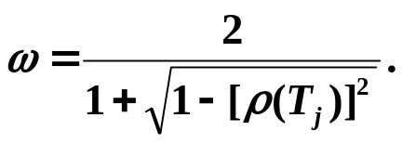

Chapter 7 Iterative Techniques in Matrix Algebra -- Iterative Techniques for Solving Linear Systems
Theorem: (Kahan) If a_{ii} ≠ 0 for each i = 1, 2, …, n. Then ρ(T_{ω}) ≥ | ω – 1 |. This implies that the SOR method can converge only if 0 < ω < 2.
Theorem: (Ostrowski-Reich) If A is positive definite and 0 < ω < 2, the the SOR method converges for any choice of initial approximation.
Theorem: If A is positive definite and tridiagonal, then ρ(T_{g}) = [ρ(T_{j})]² < 1, and the optimal choice of ω for the SOR method is
With this choice of ω, we have
HW: p.453 #13
11/14

Slide 12
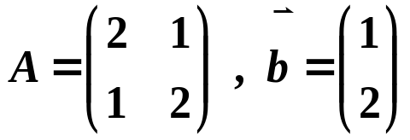

Chapter 7 Iterative Techniques in Matrix Algebra -- Iterative Techniques for Solving Linear Systems
Discussion 14: Given
and an iterative method
Then:
① For what values of ω that the method will converge?
② For what values of ω that the method will have the fastest convergence?
Solution: Consider the eigenvalues of T = I + ω A
λ₁ = 1+ ω , λ₂ = 1+ 3ω
① Convergency requires ρ ( T )<1 −2/3 < ω < 0
② For what values of ω that ρ (T) = max { | 1+ ω |, | 1+ 3ω | } assumes its minimum?
ω = − 1/2
ω
−2/3
−1/3
0
12/14

Slide 13


Chapter 7 Iterative Techniques in Matrix Algebra -- Iterative Techniques for Solving Linear Systems
Lab 04. Compare Methods of Jacobi with Gauss-Seidel
Time Limit: 1 second; Points: 3
Use Jacobi and Gauss-Seidel methods to solve a given n×n linear system with an initial approximation .
Note: When checking each a_{ii} , first scan downward for the entry with maximum absolute value (a_{ii} included). If that entry is non-zero, swap it to the diagonal. Otherwise if that entry is zero, scan upward for the entry with maximum absolute value. If that entry is non-zero, then add that row to the i-th row.
13/14

Slide 14




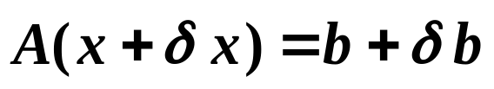

Chapter 7 Iterative Techniques in Matrix Algebra
Research topic 6:
Assume that A is accurate, and has the error . Then the solution with error can be written as . That is, .
Please analyze the relationship between the relative error of the solution and that of .
What if is accurate and A has the error ?
14/14

