Slide 1

Chapter 3 Interpolation
and Polynomial Approximation
If a function y = f(x) is too complicated for calculation or is even unknown, one way to approximate it is to first obtain its values y₀ = f(x₀), … y_{n} = f(x_{n}) at a sequence of points x₀ … x_{n}, and then construct a relatively simple approximating function g(x) ≈ f(x).
If g(x) satisfies that g(x_{i}) = f(x_{i}) for all i = 0, … n, it is called the interpolating function of f(x). The most commonly used interpolating functions are …?
algebraic polynomials.
g(x) ≈ f(x)
x₀
x₁
x₂
x
x₃
x₄
1/7

Slide 2

Chapter 3 Interpolation and Polynomial Approximation -- Interpolation and the Lagrange Polynomial
☑ 3.1 Interpolation and the Lagrange Polynomial
Find a polynomial of degree n, P_{n}(x) = a₀ + a₁x + … + a_{n}x^{n}, such that P_{n}(x_{i}) = y_{i} for all i = 0, …, n.
Note: for any i ≠ j, we must have x_{i} ≠ x_{j} .
Given x₀ , x₁; y₀ , y₁ . Find P₁(x) = a₀ + a₁x such that P₁(x₀) = y₀ and P₁(x₁) = y₁ .
Lagrange Basis,
satisfying L_{1,i}(x_{j})=δ_{ij} /* Kronecker Delta */
n = 1
P₁(x) is the line function through the two given points ( x₀ , y₀ ) and ( x₁, y₁ ) .
y
−
y
P
(
x
)
=
y
+
1
0
(
x
−
x
)
1
0
x
−
x
0
1
0
x
−
x
x
−
x
1
= y₀ + y₁
Σ
1
0
=
L
(
x
)
y
x
−
x
x
−
x
1, i
i
0
1
1
0
i
=
0
L_{1,0}(x)
L_{1,1}(x)
2/7

Slide 3
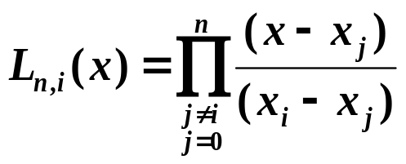
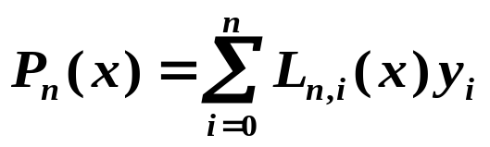
Chapter 3 Interpolation and Polynomial Approximation -- Interpolation and the Lagrange Polynomial
The mathematician S. had to move to a new place.
His wife didn't trust him very much, so when they stood
down on the street with all their things, she asked him to
watch their ten trunks, while she got a taxi. Some minutes
later she returned. Said the husband: "I thought you said
there were ten trunks, but I've only counted to nine!"
The wife said: "No, they're TEN!"
"But I have counted them: 0, 1, 2, ..."
Find L_{n,i}(x) for i = 0, …, n such that L_{n,i}(x_{j})=δ_{ij} . Then let
n ≥ 1
n
P
(
x
)
=
Σ
L_{n,i}(x)
y
. Hence P_{n}(x_{i}) = y_{i} .
n
i
i
=
0
L_{n,i}(x)
Each L_{n,i} has n roots x₀ … x_{i} … x_{n}
The n-th Lagrange interpolating polynomial
n
L_{n,i}(x)
=
C
(
x
−
x
)...(
x
−
x
)...(
x
−
x
)
=
C
Π
(
x
−
x
)
i
0
i
n
i
j ≠ i
j
L_{n,i}
=
=
Π
1
j
=
0
(
x
)
1
C
i
i
j ≠ i
(
x
−
x
)
i
j
3/7

Slide 4

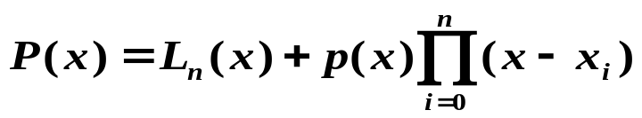
Chapter 3 Interpolation and Polynomial Approximation -- Interpolation and the Lagrange Polynomial
Theorem: If x₀, x₁, …, x_{n} are n + 1 distinct numbers and f is a function whose values are given at these numbers, then the n-th Lagrange interpolating polynomial is unique.
Proof: If not…
Then there exists two polynomials P_{n}(x) and Q_{n}(x) both satisfying the interpolating conditions.
D(x) = P_{n}(x) – Q_{n}(x) is a polynomial of degree
≤ n
Yet D(x) has distinct roots x₀, x₁, …, x_{n} .
n + 1
Note:
The interpolating polynomial is NOT unique unless its degree is constrained to be no greater than n.
A counterexample is where p(x)
can be a polynomial of any degree.
4/7

Slide 5












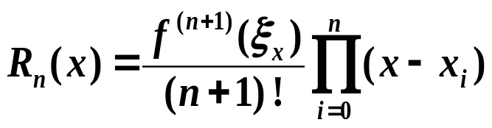
Chapter 3 Interpolation and Polynomial Approximation -- Interpolation and the Lagrange Polynomial
➢ Analyze the Remainder
Suppose
and f ∈ C^{n + 1}[a, b].
Consider the truncation error
n
=
Π
−
Rolle’s Theorem: If ϕ(x) is sufficiently smooth with ϕ(x₀) = ϕ(x₁) = 0,
then there exists ξ ∈ (x₀ , x₁) such that ϕ ’(ξ) = 0.
R_{n}(x) has at least roots
n+1
R
(
x
)
K
(
x
)
(
x
x
)
n
i
i
=
0
Fix any x ≠ x_{i} for all i = 0, …, n. Define the function g for t in [a, b] by
In general, if ϕ(x₀) = ϕ(x₁) = ϕ(x₂) = 0
n
g(t)
=
R_{n}
(
t
)
−
K
(
x
)
Π
(
t
−
x
)
i
There exist
such that
i
=
0
g(x) has n+2 distinct roots x₀ … x_{n} x
There exists
such that
f
(
n
+
1
)
(
ξ
)
−
P
(
n
+
1
)
(
ξ
)
−
K
(
x
)(
n
+
1
)
!
=
R
(
n
+
1
)
(
ξ
)
−
K
(
x
)
(
n
+
1
)
!
x
n
x
n
x
There exists
f
(
n
+
1
)
(
ξ
)
such that
K
(
x
)
=
x
(
n
+
1
)
!
5/7

Slide 6
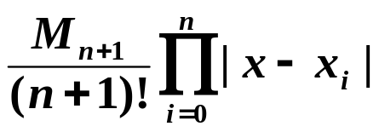

Chapter 3 Interpolation and Polynomial Approximation -- Interpolation and the Lagrange Polynomial
Note:
☞ Since in most of the cases ξ_{x} cannot be determined, we obtain the upper bound of f ^{(n+1)} instead. That is, estimate an M_{n+1} such
that for all x∈(a,b) and take
as the upper bound of the total error.
☞ The interpolating polynomial is accurate for any polynomial function f with degree ≤ n since f ^{(n+1)}(x) ≡ 0.
Quiz: Given x_{i} = i +1, i = 0, 1, 2, 3, 4, 5. Which is the graph of L_{5, 2}(x)?
y
A
y
B
y
C
1
-
1
-
1
-
0.5
-
0.5
-
0.5
-
0
1
2
3
4
5
6
x
0
1
2
3
4
5
6
x
0
1
2
3
4
5
6
x
-
0.5
-
-
0.5
-
-
0.5
✓
-
6/7

Slide 7
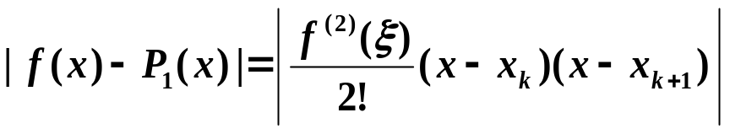
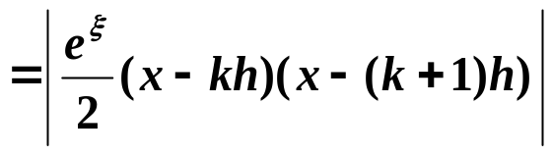
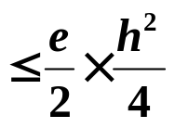
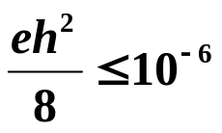
Chapter 3 Interpolation and Polynomial Approximation -- Interpolation and the Lagrange Polynomial
Discussion 17: Suppose a table is to be prepared for the function f(x) = e^{x} for x in [0, 1]. Assume that each entry of the table is accurate up to 8 decimal places and the step size is h. What should h be for linear interpolation to give an absolute error of at most 10^{– 6} ?
Solution: Suppose that [0, 1] is partitioned into n equal-spaced subintervals [x₀, x₁], [x₁, x₂], …, [x_{n–1} , x_{n}], and x is in the interval [x_{k}, x_{k+1}]. Then the error estimation gives
h ≤ 1.72 × 10^{–3}
Simply take n = 1000 and h = 0.001.
7/7

