Slide 1

Chapter 9 Approximating Eigenvalues
Compute the dominant eigenvalue of a matrix, and the corresponding eigenvector
☑ 9.2 The Power Method
Wait a second, what does that dominant eigenvalue mean?
Why in the earth do I want to know that?
That is the eigenvalue with the largest magnitude.
Don’t you have to compute the spectral radius from time to time?
1/9

Slide 2


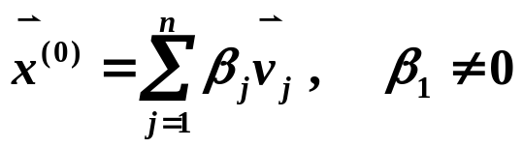

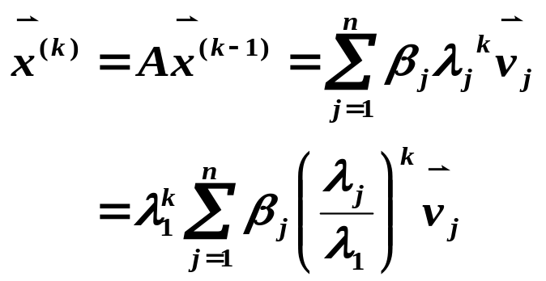
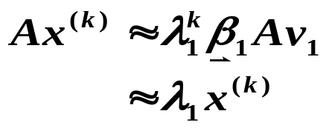
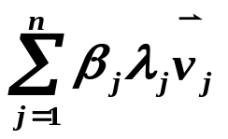

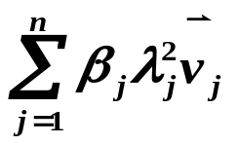

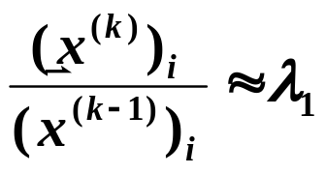

Chapter 9 Approximating Eigenvalues -- The Power Method
➢ The Original Method
Assumptions: A is an n × n matrix with eigenvalues satisfying
|λ₁| > |λ₂| ≥ … ≥ |λ_{n}| ≥ 0. The eigenvalues are associated with n linearly independent eigenvectors
Idea: Start from any and
❖
❖
≠
(
x
(
0
)
,
v
1
)
0
This is the approximation of the
eigenvector of A associated
with λ₁
… … …
For sufficiently large k, we have
2/9

Slide 3


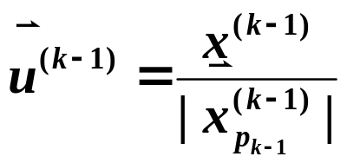

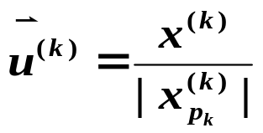
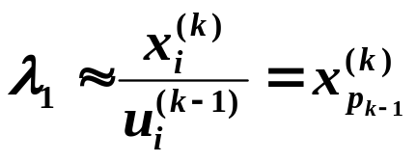

Chapter 9 Approximating Eigenvalues -- The Power Method
➢ Normalization
Make sure that at each step to guarantee the stableness.
Let
. Then
and
and
Algorithm: Power Method
To approximate the dominant eigenvalue and an associated eigenvector
of the n×n matrix A given a nonzero initial vector.
Input: dimension n; matrix a[ ][ ]; initial vector x0[ ]; tolerance TOL;
maximum number of iterations N_{max}.
Output: approximate eigenvalue λ and approximate eigenvector
(normalized) or a message of failure.
3/9

Slide 4
Chapter 9 Approximating Eigenvalues -- The Power Method
Algorithm: Power Method (continued)
Step 1 Set k = 1;
Step 2 Find index such that | x0[ index ] | = || x0 ||∞ ;
Step 3 Set x0[ ] = x0[ ] / x0[ index ]; /* normalize x0 */
Step 4 While ( k ≤ N_{max}) do steps 5-11
Step 5 x[ ] = A x0[ ]; /* compute x^{k} from u^{k−1} */
Step 6 λ = x[ index ];
Step 7 Find index such that | x[ index ] | = || x ||∞ ;
Step 8 If x[ index ] == 0 then
Output ( “A has the eigenvalue 0”; x0[ ] ) ; STOP.
/* the matrix is singular and user should try a new x0 */
Step 9 err = || x0 − x / x[ index ] || ∞ ;
x0[ ] = x[ ] / x[ index ]; /* compute u^{k} */
Step 10 If (err < TOL) then
Output ( λ ; x0[ ] ) ; STOP. /* successful */
Step 11 Set k ++;
Step 12 Output (Maximum number of iterations exceeded);
STOP. /* unsuccessful */
4/9

Slide 5

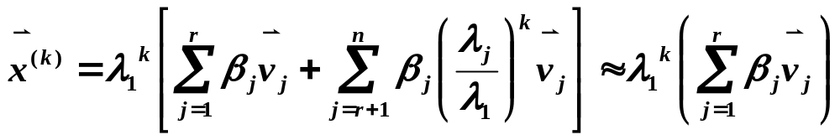




Chapter 9 Approximating Eigenvalues -- The Power Method
Note:
The method works for multiple eigenvalues λ₁ = λ₂ = … = λ_{r}
since
☞ The method fails to converge if λ₁ = −λ_{2 .}
☞ Since we cannot guarantee β₁ ≠ 0 for an arbitrary initial approximation vector , the result of such iteration might not be , but be the first to satisfy . The associated eigenvalue will be λ_{m} .
☞ Aitken’s Δ² procedure can be used to speed the
convergence. (p.563-564)
5/9

Slide 6
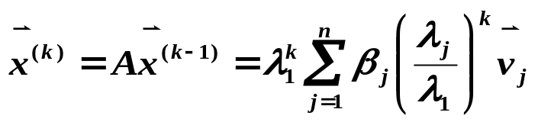

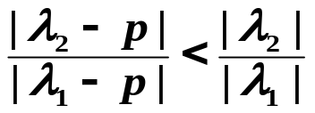
Chapter 9 Approximating Eigenvalues -- The Power Method
➢ Rate of Convergence
Make | λ₂ / λ₁ | as small as possible.
Assume λ₁ > λ₂ ≥ … ≥ λ_{n} , and | λ₂ | > | λ_{n} |.
Determines the rate of
convergence. Especially | λ₂ / λ₁ |
λ_{n}
λ₂
λ₁
O
p = ( λ₂ + λ_{n} ) / 2
Let B = A − pI , then | λI−A | = | λI−(B+pI) | = | (λ−p)I−B |
⇒ λ_{A} − p = λ_{B} . Since , the iteration for finding the eigenvalue of B converges much faster than that of A.
How are we supposed to know where p is?
Idea
As far as the laws of mathematics refer to reality, they are not certain, and as far as they are certain, they do not refer to reality.
-- Albert Einstein (1879-1955)
6/9

Slide 7



Chapter 9 Approximating Eigenvalues -- The Power Method
➢ Inverse Power Method
If A has eigenvalues | λ₁ | ≥ | λ₂ | ≥ … > | λ_{n} |, then A⁻¹ has
and they correspond to the same set of eigenvectors.
1
>
1
≥ …≥
1
λ
λ
λ
n
n
−
1
1
The dominant eigenvalue of A⁻¹
The eigenvalue of A with the smallest magnitude.
Q: How must we compute in every step?
A: Solve a linear system with A factorized.
Discussion 16: If we know that an eigenvalue λ_{i} of A is closest to a specified number p , how can we find a better approximation of λ_{i} by applying a combination of the above methods?
If we know that an eigenvalue λ_{i} of A is closest to a specified number p , then for any j ≠ i we have | λ_{i} − p | << | λ_{j} − p |. And more, if (A − pI)⁻¹ exists, then the inverse power method can be used to find the dominant eigenvalue 1/(λ_{i} − p ) of (A − pI)⁻¹ with faster convergence.
Idea
7/9

Slide 8

Chapter 9 Approximating Eigenvalues -- The Power Method
Research topic 8:
Introduce Wielandt Deflation for finding the second most dominant eigenvalue and associated eigenvector of a matrix.
8/9

Slide 9
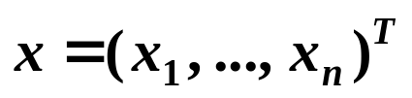
Chapter 9 Approximating Eigenvalues -- The Power Method
Lab 05. Approximating Eigenvalues
Time Limit: 1 second; Points: 4
Approximate an eigenvalue and an associated eigenvector of a given n×n matrix A near a given value p and a nonzero vector
.
9/9

