Slide 1




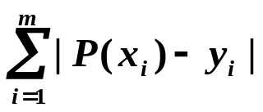
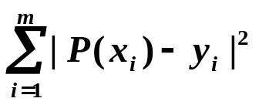
Chapter 8 Approximation Theory
Given x₁ … x_{m} and y₁ … y_{m}. Find a simpler function P(x) ≈ f(x).
However, since:
^{①} m is generally quite large, and
^{②} y_{i}’s are experimental data and are not accurate, that is, y_{i} ≠ f (x_{i}).
It would seem more reasonable to find the best fit P(x) such that the error P(x_{i}) − y_{i} is small for all the data points, even though P(x_{i}) ≠ y_{i} at any point.
Options
Discussion 20: How would you describe the requirement in a mathematical way?
➢ minimize /* minimax problem */
➢ minimize /* absolute deviation */
➢ minimize /* Least-Squares method */
1/5

Slide 2
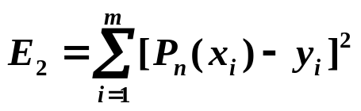

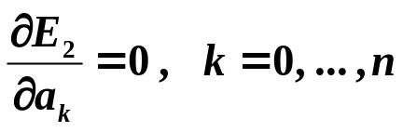
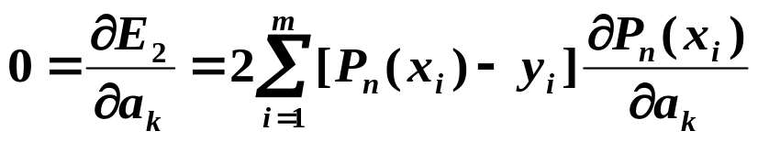
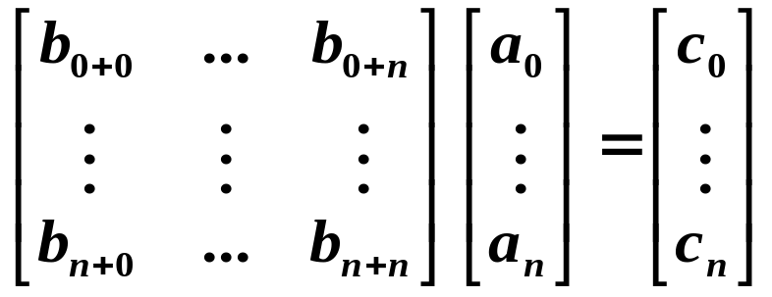
Chapter 8 Approximation Theory -- Discrete Least Squares Approximation
☑ 8.1 Discrete Least Squares Approximation
Determine the polynomial P_{n}(x) = a₀ + a₁x + … + a_{n}x^{n} to approximate a set of data { (x_{i} , y_{i}) | i = 1, 2, …, m } such that the least squares error is minimized.
Here n << m.
a₀ a₁ a_{n}
E₂ is actually a function of a₀, a₁, …, a_{n}. That is,
Normal equations.
A unique solution exists if x_{i} are
distinct.
m
[
].
(
a
,
a
,
...
,
a
)
=
Σ
a
+
a
x
+
...
+
a
x
n
−
y
2
E₂
0
1
n
0
1
i
n
i
i
i
=
1
For E₂ to be minimized it is necessary that
m
n
=
2
Σ
[
Σ
a
x
j
−
y
]
x
k
j
i
i
i
i
=
1
j
=
0
n
m
m
=
2
Σ
a
Σ
x
j
+
k
−
Σ
y
x
k
j
i
i
i
j
=
0
i
=
1
i
=
1
m
m
Let
b
=
Σ
x
k
,
c
=
Σ
y
x
k
k
i
=
1
i
k
i
=
1
i
i
2/5

Slide 3

Chapter 8 Approximation Theory -- Discrete Least Squares Approximation
Note:
☞ The order of P_{n}(x) is given by user and must be no larger than m−1. If n=m−1, then P_{n}(x) is the Lagrange interpolating polynomial with E₂ = 0.
☞ P(x) is not necessarily a polynomial.
HW:
p.494 #5
3/5

Slide 4

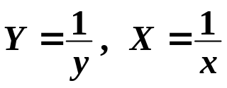
Chapter 8 Approximation Theory -- Discrete Least Squares Approximation
y
Example:
(x_{i} , y_{i}) , i = 1, 2, …, m
x
≈
=
x
y
P
(
x
)
Method 1: Let
+
ax
b
m
x_{i}
=
Σ
(
−
y_{i}
2
)
Find a and b such that is minimized.
E₂
(
a
,
b
)
ax_{i} + b
i
=
1
Take it easy! We just have to linearize it …
But hey, the system of equations for a and b is nonlinear !
Linearization: Let , then Y ≈ a + bX is a linear problem.
Convert ( x_{i} , y_{i} ) into ( X_{i} , Y_{i} ), a and b can be solved.
4/5

Slide 5
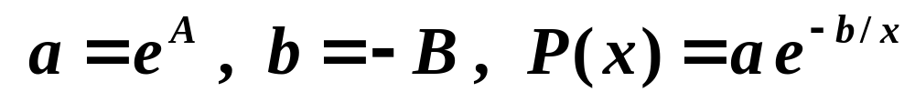
Chapter 8 Approximation Theory -- Discrete Least Squares Approximation
y
≈
P
(
x
)
=
a
e
−
b
/
x
Method 2: Let
ln
y
≈
ln
a
−
b
Linearization:
x
Discussion 21: How would you solve this one?
=
=
1
=
=
−
Y
ln
y
,
X
x
,
A
ln
a
,
B
b
Y
≈
A
+
BX
is a linear problem
Convert ( x_{i} , y_{i} ) into ( X_{i} , Y_{i} ), a and b can be solved.
5/5

