Slide 1
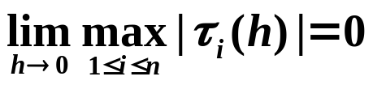
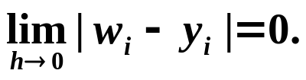
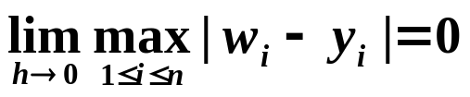
Chapter 5 Initial-Value Problems for Ordinary Differential Equations -- Stability
☑ 5.10 Stability
Definition: A one-step difference equation method with local truncation error τ_{i}(h) is said to be consistent with the differential equation it approximates if
For multistep methods it is also required that for i = 1, 2, …, m – 1
Definition: A one-step difference equation method is said to be convergent with respect to the differential equation it approximates if
Same for multistep methods.
1/8

Slide 2


Chapter 5 Initial-Value Problems for Ordinary Differential Equations -- Stability
Definition: A method is said to be stable if that small changes or perturbations in the initial conditions produce correspondingly small changes in the subsequent approximations.
Discussion 35: Use Euler’s explicit and implicit methods, and the modified Euler’s method to solve IVP: y’(t) = –30y(t), y(0) = 1, on the interval [0, 0.5] with h = 0.1.
An Engineer complains: "Math
theorems are so unstable that
a small perturbation on the conditions
will cause a crash on the conclusions!"
t_{i}
explicit
implicit
modified
accurate
0.0
0.1
0.2
0.3
0.4
0.5
1.0000
−2.0000
4.0000
−8.0000
1.6000×10¹
−3.2000×10¹
1.0000
2.5000×10⁻¹
6.2500×10⁻²
1.5625×10⁻²
3.9063×10⁻³
9.7656×10⁻⁴
1.0000
2.5000
6.2500
1.5626×10¹
3.9063×10¹
9.7656×10¹
1.0000
4.9787×10⁻²
2.4788×10⁻³
1.2341×10⁻⁴
6.1442×10⁻⁶
3.0590×10⁻⁷
What is wrong ??!
2/8

Slide 3




Chapter 5 Initial-Value Problems for Ordinary Differential Equations -- Stability
Definition: Apply a particular method to a simple test equation,
y’ = λ y, y(0) = α, where Re(λ) < 0.
Assume that roundoff error is introduced only at the initial point. If this initial error will decrease for a certain step size h, then this method is said to be absolutely stable with respect to H = λh. The set of all such H forms the region of absolute stability.
Method A is said to be more stable than method B if the region of absolute stability of A is larger than that of B.
y
y
t
t
Unstable
Stable
3/8

Slide 4




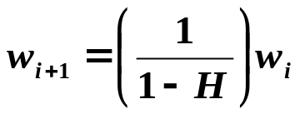
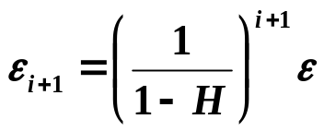
Chapter 5 Initial-Value Problems for Ordinary Differential Equations -- Stability
Example: Consider Euler’s explicit method w_{i+1} = w_{i} + h f_{i} .
Img
-
2
-
1
0
Re
Hence to guarantee that the error will decrease, we must have |1+H| < 1.
Example: Consider Euler’s implicit method w_{i+1} = w_{i} + h f_{i+1} .
Img
Hence to guarantee that the error will decrease, we must have |1–H| > 1.
0
1
2
Re
Unconditionally stable
4/8

Slide 5
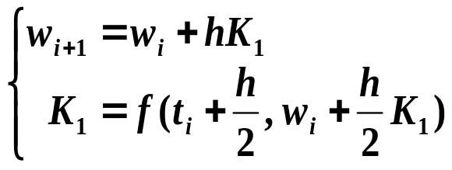
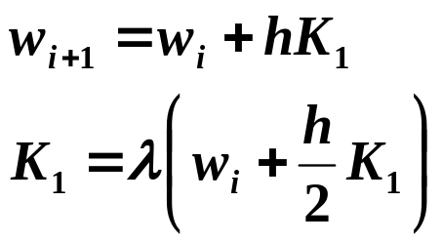
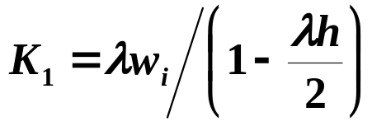
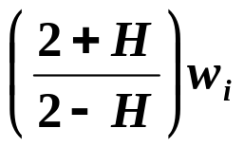
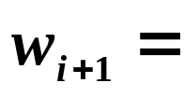
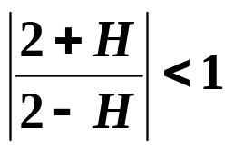
Chapter 5 Initial-Value Problems for Ordinary Differential Equations -- Stability
Discussion 36: Consider the 2nd-order Runge-Kutta implicit method
Img
0
Re
Unconditionally stable
5/8

Slide 6
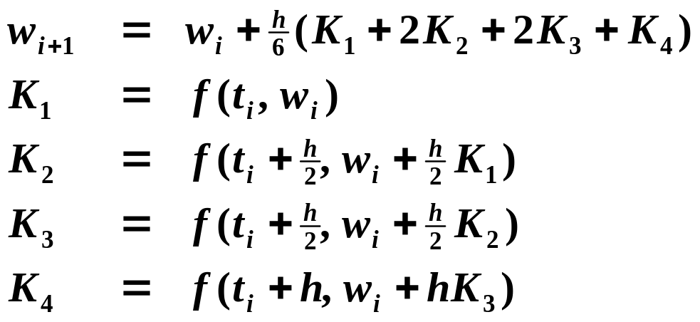








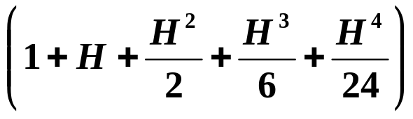

Chapter 5 Initial-Value Problems for Ordinary Differential Equations -- Stability
For the 1st to 4th-order Runge-Kutta explicit methods:
Img
k
=
4
-
3
k
=
3
k
=
2
-
2
k
=
1
-
1
-
3
-
2
-
1
Re
6/8

Slide 7
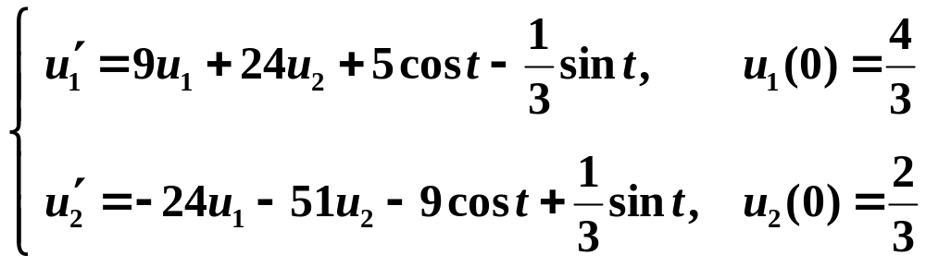
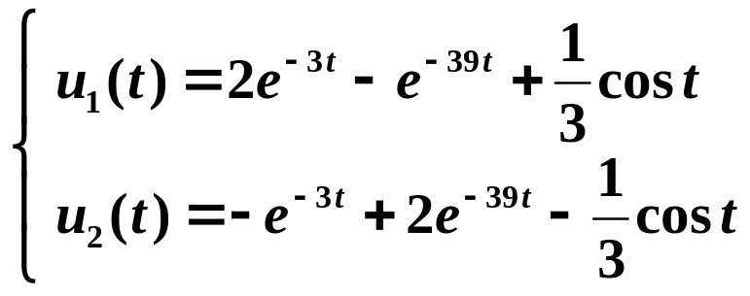
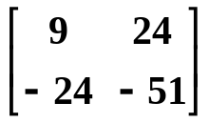



Chapter 5 Initial-Value Problems for Ordinary Differential Equations -- Stability
Example: Consider the system of IVP's
Stiff
System
How shall we select the step size h to guarantee stability of applying the Euler's explicit method?
HW: p.334 #7
The unique solution is
The eigenvalues of the matrix are:
Waste time
7/8

Slide 8

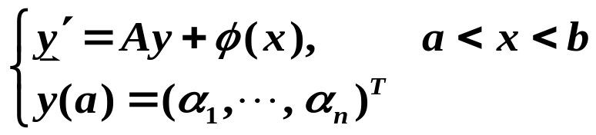
Chapter 5 Initial-Value Problems for Ordinary Differential Equations -- Stability
Research topic 17:
In general, given a system of 1st order IVP
If the eigenvalues λ₁, ..., λ_{n} of A satisfy that
Re(λ_{i}) < 0 for all 1≤i≤n, and
max| Re(λ_{i}) | / min| Re(λ_{i}) | >> 1, then the system is said to be stiff.
Introduce one method for solving the stiff systems.
(Hint: You may consider some implicit methods, or Gear's method.)
8/8

Slide 9
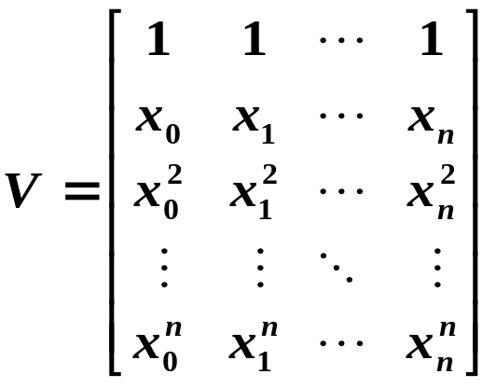

Research topic 18:
In linear algebra, a Vandermonde matrix, named after Alexandre-Théophile Vandermonde, is a matrix with the terms of a geometric progression in each column, i.e.
where x₀, x₁, ..., x_{n} are (n+1) distinct real numbers.
Introduce a method which can solve in O( n² ).

