Slide 1
Mentor Matching Project Pitch
By: Andrew Hahn, Hannah Hazelwood, Manjila Singh, Gregory Nothnagel

Slide 2
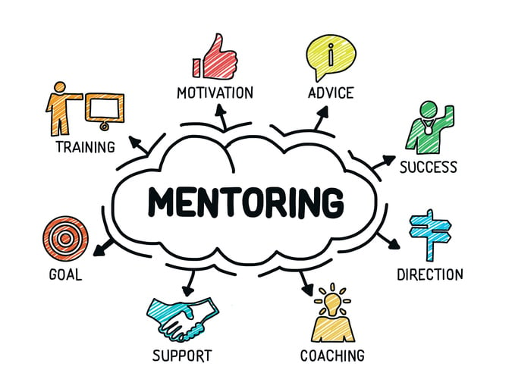

General Motivation
Creation of this project will provide the necessary framework for a freshmen mentorship program in the CS department
Facilitate meetings between faculty and freshmen and house mentor/mentee information
Provide support for freshmen in the department
Professional Development
Academic Development
College Transition

Slide 3


Users
Faculty in the Computer Science Department
Utilize service to access their list of mentees, view form responses and see current meetings/meeting history
Freshmen in the Computer Science Department
Use service to find their mentor, find information about their mentor, and schedule mentor meetings

Slide 4
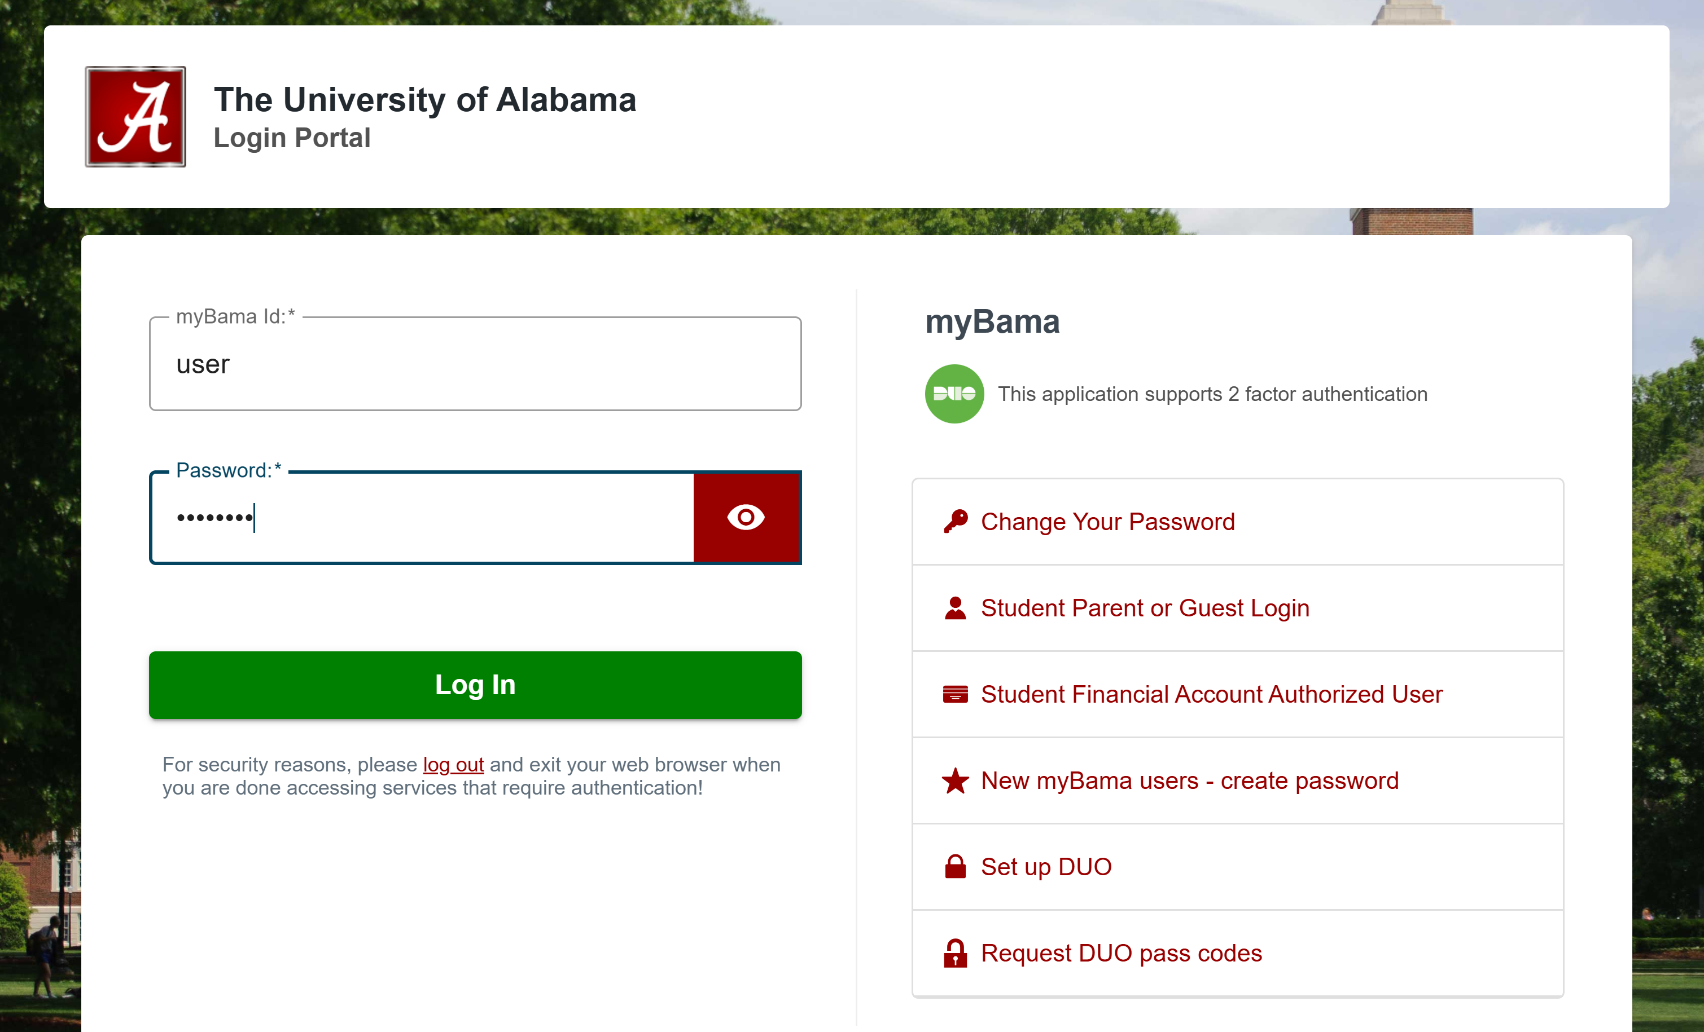

Core Features
Login System
Login for mentors and students
Secure authentication for user data protection
Interest-Based Mentor-Mentee Matching
Students looking for a mentor fill out an interest form
Automated algorithm that matches students with mentors based on availability and subject expertise

Slide 5



Email notifications
Inform mentors about new mentees
Notify students about their assigned mentors
Meeting Scheduling
Integrated calendar for students to book time slots with mentors
Data Management
Centralized database to store mentor-mentee assignments, student profiles, mentor availability, meeting history and more

Slide 6
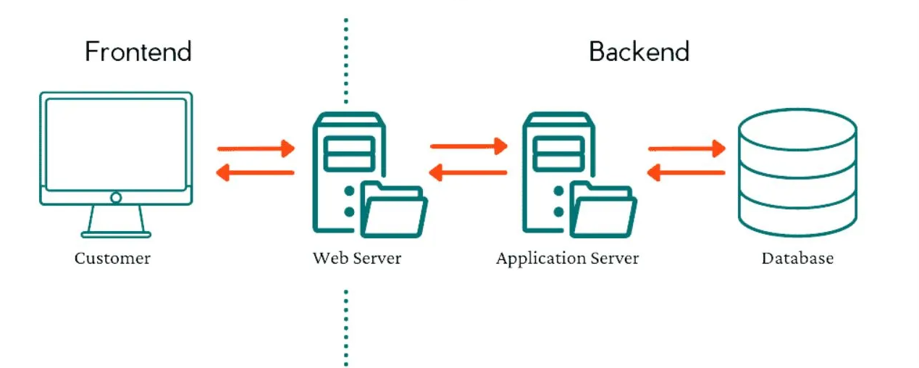
Technical Details
Format
Frontend/Backend/Database
Technologies
Database API
Matching Algorithm
Hosting Server

Slide 7


Environment
Frontend
Framework – React.js
Authentication – Firebase or similar library
Backend
Framework - Django (Python)
Database API – REST
Database
Framework - PostgreSQL

Slide 8



Related Apps
mentorcliQ
Gale-Shepley algorithm
Suggested vs. self matching
Qooper
Flash mentoring
LinkedIn
Boolean / filtered search

Slide 9



Challenges
Freshmen preferences evolving (Dynamic constraint satisfaction)
Modifying the Gale-Shepley algorithm
fairness, many-one relationships
Balancing:
Mentor workload and student needs
Ease of use and development time
Functionality and maintainability

