Slide 1


Mentor management system
By: Andrew Hahn, Hannah Hazelwood, Manjila Singh, Gregory Nothnagel
Source code: https://github.com/manjilasingh/mentor-management-system
Project website: https://hhaze2.github.io/

Slide 2


Project focus
Incoming CS students need mentors
~900 students, 15 research faculty, 9 instructors
Facilitate interaction through web app
Enhance value of education
Minimize time burden

Slide 3
Sprint goals
Complete the basic setup of the website
Use Docker to containerize the database, frontend, and backend
Implement OAuth login functionality
Allow students to login and view their mentor’s information
Create a view for mentors to see a list of their mentees/students.

Slide 4
Major sprint achievements
Successfully linked PostGres, Django, and node.js application in a fully dockerized environment. (Andy)
Implemented database structure and initial contents which can be modified in Django Admin. (Hannah)
Implemented login functionality by registering the node.js app with Microsoft Azure. (Gregory)
Designed a user-friendly frontend UI. (Manjila)
Completed the project website draft. (Hannah)

Slide 5
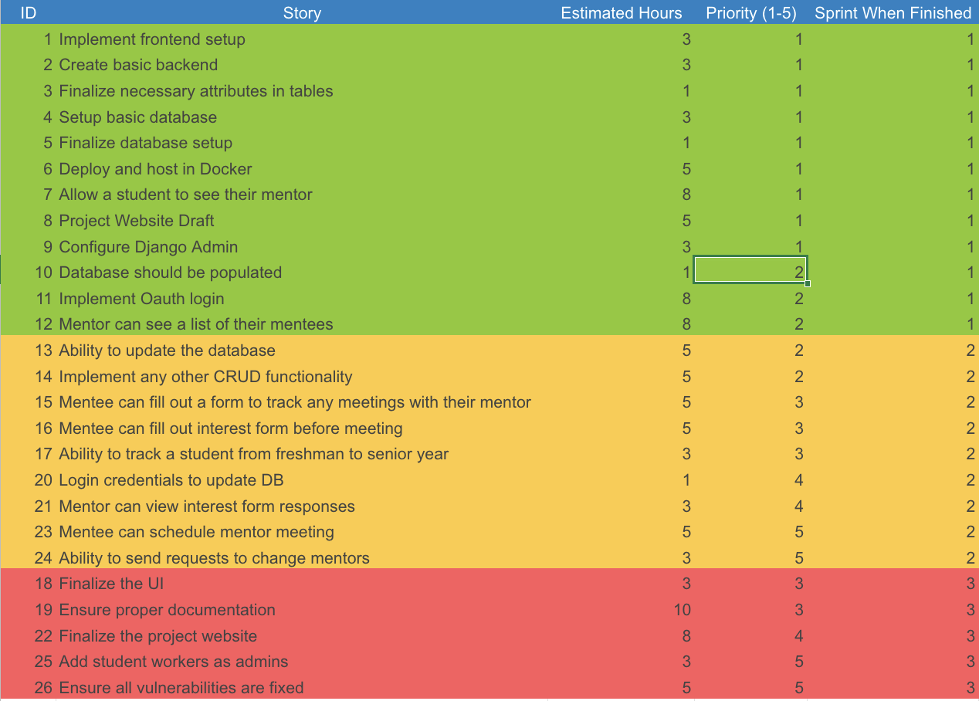

PROJECT BACKLOG

Slide 6
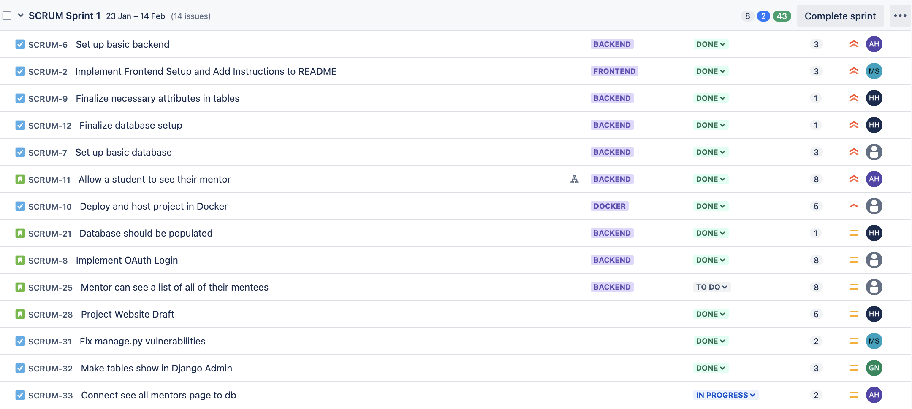
Sprint backlog

Slide 7
Incomplete tasks and lessons learned
Incomplete Tasks:
Populating the student and mentor database: Only sample data is being used for now. Stakeholder feedback was to implement a feature to upload a csv file to update the database.
Creating a view for mentors to see a list of their mentees/students
Lessons Learned:
O-Auth login
Connecting database to backend to frontend

Slide 8
sponsor feedback
CSV Import Functionality:
Import students from a CSV file into the website database
The CSV file with include mentor-student assignments
Expected-data: 200-250 freshmen in the CSV file
Hosting Requirements:
Host the website on Google Cloud for now.
Eventually, move the website to a UA server.
Positive Feedback on Current Progress:
Satisfied with the login functionality and the Meet My Mentor page.

Slide 9
Demo time
Login Functionality, Meet My Mentor Page, Mentor Directory

