Slide 1
Edge computing project overview
Shane Wang (王庆), SSG/OTC/DSS/NST
DSS: Datacenter System Software
NST: Networking and Storage Team

Slide 2

Agenda
Why Edge Computing?
Case Studies
Multi-Access Edge Computing
Intel Proposals

Slide 3












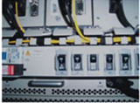


Why Edge computing? new demands of information communication technology
Autonomous
vehicles
Voice
VR/AR
Online shopping
Low latency
High throughput
Localization
SMS
Video
Intelligent
Home
MMS
Music
M2M
IM
IoT
Past on Voice
Present on Data
Future ICT

Slide 4
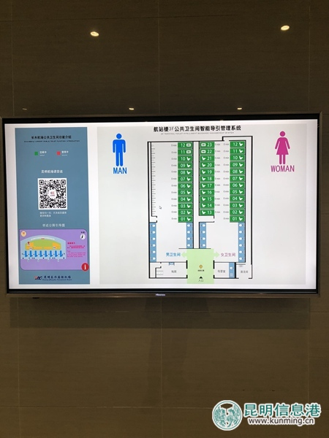
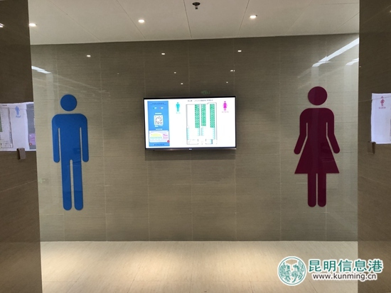
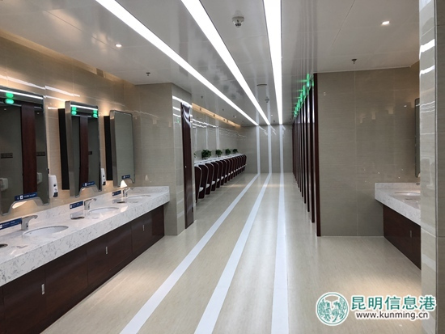
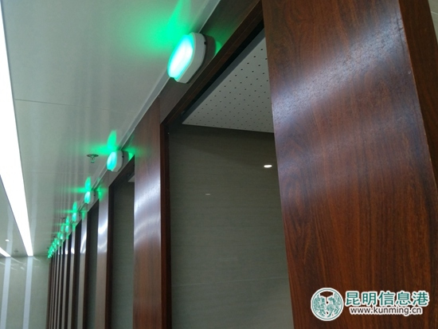
Case study 1: intelligent rest rooms at KMG airport
News on Jan 17, 2018:
试点洗手间的智能系统目前具备多种创新功能：对洗手间厕位的占用情况进行一目了然的显示，为旅客寻找空位如厕提供便利；为旅客提供高峰时期寻找空余洗手间的智能引导，指引旅客前往附近最近的有空余厕位的洗手间如厕；厕位使用频率统计：包涵单个厕位的统计和整体洗手间的统计，并且可以进行科学分析得出某时段使用频率最高的洗手间或者某个厕位；洗手间使用评价系统；旅客可以在使用后扫描门口的二维码进行满意度评价。除了以上功能外，该系统还可以根据需求进行水电计量、气味监测、保洁管控、节能减排等进一步的完善升级，以满足更多的智能洗手间功能要求。

Slide 5


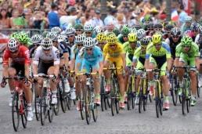





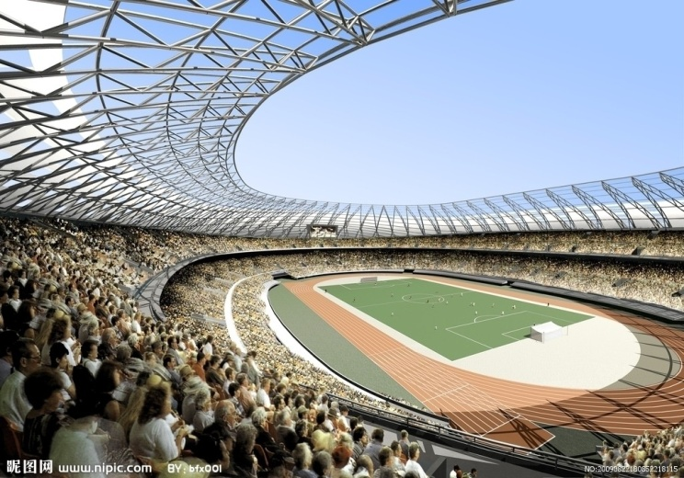




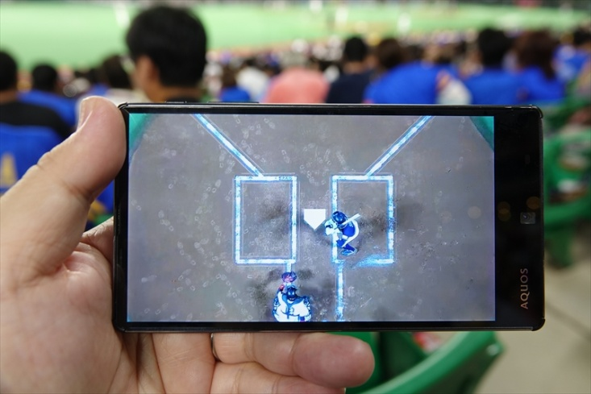
Case study 2: Live broadcasting
Edge computing provides local matches with:
Video on Demand (VoD)
Video live broadcasting
eNodeB
MEC OneBox
Core Network
MEC Server
MBSFN
Live broadcasting for sport games

Slide 6
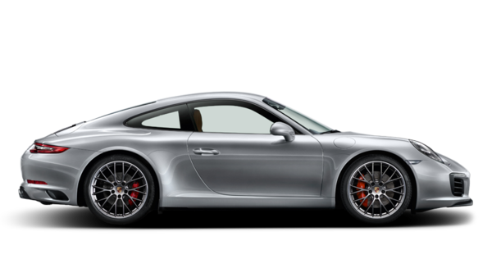


Case study 3: Intelligent Surveillance
Image Collection
Violation Detection
Video signal
Digital streaming
Optical Character Recognition (OCR)
Character Split
Plate Location
Output being
sent to DC
Violation plate: 沪A88888
Timestamp: 2018/03/15 3:00pm
Location: 880 Zixing Road
MEC Server
NVR/DVR

Slide 7







Status of edge computing development
ETSI: MEC
OPENFOG
2014成立。MEC概念提出者，标准组织和推动者
2015 年成立，定义雾计算架构，将计算、存储、网络功能分布到更靠近用户的地方
5G : 3GPP
5GAA： 聚焦5G车联网
已正式接受MEC作为5G架构关键议题
5GAA
定义雾计算架构，将计算、存储、网络功能分布到更靠近用户的地方
NGMN
CCSA-ST8：工业互联网边缘计算
已经同意将MEC纳入到5G需求和架构中
刚刚成立工业互联网领域的边缘计算组

Slide 8
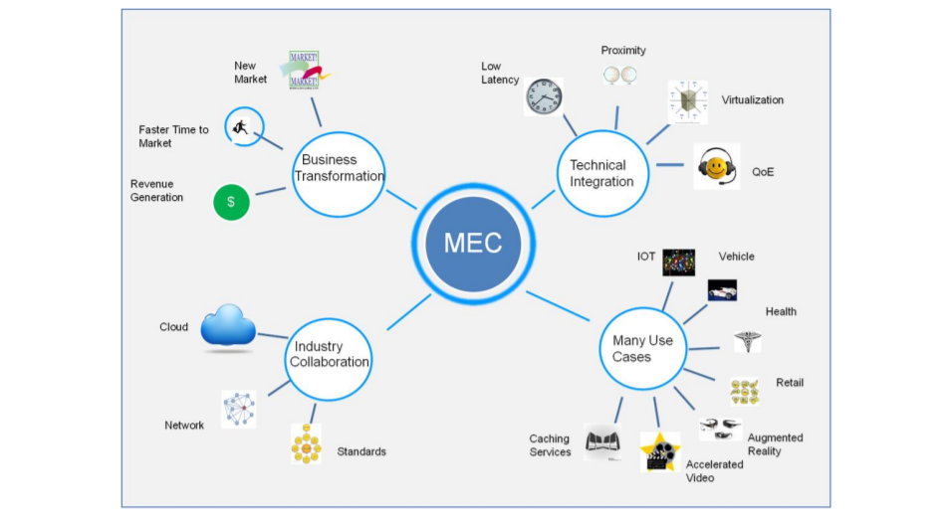
Multi-access edge computing – drivers for telcos
Major Technology Drivers:
5G (High speed, large data generation, low latency)
Application of cloud architecture principles of compute/network/storage close to the user and close to the data.

Slide 9
Mec – industry organizations
ETSI MEC ISG | Aims to standardize architecture and interfaces for edge computing. Formed in 2014
OpenFogConsortium | Aims to accelerate adoption of edge computing challenges related to IOT, AI. Establishes best practices, architecture frameworks, create guideline documents. Formed in November 2015
Open Edge computing initiative | Promote edge computing among Telcos and application service providers. Also created open source project called cloudlet (which is OpenStack++) Not much adoption (due to containers)
Edgexfoundry | Open source project related IOT edge computing, but intends to go beyond IOT use cases in future releases. Linux foundation project Announced collaboration with openfog, IIIC consortium

Slide 10
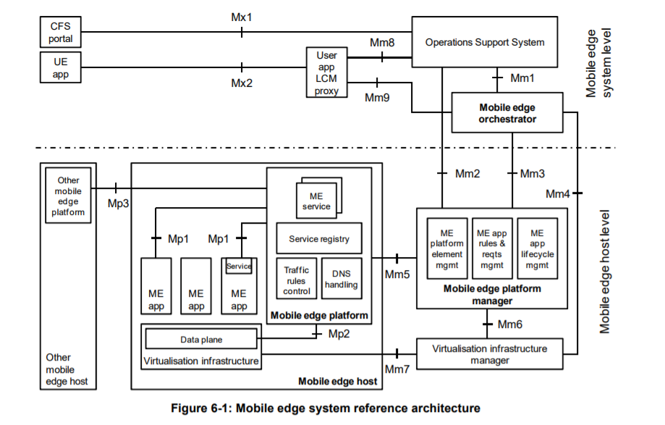
Multi-access edge computing - Ra
Multi-access
Multiple access modes: LTE, WiFi, Wired, Zigbee, LoRa, NB-IoT
Uniform user experience everywhere
Edge
Network and application are at edge, close to users
Computing
Adopt Cloud and Fog computing to reduce the cost

Slide 11
Edge computing challenges and concerns
Use case specific workload characterization to identify any gaps to fill in future silicon (NPG formed a group to work on this, but for RAN, EPC use cases)
Orchestration & Management
Central operations
Local closed loop control
Secure infrastructure (to store secrets and secure workloads at the edge)
Network connectivity and Secure communication
Orchestration of Functions
Securing FaaS workloads (New working group formed, first discussion is on Dec 14th)

Slide 12
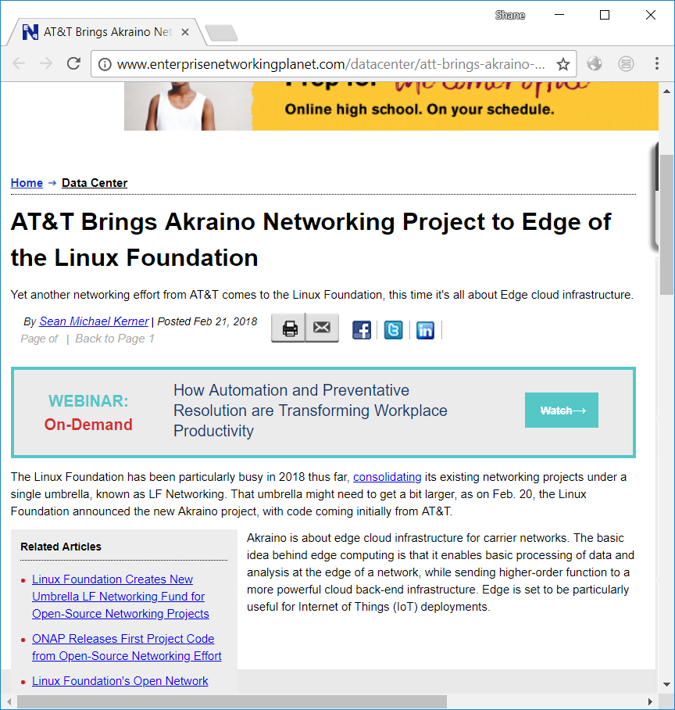
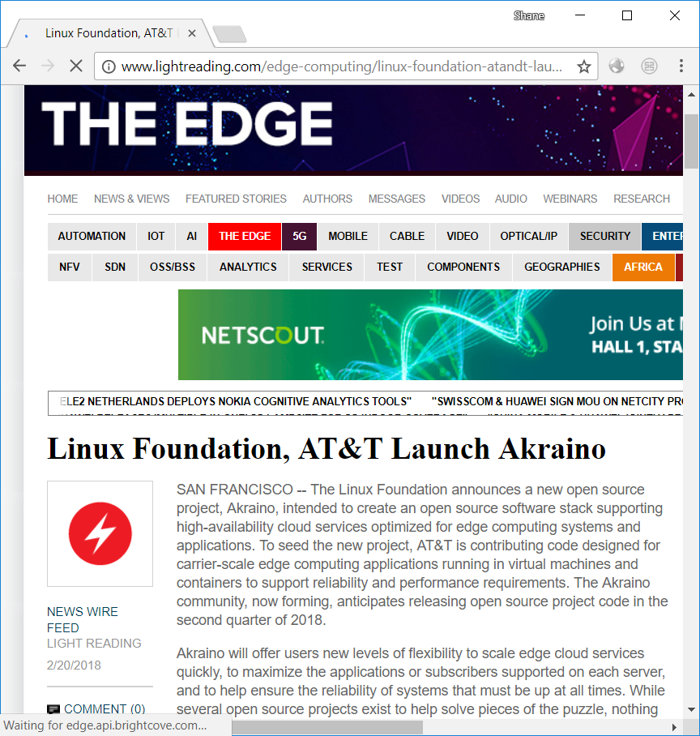
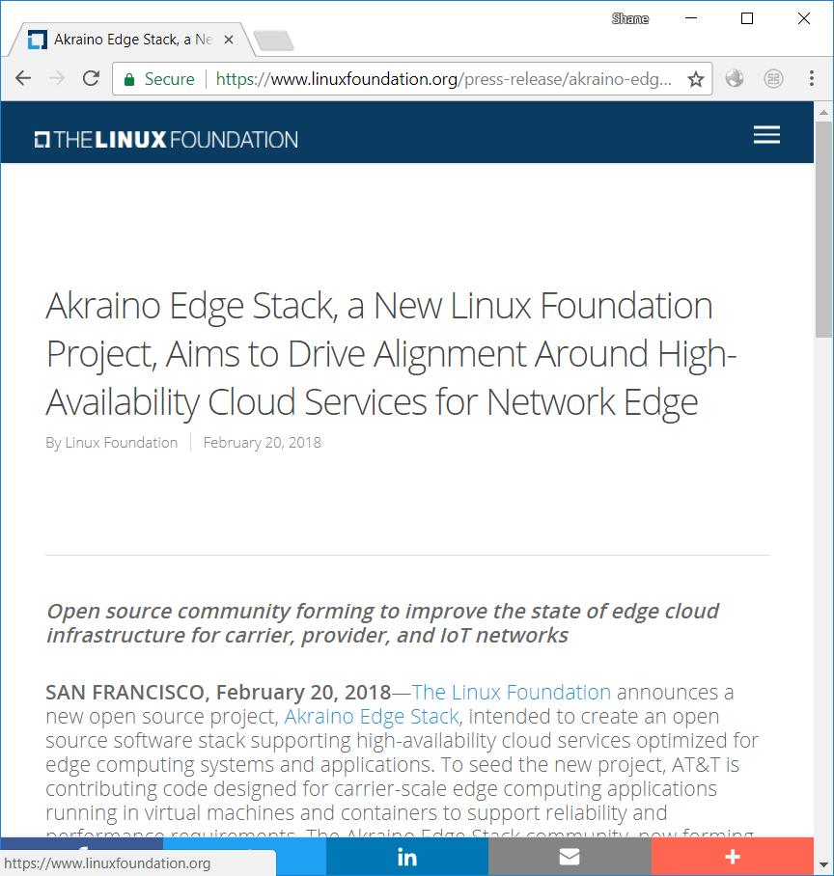


akraino

Slide 13
the industry needs to advance to support Edge & Fog
Today SDI has many complexities
Proprietary HW/SW
Diverse Networks
Time consuming to deploy equipment and services
Multiple open source distributions
Not meeting carrier grade demands
Our Solution
Scalable, standardized software framework
Seeded with code from current production solutions
Delivering mature, proven features required for carrier grade performance, management and reliability

Slide 14

Architecture Details- In progress (INITIAL TARGET)
OSS/BSS**
Zero touch provisioning (Edge commissioning)
* Patched for features and performance
** Added for completeness - Outside of Madawaska at this time
MEC Orchestrator **
ONAP**
Fabric (Switching)
Edge
Control Node
Compute Nodes
Storage Node
Glance*
Cinder*
MEC Platform Manager**
VNFs**
Carrier Grade Storage Cluster
Centralized, Local, or SAN
Keystone*
Horizon*
Nova Compute*
MEC EDGE Platform
(Intel NEV SDK )
Nova*
Neutron*
Neutron Agent*
System Inventory
Fault Mgmt
Performance Mgmt
OVS DPDK
SRIOV networking
VNF HA Mgmt
KVM – Real time
Linux OS + Kubelet + CRI
Linux OS + Kubelet + CRI
Linux OS + K8S + CRI
Notes:
Detailed project names in “Initial” slide and upleveled terms in target architecture do NOT indicate that projects are being removed in Target, but that changes will need to be made in those projects for the target, so we are just listing the functionality, not the projects in the target.

Slide 15
Architecture Details- In progress (Future TARGET)
Zero touch provisioning
OSS/BSS**
MEC Orchestrator **
ONAP**
* Patched for features and bug fixes & performance
** Added for completeness - Outside of Madawaska at this time
Regional Cloud controller
Workload Control & Scheduling
Logging
System Inventory
Management
Monitoring
Security/CA
VNF
Management
Authentication / Policy
Fault, Perf Mgmt.
Fabric (Switching)
Edge
Compute Nodes
Storage Node
VNFs** (VMs & Containers)
Carrier Grade Storage Cluster
Centralized, Local, or SAN
Agents
MEC EDGE Platform
(Intel NEV SDK )
Containerized Services
OVS DPDK
SRIOV networking
Virtualization & CRI (eg. Docker)
Linux OS
Linux OS, CRI
Notes:
Detailed project names in “Initial” slide and upleveled terms in target architecture do NOT indicate that projects are being removed in Target, but that changes will need to be made in those projects for the target, so we are just listing the functionality, not the projects in the target.

Slide 16
Intel – Overall Approach
Goals:
Scalable, flexible platform suitable for CSP, Edge, IoT, and Fog use cases
Support for VM, container, and bare metal workloads
Product-grade code
Zero-touch provisioning and operations
Ingredients:
OpenStack core
Kubernetes / Docker
Ceph
ONAP
Hypervisor projects
Approach:
Contribute Wind River Titanium Cloud portfolio and Intel NEV SDK
Collaborate with broad industry support under open governance
Work with existing communities, upstreaming enhancements and fixes
Drive scale and support new industries
Benefits:
Ease of deployment
Ability to provision and update
Secure
Lower TCO

Slide 17
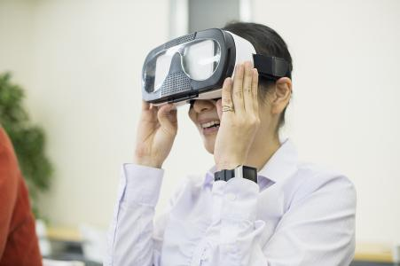





Edge computing for ai
Edge Computing & 5G support AI by offering infra elements:
Edge computing provides the fundamental infrastructure for AI computing, including data storage localization and fog computing in the scenarios, such as autonomous vehicles, intelligent surveillance, etc.
5G provides low-latency high-throughput connectivity for everyone and everywhere with multi-access.
With IA technologies such as FPGA, GPU, etc, the hardware of edge computing is optimizing the performance and accelerating the solution of AI infrastructure.
Madawaska community joint effort, China Unicom and China Mobile to be core members of governance, adopt Madawaska, contribute back.
Intelligent Health
AR/VR
Intelligent
City
Intelligent Home
Intelligent
Factory
Intelligent Transportation

Slide 18
We’re hiring, please refer friends
Networking Engineers
Python, Java, C/C++
Networking background
OpenStack Neutron, Open DayLight, ONAP, OPNFV, Container Networks
DOT Assignments
Contact: shane.wang@intel.com

