Slide 1
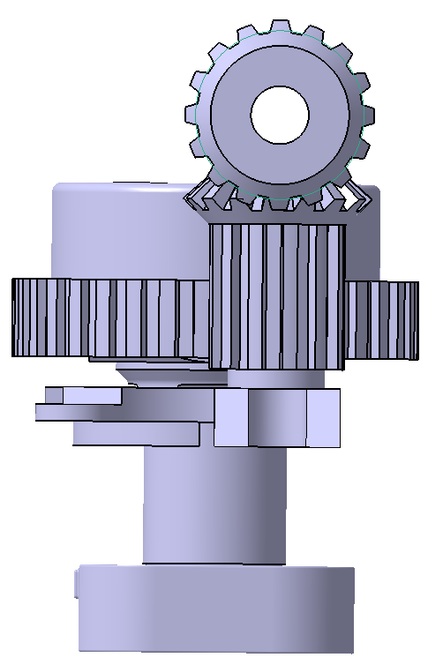
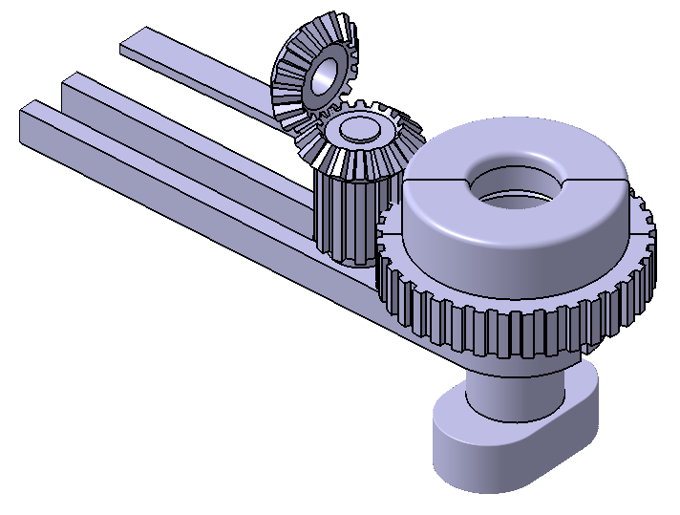






NobleTek Design 2 Loading of fitting fixture
$$\overline{F_{r}}$$
$$F_{r}cosπ/4⁡$$
$$F_{r}\sin{π/4}$$
$$l$$
$$\overline{F_{s}}$$
$$L$$

Slide 2






















$$P_{1}$$
$$P_{1}=F_{r}cos{(π}/{4)}⁡$$
Beam cross-section
$$z=\frac{P_{1}L^{3}}{3EI_{1}}$$
$$I_{1}=\frac{nbd^{3}}{12} , n=2$$
d
$$z$$
L
b
$$P_{2}$$
$$P_{2}=F_{r}sin(π/{4)}⁡$$
$$y=\frac{P_{2}L}{AE}$$
$$A=nbd$$
$$y$$
$$\overline{F_{r}} fundamental loads$$
L
M
$$z=\frac{ML^{2}}{2EI_{1}}$$
$M=F_{r}sin(π/{4)}l$
$$z$$
d₂
d₁
L
$$F_{s}$$
$$z=\frac{F_{s}L^{3}}{3EI_{2}}$$
$$I_{2}=\frac{1}{12}\left(bd_{1}^{3}−bd_{2}^{3}\right)$$
b
$$z$$
L
$$\overline{F_{s}} fundamental loads$$
T
$$T=lF_{s}$$
2b
$$G=\frac{E}{2(1+ν)}$$
$$θ=\frac{TL}{KG}$$
Θ
$$K=ab^{3}\left[\frac{16}{3}−3.36\frac{b}{a}\left(1−\frac{b^{4}}{12a^{4}}\right)\right]$$
2a

Slide 3
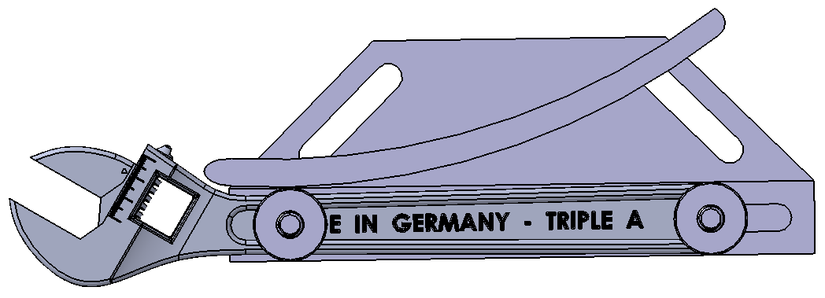
T =15 ft*lb
a = 4”
b=10”

