Slide 1
Elevator Controller
GroupA
12161427 김준혁
12161503 조성학
12161762 이영준
12171539 이홍찬
12181549 최유리
Embedded System Final Project

Slide 2
Contents
Summary
Function
Timer interrupt
Stepping motor
Keypad
Flex sensor
Ultrasonic Sensor
3. Improvement

Slide 3
Summary
Floor
Elevator
: Stepping Motor
: Keypad
D
O
O
R
: Ultrasonic Sensor
: Flex Sensor

Slide 4
Summary
Description
Develop a program for the STM32L476VG microcontroller to simulate an elevator. The keypad, ultrasonic sensor are used as an input for the microcontroller to use to change its state/output. The motor are used by the microcontroller as the output of this program. This program will be made using the C programming language. Due to the restrictions in money and time, we will simulate the rising and falling of the elevator as just the movement of the step motor. We explain more about the hardware and its uses in detail at each hardware component description.

Slide 5
Timer interrupt

Slide 6
Flow Chart - Timer interrupt
start
open_start_time = time
first_open_door_flag = 0
open_start_time = 0
time = 0
first_open_door_flag = 1
time – open_start_time
>= 500000
F
F
open == 1
T
T
close_door()
first_open_door_flag = 1
first_open_door_flag == 1
F
T

Slide 7
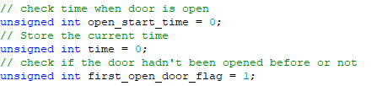
Timer interrupt
Variables

Slide 8
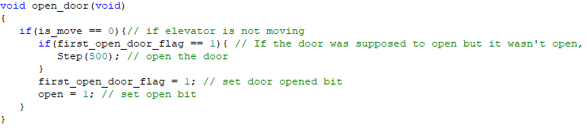

Timer interrupt
Functions
void open_door(void): function to open the door
void close_door(void): function to close the door

Slide 9
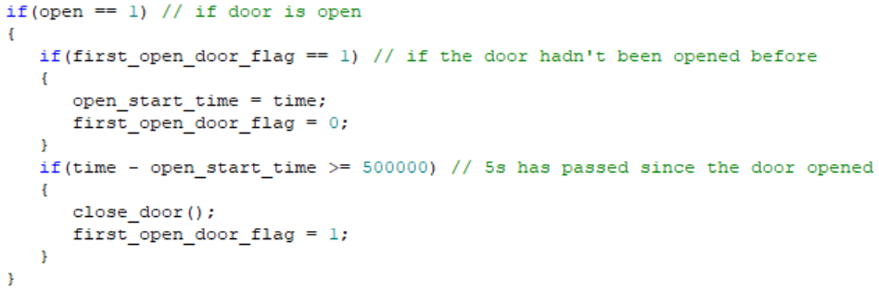
Timer interrupt
In main function

Slide 10
Stepping motor

Slide 11
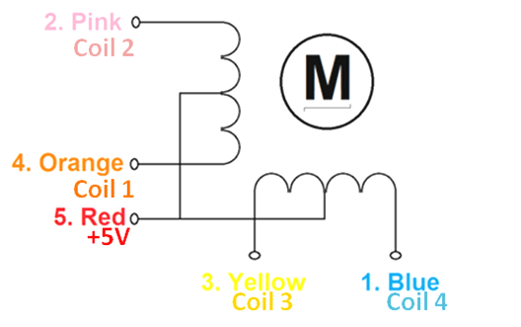
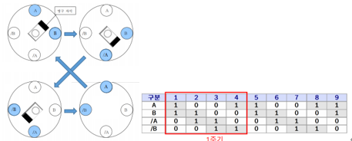
Stepping Motor
ㆍStepper Motor uses the principle that when a current flows through an internal coil, the motor rotates by magnetism.
ㆍIt is divided into full-step and half-step depending on the method of applying current to the coil.
ㆍTo save power, in this project, we use full-step method.
ㆍThe motor was used to express the movement of the elevator, the opening and closing of the elevator door.

Slide 12
Flow Chart – Stepper Motor
start
Open = 1
First_door_open_flag = 1
Joystick_right
== 1
Current_level = 1
Open = 0
Is_move = 0
Target_level = 1
F
T
T
Joystick_left
== 1
F
F
Joystick_center == 1
close_door()
T
Open_door()
T

Slide 13

Stepping Motor
Variables

Slide 14
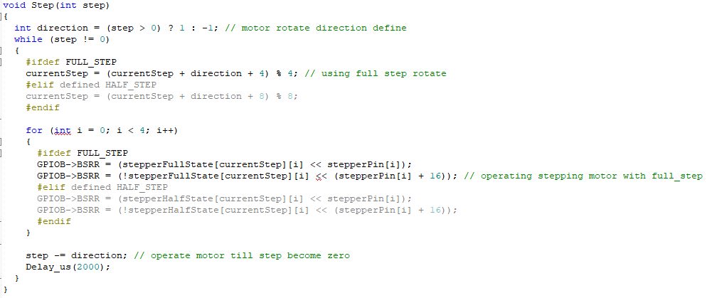
Stepping Motor
Functions

Slide 15
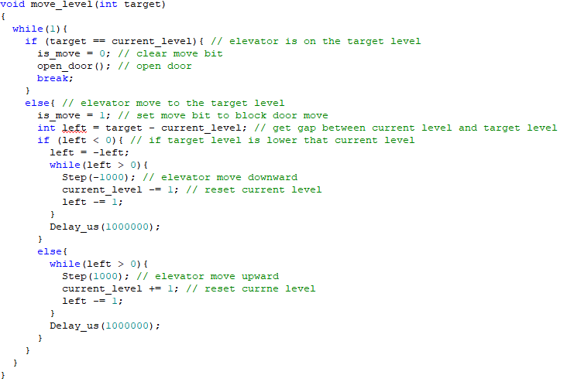
Stepping Motor
Functions

Slide 16
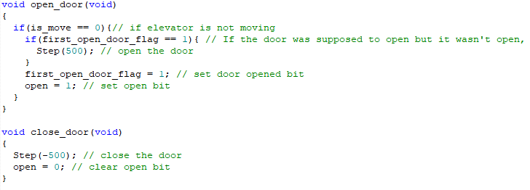
Stepping Motor
Functions

Slide 17
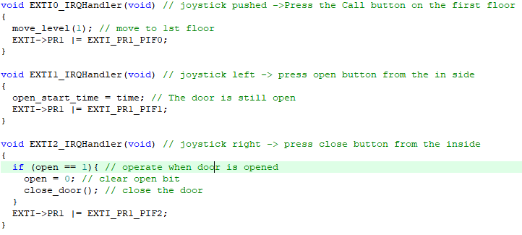
Stepping Motor
Functions

Slide 18
Keypad

Slide 19
Keypad
PE10
We only use {‘1’, ‘2’, ‘3’, ‘4’, ‘5’, ‘6’, ‘7’, ‘8’, ‘9’} on the keypad. Set to PE10~12 columns, set to PE13~15 rows.
check the input of the keypad periodically using polling method "if the door is closed”
PE11
PE12
PE13
PE14
PE15

Slide 20
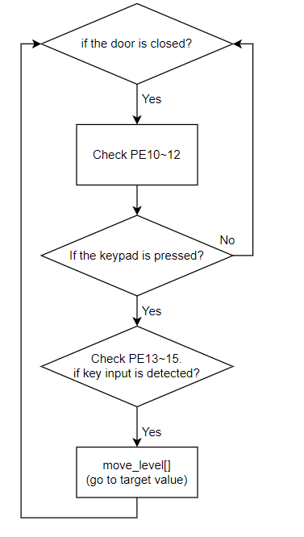
Keypad – Flow Chart
in main function

Slide 21
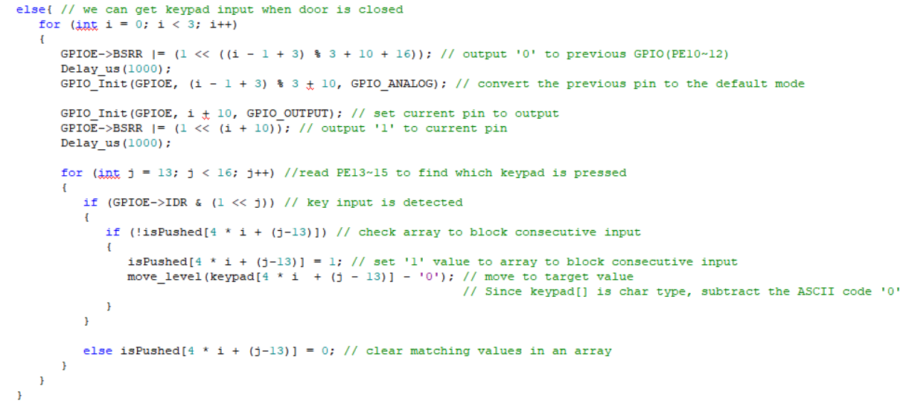
Keypad
in main function

Slide 22
Flex Sensor

Slide 23
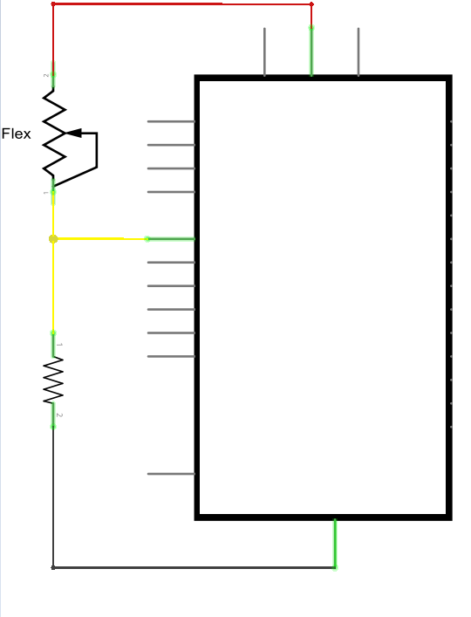
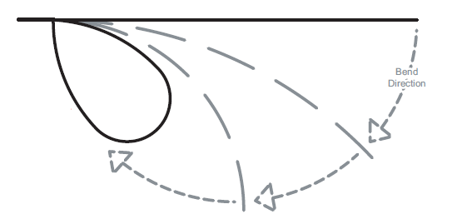
Flex Sensor
3.3V
Flex Sensor
flex_output=0
PA5(ADC1_CH10)
STM32L476
flex_output=300
flex_output=100
R1
10kΩ
flex_output=200
GND
adc value according to bend direction
circuit

Slide 24
Flex Sensor – Flow Chart
in main function
flex_output=GetADCResult()
flex_output > standard
N
Y
LED ON
open door

Slide 25
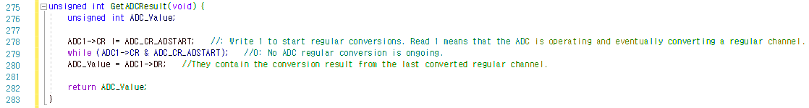
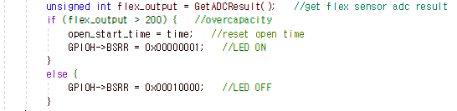
Flex Sensor
unsigned int GetADCResult(void)
: Function to Get Flex Sensor’s ADC Result
in main function
: When the elevator capacity is exceeded(when the flex sensor is bent more than the standard value), the door does not close and the LED turns ON.

Slide 26
Ultrasonic Sensor

Slide 27
Ultrasonic Sensor(HC-SR04)
Measuring distance = 2cm ~ 4m
Ranging accuracy = 3mm
Supply voltage = 5.0V
Max margin of error = 20us
Doesn’t matter because we don’t case about that small of an error to detect if a person is there

Slide 28
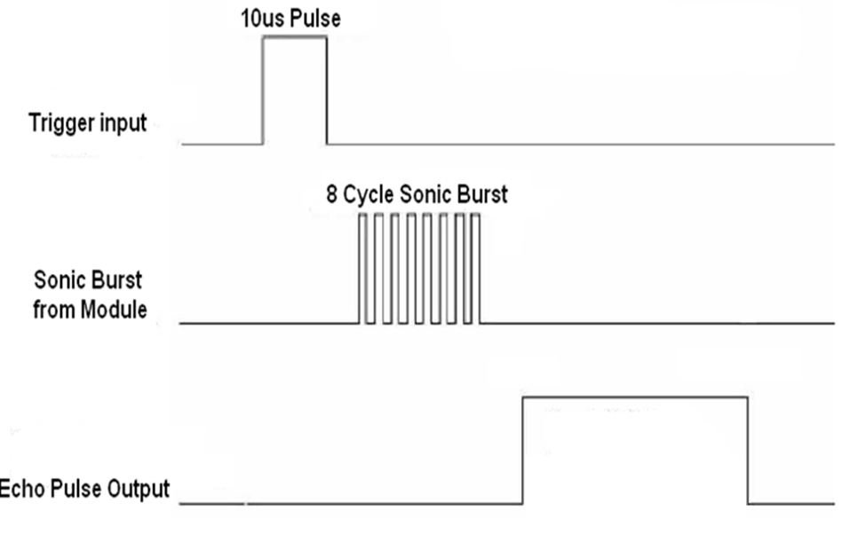
Ultrasonic Sensor(HC-SR04)
First a 10us pulse is sent to the trigger pin. Then after the sonic burst is outputted, the sensor sends a 1 signal to the echo pin till the sonic burst is returned to the sensor. When the sonic burst returns the echo pin it returned to a 0 signal.

Slide 29
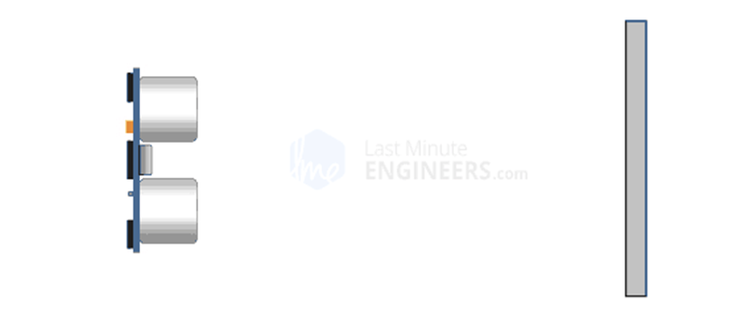
Ultrasonic Sensor(HC-SR04)

Slide 30
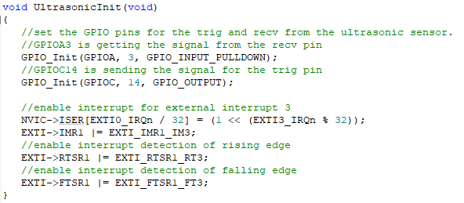
Ultrasonic Sensor(HC-SR04)

Slide 31
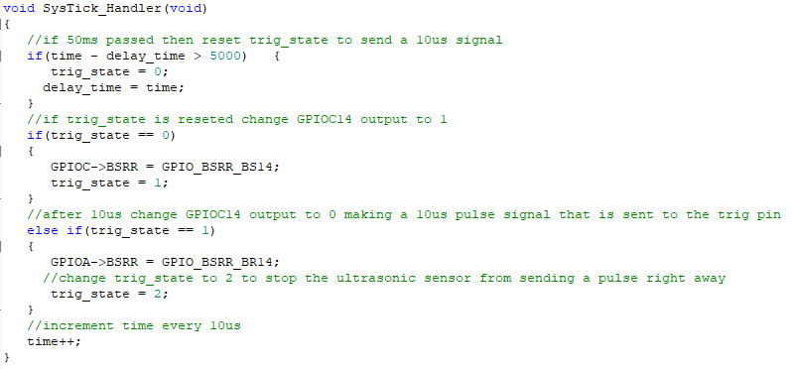
Ultrasonic Sensor(HC-SR04)

Slide 32
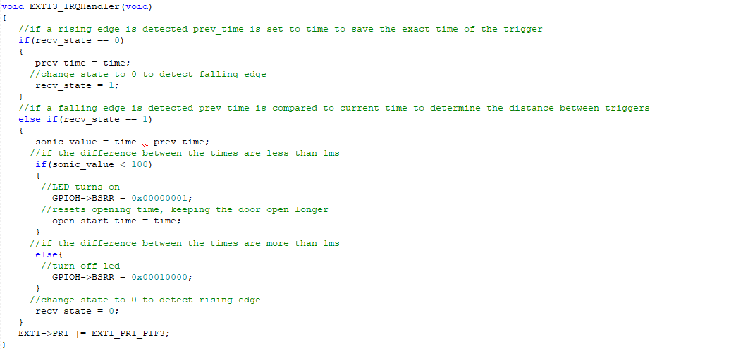
Ultrasonic Sensor(HC-SR04)

Slide 33
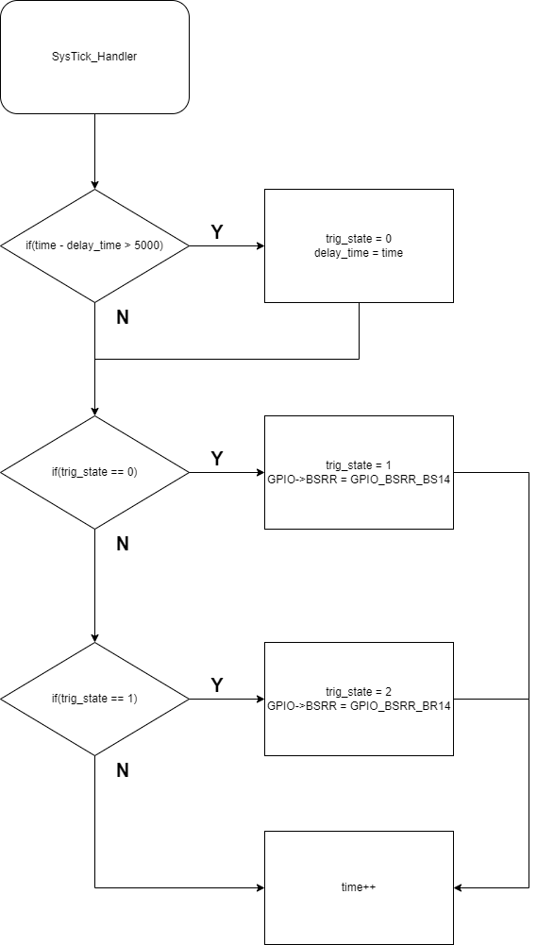
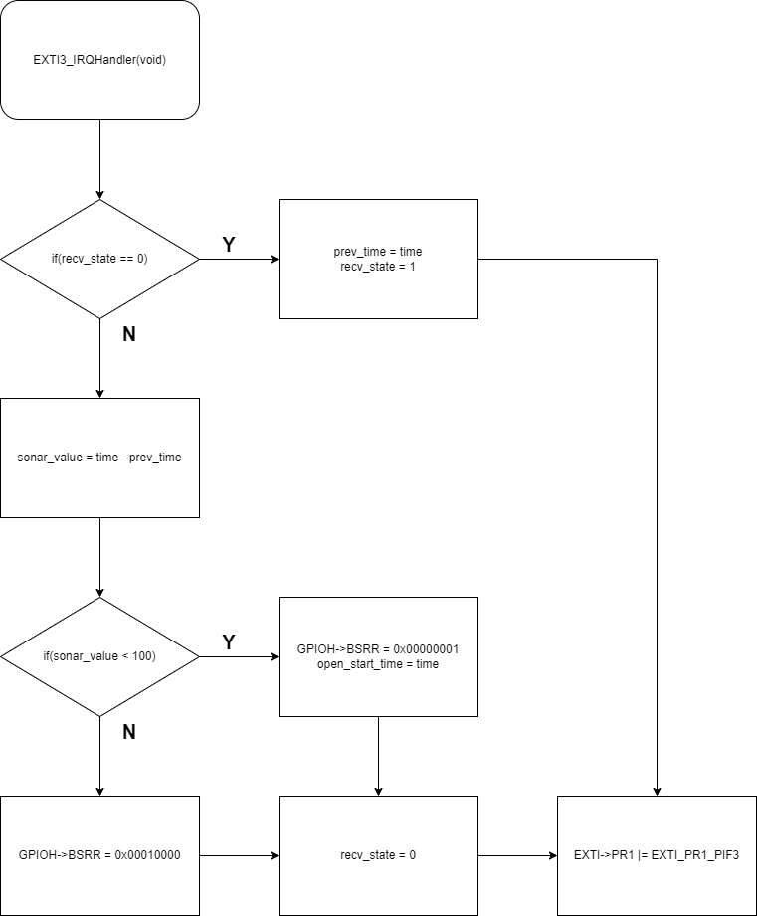

Slide 34
Ultrasonic Sensor(HC-SR04)
‘trig_state’ is only used to send a 10 us pulse to the trig pin.
State: 0 = Needs to send signal. Changes the trig pin output to 1
State: 1 = State changes from 0 after 10us. Changes the trig pin output to 0 resulting in a 10us pulse.
State: 2 = Waits for 50ms(HC-SR04 Max length = about 38ms) then resets state to 0.
‘recv_state’ is used to detect a signal through Pin A3 and determine its duration.
State: 0 = Detects rising edge from recv pin. Saves ‘prev_time’ to determine duration.
State: 1 = Detects falling edge from recv pin. Uses current ‘time’ and ‘prev_time’ to determine the time of the pulse.

Slide 35
Ultrasonic Sensor(HC-SR04)
10us SysTick - To make the SysTick_Handler function activate every 10us we had to change the SysTick->LOAD to 0x63 which equals to 10us in time.
INT3 Detection / state usage - To detect the echo pulse output we used the Pin A3 and made INT3 detect both the falling and the rising edge of a signal. Because of this when the INT3 function was called we couldn’t know if the signal was at a rising edge or a falling one. To prevent confusion we used a state variable. 0 if the signal is rising and 1 if the signal is falling.
Initially a global variable ‘state’ was used to combine the ‘trig_state’ and the ‘recv_state’ in one. But due to problems with the sensor, sometimes there would be no recv signal making the state stuck on the INT3 function every time. We decided that splitting the states and adding a ‘delay_time’ to trigger the next pulse was better.

Slide 36
Ultrasonic Sensor(HC-SR04)
Problems:
When using USART to debug the sensor, we found out that the sensor was constantly ignoring signals and causing errors. We had to hold the end of the jumpers connected to the pins of the sensor to make it activate. Even this made the sensors activate randomly.

Slide 37
Improvements
Make a buzzer ring during emergency moments.
Use the audio jack to play custom sounds for certain scenarios(over capacity, floor arrival, etc).
Improve the code to not need to have a interrupt every 10us when the elevator is moving.
Due to the limitations of the keypad in the kit, we were not able to make a external button(except for 1) that calls the elevator to that floor.
Make so that multiple floor can be choosed and the elevator will get to them in order.

Slide 38
Github link
https://github.com/hhcc05/Embedded_system_final_project

