Slide 1
Git, GitHub and GitFlow

Slide 2
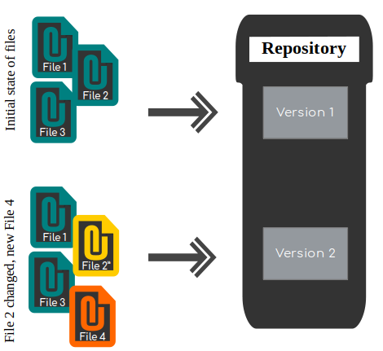
1. What is Version Control System
Version control system allow us to manage a collection of files and provide ability to work on different version of these files parallel.
The different versions of each file are storaged in storage system call repository.

Slide 3
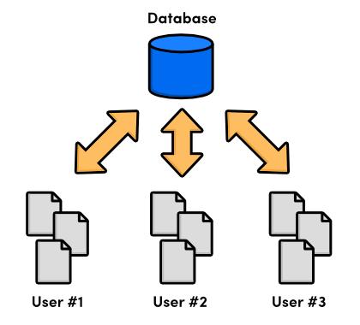
1. What is Version Control System
There are 2 types of VCS.
  Centralized version control system
    All folders, files of project will be located at 1 server called Central Repository.
    Each member must update code from repo if they want to edit the code. Finally, commit the changes to the repository.
    It makes developer easier to set up
    Enable admins control the workflow
    But, if the main server goes down, developers cant collab anymore and saving versioned changes is not possilble.
    Example: Subversion (SVN)

Slide 4
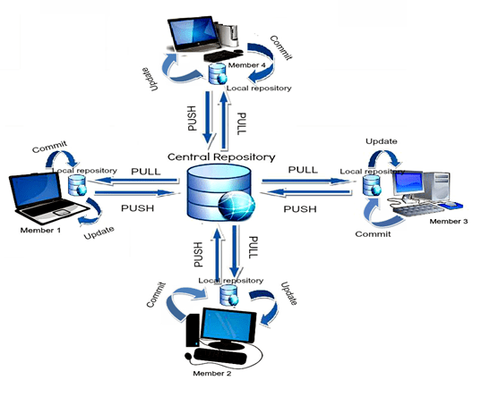
  Distributed version control system
    Each member can has their repository at local. And working on it and don’t affect to others code.
    After complete at local repository, developer can push their changes to the central repository.
    Example: Git, Mercurial...

Slide 5
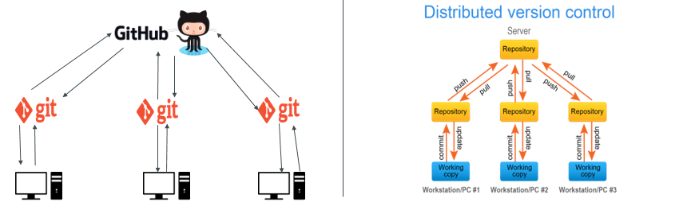
2. What is Git
Git is one of the most popular Distributed version control system.
Git and GitHub are different. Git is a version control system and GitHub is just a company allow us to store Git repositories.

Slide 6
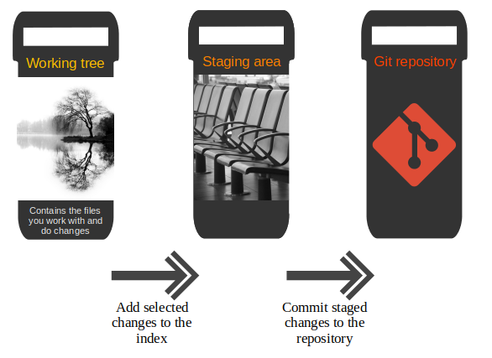
2. How Git work?
After making some changes in out working tree, we need to perform 2 steps to add these changes to out local repository.

Slide 7
If we want collab with other developers. We need to work with some remote server like GitHub or GitLab.

Slide 8
Start working with the local repository:
  Open the working directory
  Open GitBash at this directory and type: git init
  After making some changes, we can commit them to the local repository by 2 steps:
    Git add: we can add specific files or add all files and move them to the staging area.
    Git commit: git commit -m “message”. After this command, files in staging area will be commited to our local repository.

Slide 9
We can see the commit history by using:
  Git log
  Git log -- oneline
  Git log -- oneline – graph and more
We can also see the differences between files in 2 branches:
  Git diff <branch_1>..<branch_2>

Slide 10
What is branch
A branch in Git is simply a lightweight movable pointer to one of these commits. (default is main branch)
Every time you commit, the master branch pointer moves forward automatically.
By using branches, we can easily develop features then merge them to the main branch after complete.

Slide 11
What is branch
To create new branch:
  git branch <branch_name>
  Git checkout -b <branch_name>
To switch to a branch:
  Git checkout <branch_name>
We can back to the previous commit if we have some problem during coding:
A – B – C – D (main) => A – B – E – F (main)
                \ C – D (bug-branch)

Slide 12
Git tag
Git tag allow us to manage our version during working in project.
To show available tag:
  Git tag
To create new tag:
  Git tag -a <tag_name> -m <tag_description>
To push tag to the remote repository:
  Git push origin tag <tag_name>
  Git push –tags
To delete a tag: git tag -d <tag_name>

