Slide 2
Lorenz (1963) J. Atmos. Sci.
Lorenz Flow
σ = 16, ρ = 45.92, β = 4
x
z
z
y
x

Slide 3
Rösler Flow
Rösler (1976) Phys. Lett. A
a = 0.2, b = 0.2
c = 2.5
c = 3.5
c = 4
c = 5

Slide 4
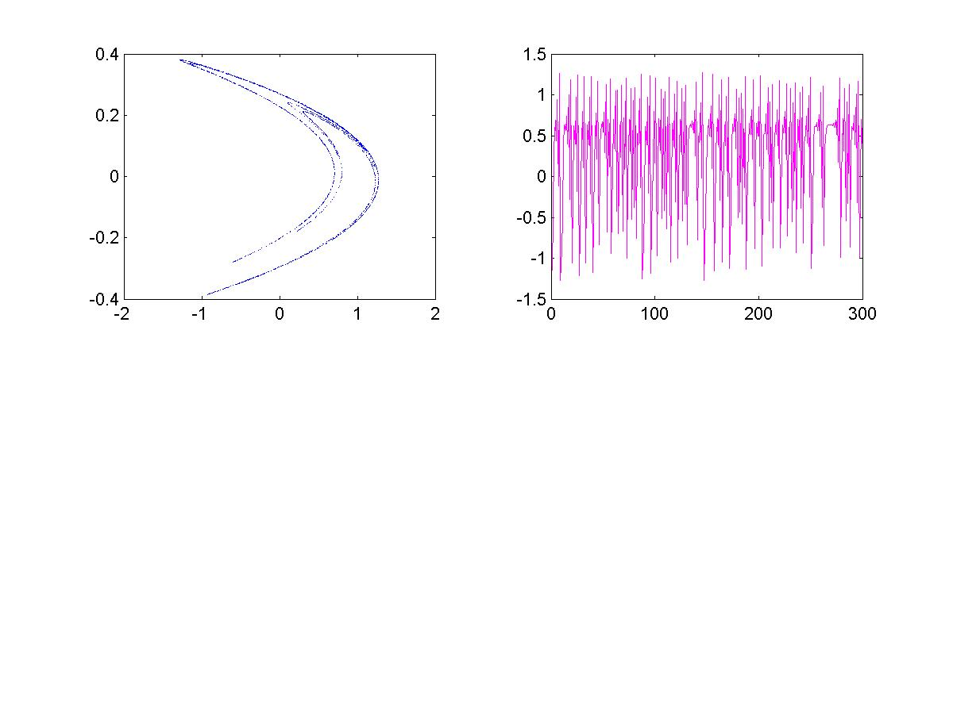
Hénon (1976) Comm. Math. Phys.
Henon Map
a = 1.4, b = 0.3
y(n)
x(n)
x(n)
n

Slide 5
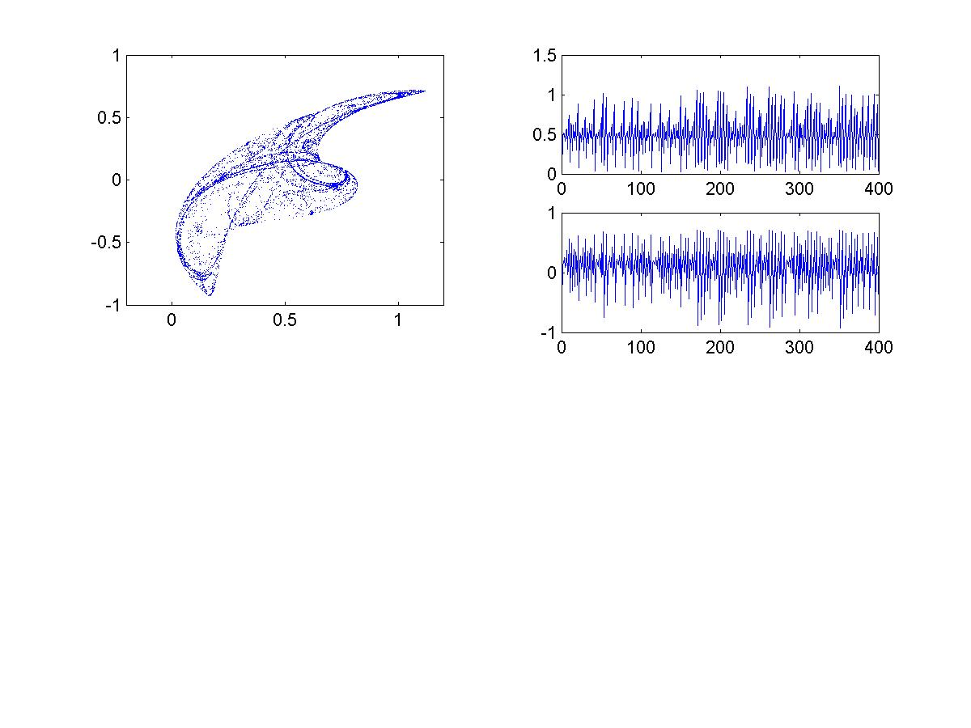
Ikeda Map
x
y
y
x
n
α = 5.4, β = 0.9, κ = 0.92

Slide 6
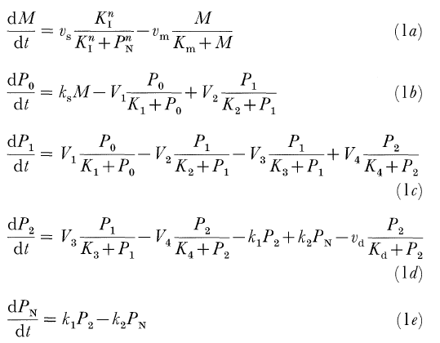
模型

Slide 7
