Slide 1


Gurobi in Python Get Started!
電管碩二 洪迎哲
Line: dv8593
Email: dv8593@yahoo.com.tw
Thanks my lab-mate Li-Ting‘s support!!

Slide 2
Agenda
Installation
Case 1 - Linear Programming Problem
Case 2 – Transportation Problem
Q&A

Slide 3

Installation Guide
Visit My Github: https://github.com/hhh2012aa/Python-Gurobi-Installation-Without-Anaconda

Slide 4
Case 1 - Linear Programming Problem

Slide 5
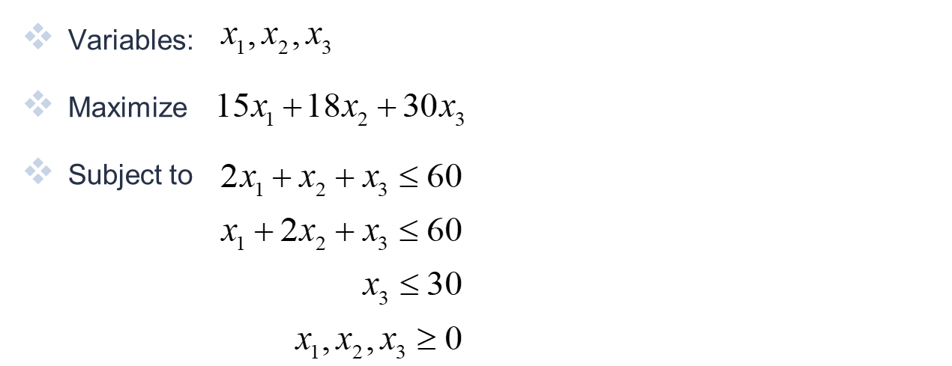
Linear Programming Problem Example

Slide 6
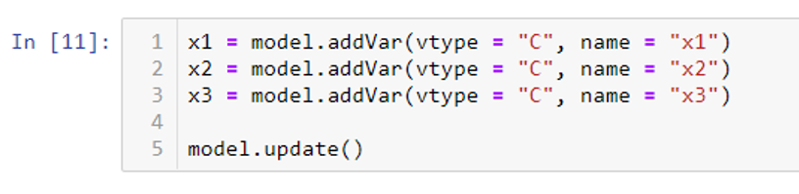
Define Variables
vtype: type of variable
C: continuous (default)
B: binary
I: integer
name: variable name

Slide 7
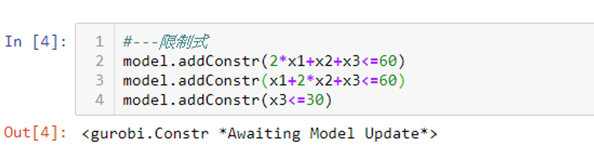
Add constraints

Slide 8

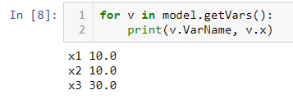
Optimize and Output results
Optimized value
Variable value
Full code: https://github.com/hhh2012aa/Python-Gurobi-Installation-Without-Anaconda/blob/master/case1.ipynb

Slide 9
Case 2 – Transportation Problem

Slide 10
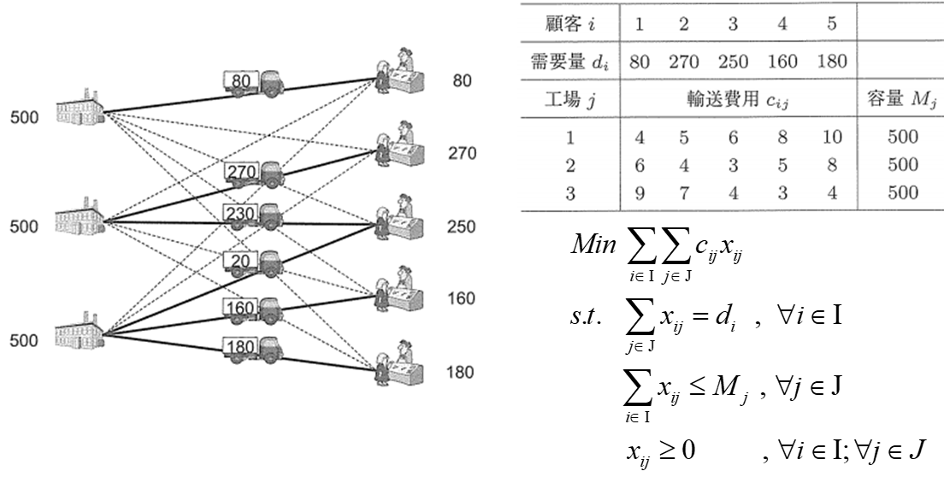
Transportation Problem Example

Slide 11
Challenge
How to define large number of variables/constraints/constants efficiently?

Slide 12
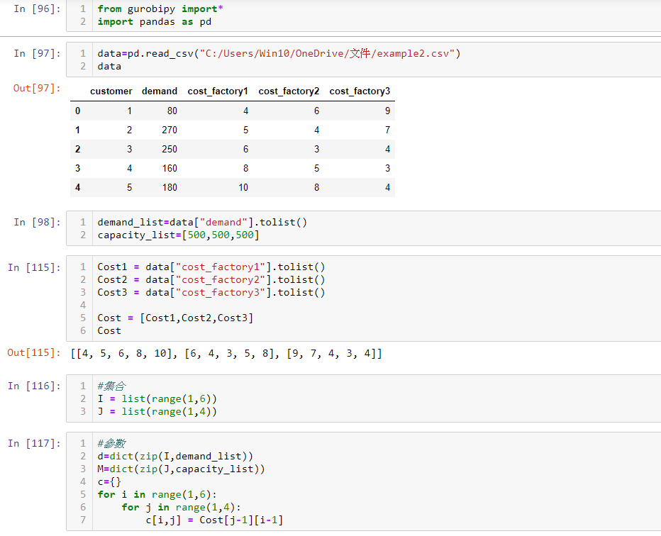
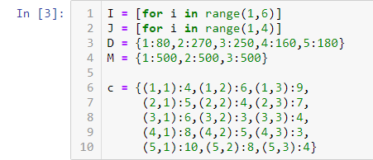
Define constants in two ways
Make good use of “dict”!
or
Load from prepared tables (csv, txt)

Slide 13
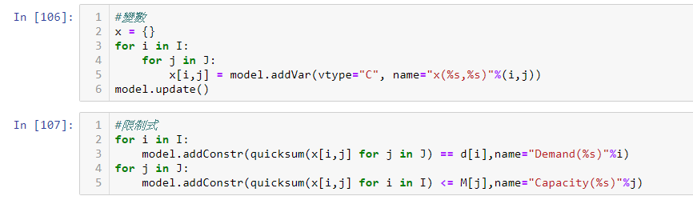
Define variables and constraints on the fly

Slide 14
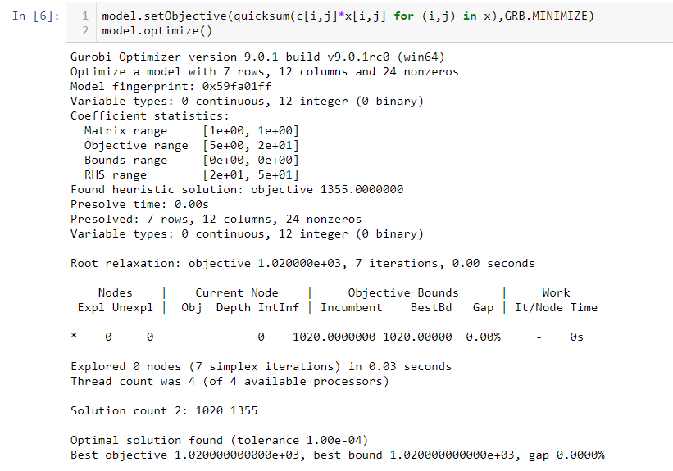
Optimize and Output results
Full code: https://github.com/hhh2012aa/Python-Gurobi-Installation-Without-Anaconda/blob/master/example2-transportation-problem.ipynb

Slide 15
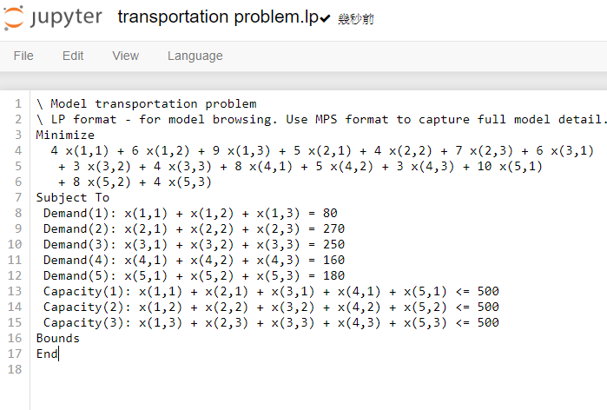
Check your model in lp file

Slide 16
Q&A

