Slide 1


BIOMEDICAL - MEMS
CELL COUNTER
USING
WATERSHED SEGMENTATION
Presented by:
Hoang Huy Hoang - 16020131
Nguyen Thanh Nam - 16020151

Slide 2
CONTENT
Introduction
Why Watershed ?
Watershed Segmentation
IV. Segmentation Process V. Software Building
VI. Conclusion

Slide 3
I. INTRODUCTION

Slide 4

I. Introduction
Cell Counting is basically the determination of the number of cells within a given volume of a sample.

Slide 5



I. Introduction
Determining health condition of patient.
Research on bacteria and viruses.
Learn about the effect of chemical on biological cells.

Slide 6
II. WHY WATERSHED ?

Slide 7
II. Why Watershed ?
Allow segmentation of overlap regions
Result of watershed segmentation is a global segmentation, border closure and high accuracy

Slide 8
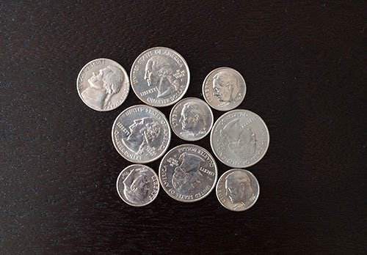
II. Why Watershed ?
Example:

Slide 9
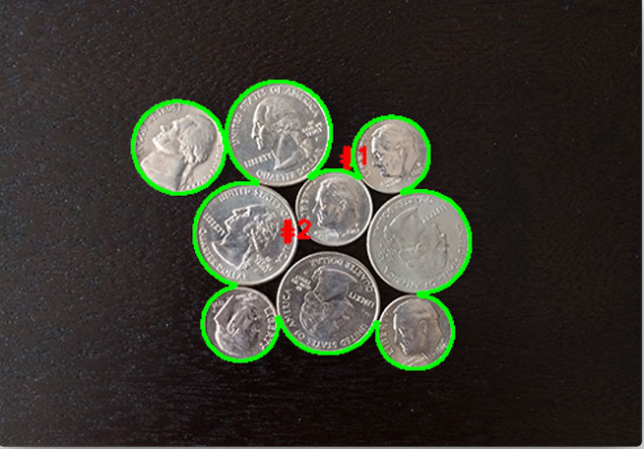
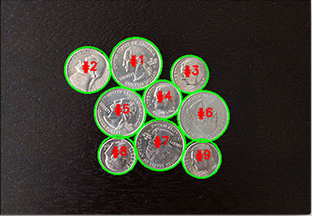
II. Why Watershed ?
Only find contours
Combine with Watershed

Slide 10
III. WATERSHED SEGMENTATION

Slide 11
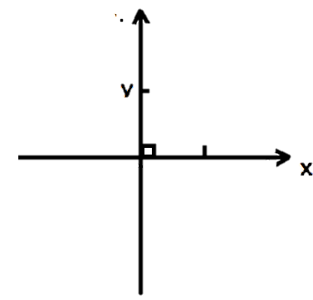

III. Watershed Segmentation
a) Idea
Visualize a grayscale image in 3 – dimensions space
2 dimensions in spatial space
The other dimension is brightness of the image

Slide 12
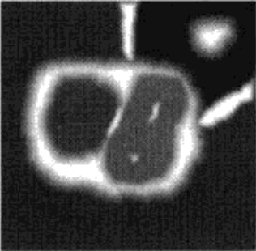
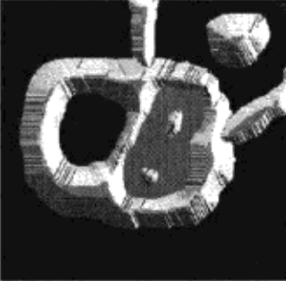
III. Watershed Segmentation
The brighter a pixel, the higher it is visualized in 3D space

Slide 13
III. Watershed Segmentation
Consider dark areas as lakes, valleys, …
Consider bright areas as mountains, hills, …
Bright area
Dark area

Slide 14
III. Watershed Segmentation
At the beginning, all areas are dry.

Slide 15
III. Watershed Segmentation
Water level is increased at a uniform rate all over the image.
This process is called “flooding”

Slide 16
III. Watershed Segmentation
When there is a sign of overflow, a dam is constructed.
Dam

Slide 17
III. Watershed Segmentation
When the flooding process is completed, all areas except for the dams are underwater.
In other words, the dams are the dividing line between segments of the segmented image.

Slide 18
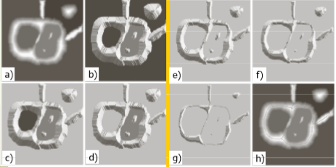
III. Watershed Segmentation

Slide 19

III. Watershed Segmentation
b) Dam construction
Suppose L1 and L2 are dark area at the step n – 1 of the flooding process.
L2
L1

Slide 20
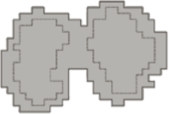
III. Watershed Segmentation
L1 and L2 area at the step n of the flooding process.
L2
L1
We can see that at this step L1 and L2 are connected. Thus a dam is needed.

Slide 21
III. Watershed Segmentation
In order to construct a dam, Dilation operation is applied on step n – 1 of the flooding process
This operation must obey following rules:
Dilation is not allowed outside area found in step n of the flooding process.
Dilation must not connect L1 and L2. Instead, the connecting part will become the dam.

Slide 22
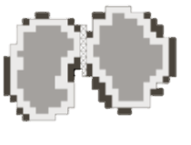

III. Watershed Segmentation
L2
L1

Slide 23
IV. SEGMENTATION PROCESS

Slide 24

IV. Segmentation Process
Input image
Blur and Sharpen
Thresholding
Distance Transformation
Count Contours
Find and Filter Contours
Watershed Segmentation

Slide 25
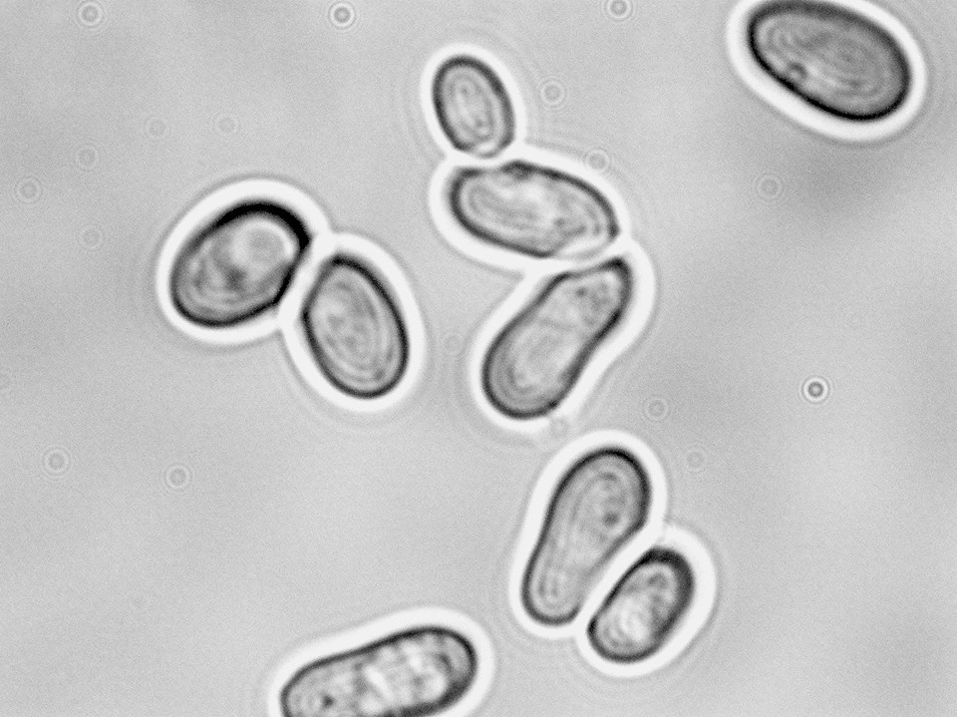
IV. Segmentation Process
Raw image

Slide 26
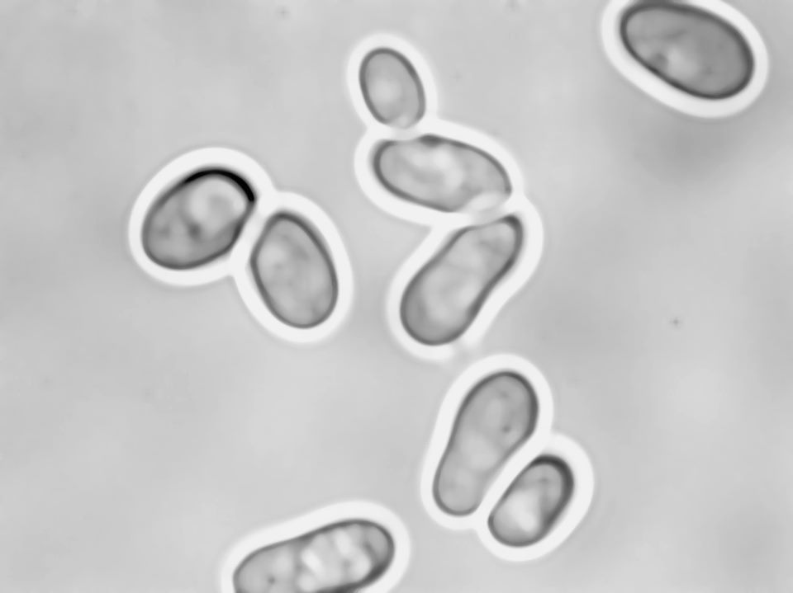
IV. Segmentation Process
Sharpened and blurred image

Slide 27
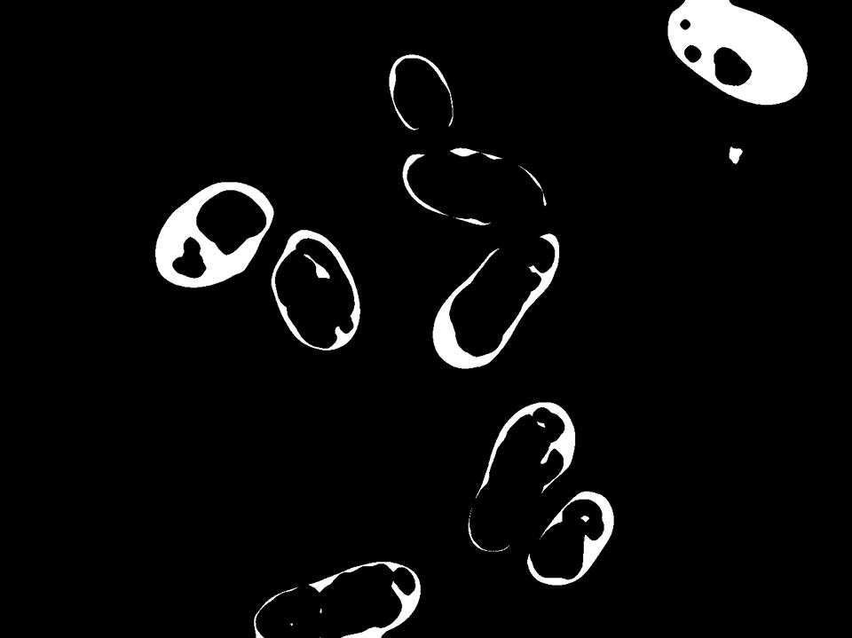
IV. Segmentation Process
Distance transformed image

Slide 28
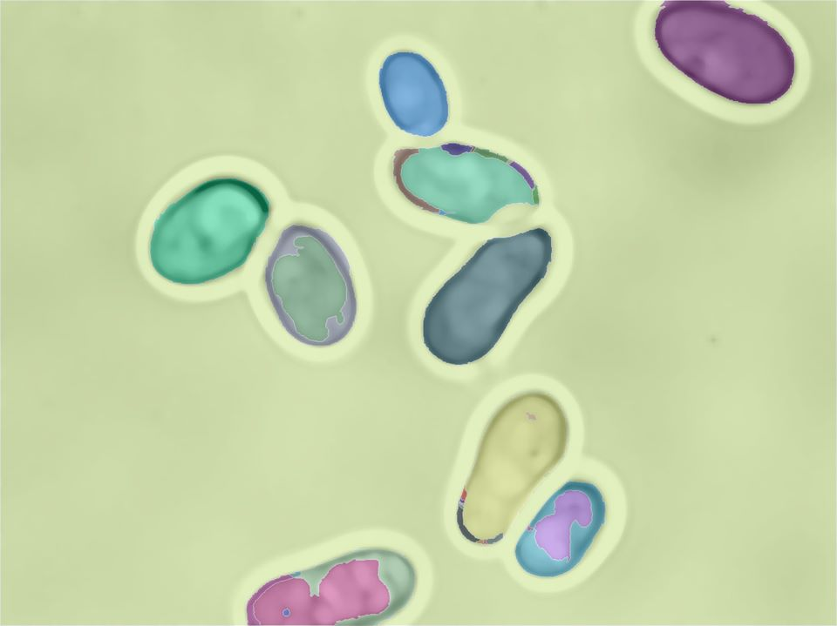
IV. Segmentation Process
Segmented image

Slide 29
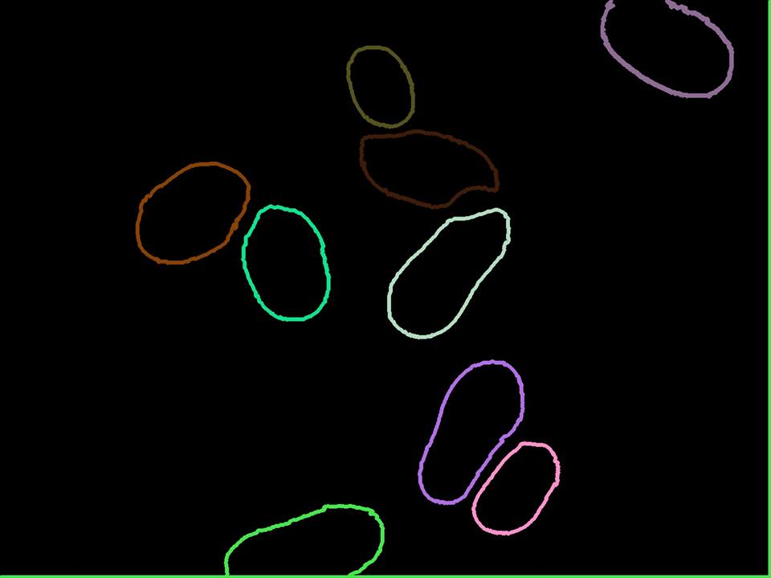
IV. Segmentation Process
Contour filtered

Slide 30
V. SOFTWARE BUILDING

Slide 31


V. Software Building
Programming language: C++
GUI framework: Qt

Slide 32
V. Software Building
Choose image
Display raw image
START Button
Display segmented image
Display counted number
Segmentation

Slide 33
VI. CONCLUSION

Slide 34
VI. Conclusion
Understand idea of the Watershed algorithm.
Combine the Watershed algorithm with other image processing method in segmenting and counting number of cells in an image.
Build an application for counting number of cells in an image.

Slide 35
QUESTION
& ANSWER

Slide 36
THANK
YOU
FOR LISTENING!

