Slide 1
Andriod:控件简介
ZhangXiangHui
2009/1/13

Slide 2
Android学习
View的子类
控件显示的简单介绍（checkbox为例）
Drawable
修改界面风格
ProgressBar
TextView
Android元素尺寸描述

Slide 3
View的子类
view
ViewGroup
ViewStub
SurfaceView
AnalogClock
ImageView
ProgressBar
TextView

Slide 4
SurfaceView
SurfaceView
VideoView
Videoview：Displays a video file.

Slide 5


Imageview
ImageView
ImageButton
ZoomButton
Imageview:Displays an arbitrary image, such as an icon.
Imagebutton: displays an image that can be pressed, or clicked, by the user.

Slide 6
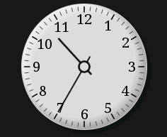
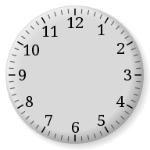


AnalogClock
This widget display an analogic clock with two hands for hours and minutes.

Slide 7
ViewStub
A ViewStub is an invisible, zero-sized View that can be used to lazily inflate layout resources at runtime.

Slide 8

ProgressBar
ProgressBar
AbsSeekBar
RatingBar
SeekBar
RatingBar : extension of SeekBar and ProgressBar that shows a rating in stars.
Seekbar : extension of ProgressBar that adds a draggable thumb.

Slide 9
Textview
textview
button
CheckedTextView
Chronometer
DigitalClock
EditText
CompoundButton
AutoCompleteTextView
CheckBox
MultiAutoCompleteTextView
RadioButton
ToggleButton

Slide 10
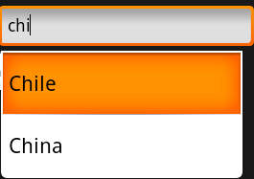
Textview
EditText : a thin veneer over TextView that configures itself to be editable.
AutoCompleteTextView:an editable text view that shows completion suggestions automatically while the user is typing.

Slide 11
Textview
DigitalClock:Like AnalogClock, but digital. Shows seconds.
Chronometer:Class that implements a simple timer. ( "MM:SS" or "H:MM:SS“, or you can use setFormat(String) to format the timer value into an arbitrary string.)
CheckedTextView:An extension to TextView that supports the Checkable interface.

Slide 12


Textview
Button:Button represents a push-button widget. Push-buttons can be pressed, or clicked, by the user to perform an action.
CompoundButton:A button with two states, checked and unchecked. When the button is pressed or clicked, the state changes automatically.
Checkbox:a specific type of two-states button that can be either checked or unchecked

Slide 13



Textview
A radio button is a two-states button that can be either checked or unchecked. When the radio button is unchecked, the user can press or click it to check it. However, contrary to a CheckBox, a radio button cannot be unchecked by the user once checked.
ToggleButton:Displays checked unchecked states as a button with a "light" indicator and by default accompanied with the text "ON" or "OFF".

Slide 14
ViewGroup
ViewGroup
Absolutelayout
FrameLayout
LinearLayout
RelativeLayout
AdapterView
mapview
LinearLayout

Slide 15
ViewGroup
Absolutelayout
webview
Absolutelayout:A layout that lets you specify exact locations (x/y coordinates) of its children.
Webview:A View that displays web pages.(webkit)

Slide 16
ViewGroup
AdapterView
AbsListView
AbsSpinner
ListView
GridView
Gallery
Spinner
ExpandableListView

Slide 17
ViewGroup
An AdapterView is a view whose children are determined by an Adapter.

Slide 18
ViewGroup
ListView :A view that shows items in a vertically scrolling list. The items come from the ListAdapter associated with this view.
ExpandableListView :A view that shows items in a vertically scrolling two-level list. This differs from the ListView by allowing two levels: groups which can individually be expanded to show its children. The items come from the ExpandableListAdapter associated with this view

Slide 19
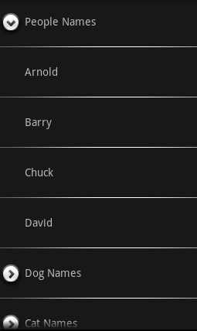
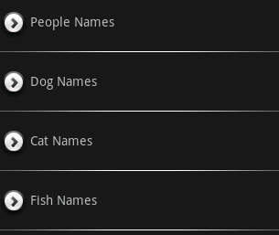

Slide 20
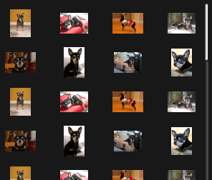
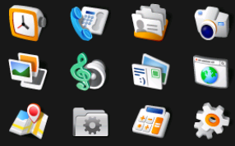
ViewGroup
GridView :view that shows items in two-dimensional scrolling grid. The items in the grid come from the ListAdapter associated with this view.

Slide 21

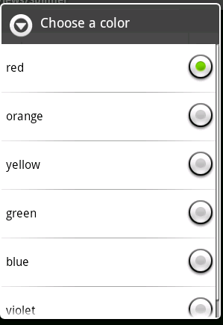

ViewGroup
Gallery:A view that shows items in a center-locked, horizontally scrolling list
Spinner:A view that displays one child at a time and lets the user pick among them. The items in the Spinner come from the Adapter associated with this view.

Slide 22
ViewGroup
FrameLayout
TimePicker
DatePicker
MediaController
ViewAnimator
ScrollView
TabHost

Slide 23
ViewGroup
FrameLayout is designed to block out an area on the screen to display a single item. You can add multiple children to a FrameLayout, but all children are pegged to the top left of the screen. Children are drawn in a stack, with the most recently added child on top.

Slide 24
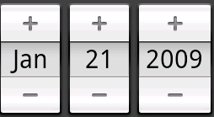
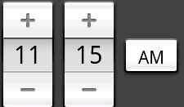
ViewGroup
TimePicker :A view for selecting the time of day, in either 24 hour or AM/PM mode.
DatePicker:A view for selecting a month / year / day based on a calendar like layout

Slide 25
ViewGroup
MediaController:A view containing controls for a MediaPlayer. Typically contains the buttons like "Play/Pause", "Rewind", "Fast Forward" and a progress slider. It takes care of synchronizing the controls with the state of the MediaPlayer.

Slide 26

ViewGroup
TabHost:Container for a tabbed window view. This object holds two children: a set of tab labels that the user clicks to select a specific tab, and a FrameLayout object that displays the contents of that page.
ScrollView:Layout container for a view hierarchy that can be scrolled by the user, allowing it to be larger than the physical display.

Slide 27
ViewGroup
ViewAnimator
ViewFlipper
ViewSwitcher
ImageSwitcher
TextSwitcher

Slide 28
ViewGroup
ViewAnimator :base class for a FrameLayout container that will perform animations when switching between its views.

Slide 29
ViewGroup
ViewSwitcher :ViewAnimator that switches between two views, and has a factory from which these views are created. You can either use the factory to create the views, or add them yourself. A ViewSwitcher can only have two child views, of which only one is shown at a time.
ViewFlipper :Simple ViewAnimator that will animate between two or more views that have been added to it. Only one child is shown at a time.

Slide 30
ViewGroup
LinearLayout
RadioGroup
TableLayout
TableRow
TabWidget
ZoomControls

Slide 31
ViewGroup
LinearLayout:A Layout that arranges its children in a single column or a single row.

Slide 32
ViewGroup
RadioGroup :This class is used to create a multiple-exclusion scope for a set of radio buttons. Checking one radio button that belongs to a radio group unchecks any previously checked radio button within the same group.
ZoomControl: displays a simple set of controls used for zooming and provides callbacks to register for events.

Slide 33
ViewGroup
TabWidget:Displays a list of tab labels representing each page in the parent's tab collection. The container object for this widget is TabHost.
TableLayout:
TableRow

Slide 34
ViewGroup
RelativeLayout
DialerFilter
TwoLineListItem
RelativeLayout :A Layout where the positions of the children can be described in relation to each other or to the parent.

Slide 35
ViewGroup
TwoLineListItem :A view group with two children, intended for use in ListViews.
DialerFilter

Slide 36









控件显示的简单介绍（checkbox为例）
off
on
disable
disable focused
pressed
selected

Slide 37
checkbox
checkbox的继承关系
View
Textview
Button
Compoundbutton
Checkbox

Slide 38
Checkbox
Checkbox的代码：
public class CheckBox extends CompoundButton {
public CheckBox(Context context) {
this(context, null);
}
public CheckBox(Context context, AttributeSet attrs) {
this(context, attrs, com.android.internal.R.attr.checkboxStyle);
}
public CheckBox(Context context, AttributeSet attrs, int defStyle) {
super(context, attrs, defStyle);
}
}

Slide 39
checkbox
Checkbox继承自CompoundButton。只是对其增加加了一个style的修改 com.android.internal.R.attr.checkboxStyle

Slide 40
R.java
在研究checkboxstyle之前，我们先简单的了解下一R文件：
Framework部分的r文件
  路径： mydroid/out/target/common/R/com/android/ineternal/r.java
  包名：com.android.internal
这个文件就是Java代码和独立于Java代码的资源文件之间的访问窗口，Java程序可以通过R.java来访问那些资源文件。

Slide 41
R.java
在R.java的注释部分,有这样一段话：“AUTO-GENERATE FILE. DO NOT MODIFY”，这个文件是自动生成的，不要修改。这个文件是在程序编译过程中由aapt(Android Asset Packaging Tool) 自动生成，这个文件中的属性都是public static final的，所以可以直接在Java代码中引用，每个属性都代表一个资源，看起来就像为每个资源都定义了一个ID，然后通过这个ID来访问资源.

Slide 42
R.java
com.android.internal.R.attr.checkboxStyle在r文件中的具体内容
Package com.android.internal;
Public final class R{
…
Public static final class attr{
…
Public static final int checkboxstyle=0x0101006c;
…
}
…
}

Slide 43
R.java
R.java内容的原始来源。以com.android.internal.R为例，主要是mydroid\frameworks\base\core\res这个目录下的xml文件。

Slide 44
public.xml
mydroid\frameworks\base\core\res\res\values\public.xml
Public.xml主要内容：
  <private-symbols package="com.android.internal" />
  包名
  <public type="attr" name="theme" id="0x01010000" />
  …
  <public type="attr" name="checkboxStyle" id="0x0101006c" />
  …
  <public type="id" name="background" id="0x01020000" />
  …type="style“;"string“;"dimen“;"color“;"array“;"drawable“;"layout“;"anim"
  R.java中id对应的解析字符串

Slide 45
*.xml
Attrs.xml
Styles.xml
Themes.xml
Arrays.xml
Strings.xml
Dimens.xml
Colors.xml

Slide 46
Styles.xml
Checkbox的style：
<style name="Widget.CompoundButton.CheckBox">
<item name="android:background">@android:drawable/btn_check_label_background</item>
<item name="android:button">@android:drawable/btn_check</item>
</style>
btn_check_label_background:btn_check_label_background.png
btn_check:btn_check.xml

Slide 47
btn_check.xml
<selector xmlns:android="http://schemas.android.com/apk/res/android">
<item android:state_checked="true" android:state_window_focused="false"
android:state_enabled="true"
android:drawable="@drawable/btn_check_on" />
…
</selector>
在不同的状态条件下显示的checkbox的icon的图

Slide 48
Drawable包
Provides classes to manage a variety of visual elements that are intended for display only, such as bitmaps and gradients. These elements are often used by widgets as background images or simply as indicators (for example, a volume level indicator). You can create most of these in XML as described in Resources.

Slide 49
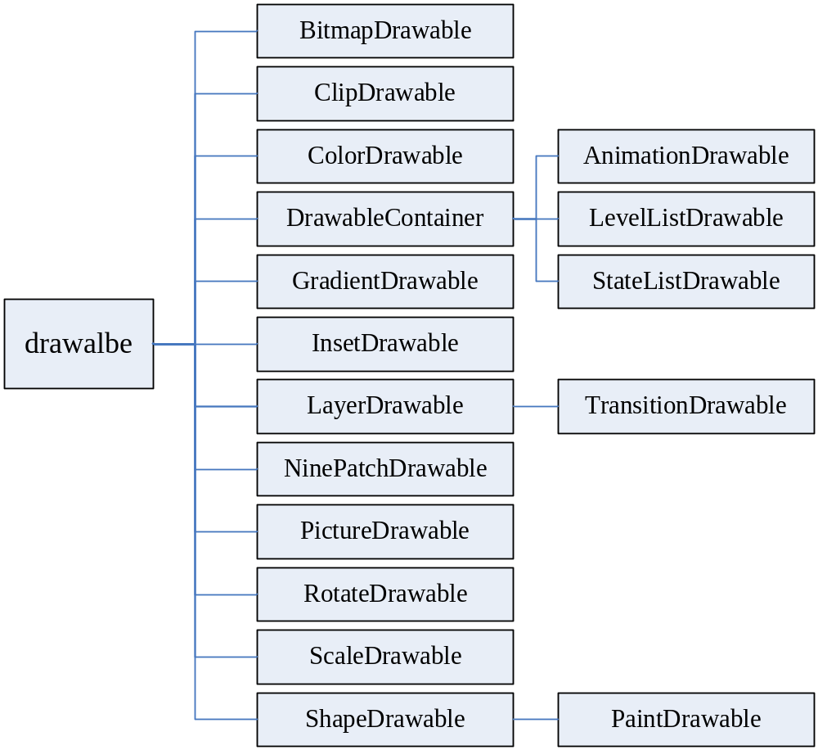
Drawable类的层次

Slide 50
Drawable类
A Drawable is a general abstraction for "something that can be drawn." Most often you will deal with Drawable as the type of resource retrieved for drawing things to the screen; the Drawable class provides a generic API for dealing with an underlying visual resource that may take a variety of forms.

Slide 51
Drawable类主要的方法
setBounds(Rect)/getBounds
The method must be called to tell the Drawable where it is drawn and how large it should be. All Drawables should respect the requested size, often simply by scaling their imagery.

Slide 52
Drawable类主要的方法
getPadding(Rect)
The method can return from some Drawables information about how to frame content that is placed inside of them. For example, a Drawable that is intended to be the frame for a button widget would need to return padding that correctly places the label inside of itself.

Slide 53
Drawable类主要的方法
setState(int[])/getState
The setState(int[]) method allows the client to tell the Drawable in which state it is to be drawn, such as "focused", "selected", etc. Some drawables may modify their imagery based on the selected state.

Slide 54
Drawable类主要的方法
setLevel(int)/getLevel
The method allows the client to supply a single continuous controller that can modify the Drawable is displayed, such as a battery level or progress level. Some drawables may modify their imagery based on the current level.

Slide 55
BitmapDrawable
bitmapdrawable是一种最简单的drawalbe，主要用来处理显示png或者jpeg等图片。

Slide 56
NinePatchDrawable
NinePatchDrawable是处理png的扩展格式9.png的一种drawalbe

Slide 57
ShapeDrawable
shapeDrawable处理显示以传入shape类为基础的drawable，若没有给出shape类，默认为RectShape类（其他的shape类：ArcShape，OvalShape，RoundRectShape，PathShape）.

Slide 58
PaintDrawable
PaintDrawable处理显示圆角的效果

Slide 59
LayersDrawable
LayersDrawable处理显示一组drawalbe。其包含的drawable是需要同时显示的。

Slide 60
TransitionDrawable
TransitionDrawable是 LayersDrawable的特殊的子类,其包含了两个drawalbe。并实现了两个drawable在交叉渐变。

Slide 61
DrawableContainer
DrawableContainer也是处理显示一组drawable，和layerdrawable不同的是，它同一时刻根据不同的条件只使用一个drawable。
  StateListDrawable是根据state来判断使用何drawable
  LevelListDrawable是根据Level来判断使用何drawable
  AnimationDrawable是frame-by-frame来使用这一组drawable

Slide 62
ColorDrawable
ColorDrawable处理显示指定颜色的drawable

Slide 63
GradientDrawable
GradientDrawable处理显示color gradient变化的一种drawable
  Shape type:RECTANGLE, OVAL, LINE, RING
  Gradient type:LINEAR_GRADIENT, RADIAL_GRADIENT, SWEEP_GRADIENT

Slide 64
ClipDrawable
ClipDrawable处理显示带有裁剪效果的drawable

Slide 65
RotateDrawable
RotateDrawable处理显示rotate效果的一种drawable
  Xml文件描述中：
    pivotX, pivotY代表rotate的中心点
    fromDegrees, toDegrees代表rotate的旋转角度范围

Slide 66
ScaleDrawable
ScaleDrawable处理显示Scale效果的一种drawable

Slide 67
PictureDrawable
PictureDrawable处理显示一个picture到指定位置。“picture”是用来保存一个区域内像素内容的类。

Slide 68
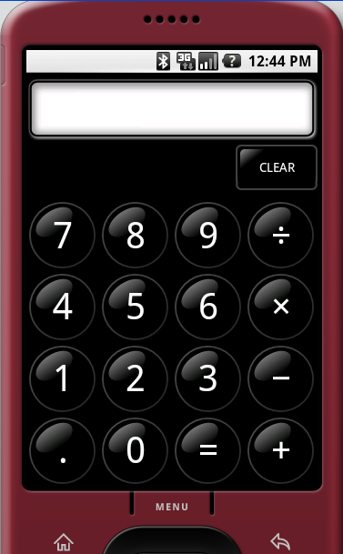
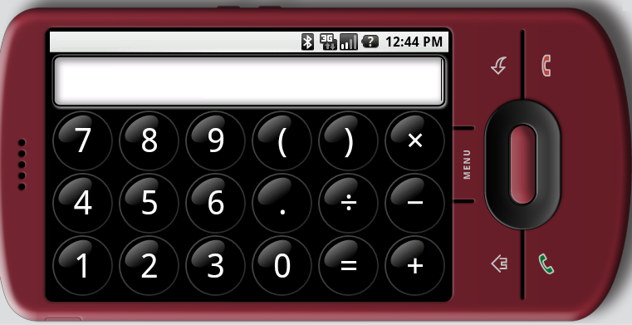
屏幕旋转的显示

Slide 69
屏幕旋转的显示
Android对于屏幕的方向的宏定义
  ORIENTATION_UNDEFINED
  ORIENTATION_PORTRAIT
  ORIENTATION_LANDSCAPE
  ORIENTATION_SQUARE

Slide 70
屏幕旋转的显示
PORTRAIT,LANDSCAPE两种布局方式是目前用的两种屏幕布局模式。分别对应到res/***-port和res/***-land两个资源目录，当这两个目录不存在的时候，会对应到res/***这个默认的资源目录。

Slide 71
屏幕旋转的显示
activity A starts activity B，当orientation改变时，B被销毁，并被第二次创建。此时得到是新的Configuration的信息，资源从新的目录读取并创建。

Slide 72
修改界面风格
窗口背景
文本风格
布局

Slide 73
窗口背景
frameworks\base\core\res\values\themes.xml中”windowBackground”指定了窗口背景的drawable，修改其内容项就可改变窗口背景。
  以颜色为背景
  以jpg，png图为背景或以9.png图为背景

Slide 74
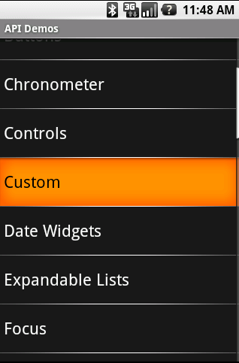
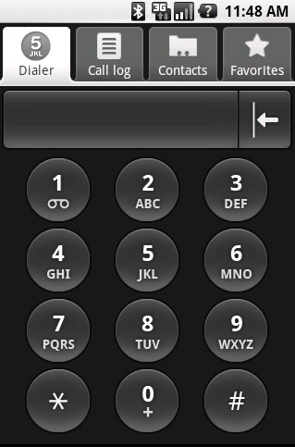
修改前的窗口背景

Slide 75
窗口背景-以色块填充
默认theme的窗口背景是以色块填充的，以下是其具体指定内容
  theme.xml:<item name="windowBackground">@android:drawable/screen_background_dark</item>
  color.xml<drawable name="screen_background_dark">#ff191919</drawable>
我们修改默认theme的窗口背景的色块颜色只需修改ff191919这个值即可。

Slide 76
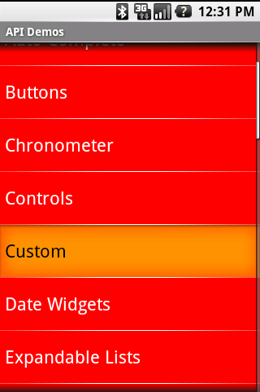
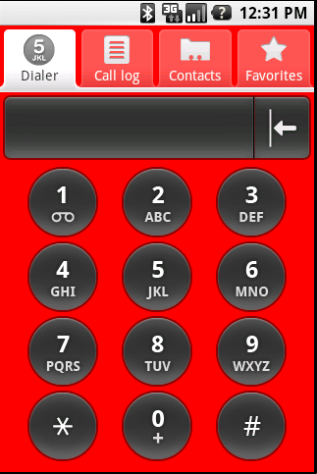
窗口背景-以色块填充
将颜色改为红色（#ffff0000）

Slide 77
窗口背景-以图填充
默认theme的窗口背景是以色块填充的，以下是其具体指定内容
  theme.xml:<item name="windowBackground">@android:drawable/screen_background_dark</item>
修改为以图填充背景，只需修改drawalbe：screen_background_dark为新的png或jpg的drawalbe，并在drawalbe目录下添加相应的图片。

Slide 78
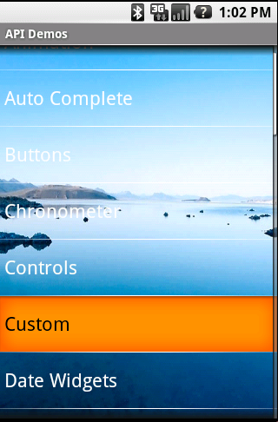
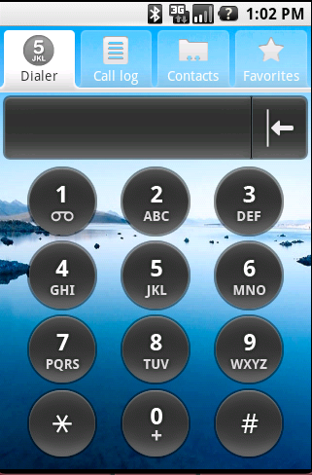
窗口背景-以图填充
以图片为窗口背景

Slide 79
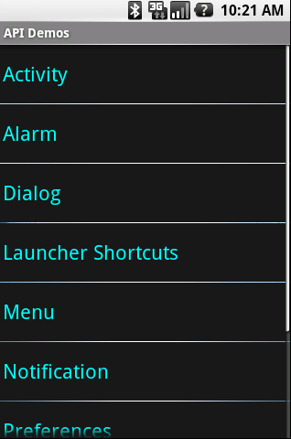
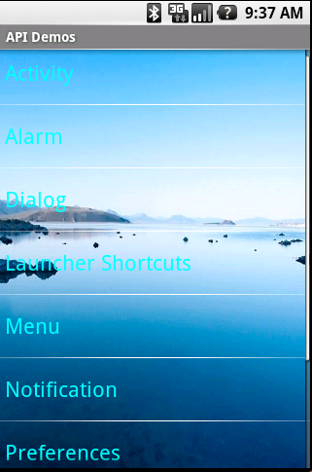
窗口背景-以图填充
以图为背景的时候，在上层的控件有些配置的颜色和图需要同时改变，以达到一致效果。例如listview有一项cacheColorHint（#ff191919）的配置，可设为#00000000
ff191919
#0000000
透明

Slide 80
文本风格
文本风格可控制内容包含以下：
  文本一般状态的颜色（textcolor）
  文本高亮状态的颜色（textColorHighlight ）
  提示文本的颜色（textColorHint ）
  链接文本的颜色（textColorLink ）
  文本的字体大小（textSize ）
  文本的字型风格（textStyle）
  文本的字体风格（Typeface）

Slide 81
textcolor
以listview(继承widget)为例默认的设置：
  在Styles.xml中widgt指定了TextAppearance为文本显示风格:
    <style name="Widget">
    <item name="android:textAppearance">?textAppearance</item> </style>
  在TextAppearance中指定textColorPrimary来描述其文本颜色
    <style name="TextAppearance">
    <item name="android:textColor">?textColorPrimary</item>
  在theme.xml中默认theme中指定textColorPrimary由primary_text_dark来描述
    <item name="textColorPrimary">@android:color/primary_text_dark</item>
  在primary_text_dark.xml中详细指定了各种状态下文本显示的颜色

Slide 82
textcolor（2）
    <item android:state_enabled="false" android:color="@android:color/bright_foreground_dark_disabled"/>
    <item android:state_window_focused="false" android:color="@android:color/bright_foreground_dark"/>
    <item android:state_pressed="true" android:color="@android:color/bright_foreground_dark_inverse"/>
    <item android:state_selected="true" android:color="@android:color/bright_foreground_dark_inverse"/>
    <item android:color="@android:color/bright_foreground_dark"/> <!-- not selected -->
  Color.xml中定义了:
    <color name="bright_foreground_dark_disabled">#80ffffff</color>
    <color name="bright_foreground_dark">#ffffffff</color>
    <color name="bright_foreground_dark_inverse">#ff000000</color>

Slide 83
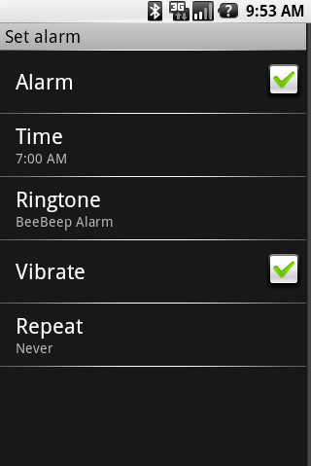
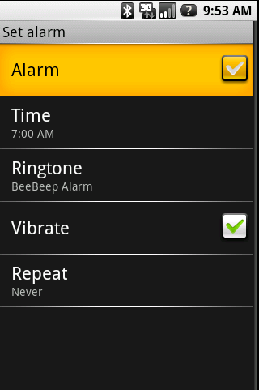
textcolor
可按需求修改这种状态对应的颜色值来修改textcolor。
#ffffffff
#ff000000

Slide 84
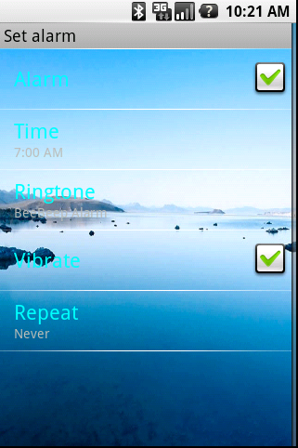
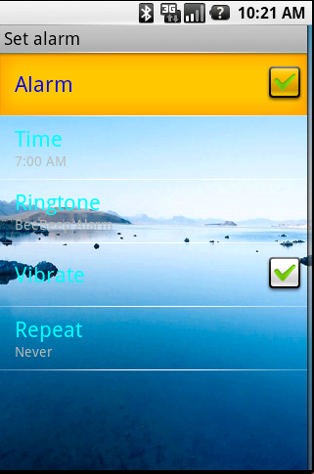
textcolor
bright_foreground_dark的值改为ff00ffff
bright_foreground_dark_inverse的值改为ff0000ff
ff00ffff
ff0000ff

Slide 85
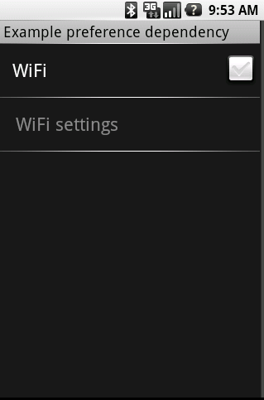
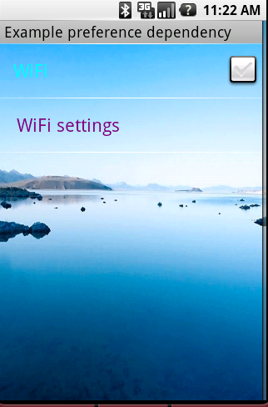
textcolor
bright_foreground_dark_disabled的值改为ff800080
80ffffff
ff800080

Slide 86
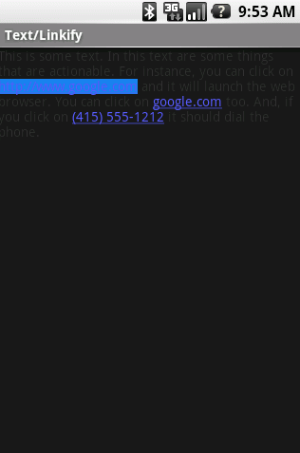

textColorHighlight
以textedit为例textColorHighlight（Selection的一段文字背景）默认的设置：
  <item name="android:textColorHighlight">#FF1B82EB</item>
ff1b82eb
ffffff00

Slide 87
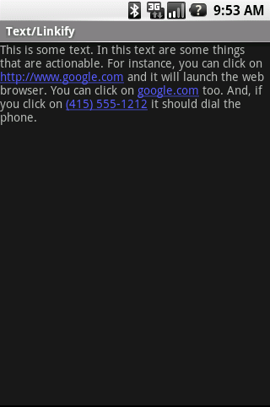

textColorLink
以textedit为例textColorLink默认的设置：
  <item name="android:textColorLink">#5C5CFF</item>
5c5cff
ff0000

Slide 88
textColorHint
以textedit为例textColorHit默认的设置：
  <item name="android:textColorHint">?textColorHintInverse</item>
  <item name=“textColorHintInverse”>@android:color/hint_foreground_dark</item>
  <color name="hint_foreground_dark">#808080</color>

Slide 89
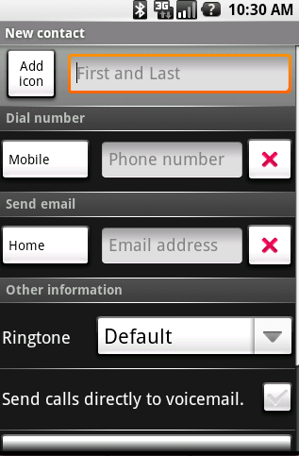
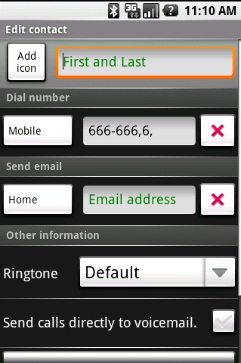
textColorHint
#808080
#008000

Slide 90


textSize
以window title为例，默认字高（textsize）14sp
  <style name="TextAppearance.WindowTitle">
  <item name="android:textSize">14sp</item>
现将字高修改为22
  <item name="android:textSize">22sp</item>

Slide 91

textStyle
Textstyle类型：normal,bold, italic.
以window title为例，默认文本的字型风格bold
  <style name=“TextAppearance.WindowTitle”> …
  <item name="android:textStyle">bold</item> …
现在将window title的文本改为斜体
  <item name="android:textStyle">italic</item>

Slide 92



Typeface
Typeface指定字体风格（normal, sans, serif, monospace）
  默认未显式指定字体风格
  可加入<item name=“android:typeface”>serif</item>来指定
sans
serif
monospace

Slide 93
布局
复杂控件一般都会有布局上的要求。例如timepicker，AutoCompleteTextView等。
Timepicker是一个组合控件，由numberPickerButton（ImageButton），edittext， button控件组成。其中对这些子控件的位置大小的控制就产生了布局问题。下面将以此为例简单说明如何修改控件的布局。

Slide 94
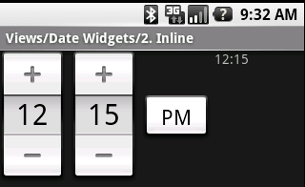
Timepicker
Timerpicker由hour，minute，AM/PM三个部分
hour
minute
AM/PM

Slide 95

NumberPicker
Timerpicker中hour，minute部分都是numberPicker。 numberPicker由“+”，“-”，editext三个部分组成。
NumberPickerButton
edittext
NumberPickerButton

Slide 96
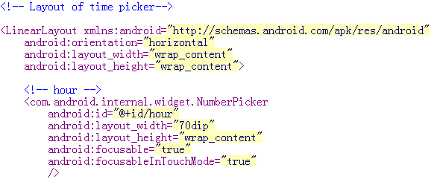
Timepicker layout
Timepicker布局在time_picker.xml中指定

Slide 97
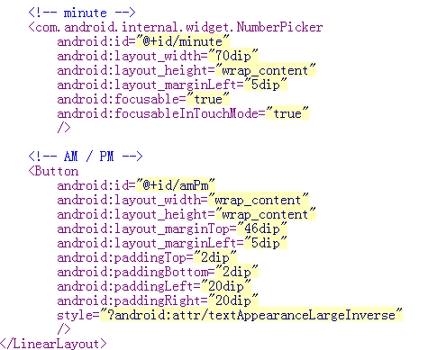
Timepicker layout

Slide 98
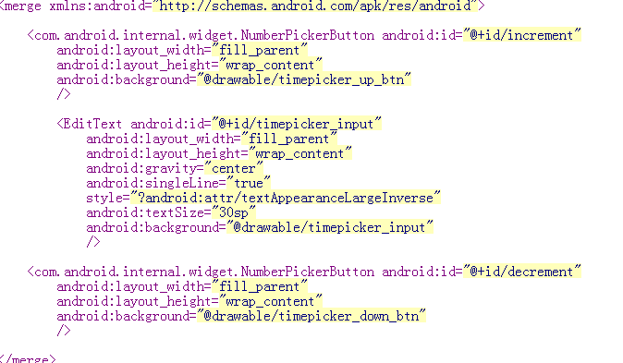
NumberPicker layout
numberpiker布局在number_picker.xml中指定

Slide 99
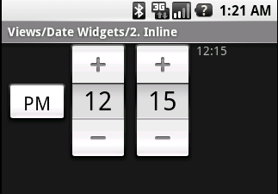
Timepicker布局修改
Timepicker是以LinearLayout的水平方式布局的。现对其水平布局的顺序做点调整，将AM/PM的button放到前面。只需修改time_picker.xml，将AM/PM的button描述提前。

Slide 100
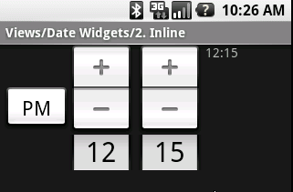
Timepicker布局修改
对numberpiker的布局改动，只需修改number_picker.xml

Slide 101
ProgressBar
view
ProgressBar
AbsSeekBar
RatingBar
SeekBar

Slide 102
ProgressBar
Visual indicator of progress in some operation. Displays a bar to the user representing how far the operation has progressed; the application can change the amount of progress (modifying the length of the bar) as it moves forward. There is also a secondary progress displayable on a progress bar which is useful for displaying intermediate progress, such as the buffer level during a streaming playback progress bar.

Slide 103
Progressbar
Default Progressbar
Secondary Progressbar

Slide 104



Indeterminate Progressbar
A progress bar can also be made indeterminate. In indeterminate mode, the progress bar shows a cyclic animation. This mode is used by applications. when the length of the task is unknown.

Slide 105
Progressbar Member
mIndeterminate
  Indicate whether this progressbar is in indeterminate mode
mOnlyIndeterminate
  This progressbar only indeterminate mode(such as the circular progress bars)

Slide 106
Progressbar Member
mMax
  the range of the progress bar
mProgress
  the value of the current progress
mSecondaryProgress
  the value of the current Secondary progress
    Indeterminate mode the vaule is invalid

Slide 107
Progressbar Member
mIndeterminateDrawable
  Indeterminiate mode drawable（AnimationDrawable）
mProgressDrawable
  Normal mode drawable（LayerDrawable）
mCurrentDrawable
  Current Drawalbe

Slide 108
Progressbar Function
setMax, getMax
setProgress, getProgress, incrementProgressBy
setSecondaryProgress,getSecondaryProgress, incrementSecondaryProgressBy
isIndeterminate, setIndeterminate
setIndeterminateDrawable, setProgressDrawable

Slide 109
Progressbar Function
doRefreshProgress
  对于普通进度条的跟新进度时的处理，主要是重新设置R.id.secondaryProgress或R.id.Progress对应LayerDrawable的level。
startAnimation，stopAnimation
  start the indeterminate progress animation，分当mIndeterminateDrawable为AnimationDrawable的处理和非AnimationDrawable 时创建AlphaAnimation这种方式的处理

Slide 110
AbsSeekBar
AbsSeekBar是以ProgressBar为基类的一个抽象类。主要是引入了Thumb这个部分以及对touchevent做了Override。

Slide 111
AbsSeekBar Function
onStartTrackingTouch
  This is called when the user has started touching this widget
onStopTrackingTouch
  This is called when the user either releases his touch or the touch is canceled.
trackTouchEvent
  setProgress when MotionEvent
setThumbOffset，getThumbOffset

Slide 112
SeekBar
A Seekbar is an extension of ProgressBar that adds a draggable thumb. The user can touch the thumb and drag left or right to set the current progress level.
thumb

Slide 113
Seekbar function
setOnSeekBarChangeListener
  Sets a listener to receive notifications of the SeekBar's progress
OnSeekBarChangeListener(interface)
  A callback that notifies clients when the progress level has been changed. This includes changes that were initiated by the user through a touch gesture as well as changes that were initiated programmatically

Slide 114
OnSeekBarChangeListener
onProgressChanged
  Notification that the progress level has changed
onStartTrackingTouch
  Notification that the user has started a touch gesture
onStopTrackingTouch
  Notification that the user has finished a touch gesture

Slide 115


RatingBar
A RatingBar is an extension of SeekBar and ProgressBar that shows a rating instars. The user can touch and/or drag to set the rating when using the default size RatingBar.

Slide 116
RatingBar
The smaller RatingBar style and the larger indicator-only style do not support user interaction and should only be used as indicators.

Slide 117
RatingBar
The secondary progress should not be modified by the client as it is used internally as the background for a fractionally filled star.

Slide 118
RatingBar member
mNumStars
  the number of stars to show
mIsUserSeekable
  whether this is user seekable, whether this rating bar is only an indicator

Slide 119
RatingBar function
setNumStars/getNumStars
  Sets the number of stars to show.
setRating/getRating
  Sets the rating (the number of stars filled)
setStepSize/getStepSize
  Sets the step size (granularity) of this rating bar. if half-star granularity is wanted, this would be 0.5.

Slide 120
Textview
textview
button
CheckedTextView
Chronometer
DigitalClock
EditText
CompoundButton
AutoCompleteTextView
CheckBox
MultiAutoCompleteTextView
RadioButton
ToggleButton

Slide 121
Textview
Textview是主要用来显示文本和编辑文本的控件。

Slide 122
Textview Member
Textview作为文本显示，其主要的member有如下：
  文本内容
    mText
  文本绘制方式
    mTextPaint-文字显示方式
    mHighlightPaint-选中高亮绘制方式

Slide 123
Textview Member
  mTextPaint的具体内容
    textColor-一般文字颜色
    textColorHint-提示文字颜色
    textColorLink-链接文字颜色
    textSize-文字尺寸
    typefaceIndex-字形（ normal, sans, serif, monospace ）
    styleIndex-字形(normal,bold, italic )
  mHighlightPaint的具体内容
    textColorHighlight-选中高亮色块颜色

Slide 124
Textview Member
文本属性相关的member
  autolink属性（web，email，phone，map）
    mAutoLinkMask
  autoText属性（correct some spelling errors ）
    Autotext
  getText() return type
    bufferType
  automatically capitalize （none，sentences，words，characters）
    Cap
  cursorVisible
    mCursorVisible

Slide 125
Textview Member
文本属性相关的member
  Editable（是否可编辑）
    Editable
  numeric （integer ，signed ，decimal ）
    Numeric
  password （displayed as password dots ）
    password
  singleLine （单行edit）
    singleLine
  ellipsize （start ，middle ，end ）
    ellipsize

Slide 126
Edittext
Editext从textview派生出来，主要的区别是
  重写了getDefaultEditable，以到达textview中Editable的值为true，即可编辑。
  引入了Selection类，以达到对文字可选操作。

Slide 127
Button
Button从textview派生出来，主要的区别是
  指定了一些特定的style：focusable，clickable使其响应点击。
CompoundButton在button的基础上增加了mChecked成员和实现了Checkable接口类，使其增加check的状态和操作。
Checkbox，radiobutton，ToggleButton都是从compoundbutton派生出来，主要区别是在不同状态下显示的内容不同。Radiobutton比checkbox多了一个判断即选中状态不能toggle

Slide 128
CheckTextView
CheckTextView直接重textview派生，实现了checkable接口类，使可对文本做check/uncheck操作。和checkbox的区别在于其无法响应点击。

Slide 129
DigitalClock
实现中增加了一个Runnable，在时间走秒的时候，可以重绘Digitalclock。另外增加了一些对时间格式，时间内容的操作。

Slide 130
Android元素尺寸描述

Slide 131
元素尺寸单位类型
Android的文字，图像，控件等元素的尺寸描述一般分：
  px
    raw pixel
  dip
    device independent pixels
  sp
    scaled pixel
  pt
    points
  In
    inches
  Mm
    millimeters

Slide 132
元素尺寸单位类型
Pt（1/72英寸）, In(英寸), MM(毫米)这三重类型都是以物理尺寸来描述元素的。即无论屏幕如何变化，其描述的对象的物理长度都是一样的。
Px（像素）这种类型是以像素点来描述元素。即无论屏幕如何变化，其描述对象所占的像素点是一样的。
Sp主要用于描述字体大小等受系统缩放比例控制的元素。当缩放比例变化，其元素所占的像素点即变化。

Slide 133
元素尺寸单位类型
dip（设备无关像素）这种类型主要以显示逻辑密度为1时所占得象素值来描述元素。所以其大小与屏幕大小无关，通常来说屏幕改变时，元素用其描述的值无需变化。
  屏幕像素密度（dpi）：每一英寸所含的像素点
  显示逻辑密度：屏幕的像素密度与160dpi的比例

Slide 134
屏幕像素密度的配置
Android中默认屏幕像素密度为160，对应的显示逻辑密度为1.若
  自定义值得加入只需修改：
android\build\buildinfo.sh,在该文件中加入
echo “ro.sf.lcd_density=160”
  修改后编译将在out\target\product\generic\system\build.prop文件中出现ro.sf.lcd_density=160这项配置
  在displayhardware.init()中会读取该配置，并依此计算且初始化显示逻辑密度，从而影响元素显示大小。

Slide 135
和元素尺寸相关的类
display.java
  通过该类可以取得与显示相关的一些信息
DisplayMerics.java
  该类主要用于描述显示信息。如size，density，font scaling
Typedvalue.applyDimension
  用于计算元素的具体像素大小，在对应的displaymerics和type下。

Slide 136
THE END

