Slide 1
CalmBot
AI-Powered Mental Health Support
in Times of Crisis
Han Han
Notes:
Hello everyone. My name is Han Han.
Today, I will be presenting my project, CalmBot — an AI-driven mental health assistant designed to support individuals experiencing emotional crises in real-time.
I will walk through the problem I identified, the solution I developed, the technical pipeline, the product demo, the challenges I encountered, and potential directions for future improvement.

Slide 2

Problem Statement
Mental Health Issues in the U.S.:
- 1 in 5 adults experienced mental illness in 2022 (~59.3 million people). (NIMH)
- Over half did not receive timely treatment. (NIMH) Barriers include workforce shortages, high costs, stigma (BonterraTech, 2023).
Crisis Moments:
- Individuals in acute emotional distress (fear, despair, anxiety) often cannot clearly express their needs.
- Traditional AI chatbots are inadequate for real-time crisis support.
Urgency:
- Without immediate intervention, risks of impulsive actions including actionsself-harm or even social violence incidents escalate.
- There is a critical need for fast, empathetic, and accessible support which AI alone could not fully provide.
Notes:
Mental health remains a major isssue in the United States.
According to the National Institute of Mental Health, one in five adults experienced mental illness in 2022, amounting to nearly 59 million people.
Unfortunately, over half of these individuals did not receive timely treatment, often due to barriers like workforce shortages, high costs, and social stigma.
In moments of acute emotional distress, such as fear, despair, anxiety, individuals often struggle to clearly express their needs, their minds would be taken by those emotions.
Traditional AI chatbots are not equipped to provide real-time, empathetic support in such situations. In the screenshot... the chatbot only outputs some words like your not alone, but as in extreme emotions, these words didnt help a lot. and Without immediate intervention, the risks of impulsive actions including self-harm or even social violence incidents escalate.
Recognizing this gap, There is a critical need for fast, empathetic, and accessible support which AI alone could not fully provide.

Slide 3
Proposed Solution
CalmBot: An AI-Driven Emotional First Aid Assistant
Emotion Detection: Classifies user emotions (e.g., fear, sadness) using fine-tuned NLP.
Empathetic Responses: Generates warm, supportive replies with LLMs.
Hotline Recommendation: If severe distress is detected, suggests relevant national hotlines.
AI-Human Hybrid Model: AI provides immediate help; human services are escalated when needed.
Notes:
To address this urgent need, I designed CalmBot — an AI-driven emotional first aid assistant.
CalmBot detects the user's emotions through fine-tuned NLP models, generates supportive and empathetic responses using lightweight LLMs, and recommends appropriate crisis hotlines if the distress level is deemed severe.
Importantly, CalmBot follows an AI-human hybrid model: it provides immediate AI support while escalating to human services when necessary, ensuring users receive the right help at the right time.

Slide 4
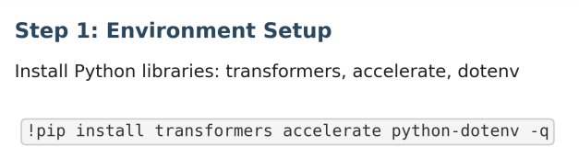
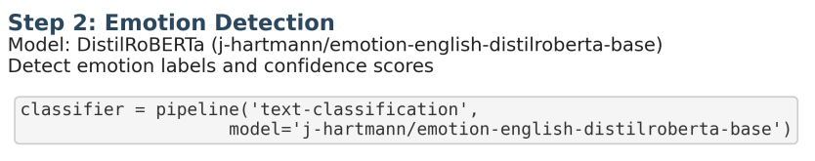
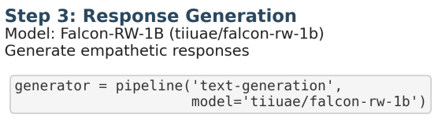
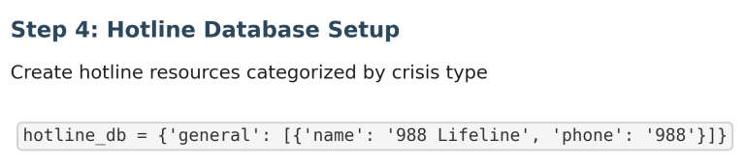
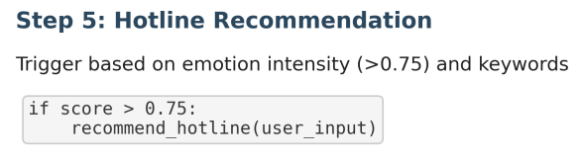
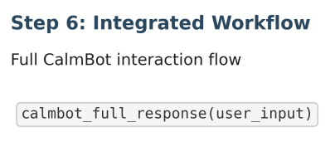
Methodology & Pipeline
Notes:
CalmBot’s workflow follows a simple and streamlined pipeline.
First, I prepared the environment .
Then, CalmBot detects the user’s emotion using a lightweight classification model, identifying both the emotional label and its intensity.
Based on this, it generates an empathetic response through Falcon-RW-1B model, using a structured prompt to guide the tone and content.
In parallel, a hotline database is set up, allowing CalmBot to recommend crisis resources if the user's emotional intensity is high and certain keywords are detected.
Finally, all these steps are integrated into a complete interaction flow, ensuring users receive both immediate support and, when necessary, professional resource guidance.

Slide 5
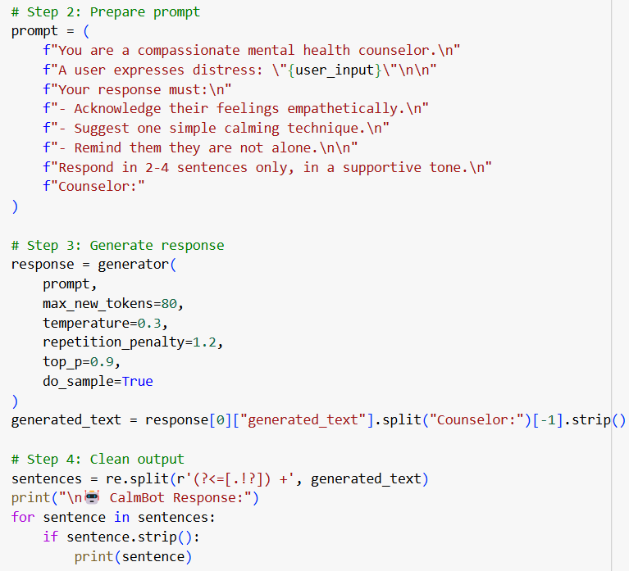
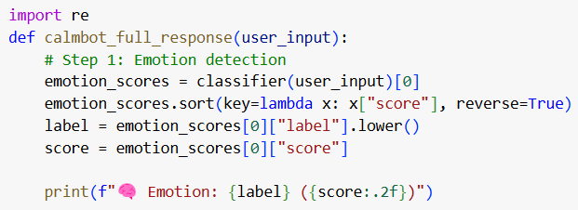
Step 6 in Detail
Notes:
In the following two slides, I provide additional technical details about Step 6.
The first part covers how CalmBot processes emotion detection, builds prompts, generates text responses, and cleans outputs into clear sentences.

Slide 6
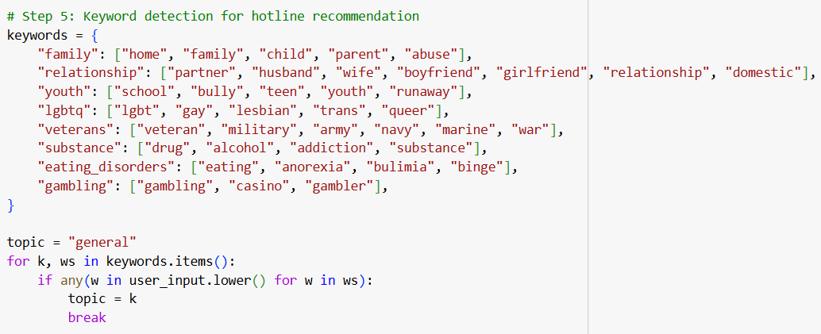
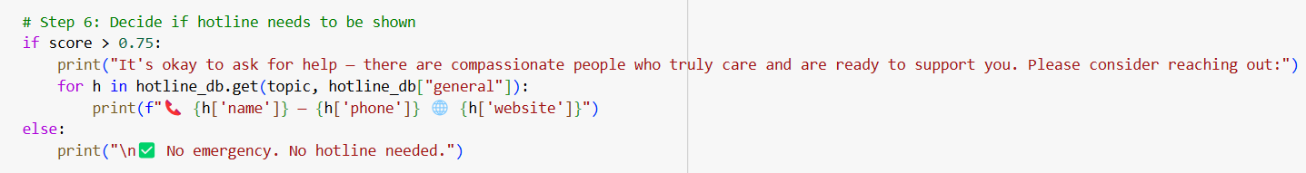
Step 6 in Detail
Notes:
The second part explains how CalmBot matches detected emotions and keywords to recommend the right crisis hotlines when needed.

Slide 7

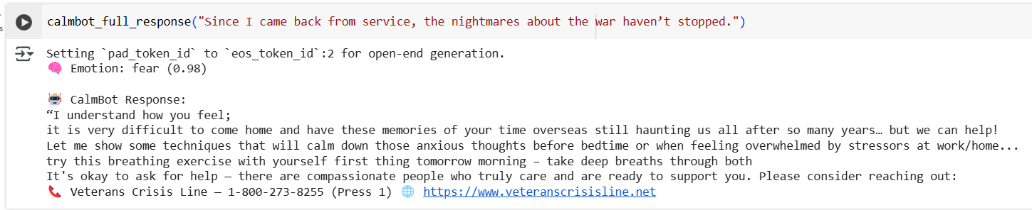
CalmBot Full Interaction Example
Veteran PTSD Case
Notes:
Here, I present a test example where the user describes experiencing nightmares following military service, a classic PTSD symptom.
CalmBot accurately detects fear with a high score.
Although the reply is slightly condensed due to token limit settings to prevent output drift, The response acknowledges the veteran’s ongoing struggles, gently suggests monitoring for additional symptoms, and provides supportive reassurance.
Recognizing the high distress level, CalmBot recommends the specialized Veterans Crisis Line, offering a highly appropriate escalation path.

Slide 8
CalmBot Project – Key Challenges
Hardware Limitations
Prompt Design Instability
Output Drift
Limited Model Naturalness
Unable to run large models like Mistral-7B due to memory constraints.
Switched to lightweight models (DistilRoBERTa, Falcon-RW-1B).
Early prompts were too verbose, causing inconsistent outputs.
Standardized simple, structured, role-guided prompts.
Responses sometimes included irrelevant or repetitive trailing content.
Tuned generation parameters; partial mitigation achieved.
Small models lacked full conversational nuance and depth.
Improved prompts; accepted as a hardware-driven limitation.
Notes:
Throughout the project, I faced several significant challenges.
First, due to hardware limitations, I was unable to use large models like Mistral-7B and instead optimized the system for lightweight models such as DistilRoBERTa and Falcon-RW-1B.
Early prompt designs were verbose and unstable, which led me to standardize prompt structures for consistent output.
Although tuning generation parameters helped, output drift could not be fully eliminated.
Finally, I accepted that small models naturally offer limited conversational depth compared to large LLMs.

Slide 9
Future Directions
Model Architecture
Emotion Detection
Multi-turn Dialogue
Hotline Recommendation
Upgrade to larger, fine-tuned LLMs (e.g., GPT-4, Mistral-7B, Llama-3) for significantly enhanced empathy, coherence, and response quality.
Train a custom, multi-label emotion classifier with better emotion detection and real-time intensity scaling.
Integrate semantic search (e.g., FAISS) to dynamically match hotline resources based on user context and emotional state.
Implement memory-augmented dialogue systems to maintain empathetic, coherent multi-turn conversations across user sessions.
01
02
03
04
Notes:
Looking ahead, several areas could greatly enhance CalmBot’s capabilities.
First, upgrading to larger, fine-tuned LLMs like GPT-4 or Mistral-7B would significantly improve emotional nuance and coherence.
Second, developing a custom multi-label emotion classifier would allow better detection of complex emotional states.
Third, integrating semantic search would improve hotline matching accuracy based on user context.
Finally, building memory-augmented dialogue systems would support coherent, empathetic multi-turn interactions over time.

Slide 10
Works Cited
National Institute of Mental Health (NIMH). Mental Illness. 2022. https://www.nimh.nih.gov/health/statistics/mental-illness.
Project HOPE. “Global Mental Health: Frequently Asked Questions.” 2023. https://www.projecthope.org.
Time. “The U.S. Faces a Shortage of Mental Health Professionals.” 2023. https://time.com.
Bonterra Tech. “State of Mental Health in the U.S.: Access and Barriers.” 2023. https://bonterratech.com.
NAMI (National Alliance on Mental Illness). Mental Health by the Numbers. 2023. https://www.nami.org/mhstats.
Built In. “The Role of AI in Mental Health Support.” 2023. https://builtin.com/artificial-intelligence/ai-mental-health.
PMC (PubMed Central). “Barriers to Mental Health Care and Use of Mental Health Services.” 2022. https://www.ncbi.nlm.nih.gov/pmc/articles/PMC.
Nature Digital Medicine. “Human-AI Collaboration Improves Empathic Engagement in Therapy Support Tools.” 2022. https://www.nature.com/articles/s41746-022-00589-7.
Notes:
Here are the references that supported the CalmBot project.

Slide 11
THANK YOU
Notes:
Thank you for your attention.

