Slide 1
CalmBot
AI-Powered Mental Health Support
in Times of Crisis
Han Han
Notes:
Hello everyone. My name is Han Han.
Today, I will be presenting my project, CalmBot — an AI-driven mental health assistant designed to support individuals experiencing emotional crises in real-time.
I will walk through the problem I identified, the solution I developed, the technical pipeline, the product demo, the challenges I encountered, and potential directions for future improvement.

Slide 2
Problem Statement
Mental Health Crisis in the U.S.:
- 1 in 5 adults experienced mental illness in 2022 (~59.3 million people). (NIMH)
- Over half did not receive timely treatment. (NIMH)
Crisis Moments:
- Individuals in acute emotional distress (fear, sadness, anxiety) often cannot clearly express their needs.
- Traditional AI chatbots are inadequate for real-time crisis support.
Urgency:
- Without immediate intervention, risks of self-harm or worsening mental health escalate.
- There is a critical need for fast, empathetic, and accessible support.
Notes:
Mental health is a critical issue in the U.S., with 1 in 5 adults experiencing mental illness annually — approximately 59.3 million people.
However, over half of these individuals do not receive timely treatment.
In crisis moments involving emotions like fear, sadness, or anxiety, individuals often cannot clearly express their needs.
Traditional AI chatbots are inadequate for real-time, empathetic crisis support.
Without immediate intervention, there is a serious risk of self-harm or worsening mental health.
This situation highlighted the urgent need for fast, empathetic, and accessible emotional assistance, which inspired me to create CalmBot.

Slide 3
Proposed Solution
CalmBot: An AI-Driven Emotional First Aid Assistant
Emotion Detection: Classifies user emotions (e.g., fear, sadness) using fine-tuned NLP.
Empathetic Responses: Generates warm, supportive replies with LLMs.
Hotline Recommendation: If severe distress is detected, suggests relevant national hotlines.
AI-Human Hybrid Model: AI provides immediate help; human services are escalated when needed.
Notes:
I designed CalmBot as an AI-driven emotional first aid assistant.
CalmBot detects the user's emotions using fine-tuned NLP models.
It generates warm, supportive responses through lightweight language models.
If severe distress is detected, CalmBot recommends relevant national hotlines.
Additionally, CalmBot is built as an AI-human hybrid system: it provides immediate AI-driven support and suggests escalation to human services when necessary.

Slide 4
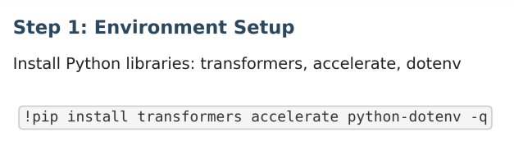
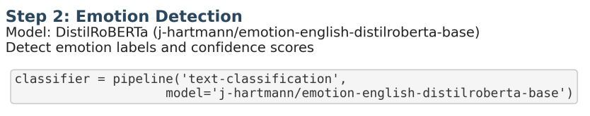
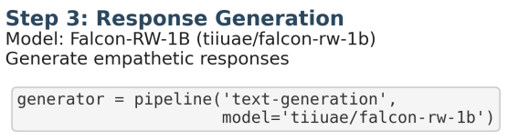
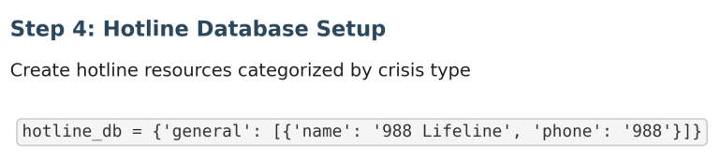
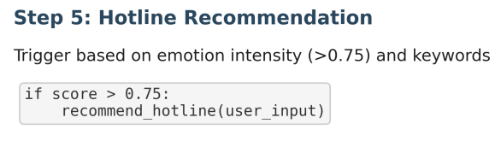
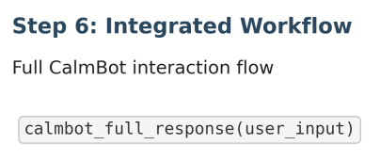
Methodology & Pipeline
Notes:
This slide shows the high-level structure of CalmBot’s methodology.
First, the user submits an emotional message.
CalmBot detects the dominant emotion and evaluates its intensity.
Based on these findings, CalmBot generates an empathetic, supportive response.
If the emotional intensity crosses a critical threshold, CalmBot recommends a hotline resource suitable for the user's situation.

Slide 5
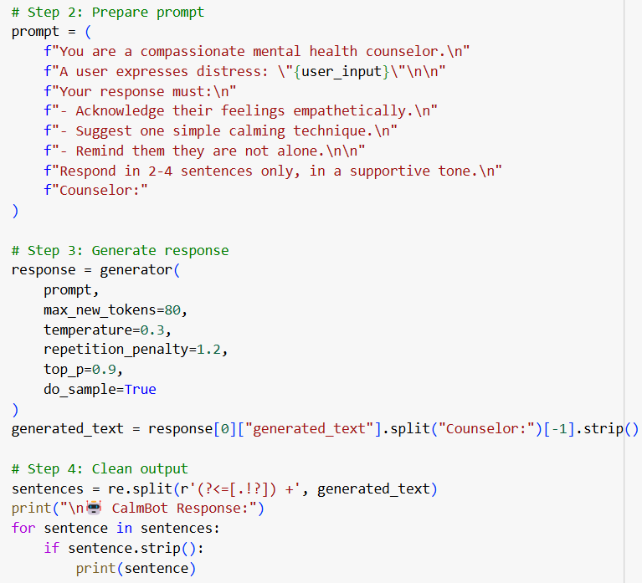
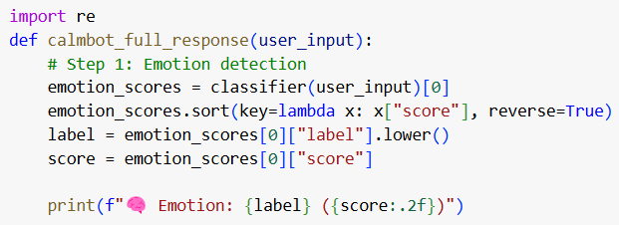
Step 6 in Detail
Notes:
This slide presents the first half of Step 6, which covers emotion detection, prompt construction, response generation, and output cleaning.
First, in Step 1, CalmBot uses a fine-tuned DistilRoBERTa emotion classifier to process the user input and predict the primary emotional label, along with its confidence score.
The system sorts the emotion scores to identify the most dominant emotion and prepares this information for subsequent steps.
Next, in Step 2, CalmBot constructs a prompt dynamically.
The prompt explicitly defines CalmBot’s role as a compassionate counselor and instructs the model to acknowledge feelings, suggest a calming technique, and remind users they are not alone, all within 2 to 4 sentences.
Then, in Step 3, the structured prompt is passed into the Falcon-RW-1B text generation model.
Specific generation parameters like maximum token length, temperature, and repetition penalty are configured to promote focused and emotionally appropriate outputs.
Finally, in Step 4, the generated text is post-processed.
Using regular expression splitting, the long output is divided into individual sentences to facilitate cleaner and more readable responses.
Only non-empty sentences are printed to ensure that CalmBot’s reply remains concise and clear.

Slide 6
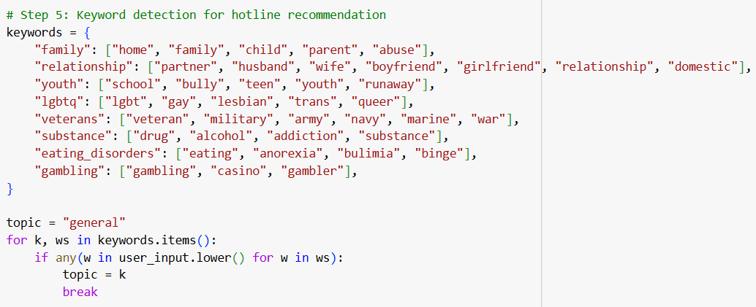
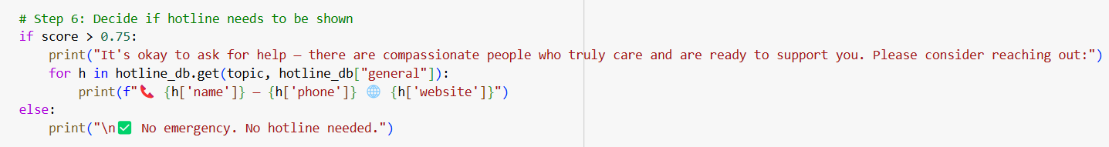
Step 6 in Detail
Notes:
This slide covers the second half of Step 6, which focuses on crisis hotline recommendation based on emotional severity and user context.
In Step 5, CalmBot scans the user input against a set of pre-defined keyword categories.
Categories such as family, relationships, youth, LGBTQ, veterans, substance abuse, eating disorders, and gambling are defined.
If keywords associated with a particular crisis category are detected in the input, CalmBot assigns that category as the user’s context.
Then, in Step 6, CalmBot evaluates the severity of the user’s emotional state.
If the detected emotion’s confidence score exceeds a critical threshold — specifically 0.75 — CalmBot proactively triggers a hotline recommendation.
The system searches for relevant hotlines associated with the detected context and prints out structured hotline information, including the name, phone number, and website.
If the severity threshold is not met, CalmBot simply reassures the user that there is no immediate crisis requiring external intervention.
This structure ensures that CalmBot not only provides emotional support but also connects users to specialized human help when necessary.

Slide 7

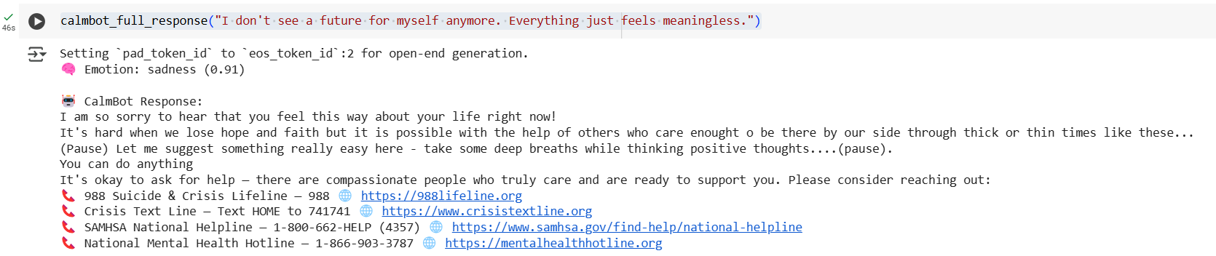
CalmBot Full Interaction Example
Hopeless Case
Notes:
In this example, the user expresses a profound sense of hopelessness, stating, "I don't see a future for myself anymore. Everything just feels meaningless."
CalmBot successfully detects the dominant emotion as sadness, with a high confidence score of 0.91.
The generated response begins with an empathetic acknowledgment of the user's feelings, followed by a simple calming technique suggestion, encouraging the user to practice deep breathing and maintain positive thoughts.
While the overall emotional tone is appropriate and the structure follows the prompt design well, it is important to note some limitations.
Due to the configured token limit during generation (to prevent excessive or drifting output), the response may sometimes feel slightly abrupt or less elaborated toward the end.
Minor language imperfections, such as small typographical errors ("enought o" instead of "enough to"), are also present, reflecting the limitations of using lightweight models like Falcon-RW-1B.
Despite these issues, CalmBot effectively transitions into recommending appropriate national hotlines, providing four different crisis support options tailored to the severity of the detected emotion.

Slide 8

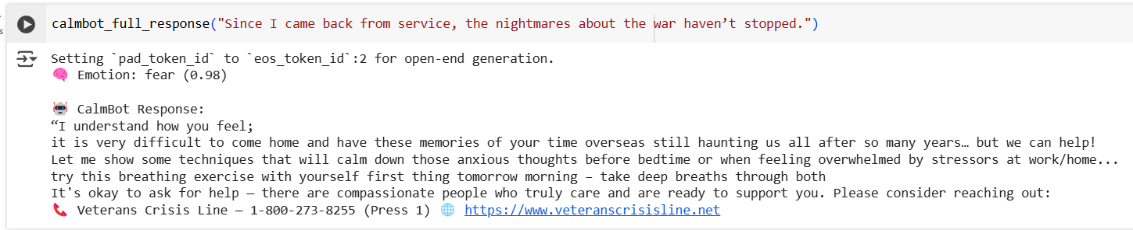
CalmBot Full Interaction Example
Veteran PTSD Case
Notes:
This example involves a user describing persistent nightmares after returning from military service, a classic symptom associated with PTSD.
CalmBot correctly identifies the primary emotion as fear, with an exceptionally high confidence score of 0.98.
The response begins with empathetic validation, acknowledges the user's ongoing struggles, and offers a practical calming technique — suggesting a breathing exercise to manage anxiety symptoms.
The generated text flows naturally for the most part; however, as with the previous case, the imposed token limit can occasionally result in slightly condensed or truncated expressions, particularly in longer or more detailed sentences.
Overall, the emotional resonance and supportive tone are preserved effectively.
Notably, CalmBot recommends the specialized Veterans Crisis Line, which is a highly accurate and context-sensitive resource given the user's background.
This example demonstrates CalmBot's capability to provide relevant emotional support and connect users to specific crisis intervention services, while also highlighting some inherent constraints in generation depth due to lightweight model and token limit settings..

Slide 9
CalmBot Project – Key Challenges
Hardware Limitations
Prompt Design Instability
Output Drift
Limited Model Naturalness
Unable to run large models like Mistral-7B due to memory constraints.
Switched to lightweight models (DistilRoBERTa, Falcon-RW-1B).
Early prompts were too verbose, causing inconsistent outputs.
Standardized simple, structured, role-guided prompts.
Responses sometimes included irrelevant or repetitive trailing content.
Tuned generation parameters; partial mitigation achieved.
Small models lacked full conversational nuance and depth.
Improved prompts; accepted as a hardware-driven limitation.
Notes:
During this project, I faced several major challenges:
First, I was unable to run large models like Mistral-7B due to Colab memory limitations, so I shifted to lightweight models like DistilRoBERTa and Falcon-RW-1B.
Second, my early prompt designs were too verbose, causing inconsistent outputs; I resolved this by creating a standardized, structured prompt format.
Third, output drift remained a persistent issue, where responses sometimes included irrelevant or repetitive endings, despite parameter tuning.
Finally, small models inherently lacked conversational depth, which I partially addressed through prompt optimization, but recognized as a hardware-driven limitation.

Slide 10
Future Directions
Model Architecture
Emotion Detection
Multi-turn Dialogue
Hotline Recommendation
Upgrade to larger, fine-tuned LLMs (e.g., GPT-4, Mistral-7B, Llama-3) for significantly enhanced empathy, coherence, and response quality.
Train a custom, multi-label emotion classifier with finer emotional granularity and real-time intensity scaling.
Integrate semantic search (e.g., FAISS) to dynamically match hotline resources based on user context and emotional state.
Implement memory-augmented dialogue systems to maintain empathetic, coherent multi-turn conversations across user sessions.
01
02
03
04
Notes:
Looking forward, I have identified four key areas for further development:
First, upgrading to larger fine-tuned LLMs like GPT-4 or Mistral-7B to improve empathy and coherence.
Second, developing a custom, multi-label emotion classifier with more nuanced emotional detection.
Third, enhancing hotline recommendation using semantic search to match resources based on real context.
And fourth, implementing memory-augmented dialogue systems to support empathetic, multi-turn interactions.

Slide 11
Works Cited
National Institute of Mental Health (NIMH). Mental Illness. 2022. https://www.nimh.nih.gov/health/statistics/mental-illness.
Project HOPE. “Global Mental Health: Frequently Asked Questions.” 2023. https://www.projecthope.org.
Time. “The U.S. Faces a Shortage of Mental Health Professionals.” 2023. https://time.com.
Bonterra Tech. “State of Mental Health in the U.S.: Access and Barriers.” 2023. https://bonterratech.com.
NAMI (National Alliance on Mental Illness). Mental Health by the Numbers. 2023. https://www.nami.org/mhstats.
Built In. “The Role of AI in Mental Health Support.” 2023. https://builtin.com/artificial-intelligence/ai-mental-health.
PMC (PubMed Central). “Barriers to Mental Health Care and Use of Mental Health Services.” 2022. https://www.ncbi.nlm.nih.gov/pmc/articles/PMC.
Nature Digital Medicine. “Human-AI Collaboration Improves Empathic Engagement in Therapy Support Tools.” 2022. https://www.nature.com/articles/s41746-022-00589-7.
Notes:
Here are the references that supported the CalmBot project.
These include mental health statistics, reports on access barriers, and research studies on AI and human collaboration in therapy support contexts.
I based CalmBot’s design on both real-world mental health needs and the latest research in empathetic AI systems.

Slide 12
THANK YOU
Notes:
Thank you for your attention.

