Slide 1
Representing Information

Slide 2
Outline
Bit and Byte
Understand machine representations of numbers
Suggested reading
  1.1, 2.1.1

Slide 3
Why Bit?
Modern computers store and process
  Information represented as two-valued signals
  These lowly binary digits are bits
Bits form the basis of the digital revolution

Slide 4
The Decimal Representation
Base-10
Has been in use for over 1000 years
Developed in India
Improved by Arab mathematicians in the 12th century
Brought to the West in the 13th century by
  the Italian mathematician Leonardo Pisano,
    better known as Fibonacci.

Slide 5
Why Bit?
Using decimal notation is natural for ten-fingered humans
But binary values work better when building machines
  that store and process information

Slide 6
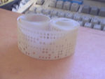
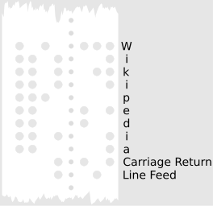
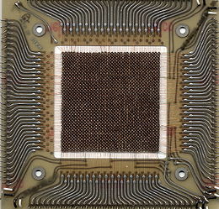
Why Bit?
Two-valued signals can readily be
  represented, stored, and transmitted,
Examples
  The presence or absence of a hole in a punched card
  A high or low voltage on a wire
  A magnetic domain oriented clockwise or counterclockwise.
0
1
0
Voltage
Time

Slide 7
Why Bit?
The electronic circuitry is very simple and reliable for
  storing and performing computations on two-valued signals
This enabling manufacturers to integrate
  millions of such circuits on a single silicon chip

Slide 8
Group Bits
In isolation, a single bit is not very useful
In English, there are 26(or 52) characters in its alphabet. They are not useful either in isolation
However, there are plenty of words in its vocabulary. How is this achieved?
Similarly, we are able to represent the elements of any finite set by using bits (instead of bit)

Slide 9
Group Bits
To do this, we
  first group bits together
  then apply some interpretation to the different possible bit patterns
    that gives meaning to each patterns
8-bit chunks are organized as a byte
  Dr. Werner Buchholz in July 1956
  during the early design phase for the IBM Stretch computer

Slide 10
Value of Bits
Bits 01010
Value 0*2⁴+1*2³+0*2²+1*2¹+0*2⁰ = 10
Value 102(1100110)
Bits 102 = 51*2 + 0 (0)
51 = 25*2 + 1 (1)
25 = 12*2 + 1 (1)
12 = 6*2 + 0 (0)
6 = 3*2 + 0 (0)
3 = 1*2 + 1 (1)
1 = 0*2 + 1 (1)

Slide 11
Group bits as numbers ⎯ Three encodings
Unsigned encoding
  Representing numbers greater than or equal to 0
  Using traditional binary representation
Two’s-complement encoding
  Most common way to represent either positive or negative numbers
Floating point encoding
  Base-two version of scientific notation for representing real numbers

Slide 12
Group bits as numbers ⎯ Understanding numbers
Machine representation of numbers are not same as
  Integers and real numbers
They are finite approximations to integers and real numbers
  Sometimes, they can behave in unexpected way

Slide 13
‘int’ is not integer
Overflow
  200*300*400*500 = -884,901,888
  Product of a set of positive numbers yielded a negative result
Commutativity & Associativity remain
  (500 * 400) * (300 * 200)
  ((500 * 400) * 300) * 200
  ((200 * 500) * 300) * 400
  400 * (200 * (300 * 500))

Slide 14
‘float’ is not real number
Product of a set of positive numbers is positive
Overflow and Underflow
Associativity does not hold
  (3.14+1e20)-1e20 = 0.0
  3.14+(1e20-1e20) = 3.14

Slide 15
Hexadecimal
Base 16 number representation
Use characters ‘0’ to ‘9’ and ‘A’ to ‘F’
Write FA1D37B₁₆ in C as
  0xFA1D37B or
  0xfa1d37b

Slide 16
Hexadecimal
Byte = 8 bits
  Binary 00000000₂ to 11111111₂
  Decimal: 0₁₀ to 255₁₀
  Hexadecimal 00₁₆ to FF₁₆
Decimal
Hex
Binary
0
0
0000
1
1
0001
2
2
0010
3
3
0011
4
4
0100
5
5
0101
6
6
0110
7
7
0111
8
8
1000
9
9
1001
A
10
1010
B
11
1011
C
12
1100
D
13
1101
E
14
1110
F
15
1111

Slide 17
Hexadecimal vs. Binary
0x173A4C
Hexadecimal 1 7 3 A 4 C
Binary 0001 0111 0011 1010 0100 1100
1111001010110110110011
Binary 11 1100 1010 1101 1011 0011
Hexadecimal 3 C A D B 3
0x3CADB3

Slide 18
Hexadecimal vs. Decimal
Hexadecimal 0xA7
Decimal 10*16+7 = 167
Decimal 314156 = 19634*16 + 12 (C)
19634 = 1227*16 + 2 (2)
1227 = 76*16 + 11 (B)
76 = 4*16 + 12 (C)
4 = 0*16 + 4 (4)
Hexadecimal 0x4CB2C

Slide 19
Hexadecimal vs. Binary
0x39A7F8 ->
1100100101111011 ->
0xD5E4C ->
1001101110011110110101 ->
0011 1001 1010 0111 11111 000
C97B
1101 0101 1110 0100 1100
2 6 E 7 B 5

Slide 20
Decimal, Hexadecimal, Binary
Decimal Binary Hexadecimal
167
62
188
0011 0111
1000 1000
1111 0011
0x52
0xAC
0xE7
10100111
0xA7
00111110
0x3E
10111100
0xBC
3*16+7=55
0x37
8*16+8=136
0x88
15*16+3=243
0xF3
5*16+2=82
01010010
10*16+12=172
10101100
14*16+7=231
11100111

Slide 21
Manipulating Information

Slide 22
Outline
Bit-level operations
Suggested reading
  2.1.6~2.1.9

Slide 23
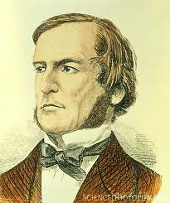
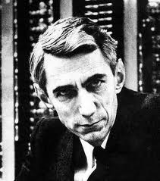
Boolean Algebra
Developed by George Boole(1815-1864)
  Algebraic representation of logic
    Encode “True” as 1
    Encode “False” as 0
Claude Shannon(1916–2001)founded the information theory
  made the connection between Boolean algebra and digital logic
Plays a central role in the design and analysis of digital systems

Slide 24
Boolean Algebra
And
  A&B = 1 when both A=1 and B=1
Or
  A|B = 1 when either A=1 or B=1
Not
  ~A = 1 when A=0
Exclusive-Or (Xor)
  A^B = 1 when either A=1 or B=1, but not both

Slide 25
General Boolean Algebras
Operate on Bit Vectors
  Operations applied bitwise
01101001
& 01010101
01000001
01101001
| 01010101
01111101
01101001
^ 01010101
00111100
~ 01010101
10101010

Slide 26
General Boolean Algebras
Representation of Sets
  Width w bit vector represents subsets of {0, …, w–1}
  a_{j} = 1 if j ∈ A
    01101001 { 0, 3, 5, 6 }
    01010101 { 0, 2, 4, 6 }
  & Intersection 01000001 { 0, 6 }
  | Union 01111101 { 0, 2, 3, 4, 5, 6 }
  ^ Symmetric difference 00111100 { 2, 3, 4, 5 }
  ~Complement 10101010 { 1, 3, 5, 7 }

Slide 27
Bit-Level Operations in C
Operations &, |, ~, ^ Available in C
  Apply to any “integral” data type
    long, int, short, char
  View arguments as bit vectors
  Arguments applied bit-wise

Slide 28
Bit-Level Operations in C
~0x41 | 0xBE
~0x00 | 0xFF
0x69 & 0x55 | 0X41
0x69 | 0x55 | 0x7D
~0100 0001
1011 1110
~0000 0000
1111 1111
0110 1001 & 0101 0101
0100 0001
0110 1001 | 0101 0101
0111 1101

Slide 29
Mask Operations
Bit pattern
  0xFF
    Having 1s for the least significant eight bits
    Indicates the lower-order byte of a word
Mask Operation
  X = 0x89ABCDEF
  X & 0xFF =?
Bit Pattern ~0
  Why not 0xFFFFFFFF?

Slide 30
Mask Operations
Write C expressions that work for any word size w ≥ 8
For x = 0x87654321, with w = 32
The least significant byte of x, with all other bits set to 0
  [0x00000021].

Slide 31
Mask Operations
All but the least significant byte of complemented, with the least significant byte left unchanged
  [0x789ABC21]
The least significant byte set to all 1s, and all other bytes of x left unchanged.
  [0x876543FF].

Slide 32
Logical Operations in C
Logical Operators
  &&, ||, !
    View 0 as “False”
    Anything nonzero as “True”
    Always return 0 or 1
    Early termination (short cut)

Slide 33
Logical Operations in C
Examples (char data type)
  !0x41 --> 0x00
  !0x00 --> 0x01
  !!0x41 --> 0x01
  0x69 && 0x55 --> 0x01
  0x69 || 0x55 --> 0x01

Slide 34
Short Cut in Logical Operations
a && 5/a
  If a is zero, the evaluation of 5/a is stopped
  avoid division by zero
Using only bit-level and logical operations
  Implement x == y
  it returns 1 when x and y are equal, and 0 otherwise

Slide 35
Shift Operations in C
Left Shift: x << y
  Shift bit-vector x left y positions
    Throw away extra bits on left
    Fill with 0’s on right
Argument x
01100010
<< 3
00010000
Argument x
10100010
<< 3
00010000

Slide 36
Shift Operations in C
Right Shift: x >> y
  Shift bit-vector x right y positions
    Throw away extra bits on right
  Logical shift
    Fill with 0’s on left
  Arithmetic shift
    Replicate most significant bit on right
    Useful with two’s complement integer representation (especially for the negative number )
Argument x
01100010
Log. >> 2
00011000
Arith. >> 2
00011000
Argument x
10100010
Log. >> 2
00101000
Arith. >> 2
11101000

Slide 37
Shift Operations in C
What happens ?
  int lval = 0xFEDCBA98 << 32;
  int aval = 0xFEDCBA98 >> 36;
  unsigned uval = 0xFEDCBA98u >> 40;
It may be
  lval 0xFEDCBA98 (0)
  aval 0xFFEDCBA9 (4)
  uval 0x00FEDCBA (8)
Be careful about
  1<<2 + 3<<4 means 1<<(2 + 3)<<4

Slide 38
Shift Operations in Computer Systems
Advantages
  Performance Optimization
    Fast multiplication and division, bit manipulation
  Resource conservation
    The shift operation requires fewer hardware resources.
Applications
  Data Compression: bit packing, bitmap
  Cryptography: hash function, encryption algorithm (e.g. AES)
  Signal Processing: Fast Fourier Transform (FFT)

Slide 39
Information Storage

Slide 40
Outline
Virtual Memory
Pointers and word size
Suggested reading
  The first paragraph of 2.1
  1.4, 2.1.2, 2.1.3, 2.1.4

Slide 41
Computer Hardware - Von Neumann Architecture
Instructions / Program
Main
Memory
Arithmetic
Unit
Control
Unit
PC
AC
IR
SR
Addresses
Input/Output
Unit
E.g. Storage

Slide 42
Storage
The system component that remembers data values for use in computation
A wide-ranging technology
  RAM chip
  Flash memory
  Magnetic disk
  CD
Abstract model
  READ and WRITE operations

Slide 43
READ/WRITE operations
Two important concepts
  Name and value
WRITE(name, value) value ← READ(name)
WRITE operation specifies
  a value to be remembered
  a name by which one can recall that value in the future
READ operation specifies
  the name of some previous remembered value
  the memory device returns that value

Slide 44
Memory
Bytes
Addr.
One kind of storage device
  Value has only fixed size (usually byte)
  Name belongs to a set consisting of consecutive integers started from 0
    The integer number is called address
    The set is called address space
0000
0001
0002
0003
0004
0005
0006
0007
0008
0009
0010
0011
0012
0013
0014

Slide 45
Word Size
Indicating the normal size of
  pointer data
A virtual address is encoded by
  such a word
The maximum size of the virtual address space
  the most important system parameter determined by the word size

Slide 46
Word Size
For machine with n-bit word size
  Virtual address can range from 0 to 2^{n}-1
Most current machines are 64 bits (8 bytes)
  Potentially address ≈ 1.84 X 10¹⁹ bytes
Most current machines also support 32 bits (4 bytes)
  Limits addresses to 4GB
  Becoming too small for memory-intensive applications
Unfortunately
  it also used to indicate the normal size of integer

Slide 47
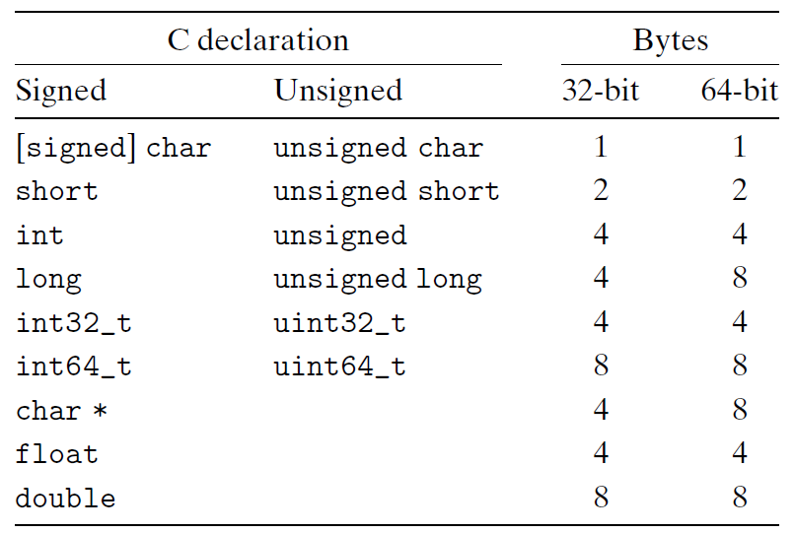
Data Size
Machines support multiple data formats
  Always integral number of bytes
Sizes of C Objects (in Bytes)

Slide 48
intN_t and uintN_t
Another class of integer types
  specifying N-bit signed and unsigned integers
  Introduced by the ISO C99 standard
  In the file stdint.h.
Typical values
  int8_t, int16_t, int32_t, int64_t
  unit8_t, uint16_t, uint32_t, uint64_t
  N are implementation dependent

Slide 49
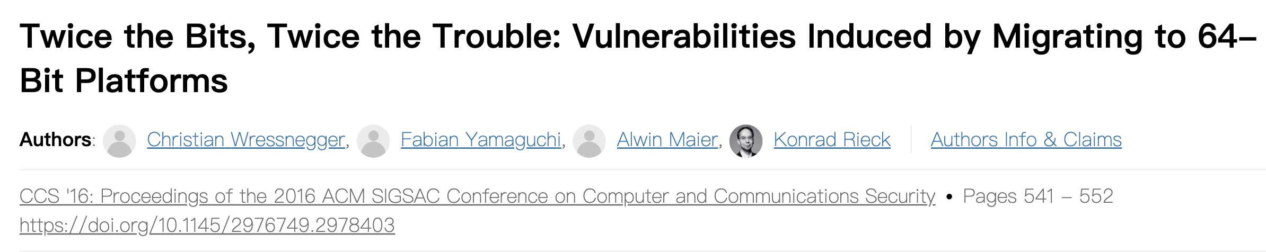
Data Size Related Bugs
32-bit machines have been the standard from 1990s to 2010s
  Many programs assume “32-bit” in the table
With the increasing of 64-bit machines
  many hidden word size dependencies show up as
    bugs in migrating these programs to new machines

Slide 50
Example
At the time 32-bit dominated, many programmers assumed that
  a program object declared as type int can be used to store a pointer
This works fine for most 32-bit machines
But leads to problems on an 64-bit machine

Slide 51
Virtual Memory
The memory introduced in previous slides
  is only an conceptual object and
  does not exist actually
It provides the program with what appears to be a monolithic byte array
It is a conceptual image presented to the machine-level program

Slide 52
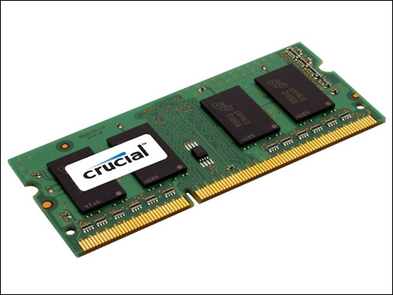
Virtual Memory
The actual implementation uses a combination of
  Hardware
  Software
Hardware
  random-access memory (RAM) (physical)
  disk storage (physical)
  special hardware (performing the abstraction )
Software
  and operating system software (abstraction)

Slide 53
Way to the Abstraction
Taking something physical and abstract it logical
Virtual memory
WRITE
(vadd value)
Operating
System
Special
hardware
RAM
Chips
Disk
storage
WRITE
(padd value)
READ(vadd)
READ(padd)
Abstraction
layer
Physical
layer

Slide 54
Subdivide Virtual Memory into More Manageable Units
One task of
  a compiler and
  the run-time system
To store the different program objects
  Program data
  Instructions
  Control information

Slide 55
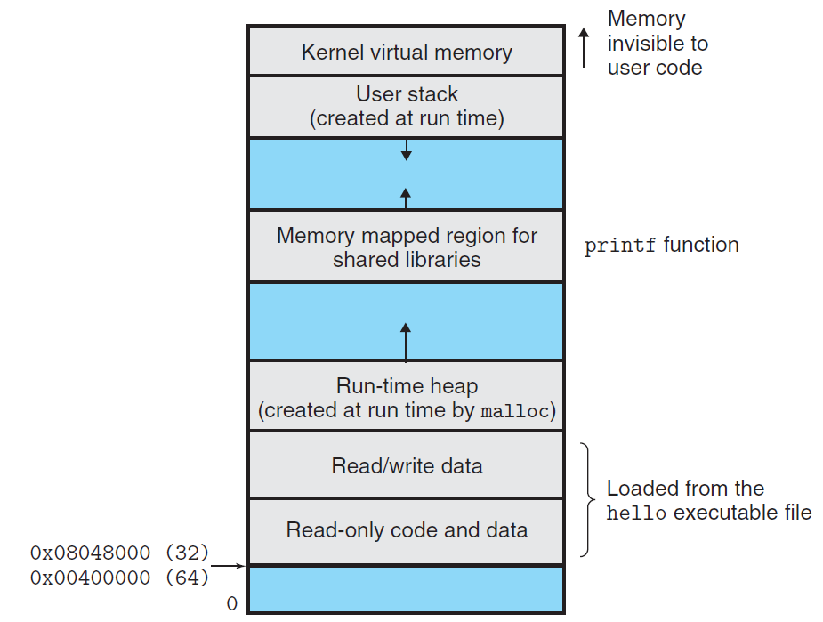

Slide 56
Byte Ordering
How should a large object be stored in memory?
For program objects that span multiple bytes
  What will be the address of the object?
  How will we order the bytes in memory?
A multi-byte object is stored as
  a contiguous sequence of bytes
  with the address of the object given by the smallest address of the bytes used

Slide 57
Byte Ordering
Little Endian
  Least significant byte has lowest address
  Intel
Big Endian
  Least significant byte has highest address
  Sun, IBM
Bi-Endian
  Machines can be configured to operate as either little- or big-endian
  Many recent microprocessors

Slide 58
Big Endian vs Little Endian (0x1234567)
0x100
0x101
0x102
0x103
Big Endian
01
23
45
67
0x100
0x101
0x102
0x103
Little Endian
67
45
23
01

Slide 59
Byte Ordering Becomes Visible
Circumvent the normal type system
  Casting
  Reference an object according to a different data type from which it was created
  Strongly discouraged for most application programming
  Quite useful and even necessary for system-level programming
Disassembler
  80483bd: 01 05 64 94 04 08->add %eax, 0x8049464
Communicate between different machines

Slide 60
How to Access an Object
The actual machine-level program generated by C compiler
  simply treats each program object as a block of bytes
The value of a pointer in C
  is the virtual address of the first byte of the above block of storage

Slide 61
How to Access an Object
The C compiler
  Associates type information with each pointer
  Generates different machine-level code to access the pointed value
    stored at the location designated by the pointer depending on the type of that value
The actual machine-level program generated by C compiler
  has no information about data types

Slide 62
Code to Print Byte Representation
typedef unsigned char *byte_pointer;
void show_bytes(byte_pointer start, int len)
{
int i;
for (i = 0; i < len; i++)
printf("0x%p\t0x%.2x\n",
start+i, start[i]);
printf("\n");
}

Slide 63
Code to Print Byte Representation
void show_int(int x) {
show_bytes((byte_pointer) &x, sizeof(int));
}
void show_float(float x) {
show_bytes((byte_pointer) &x, sizeof(float));
}
void show_pointer(void *x) {
show_bytes((byte_pointer) &x, sizeof(void *));
}

Slide 64
Features in C
typedef
  Giving a name of type
  Syntax is exactly like that of declaring a variable
printf
  Format string: %d, %c, %x, %f, %p
sizeof
  sizeof(T) returns the number of bytes required to store an object of type T
  One step toward writing code that is portable across different machine types

Slide 65
Features in C
Pointers and arrays
  start is declared as a pointer
  It is referenced as an array start[i]
Pointer creation and dereferencing
  Address of operator &
  &x
Type casting
  (byte_pointer) &x

Slide 66
Code to Print Byte Representation
void test_show_bytes(int val) {
int ival = val;
float fval = (float) ival;
int *pval = &ival;
show_int(ival);
show_float(fval);
show_pointer(pval);
}

Slide 67
Example
Linux 32: Intel IA32 processor running Linux
Windows: Intel IA32 processor running Windows
Sun: Sun Microsystems SPARC processor running Solaris
Linux 64: Intel x86-64 processor running Linux
With argument 12345 which is 0x3039

Slide 68
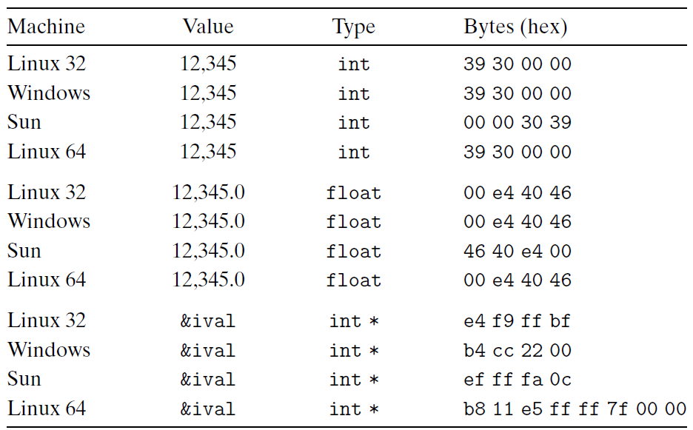
Example
Linux 32: Intel IA32 processor running Linux
Windows: Intel IA32 processor running Windows
Sun: Sun Microsystems SPARC processor running Solaris
Linux 64: Intel x86-64 processor running Linux

Slide 69
Representing Codes
int sum(int x, int y) {
return x + y;
}
Linux 32: 55 89 e5 8b 45 0c 03 45 08 c9 c3
Windows: 55 89 e5 8b 45 0c 03 45 08 5d c3
Sun: 81 c3 e0 08 90 02 00 09
Linux 64: 55 48 89 e5 89 7d fc 89 75 f8 03 45 fc c9 c3

Slide 70
Representing Strings
Strings in C
  Represented by array of characters
  Each character encoded in ASCII format
  String should be null-terminated Final character = 0
  \a \b \f \n \r \t \v
  \\ \? \’ \” \000 \xhh
char S[6] = "12345";
Linux S
Sun S
31
31
32
32
33
33
34
34
35
35
00
00

Slide 71
Representing Strings
Compatibility
  Byte ordering not an issue
    Data are single byte quantities
  Text files generally platform independent
    Except for different
    conventions of line termination
    character!
char S[6] = "12345";
Linux S
Sun S
31
31
32
32
33
33
34
34
35
35
00
00

Slide 72
Representing Information (2)

Slide 73
Outline
Encodings
  Unsigned and two’s complement
Suggested reading
  Chap 2.2.1 ~ 2.2.3

Slide 74
Unsigned Representation
Binary (physical)
  Bit vector [x_{w-1},x_{w-2},x_{w-3},…x₀]
Binary to Unsigned (logical)

Slide 75
Two’s Complement
Binary (physical)
  Bit vector [x_{w-1},x_{w-2},x_{w-3},…x₀]
Binary to Signed (logical)
2’s complement
Sign
Bit

Slide 76
From Two’s Complement to Binary
If nonnegative
  Nothing changes
If negative, its binary representation is
Its value is x
  Assume its absolute value is y = -x
  The binary representation of y is

Slide 77
From Two’s Complement to Binary

Slide 78
Two’s Complement
What does it mean?
  Computing the negation of x into binary with w-bits
  Complementing the result
  Adding 1

Slide 79
From a Number to Two’s Complement
-5
  5
  0101 (binary for 5)
  1010 (after complement)
  1011 (add 1)

Slide 80
Two’s Complement Encoding Examples
Binary/Hexadecimal Representation for -12345
Binary: 0011 0000 0011 1001 (12345)
Hex: 3 0 3 9
Binary: 1100 1111 1100 0110 (after complement)
Hex: C F C 6
Binary: 1100 1111 1100 0111 (add 1)
Hex: C F C 7

Slide 81
Numeric Range
Unsigned Values
  Umin=0
  Umax=2^{w}-1
Two’s Complement Values
  Tmin = -2^{w-1}
  Tmax = 2^{w-1}-1

Slide 82
Numeric Range
Relationship
  |TMin| = TMax + 1
  Umax = 2*TMax + 1
  -1 has the same bit representation as Umax,
    a string of all 1s
  Numeric value 0 is represented as
    a string of all 0s in both representations

Slide 83
X
B2U(X)
B2T(X)
0000
0
0
0001
1
1
0010
2
2
0011
3
3
0100
4
4
0101
5
5
0110
6
6
0111
7
7
1000
8
–8
1001
9
–7
1010
10
–6
1011
11
–5
1100
12
–4
1101
13
–3
1110
14
–2
1111
15
–1

Slide 84
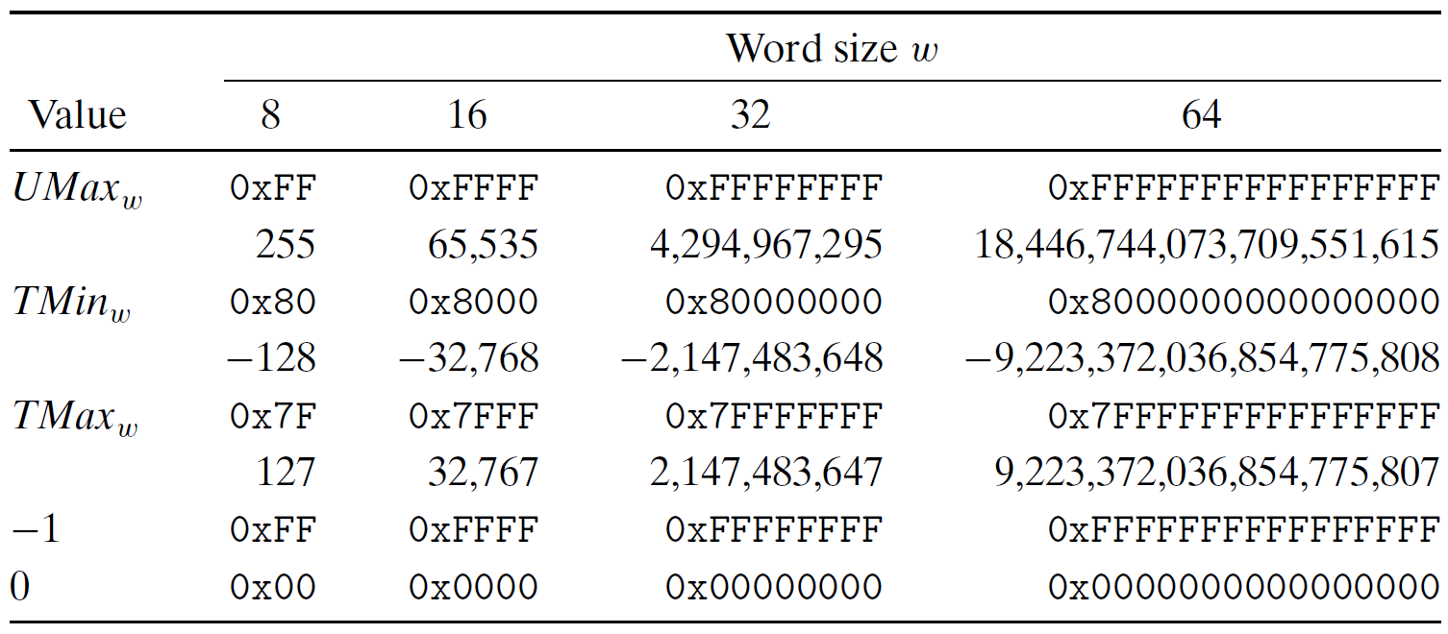
Interesting Numbers

Slide 85
Alternative representations of signed numbers
Ones’ Complement:
  The most significant bit has weight 2^{w-1}-1
Sign-Magnitude
  The most significant bit is a sign bit
    that determines whether the remaining bits should be given negative or positive weight

Slide 86
Mappings between logical and physical
Uniqueness
  Every bit pattern represents unique integer value
  Each representable integer has unique bit encoding

Slide 87
Mappings between logical and physical
Invert Mappings (from logical to physical)
  U2B(x) = B2U⁻¹(x)
    Bit pattern for unsigned integer
  T2B(x) = B2T⁻¹(x)
    Bit pattern for two’s comp integer

Slide 88
Relation Between 2’s Comp. & Unsigned
Two’s Complement
T2U
Unsigned
x
T2B
B2U
ux
X
Maintain Same Bit Pattern
w–1
0
ux
+
+
+
• • •
+
+
+
-
x
-
+
+
• • •
+
+
+
+2^{w–1} – –2^{w–1} = 2*2^{w–1} = 2^{w}

Slide 89
Conversion between two Representations
UMax
UMax – 1
TMax + 1
Unsigned
Range
TMax
TMax
2’s Comp.
Range
0
0
–1
–2
TMin

Slide 90
Casting among Integral Data Type

Slide 91
Outline
Conversions
  Signed vs. unsigned
  Long vs. short
Suggested reading
  Chap 2.2.4 ~ 2.2.8

Slide 92
Integral data type in C
Signed type (for integer numbers)
  char, short [int], int, long [int]
Unsigned type (for nonnegative numbers)
  unsigned char, unsigned short [int], unsigned [int], unsigned long [int]
Java has no unsigned data type
  Using byte to replace the char

Slide 93
Casting among Signed and Unsigned in C
C Allows a variable of one type to be interpreted as other data type
  Type conversion (implicitly)
  Type casting (explicitly)

Slide 94
Signed vs. Unsigned in C
Casting
  Explicit casting between signed & unsigned
  same as U2T and T2U
    int tx, ty;
    unsigned ux, uy;
    tx = (int) ux;
    uy = (unsigned) ty;

Slide 95
Signed vs. Unsigned in C
Conversion
  Implicit casting also occurs via assignments and procedure calls
    int tx, ty;
    unsigned ux, uy;
    tx = ux;
    uy = ty;

Slide 96
Casting from Signed to Unsigned
short int x = 12345;
unsigned short int ux = (unsigned short) x;
short int y = -12345;
unsigned short int uy = (unsigned short) y;
Resulting Value
  No change in bit representation
  Nonnegative values unchanged
    ux = 12345
  Negative values change into (large) positive values
    uy = 53191

Slide 97
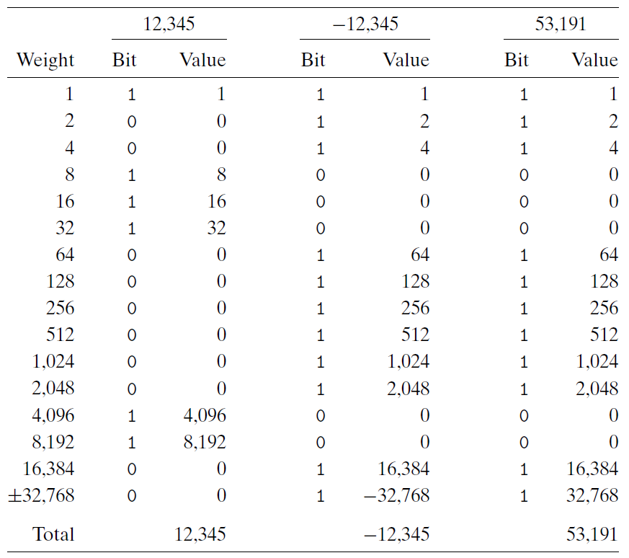

Slide 98
Unsigned Constants in C
By default
  constants are considered to be signed integers
Unsigned if have “U” or “u” as suffix
  0u, 4294967259U

Slide 99
Casting Convention
Expression Evaluation
  If mix unsigned and signed in single expression
    signed values implicitly cast to unsigned
  Including comparison operations <, >, ==, <=, >=
  Examples for W = 32

Slide 100
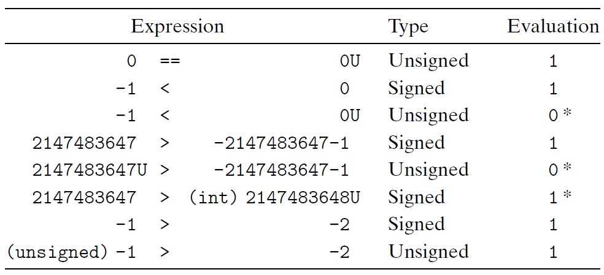
Casting Convention

Slide 101
From short to long
short int x = 12345;
int ix = (int) x;
short int y = -12345;
int iy = (int) y;
We need to expand the data size
Casting among unsigned types is normal
Casing among signed types is trick

Slide 102
Expanding the Bit Representation
Zero extension
  Add leading 0s to the representation
Sign extension
  [x_{w-1},x_{w-2},x_{w-3},…x₀]
w
X
• • •
X
-
• • •
• • •
X ′
X ′
• • •
• • •
-
+
• • •
w+1

Slide 103
From short to long
short int sx = 12345; ：0x0309
int x = (int) sx; : 0x00000309
short int sy =-12345;: 0xcfc7
int y = (int) sy; : 0xffffcfc7
usinged ux = sy; : 0xffffcfc7

Slide 104
From short to long
int fun1(unsigned word) {
return (int) ((word << 24) >> 24);
}
int fun2(unsigned word) {
return ((int) word << 24) >> 24;
}
w fun1(w) fun2(w)
0x00000076
0x87654321
0x000000C9
0xEDCBA987
Describe in words the useful computation each of these functions performs.
00000076 00000076
00000021 00000021
000000C9 FFFFFFC9
00000087 FFFFFF87

Slide 105
From long to short
int x = 53191;
short int sx = x;
int y = -12345;
Short int sy = y;
We need to truncate the data size
Casing from long to short is trick

Slide 106
Truncating Numbers
 | Decimal | Hex | Binary
x | 53191 | 00 00 CF C7 | 00000000 00000000 11001111 11000111
sx | -12345 | CF C7 | 11001111 11000111
y | -12345 | FF FF CF C7 | 11111111 11111111 11001111 11000111
sy | -12345 | CF C7 | 11001111 11000111
X ′
• • •
• • •
X
• • •

Slide 107
Truncating Numbers
Unsigned Truncating
Signed Truncating

Slide 108
Advice on Signed vs. Unsigned
Non-intuitive Features
float sum_elements ( float a[], unsigned length )
{
int i ;
float result = 0;
for ( i = 0; i <= length – 1; i++)
result += a[i] ;
return result
}

Slide 109
Advice on Signed vs. Unsigned
/* Prototype for library function strlen */
size_t strlen(const char *s); /*size_t is usigned */
/* Determine whether string s is longer than string t */
/* WARNING: This function is buggy */
int strlonger(char *s, char *t) {
return strlen(s) - strlen(t) > 0;
}

Slide 110
Advice on Signed vs. Unsigned
1 /*
2 * Illustration of code vulnerability similar to that found in
3 * FreeBSD’s implementation of getpeername()
4 */
5
6 /* Declaration of library function memcpy */
7 void *memcpy(void *dest, void *src, size_t n);
8

Slide 111
Advice on Signed vs. Unsigned
9 /* Kernel memory region holding user-accessible data */
10 #define KSIZE 1024
11 char kbuf[KSIZE];
12
13 /* Copy at most maxlen bytes from kernel region to user buffer */
14 int copy_from_kernel(void *user_dest, int maxlen) {
15 /* Byte count len is minimum of buffer size and maxlen */
16 int len = KSIZE < maxlen ? KSIZE : maxlen;
17 memcpy(user_dest, kbuf, len);
18 return len;
19 }
Invoking copy_from_kernel() with a negative maxlen

Slide 112
Advice on Signed vs. Unsigned
Collections of bits
  Bit vectors
  Masks
Addresses
Multiprecision Arithmetic
  Numbers are represented by arrays of words

Slide 113
Arithmetic Operations

Slide 114
Outline
Arithmetic Operations
  Unsigned addition, multiplication
  Signed addition, negation, multiplication
  Using Shift to perform power-of-2 multiply
Suggested reading
  Chap 2.3

Slide 115
Unsigned Addition
u
• • •
Operands: w bits
+
v
• • •
True Sum: w+1 bits
u + v
• • •
Discard Carry: w bits
UAdd_{w}(u , v)
• • •

Slide 116
Unsigned Addition
Standard Addition Function
  Ignores carry output
Implements Modular Arithmetic
  s = UAddw(u , v) = (u + v) mod 2^{w}

Slide 117
Unsigned Addition
Practice Problem 2.27
Write a function with the following prototype:
/* Determine whether arguments can be added without overflow */
int uadd_ok(unsigned x, unsigned y);
This function should return 1 if arguments x and y can be added without causing overflow
  Overflow iff (X+Y) < X

Slide 118
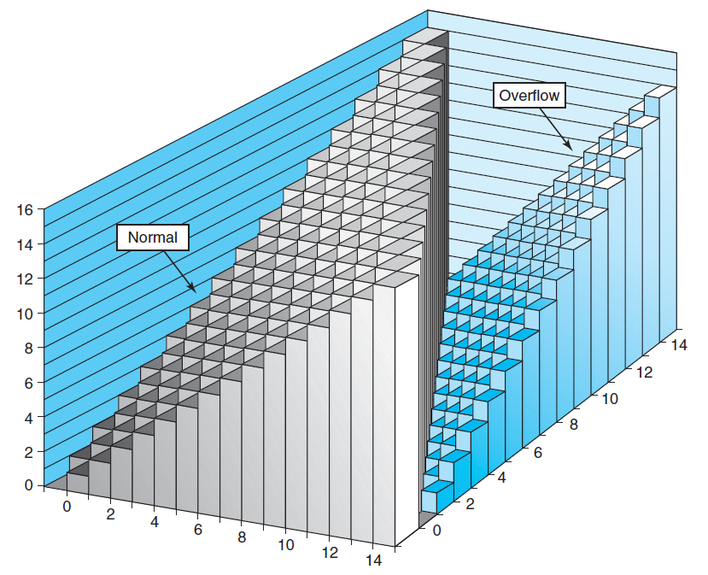
Unsigned Addition

Slide 119
Unsigned Addition Forms an Abelian Group
Closed under addition
  0 ≤ UAdd_{w}(u , v) ≤ 2^{w} –1
Associative
  UAdd_{w} (t, UAdd_{w} (u,v)) = UAdd_{w} (UAdd_{w} (t, u ), v)
0 is additive identity
  UAdd_{w} (u , 0) = u

Slide 120
Unsigned Addition Forms an Abelian Group
Every element has additive inverse
  Let UComp_{w} (u ) = 2^{w} – u
  UAddw(u , UComp_{w} (u )) = 0
Commutative
  UAdd_{w}(u , v) = UAdd_{w}(v , u)

Slide 121
Signed Addition
Functionality
  True sum requires w+1 bits
  Drop off MSB
  Treat remaining bits as 2’s comp. integer

Slide 122
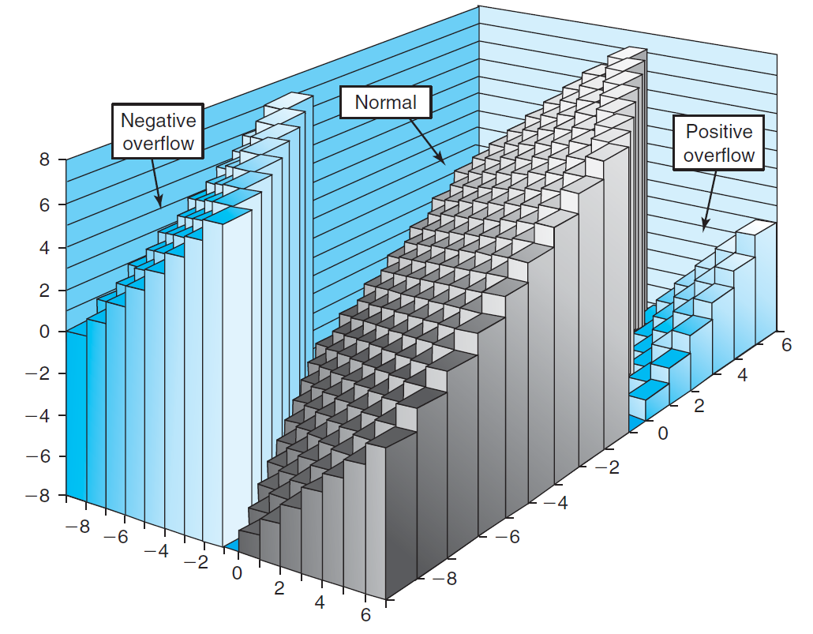
Signed Addition

Slide 123
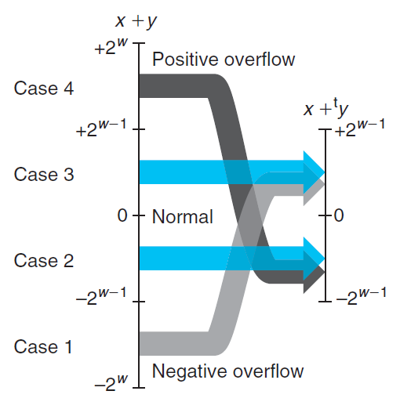
Signed Addition

Slide 124
Integer Overflow Vulnerabilities
Impact
  Unexpected result
  Security
    Buffer overflow
    Privilege escalation
Prevention Strategies
  Calculation Validation
  Use Safe Type or Libraries
    C: long, long long, safeInt…
    Python’s arbitrary-precision integers
  Program Analysis

Slide 125
Integer Overflow Vulnerabilities
A case: underSell (CVE-2018-11811)
  function sell(uint256 amount) {
  require(this.balance >= amount * sellPrice);
  _transfer(msg.sender, this, amount);
  msg.sender.transfer(amount * sellPrice);
  }
  After overflow, the buyer actually pays much less!

Slide 126
Detecting Tadd Overflow
Task
  Given s = TAdd_{w}(u , v)
  Determine if s = Add_{w}(u , v)
Claim
  Overflow iff either:
    u, v < 0, s ≥ 0 (NegOver)
    u, v ≥ 0, s < 0 (PosOver)
  ovf = (u<0 == v<0) && (u<0 != s<0);

Slide 127
Mathematical Properties of TAdd
Two’s Complement Under TAdd Forms a Group
  Closed, Commutative, Associative, 0 is additive identity
  Every element has additive inverse
    Let
    TAdd_{w}(u , TComp_{w} (u )) = 0

Slide 128
Detecting Tadd Overflow
int tadd_ok_bugy(int x, int y)
{
int sum = x + y ;
return (sum-x == y) && (sum-y == x)
}
Abelian group(x+y-x=y+x-x, always true)
int tsub_ok(int x, int y)
{
return tadd_ok(x, -y) ;
}
Set y to TMIN, -y is also TMIN. If x is negative, add will always overflow, sub will not.

Slide 129
Multiplication
Computing Exact Product of w-bit numbers x, y
  Either signed or unsigned
Ranges
  Unsigned: 0 ≤ x * y ≤ (2^{w} – 1) ² = 2^{2w} – 2^{w+1} + 1
    Up to 2w bits
  Two’s complement min: x *y ≥–2^{w–1}*(2^{w–1}–1) = –2^{2w–2} + 2^{w–1}
    Up to 2w–1 bits
  Two’s complement max: x * y ≤ (–2^{w–1}) ² = 2^{2w–2}
    Up to 2w bits, but only for TMinw²

Slide 130





Multiplication
Unsigned
Signed
Given two bit vectors and
is identical to
in binary

Slide 131
Multiplication
Maintaining Exact Results
  Would need to keep expanding word size with each product computed
  Done in software by “arbitrary precision” arithmetic packages

Slide 132
Power-of-2 Multiply with Shift
k
u
• • •
Operands: w bits
*
2^{k}
0
•••
0
1
0
•••
0
0
True Product: w+k bits
u · 2^{k}
• • •
0
•••
0
0
Discard k bits: w bits
UMult_{w}(u , 2^{k})
•••
0
•••
0
0
TMult_{w}(u , 2^{k})

Slide 133
Power-of-2 Multiply with Shift
Operation
  u << k gives u * 2^{k}
  Both signed and unsigned
Examples
  u << 3 == u * 8
  u << 5 - u << 3 == u * 24
  Most machines shift and add much faster than multiply
    Compiler will generate this code automatically

Slide 134
Floating Point

Slide 135
Topics
Fractional Binary Numbers
IEEE 754 Standard
Rounding Mode
FP Operations
Floating Point in C
Suggested Reading: 2.4

Slide 136
Encoding Rational Numbers
Form V =
Very useful when >> 0 or <<1
An Approximation to real arithmetic
From programmer’s perspective
  Uninteresting
  Arcane and incomprehensive

Slide 137
Fractional Binary Numbers
2^{m}
2^{m–1}
4
• • •
2
1
b_{m}
b_{m–1}
• • •
b₂
b₁
b₀
.
b_{–1}
b_{–2}
b_{–3}
• • •
b_{–n}
1/2
1/4
• • •
1/8
1/2^{–n}

Slide 138
Fractional Binary Numbers
Bits to right of “binary point” represent fractional powers of 2
Represents rational number: 2^{i}

Slide 139
Fractional Numbers to Binary Bits
unsigned result_bits=0, current_bit=0x80000000
for (i=0;i<32;i++) {
x *= 2
if ( x>= 1 ) {
result_bits |= current_bit ;
if ( x == 1)
break ;
x -= 1 ;
}
current_bit >> 1 ;
}

Slide 140
Fraction Binary Number Examples
Value Binary Fraction
0.2 0.00110011[0011]
Observations:
  The form 0.11111…11 represent numbers just below 1.0 which is noted as 1.0-ε
  Binary Fractions can only exactly represent x/2^{k}
  Others have repeated bit patterns

Slide 141
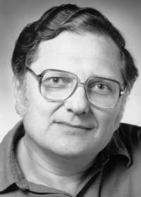
Encoding Rational Numbers
Until 1980s
  Many idiosyncratic formats, fast speed, easy implementation, less accuracy
IEEE 754
  Designed by W. Kahan for Intel processors (Turing Award 1989)
  Based on a small and consistent set of principles, elegant, understandable, hard to make go fast

Slide 142
IEEE Floating-Point Representation
Numeric form
  V=(-1)^{s}×M × 2E
    Sign bit s determines whether number is negative or positive
    Significand M normally a fractional value in range [1.0,2.0).
    Exponent E weights value by power of two

Slide 143
IEEE Floating-Point Representation
Encoding
  s is sign bit
  exp field encodes E
  frac field encodes M
Sizes
  Single precision (32 bits): 8 exp bits, 23 frac bits
  Double precision (64 bits): 11 exp bits, 52 frac bits
s
exp
frac

Slide 144
Normalize Values
Condition
  exp ≠ 000…0 and exp ≠ 111…1
Exponent coded as biased value
  E = Exp – Bias
    Exp : unsigned value denoted by exp
    Bias : Bias value
      Single precision: 127 (Exp: 1…254, E : -126…127)
      Double precision: 1023 (Exp: 1…2046, E : -1022 …1023)
      In general: Bias = 2^{m-1} - 1, where m is the number of exponent bits

Slide 145
Normalize Values
Significand coded with implied leading 1
  m = 1.xxx…x₂
    xxx…x: bits of frac
    Minimum when 000…0 (M = 1.0)
    Maximum when 111…1 (M = 2.0 – ε)
    Get extra leading bit for “free”

Slide 146
Normalized Encoding Examples
Value: 12345 (Hex: 0x3039)
Binary bits: 11000000111001
Fraction representation: 1.1000000111001*2¹³
M: 10000001110010000000000
E: 10001100 (140)
Binary Encoding
  0100 0110 0100 0000 1110 0100 0000 0000
  4640E400

Slide 147
Denormalized Values
Condition
  exp = 000…0
Values
  Exponent Value: E = 1 – Bias
  Significant Value m = 0.xxx…x₂
    xxx…x: bits of frac

Slide 148
Denormalized Values
Cases
  exp = 000…0, frac = 000…0
    Represents value 0
    Note that have distinct values +0 and –0
  exp = 000…0, frac ≠ 000…0
    Numbers very close to 0.0
    Lose precision as get smaller
    “Gradual underflow”

Slide 149
Special Values
Condition
  exp = 111…1

Slide 150
Special Values
exp = 111…1, frac = 000…0
  Represents value ∞ (infinity)
  Operation that overflows
  Both positive and negative
  E.g., 1.0/0.0 = −1.0/−0.0 = +∞, 1.0/−0.0 = −∞

Slide 151
Special Values
exp = 111…1, frac ≠ 000…0
  Not-a-Number (NaN)
  Represents case when no numeric value can be determined
  E.g., sqrt(–1), ∞ − ∞

Slide 152
Summary of Real Number Encodings
−∞
+∞
-Normalized
-Denorm
+Denorm
+Normalized
NaN
−0
+0
NaN

Slide 153
8-bit Floating-Point Representations
7
6
3
2
0
s
exp
frac

Slide 154
8-bit Floating-Point Representations
Exp exp E 2E
0 0000 -6 1/64 (denorms)
1 0001 -6 1/64
2 0010 -5 1/32
3 0011 -4 1/16
4 0100 -3 1/8
5 0101 -2 1/4
6 0110 -1 1/2
7 0111 0 1
8 1000 +1 2
9 1001 +2 4
10 1010 +3 8
11 1011 +4 16
12 1100 +5 32
13 1101 +6 64
14 1110 +7 128
15 1111 n/a (inf, NaN)

Slide 155
Dynamic Range (Denormalized numbers)
s exp frac E Value
0 0000 000 -6 0
0 0000 001 -6 1/8*1/64 = 1/512
0 0000 010 -6 2/8*1/64 = 2/512
…
0 0000 110 -6 6/8*1/64 = 6/512
0 0000 111 -6 7/8*1/64 = 7/512

Slide 156
Dynamic Range
s exp frac E Value
0 0001 000 -6 8/8*1/64 = 8/512
0 0001 001 -6 9/8*1/64 = 9/512
…
0 0110 110 -1 14/8*1/2 = 14/16
0 0110 111 -1 15/8*1/2 = 15/16
0 0111 000 0 8/8*1 = 1
0 0111 001 0 9/8*1 = 9/8

Slide 157
Dynamic Range (Denormalized numbers)
s exp frac E Value
0 0111 010 0 10/8*1 = 10/8
…
0 1110 110 7 14/8*128 = 224
0 1110 111 7 15/8*128 = 240
0 1111 000 n/a inf

Slide 158
Distribution of Representable Values
6-bit IEEE-like format
  K = 3 exponent bits
  n = 2 significand bits
  Bias is 3
Notice how the distribution gets denser toward zero.

Slide 159
Distribution of Representable Values

Slide 160
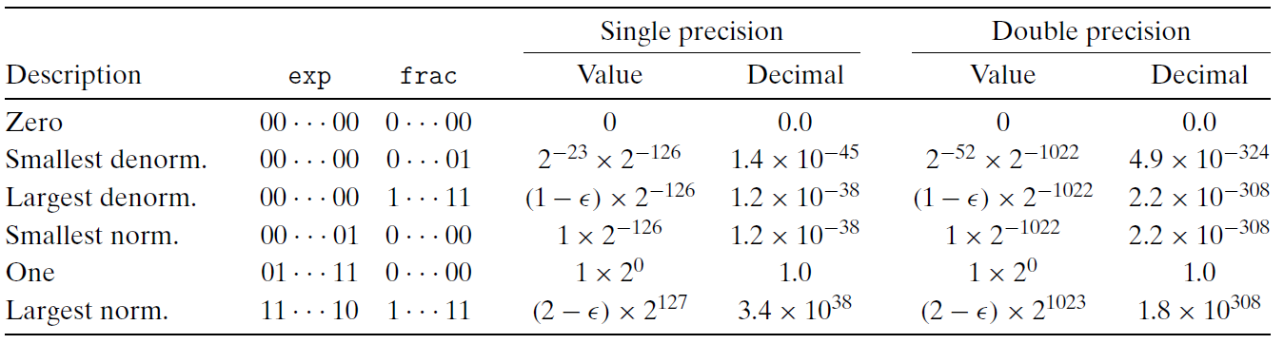
Interesting Numbers

Slide 161
Rounding Mode
Round down:
  rounded result is close to but no greater than true result.
Round up:
  rounded result is close to but no less than true result.

Slide 162
Rounding Mode
Mode | 1.40 | 1.60 | 1.50 | 2.50 | -1.50
Round-to-Even | 1 | 2 | 2 | 2 | -2
Round-toward-zero | 1 | 1 | 1 | 2 | -1
Round-down | 1 | 1 | 1 | 2 | -2
Round-up | 2 | 2 | 2 | 3 | -1

Slide 163
Round-to-Even
Default Rounding Mode
  Hard to get any other kind without dropping into assembly
  All others are statistically biased
    Sum of set of positive numbers will consistently be over- or under- estimated

Slide 164
Round-to-Even
Applying to Other Decimal Places
  When exactly halfway between two possible values
    Round so that least significant digit is even
  E.g., round to nearest hundredth
    1.2349999 1.23 (Less than half way)
    1.2350001 1.24 (Greater than half way)
    1.2350000 1.24 (Half way—round up)
    1.2450000 1.24 (Half way—round down)

Slide 165
Rounding Binary Number
“Even” when least significant bit is 0
Half way when bits to right of rounding position = 100…₂
Value | Binary | Rounded | Action | Round Decimal
2 3/32 | 10.00011 | 10.00 | Down | 2
2 3/16 | 10.0011 | 10.01 | Up | 2 1/4
2 7/8 | 10.111 | 11.00 | Up | 3
2 5/8 | 10.101 | 10.10 | Down | 2 1/2

Slide 166
Floating-Point Operations
Conceptual View
  First compute exact result
  Make it fit into desired precision
    Possibly overflow if exponent too large
    Possibly round to fit into frac

Slide 167
FP Multiplication
Operands
  (–1)^{s1} M1 2^{E1}
  (–1)^{s2} M2 2^{E2}
Exact Result
  (–1)^{s} M 2E
  Sign s : s1 ^ s2
  Significand M : M1 * M2
  Exponent E : E1 + E2

Slide 168
FP Multiplication
Fixing
  If M ≥ 2, shift M right, increment E
  If E out of range, overflow
  Round M to fit frac precision

Slide 169
FP Addition
Operands
  (–1)^{s1} M1 2^{E1}
  (–1)^{s2} M2 2^{E2}
  Assume E1 > E2
Exact Result
  (–1)^{s} M 2E
  Sign s, significand M:
    Result of signed align & add
  Exponent E : E1

Slide 170
FP Addition
E1–E2
  (–1)^{s1} m1
+
  (–1)^{s2} m2
  (–1)^{s} m

Slide 171
FP Addition
Fixing
  If M ≥ 2, shift M right, increment E
  if M < 1, shift M left k positions, decrement E by k
  Overflow if E out of range
  Round M to fit frac precision

Slide 172
Floating Point in C
C Guarantees Two Levels
  float single precision
  double double precision

Slide 173
Floating Point Puzzles
int x = …;
float f = …;
double d = …;
Assume neither d nor f is NAN or infinity

Slide 174
Floating Point Puzzles
x == (int)(float) x
x == (int)(double) x
f == (float)(double) f
d == (float) d
f == -(-f);
2/3 == 2/3.0
d < 0.0⇒ ((d*2) < 0.0)
d > f ⇒ -f < -d
d *d >= 0.0
(d+f)-d == f

Slide 175
Answers to Floating Point Puzzles
x == (int)(float) x No: 24 bit significand
x == (int)(double) x Yes: 53 bit significand
f == (float)(double) f Yes: increases precision
d == (float) d No: loses precision
f == -(-f); Yes: Just change sign bit
2/3 == 2/3.0 No: 2/3 == 0
d < 0.0⇒ ((d*2) < 0.0) Yes!
d > f ⇒ -f < -d Yes
d *d >= 0.0 Yes!
(d+f)-d == f No: Not associative

Slide 176
Answers to Floating Point Puzzles
Conversions
  Casting between int, float, and double changes numeric values
  Double or float to int
    Truncates fractional part
    Like rounding toward zero
    Not defined when out of range
      Generally saturates to TMin or TMax
  int to double
    Exact conversion, as long as int has ≤ 53 bit word size
  int to float
    Will round according to rounding mode

