Slide 1
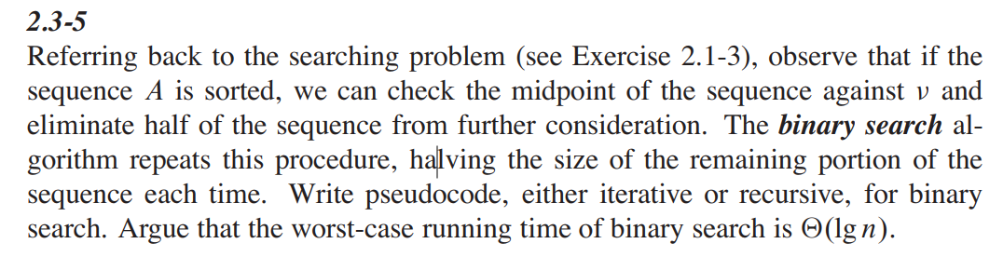
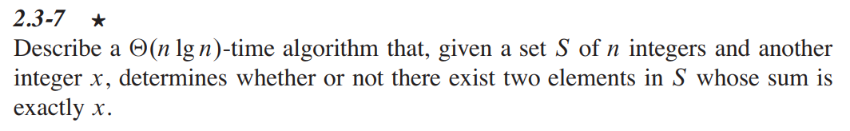
Homework on chap2
Exercise 2.3-5
2. Design an algorithm to compute Fibonacci numbers in pseudo code. Give an analysis for the time complexity of your algorithm.
3.
Notes:
nput: integer n
Output: number of line 5 that is executed
count=0
for i=1 to n
m=[n/i]
for j=1 to m
count=count+1`
end for
end for
return count

Slide 2
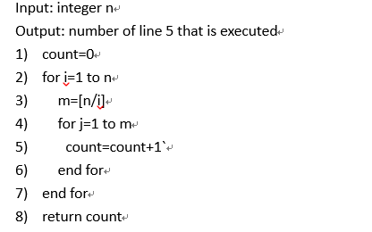
Homework
Answer the following problem and justify your answer.

